Slide 1
Spelling Y2
Mastering spellings: building on the foundations of phonics
Summer 2
Week 6

Slide 2
Year 2 - Summer 2
Week 6 - Monday

Slide 3
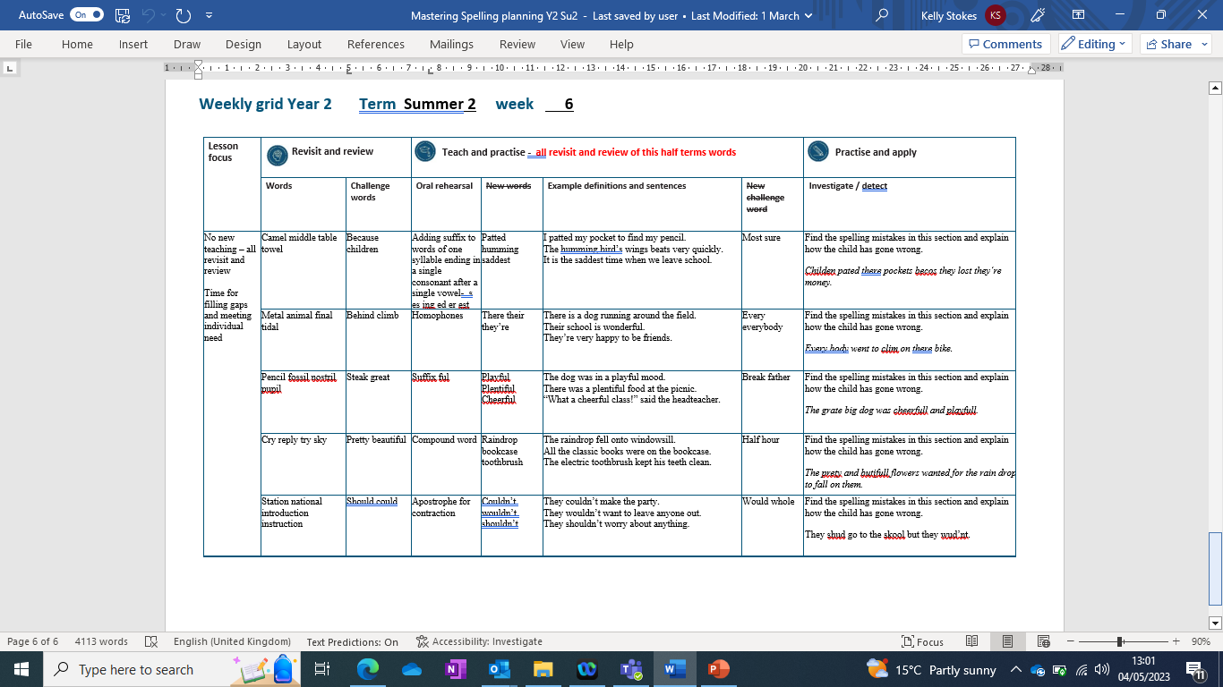

Slide 4
Let’s Revisit and Review…

Slide 5
Do you remember this challenge word?

Slide 6

because
CONJUNCTION
Definition – giving a reason

Slide 7
I am hungry because I missed breakfast.
_______

Slide 8
Do you remember this challenge word?

Slide 9
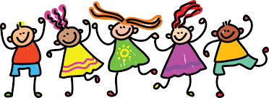
children
NOUN
Definition – young people

Slide 10
Children enjoy spelling sessions.
________

Slide 11
The suffix
-le

Slide 12
-le this is the most common suffix to use

Slide 13
-le

Slide 14
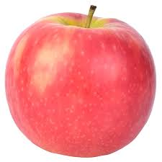
apple

Slide 15
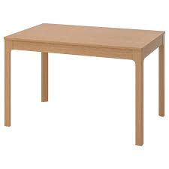
table

Slide 16
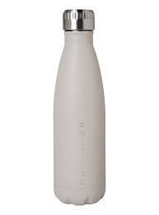
bottle

Slide 17

little

Slide 18
Let’s Teach and Practise

Slide 19
The suffix
-ies

Slide 20
-ies if a noun or verb ends in y change the y to an i and add es

Slide 21
Noun ending in y – change y to an i and add es
Verb ending in y – change y to an i and add es

Slide 22
-ies

Slide 23
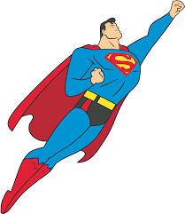
flies

Slide 24

tries n

Slide 25
babies

Slide 26
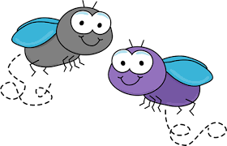
flies
noun
fly ->i + es = flies
verb
Definition
noun – more than one fly
verb – moves through the air

Slide 27
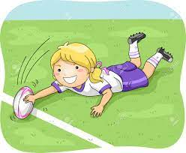
tries
noun
try ->i + es = tries
verb
Definition
Noun - a score in rugby
verb – making an effort

Slide 28
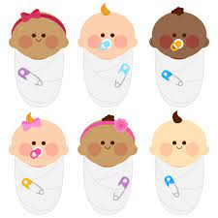
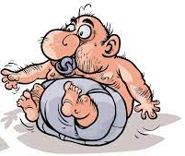
babies
noun
baby ->i + es = babies
verb
Definition
noun – more than one baby
verb – treating someone like a baby

Slide 29
A bird flies across the sky.
_____

Slide 30
Everyone tries hard at school.
_____

Slide 31
The babies were crying loudly for their food.
______

Slide 32
New CHALLENGE words.

Slide 33
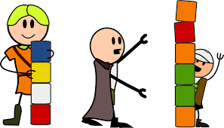
most
DETERMINER
Definition - greatest in amount, quantity, or degree

Slide 34
Children love spelling quizzes the most.
____

Slide 35

sure
ADJECTIVE
Definition - completely confident that one is right

Slide 36
The runner was sure he won.
____

Slide 37
Let’s investigate.

Slide 38
Can you spot the spelling errors in these sentences?
Write the correct spelling and explain where they went wrong.

Slide 39
Childen pated there pockets becos they lost they’re money.

Slide 40
Childen pated there pockets becos they lost they’re money.
Children – r missed children comes from the root word child – ren to make it plural

Slide 41
Childen pated there pockets becos they lost they’re money. patted – consonant wasn’t doubled
Root word ‘pat’ ending vowel consonant. Double the consonant before adding the suffix –ed.

Slide 42
Childen pated there pockets becos they lost they’re money. their – wrong homophone chosen
Their is the possession homophone showing the pockets belong to the children.

Slide 43
Childen pated there pockets becos they lost they’re money. because – sounded out phonetically but this is a challenge word
Big Elephants Can’t Always Use Small Exits

Slide 44
Childen pated there pockets becos they lost they’re money. their – wrong homophone chosen
Their is the possessive homophone showing the money belongs to the children.

Slide 45
Children patted their pockets because they lost their money.

Slide 46
Year 2 - Summer 2
Week 6 - Tuesday

Slide 48
Let’s Revisit and Review…

Slide 49
Do you remember this challenge word?

Slide 50
behind

Slide 51
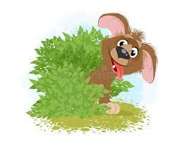
behind
PREPOSITION
Definition – hidden

Slide 52
The dog was behind the bush.
______

Slide 53
Do you remember this challenge word?

Slide 54
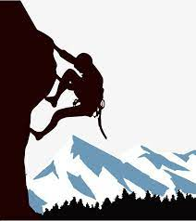
Definition – go up
climb
VERB

Slide 55
Many people climb mountains for enjoyment.
_____

Slide 56
Words ending
-al

Slide 57
-al

Slide 58
-al
Not many nouns end in –al, but many adjectives do.

Slide 59
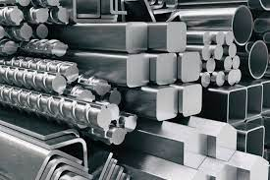
metal

Slide 60
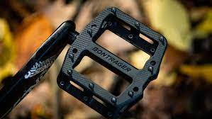
pedal

Slide 61
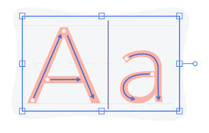
capital

Slide 62
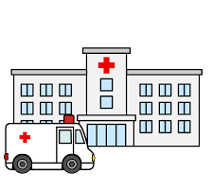
hospital

Slide 63
Let’s Teach and Practise

Slide 64
Homophones and near homophones

Slide 65
homophones homo = same phone = sound

Slide 66
homophones words that sound the same but mean different things

Slide 67

their

Slide 68
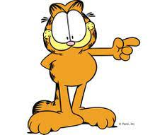
there n

Slide 69
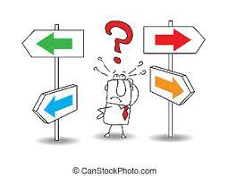
they’re

Slide 70
Definition - in, at, or to that place or position
there
here there where
ADVERB

Slide 71
Definition - belonging to or associated with the people or things previously mentioned
their
I - belonging
DETERMINER

Slide 72
they’re
they are = they’re
CONTRACTION
Definition – contraction of they are

Slide 73
There is a dog running around the field.
_____

Slide 74
Their school is wonderful.
_____

Slide 75
They’re very happy to be friends.
_______

Slide 76
New CHALLENGE words.

Slide 77
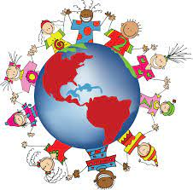
Definition - used before an amount to indicate how often something happens
every
DETERMINER

Slide 78
Christmas happens every year.
_____

Slide 79
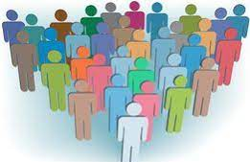
everybody
PRONOUN
Definition -every person

Slide 80
Everybody laughed at the funny joke.
_________

Slide 81
Let’s investigate.

Slide 82
Can you spot the spelling errors in these sentences?
Write the correct spelling and explain where they went wrong.

Slide 83
Every body went to clim on there bike.

Slide 84
Every body went to clim on there bike.
Everybody – one word, not two
Challenge word that is a noun showing a group

Slide 85
Every body went to clim on there bike.
Climb – silent b missed rehearse saying the word out loud sounding out the b and remember it is from an old English word ‘climban’

Slide 86
Every body went to clim on there bike. their – wrong homophone chosen
Their is the possession homophone showing the pockets belong to the children.

Slide 87
Everybody went to climb on their bike.

Slide 88
Year 2 - Summer 2
Week 6 - Wednesday

Slide 90
Let’s Revisit and Review…

Slide 91
Do you remember this challenge word?

Slide 92

Definition – large and grand
great
ADJECTIVE

Slide 93
It was a great day.
_____

Slide 94
Do you remember this challenge word?

Slide 95

NOUN
steak
Definition – a piece of meat

Slide 96
The dog enjoyed eating the steak.
_____

Slide 97
Words ending
-il

Slide 98
-il

Slide 99
-il
There are not many of these words.

Slide 100

pencil

Slide 101
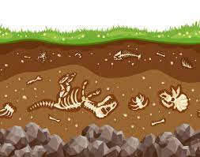
fossil

Slide 102

nostril

Slide 103

pupil

Slide 104
Let’s Teach and Practise

Slide 105
The suffix -ment

Slide 106
-ment

Slide 107
-ment
If a suffix starts with a consonant letter, it is added straight on to most root words without any change to the last letter of those words.

Slide 108
-ment
Exceptions:
(1) argument
(2) root words ending in –y with a consonant before it but only if the root word has more than one syllable.

Slide 109
enjoyment

Slide 110
argument n

Slide 111
merriment

Slide 112

enjoy + ment = enjoyment
enjoyment
NOUN
Definition – taking pleasure in something

Slide 113
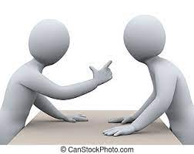
argue - e + ment = argument
argument
NOUN
Definition – an angry exchange of words

Slide 114
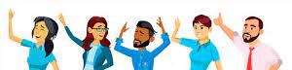
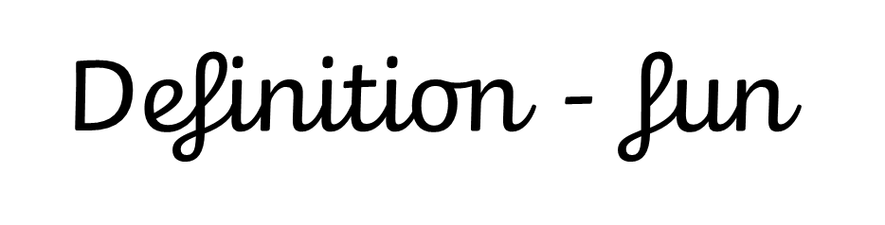
merry – y +i + ment = merriment
merriment
NOUN

Slide 115
The enjoyment was seen on the faces of the children.
_________

Slide 116
The teacher won the argument.
________

Slide 117
There was a merriment on the school trip.
_________

Slide 118
New CHALLENGE words.

Slide 119
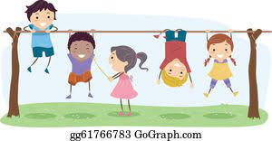
Definition - a pause in work or during an activity or event
break
NOUN

Slide 120
During break, children go outside.
_____

Slide 121
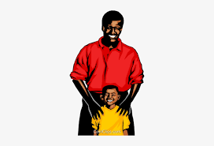
Definition - a man in relation to his child or children
father
NOUN

Slide 122
My father is lovely.
______

Slide 123
Let’s investigate.

Slide 124
Can you spot the spelling errors in these sentences?
Write the correct spelling and explain where they went wrong.

Slide 125
The grate big dog was cheerfull and playfull.

Slide 126
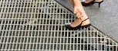
The grate big dog was cheerfull and playfull. great – incorrect homophone used
The grate ate my foot.

Slide 127
The grate big dog was cheerfull and playfull. cheerful – only 1 l on the suffix ‘ful’ you don’t want to fill your suffix full

Slide 128
The grate big dog was cheerfull and playfull. playful – only 1 l on the suffix ‘ful’ you don’t want to fill your suffix full

Slide 129
The great big dog was cheerful and playful.

Slide 130
Year 2 - Summer 2
Week 6 - Thursday

Slide 132
Let’s Revisit and Review…

Slide 133
Do you remember this challenge word?

Slide 134

Definition – attractive in a delicate way
pretty
adjective

Slide 135
The flower was pretty.
______

Slide 136
Do you remember this challenge word?

Slide 137

Definition – pleasing to the eye
beautiful
adjective

Slide 138
The butterfly was beautiful.
_________

Slide 139
Words ending
-y

Slide 140
-y
Notes:
Sound of aI

Slide 141
-y
This is by far the most common spelling for this sound at the end of words.

Slide 142
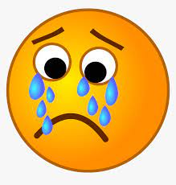
cry

Slide 143
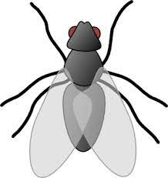

fly
verb
noun

Slide 144
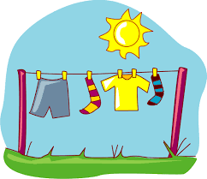
dry

Slide 145
Let’s Teach and Practise

Slide 146
Compound Words

Slide 147
Compound Words

Slide 148
Compound Words
Two or more words that have been grouped together to create a new word that has a different, individual meaning.

Slide 149
bedroom

Slide 150
football n

Slide 151
eyebrow

Slide 152
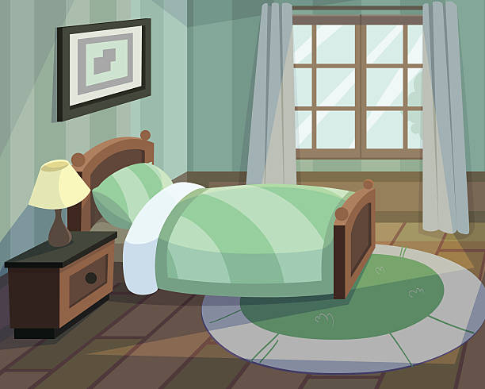
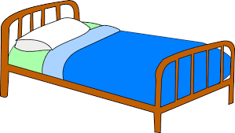
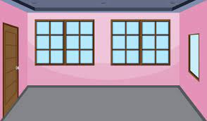
Definition – a room for sleeping in
+ =
bedroom
bed + room = bedroom
(noun)

Slide 153

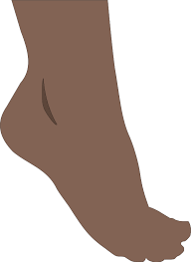
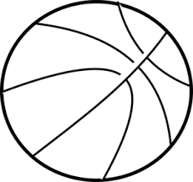
Definition – any game involving kicking a ball
+ =
football
foot + ball = football
(noun)

Slide 154


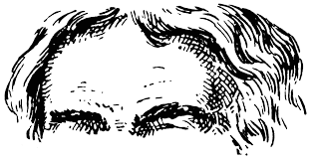
Definition – a strip of hair above the eye
+ =
eyebrow
eye + brow = eyebrow
(noun)
Notes:
Brow being forehead

Slide 155
The bedroom was full of books to read at night.
_______

Slide 156
The football match was competitive.
________

Slide 157
Can you raise just one eyebrow?
_______

Slide 158
New CHALLENGE words.

Slide 159
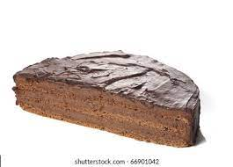
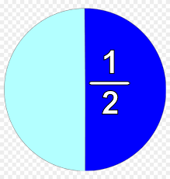
Definition - either of two equal or corresponding parts into which something is or can be divided
half
NOUN

Slide 160
Half of the cake was eaten by the teacher.
____

Slide 161
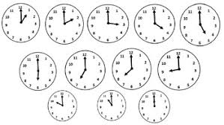
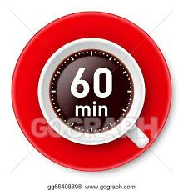
Definition - a period of time equal to a twenty-fourth part of a day and night and divided into 60 minutes
hour
NOUN

Slide 162
The lesson lasted an hour.
____

Slide 163
Let’s investigate.

Slide 164
Can you spot the spelling errors in these sentences?
Write the correct spelling and explain where they went wrong.

Slide 165
The prety and butifull flowers waited for the rain drops to fall on them.

Slide 166
The prety and butifull flowers waited for the rain drops to fall on them. pretty – missed a t shout vowel sound usually means doubling the consonant

Slide 167
The prety and butifull flowers waited for the rain drops to fall on them. beautiful – missed unstressed vowels and doubled the l in suffix ful beauty + ful = change y to i = beautiful

Slide 168
The prety and butifull flowers waited for the rain drops to fall on them. raindrops – used two words instead of one
Compound word rain + drops = raindrops

Slide 169
The pretty and beautiful flowers waited for the raindrops to fall on them.

Slide 170
Year 2 - Summer 2
Week 6 - Friday

Slide 172
Let’s Revisit and Review…

Slide 173
Do you remember this challenge word?

Slide 174
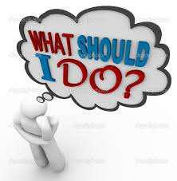
Definition – shows possibility
should
(modal verb)

Slide 175
People should clean their teeth.
______

Slide 176
Do you remember this challenge word?

Slide 177

Definition – shows possibility
could
(modal verb)

Slide 178
We could go swimming if it is hot enough.
______

Slide 179
Can you remember this spelling rule?

Slide 180
Words ending
-tion

Slide 181
-tion
Notes:
Sound of aI

Slide 182
-tion
This is the most common spelling for this sound at the end of words.

Slide 183
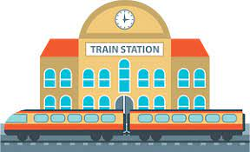
station

Slide 184

fiction

Slide 185

motion

Slide 186
Let’s Teach and Practise

Slide 187
Apostrophe - contraction

Slide 188
_____’____ apostrophe

Slide 189
Apostrophe a punctuation mark (')

Slide 190
Contraction becoming smaller

Slide 191
Contraction becoming smaller
Joining two words together with an apostrophe to show the missing letters
Apostrophe
a punctuation mark (')

Slide 192
can’t

Slide 193
didn’t

Slide 194
hasn’t

Slide 195

Definition – can not
can’t
can + not -> cannot = can’t
(modal verb)

Slide 196
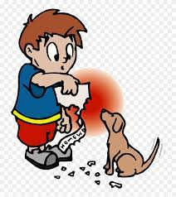
Definition – did not
didn’t
did + not -> didnot = didn’t
(modal verb)

Slide 197
hasn’t has + not -> hasnot = hasn’t
(modal verb)
Definition – has not

Slide 198
We can’t go outside because of the storm.
_____

Slide 199
We didn’t make the train because we were late.
______

Slide 200
It hasn’t been a record breaker.
_____

Slide 201
New CHALLENGE words.

Slide 202
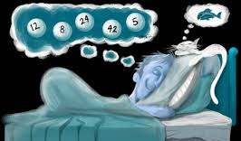
Definition - past of will, in various senses
would
VERB

Slide 203
People would like to win the lottery.
_____

Slide 204
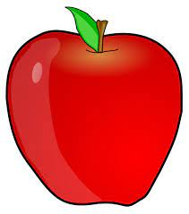
Definition - all of; entire
whole
ADJECTIVE

Slide 205
A whole apple was cut up to share.
_____

Slide 206
Let’s investigate.

Slide 207
Can you spot the spelling errors in these sentences?
Write the correct spelling and explain where they went wrong.

Slide 208
They shud go to the skool but they wud’nt.

Slide 209
They shud go to the skool but they wud’nt. should– missed letters
Modal verbs that are similar -would and could

Slide 210
They shud go to the skool but they wud’nt. school – used phonics only
From Latin schola = "meeting place for teachers and students, place of instruction"

Slide 211
They shud go to the skool but they wud’nt.
Wouldn’t– missed letters and apostrophe in the wrong place
Apostrophe shows where there are missing letters, not where the words join.

Slide 212
They should go to the school but they wouldn’t.

