Slide 1
Spelling Y3
Mastering spellings: building on the foundations of phonics
Autumn 1
Week 1
Notes:
These slides are the same as Y2 Summer 2 as this is a revisit and review half term

Slide 2
Year 3 - Autumn 1
Week 1 - Monday
Notes:
Revisit and review the words from Y2 with the el and le suffix and challenge words – I say, we say, you say
Ask children to write words only in their spelling book
Introduce the new spelling rule of suffix ies / ed / es / ing / er / est
Children to write the new spelling rule words and challenge words into books when the sentences are shown with the spelling word missing.
Read the extract with the class as choral reading. Practise model of prosody etc.
Ask children to find the spelling words from the session in the text.
Then read allowed the chosen sentence for children to write fully in their books.
Show the extract and ask children to then edit their work to check they were correct in their dictation.

Slide 3
The –el spelling is much less common than –le. The –el spelling is used after m, n, r, s, v, w and more often than not after s.
The –le spelling is the most common spelling for this sound at the end of words.
The –e at the end of the root word is dropped before –ing, –ed, –er, –est, –y or any other suffix beginning with a vowel letter is added. Exception: being
The y is changed to i before –ed, –er and –est are added, but not before – ing as this would result in ii. The only ordinary words with ii are skiing and taxiing.
The y is changed to i before –es is added.
The last consonant letter of the root word is doubled to keep the /æ/, /ɛ/, /ɪ ɒ /, / / and /ʌ/ sound (i.e. to keep the vowel ‘short’). Exception: The letter ‘x’ is never doubled: mixing, mixed, boxer, sixes.
Notes:
Rules – taken from NC

Slide 4
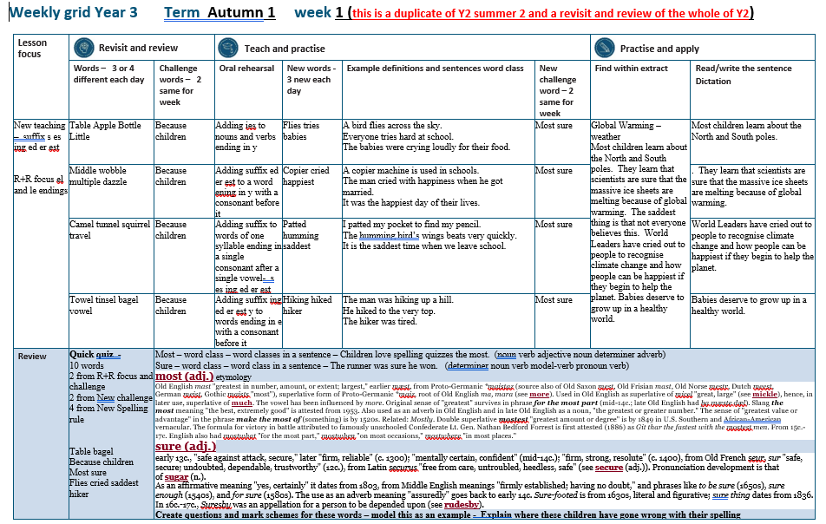

Slide 5
Let’s Revisit and Review…

Slide 6
Do you remember this challenge word?

Slide 7
because
CONJUNCTION
Definition – giving a reason

Slide 8
I am hungry because I missed breakfast.
_______

Slide 9
Do you remember this challenge word?

Slide 10
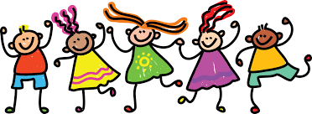
children
NOUN
Definition – young people

Slide 11
Children enjoy spelling sessions.
________

Slide 12
The suffix -le

Slide 13
-le this is the most common suffix to use

Slide 14
-le

Slide 15
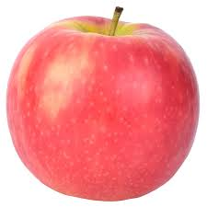
apple

Slide 16
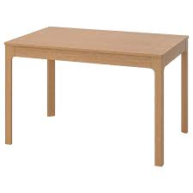
table

Slide 17
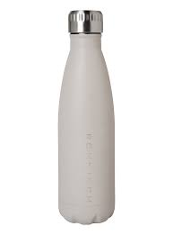
bottle

Slide 18
little

Slide 19
Let’s Teach and Practise

Slide 20
The suffix -ies

Slide 21
-ies if a noun or verb ends in y change the y to an i and add es

Slide 22
Noun ending in y – change y to an i and add es
Verb ending in y – change y to an i and add es

Slide 23
-ies

Slide 24
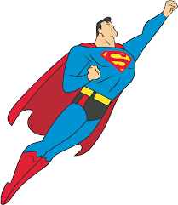
flies

Slide 25
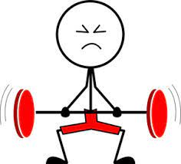
tries n

Slide 26
babies

Slide 27
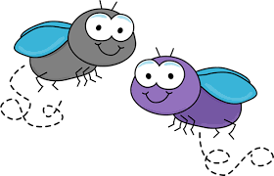
flies
noun
fly ->i + es = flies
verb
Definition noun – more than one fly verb – moves through the air

Slide 28
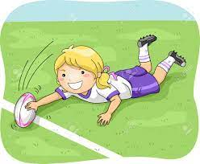
tries
noun
try ->i + es = tries
verb
Definition Noun - a score in rugby verb – making an effort

Slide 29
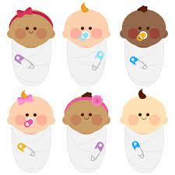
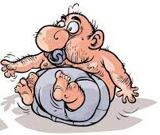
babies
noun
baby ->i + es = babies
verb
Definition noun – more than one baby verb – treating someone like a baby

Slide 30
A bird flies across the sky.
_____

Slide 31
Everyone tries hard at school.
_____

Slide 32
The babies were crying loudly for their food.
______

Slide 33
New CHALLENGE words.

Slide 34
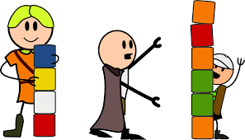
most
DETERMINER
Definition - greatest in amount, quantity, or degree

Slide 35
Children love spelling quizzes the most.
____

Slide 36
sure
ADJECTIVE
Definition - completely confident that one is right

Slide 37
The runner was sure he won.
____

Slide 38
Let’s Practise and Apply.

Slide 39
Can you spot the spelling rule words and the challenge words?

Slide 40
Most children learn about the North and South poles. They learn that scientists are sure that the massive ice sheets are melting because of global warming. The saddest thing is that not everyone believes this. World Leaders have cried out to people to recognise climate change and how people can be happiest if they begin to help the planet. Babies deserve to grow up in a healthy world.

Slide 41
Most children learn about the North and South poles. They learn that scientists are sure that the massive ice sheets are melting because of global warming. The saddest thing is that not everyone believes this. World Leaders have cried out to people to recognise climate change and how people can be happiest if they begin to help the planet. Babies deserve to grow up in a healthy world.

Slide 42
Write this sentence as I dictate it to you.
Notes:
Most children learn about the North and South poles.

Slide 43
Most children learn about the North and South poles.
Did you write it correctly?
Edit your work and make sure you have it correct.
Can you underline the spelling word that we have covered in this session?

Slide 44
Year 3 - Autumn 2
Week 1 - Tuesday
Notes:
Revisit and review the words from Y2 and challenge words – I say, we say, you say
Ask children to write words only in their spelling book
Introduce the new spelling rule
Children to write the new spelling rule words and challenge words into books when the sentences are shown with the spelling word missing.
Read the extract with the class as choral reading. Practise model of prosody etc.
Ask children to find the spelling words from the session in the text.
Then read allowed the chosen sentence for children to write fully in their books.
Show the extract and ask children to then edit their work to check they were correct in their dictation.

Slide 46
Let’s Revisit and Review…

Slide 47
Do you remember this challenge word?

Slide 48
because
CONJUNCTION
Definition – giving a reason

Slide 49
I am hungry because I missed breakfast.
_______

Slide 50
Do you remember this challenge word?

Slide 51
children
NOUN
Definition – young people

Slide 52
Children enjoy spelling sessions.
________

Slide 53
The suffix -le

Slide 54
-le

Slide 55
-le this is the most common suffix to use

Slide 56
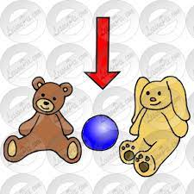
middle

Slide 57
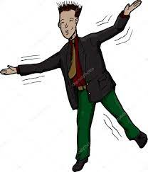
wobble

Slide 58
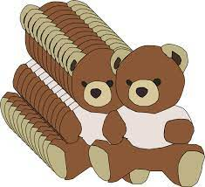
multiple

Slide 59
dazzle

Slide 60
Let’s Teach and Practise

Slide 61
The suffixes -ed -er -est

Slide 62
-ed

Slide 63
-er

Slide 64
-est

Slide 65
-ed -er -est if the word ends consonant y change the y to an i and add suffix

Slide 66
word ending in consonant y – change y to an i and add ed
word ending in consonant y – change y to an i and add er
word ending in consonant y – change y to an i and add est

Slide 67
er

Slide 68
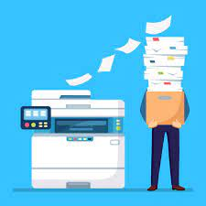
copier

Slide 69
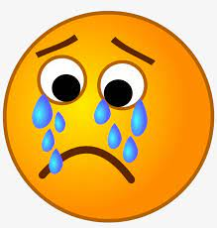
cried n

Slide 70
happiest

Slide 71
copy ->i + er = copier
copier
NOUN
Definition – a machine that makes copies

Slide 72
cry ->i + ed = cried
cried
VERB
Definition – shed tear

Slide 73
happy ->i + est = happiest
happiest
ADJECTIVE
Definition – showing pleasure

Slide 74
A copier machine is used in school.

Slide 75
A copier machine is used in school.
______

Slide 76
The man cried with happiness when he got married.

Slide 77
The man cried with happiness when he got married.
_____

Slide 78
It was the happiest day of their lives.

Slide 79
It was the happiest day of their lives.
________

Slide 80
New CHALLENGE words.

Slide 81
most
DETERMINER
Definition - greatest in amount, quantity, or degree

Slide 82
Children love spelling quizzes the most.
____

Slide 83
sure
ADJECTIVE
Definition - completely confident that one is right

Slide 84
The runner was sure he won.
____

Slide 85
Let’s Practise and Apply.

Slide 86
Can you spot the spelling rule words and the challenge words?

Slide 87
Most children learn about the North and South poles. They learn that scientists are sure that the massive ice sheets are melting because of global warming. The saddest thing is that not everyone believes this. World Leaders have cried out to people to recognise climate change and how people can be happiest if they begin to help the planet. Babies deserve to grow up in a healthy world.

Slide 88
Most children learn about the North and South poles. They learn that scientists are sure that the massive ice sheets are melting because of global warming. The saddest thing is that not everyone believes this. World Leaders have cried out to people to recognise climate change and how people can be happiest if they begin to help the planet. Babies deserve to grow up in a healthy world.

Slide 89
Write this sentence as I dictate it to you.
Notes:
They learn that scientists are sure that the massive ice sheets are melting because of global warming.

Slide 90
They learn that scientists are sure that the massive ice sheets are melting because of global warming.
Did you write it correctly?
Edit your work and make sure you have it correct.
Can you underline the spelling word that we have covered in this session?

Slide 91
Year 3 - Autumn 2
Week 1 - Wednesday
Notes:
Revisit and review the words from Y2 with the prefix un and challenge words – I say, we say, you say
Ask children to write words only in their spelling book
Introduce the new spelling rule of mis prefix
Children to write the new spelling rule words and challenge words into books when the sentences are shown with the spelling word missing.
Read the extract with the class as choral reading. Practise model of prosody etc.
Ask children to find the spelling words from the session in the text.
Then read allowed the chosen sentence for children to write fully in their books.
Show the extract and ask children to then edit their work to check they were correct in their dictation.

Slide 93
Let’s Revisit and Review…

Slide 94
Do you remember this challenge word?

Slide 95
because
CONJUNCTION
Definition – giving a reason

Slide 96
I am hungry because I missed breakfast.
_______

Slide 97
Do you remember this challenge word?

Slide 98
children
NOUN
Definition – young people

Slide 99
Children enjoy spelling sessions.
________

Slide 100
The suffix -el

Slide 101
-el

Slide 102
-el The –el spelling is much less common than –le. The –el spelling is used after m, n, r, s, v, w and more often than not after s.

Slide 103
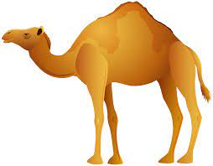
camel

Slide 104
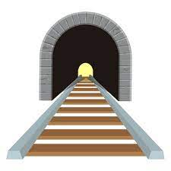
tunnel

Slide 105
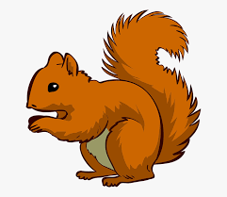
squirrel

Slide 106
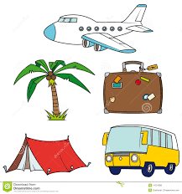
travel

Slide 107
Let’s Teach and Practise

Slide 108
The suffixes -ing -ed -er -est

Slide 109
-ing

Slide 110
-ed

Slide 111
-er

Slide 112
-est

Slide 113
-ing -ed -er -est words ending in vowel consonant double the consonant and add the suffix

Slide 114
vowel + consonant =
consonant + suffix

Slide 115
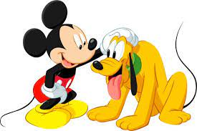
patted

Slide 116
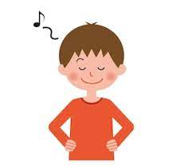
humming n

Slide 117
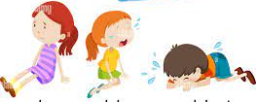
saddest

Slide 118
pat ->t + ed = patted
patted
VERB
Definition – touch gentle with hand

Slide 119
hum ->m + ing = humming
humming
VERB
Definition – sing with closed lips

Slide 120
sad ->d + est = saddest
saddest
ADJECTIVE
Definition – most unhappy

Slide 121
I patted my pocket to find my pencil.
______

Slide 122
The humming bird’s wings beat very quickly.
_______

Slide 123
It is the saddest time when we leave school.
_______

Slide 124
New CHALLENGE words.

Slide 125
most
DETERMINER
Definition - greatest in amount, quantity, or degree

Slide 126
Children love spelling quizzes the most.
____

Slide 127
sure
ADJECTIVE
Definition - completely confident that one is right

Slide 128
The runner was sure he won.
____

Slide 129
Let’s Practise and Apply.

Slide 130
Can you spot the spelling rule words and the challenge words?

Slide 131
Most children learn about the North and South poles. They learn that scientists are sure that the massive ice sheets are melting because of global warming. The saddest thing is that not everyone believes this. World Leaders have cried out to people to recognise climate change and how people can be happiest if they begin to help the planet. Babies deserve to grow up in a healthy world.

Slide 132
Most children learn about the North and South poles. They learn that scientists are sure that the massive ice sheets are melting because of global warming. The saddest thing is that not everyone believes this. World Leaders have cried out to people to recognise climate change and how people can be happiest if they begin to help the planet. Babies deserve to grow up in a healthy world.

Slide 133
Write this sentence as I dictate it to you.
Notes:
World Leaders have cried out to people to recognise climate change and how people can be happiest if they begin to help the planet.

Slide 134
World Leaders have cried out to people to recognise climate change and how people can be happiest if they begin to help the planet.
Did you write it correctly?
Edit your work and make sure you have it correct.
Can you underline the spelling word that we have covered in this session?

Slide 135
Year 3 - Autumn 2
Week 1 - Thursday
Notes:
Revisit and review the words from Y2 with the prefix un and challenge words – I say, we say, you say
Ask children to write words only in their spelling book
Introduce the new spelling rule of mis prefix
Children to write the new spelling rule words and challenge words into books when the sentences are shown with the spelling word missing.
Read the extract with the class as choral reading. Practise model of prosody etc.
Ask children to find the spelling words from the session in the text.
Then read allowed the chosen sentence for children to write fully in their books.
Show the extract and ask children to then edit their work to check they were correct in their dictation.

Slide 137
Let’s Revisit and Review…

Slide 138
Do you remember this challenge word?

Slide 139
because
CONJUNCTION
Definition – giving a reason

Slide 140
I am hungry because I missed breakfast.
_______

Slide 141
Do you remember this challenge word?

Slide 142
children
NOUN
Definition – young people

Slide 143
Children enjoy spelling sessions.
________

Slide 144
The suffix -el

Slide 145
-el

Slide 146
-el The –el spelling is much less common than –le. The –el spelling is used after m, n, r, s, v, w and more often than not after s.

Slide 147
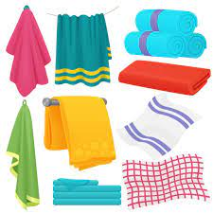
towel

Slide 148
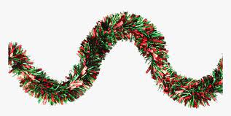
tinsel

Slide 149
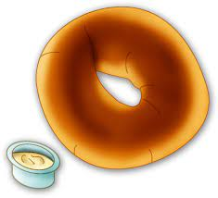
bagel

Slide 150
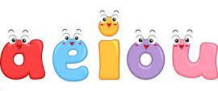
vowel

Slide 151
Let’s Teach and Practise

Slide 152
The suffixes -ing -ed -er -est

Slide 153
-ing

Slide 154
-ed

Slide 155
-er

Slide 156
-est

Slide 157
-ing -ed -er -est if the word ends in an e remove the e and add the suffix

Slide 158
Word ends in e – take off the e and add ing
Word ends in e – take off the e and add ed
Word ends in e – take off the e and add er
Word ends in e – take off the e and add est

Slide 159
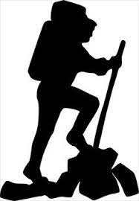
hiking

Slide 160
hiked n

Slide 161
hiker

Slide 162
hike - e + ing = hiking
hiking
VERB
Definition – going on a long walk

Slide 163
hike -e + ed = hiked
hiked
VERB
Definition – walked a long distance

Slide 164
hike -e + er = hiker
hiker
NOUN
Definition – a person who walks a long distance

Slide 165
The man was hiking up a hill.
______

Slide 166
He hiked to the very top.
_____

Slide 167
The hiker was tired.
_____

Slide 168
New CHALLENGE words.

Slide 169
most
DETERMINER
Definition - greatest in amount, quantity, or degree

Slide 170
Children love spelling quizzes the most.
____

Slide 171
sure
ADJECTIVE
Definition - completely confident that one is right

Slide 172
The runner was sure he won.
____

Slide 173
Let’s Practise and Apply.

Slide 174
Can you spot the spelling rule words and the challenge words?

Slide 175
Most children learn about the North and South poles. They learn that scientists are sure that the massive ice sheets are melting because of global warming. The saddest thing is that not everyone believes this. World Leaders have cried out to people to recognise climate change and how people can be happiest if they begin to help the planet. Babies deserve to grow up in a healthy world.

Slide 176
Most children learn about the North and South poles. They learn that scientists are sure that the massive ice sheets are melting because of global warming. The saddest thing is that not everyone believes this. World Leaders have cried out to people to recognise climate change and how people can be happiest if they begin to help the planet. Babies deserve to grow up in a healthy world.

Slide 177
Write this sentence as I dictate it to you.
Notes:
Babies deserve to grow up in a healthy world.

Slide 178
Babies deserve to grow up in a healthy world.
Did you write it correctly?
Edit your work and make sure you have it correct.
Can you underline the spelling word that we have covered in this session?

Slide 179
Year 3 - Autumn 2
Week 1 - Friday
Notes:
Click through the slides for all the R+R words for the week (both the focus and the challenge words)
Click through the slides for all the new learning this week

Slide 181
Old challenge words…

Slide 182
because

Slide 183
children

Slide 184
Old spelling rule words…

Slide 185
table

Slide 186
apple

Slide 187
bottle

Slide 188
little

Slide 189
middle

Slide 190
wobble

Slide 191
multiple

Slide 192
dazzle

Slide 193
camel

Slide 194
tunnel

Slide 195
squirrel

Slide 196
travel

Slide 197
towel

Slide 198
tinsel

Slide 199
bagel

Slide 200
vowel

Slide 201
New spelling rule words…

Slide 202
flies

Slide 203
tries

Slide 204
babies

Slide 205
copier

Slide 206
cried

Slide 207
happiest

Slide 208
patted

Slide 209
humming

Slide 210
saddest

Slide 211
hiking

Slide 212
hiked

Slide 213
hiker

Slide 214
New challenge words…

Slide 215
most

Slide 216
sure

Slide 217
Quick Quiz time…
Notes:
Say these words for the quiz
Table bagel because children most sure flies cried saddest hiker

Slide 218
Did you get them correct?
Edit your work.
table bagel because children most sure flies cried saddest hiker
Notes:
Say these words for the quiz
unhappy undress unable actual learn mishap mistreat misprint mislead mistrust

Slide 219
Word class time…

Slide 220
Children love spelling quizzes the most.
Notes:
Ask for these words to be classed

Slide 221
Children love spelling quizzes the most.
noun verb adjective noun determiner adverb
Notes:
Ask for these words to be classed

Slide 222
Children love spelling quizzes the most.
noun verb adjective noun determiner adverb
Notes:
Ask for these words to be classed

Slide 223
The runner was sure he won.
Notes:
Ask for these words to be classed

Slide 224
The runner was sure he won.
determiner noun verb determiner pronoun verb

Slide 225
The runner was sure he won.
determiner noun verb adverb determiner pronoun verb

Slide 226
Etymology
The history of a word….

Slide 227
sure (adj.)
early 13c., "safe against attack, secure," later "firm, reliable" (c. 1300); "mentally certain, confident" (mid-14c.); "firm, strong, resolute" (c. 1400), from Old French seur, sur "safe, secure; undoubted, dependable, trustworthy" (12c.), from Latin securus "free from care, untroubled, heedless, safe" (see secure (adj.)). Pronunciation development is that of sugar (n.). As an affirmative meaning "yes, certainly" it dates from 1803, from Middle English meanings "firmly established; having no doubt," and phrases like to be sure (1650s), sure enough (1540s), and for sure (1580s). The use as an adverb meaning "assuredly" goes back to early 14c. Sure-footed is from 1630s, literal and figurative; sure thing dates from 1836. In 16c.-17c., Suresby was an appellation for a person to be depended upon (see rudesby).

Slide 228
most (adj.)
Old English mast "greatest in number, amount, or extent; largest," earlier mæst, from Proto-Germanic *maistaz (source also of Old Saxon mest, Old Frisian mast, Old Norse mestr, Dutch meest, German meist, Gothic maists "most"), superlative form of Proto-Germanic *maiz, root of Old English ma, mara (see more). Used in Old English as superlative of micel "great, large" (see mickle), hence, in later use, superlative of much. The vowel has been influenced by more.
Original sense of "greatest" survives in phrase for the most part (mid-14c.; late Old English had þa mæste dæl). Slang the most meaning "the best, extremely good" is attested from 1953. Also used as an adverb in Old English and in late Old English as a noun, "the greatest or greater number." The sense of "greatest value or advantage" in the phrase make the most of (something) is by 1520s. Related: Mostly.
Double superlative mostest "greatest amount or degree" is by 1849 in U.S. Southern and African-American vernacular. The formula for victory in battle attributed to famously unschooled Confederate Lt. Gen. Nathan Bedford Forrest is first attested (1886) as Git thar the fastest with the mostest men.
From 15c.-17c. English also had mostwhat "for the most part," mostwhen "on most occasions," mostwhere "in most places."

Slide 229
Let’s investigate….
Can you find words linked to sure and most?

Slide 230
Words linked to sure…
Ensure
Insure
Secure
Unsure
Surely

Slide 231
Words linked to most…
Bottom-most
Uppermost
Westernmost
Southernmost
Lowermost

