Slide 1
Spelling Y3
Mastering spellings: building on the foundations of phonics
Autumn 1
Week 2
Notes:
These slides are the same as Y2 Summer 2 as this is a revisit and review half term

Slide 2
Year 3 - Autumn 1
Week 2 - Monday
Notes:
Revisit and review the words from Y2 with the el and le suffix and challenge words – I say, we say, you say
Ask children to write words only in their spelling book
Introduce the new spelling rule of suffix ies / ed / es / ing / er / est
Children to write the new spelling rule words and challenge words into books when the sentences are shown with the spelling word missing.
Read the extract with the class as choral reading. Practise model of prosody etc.
Ask children to find the spelling words from the session in the text.
Then read allowed the chosen sentence for children to write fully in their books.
Show the extract and ask children to then edit their work to check they were correct in their dictation.

Slide 3
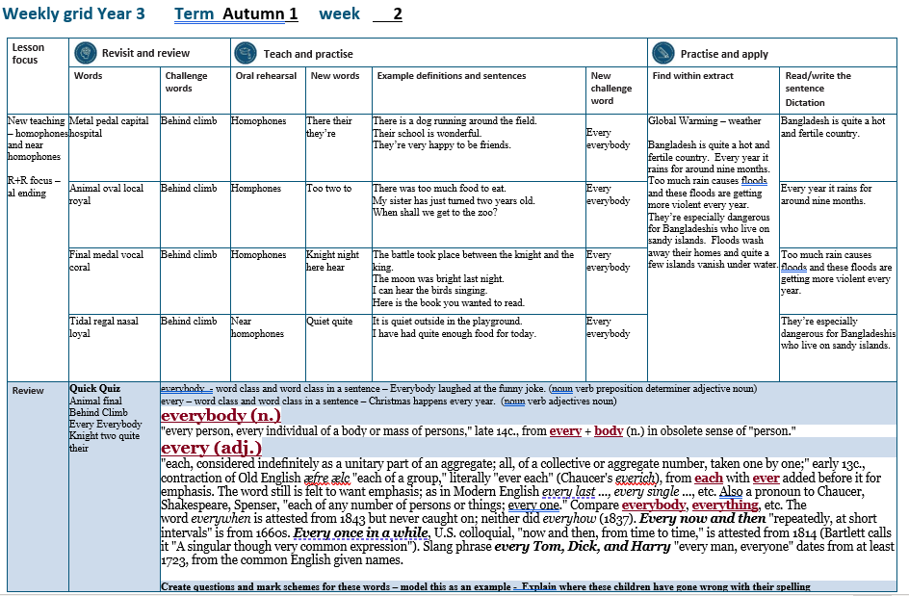

Slide 4
Let’s Revisit and Review…

Slide 5
Do you remember this challenge word?

Slide 6
behind

Slide 7
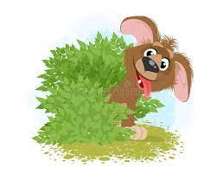
behind
PREPOSITION
Definition – hidden

Slide 8
The dog was behind the bush.
______

Slide 9
Do you remember this challenge word?

Slide 10
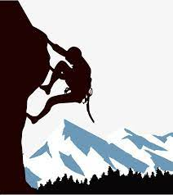
Definition – go up
climb
VERB

Slide 11
Many people climb mountains for enjoyment.
_____

Slide 12
Words ending
-al

Slide 13
-al

Slide 14
-al
Not many nouns end in –al, but many adjectives do.

Slide 15
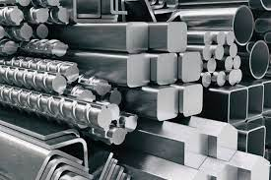
metal

Slide 16

pedal

Slide 17
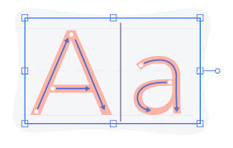
capital

Slide 18

hospital

Slide 19
Let’s Teach and Practise

Slide 20
Homophones and near homophones

Slide 21
homophones homo = same phone = sound

Slide 22
homophones words that sound the same but mean different things

Slide 23
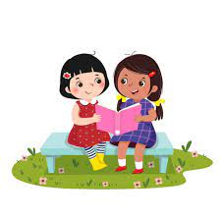
their

Slide 24
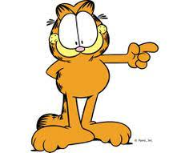
there n

Slide 25
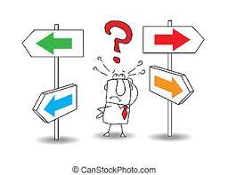
they’re

Slide 26
Definition - in, at, or to that place or position
there
here there where
ADVERB

Slide 27
Definition - belonging to or associated with the people or things previously mentioned
their
I - belonging
DETERMINER

Slide 28
they’re
they are = they’re
CONTRACTION
Definition – contraction of they are

Slide 29
There is a dog running around the field.
_____

Slide 30
Their school is wonderful.
_____

Slide 31
They’re very happy to be friends.
_______

Slide 32
New CHALLENGE words.

Slide 33
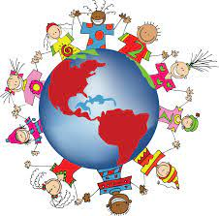
Definition - used before an amount to indicate how often something happens
every
DETERMINER

Slide 34
Christmas happens every year.
_____

Slide 35
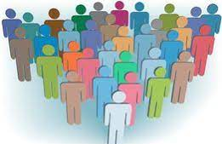
everybody
PRONOUN
Definition -every person

Slide 36
Everybody laughed at the funny joke.
_________

Slide 37
Let’s Practise and Apply.

Slide 38
Can you spot the spelling rule words and the challenge words?

Slide 39
Global Warming – weather
Bangladesh is quite a hot and fertile country. Every year it rains for around nine months. Too much rain causes floods and these floods are getting more violent every year. They’re especially dangerous for Bangladeshis who live on sandy islands. Floods wash away their homes and quite a few islands vanish under water.

Slide 40
Global Warming – weather
Bangladesh is quite a hot and fertile country. Every year it rains for around nine months. Too much rain causes floods and these floods are getting more violent every year. They’re especially dangerous for Bangladeshis who live on sandy islands. Floods wash away their homes and quite a few islands vanish under water.

Slide 41
Write this sentence as I dictate it to you.
Notes:
Bangladesh is quite a hot and fertile country.

Slide 42
Bangladesh is quite a hot and fertile country.
Did you write it correctly?
Edit your work and make sure you have it correct.
Can you underline the spelling word that we have covered in this session?

Slide 43
Year 3 - Autumn 2
Week 2 - Tuesday
Notes:
Revisit and review the words from Y2 and challenge words – I say, we say, you say
Ask children to write words only in their spelling book
Introduce the new spelling rule
Children to write the new spelling rule words and challenge words into books when the sentences are shown with the spelling word missing.
Read the extract with the class as choral reading. Practise model of prosody etc.
Ask children to find the spelling words from the session in the text.
Then read allowed the chosen sentence for children to write fully in their books.
Show the extract and ask children to then edit their work to check they were correct in their dictation.

Slide 45
Let’s Revisit and Review…

Slide 46
Do you remember this challenge word?

Slide 47
behind
PREPOSITION
Definition – hidden

Slide 48
The dog was behind the bush.
______

Slide 49
Do you remember this challenge word?

Slide 50
Definition – go up
climb
VERB

Slide 51
Many people climb mountains for enjoyment.
_____

Slide 52
Words ending
-al

Slide 53
-al

Slide 54
-al
Not many nouns end in –al, but many adjectives do.

Slide 55
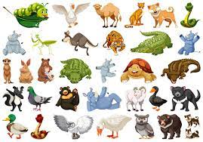
animal

Slide 56

oval

Slide 57

local

Slide 58

royal

Slide 59
Let’s Teach and Practise

Slide 60
Homophones and near homophones

Slide 61
homophones homo = same phone = sound

Slide 62
homophones words that sound the same but mean different things

Slide 63
to

Slide 64
too n

Slide 65
two

Slide 66

Definition - expressing motion in the direction of
to
PREPOSTITION

Slide 67
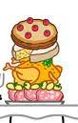
Definition - to a higher degree than is desirable, permissible, or possible; excessively
too
ADVERB

Slide 68

Definition - equivalent to the sum of one and one; one less than three
two
NUMBER

Slide 69
When shall we get to the zoo?
__

Slide 70
There was too much food to eat.
___

Slide 71
My sister has just turned two years old.
___

Slide 72
New CHALLENGE words.

Slide 73
Definition - used before an amount to indicate how often something happens
every
DETERMINER

Slide 74
Christmas happens every year.
_____

Slide 75
everybody
PRONOUN
Definition -every person

Slide 76
Everybody laughed at the funny joke.
_________

Slide 77
Let’s Practise and Apply.

Slide 78
Can you spot the spelling rule words and the challenge words?

Slide 79
Global Warming – weather
Bangladesh is quite a hot and fertile country. Every year it rains for around nine months. Too much rain causes floods and these floods are getting more violent every year. They’re especially dangerous for Bangladeshis who live on sandy islands. Floods wash away their homes and quite a few islands vanish under water.

Slide 80
Global Warming – weather
Bangladesh is quite a hot and fertile country. Every year it rains for around nine months. Too much rain causes floods and these floods are getting more violent every year. They’re especially dangerous for Bangladeshis who live on sandy islands. Floods wash away their homes and quite a few islands vanish under water.

Slide 81
Write this sentence as I dictate it to you.
Notes:
Every year it rains for around nine months.

Slide 82
Every year it rains for around nine months.
Did you write it correctly?
Edit your work and make sure you have it correct.
Can you underline the spelling word that we have covered in this session?

Slide 83
Year 3 - Autumn 2
Week 2 - Wednesday
Notes:
Revisit and review the words from Y2 and challenge words – I say, we say, you say
Ask children to write words only in their spelling book
Introduce the new spelling rule
Children to write the new spelling rule words and challenge words into books when the sentences are shown with the spelling word missing.
Read the extract with the class as choral reading. Practise model of prosody etc.
Ask children to find the spelling words from the session in the text.
Then read allowed the chosen sentence for children to write fully in their books.
Show the extract and ask children to then edit their work to check they were correct in their dictation.

Slide 85
Let’s Revisit and Review…

Slide 86
Do you remember this challenge word?

Slide 87
behind
PREPOSITION
Definition – hidden

Slide 88
The dog was behind the bush.
______

Slide 89
Do you remember this challenge word?

Slide 90
Definition – go up
climb
VERB

Slide 91
Many people climb mountains for enjoyment.
_____

Slide 92
Words ending
-al

Slide 93
-al

Slide 94
-al
Not many nouns end in –al, but many adjectives do.

Slide 95
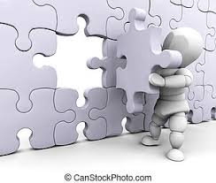
final

Slide 96

medal

Slide 97

vocal

Slide 98
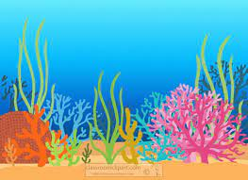
coral

Slide 99
Let’s Teach and Practise

Slide 100
Homophones and near homophones

Slide 101
homophones homo = same phone = sound

Slide 102
homophones words that sound the same but mean different things

Slide 103
knight

Slide 104
night

Slide 105
here n

Slide 106
hear

Slide 107

Definition - (in the Middle Ages) a man who served his sovereign or lord as a mounted soldier in armour
knight
NOUN

Slide 108
The k is silent.
It used to be pronounced as it came from the German language. It was hard to pronounce so people stopped saying it.

Slide 109

Definition - the period from sunset to sunrise in each twenty-four hours
night
NOUN

Slide 110

Definition - in, at, or to this place or position
here
ADVERB

Slide 111

Definition - perceive with the ear the sound made
hear
VERB

Slide 112
The battle took place between the knight and the king.
______

Slide 113
The moon was bright last night.
_____

Slide 114
Here is the book you wanted to read.
____

Slide 115
I can hear the birds singing.
____

Slide 116
New CHALLENGE words.

Slide 117
Definition - used before an amount to indicate how often something happens
every
DETERMINER

Slide 118
Christmas happens every year.
_____

Slide 119
everybody
PRONOUN
Definition -every person

Slide 120
Everybody laughed at the funny joke.
_________

Slide 121
Let’s Practise and Apply.

Slide 122
Can you spot the spelling rule words and the challenge words?

Slide 123
Global Warming – weather
Bangladesh is quite a hot and fertile country. Every year it rains for around nine months. Too much rain causes floods and these floods are getting more violent every year. They’re especially dangerous for Bangladeshis who live on sandy islands. Floods wash away their homes and quite a few islands vanish under water.

Slide 124
Global Warming – weather
Bangladesh is quite a hot and fertile country. Every year it rains for around nine months. Too much rain causes floods and these floods are getting more violent every year. They’re especially dangerous for Bangladeshis who live on sandy islands. Floods wash away their homes and quite a few islands vanish under water.

Slide 125
Write this sentence as I dictate it to you.
Notes:
Too much rain causes floods and these floods are getting more violent every year.

Slide 126
Too much rain causes floods and these floods are getting more violent every year.
Did you write it correctly?
Edit your work and make sure you have it correct.
Can you underline the spelling word that we have covered in this session?

Slide 127
Year 3 - Autumn 2
Week 2 - Thursday
Notes:
Revisit and review the words from Y2 and challenge words – I say, we say, you say
Ask children to write words only in their spelling book
Introduce the new spelling rule
Children to write the new spelling rule words and challenge words into books when the sentences are shown with the spelling word missing.
Read the extract with the class as choral reading. Practise model of prosody etc.
Ask children to find the spelling words from the session in the text.
Then read allowed the chosen sentence for children to write fully in their books.
Show the extract and ask children to then edit their work to check they were correct in their dictation.

Slide 129
Let’s Revisit and Review…

Slide 130
Do you remember this challenge word?

Slide 131
behind
PREPOSITION
Definition – hidden

Slide 132
The dog was behind the bush.
______

Slide 133
Do you remember this challenge word?

Slide 134
Definition – go up
climb
VERB

Slide 135
Many people climb mountains for enjoyment.
_____

Slide 136
Words ending
-al

Slide 137
-al

Slide 138
-al
Not many nouns end in –al, but many adjectives do.

Slide 139
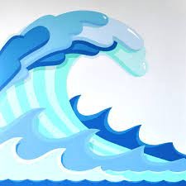
tidal

Slide 140

regal

Slide 141
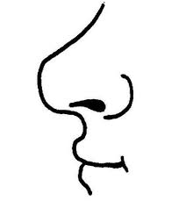
nasal

Slide 142
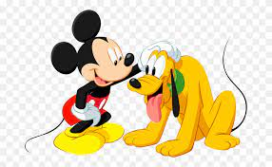
loyal

Slide 143
Let’s Teach and Practise

Slide 144
Homophones and near homophones

Slide 145
homophones homo = same phone = sound

Slide 146
homophones words that sound the same but mean different things

Slide 147
Near homophones are words that sound very similar but are different.

Slide 148
quiet

Slide 149
quite n

Slide 150

Definition - making little or no noise
quiet
ADJECTIVE

Slide 151
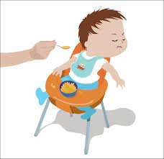
Definition - to the utmost or most absolute extent or degree; absolutely; completely
quite
ADVERB

Slide 152
It is quiet in the playground.
_____

Slide 153
I have had quite enough food for today.
_____

Slide 154
New CHALLENGE words.

Slide 155
Definition - used before an amount to indicate how often something happens
every
DETERMINER

Slide 156
Christmas happens every year.
_____

Slide 157
everybody
PRONOUN
Definition -every person

Slide 158
Everybody laughed at the funny joke.
_________

Slide 159
Let’s Practise and Apply.

Slide 160
Can you spot the spelling rule words and the challenge words?

Slide 161
Global Warming – weather
Bangladesh is quite a hot and fertile country. Every year it rains for around nine months. Too much rain causes floods and these floods are getting more violent every year. They’re especially dangerous for Bangladeshis who live on sandy islands. Floods wash away their homes and quite a few islands vanish under water.

Slide 162
Global Warming – weather
Bangladesh is quite a hot and fertile country. Every year it rains for around nine months. Too much rain causes floods and these floods are getting more violent every year. They’re especially dangerous for Bangladeshis who live on sandy islands. Floods wash away their homes and quite a few islands vanish under water.

Slide 163
Write this sentence as I dictate it to you.
Notes:
Floods wash away their homes and quite a few islands vanish under water.

Slide 164
Floods wash away their homes and quite a few islands vanish under water.
Did you write it correctly?
Edit your work and make sure you have it correct.
Can you underline the spelling word that we have covered in this session?

Slide 165
Year 3 - Autumn 2
Week 2 - Friday
Notes:
Click through the slides for all the R+R words for the week (both the focus and the challenge words)
Click through the slides for all the new learning this week

Slide 167
Old challenge words…

Slide 168
behind

Slide 169
climb

Slide 170
Old spelling rule words…

Slide 171
metal

Slide 172
pedal

Slide 173
capital

Slide 174
hospital

Slide 175
animal

Slide 176
oval

Slide 177
local

Slide 178
royal

Slide 179
final

Slide 180
medal

Slide 181
vocal

Slide 182
coral

Slide 183
tidal

Slide 184
regal

Slide 185
nasal

Slide 186
loyal

Slide 187
New spelling rule words…

Slide 188
there

Slide 189
their

Slide 190
they’re

Slide 191
too

Slide 192
to

Slide 193
two

Slide 194
knight

Slide 195
night

Slide 196
here

Slide 197
hear

Slide 198
quiet

Slide 199
quite

Slide 200
New challenge words…

Slide 201
every

Slide 202
everybody

Slide 203
Quick Quiz time…
Notes:
Say these words for the quiz
animal final behind climb every everybody knight two quite their

Slide 204
Did you get them correct?
Edit your work.
animal final behind climb every everybody knight two quite their
Notes:
Say these words for the quiz
unhappy undress unable actual learn mishap mistreat misprint mislead mistrust

Slide 205
Word class time…

Slide 206
Everybody laughed at the funny joke.
Notes:
Ask for these words to be classed

Slide 207
Everybody laughed at the funny joke.
noun verb preposition determiner adjective noun
Notes:
Ask for these words to be classed

Slide 208
Everybody laughed at the funny joke.
noun verb preposition determiner adjective noun
Notes:
Ask for these words to be classed

Slide 209
Christmas happens every year.
Notes:
Ask for these words to be classed

Slide 210
Christmas happens every year.
noun verb adverbial

Slide 211
Christmas happens every year.
noun verb adverbial

Slide 212
Etymology
The history of a word….

Slide 213
every (adj.)
"each, considered indefinitely as a unitary part of an aggregate; all, of a collective or aggregate number, taken one by one;" early 13c., contraction of Old English æfre ælc "each of a group," literally "ever each" (Chaucer's everich), from each with ever added before it for emphasis. The word still is felt to want emphasis; as in Modern English every last ..., every single ..., etc.
Also a pronoun to Chaucer, Shakespeare, Spenser, "each of any number of persons or things; every one." Compare everybody, everything, etc. The word everywhen is attested from 1843 but never caught on; neither did everyhow (1837).
Every now and then "repeatedly, at short intervals" is from 1660s. Every once in a while, U.S. colloquial, "now and then, from time to time," is attested from 1814 (Bartlett calls it "A singular though very common expression"). Slang phrase every Tom, Dick, and Harry "every man, everyone" dates from at least 1723, from the common English given names.

Slide 214
everybody (n.)
"every person, every individual of a body or mass of persons," late 14c., from every + body (n.) in obsolete sense of "person."

Slide 215
Let’s investigate….
Can you find words linked to every?

Slide 216
Words linked to every…
Everyone
Everybody
Everyman
Everyday
Everywhere
Everything

