Slide 1
Spelling Y3
Mastering spellings: building on the foundations of phonics
Autumn 1
Week 3
Notes:
These slides are the same as Y2 Summer 2 as this is a revisit and review half term

Slide 2
Year 3 - Autumn 1
Week 3 - Monday
Notes:
Revisit and review the words from Y2 and challenge words – I say, we say, you say
Ask children to write words only in their spelling book
Introduce the new spelling rule
Children to write the new spelling rule words and challenge words into books when the sentences are shown with the spelling word missing.
Read the extract with the class as choral reading. Practise model of prosody etc.
Ask children to find the spelling words from the session in the text.
Then read allowed the chosen sentence for children to write fully in their books.
Show the extract and ask children to then edit their work to check they were correct in their dictation.

Slide 3
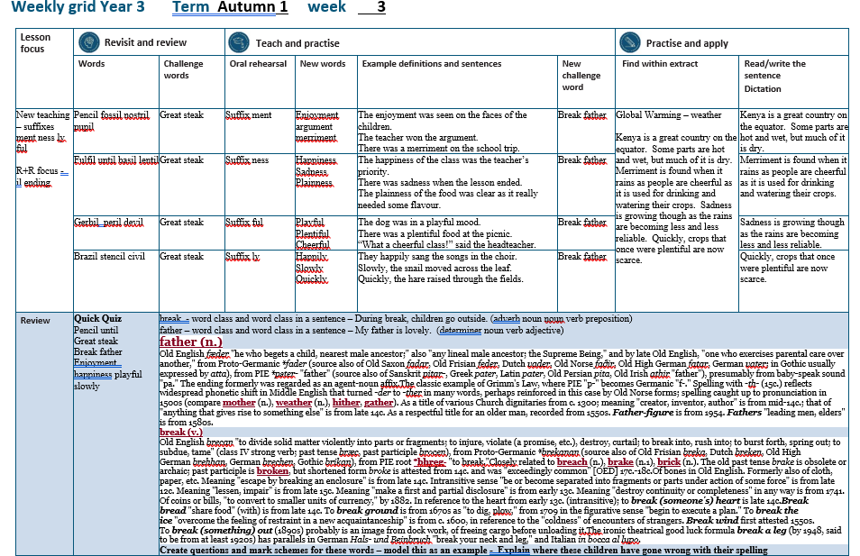

Slide 4
Let’s Revisit and Review…

Slide 5
Do you remember this challenge word?

Slide 6

Definition – large and grand
great
ADJECTIVE

Slide 7
It was a great day.
_____

Slide 8
Do you remember this challenge word?

Slide 9
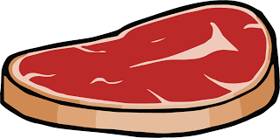
NOUN
steak
Definition – a piece of meat

Slide 10
The dog enjoyed eating the steak.
_____

Slide 11
Words ending
-il

Slide 12
-il

Slide 13
-il
There are not many of these words.

Slide 14

pencil

Slide 15
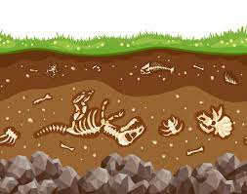
fossil

Slide 16

nostril

Slide 17
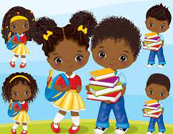
pupil

Slide 18
Let’s Teach and Practise

Slide 19
The suffix -ment

Slide 20
-ment

Slide 21
-ment
If a suffix starts with a consonant letter, it is added straight on to most root words without any change to the last letter of those words.

Slide 22
-ment
Exceptions:
(1) argument
(2) root words ending in –y with a consonant before it but only if the root word has more than one syllable.

Slide 23
enjoyment

Slide 24
argument n

Slide 25
merriment

Slide 26
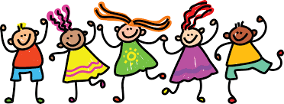
enjoy + ment = enjoyment
enjoyment
NOUN
Definition – taking pleasure in something

Slide 27
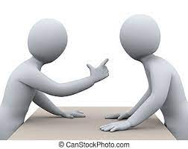
argue - e + ment = argument
argument
NOUN
Definition – an angry exchange of words

Slide 28
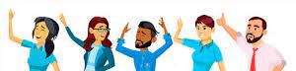
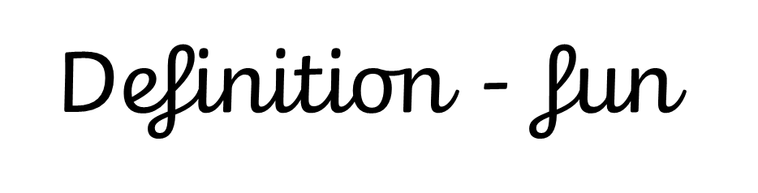
merry – y +i + ment = merriment
merriment
NOUN

Slide 29
The enjoyment was seen on the faces of the children.
_________

Slide 30
The teacher won the argument.
________

Slide 31
There was a merriment on the school trip.
_________

Slide 32
New CHALLENGE words.

Slide 33
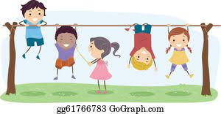
Definition - a pause in work or during an activity or event
break
NOUN

Slide 34
During break, children go outside.
_____

Slide 35
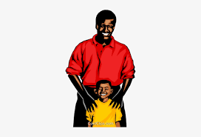
Definition - a man in relation to his child or children
father
NOUN

Slide 36
My father is lovely.
______

Slide 37
Let’s Practise and Apply.

Slide 38
Can you spot the spelling rule words and the challenge words?

Slide 39
Global Warming – weather
Global Warming – weather
Kenya is a great country on the equator. Some parts are hot and wet, but much of it is dry. Merriment is found when it rains as people are cheerful as it is used for drinking and watering their crops. Sadness is growing though as the rains are becoming less and less reliable. Quickly, crops that once were plentiful are now scarce.

Slide 40
Global Warming – weather
Global Warming – weather
Kenya is a great country on the equator. Some parts are hot and wet, but much of it is dry. Merriment is found when it rains as people are cheerful as it is used for drinking and watering their crops. Sadness is growing though as the rains are becoming less and less reliable. Quickly, crops that once were plentiful are now scarce.

Slide 41
Write this sentence as I dictate it to you.
Notes:
Kenya is a great country on the equator.

Slide 42
Kenya is a great country on the equator.
Did you write it correctly?
Edit your work and make sure you have it correct.
Can you underline the spelling word that we have covered in this session?

Slide 43
Year 3 - Autumn 2
Week 3 - Tuesday
Notes:
Revisit and review the words from Y2 and challenge words – I say, we say, you say
Ask children to write words only in their spelling book
Introduce the new spelling rule
Children to write the new spelling rule words and challenge words into books when the sentences are shown with the spelling word missing.
Read the extract with the class as choral reading. Practise model of prosody etc.
Ask children to find the spelling words from the session in the text.
Then read allowed the chosen sentence for children to write fully in their books.
Show the extract and ask children to then edit their work to check they were correct in their dictation.

Slide 45
Let’s Revisit and Review…

Slide 46
Do you remember this challenge word?

Slide 47
Definition – large and grand
great
ADJECTIVE

Slide 48
It was a great day.
_____

Slide 49
Do you remember this challenge word?

Slide 50
NOUN
steak
Definition – a piece of meat

Slide 51
The dog enjoyed eating the steak.
_____

Slide 52
Words ending
-il

Slide 53
-il

Slide 54
-il
There are not many of these words.

Slide 55
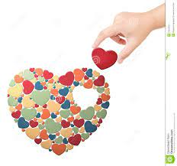
fulfil

Slide 56
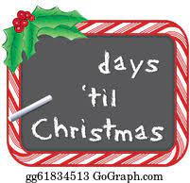
until

Slide 57
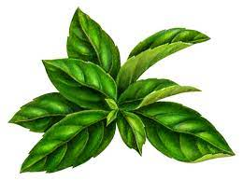
basil

Slide 58
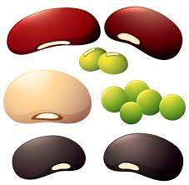
lentil

Slide 59
Let’s Teach and Practise

Slide 60
The suffix -ness

Slide 61
-ness

Slide 62
-ness
If a suffix starts with a consonant letter, it is added straight on to most root words without any change to the last letter of those words.

Slide 63
-ment
Exceptions:
(1) argument
(2) root words ending in –y with a consonant before it but only if the root word has more than one syllable.

Slide 64
happiness

Slide 65
sadness n

Slide 66
plainness

Slide 67
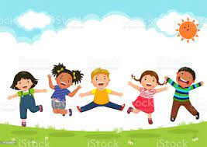
happy – y + i + ness = happiness
happiness
NOUN
Definition – the state of being happy

Slide 68
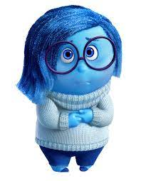
sad + ness = sadness
sadness
NOUN
Definition – the state of being sad

Slide 69
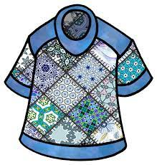
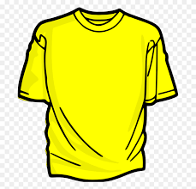
plain + ness = plainness
plainness
ADJECTIVE
Definition – not patterned

Slide 70
The happiness of the class was the teacher’s priority.
_________

Slide 71
There was sadness when the lesson ended.
_______

Slide 72
The plainness of the food was clear as it was lacking in flavour.
_________

Slide 73
New CHALLENGE words.

Slide 74
Definition - a pause in work or during an activity or event
break
NOUN

Slide 75
During break, children go outside.
_____

Slide 76
Definition - a man in relation to his child or children
father
NOUN

Slide 77
My father is lovely.
______

Slide 78
Let’s Practise and Apply.

Slide 79
Can you spot the spelling rule words and the challenge words?

Slide 80
Global Warming – weather
Global Warming – weather
Kenya is a great country on the equator. Some parts are hot and wet, but much of it is dry. Merriment is found when it rains as people are cheerful as it is used for drinking and watering their crops. Sadness is growing though as the rains are becoming less and less reliable. Quickly, crops that once were plentiful are now scarce.

Slide 81
Global Warming – weather
Global Warming – weather
Kenya is a great country on the equator. Some parts are hot and wet, but much of it is dry. Merriment is found when it rains as people are cheerful as it is used for drinking and watering their crops. Sadness is growing though as the rains are becoming less and less reliable. Quickly, crops that once were plentiful are now scarce.

Slide 82
Write this sentence as I dictate it to you.
Notes:
Merriment is found when it rains as people are cheerful as it is used for drinking and watering their crops.

Slide 83
Merriment is found when it rains as people are cheerful as it is used for drinking and watering their crops.
Did you write it correctly?
Edit your work and make sure you have it correct.
Can you underline the spelling word that we have covered in this session?

Slide 84
Year 3 - Autumn 2
Week 3 - Wednesday
Notes:
Revisit and review the words from Y2 and challenge words – I say, we say, you say
Ask children to write words only in their spelling book
Introduce the new spelling rule
Children to write the new spelling rule words and challenge words into books when the sentences are shown with the spelling word missing.
Read the extract with the class as choral reading. Practise model of prosody etc.
Ask children to find the spelling words from the session in the text.
Then read allowed the chosen sentence for children to write fully in their books.
Show the extract and ask children to then edit their work to check they were correct in their dictation.

Slide 86
Let’s Revisit and Review…

Slide 87
Do you remember this challenge word?

Slide 88
Definition – large and grand
great
ADJECTIVE

Slide 89
It was a great day.
_____

Slide 90
Do you remember this challenge word?

Slide 91
NOUN
steak
Definition – a piece of meat

Slide 92
The dog enjoyed eating the steak.
_____

Slide 93
Words ending
-il

Slide 94
-il

Slide 95
-il
There are not many of these words.

Slide 96
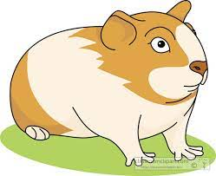
gerbil

Slide 97

peril

Slide 98

devil

Slide 99
Let’s Teach and Practise

Slide 100
The suffix -ful

Slide 101
-ful

Slide 102
-ful
If a suffix starts with a consonant letter, it is added straight on to most root words without any change to the last letter of those words.

Slide 103
-ful
Exceptions:
(1) argument
(2) root words ending in –y with a consonant before it but only if the root word has more than one syllable.

Slide 104
playful

Slide 105
plentiful n

Slide 106
cheerful

Slide 107
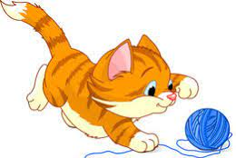
play + ful = playful
playful
ADJECTIVE
Definition – fond of games

Slide 108
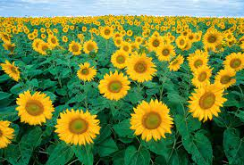
plenty – y + i + ful = plentiful
plentiful
ADJECTIVE
Definition - lots

Slide 109
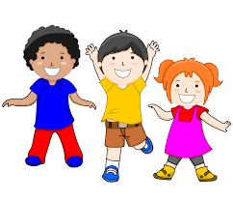
cheer + ful = cheerful
cheerful
ADJECTIVE
Definition – noticeably happy

Slide 110
The dog was in a playful mood.
_______

Slide 111
There was plentiful food at the picnic.
________

Slide 112
“What a cheerful class!” said the headteacher.
________

Slide 113
New CHALLENGE words.

Slide 114
Definition - a pause in work or during an activity or event
break
NOUN

Slide 115
During break, children go outside.
_____

Slide 116
Definition - a man in relation to his child or children
father
NOUN

Slide 117
My father is lovely.
______

Slide 118
Let’s Practise and Apply.

Slide 119
Can you spot the spelling rule words and the challenge words?

Slide 120
Global Warming – weather
Global Warming – weather
Kenya is a great country on the equator. Some parts are hot and wet, but much of it is dry. Merriment is found when it rains as people are cheerful as it is used for drinking and watering their crops. Sadness is growing though as the rains are becoming less and less reliable. Quickly, crops that once were plentiful are now scarce.

Slide 121
Global Warming – weather
Global Warming – weather
Kenya is a great country on the equator. Some parts are hot and wet, but much of it is dry. Merriment is found when it rains as people are cheerful as it is used for drinking and watering their crops. Sadness is growing though as the rains are becoming less and less reliable. Quickly, crops that once were plentiful are now scarce.

Slide 122
Write this sentence as I dictate it to you.
Notes:
Sadness is growing though as the rains are becoming less and less reliable.

Slide 123
Sadness is growing though as the rains are becoming less and less reliable.
Did you write it correctly?
Edit your work and make sure you have it correct.
Can you underline the spelling word that we have covered in this session?

Slide 124
Year 3 - Autumn 2
Week 3 - Thursday
Notes:
Revisit and review the words from Y2 and challenge words – I say, we say, you say
Ask children to write words only in their spelling book
Introduce the new spelling rule
Children to write the new spelling rule words and challenge words into books when the sentences are shown with the spelling word missing.
Read the extract with the class as choral reading. Practise model of prosody etc.
Ask children to find the spelling words from the session in the text.
Then read allowed the chosen sentence for children to write fully in their books.
Show the extract and ask children to then edit their work to check they were correct in their dictation.

Slide 126
Let’s Revisit and Review…

Slide 127
Do you remember this challenge word?

Slide 128
Definition – large and grand
great
ADJECTIVE

Slide 129
It was a great day.
_____

Slide 130
Do you remember this challenge word?

Slide 131
NOUN
steak
Definition – a piece of meat

Slide 132
The dog enjoyed eating the steak.
_____

Slide 133
Words ending
-il

Slide 134
-il

Slide 135
-il
There are not many of these words.

Slide 136
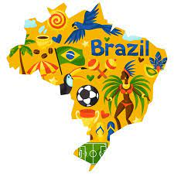
Brazil

Slide 137
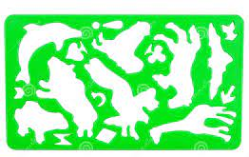
stencil

Slide 138

civil

Slide 139
Let’s Teach and Practise

Slide 140
The suffix -ly

Slide 141
-ly

Slide 142
-ly
If a suffix starts with a consonant letter, it is added straight on to most root words without any change to the last letter of those words.

Slide 143
-ly
Exceptions:
(1) argument
(2) root words ending in –y with a consonant before it but only if the root word has more than one syllable.

Slide 144
happily

Slide 145
slowly n

Slide 146
quickly

Slide 147
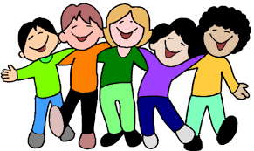
happy –y +i + ly = happily
happily
ADVERB
Definition – in a happy way

Slide 148
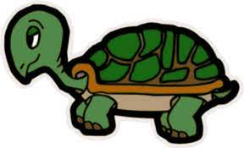
slow + ly = slowly
slowly
ADVERB
Definition – move very slow

Slide 149
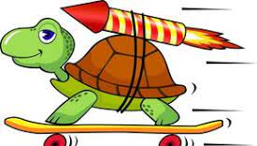
quick + ly = quickly
quickly
ADVERB
Definition - fast

Slide 150
They happily sang the songs in the choir.
_______

Slide 151
Slowly, the snail moved across the leaf.
______

Slide 152
Quickly, the hare raised through the fields.
_______

Slide 153
New CHALLENGE words.

Slide 154
Definition - a pause in work or during an activity or event
break
NOUN

Slide 155
During break, children go outside.
_____

Slide 156
Definition - a man in relation to his child or children
father
NOUN

Slide 157
My father is lovely.
______

Slide 158
Let’s Practise and Apply.

Slide 159
Can you spot the spelling rule words and the challenge words?

Slide 160
Global Warming – weather
Global Warming – weather
Kenya is a great country on the equator. Some parts are hot and wet, but much of it is dry. Merriment is found when it rains as people are cheerful as it is used for drinking and watering their crops. Sadness is growing though as the rains are becoming less and less reliable. Quickly, crops that once were plentiful are now scarce.

Slide 161
Global Warming – weather
Global Warming – weather
Kenya is a great country on the equator. Some parts are hot and wet, but much of it is dry. Merriment is found when it rains as people are cheerful as it is used for drinking and watering their crops. Sadness is growing though as the rains are becoming less and less reliable. Quickly, crops that once were plentiful are now scarce.

Slide 162
Write this sentence as I dictate it to you.
Notes:
Quickly, crops that once were plentiful are now scarce.

Slide 163
Quickly, crops that once were plentiful are now scarce.
Did you write it correctly?
Edit your work and make sure you have it correct.
Can you underline the spelling word that we have covered in this session?

Slide 164
Year 3 - Autumn 2
Week 3 - Friday
Notes:
Click through the slides for all the R+R words for the week (both the focus and the challenge words)
Click through the slides for all the new learning this week

Slide 165
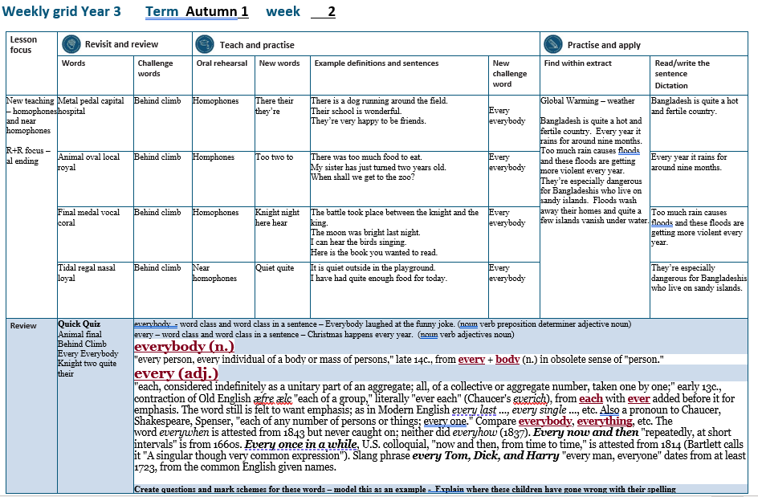

Slide 166
Old challenge words…

Slide 167
great

Slide 168
steak

Slide 169
Old spelling rule words…

Slide 170
pencil

Slide 171
fossil

Slide 172
nostril

Slide 173
pupil

Slide 174
fulfil

Slide 175
until

Slide 176
basil

Slide 177
lentil

Slide 178
gerbil

Slide 179
peril

Slide 180
devil

Slide 181
Brazil

Slide 182
stencil

Slide 183
civil

Slide 184
New spelling rule words…

Slide 185
enjoyment

Slide 186
argument

Slide 187
merriment

Slide 188
happiness

Slide 189
happiness

Slide 190
sadness

Slide 191
plainness

Slide 192
playful

Slide 193
plentiful

Slide 194
cheerful

Slide 195
happily

Slide 196
slowly

Slide 197
quickly

Slide 198
New challenge words…

Slide 199
break

Slide 200
father

Slide 201
Quick Quiz time…
Notes:
Say these words for the quiz
pencil until great steak break father enjoyment happiness playful slowly

Slide 202
Did you get them correct?
Edit your work.
pencil until great steak break father enjoyment happiness playful slowly

Slide 203
Word class time…

Slide 204
During break, children go outside.
Notes:
Ask for these words to be classed

Slide 205
During break, children go outside.
adverb noun noun verb preposition
Notes:
Ask for these words to be classed

Slide 206
During break, children go outside.
adverb noun noun verb preposition
Notes:
Ask for these words to be classed

Slide 207
My father is lovely.
Notes:
Ask for these words to be classed

Slide 208
My father is lovely.
determiner noun verb adjective

Slide 209
My father is lovely.
determiner noun verb adjective

Slide 210
Etymology
The history of a word….

Slide 211
break (v.)
Old English brecan "to divide solid matter violently into parts or fragments; to injure, violate (a promise, etc.), destroy, curtail; to break into, rush into; to burst forth, spring out; to subdue, tame" (class IV strong verb; past tense bræc, past participle brocen), from Proto-Germanic *brekanan (source also of Old Frisian breka, Dutch breken, Old High German brehhan, German brechen, Gothic brikan), from PIE root *bhreg- "to break."
Closely related to breach (n.), brake (n.1), brick (n.). The old past tense brake is obsolete or archaic; past participle is broken, but shortened form broke is attested from 14c. and was "exceedingly common" [OED] 17c.-18c.
Of bones in Old English. Formerly also of cloth, paper, etc. Meaning "escape by breaking an enclosure" is from late 14c. Intransitive sense "be or become separated into fragments or parts under action of some force" is from late 12c. Meaning "lessen, impair" is from late 15c. Meaning "make a first and partial disclosure" is from early 13c. Meaning "destroy continuity or completeness" in any way is from 1741. Of coins or bills, "to convert to smaller units of currency," by 1882. In reference to the heart from early 13c. (intransitive); to break (someone's) heart is late 14c.
Break bread "share food" (with) is from late 14c. To break ground is from 1670s as "to dig, plow," from 1709 in the figurative sense "begin to execute a plan." To break the ice "overcome the feeling of restraint in a new acquaintanceship" is from c. 1600, in reference to the "coldness" of encounters of strangers. Break wind first attested 1550s. To break (something) out (1890s) probably is an image from dock work, of freeing cargo before unloading it.
The ironic theatrical good luck formula break a leg (by 1948, said to be from at least 1920s) has parallels in German Hals- und Beinbruch "break your neck and leg," and Italian in bocca al lupo.

Slide 212
father (n.)
Origin and meaning of father
Old English fæder "he who begets a child, nearest male ancestor;" also "any lineal male ancestor; the Supreme Being," and by late Old English, "one who exercises parental care over another," from Proto-Germanic *fader (source also of Old Saxon fadar, Old Frisian feder, Dutch vader, Old Norse faðir, Old High German fatar, German vater; in Gothic usually expressed by atta), from PIE *pəter- "father" (source also of Sanskrit pitar-, Greek pater, Latin pater, Old Persian pita, Old Irish athir "father"), presumably from baby-speak sound "pa." The ending formerly was regarded as an agent-noun affix.
The classic example of Grimm's Law, where PIE "p-" becomes Germanic "f-." Spelling with -th- (15c.) reflects widespread phonetic shift in Middle English that turned -der to -ther in many words, perhaps reinforced in this case by Old Norse forms; spelling caught up to pronunciation in 1500s (compare mother (n.), weather (n.), hither, gather). As a title of various Church dignitaries from c. 1300; meaning "creator, inventor, author" is from mid-14c.; that of "anything that gives rise to something else" is from late 14c. As a respectful title for an older man, recorded from 1550s. Father-figure is from 1954. Fathers "leading men, elders" is from 1580s.

Slide 213
Let’s investigate….
Can you find words linked to break and father?

Slide 214
Words linked to break…
brake
breakfast
back-breaking
breakneck
breakwater
breakable

Slide 215
Words linked to father…
father as verb – to father a child
father-in-law
fatherhood
stepfather
fatherless
patriarch

