Slide 1
Spelling Y3
Mastering spellings: building of the foundations of phonics
Autumn 2
Week 1

Slide 2
Year 3 - Autumn 2
Week 1 - Monday
Notes:
Revisit and review the words from Y2 with the prefix un and challenge words – I say, we say, you say
Ask children to write words only in their spelling book
Introduce the new spelling rule of mis prefix
Children to write the new spelling rule words and challenge words into books when the sentences are shown with the spelling word missing.
Read the extract with the class as choral reading. Practise model of prosody etc.
Ask children to find the spelling words from the session in the text.
Then read allowed the chosen sentence for children to write fully in their books.
Show the extract and ask children to then edit their work to check they were correct in their dictation.

Slide 3
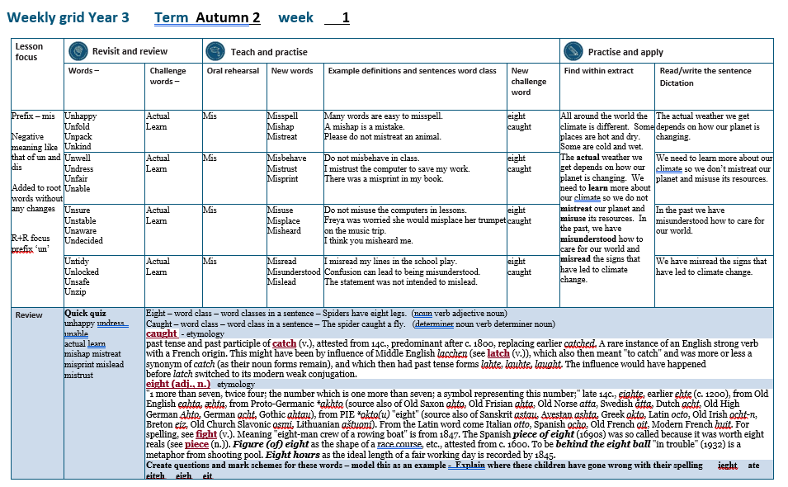

Slide 4
Let’s Revisit and Review…

Slide 5
Do you remember this challenge word?

Slide 6
actual

Slide 7
actual Definition - real

Slide 8
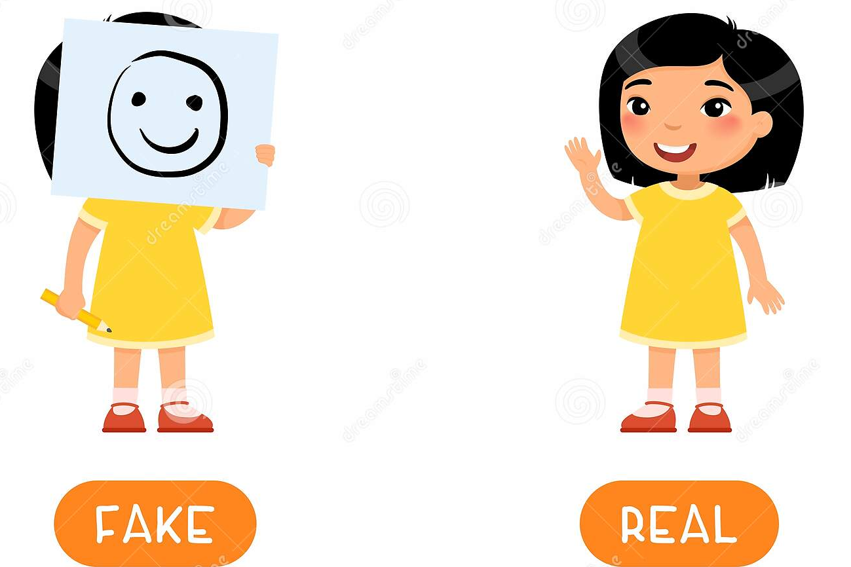
actual My mum says I behave like an 80 year old, but my actual age is 7.

Slide 9
Do you remember this challenge word?

Slide 10
learn

Slide 11
learn Definition - to gain knowledge

Slide 12
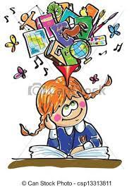
learn I love to learn my spellings.

Slide 13
The prefix un-

Slide 14
un

Slide 15
un- means ‘not’ ‘opposite’

Slide 16
un + root

Slide 17
unhappy

Slide 18
unhappy

Slide 19
unhappy

Slide 20
unfold

Slide 21
unfold

Slide 22
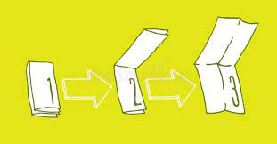
unfold

Slide 23
unpack

Slide 24
unpack

Slide 25
unpack

Slide 26
unkind

Slide 27
unkind

Slide 28
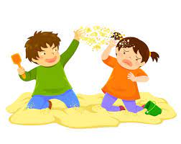
unkind

Slide 29
Let’s Teach and Practise

Slide 30
The prefix mis-

Slide 31
mis-

Slide 32
mis- means ‘not’ ‘opposite’
Notes:
Just like ‘un’

Slide 33
misspell

Slide 34
misspell

Slide 35
mishap

Slide 36
mishap n

Slide 37
mistreat

Slide 38
mistreat

Slide 39
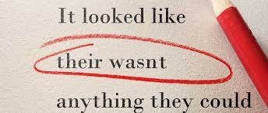
misspell mis + spell = misspell

Slide 40
misspell mis + spell = misspell Definition – spelling a word incorrectly

Slide 41
mishap

Slide 42
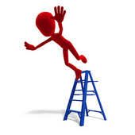
mishap mis + hap = mishap

Slide 43
mishap mis + hap = mishap Definition – an unlucky accident

Slide 44
mistreat

Slide 45
mistreat mis + treat = mistreat

Slide 46
mistreat mis + treat = mistreat Definition – to treat a person badly

Slide 47
Many words are easy to misspell.

Slide 48
Many words are easy to ________.

Slide 49
Many words are easy to misspell.

Slide 50
A mishap is a mistake.

Slide 51
A ______ is a mistake.

Slide 52
A mishap is a mistake.

Slide 53
Please do not mistreat an animal.

Slide 54
Please do not ________ an animal.

Slide 55
Please do not mistreat an animal.

Slide 56
New CHALLENGE words.

Slide 57
eight

Slide 58
eight The number eight is one more than seven.

Slide 59
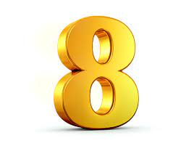
eight The number eight is one more than seven.

Slide 60
The number _____ is one more than seven.

Slide 61
The number eight is one more than seven.

Slide 62
caught

Slide 63
caught The fish he caught was huge.

Slide 64
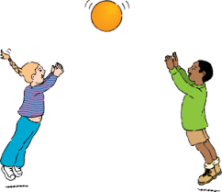
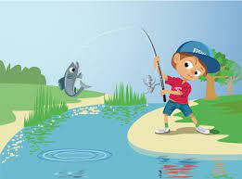
caught The fish he caught was huge.

Slide 65
The fish he ______ was huge.

Slide 66
The fish he caught was huge.

Slide 67
Let’s Practise and Apply.

Slide 68
Can you spot the spelling rule words and the challenge words?

Slide 69
All around the world the climate is different. Some places are hot and dry. Some are cold and wet. The actual weather we get depends on how our planet is changing. We need to learn more about our climate so we do not mistreat our planet and misuse its resources. In the past, we have misunderstood how to care for our world and misread the signs that have led to climate change.

Slide 70
All around the world the climate is different. Some places are hot and dry. Some are cold and wet. The actual weather we get depends on how our planet is changing. We need to learn more about our climate so we do not mistreat our planet and misuse its resources. In the past, we have misunderstood how to care for our world and misread the signs that have led to climate change.

Slide 71
Write this sentence as I dictate it to you.
Notes:
The actual weather we get depends on how our planet is changing.

Slide 72
The actual weather we get depends on how our planet is changing.
Did you write it correctly?
Edit your work and make sure you have it correct.
Can you underline the spelling word that we have covered in this session?

Slide 73
Year 3 - Autumn 2
Week 1 - Tuesday
Notes:
Revisit and review the words from Y2 with the prefix un and challenge words – I say, we say, you say
Ask children to write words only in their spelling book
Introduce the new spelling rule of mis prefix
Children to write the new spelling rule words and challenge words into books when the sentences are shown with the spelling word missing.
Read the extract with the class as choral reading. Practise model of prosody etc.
Ask children to find the spelling words from the session in the text.
Then read allowed the chosen sentence for children to write fully in their books.
Show the extract and ask children to then edit their work to check they were correct in their dictation.

Slide 75
Let’s Revisit and Review…

Slide 76
Do you remember this challenge word?

Slide 77
actual

Slide 78
actual Definition - real

Slide 79
actual My mum says I behave like an 80 year old, but my actual age is 7.

Slide 80
Do you remember this challenge word?

Slide 81
learn

Slide 82
learn Definition - to gain knowledge

Slide 83
learn I love to learn my spellings.

Slide 84
The prefix un-

Slide 85
un

Slide 86
un- means ‘not’ ‘opposite’

Slide 87
un + root

Slide 88
unwell

Slide 89
unwell

Slide 90
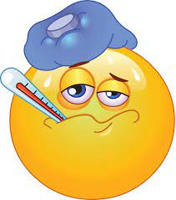
unwell

Slide 91
undress

Slide 92
undress

Slide 93
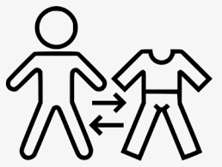
undress

Slide 94
unfair

Slide 95
unfair

Slide 96
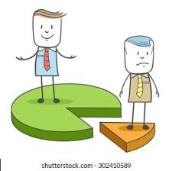
unfair

Slide 97
unable

Slide 98
unable

Slide 99
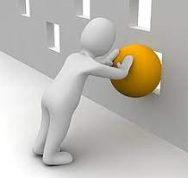
unable

Slide 100
Let’s Teach and Practise

Slide 101
The prefix mis-

Slide 102
mis-

Slide 103
mis- means ‘not’ ‘opposite’
Notes:
Just like ‘un’

Slide 104
misbehave

Slide 105
misbehave

Slide 106
mistrust

Slide 107
mistrust n

Slide 108
misprint

Slide 109
misprint

Slide 110
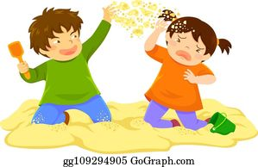
misbehave mis + behave = misbehave

Slide 111
misbehave mis + behave = misbehave Definition – behave badly

Slide 112
mistrust

Slide 113
mistrust mis + trust = mistrust

Slide 114
mistrust mis + trust = mistrust Definition – not trusting

Slide 115
misprint

Slide 116
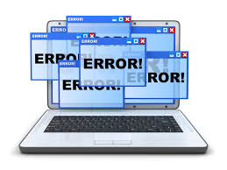
misprint mis + print = misprint

Slide 117
misprint mis + print = misprint Definition – an error in printing

Slide 118
Do not misbehave in class.

Slide 119
Do not _________ in class.

Slide 120
Do not misbehave in class.

Slide 121
I mistrust the computer to save my work.

Slide 122
I ________ the computer to save my work.

Slide 123
I mistrust the computer to save my work.

Slide 124
There was a misprint in my book.

Slide 125
There was a ________ in my book.

Slide 126
There was a misprint in my book.

Slide 127
New CHALLENGE words.

Slide 128
eight

Slide 129
eight The number eight is one more than seven.

Slide 130
eight The number eight is one more than seven.

Slide 131
The number _____ is one more than seven.

Slide 132
The number eight is one more than seven.

Slide 133
caught

Slide 134
caught The fish he caught was huge.

Slide 135
caught The fish he caught was huge.

Slide 136
The fish he ______ was huge.

Slide 137
The fish he caught was huge.

Slide 138
Let’s Practise and Apply.

Slide 139
Can you spot the spelling rule words and the challenge words?

Slide 140
All around the world the climate is different. Some places are hot and dry. Some are cold and wet. The actual weather we get depends on how our planet is changing. We need to learn more about our climate so we do not mistreat our planet and misuse its resources. In the past, we have misunderstood how to care for our world and misread the signs that have led to climate change.

Slide 141
All around the world the climate is different. Some places are hot and dry. Some are cold and wet. The actual weather we get depends on how our planet is changing. We need to learn more about our climate so we do not mistreat our planet and misuse its resources. In the past, we have misunderstood how to care for our world and misread the signs that have led to climate change.

Slide 142
Write this sentence as I dictate it to you.
Notes:
We need to learn more about our climate so we do not mistreat our planet and misuse its resources.

Slide 143
We need to learn more about our climate so we do not mistreat our planet and misuse its resources.
Did you write it correctly?
Edit your work and make sure you have it correct.
Can you underline the spelling words that we have covered in this session?

Slide 144
Year 3 - Autumn 2
Week 1 - Wednesday
Notes:
Revisit and review the words from Y2 with the prefix un and challenge words – I say, we say, you say
Ask children to write words only in their spelling book
Introduce the new spelling rule of mis prefix
Children to write the new spelling rule words and challenge words into books when the sentences are shown with the spelling word missing.
Read the extract with the class as choral reading. Practise model of prosody etc.
Ask children to find the spelling words from the session in the text.
Then read allowed the chosen sentence for children to write fully in their books.
Show the extract and ask children to then edit their work to check they were correct in their dictation.

Slide 146
Let’s Revisit and Review…

Slide 147
Do you remember this challenge word?

Slide 148
actual

Slide 149
actual Definition - real

Slide 150
actual My mum says I behave like an 80 year old, but my actual age is 7.

Slide 151
Do you remember this challenge word?

Slide 152
learn

Slide 153
learn Definition - to gain knowledge

Slide 154
learn I love to learn my spellings.

Slide 155
The prefix un-

Slide 156
un

Slide 157
un- means ‘not’ ‘opposite’

Slide 158
un + root

Slide 159
unsure

Slide 160
unsure

Slide 161
unsure

Slide 162
unstable

Slide 163
unstable

Slide 164
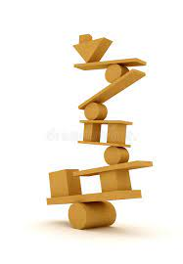
unstable

Slide 165
unaware

Slide 166
unaware

Slide 167
unaware

Slide 168
undecided

Slide 169
undecided

Slide 170
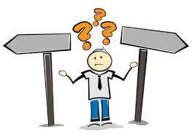
undecided

Slide 171
Let’s Teach and Practise

Slide 172
The prefix mis-

Slide 173
mis-

Slide 174
mis- means ‘not’ ‘opposite’
Notes:
Just like ‘un’

Slide 175
misuse

Slide 176
misuse

Slide 177
misplace

Slide 178
misplace n

Slide 179
misheard

Slide 180
misheard

Slide 181
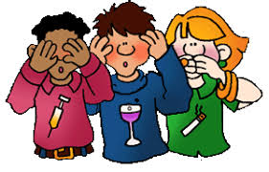
misuse mis + use = misuse

Slide 182
misuse mis + use = misuse Definition – use things in the wrong way

Slide 183
misplace

Slide 184
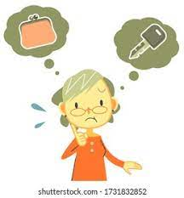
misplace mis + place = misplace

Slide 185
misplace mis + place = misplace Definition – put an object in the wrong place

Slide 186
misheard

Slide 187
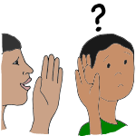
misheard mis + heard = misheard

Slide 188
misheard mis + heard = misheard Definition – fail to hear correctly

Slide 189
Do not misuse the computers in lessons.

Slide 190
Do not ______ the computers in lessons.

Slide 191
Do not misuse the computers in lessons.

Slide 192
Freya was worried she would misplace her trumpet on the music trip.

Slide 193
Freya was worried she would ________ her trumpet on the music trip.

Slide 194
Freya was worried she would misplace her trumpet on the music trip.

Slide 195
I think you misheard me.

Slide 196
I think you ________ me.

Slide 197
I think you misheard me.

Slide 198
New CHALLENGE words.

Slide 199
eight

Slide 200
eight The number eight is one more than seven.

Slide 201
eight The number eight is one more than seven.

Slide 202
The number _____ is one more than seven.

Slide 203
The number eight is one more than seven.

Slide 204
caught

Slide 205
caught The fish he caught was huge.

Slide 206
caught The fish he caught was huge.

Slide 207
The fish he ______ was huge.

Slide 208
The fish he caught was huge.

Slide 209
Let’s Practise and Apply.

Slide 210
Can you spot the spelling rule words and the challenge words?

Slide 211
All around the world the climate is different. Some places are hot and dry. Some are cold and wet. The actual weather we get depends on how our planet is changing. We need to learn more about our climate so we do not mistreat our planet and misuse its resources. In the past, we have misunderstood how to care for our world and misread the signs that have led to climate change.

Slide 212
All around the world the climate is different. Some places are hot and dry. Some are cold and wet. The actual weather we get depends on how our planet is changing. We need to learn more about our climate so we do not mistreat our planet and misuse its resources. In the past, we have misunderstood how to care for our world and misread the signs that have led to climate change.

Slide 213
Write this sentence as I dictate it to you.
Notes:
In the past, we have misunderstood how to care for our world.

Slide 214
In the past, we have misunderstood how to care for our world.
Did you write it correctly?
Edit your work and make sure you have it correct.
Can you underline the spelling word that we have covered in this session?

Slide 215
Year 3 - Autumn 2
Week 1 - Thursday
Notes:
Revisit and review the words from Y2 with the prefix un and challenge words – I say, we say, you say
Ask children to write words only in their spelling book
Introduce the new spelling rule of mis prefix
Children to write the new spelling rule words and challenge words into books when the sentences are shown with the spelling word missing.
Read the extract with the class as choral reading. Practise model of prosody etc.
Ask children to find the spelling words from the session in the text.
Then read allowed the chosen sentence for children to write fully in their books.
Show the extract and ask children to then edit their work to check they were correct in their dictation.

Slide 217
Let’s Revisit and Review…

Slide 218
Do you remember this challenge word?

Slide 219
actual

Slide 220
actual Definition - real

Slide 221
actual My mum says I behave like an 80 year old, but my actual age is 7.

Slide 222
Do you remember this challenge word?

Slide 223
learn

Slide 224
learn Definition - to gain knowledge

Slide 225
learn I love to learn my spellings.

Slide 226
The prefix un-

Slide 227
un

Slide 228
un- means ‘not’ ‘opposite’

Slide 229
un + root

Slide 230
untidy

Slide 231
untidy

Slide 232
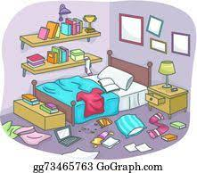
untidy

Slide 233
unlocked

Slide 234
unlocked

Slide 235
unlocked

Slide 236
unsafe

Slide 237
unsafe

Slide 238
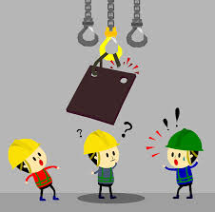
unsafe

Slide 239
unzip

Slide 240
unzip

Slide 241
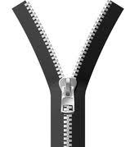
unzip

Slide 242
Let’s Teach and Practise

Slide 243
The prefix mis-

Slide 244
mis-

Slide 245
mis- means ‘not’ ‘opposite’
Notes:
Just like ‘un’

Slide 246
misread

Slide 247
misread

Slide 248
misunderstood

Slide 249
misunderstood n

Slide 250
mislead

Slide 251
mislead

Slide 252
misread mis + read = misread

Slide 253
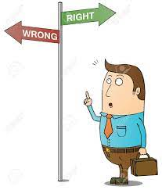
misread mis + read = misread Definition – read things wrongly

Slide 254
misunderstood

Slide 255
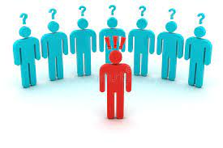
misunderstood mis + understood = misunderstood

Slide 256
misunderstood mis + understood = misunderstood Definition – not understood

Slide 257
mislead

Slide 258
mislead mis + lead = mislead

Slide 259
mislead mis + lead = mislead Definition – have a wrong idea

Slide 260
I misread my lines in the school play.

Slide 261
I _______ my lines in the school play.

Slide 262
I misread my lines in the school play.

Slide 263
Confusion can lead to being misunderstood.

Slide 264
Confusion can lead to being _____________.

Slide 265
Confusion can lead to being misunderstood.

Slide 266
The statement was not intended to mislead.

Slide 267
The statement was not intended to _______.

Slide 268
The statement was not intended to mislead.

Slide 269
New CHALLENGE words.

Slide 270
eight

Slide 271
eight The number eight is one more than seven.

Slide 272
eight The number eight is one more than seven.

Slide 273
The number _____ is one more than seven.

Slide 274
The number eight is one more than seven.

Slide 275
caught

Slide 276
caught The fish he caught was huge.

Slide 277
caught The fish he caught was huge.

Slide 278
The fish he ______ was huge.

Slide 279
The fish he caught was huge.

Slide 280
Let’s Practise and Apply.

Slide 281
Can you spot the spelling rule words and the challenge words?

Slide 282
All around the world the climate is different. Some places are hot and dry. Some are cold and wet. The actual weather we get depends on how our planet is changing. We need to learn more about our climate so we do not mistreat our planet and misuse its resources. In the past, we have misunderstood how to care for our world and misread the signs that have led to climate change.

Slide 283
All around the world the climate is different. Some places are hot and dry. Some are cold and wet. The actual weather we get depends on how our planet is changing. We need to learn more about our climate so we do not mistreat our planet and misuse its resources. In the past, we have misunderstood how to care for our world and misread the signs that have led to climate change.

Slide 284
Write this sentence as I dictate it to you.
Notes:
We have misread the signs that have led to climate change.

Slide 285
We have misread the signs that have led to climate change.
Did you write it correctly?
Edit your work and make sure you have it correct.
Can you underline the spelling word that we have covered in this session?

Slide 286
Year 3 - Autumn 2
Week 1 - Friday
Notes:
Click through the slides for all the R+R words for the week (both the focus and the challenge words)
Click through the slides for all the new learning this week

Slide 288
Year 3 - Autumn 2
Week 1 - Friday
Notes:
Click through the slides for all the R+R words for the week (both the focus and the challenge words)
Click through the slides for all the new learning this week
Quiz to be done in books for 10 words

Slide 289
Old challenge words…

Slide 290
actual

Slide 291
learn

Slide 292
Old spelling rule words…

Slide 293
unhappy

Slide 294
unfold

Slide 295
unpack

Slide 296
unkind

Slide 297
unwell

Slide 298
undress

Slide 299
unfair

Slide 300
unable

Slide 301
unsure

Slide 302
unstable

Slide 303
unaware

Slide 304
undecided

Slide 305
untidy

Slide 306
unlocked

Slide 307
unsafe

Slide 308
unzip

Slide 309
New spelling rule words…

Slide 310
misspell

Slide 311
mishap

Slide 312
mistreat

Slide 313
misbehave

Slide 314
mistrust

Slide 315
misprint

Slide 316
misuse

Slide 317
misplace

Slide 318
misheard

Slide 319
misread

Slide 320
misunderstood

Slide 321
mislead

Slide 322
New challenge words…

Slide 323
eight

Slide 324
caught

Slide 325
Quick Quiz time…
Notes:
Say these words for the quiz
unhappy undress unable actual learn mishap mistreat misprint mislead mistrust

Slide 326
Did you get them correct?
Edit your work.
unhappy undress unable actual learn mishap mistreat misprint mislead mistrust
Notes:
Say these words for the quiz
unhappy undress unable actual learn mishap mistreat misprint mislead mistrust

Slide 327
Word class time…

Slide 328
Spiders have eight legs.
Notes:
Ask for these words to be classed

Slide 329
Spiders have eight legs.
noun verb adjective noun
Notes:
Ask for these words to be classed

Slide 330
Spiders have eight legs.
noun verb adjective noun
Notes:
Ask for these words to be classed

Slide 331
The spider caught a fly.
Notes:
Ask for these words to be classed

Slide 332
The spider caught a fly.
determiner noun verb determiner noun

Slide 333
The spider caught a fly.
determiner noun verb determiner noun

Slide 334
Etymology
The history of a word….

Slide 335
caught - verb
past tense and past participle of catch (v.), attested from 14c., predominant after c. 1800, replacing earlier catched.
A rare instance of an English strong verb with a French origin.
This might have been by influence of Middle English lacchen (see latch (v.)), which also then meant "to catch" and was more or less a synonym of catch (as their noun forms remain), and which then had past tense forms lahte, lauhte, laught.
The influence would have happened before latch switched to its modern weak conjugation.

Slide 336
eight (adj., n.)
"1 more than seven, twice four; the number which is one more than seven; a symbol representing this number;”
Late 14c., eighte, earlier ehte (c. 1200), from Old English eahta, æhta, from Proto-Germanic *akhto (source also of Old Saxon ahto, Old Frisian ahta, Old Norse atta, Swedish åtta, Dutch acht, Old High German Ahto, German acht, Gothic ahtau), from PIE *okto(u) "eight" (source also of Sanskrit astau, Avestan ashta, Greek okto, Latin octo, Old Irish ocht-n, Breton eiz, Old Church Slavonic osmi, Lithuanian aštuoni).
From the Latin word come Italian otto, Spanish ocho, Old French oit, Modern French huit. For spelling, see fight (v.).
Meaning "eight-man crew of a rowing boat" is from 1847.
The Spanish piece of eight (1690s) was so called because it was worth eight reals (see piece (n.)).
Figure (of) eight as the shape of a race course, etc., attested from c. 1600.
To be behind the eight ball "in trouble" (1932) is a metaphor from shooting pool.
Eight hours as the ideal length of a fair working day is recorded by 1845.

Slide 337
Let’s investigate….
Can you find synonyms?
Can you create questions?

Slide 338
Synonyms of eight…
octadic
octagonal
octennial

Slide 339
Synonyms of caught…
seized
grabbed
grasped

Slide 340
Investigate ways of creating questions for other children using the words eight and caught.
Think about a mark scheme to show if they are correct.

Slide 341
Example…
Some children have written down the word eight and misspelled it.
Can you explain where these children have gone wrong with their spelling?
ieght
ate
eitgh
eigh
eit

Slide 342
Example…
Some children have written down the word eight and misspelled it.
Can you explain where these children have gone wrong with their spelling?
ieght - They have the ie the wrong way round.
ate - They have used the homophone for the verb to eat.
eitgh -
eigh
eit

