Slide 1
Spelling Y3
Mastering spellings: building on the foundations of phonics
Autumn 1
Week 2
Notes:
These slides are the same as Y2 Summer 2 as this is a revisit and review half term

Slide 2
Year 3 - Autumn 2
Week 2 - Monday
Notes:
Revisit and review the words from Y2 and challenge words – I say, we say, you say
Ask children to write words only in their spelling book
Introduce the new spelling rule
Children to write the new spelling rule words and challenge words into books when the sentences are shown with the spelling word missing.
Read the extract with the class as choral reading. Practise model of prosody etc.
Ask children to find the spelling words from the session in the text.
Then read allowed the chosen sentence for children to write fully in their books.
Show the extract and ask children to then edit their work to check they were correct in their dictation.

Slide 3
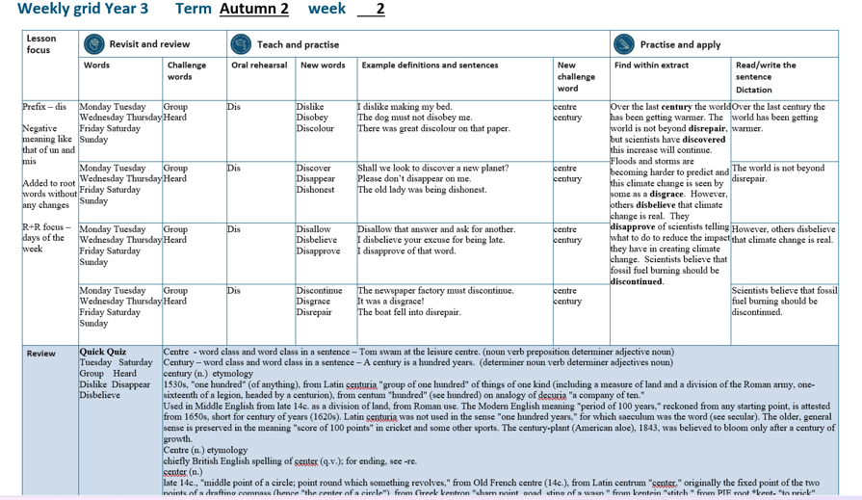

Slide 4
Let’s Revisit and Review…

Slide 5
Do you remember this challenge word?

Slide 6
group

Slide 7
group
Definition – a number of people or things together

Slide 8
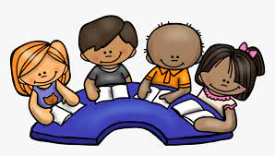
group
The group were excited to read together.

Slide 9
Do you remember this challenge word?

Slide 10
heard

Slide 11
heard
Definition – used ears to perceive sounds

Slide 12

heard
The audience heard a beautiful song.

Slide 13
Days of the week

Slide 14
Monday

Slide 15
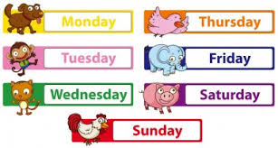
Monday

Slide 16
Tuesday

Slide 17
Tuesday

Slide 18
Wednesday

Slide 19
Wednesday

Slide 20
Thursday

Slide 21
Thursday

Slide 22
Friday

Slide 23
Friday

Slide 24
Saturday

Slide 25
Saturday

Slide 26
Sunday

Slide 27
Sunday

Slide 28
Let’s Teach and Practise

Slide 29
The prefix dis-

Slide 30
dis-
NOT

Slide 31
The prefixes un–, dis– and mis– have negative meanings.

Slide 32
The prefixes un–, dis– and mis– have negative meanings.
NOT

Slide 33
Most prefixes are added to the beginning of root words without any changes in spelling,

Slide 34
dislike

Slide 35
dislike

Slide 36
disobey

Slide 37
disobey n

Slide 38
discolour

Slide 39
discolour

Slide 40
dislike

Slide 41

dislike dis + like = dislike

Slide 42
dislike dis + like = dislike
(verb)
Definition – not like

Slide 43
disobey

Slide 44
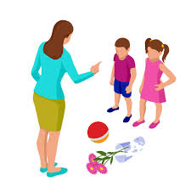
disobey dis + obey = disobey

Slide 45
disobey dis + obey = disobey
(verb)
Definition – not obey

Slide 46
discolour

Slide 47
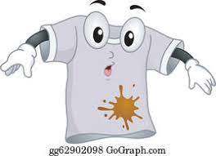
discolour dis + colour = discolour

Slide 48
discolour dis + colour = discolour
(verb)
Definition – not colour / change colour

Slide 49
I dislike making my bed.

Slide 50
I _______ making my bed.

Slide 51
I dislike making my bed.

Slide 52
The dog must not disobey me.

Slide 53
The dog must not _______ me.

Slide 54
The dog must not disobey me.

Slide 55
There was great discolour on that paper.

Slide 56
There was great _________ on that paper.

Slide 57
There was great discolour on that paper.

Slide 58
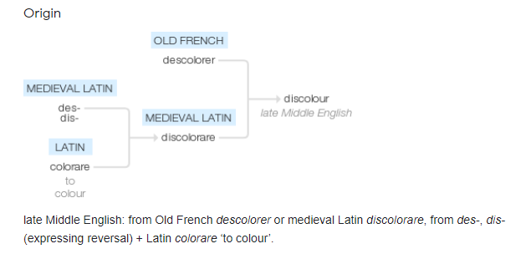

Slide 59
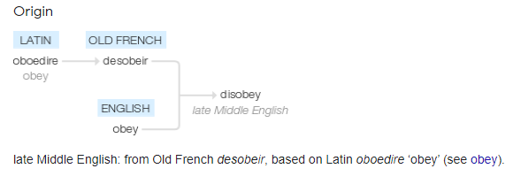

Slide 60
New CHALLENGE words.

Slide 61
centre

Slide 62
centre
Tom swam at the leisure centre.

Slide 63

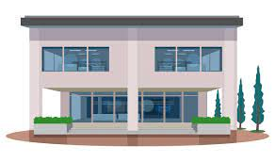
centre
Tom swam at the leisure centre.

Slide 64
Tom swam at the leisure centre.

Slide 65
Tom swam at the leisure ______.

Slide 66
Tom swam at the leisure centre.

Slide 67
century

Slide 68
century
A century is 100 years.

Slide 69

century
A century is 100 years.

Slide 70
A century is 100 years.

Slide 71
A _______ is 100 years.

Slide 72
A century is 100 years.

Slide 73
Let’s Practise and Apply.

Slide 74
Can you spot the spelling rule words and the challenge words?

Slide 75
Over the last century the world has been getting warmer. The world is not beyond disrepair, but scientists have discovered this increase will continue. Floods and storms are becoming harder to predict and this climate change is seen by some as a disgrace. However, others disbelieve that climate change is real. They disapprove of scientists telling what to do to reduce the impact they have in creating climate change. Scientists believe that fossil fuel burning should be discontinued.

Slide 76
Over the last century the world has been getting warmer. The world is not beyond disrepair, but scientists have discovered this increase will continue. Floods and storms are becoming harder to predict and this climate change is seen by some as a disgrace. However, others disbelieve that climate change is real. They disapprove of scientists telling what to do to reduce the impact they have in creating climate change. Scientists believe that fossil fuel burning should be discontinued.

Slide 77
Write this sentence as I dictate it to you.
Notes:
Over the last century the world has been getting warmer.

Slide 78
Over the last century the world has been getting warmer.
Did you write it correctly?
Edit your work and make sure you have it correct.
Can you underline the spelling word that we have covered in this session?

Slide 79
Year 3 - Autumn 2
Week 2 - Tuesday
Notes:
Revisit and review the words from Y2 and challenge words – I say, we say, you say
Ask children to write words only in their spelling book
Introduce the new spelling rule
Children to write the new spelling rule words and challenge words into books when the sentences are shown with the spelling word missing.
Read the extract with the class as choral reading. Practise model of prosody etc.
Ask children to find the spelling words from the session in the text.
Then read allowed the chosen sentence for children to write fully in their books.
Show the extract and ask children to then edit their work to check they were correct in their dictation.

Slide 81
Let’s Revisit and Review…

Slide 82
Do you remember this challenge word?

Slide 83
group

Slide 84
group
Definition – a number of people or things together

Slide 85
group
The group were excited to read together.

Slide 86
Do you remember this challenge word?

Slide 87
heard

Slide 88
heard
Definition – used ears to perceive sounds

Slide 89
heard
The audience heard a beautiful song.

Slide 90
Days of the week

Slide 91
Monday

Slide 92
Monday

Slide 93
Tuesday

Slide 94
Tuesday

Slide 95
Wednesday

Slide 96
Wednesday

Slide 97
Thursday

Slide 98
Thursday

Slide 99
Friday

Slide 100
Friday

Slide 101
Saturday

Slide 102
Saturday

Slide 103
Sunday

Slide 104
Sunday

Slide 105
Let’s Teach and Practise

Slide 106
The prefix dis-

Slide 107
dis-
NOT

Slide 108
The prefixes un–, dis– and mis– have negative meanings.

Slide 109
The prefixes un–, dis– and mis– have negative meanings.
NOT

Slide 110
Most prefixes are added to the beginning of root words without any changes in spelling,

Slide 111
discover

Slide 112
discover

Slide 113
disappear

Slide 114
disappear n

Slide 115
disapprove

Slide 116
disapprove

Slide 117
discover

Slide 118

discover dis + cover = discover

Slide 119
discover dis + cover = discover
(verb)
Definition – find something

Slide 120
disappear

Slide 121

disappear dis + appear = disappear

Slide 122
disappear dis + appear = disappear
(verb)
Definition – stop being seen

Slide 123
dishonest

Slide 124
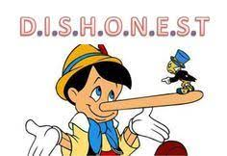
dishonest dis + honest = dishonest

Slide 125
dishonest dis + honest = dishonest
(verb)
Definition – not honest / telling lies

Slide 126
Shall we look to discover a new planet?

Slide 127
Shall we look to ________ a new planet?

Slide 128
Shall we look to discover a new planet?

Slide 129
Please don’t disappear on me.

Slide 130
Please don’t _________ on me.

Slide 131
Please don’t disappear on me.

Slide 132
The old lady was being dishonest.

Slide 133
The old lady was being _________.

Slide 134
The old lady was being dishonest.

Slide 135
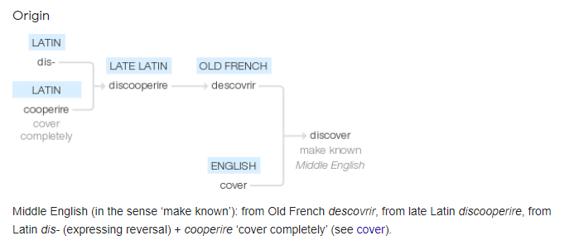

Slide 136
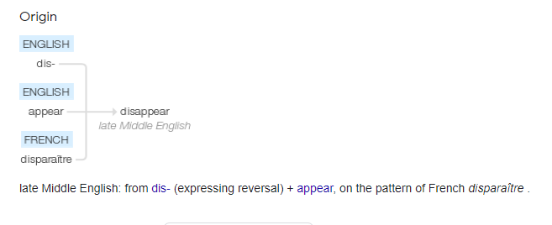

Slide 137
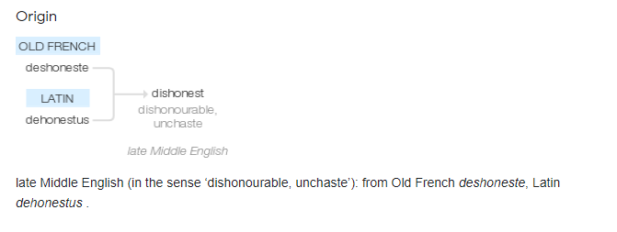

Slide 138
New CHALLENGE words.

Slide 139
centre

Slide 140
centre
Tom swam at the leisure centre.

Slide 141
centre
Tom swam at the leisure centre.

Slide 142
Tom swam at the leisure centre.

Slide 143
Tom swam at the leisure ______.

Slide 144
Tom swam at the leisure centre.

Slide 145
century

Slide 146
century
A century is 100 years.

Slide 147
century
A century is 100 years.

Slide 148
A century is 100 years.

Slide 149
A _______ is 100 years.

Slide 150
A century is 100 years.

Slide 151
Let’s Practise and Apply.

Slide 152
Can you spot the spelling rule words and the challenge words?

Slide 153
Over the last century the world has been getting warmer. The world is not beyond disrepair, but scientists have discovered this increase will continue. Floods and storms are becoming harder to predict and this climate change is seen by some as a disgrace. However, others disbelieve that climate change is real. They disapprove of scientists telling what to do to reduce the impact they have in creating climate change. Scientists believe that fossil fuel burning should be discontinued.

Slide 154
Over the last century the world has been getting warmer. The world is not beyond disrepair, but scientists have discovered this increase will continue. Floods and storms are becoming harder to predict and this climate change is seen by some as a disgrace. However, others disbelieve that climate change is real. They disapprove of scientists telling what to do to reduce the impact they have in creating climate change. Scientists believe that fossil fuel burning should be discontinued.

Slide 155
Write this sentence as I dictate it to you.
Notes:
The world is not beyond disrepair, but scientists have discovered this increase will continue.

Slide 156
The world is not beyond disrepair, but scientists have discovered this increase will continue.
Did you write it correctly?
Edit your work and make sure you have it correct.
Can you underline the spelling word that we have covered in this session?

Slide 157
Year 3 - Autumn 2
Week 2 - Wednesday
Notes:
Revisit and review the words from Y2 and challenge words – I say, we say, you say
Ask children to write words only in their spelling book
Introduce the new spelling rule
Children to write the new spelling rule words and challenge words into books when the sentences are shown with the spelling word missing.
Read the extract with the class as choral reading. Practise model of prosody etc.
Ask children to find the spelling words from the session in the text.
Then read allowed the chosen sentence for children to write fully in their books.
Show the extract and ask children to then edit their work to check they were correct in their dictation.

Slide 159
Let’s Revisit and Review…

Slide 160
Do you remember this challenge word?

Slide 161
group

Slide 162
group
Definition – a number of people or things together

Slide 163
group
The group were excited to read together.

Slide 164
Do you remember this challenge word?

Slide 165
heard

Slide 166
heard
Definition – used ears to perceive sounds

Slide 167
heard
The audience heard a beautiful song.

Slide 168
Days of the week

Slide 169
Monday

Slide 170
Monday

Slide 171
Tuesday

Slide 172
Tuesday

Slide 173
Wednesday

Slide 174
Wednesday

Slide 175
Thursday

Slide 176
Thursday

Slide 177
Friday

Slide 178
Friday

Slide 179
Saturday

Slide 180
Saturday

Slide 181
Sunday

Slide 182
Sunday

Slide 183
Let’s Teach and Practise

Slide 184
The prefix dis-

Slide 185
dis-
NOT

Slide 186
The prefixes un–, dis– and mis– have negative meanings.

Slide 187
The prefixes un–, dis– and mis– have negative meanings.
NOT

Slide 188
Most prefixes are added to the beginning of root words without any changes in spelling,

Slide 189
disallow

Slide 190
disallow

Slide 191
disbelieve

Slide 192
disbelieve n

Slide 193
disapprove

Slide 194
disapprove

Slide 195
disallow

Slide 196

disallow dis + allow = disallow

Slide 197
disallow dis + allow = disallow
(verb)
Definition – not allow / NO

Slide 198
disbelieve

Slide 199

disbelieve dis + believe = disbelieve

Slide 200
disbelieve dis + believe = disbelieve
(verb)
Definition – not believe

Slide 201
disapprove

Slide 202

disapprove dis + approve = disapprove

Slide 203
disapprove dis + approve = disapprove
(verb)
Definition – not approve / refuse to agree

Slide 204
I disallow that answer, please give me another.

Slide 205
I ________ that answer, please give me another.

Slide 206
I disallow that answer, please give me another.

Slide 207
I disbelieve your excuse for being late.

Slide 208
I __________ your excuse for being late.

Slide 209
I disbelieve your excuse for being late.

Slide 210
I disapprove of that word.

Slide 211
I __________ of that word.

Slide 212
I disapprove of that word.

Slide 213
New CHALLENGE words.

Slide 214
centre

Slide 215
centre
Tom swam at the leisure centre.

Slide 216
centre
Tom swam at the leisure centre.

Slide 217
Tom swam at the leisure centre.

Slide 218
Tom swam at the leisure ______.

Slide 219
Tom swam at the leisure centre.

Slide 220
century

Slide 221
century
A century is 100 years.

Slide 222
century
A century is 100 years.

Slide 223
A century is 100 years.

Slide 224
A _______ is 100 years.

Slide 225
A century is 100 years.

Slide 226
Let’s Practise and Apply.

Slide 227
Can you spot the spelling rule words and the challenge words?

Slide 228
Over the last century the world has been getting warmer. The world is not beyond disrepair, but scientists have discovered this increase will continue. Floods and storms are becoming harder to predict and this climate change is seen by some as a disgrace. However, others disbelieve that climate change is real. They disapprove of scientists telling what to do to reduce the impact they have in creating climate change. Scientists believe that fossil fuel burning should be discontinued.

Slide 229
Over the last century the world has been getting warmer. The world is not beyond disrepair, but scientists have discovered this increase will continue. Floods and storms are becoming harder to predict and this climate change is seen by some as a disgrace. However, others disbelieve that climate change is real. They disapprove of scientists telling what to do to reduce the impact they have in creating climate change. Scientists believe that fossil fuel burning should be discontinued.

Slide 230
Write this sentence as I dictate it to you.
Notes:
However, others disbelieve that climate change is real.

Slide 231
However, others disbelieve that climate change is real.
Did you write it correctly?
Edit your work and make sure you have it correct.
Can you underline the spelling word that we have covered in this session?

Slide 232
Year 3 - Autumn 2
Week 2 - Thursday
Notes:
Revisit and review the words from Y2 and challenge words – I say, we say, you say
Ask children to write words only in their spelling book
Introduce the new spelling rule
Children to write the new spelling rule words and challenge words into books when the sentences are shown with the spelling word missing.
Read the extract with the class as choral reading. Practise model of prosody etc.
Ask children to find the spelling words from the session in the text.
Then read allowed the chosen sentence for children to write fully in their books.
Show the extract and ask children to then edit their work to check they were correct in their dictation.

Slide 234
Let’s Revisit and Review…

Slide 235
Do you remember this challenge word?

Slide 236
group

Slide 237
group
Definition – a number of people or things together

Slide 238
group
The group were excited to read together.

Slide 239
Do you remember this challenge word?

Slide 240
heard

Slide 241
heard
Definition – used ears to perceive sounds

Slide 242
heard
The audience heard a beautiful song.

Slide 243
Days of the week

Slide 244
Monday

Slide 245
Monday

Slide 246
Tuesday

Slide 247
Tuesday

Slide 248
Wednesday

Slide 249
Wednesday

Slide 250
Thursday

Slide 251
Thursday

Slide 252
Friday

Slide 253
Friday

Slide 254
Saturday

Slide 255
Saturday

Slide 256
Sunday

Slide 257
Sunday

Slide 258
Let’s Teach and Practise

Slide 259
The prefix dis-

Slide 260
dis-
NOT

Slide 261
The prefixes un–, dis– and mis– have negative meanings.

Slide 262
The prefixes un–, dis– and mis– have negative meanings.
NOT

Slide 263
Most prefixes are added to the beginning of root words without any changes in spelling,

Slide 264
discontinue

Slide 265
discontinue

Slide 266
disgrace

Slide 267
disgrace n

Slide 268
disrepair

Slide 269
disrepair

Slide 270
discontinue

Slide 271

discontinue dis + continue = discontinue

Slide 272
discontinue dis + continue = discontinue
(verb)
Definition – not continue / stop

Slide 273
disgrace

Slide 274
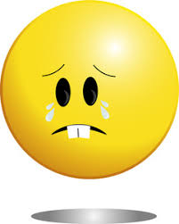
disgrace dis + grace = disgrace

Slide 275
disgrace dis + grace = disgrace
(verb)
Definition – to bring shame

Slide 276
disrepair

Slide 277
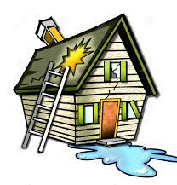
disrepair dis + repair = disrepair

Slide 278
disrepair dis + repair = disrepair
(verb)
Definition – poor and broken condition

Slide 279
That newspaper must discontinue.

Slide 280
That newspaper must ___________.

Slide 281
That newspaper must discontinue.

Slide 282
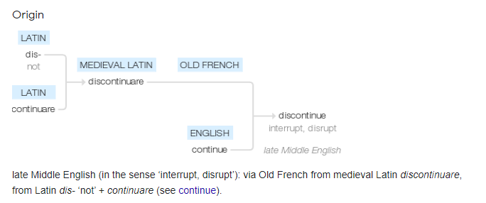

Slide 283
It was a disgrace!

Slide 284
It was a ________!

Slide 285
It was a disgrace!

Slide 286
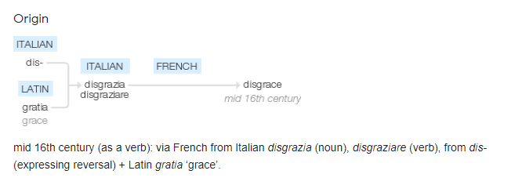

Slide 287
The boat fell into disrepair.

Slide 288
The boat fell into _________.

Slide 289
The boat fell into disrepair.

Slide 290
New CHALLENGE words.

Slide 291
centre

Slide 292
centre
Tom swam at the leisure centre.

Slide 293
centre
Tom swam at the leisure centre.

Slide 294
Tom swam at the leisure centre.

Slide 295
Tom swam at the leisure ______.

Slide 296
Tom swam at the leisure centre.

Slide 297
century

Slide 298
century
A century is 100 years.

Slide 299
century
A century is 100 years.

Slide 300
A century is 100 years.

Slide 301
A _______ is 100 years.

Slide 302
A century is 100 years.

Slide 303
Let’s Practise and Apply.

Slide 304
Can you spot the spelling rule words and the challenge words?

Slide 305
Over the last century the world has been getting warmer. The world is not beyond disrepair, but scientists have discovered this increase will continue. Floods and storms are becoming harder to predict and this climate change is seen by some as a disgrace. However, others disbelieve that climate change is real. They disapprove of scientists telling what to do to reduce the impact they have in creating climate change. Scientists believe that fossil fuel burning should be discontinued.

Slide 306
Over the last century the world has been getting warmer. The world is not beyond disrepair, but scientists have discovered this increase will continue. Floods and storms are becoming harder to predict and this climate change is seen by some as a disgrace. However, others disbelieve that climate change is real. They disapprove of scientists telling what to do to reduce the impact they have in creating climate change. Scientists believe that fossil fuel burning should be discontinued.

Slide 307
Write this sentence as I dictate it to you.
Notes:
Scientists believe that fossil fuel burning should be discontinued.

Slide 308
Scientists believe that fossil fuel burning should be discontinued.
Did you write it correctly?
Edit your work and make sure you have it correct.
Can you underline the spelling word that we have covered in this session?

Slide 309
Year 3 - Autumn 2
Week 2 - Friday
Notes:
Click through the slides for all the R+R words for the week (both the focus and the challenge words)
Click through the slides for all the new learning this week

Slide 311
Old challenge words…

Slide 312
group

Slide 313
heard

Slide 314
Old spelling rule words…

Slide 315
Monday

Slide 316
Tuesday

Slide 317
Wednesday

Slide 318
Thursday

Slide 319
Friday

Slide 320
Saturday

Slide 321
Sunday

Slide 322
New spelling rule words…

Slide 323
dislike

Slide 324
disobey

Slide 325
discolour

Slide 326
discover

Slide 327
disappear

Slide 328
dishonest

Slide 329
disallow

Slide 330
disbelieve

Slide 331
disapprove

Slide 332
discontinue

Slide 333
disgrace

Slide 334
disrepair

Slide 335
New challenge words…

Slide 336
centre

Slide 337
century

Slide 338
Quick Quiz time…
Notes:
Say these words for the quiz
Tuesday Saturday group heard centre century dislike disappear disbelieve discover

Slide 339
Did you get them correct?
Edit your work.
Tuesday Saturday group heard centre century dislike disappear disbelieve discover
Notes:
Say these words for the quiz
unhappy undress unable actual learn mishap mistreat misprint mislead mistrust

Slide 340
Word class time…

Slide 341
Tom swam at the leisure centre.
Notes:
Ask for these words to be classed

Slide 342
Tom swam at the leisure centre.
noun verb preposition determiner adjective noun
Notes:
Ask for these words to be classed

Slide 343
Tom swam at the leisure centre.
noun verb preposition determiner adjective noun
Notes:
Ask for these words to be classed

Slide 344
A century is a hundred years.
Notes:
Ask for these words to be classed

Slide 345
A century is a hundred years.
determiner noun verb determiner adjective noun

Slide 346
A century is a hundred years.
determiner noun verb determiner adjective noun

Slide 347
Etymology
The history of a word….

Slide 348
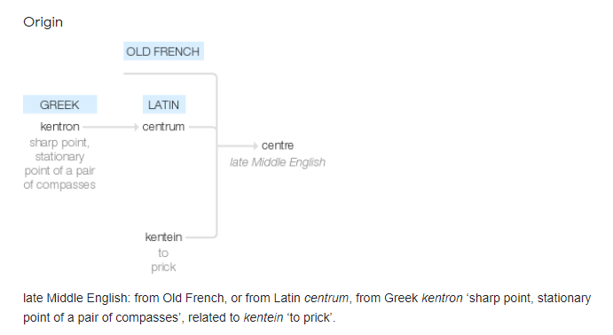
centre
chiefly British English spelling of center (q.v.); for ending, see -re.
center (n.)
late 14c., "middle point of a circle; point round which something revolves," from Old French centre (14c.), from Latin centrum "center," originally the fixed point of the two points of a drafting compass (hence "the center of a circle"), from Greek kentron "sharp point, goad, sting of a wasp," from kentein "stitch," from PIE root *kent- "to prick" (source also of Breton kentr "a spur," Welsh cethr "nail," Old High German hantag "sharp, pointed").
The spelling with -re was popularized in Britain by Johnson's dictionary (following Bailey's), though -er is older and was used by Shakespeare, Milton, and Pope. Meaning "the middle of anything" attested from 1590s. Figuratively, "point of concentration" (of power, etc.) is from 1680s. Political use, originally in reference to France, "representatives of moderate views" (between left and right) is from 1837. Center of gravity is recorded from 1650s. Center of attention is from 1868.

Slide 349
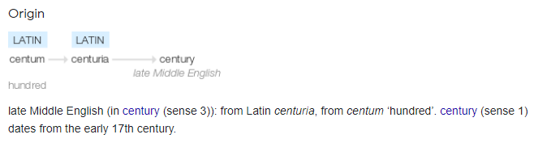
century (n.)
1530s, "one hundred" (of anything), from Latin centuria "group of one hundred" of things of one kind (including a measure of land and a division of the Roman army, one-sixteenth of a legion, headed by a centurion), from centum "hundred" (see hundred) on analogy of decuria "a company of ten."
Used in Middle English from late 14c. as a division of land, from Roman use. The Modern English meaning "period of 100 years," reckoned from any starting point, is attested from 1650s, short for century of years (1620s). Latin centuria was not used in the sense "one hundred years," for which saeculum was the word (see secular). The older, general sense is preserved in the meaning "score of 100 points" in cricket and some other sports. The century-plant (American aloe), 1843, was believed to bloom only after a century of growth.

Slide 350
Let’s investigate….
Can you find the difference between the re and er endings?

Slide 351
re or er endings?
-re
word-ending that sometimes distinguish British from American English. In the U.S., the change from -re to -er (to match pronunciation) in words such as fibre, centre, theatre began in late 18c. and became standard there over the next 25 years at the urging of Noah Webster (the 1804 edition of his speller, and especially his 1806 dictionary). The -re spelling, like -our, however, had the authority of Johnson's dictionary behind it and was unmoved in Britain, where it came to be a point of national pride, contra the Yankees.
Despite Webster's efforts, -re was retained in words with -c- or -g- (such as ogre, acre, the latter of which Webster insisted to the end of his days ought to be aker, and it was so printed in editions of the dictionary during his lifetime). The -re spelling generally is more justified by conservative etymology, based on French antecedents. It is met today in the U.S. only in Theatre as an element in the proper names of entertainment showplaces, where it is perhaps felt to inspire a perception of bon ton.

