Slide 1
Spelling Y3
Mastering spellings: building on the foundations of phonics
Autumn 2
Week 3
Notes:
These slides are the same as Y2 Summer 2 as this is a revisit and review half term

Slide 2
Year 3 - Autumn 2
Week 3 - Monday
Notes:
Revisit and review the words from Y2 and challenge words – I say, we say, you say
Ask children to write words only in their spelling book
Introduce the new spelling rule
Children to write the new spelling rule words and challenge words into books when the sentences are shown with the spelling word missing.
Read the extract with the class as choral reading. Practise model of prosody etc.
Ask children to find the spelling words from the session in the text.
Then read allowed the chosen sentence for children to write fully in their books.
Show the extract and ask children to then edit their work to check they were correct in their dictation.

Slide 3
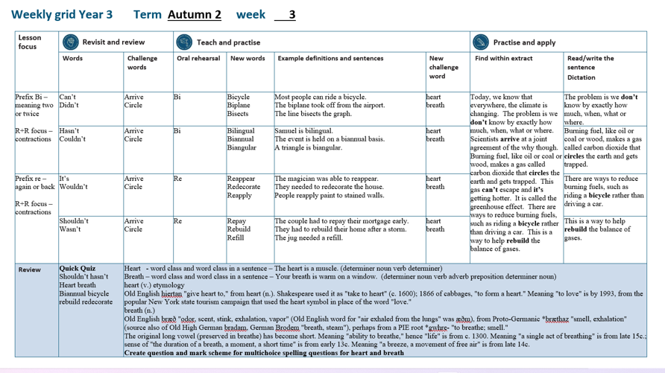

Slide 4
Let’s Revisit and Review…

Slide 5
Do you remember this challenge word?

Slide 6
arrive

Slide 7
arrive
Definition – reach a place at the end of a journey

Slide 8
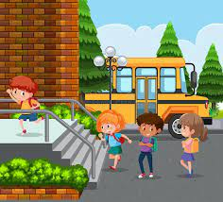
arrive
Definition – reach a place at the end of a journey

Slide 9
Do you remember this challenge word?

Slide 10
circle

Slide 11
circle
Definition – a round 2d shape

Slide 12

circle
Definition – a round 2d shape

Slide 13
Contractions

Slide 14
apostrophe (‘) to show missing letters

Slide 15
can’t

Slide 16
can’t

Slide 17
didn’t

Slide 18
didn’t

Slide 19
Let’s Teach and Practise

Slide 20
The prefix bi-

Slide 21
bi-

Slide 22
bi- meaning two or twice

Slide 23
bi- this prefix can just be added to the root word

Slide 24
bicycle

Slide 25
bicycle

Slide 26
biplane

Slide 27
biplane n

Slide 28
bisects

Slide 29
bisects

Slide 30
bicycle

Slide 31
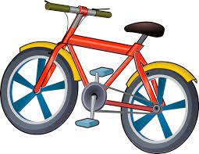
bicycle bi + cycle = bicycle

Slide 32
bicycle bi + cycle = bicycle
(noun)
Definition – a vehicle with two wheels

Slide 33
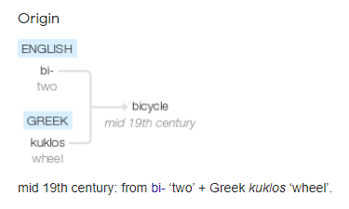

Slide 34
biplane

Slide 35
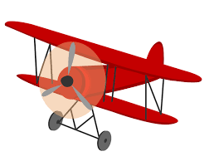
biplane bi + plane = biplane

Slide 36
biplane bi + plane = biplane
(noun)
Definition – aircraft with two pairs of wings

Slide 37
bisects

Slide 38
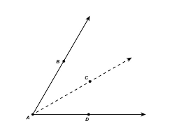
bisects bi + sects = bisects

Slide 39
bisects bi + sects = bisects
(verb)
Definition – divide into two

Slide 40
Most people can ride a bicycle.

Slide 41
Most people can ride a _______.

Slide 42
Most people can ride a bicycle.

Slide 43
The biplane took off from the airport.

Slide 44
The _______ took off from the airport.

Slide 45
The biplane took off from the airport.

Slide 46
The line bisects the graph.

Slide 47
The line _______ the graph.

Slide 48
The line bisects the graph.

Slide 49
New CHALLENGE words.

Slide 50
heart

Slide 51
heart
The heart is a muscle.

Slide 52
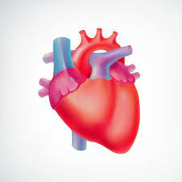
heart
The heart is a muscle.

Slide 53
The heart is a muscle.

Slide 54
The ______ is a muscle.

Slide 55
The heart is a muscle.

Slide 56
breath

Slide 57
breath
Your breath is warm on a window.

Slide 58
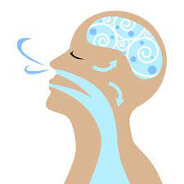
breath
Your breath is warm on a window.

Slide 59
Your breath is warm on a window.

Slide 60
Your ______ is warm on a window.

Slide 61
Your breath is warm on a window.

Slide 62
Let’s Practise and Apply.

Slide 63
Can you spot the spelling rule words and the challenge words?

Slide 64
Global Warming – weather
Today, we know that everywhere, the climate is changing. The problem is we don’t know by exactly how much, when, what or where. Scientists arrive at a joint agreement of the why though. Burning fuel, like oil or coal or wood, makes a gas called carbon dioxide that circles the earth and gets trapped. This gas can’t escape and it’s getting hotter. It is called the greenhouse effect. There are ways to reduce burning fuels, such as riding a bicycle rather than driving a car. This is a way to help rebuild the balance of gases.

Slide 65
Global Warming – weather
Today, we know that everywhere, the climate is changing. The problem is we don’t know by exactly how much, when, what or where. Scientists arrive at a joint agreement of the why though. Burning fuel, like oil or coal or wood, makes a gas called carbon dioxide that circles the earth and gets trapped. This gas can’t escape and it’s getting hotter. It is called the greenhouse effect. There are ways to reduce burning fuels, such as riding a bicycle rather than driving a car. This is a way to help rebuild the balance of gases.

Slide 66
Write this sentence as I dictate it to you.
Notes:
The problem is we don’t know by exactly how much, when, what or where.

Slide 67
The problem is we don’t know by exactly how much, when, what or where.
Did you write it correctly?
Edit your work and make sure you have it correct.
Can you underline the spelling word that we have covered in this session?

Slide 68
Year 3 - Autumn 2
Week 3 - Tuesday
Notes:
Revisit and review the words from Y2 and challenge words – I say, we say, you say
Ask children to write words only in their spelling book
Introduce the new spelling rule
Children to write the new spelling rule words and challenge words into books when the sentences are shown with the spelling word missing.
Read the extract with the class as choral reading. Practise model of prosody etc.
Ask children to find the spelling words from the session in the text.
Then read allowed the chosen sentence for children to write fully in their books.
Show the extract and ask children to then edit their work to check they were correct in their dictation.

Slide 70
Let’s Revisit and Review…

Slide 71
Do you remember this challenge word?

Slide 72
arrive

Slide 73
arrive
Definition – reach a place at the end of a journey

Slide 74
arrive
Definition – reach a place at the end of a journey

Slide 75
Do you remember this challenge word?

Slide 76
circle

Slide 77
circle
Definition – a round 2d shape

Slide 78
circle
Definition – a round 2d shape

Slide 79
Contractions

Slide 80
apostrophe (‘) to show missing letters

Slide 81
hasn’t

Slide 82
hasn’t

Slide 83
couldn’t

Slide 84
couldn’t

Slide 85
Let’s Teach and Practise

Slide 86
The prefix bi-

Slide 87
bi-

Slide 88
bi- meaning two or twice

Slide 89
bi- this prefix can just be added to the root word

Slide 90
bilingual

Slide 91
bilingual

Slide 92
biannual

Slide 93
biannual

Slide 94
biangular

Slide 95
biangular

Slide 96
bilingual

Slide 97
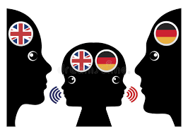
bilingual bi + lingual = bilingual

Slide 98
bilingual bi + lingual = bilingual
(noun)
Definition – a person speaking more than one language

Slide 99
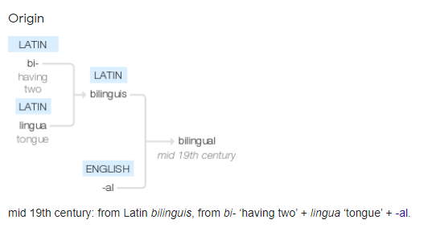

Slide 100
biannual

Slide 101

biannual bi + annual = biannual

Slide 102
biannual bi + annual = biannual
(adjective)
Definition – happening twice a year

Slide 103
biangular

Slide 104
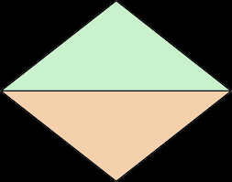
biangular bi + angular = biangular

Slide 105
biangular bi + angular = biangular
(adjective)
Definition – having two angles

Slide 106
Samuel is bilingual.

Slide 107
Samuel is _________.

Slide 108
Samuel is bilingual.

Slide 109
The event is held on a biannual basis.

Slide 110
The event is held on a ________ basis.

Slide 111
The event is held on a biannual basis.

Slide 112
A triangle is biangular.

Slide 113
A triangle is _________.

Slide 114
A triangle is biangular.

Slide 115
New CHALLENGE words.

Slide 116
heart

Slide 117
heart
The heart is a muscle.

Slide 118
heart
The heart is a muscle.

Slide 119
The heart is a muscle.

Slide 120
The ______ is a muscle.

Slide 121
The heart is a muscle.

Slide 122
breath

Slide 123
breath
Your breath is warm on a window.

Slide 124
breath
Your breath is warm on a window.

Slide 125
Your breath is warm on a window.

Slide 126
Your ______ is warm on a window.

Slide 127
Your breath is warm on a window.

Slide 128
Let’s Practise and Apply.

Slide 129
Can you spot the spelling rule words and the challenge words?

Slide 130
Global Warming – weather
Today, we know that everywhere, the climate is changing. The problem is we don’t know by exactly how much, when, what or where. Scientists arrive at a joint agreement of the why though. Burning fuel, like oil or coal or wood, makes a gas called carbon dioxide that circles the earth and gets trapped. This gas can’t escape and it’s getting hotter. It is called the greenhouse effect. There are ways to reduce burning fuels, such as riding a bicycle rather than driving a car. This is a way to help rebuild the balance of gases.

Slide 131
Global Warming – weather
Today, we know that everywhere, the climate is changing. The problem is we don’t know by exactly how much, when, what or where. Scientists arrive at a joint agreement of the why though. Burning fuel, like oil or coal or wood, makes a gas called carbon dioxide that circles the earth and gets trapped. This gas can’t escape and it’s getting hotter. It is called the greenhouse effect. There are ways to reduce burning fuels, such as riding a bicycle rather than driving a car. This is a way to help rebuild the balance of gases.

Slide 132
Write this sentence as I dictate it to you.
Notes:
Burning fuel, like oil or coal or wood, makes a gas called carbon dioxide that circles the earth and gets trapped.

Slide 133
Burning fuel, like oil or coal or wood, makes a gas called carbon dioxide that circles the earth and gets trapped.
Did you write it correctly?
Edit your work and make sure you have it correct.
Can you underline the spelling word that we have covered in this session?

Slide 134
Year 3 - Autumn 2
Week 3 - Wednesday
Notes:
Revisit and review the words from Y2 and challenge words – I say, we say, you say
Ask children to write words only in their spelling book
Introduce the new spelling rule
Children to write the new spelling rule words and challenge words into books when the sentences are shown with the spelling word missing.
Read the extract with the class as choral reading. Practise model of prosody etc.
Ask children to find the spelling words from the session in the text.
Then read allowed the chosen sentence for children to write fully in their books.
Show the extract and ask children to then edit their work to check they were correct in their dictation.

Slide 136
Let’s Revisit and Review…

Slide 137
Do you remember this challenge word?

Slide 138
arrive

Slide 139
arrive
Definition – reach a place at the end of a journey

Slide 140
arrive
Definition – reach a place at the end of a journey

Slide 141
Do you remember this challenge word?

Slide 142
circle

Slide 143
circle
Definition – a round 2d shape

Slide 144
circle
Definition – a round 2d shape

Slide 145
Contractions

Slide 146
apostrophe (‘) to show missing letters

Slide 147
It’s

Slide 148
It’s

Slide 149
wouldn’t

Slide 150
wouldn’t

Slide 151
Let’s Teach and Practise

Slide 152
The prefix re-

Slide 153
re-

Slide 154
re- meaning again or back

Slide 155
re- this prefix can just be added to the root word

Slide 156
reappear

Slide 157
reappear

Slide 158
redecorate

Slide 159
redecorate n

Slide 160
reapply

Slide 161
reapply

Slide 162
reappear

Slide 163
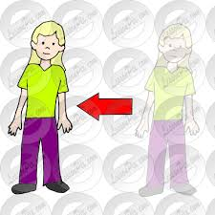
reappear re + appear = reappear

Slide 164
reappear re + appear = reappear
(verb)
Definition – appear again

Slide 165
redecorate

Slide 166
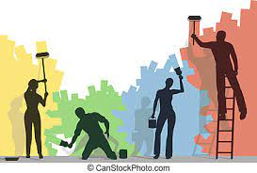
redecorate re + decorate = redecorate

Slide 167
redecorate re + decorate = redecorate
(verb)
Definition – apply paint or wallpaper again

Slide 168
reapply

Slide 169

reapply re + apply = reapply

Slide 170
reapply re + apply = reapply
(verb)
Definition – apply again (like sunscreen when it has run out)

Slide 171
The magician was able to reappear.

Slide 172
The magician was able to ________.

Slide 173
The magician was able to reappear.

Slide 174
They needed to redecorate the house.

Slide 175
They needed to __________ the house.

Slide 176
They needed to redecorate the house.

Slide 177
People reapply paint to stained walls.

Slide 178
People _______ paint to stained walls.

Slide 179
People reapply paint to stained walls.

Slide 180
New CHALLENGE words.

Slide 181
heart

Slide 182
heart
The heart is a muscle.

Slide 183
heart
The heart is a muscle.

Slide 184
The heart is a muscle.

Slide 185
The ______ is a muscle.

Slide 186
The heart is a muscle.

Slide 187
breath

Slide 188
breath
Your breath is warm on a window.

Slide 189
breath
Your breath is warm on a window.

Slide 190
Your breath is warm on a window.

Slide 191
Your ______ is warm on a window.

Slide 192
Your breath is warm on a window.

Slide 193
Let’s Practise and Apply.

Slide 194
Can you spot the spelling rule words and the challenge words?

Slide 195
Global Warming – weather
Today, we know that everywhere, the climate is changing. The problem is we don’t know by exactly how much, when, what or where. Scientists arrive at a joint agreement of the why though. Burning fuel, like oil or coal or wood, makes a gas called carbon dioxide that circles the earth and gets trapped. This gas can’t escape and it’s getting hotter. It is called the greenhouse effect. There are ways to reduce burning fuels, such as riding a bicycle rather than driving a car. This is a way to help rebuild the balance of gases.

Slide 196
Global Warming – weather
Today, we know that everywhere, the climate is changing. The problem is we don’t know by exactly how much, when, what or where. Scientists arrive at a joint agreement of the why though. Burning fuel, like oil or coal or wood, makes a gas called carbon dioxide that circles the earth and gets trapped. This gas can’t escape and it’s getting hotter. It is called the greenhouse effect. There are ways to reduce burning fuels, such as riding a bicycle rather than driving a car. This is a way to help rebuild the balance of gases.

Slide 197
Write this sentence as I dictate it to you.
Notes:
There are ways to reduce burning fuels, such as riding a bicycle rather than driving a car.

Slide 198
There are ways to reduce burning fuels, such as riding a bicycle rather than driving a car.
Did you write it correctly?
Edit your work and make sure you have it correct.
Can you underline the spelling word that we have covered in this session?

Slide 199
Year 3 - Autumn 2
Week 3 - Thursday
Notes:
Revisit and review the words from Y2 and challenge words – I say, we say, you say
Ask children to write words only in their spelling book
Introduce the new spelling rule
Children to write the new spelling rule words and challenge words into books when the sentences are shown with the spelling word missing.
Read the extract with the class as choral reading. Practise model of prosody etc.
Ask children to find the spelling words from the session in the text.
Then read allowed the chosen sentence for children to write fully in their books.
Show the extract and ask children to then edit their work to check they were correct in their dictation.

Slide 201
Let’s Revisit and Review…

Slide 202
Do you remember this challenge word?

Slide 203
arrive

Slide 204
arrive
Definition – reach a place at the end of a journey

Slide 205
arrive
Definition – reach a place at the end of a journey

Slide 206
Do you remember this challenge word?

Slide 207
circle

Slide 208
circle
Definition – a round 2d shape

Slide 209
circle
Definition – a round 2d shape

Slide 210
Contractions

Slide 211
apostrophe (‘) to show missing letters

Slide 212
shouldn’t

Slide 213
shouldn’t

Slide 214
wasn’t

Slide 215
wasn’t

Slide 216
Let’s Teach and Practise

Slide 217
The prefix re-

Slide 218
re-

Slide 219
re- meaning back or again

Slide 220
re- this prefix can just be added to the root word

Slide 221
repay

Slide 222
repay

Slide 223
rebuild

Slide 224
rebuild n

Slide 225
refill

Slide 226
refill

Slide 227
repay

Slide 228
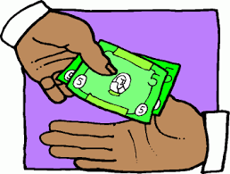
repay re + pay = repay

Slide 229
repay re + pay = repay
(verb)
Definition – pay back

Slide 230
rebuild

Slide 231
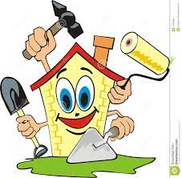
rebuild re + build = rebuild

Slide 232
rebuild re + build = rebuild
(verb)
Definition – build something again

Slide 233
refill

Slide 234

refill re + fill = refill

Slide 235
refill re + fill = refill
(verb)
Definition – fill again

Slide 236
The couple had to repay their mortgage early.

Slide 237
The couple had to _____ their mortgage early.

Slide 238
The couple had to repay their mortgage early.

Slide 239
They had to rebuild their home after a storm.

Slide 240
They had to _______ their home after a storm.

Slide 241
They had to rebuild their home after a storm.

Slide 242
The jug needed a refill.

Slide 243
The jug needed a ______.

Slide 244
The jug needed a refill.

Slide 245
New CHALLENGE words.

Slide 246
heart

Slide 247
heart
The heart is a muscle.

Slide 248
heart
The heart is a muscle.

Slide 249
The heart is a muscle.

Slide 250
The ______ is a muscle.

Slide 251
The heart is a muscle.

Slide 252
breath

Slide 253
breath
Your breath is warm on a window.

Slide 254
breath
Your breath is warm on a window.

Slide 255
Your breath is warm on a window.

Slide 256
Your ______ is warm on a window.

Slide 257
Your breath is warm on a window.

Slide 258
Let’s Practise and Apply.

Slide 259
Can you spot the spelling rule words and the challenge words?

Slide 260
Global Warming – weather
Today, we know that everywhere, the climate is changing. The problem is we don’t know by exactly how much, when, what or where. Scientists arrive at a joint agreement of the why though. Burning fuel, like oil or coal or wood, makes a gas called carbon dioxide that circles the earth and gets trapped. This gas can’t escape and it’s getting hotter. It is called the greenhouse effect. There are ways to reduce burning fuels, such as riding a bicycle rather than driving a car. This is a way to help rebuild the balance of gases.

Slide 261
Global Warming – weather
Today, we know that everywhere, the climate is changing. The problem is we don’t know by exactly how much, when, what or where. Scientists arrive at a joint agreement of the why though. Burning fuel, like oil or coal or wood, makes a gas called carbon dioxide that circles the earth and gets trapped. This gas can’t escape and it’s getting hotter. It is called the greenhouse effect. There are ways to reduce burning fuels, such as riding a bicycle rather than driving a car. This is a way to help rebuild the balance of gases.

Slide 262
Write this sentence as I dictate it to you.
Notes:
This is a way to help rebuild the balance of gases.

Slide 263
This is a way to help rebuild the balance of gases.
Did you write it correctly?
Edit your work and make sure you have it correct.
Can you underline the spelling word that we have covered in this session?

Slide 264
Year 3 - Autumn 2
Week 3 - Friday
Notes:
Click through the slides for all the R+R words for the week (both the focus and the challenge words)
Click through the slides for all the new learning this week

Slide 266
Old challenge words…

Slide 267
arrive

Slide 268
circle

Slide 269
Old spelling rule words…

Slide 270
can’t

Slide 271
didn’t

Slide 272
hasn’t

Slide 273
couldn’t

Slide 274
It’s

Slide 275
wouldn’t

Slide 276
shouldn’t

Slide 277
wasn’t

Slide 278
New spelling rule words…

Slide 279
bicycle

Slide 280
biplane

Slide 281
bisects

Slide 282
bilingual

Slide 283
biannual

Slide 284
biangular

Slide 285
reappear

Slide 286
redecorate

Slide 287
reapply

Slide 288
repay

Slide 289
rebuild

Slide 290
refill

Slide 291
New challenge words…

Slide 292
heart

Slide 293
breath

Slide 294
Quick Quiz time…
Notes:
Say these words for the quiz
Shouldn’t hasn’t heart breath arrive circle biannual bicycle rebuild redecorate

Slide 295
Did you get them correct?
Edit your work.
shouldn’t hasn’t heart breath arrive circle biannual bicycle rebuild redecorate

Slide 296
Word class time…

Slide 297
The heart is a muscle.
Notes:
Ask for these words to be classed

Slide 298
The heart is a muscle.
determiner noun verb determiner noun
Notes:
Ask for these words to be classed

Slide 299
The heart is a muscle.
determiner noun verb determiner noun
Notes:
Ask for these words to be classed

Slide 300
Your breath is warm on the window.
Notes:
Ask for these words to be classed

Slide 301
Your breath is warm on the window.
determiner noun verb adjective preposition determiner noun

Slide 302
Your breath is warm on the window.
determiner noun verb adjective preposition determiner noun

Slide 303
Etymology
The history of a word….

Slide 304
heart (v.)
Old English hiertan "give heart to," from heart (n.). Shakespeare used it as "take to heart" (c. 1600); 1866 of cabbages, "to form a heart." Meaning "to love" is by 1993, from the popular New York state tourism campaign that used the heart symbol in place of the word "love.“
heart (n.)
Old English heorte "heart (hollow muscular organ that circulates blood); breast, soul, spirit, will, desire; courage; mind, intellect," from Proto-Germanic *hertan- (source also of Old Saxon herta, Old Frisian herte, Old Norse hjarta, Dutch hart, Old High German herza, German Herz, Gothic hairto), from PIE root *kerd- "heart."
Spelling with -ea- is c. 1500, reflecting what then was a long vowel, and the spelling remained when the pronunciation shifted. Most of the modern figurative senses were present in Old English, including "memory" (from the notion of the heart as the seat of all mental faculties, now only in by heart, which is from late 14c.), "seat of inmost feelings; will; seat of emotions, especially love and affection; seat of courage." Meaning "inner part of anything" is from early 14c. In reference to the conventional heart-shape in illustration, late 15c.; heart-shaped is from 1744.
Heart attack attested from 1875; heart disease is from 1864. The card game hearts is so called from 1886. To have one's heart in the right place "mean well" is from 1774. Heart and soul "one's whole being" is from 1650s. To eat (one's own) heart "waste away with grief, resentment, etc." is from 1580s.

Slide 305
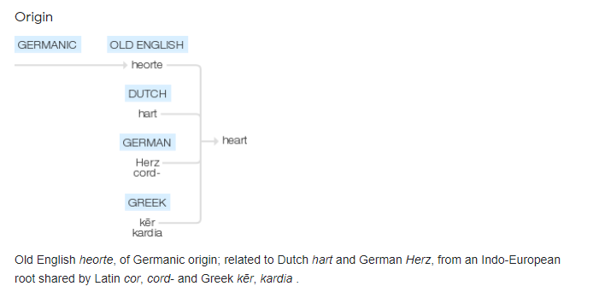

Slide 306
breath (n.)
Old English bræð "odor, scent, stink, exhalation, vapor" (Old English word for "air exhaled from the lungs" was æðm), from Proto-Germanic *bræthaz "smell, exhalation" (source also of Old High German bradam, German Brodem "breath, steam"), perhaps from a PIE root *gwhre- "to breathe; smell."
The original long vowel (preserved in breathe) has become short. Meaning "ability to breathe," hence "life" is from c. 1300. Meaning "a single act of breathing" is from late 15c.; sense of "the duration of a breath, a moment, a short time" is from early 13c. Meaning "a breeze, a movement of free air" is from late 14c.

Slide 307
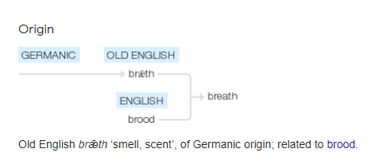

Slide 308
Let’s investigate….
What word classes can be made with breath and heart by adding prefixes and suffixes?

Slide 309
Word classes with root heart…
Nouns – heart-throb / heart-strings / heart-aches / heartland / heartbreak / sweetheart
Verbs – hearten / heartened
Adjectives – heart-felt / heart-warming

Slide 310
Word classes with root breath…
Nouns – breather
Verbs – breathe
Adjectives – breath-taking / breathy / breathless

