Slide 1
Spelling Y3
Mastering spellings: building on the foundations of phonics
Autumn 2
Week 4

Slide 2
Year 3 - Autumn 2
Week 4 - Monday
Notes:
Revisit and review the words from Y2 and challenge words – I say, we say, you say
Ask children to write words only in their spelling book
Introduce the new spelling rule
Children to write the new spelling rule words and challenge words into books when the sentences are shown with the spelling word missing.
Read the extract with the class as choral reading. Practise model of prosody etc.
Ask children to find the spelling words from the session in the text.
Then read allowed the chosen sentence for children to write fully in their books.
Show the extract and ask children to then edit their work to check they were correct in their dictation.

Slide 3
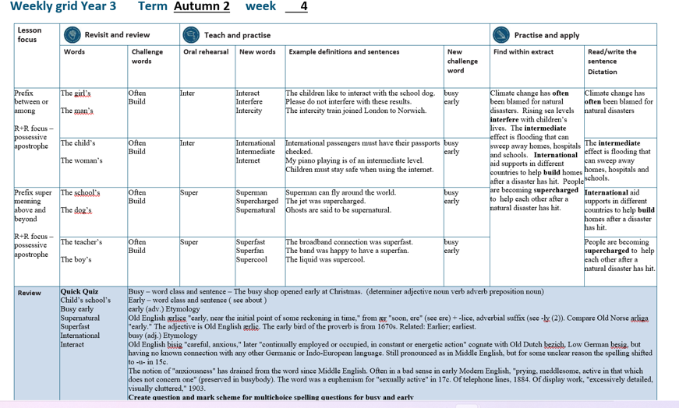

Slide 4
Let’s Revisit and Review…

Slide 5
Do you remember this challenge word?

Slide 6
often

Slide 7
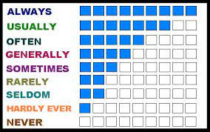
often
(adverb)
Definition – frequency / many times

Slide 8
often
I eat fruit often.

Slide 9
Do you remember this challenge word?

Slide 10
build

Slide 11
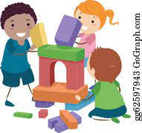
build
(verb)
Definition – make something

Slide 12
build
Together, we can build great things.

Slide 13
Possessive apostrophe

Slide 14
- ’s
Notes:
Sound of aI

Slide 15
Possessive apostrophe
Shows something belonging to someone.

Slide 16
the girl’s shoes

Slide 17
the girl’s shoes

Slide 18
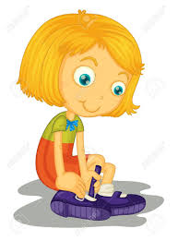
the girl’s shoes

Slide 19
the man’s shoes

Slide 20
the man’s shoes

Slide 21
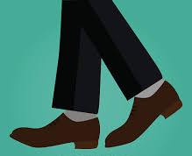
the man’s shoes

Slide 22
Let’s Teach and Practise

Slide 23
The prefix inter-

Slide 24
inter-

Slide 25
inter- meaning between or among.

Slide 26
inter- meaning between or among.
The prefix inter can just be added to a root word.

Slide 27
interact

Slide 28
interact

Slide 29
interfere

Slide 30
interfere

Slide 31
intercity

Slide 32
intercity

Slide 33
interact

Slide 34

interact inter + act = interact

Slide 35
interact inter + act = interact
(verb)
Definition – talk to each other

Slide 36
interfere

Slide 37

interfere inter + fere = interfere

Slide 38
interfere inter + fere = interfere
(verb)
Definition – get involved in something without being a part of it

Slide 39
intercity

Slide 40
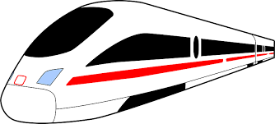
intercity inter + city = intercity

Slide 41
intercity inter + city = intercity
(adjective)
Definition – travelling between cities

Slide 42
The children like to interact with the school dog.

Slide 43
The children like to ________ with the school dog.

Slide 44
The children like to interact with the school dog.

Slide 45
Please do not interfere with these results.

Slide 46
Please do not _________ with these results.

Slide 47
Please do not interfere with these results.

Slide 48
The intercity train joined London to Norwich.

Slide 49
The _________ train joined London to Norwich.

Slide 50
The intercity train joined London to Norwich.

Slide 51
New CHALLENGE words.

Slide 52
busy

Slide 53
busy
The busy shop opened early for Christmas.

Slide 54
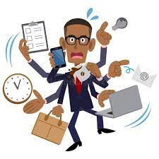
busy
The busy shop opened early for Christmas.

Slide 55
The busy shop opened early for Christmas.

Slide 56
The ____ shop opened early for Christmas.

Slide 57
The busy shop opened early for Christmas.

Slide 58
early

Slide 59
early
The busy shop opened early for Christmas.

Slide 60
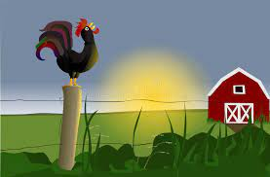
early
The busy shop opened early for Christmas.

Slide 61
The busy shop opened early for Christmas.

Slide 62
The busy shop opened _____ for Christmas.

Slide 63
The busy shop opened early for Christmas.

Slide 64
Let’s Practise and Apply.

Slide 65
Can you spot the spelling rule words and the challenge words?

Slide 66
Climate change has often been blamed for natural disasters. Rising sea levels interfere with children’s lives. The intermediate effect is flooding that can sweep away homes, hospitals and schools. International aid supports in different countries to help build homes after a disaster has hit. People are becoming supercharged to help each other after a natural disaster has hit.

Slide 67
Climate change has often been blamed for natural disasters. Rising sea levels interfere with children’s lives. The intermediate effect is flooding that can sweep away homes, hospitals and schools. International aid supports in different countries to help build homes after a disaster has hit. People are becoming supercharged to help each other after a natural disaster has hit.

Slide 68
Write this sentence as I dictate it to you.
Notes:
Climate change has often been blamed for natural disasters.

Slide 69
Climate change has often been blamed for natural disasters.
Did you write it correctly?
Edit your work and make sure you have it correct.
Can you underline the spelling word that we have covered in this session?

Slide 70
Year 3 - Autumn 2
Week 4 - Tuesday
Notes:
Revisit and review the words from Y2 and challenge words – I say, we say, you say
Ask children to write words only in their spelling book
Introduce the new spelling rule
Children to write the new spelling rule words and challenge words into books when the sentences are shown with the spelling word missing.
Read the extract with the class as choral reading. Practise model of prosody etc.
Ask children to find the spelling words from the session in the text.
Then read allowed the chosen sentence for children to write fully in their books.
Show the extract and ask children to then edit their work to check they were correct in their dictation.

Slide 72
Let’s Revisit and Review…

Slide 73
Do you remember this challenge word?

Slide 74
often

Slide 75
often
(adverb)
Definition – frequency / many times

Slide 76
often
I eat fruit often.

Slide 77
Do you remember this challenge word?

Slide 78
build

Slide 79
build
(verb)
Definition – make something

Slide 80
build
Together, we can build great things.

Slide 81
Possessive apostrophe

Slide 82
- ’s
Notes:
Sound of aI

Slide 83
Possessive apostrophe
Shows something belonging to someone.

Slide 84
the child’s shoes

Slide 85
the child’s shoes

Slide 86
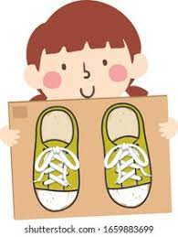
the child’s shoes

Slide 87
the woman’s shoes

Slide 88
the woman’s shoes

Slide 89
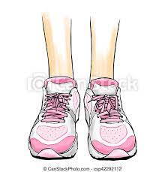
the woman’s shoes

Slide 90
Let’s Teach and Practise

Slide 91
The prefix inter-

Slide 92
inter-

Slide 93
inter- meaning between or among.

Slide 94
inter- meaning between or among.
The prefix inter can just be added to a root word.

Slide 95
international

Slide 96
international

Slide 97
intermediate

Slide 98
intermediate

Slide 99
internet

Slide 100
internet

Slide 101
international

Slide 102

international inter + national = international

Slide 103
international inter + national = international
(adjective)
Definition – between nations / countries

Slide 104
intermediate

Slide 105
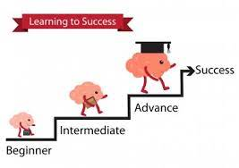
intermediate inter + mediate = intermediate

Slide 106
intermediate inter + mediate = intermediate
(adjective)
Definition – coming between two things

Slide 107
internet

Slide 108

internet inter + net = internet

Slide 109
internet inter + net = internet
(noun)
Definition – communication between people and places

Slide 110
International passengers must have their passports checked.

Slide 111
_____________ passengers must have their passports checked.

Slide 112
International passengers must have their passports checked.

Slide 113
My piano playing is of an intermediate level.

Slide 114
My piano playing is of an ____________ level.

Slide 115
My piano playing is of an intermediate level.

Slide 116
Children must stay safe when using the internet.

Slide 117
Children must stay safe when using the ________.

Slide 118
Children must stay safe when using the internet.

Slide 119
New CHALLENGE words.

Slide 120
busy

Slide 121
busy
The busy shop opened early for Christmas.

Slide 122
busy
The busy shop opened early for Christmas.

Slide 123
The busy shop opened early for Christmas.

Slide 124
The ____ shop opened early for Christmas.

Slide 125
The busy shop opened early for Christmas.

Slide 126
early

Slide 127
early
The busy shop opened early for Christmas.

Slide 128
early
The busy shop opened early for Christmas.

Slide 129
The busy shop opened early for Christmas.

Slide 130
The busy shop opened _____ for Christmas.

Slide 131
The busy shop opened early for Christmas.

Slide 132
Let’s Practise and Apply.

Slide 133
Can you spot the spelling rule words and the challenge words?

Slide 134
Climate change has often been blamed for natural disasters. Rising sea levels interfere with children’s lives. The intermediate effect is flooding that can sweep away homes, hospitals and schools. International aid supports in different countries to help build homes after a disaster has hit. People are becoming supercharged to help each other after a natural disaster has hit.

Slide 135
Climate change has often been blamed for natural disasters. Rising sea levels interfere with children’s lives. The intermediate effect is flooding that can sweep away homes, hospitals and schools. International aid supports in different countries to help build homes after a disaster has hit. People are becoming supercharged to help each other after a natural disaster has hit.

Slide 136
Write this sentence as I dictate it to you.
Notes:
The intermediate effect is flooding that can sweep away homes, hospitals and schools.

Slide 137
The intermediate effect is flooding that can sweep away homes, hospitals and schools.
Did you write it correctly?
Edit your work and make sure you have it correct.
Can you underline the spelling word that we have covered in this session?

Slide 138
Year 3 - Autumn 2
Week 4 - Wednesday
Notes:
Revisit and review the words from Y2 and challenge words – I say, we say, you say
Ask children to write words only in their spelling book
Introduce the new spelling rule
Children to write the new spelling rule words and challenge words into books when the sentences are shown with the spelling word missing.
Read the extract with the class as choral reading. Practise model of prosody etc.
Ask children to find the spelling words from the session in the text.
Then read allowed the chosen sentence for children to write fully in their books.
Show the extract and ask children to then edit their work to check they were correct in their dictation.

Slide 140
Let’s Revisit and Review…

Slide 141
Do you remember this challenge word?

Slide 142
often

Slide 143
often
(adverb)
Definition – frequency / many times

Slide 144
often
I eat fruit often.

Slide 145
Do you remember this challenge word?

Slide 146
build

Slide 147
build
(verb)
Definition – make something

Slide 148
build
Together, we can build great things.

Slide 149
Possessive apostrophe

Slide 150
- ’s
Notes:
Sound of aI

Slide 151
Possessive apostrophe
Shows something belonging to someone.

Slide 152
the school’s plaground

Slide 153
the school’s playground.

Slide 154
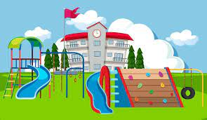
the school’s playground.

Slide 155
the dog’s bone.

Slide 156
the dog’s bone

Slide 157

the dog’s bone

Slide 158
Let’s Teach and Practise

Slide 159
The prefix super-

Slide 160
super-

Slide 161
super- meaning above / best

Slide 162
super- meaning above / best
The prefix super- can just be added to a root word.

Slide 163
superman

Slide 164
superman

Slide 165
supercharged

Slide 166
supercharged

Slide 167
supernatural

Slide 168
supernatural

Slide 169
superman

Slide 170

superman super + man = superman

Slide 171
superman super + man = superman
(noun)
Definition – a character with great strength

Slide 172
supercharged

Slide 173
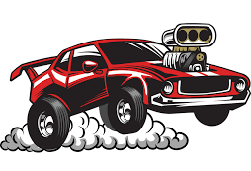
supercharged super + charged = supercharged

Slide 174
supercharged super + charged = supercharged
(adjective)
Definition – extremely powerful or fast

Slide 175
supernatural

Slide 176
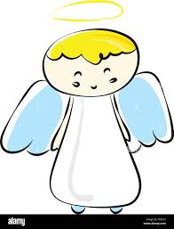
supernatural super + natural = supernatural

Slide 177
supernatural super + natural = supernatural
(noun)
Definition – being not explained by the laws of nature

Slide 178
Superman can fly around the world.

Slide 179
_________ can fly around the world.

Slide 180
Superman can fly around the world.

Slide 181
The jet was supercharged.

Slide 182
The jet was ____________.

Slide 183
The jet was supercharged.

Slide 184
Ghosts are said to be supernatural.

Slide 185
Ghosts are said to be ____________.

Slide 186
Ghosts are said to be supernatural.

Slide 187
New CHALLENGE words.

Slide 188
busy

Slide 189
busy
The busy shop opened early for Christmas.

Slide 190
busy
The busy shop opened early for Christmas.

Slide 191
The busy shop opened early for Christmas.

Slide 192
The ____ shop opened early for Christmas.

Slide 193
The busy shop opened early for Christmas.

Slide 194
early

Slide 195
early
The busy shop opened early for Christmas.

Slide 196
early
The busy shop opened early for Christmas.

Slide 197
The busy shop opened early for Christmas.

Slide 198
The busy shop opened _____ for Christmas.

Slide 199
The busy shop opened early for Christmas.

Slide 200
Let’s Practise and Apply.

Slide 201
Can you spot the spelling rule words and the challenge words?

Slide 202
Climate change has often been blamed for natural disasters. Rising sea levels interfere with children’s lives. The intermediate effect is flooding that can sweep away homes, hospitals and schools. International aid supports in different countries to help build homes after a disaster has hit. People are becoming supercharged to help each other after a natural disaster has hit.

Slide 203
Climate change has often been blamed for natural disasters. Rising sea levels interfere with children’s lives. The intermediate effect is flooding that can sweep away homes, hospitals and schools. International aid supports in different countries to help build homes after a disaster has hit. People are becoming supercharged to help each other after a natural disaster has hit.

Slide 204
Write this sentence as I dictate it to you.
Notes:
International aid supports in different countries to help build homes after a disaster has hit.

Slide 205
International aid supports in different countries to help build homes after a disaster has hit.
Did you write it correctly?
Edit your work and make sure you have it correct.
Can you underline the spelling word that we have covered in this session?

Slide 206
Year 3 - Autumn 2
Week 4 - Thursday
Notes:
Revisit and review the words from Y2 and challenge words – I say, we say, you say
Ask children to write words only in their spelling book
Introduce the new spelling rule
Children to write the new spelling rule words and challenge words into books when the sentences are shown with the spelling word missing.
Read the extract with the class as choral reading. Practise model of prosody etc.
Ask children to find the spelling words from the session in the text.
Then read allowed the chosen sentence for children to write fully in their books.
Show the extract and ask children to then edit their work to check they were correct in their dictation.

Slide 208
Let’s Revisit and Review…

Slide 209
Do you remember this challenge word?

Slide 210
often

Slide 211
often
(adverb)
Definition – frequency / many times

Slide 212
often
I eat fruit often.

Slide 213
Do you remember this challenge word?

Slide 214
build

Slide 215
build
(verb)
Definition – make something

Slide 216
build
Together, we can build great things.

Slide 217
Possessive apostrophe

Slide 218
- ’s
Notes:
Sound of aI

Slide 219
Possessive apostrophe
Shows something belonging to someone.

Slide 220
the teacher’s pen

Slide 221
the teacher’s pen

Slide 222

the teacher’s pen

Slide 223
the boy’s pen

Slide 224
the boy’s pen

Slide 225

the boy’s pen

Slide 226
Let’s Teach and Practise

Slide 227
The prefix super-

Slide 228
super-

Slide 229
super- meaning above / best

Slide 230
super- meaning above / best
The prefix super- can just be added to a root word.

Slide 231
superfast

Slide 232
superfast

Slide 233
superfan

Slide 234
superfan

Slide 235
supercool

Slide 236
supercool

Slide 237
superfast

Slide 238

superfast super + fast = superfast

Slide 239
superfast super + fast = superfast
(adjective)
Definition – extremely quick

Slide 240
superfan

Slide 241

superfan super + fan = superfan

Slide 242
superfan super + fan = superfan
(noun)
Definition – person who likes something alot

Slide 243
supercool

Slide 244
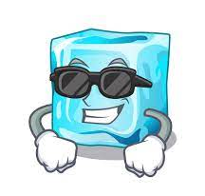
supercool super + cool = supercool

Slide 245
supercool super + cool = supercool
(noun)
Definition – extremely cold

Slide 246
The broadband connection was superfast.

Slide 247
The broadband connection was _________.

Slide 248
The broadband connection was superfast.

Slide 249
The band was happy to have a superfan.

Slide 250
The band was happy to have a ________.

Slide 251
The band was happy to have a superfan.

Slide 252
The liquid was supercool.

Slide 253
The liquid was _________.

Slide 254
The liquid was supercool.

Slide 255
New CHALLENGE words.

Slide 256
busy

Slide 257
busy
The busy shop opened early for Christmas.

Slide 258
busy
The busy shop opened early for Christmas.

Slide 259
The busy shop opened early for Christmas.

Slide 260
The ____ shop opened early for Christmas.

Slide 261
The busy shop opened early for Christmas.

Slide 262
early

Slide 263
early
The busy shop opened early for Christmas.

Slide 264
early
The busy shop opened early for Christmas.

Slide 265
The busy shop opened early for Christmas.

Slide 266
The busy shop opened _____ for Christmas.

Slide 267
The busy shop opened early for Christmas.

Slide 268
Let’s Practise and Apply.

Slide 269
Can you spot the spelling rule words and the challenge words?

Slide 270
Climate change has often been blamed for natural disasters. Rising sea levels interfere with children’s lives. The intermediate effect is flooding that can sweep away homes, hospitals and schools. International aid supports in different countries to help build homes after a disaster has hit. People are becoming supercharged to help each other after a natural disaster has hit.

Slide 271
Climate change has often been blamed for natural disasters. Rising sea levels interfere with children’s lives. The intermediate effect is flooding that can sweep away homes, hospitals and schools. International aid supports in different countries to help build homes after a disaster has hit. People are becoming supercharged to help each other after a natural disaster has hit.

Slide 272
Write this sentence as I dictate it to you.
Notes:
People are becoming supercharged to help each other after a natural disaster has hit.

Slide 273
People are becoming supercharged to help each other after a natural disaster has hit.
Did you write it correctly?
Edit your work and make sure you have it correct.
Can you underline the spelling word that we have covered in this session?

Slide 274
Year 3 - Autumn 2
Week 4 - Friday
Notes:
Click through the slides for all the R+R words for the week (both the focus and the challenge words)
Click through the slides for all the new learning this week

Slide 276
Old challenge words…

Slide 277
often

Slide 278
build

Slide 279
Old spelling rule words…

Slide 280
girl’s

Slide 281
man’s

Slide 282
child’s

Slide 283
woman’s

Slide 284
school’s

Slide 285
dog’s

Slide 286
teacher’s

Slide 287
boy’s

Slide 288
New spelling rule words…

Slide 289
interact

Slide 290
interfere

Slide 291
intercity

Slide 292
international

Slide 293
intermediate

Slide 294
internet

Slide 295
superman

Slide 296
supercharged

Slide 297
supernatural

Slide 298
superfast

Slide 299
superfan

Slide 300
supercool

Slide 301
New challenge words…

Slide 302
busy

Slide 303
early

Slide 304
Quick Quiz time…
Notes:
Say these words for the quiz
Child’s school’s busy early often build supernatural superfast international interact

Slide 305
Did you get them correct?
Edit your work.
child’s school’s busy early often build supernatural superfast international interact

Slide 306
Word class time…

Slide 307
The busy shop opened early at Christmas.
Notes:
Ask for these words to be classed

Slide 308
The busy shop opened early at Christmas.
determiner adjective noun verb adverb preposition noun
Notes:
Ask for these words to be classed

Slide 309
The busy shop opened early at Christmas.
determiner adjective noun verb adverb preposition noun
Notes:
Ask for these words to be classed

Slide 310
The busy shop opened early at Christmas.
determiner adjective noun verb adverb preposition noun
Notes:
Ask for these words to be classed

Slide 311
Etymology
The history of a word….

Slide 312
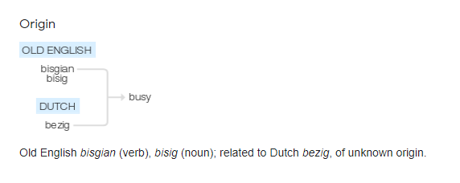
busy (adj.)
Old English bisig "careful, anxious," later "continually employed or occupied, in constant or energetic action" cognate with Old Dutch bezich, Low German besig, but having no known connection with any other Germanic or Indo-European language. Still pronounced as in Middle English, but for some unclear reason the spelling shifted to -u- in 15c.
The notion of "anxiousness" has drained from the word since Middle English. Often in a bad sense in early Modern English, "prying, meddlesome, active in that which does not concern one" (preserved in busybody)

Slide 313
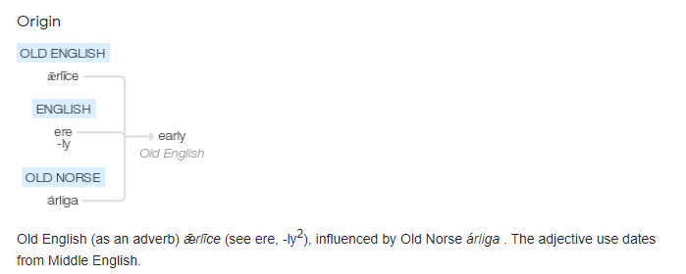
early (adv.)
Old English ærlice "early, near the initial point of some reckoning in time," from ær "soon, ere" (see ere) + -lice, adverbial suffix (see -ly (2)). Compare Old Norse arliga "early." The adjective is Old English ærlic. The early bird of the proverb is from 1670s. Related: Earlier; earliest.

Slide 314
Let’s investigate….
How many synonyms can you find for busy?
You can look at busy being ‘active’ or ‘decorated excessively’

Slide 315
Synonyms for busy (active)…
* occupied (in) · engaged in · involved in · employed in · working at · labouring at · toiling at · slaving at · hard at work (on) · wrapped up (in/with) · rushed off one's feet (with) · hard-pressed · time-poor · at work (on) · on the job · absorbed in · engrossed in · immersed in · preoccupied with · active (in) · lively · industrious · bustling · energetic · tireless · have one's hands full

Slide 316
Synonyms for busy
(excessively decorated)…
excessively ornate · over-ornate · over-elaborate · over-embellished · overdecorated · overblown · overripe · overwrought · exaggerated · overdone · florid · fussy · cluttered · contrived · overworked · over-detailed · strained · laboured · baroque · rococo

