Slide 1
Spelling Y3
Mastering spellings: building on the foundations of phonics
Autumn 2
Week 5

Slide 2
Year 3 - Autumn 2
Week 5 - Monday
Notes:
Revisit and review the words from Y2 and challenge words – I say, we say, you say
Ask children to write words only in their spelling book
Introduce the new spelling rule
Children to write the new spelling rule words and challenge words into books when the sentences are shown with the spelling word missing.
Read the extract with the class as choral reading. Practise model of prosody etc.
Ask children to find the spelling words from the session in the text.
Then read allowed the chosen sentence for children to write fully in their books.
Show the extract and ask children to then edit their work to check they were correct in their dictation.

Slide 3
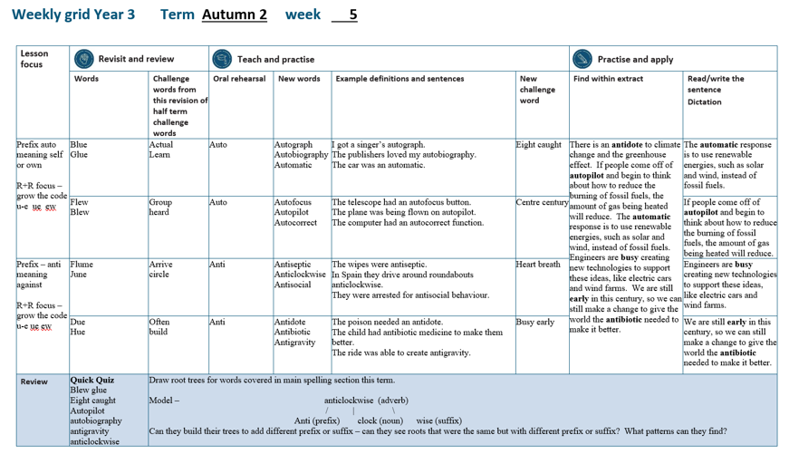

Slide 4
Let’s Revisit and Review…

Slide 5
Do you remember this challenge word?

Slide 6
actual

Slide 7
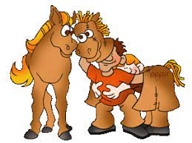
actual
(adjective)
Definition – real

Slide 8
actual
The actual horse was confused by the pantomime one.

Slide 9
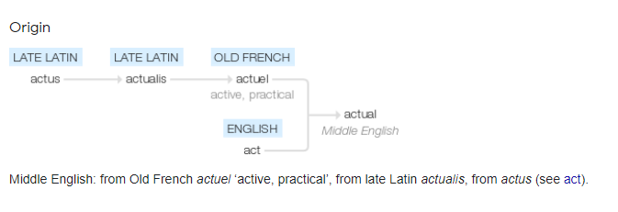

Slide 10
Do you remember this challenge word?

Slide 11
learn

Slide 12

learn
(verb)
Definition – gain knowledge or skill

Slide 13
learn
Everyone loves to learn new things.

Slide 14
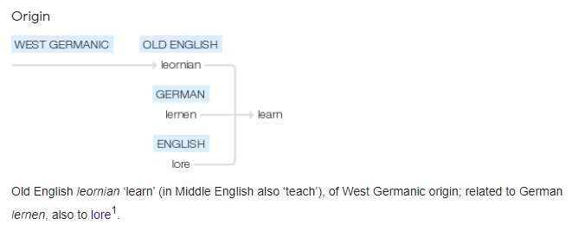

Slide 15
Can you remember this spelling rule?

Slide 16
Words ending
-ew ue u_e

Slide 17
-ue
Notes:
Sound of aI

Slide 18
blue

Slide 19
blue

Slide 20

blue

Slide 21
glue

Slide 22
glue

Slide 23
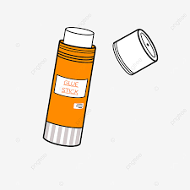
glue

Slide 24
Let’s Teach and Practise

Slide 25
The prefix auto-

Slide 26
auto -

Slide 27
auto - meaning self or own

Slide 28
auto - meaning self or own
The prefix auto- can be added to most root words without changes.

Slide 29
autograph

Slide 30
autograph

Slide 31
autobiography

Slide 32
autobiography

Slide 33
automatic

Slide 34
automatic

Slide 35
autograph

Slide 36
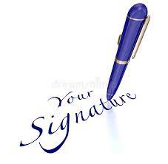
autograph auto + graph = autograph

Slide 37
autograph auto + graph = autograph
(noun)
Definition – someone signing their name

Slide 38
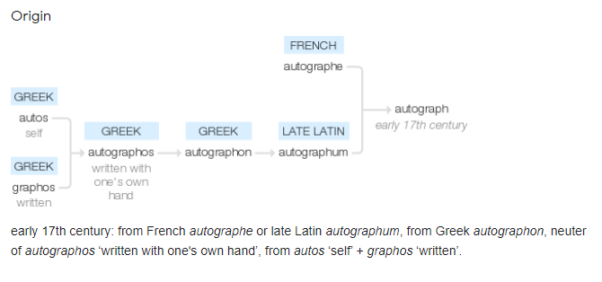

Slide 39
autobiography

Slide 40

autobiography auto + biography = autobiography

Slide 41
autobiography auto + biography = autobiography
(noun)
Definition – an account of a person's life written by that person.

Slide 42
automatic

Slide 43
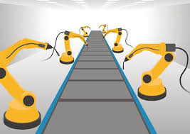
automatic auto + matic = automatic

Slide 44
automatic auto + matic = automatic
(adjective)
Definition – device working by itself

Slide 45
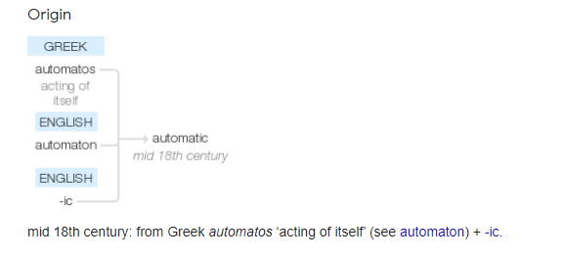

Slide 46
I got a singer’s autograph.

Slide 47
I got a singer’s _________.

Slide 48
I got a singer’s autograph.

Slide 49
The publisher loved my autobiography.

Slide 50
The publisher loved my _____________.

Slide 51
The publisher loved my autobiography.

Slide 52
The car was an automatic.

Slide 53
The car was an _________.

Slide 54
The car was an automatic.

Slide 55
New CHALLENGE words.

Slide 56
eight

Slide 57
eight
The number after seven is eight.

Slide 58

eight
The number after seven is eight.

Slide 59
The number after seven is eight.

Slide 60
The number after seven is _____.

Slide 61
The number after seven is eight.

Slide 62
caught

Slide 63
caught
The spider caught the fly.

Slide 64
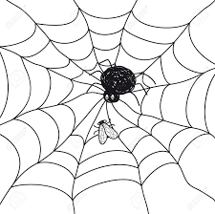
caught
The spider caught the fly.

Slide 65
The spider caught the fly.

Slide 66
The spider ______ the fly.

Slide 67
The spider caught the fly.

Slide 68
Let’s Practise and Apply.

Slide 69
Can you spot the spelling rule words and the challenge words?

Slide 70
There is an antidote to climate change and the greenhouse effect. If people come off of autopilot and begin to think about how to reduce the burning of fossil fuels, the amount of gas being heated will reduce. The automatic response is to use renewable energies, such as solar and wind, instead of fossil fuels. Engineers are busy creating new technologies to support these ideas, like electric cars and wind farms. We are still early in this century, so we can still make a change to give the world the antibiotic needed to make it better.

Slide 71
There is an antidote to climate change and the greenhouse effect. If people come off of autopilot and begin to think about how to reduce the burning of fossil fuels, the amount of gas being heated will reduce. The automatic response is to use renewable energies, such as solar and wind, instead of fossil fuels. Engineers are busy creating new technologies to support these ideas, like electric cars and wind farms. We are still early in this century, so we can still make a change to give the world the antibiotic needed to make it better.

Slide 72
There is an antidote to climate change and the greenhouse effect. If people come off of autopilot and begin to think about how to reduce the burning of fossil fuels, the amount of gas being heated will reduce. The automatic response is to use renewable energies, such as solar and wind, instead of fossil fuels. Engineers are busy creating new technologies to support these ideas, like electric cars and wind farms. We are still early in this century, so we can still make a change to give the world the antibiotic needed to make it better.
Notes:
Highlighted are other words that have been covered this term.

Slide 73
Write this sentence as I dictate it to you.
Notes:
The automatic response is to use renewable energies, such as solar and wind, instead of fossil fuels.

Slide 74
The automatic response is to use renewable energies, such as solar and wind, instead of fossil fuels.
Did you write it correctly?
Edit your work and make sure you have it correct.
Can you underline the spelling word that we have covered in this session?

Slide 75
Year 3 - Autumn 2
Week 5 - Tuesday
Notes:
Revisit and review the words from Y2 and challenge words – I say, we say, you say
Ask children to write words only in their spelling book
Introduce the new spelling rule
Children to write the new spelling rule words and challenge words into books when the sentences are shown with the spelling word missing.
Read the extract with the class as choral reading. Practise model of prosody etc.
Ask children to find the spelling words from the session in the text.
Then read allowed the chosen sentence for children to write fully in their books.
Show the extract and ask children to then edit their work to check they were correct in their dictation.

Slide 77
Let’s Revisit and Review…

Slide 78
Do you remember this challenge word?

Slide 79
actual

Slide 80
actual
(adjective)
Definition – real

Slide 81
actual
The actual horse was confused by the pantomime one.

Slide 83
Do you remember this challenge word?

Slide 84
learn

Slide 85
learn
(verb)
Definition – gain knowledge or skill

Slide 86
learn
Everyone loves to learn new things.

Slide 88
Can you remember this spelling rule?

Slide 89
Words ending
-ew ue u_e

Slide 90
-ew
Notes:
Sound of aI

Slide 91
flew

Slide 92
flew

Slide 93
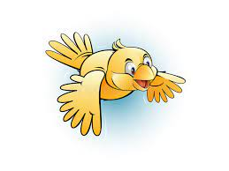
flew

Slide 94
blew

Slide 95
blew

Slide 96
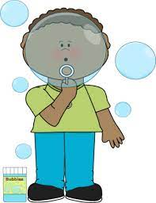
blew

Slide 97
Let’s Teach and Practise

Slide 98
The prefix auto-

Slide 99
auto -

Slide 100
auto - meaning self or own

Slide 101
auto - meaning self or own
The prefix auto- can be added to most root words without changes.

Slide 102
autofocus

Slide 103
autofocus

Slide 104
autopilot

Slide 105
autopilot

Slide 106
autocorrect

Slide 107
autocorrect

Slide 108
autofocus

Slide 109
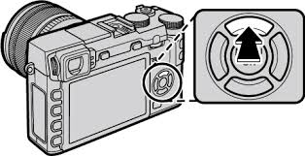
autofocus auto + focus = autofocus

Slide 110
autofocus auto + focus = autofocus
(noun)
Definition – device to focus a camera so it is not blurry

Slide 111
autopilot

Slide 112
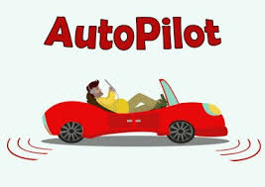
autopilot auto + pilot = autopilot

Slide 113
autopilot auto + pilot = autopilot
(noun)
Definition – device control the direction and speed of a vehicle

Slide 114
autocorrect

Slide 115

autocorrect auto + correct = autocorrect

Slide 116
autocorrect auto + correct = autocorrect
(verb)
Definition – changing text to make sure it is right

Slide 117
The telescope had an autofocus button.

Slide 118
The telescope had an _________ button.

Slide 119
The telescope had an autofocus button.

Slide 120
The plane was being flown on autopilot.

Slide 121
The plane was being flown on _________.

Slide 122
The plane was being flown on autopilot.

Slide 123
The computer had an autocorrect function.

Slide 124
The computer had an ___________ function.

Slide 125
The computer had an autocorrect function.

Slide 126
New CHALLENGE words.

Slide 127
eight

Slide 128
eight
The number after seven is eight.

Slide 129
eight
The number after seven is eight.

Slide 130
The number after seven is eight.

Slide 131
The number after seven is _____.

Slide 132
The number after seven is eight.

Slide 133
caught

Slide 134
caught
The spider caught the fly.

Slide 135
caught
The spider caught the fly.

Slide 136
The spider caught the fly.

Slide 137
The spider ______ the fly.

Slide 138
The spider caught the fly.

Slide 139
Let’s Practise and Apply.

Slide 140
Can you spot the spelling rule words and the challenge words?

Slide 141
There is an antidote to climate change and the greenhouse effect. If people come off of autopilot and begin to think about how to reduce the burning of fossil fuels, the amount of gas being heated will reduce. The automatic response is to use renewable energies, such as solar and wind, instead of fossil fuels. Engineers are busy creating new technologies to support these ideas, like electric cars and wind farms. We are still early in this century, so we can still make a change to give the world the antibiotic needed to make it better.

Slide 142
There is an antidote to climate change and the greenhouse effect. If people come off of autopilot and begin to think about how to reduce the burning of fossil fuels, the amount of gas being heated will reduce. The automatic response is to use renewable energies, such as solar and wind, instead of fossil fuels. Engineers are busy creating new technologies to support these ideas, like electric cars and wind farms. We are still early in this century, so we can still make a change to give the world the antibiotic needed to make it better.

Slide 143
There is an antidote to climate change and the greenhouse effect. If people come off of autopilot and begin to think about how to reduce the burning of fossil fuels, the amount of gas being heated will reduce. The automatic response is to use renewable energies, such as solar and wind, instead of fossil fuels. Engineers are busy creating new technologies to support these ideas, like electric cars and wind farms. We are still early in this century, so we can still make a change to give the world the antibiotic needed to make it better.
Notes:
Highlighted are other words that have been covered this term.

Slide 144
Write this sentence as I dictate it to you.
Notes:
If people come off of autopilot and begin to think about how to reduce the burning of fossil fuels, the amount of gas being heated will reduce.

Slide 145
If people come off of autopilot and begin to think about how to reduce the burning of fossil fuels, the amount of gas being heated will reduce.
Did you write it correctly?
Edit your work and make sure you have it correct.
Can you underline the spelling word that we have covered in this session?

Slide 146
Year 3 - Autumn 2
Week 5 - Wednesday
Notes:
Revisit and review the words from Y2 and challenge words – I say, we say, you say
Ask children to write words only in their spelling book
Introduce the new spelling rule
Children to write the new spelling rule words and challenge words into books when the sentences are shown with the spelling word missing.
Read the extract with the class as choral reading. Practise model of prosody etc.
Ask children to find the spelling words from the session in the text.
Then read allowed the chosen sentence for children to write fully in their books.
Show the extract and ask children to then edit their work to check they were correct in their dictation.

Slide 148
Let’s Revisit and Review…

Slide 149
Do you remember this challenge word?

Slide 150
actual

Slide 151
actual
(adjective)
Definition – real

Slide 152
actual
The actual horse was confused by the pantomime one.

Slide 154
Do you remember this challenge word?

Slide 155
learn

Slide 156
learn
(verb)
Definition – gain knowledge or skill

Slide 157
learn
Everyone loves to learn new things.

Slide 159
Can you remember this spelling rule?

Slide 160
Words ending
-ew ue u_e

Slide 161
- u_e
Notes:
Sound of aI

Slide 162
flume

Slide 163
flume

Slide 164
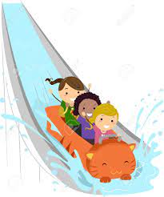
flume

Slide 165
June

Slide 166
June

Slide 167
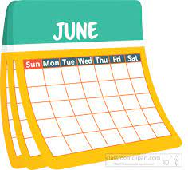
June

Slide 168
Let’s Teach and Practise

Slide 169
The prefix anti-

Slide 170
anti -

Slide 171
anti - meaning against

Slide 172
auto - meaning against
The prefix anti- can be added to most root words without changes.

Slide 173
antiseptic

Slide 174
antiseptic

Slide 175
anticlockwise

Slide 176
anticlockwise

Slide 177
antisocial

Slide 178
antisocial

Slide 179
antiseptic

Slide 180
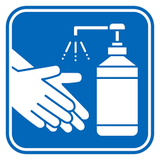
antiseptic anti + septic = antiseptic

Slide 181
antiseptic anti + septic = antiseptic
(adjective)
Definition – killing diseases

Slide 182
anticlockwise

Slide 183

anticlockwise anti + clockwise = anticlockwise

Slide 184
anticlockwise anti + clockwise = anticlockwise
(adverb)
Definition – moving against the way a clock goes

Slide 185
antisocial

Slide 186
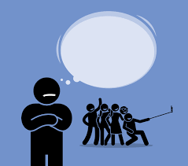
antisocial anti + social = antisocial

Slide 187
antisocial anti + social = antisocial
(adjective)
Definition – not wanting to be with others

Slide 188
The wipes were antiseptic.

Slide 189
The wipes were __________.

Slide 190
The wipes were antiseptic.

Slide 191
In Spain, they drive around roundabouts anticlockwise.

Slide 192
In Spain, they drive around roundabouts _____________.

Slide 193
In Spain, they drive around roundabouts anticlockwise.

Slide 194
They were arrested for extreme antisocial behaviour.

Slide 195
They were arrested for extreme __________ behaviour.

Slide 196
They were arrested for extreme antisocial behaviour.

Slide 197
New CHALLENGE words.

Slide 198
eight

Slide 199
eight
The number after seven is eight.

Slide 200
eight
The number after seven is eight.

Slide 201
The number after seven is eight.

Slide 202
The number after seven is _____.

Slide 203
The number after seven is eight.

Slide 204
caught

Slide 205
caught
The spider caught the fly.

Slide 206
caught
The spider caught the fly.

Slide 207
The spider caught the fly.

Slide 208
The spider ______ the fly.

Slide 209
The spider caught the fly.

Slide 210
Let’s Practise and Apply.

Slide 211
Can you spot the spelling rule words and the challenge words?

Slide 212
There is an antidote to climate change and the greenhouse effect. If people come off of autopilot and begin to think about how to reduce the burning of fossil fuels, the amount of gas being heated will reduce. The automatic response is to use renewable energies, such as solar and wind, instead of fossil fuels. Engineers are busy creating new technologies to support these ideas, like electric cars and wind farms. We are still early in this century, so we can still make a change to give the world the antibiotic needed to make it better.

Slide 213
There is an antidote to climate change and the greenhouse effect. If people come off of autopilot and begin to think about how to reduce the burning of fossil fuels, the amount of gas being heated will reduce. The automatic response is to use renewable energies, such as solar and wind, instead of fossil fuels. Engineers are busy creating new technologies to support these ideas, like electric cars and wind farms. We are still early in this century, so we can still make a change to give the world the antibiotic needed to make it better.

Slide 214
There is an antidote to climate change and the greenhouse effect. If people come off of autopilot and begin to think about how to reduce the burning of fossil fuels, the amount of gas being heated will reduce. The automatic response is to use renewable energies, such as solar and wind, instead of fossil fuels. Engineers are busy creating new technologies to support these ideas, like electric cars and wind farms. We are still early in this century, so we can still make a change to give the world the antibiotic needed to make it better.
Notes:
Highlighted are other words that have been covered this term.

Slide 215
Write this sentence as I dictate it to you.
Notes:
Engineers are busy creating new technologies to support these ideas, like electric cars and wind farms.

Slide 216
Engineers are busy creating new technologies to support these ideas, like electric cars and wind farms.
Did you write it correctly?
Edit your work and make sure you have it correct.
Can you underline the spelling word that we have covered in this session?

Slide 217
Year 3 - Autumn 2
Week 5 - Thursday
Notes:
Revisit and review the words from Y2 and challenge words – I say, we say, you say
Ask children to write words only in their spelling book
Introduce the new spelling rule
Children to write the new spelling rule words and challenge words into books when the sentences are shown with the spelling word missing.
Read the extract with the class as choral reading. Practise model of prosody etc.
Ask children to find the spelling words from the session in the text.
Then read allowed the chosen sentence for children to write fully in their books.
Show the extract and ask children to then edit their work to check they were correct in their dictation.

Slide 219
Let’s Revisit and Review…

Slide 220
Do you remember this challenge word?

Slide 221
actual

Slide 222
actual
(adjective)
Definition – real

Slide 223
actual
The actual horse was confused by the pantomime one.

Slide 225
Do you remember this challenge word?

Slide 226
learn

Slide 227
learn
(verb)
Definition – gain knowledge or skill

Slide 228
learn
Everyone loves to learn new things.

Slide 230
Can you remember this spelling rule?

Slide 231
Words ending
-ew ue u_e

Slide 232
-ue
Notes:
Sound of aI

Slide 233
due

Slide 234
due

Slide 235

due

Slide 236
hue

Slide 237
hue

Slide 238
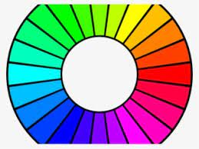
hue

Slide 239
Let’s Teach and Practise

Slide 240
anti -

Slide 241
anti - meaning against

Slide 242
auto - meaning against
The prefix anti- can be added to most root words without changes.

Slide 243
antidote

Slide 244
antidote

Slide 245
antibiotic

Slide 246
antibiotic

Slide 247
antigravity

Slide 248
antigravity

Slide 249
antidote

Slide 250
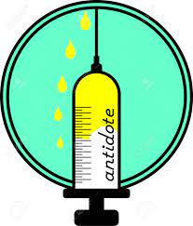
antidote anti + dote = antidote

Slide 251
antidote anti + dote = antidote
(noun)
Definition – medicine to counteract a particular poison

Slide 252
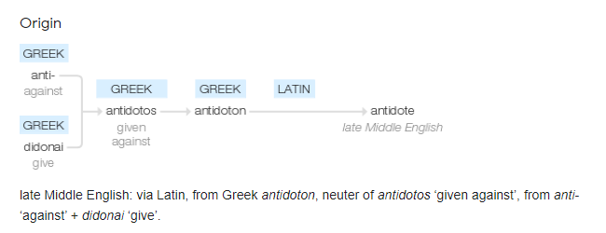

Slide 253
antibiotic

Slide 254
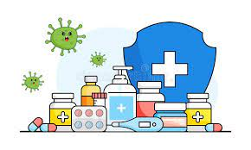
antibiotic anti + biotic = antibiotic

Slide 255
antibiotic anti + biotic = antibiotic
(noun)
Definition – medicine that kills microorganisms

Slide 256
antigravity

Slide 257
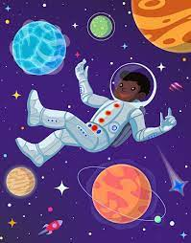
antigravity anti + gravity = antigravity

Slide 258
antigravity anti + gravity = antigravity
(noun)
Definition – a force working against gravity

Slide 259
The poison needed an antidote.

Slide 260
The poison needed an ________.

Slide 261
The poison needed an antidote.

Slide 262
The child had antibiotics to make them feel better.

Slide 263
The child had ___________ to make them feel better.

Slide 264
The child had antibiotics to make them feel better.

Slide 265
The ride was able to create antigravity.

Slide 266
The ride was able to create ___________.

Slide 267
The ride was able to create antigravity.

Slide 268
New CHALLENGE words.

Slide 269
eight

Slide 270
eight
The number after seven is eight.

Slide 271
eight
The number after seven is eight.

Slide 272
The number after seven is eight.

Slide 273
The number after seven is _____.

Slide 274
The number after seven is eight.

Slide 275
caught

Slide 276
caught
The spider caught the fly.

Slide 277
caught
The spider caught the fly.

Slide 278
The spider caught the fly.

Slide 279
The spider ______ the fly.

Slide 280
The spider caught the fly.

Slide 281
Let’s Practise and Apply.

Slide 282
Can you spot the spelling rule words and the challenge words?

Slide 283
There is an antidote to climate change and the greenhouse effect. If people come off of autopilot and begin to think about how to reduce the burning of fossil fuels, the amount of gas being heated will reduce. The automatic response is to use renewable energies, such as solar and wind, instead of fossil fuels. Engineers are busy creating new technologies to support these ideas, like electric cars and wind farms. We are still early in this century, so we can still make a change to give the world the antibiotic needed to make it better.

Slide 284
There is an antidote to climate change and the greenhouse effect. If people come off of autopilot and begin to think about how to reduce the burning of fossil fuels, the amount of gas being heated will reduce. The automatic response is to use renewable energies, such as solar and wind, instead of fossil fuels. Engineers are busy creating new technologies to support these ideas, like electric cars and wind farms. We are still early in this century, so we can still make a change to give the world the antibiotic needed to make it better.

Slide 285
There is an antidote to climate change and the greenhouse effect. If people come off of autopilot and begin to think about how to reduce the burning of fossil fuels, the amount of gas being heated will reduce. The automatic response is to use renewable energies, such as solar and wind, instead of fossil fuels. Engineers are busy creating new technologies to support these ideas, like electric cars and wind farms. We are still early in this century, so we can still make a change to give the world the antibiotic needed to make it better.
Notes:
Highlighted are other words that have been covered this term.

Slide 286
Write this sentence as I dictate it to you.
Notes:
We are still early in this century, so we can still make a change to give the world the antibiotic needed to make it better.

Slide 287
We are still early in this century, so we can still make a change to give the world the antibiotic needed to make it better.
Did you write it correctly?
Edit your work and make sure you have it correct.
Can you underline the spelling word that we have covered in this session?

Slide 288
Year 3 - Autumn 2
Week 5 - Friday
Notes:
Click through the slides for all the R+R words for the week (both the focus and the challenge words)
Click through the slides for all the new learning this week

Slide 290
Old challenge words…

Slide 291
actual

Slide 292
learn

Slide 293
Old spelling rule words…

Slide 294
blue

Slide 295
glue

Slide 296
flew

Slide 297
blew

Slide 298
flume

Slide 299
June

Slide 300
due

Slide 301
hue

Slide 302
New spelling rule words…

Slide 303
autograph

Slide 304
autobiography

Slide 305
automatic

Slide 306
autofocus

Slide 307
autopilot

Slide 308
autocorrect

Slide 309
antiseptic

Slide 310
anticlockwise

Slide 311
antisocial

Slide 312
antidote

Slide 313
antibiotic

Slide 314
antigravity

Slide 315
New challenge words…

Slide 316
eight

Slide 317
caught

Slide 318
Quick Quiz time…
Notes:
Say these words for the quiz
Blew glue eight caught actual learn autopilot autobiography antigravity anticlockwise

Slide 319
Did you get them correct?
Edit your work.
blew glue eight caught actual learn autopilot autobiography antigravity anticlockwise

Slide 320
Word Trees time…

Slide 321
anticlockwise
Notes:
Ask for these words to be classed

Slide 322
anticlockwise
(adverb)
Notes:
Ask for these words to be classed

Slide 323
anticlockwise
(adverb)
anti (prefix)
Notes:
Ask for these words to be classed

Slide 324
anticlockwise
(adverb)
anti (prefix)
clock (noun)
Notes:
Ask for these words to be classed

Slide 325
anticlockwise
(adverb)
anti (prefix) wise (suffix)
clock (noun)
Notes:
Ask for these words to be classed

Slide 326
anticlockwise
(adverb)
anti (prefix) wise (suffix)
clock (noun)
Notes:
Ask for these words to be classed

Slide 327
anticlockwise
(adverb)
anti (prefix) wise (suffix)
clock (noun)
Notes:
Ask for these words to be classed

Slide 328
anticlockwise
(adverb)
anti (prefix) wise (suffix)
clock (noun)
Notes:
Ask for these words to be classed

Slide 329
Here is a word tree for anticlockwise.
Can you create some trees using other root words using this weeks prefixes ‘auto’ and ‘anti’?
anticlockwise
(adverb)
anti (prefix) wise (suffix)
clock (noun)
Notes:
Ask for these words to be classed

Slide 330
autocorrection
auto (prefix) tion (suffix)
correct (noun)
Notes:
Ask for these words to be classed

