Slide 1
Spelling Y3
Mastering spellings: building on the foundations of phonics
Autumn 2
Week 6

Slide 2
Year 3 - Autumn 2
Week 6 - Monday
Notes:
Week 6 is a revisit and review week of the half term.
Each day revisits learning from one of the weeks in the half term.
Go through the words as a recap – explain the teaching rule again and children to write words that are missing from sentences into their books.
The main chunk of the lesson is to investigate and detect.
Sentences are given with the spellings from the session misspelt. Children to correct the spellings and explain where the sentence spellings went wrong and how they would support someone to get it right the next time.

Slide 3
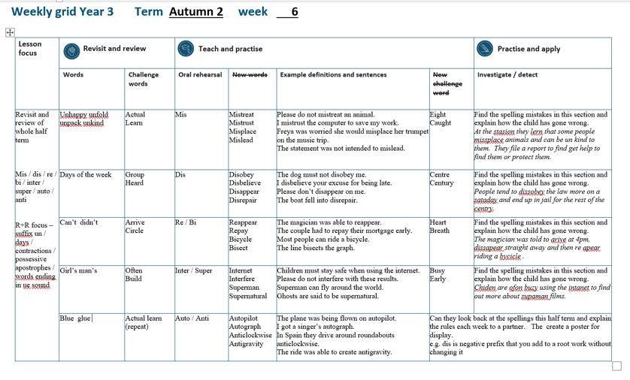

Slide 4
Revisit and Review of A2 Week 1

Slide 5
Challenge words

Slide 6
actual

Slide 7
actual
Definition - real

Slide 8
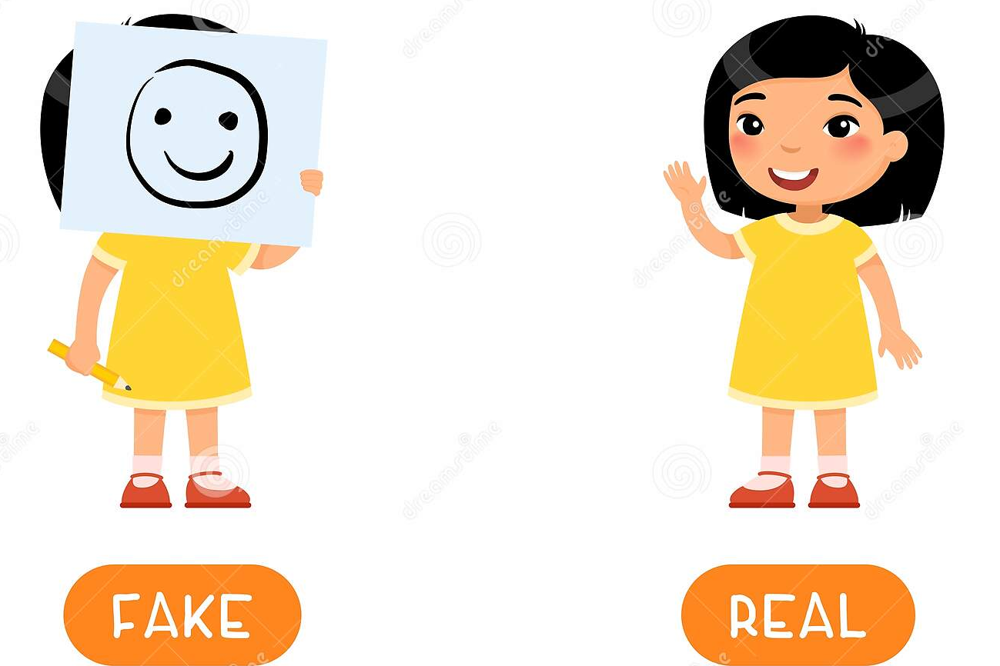
actual
My mum says I behave like an 80 year old, but my actual age is 7.

Slide 9
Do you remember this challenge word?

Slide 10
learn

Slide 11
learn
Definition - to gain knowledge

Slide 12
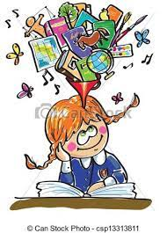
learn
I love to learn my spellings.

Slide 13
The prefix un-

Slide 14
un

Slide 15
un- means
‘not’
‘opposite’

Slide 16
un + root

Slide 17
unhappy

Slide 18
unhappy

Slide 19

unhappy

Slide 20
unfold

Slide 21
unfold

Slide 22
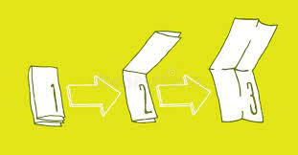
unfold

Slide 23
unpack

Slide 24
unpack

Slide 25

unpack

Slide 26
unkind

Slide 27
unkind

Slide 28
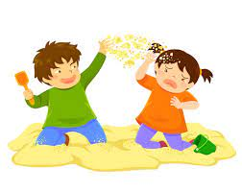
unkind

Slide 29
The prefix mis-

Slide 30
mis-

Slide 31
mis- means
‘not’
‘opposite’
Notes:
Just like ‘un’

Slide 32
mistreat

Slide 33
mistreat

Slide 34
mistreat

Slide 35

mistreat mis + treat = mistreat

Slide 36
mistreat mis + treat = mistreat
Definition – to treat a person badly

Slide 37
Please do not mistreat an animal.

Slide 38
Please do not ________ an animal.

Slide 39
Please do not mistreat an animal.

Slide 40
mistrust

Slide 41
mistrust n

Slide 42
mistrust

Slide 43

mistrust mis + trust = mistrust

Slide 44
mistrust mis + trust = mistrust
Definition – not trusting

Slide 45
I mistrust the computer to save my work.

Slide 46
I ________ the computer to save my work.

Slide 47
I mistrust the computer to save my work.

Slide 48
misplace

Slide 49
misplace n

Slide 50
misplace

Slide 51
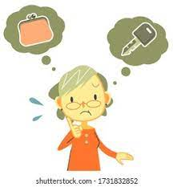
misplace mis + place = misplace

Slide 52
misplace mis + place = misplace
Definition – put an object in the wrong place

Slide 53
Freya was worried she would misplace her trumpet on the music trip.

Slide 54
Freya was worried she would ________ her trumpet on the music trip.

Slide 55
Freya was worried she would misplace her trumpet on the music trip.

Slide 56
mislead

Slide 57
mislead

Slide 58
mislead

Slide 59

mislead mis + lead = mislead

Slide 60
mislead mis + lead = mislead
Definition – have a wrong idea

Slide 61
The statement was not intended to mislead.

Slide 62
The statement was not intended to _______.

Slide 63
The statement was not intended to mislead.

Slide 64
Challenge words

Slide 65
eight

Slide 66
eight
The number eight is one more than seven.

Slide 67

eight
The number eight is one more than seven.

Slide 68
The number _____ is one more than seven.

Slide 69
The number eight is one more than seven.

Slide 70
caught

Slide 71
caught
The fish he caught was huge.

Slide 72
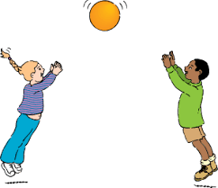
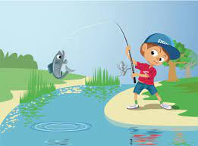
caught
The fish he caught was huge.

Slide 73
The fish he ______ was huge.

Slide 74
The fish he caught was huge.

Slide 75
Let’s investigate and detect…

Slide 76
Look at this sentence.
Change the spellings that are incorrect.
Explain how each one is wrong and how to remember to get it right next time.
At the police stasion they lern that some people missplace animals and can be un kind to them. A report is filed to help find them or protect them.

Slide 77
At the police stasion they lern that some people missplace animals and can be un kind to them. station – tion not sion

Slide 78
At the police stasion they lern that some people missplace animals and can be un kind to them. learn – a missing challenge word

Slide 79
At the police stasion they lern that some people missplace animals and can be un kind to them. misplace – added an s mis + place = misplace

Slide 80
At the police stasion they lern that some people missplace animals and can be un kind to them. unkind – not connected un + kind = unkind

Slide 81
At the police stasion they lern that some people missplace animals and can be un kind to them. unkind – not connected un + kind = unkind

Slide 82
At the police station they learn that some people misplace animals and can be unkind to them. A report is filed to help find them or protect them.

Slide 83
Year 3 - Autumn 2
Week 6 - Tuesday
Notes:
Week 6 is a revisit and review week of the half term.
Each day revisits learning from one of the weeks in the half term.
Go through the words as a recap – explain the teaching rule again and children to write words that are missing from sentences into their books.
The main chunk of the lesson is to investigate and detect.
Sentences are given with the spellings from the session misspelt. Children to correct the spellings and explain where the sentence spellings went wrong and how they would support someone to get it right the next time.

Slide 85
Revisit and Review of A2 Week 2

Slide 86
Challenge words

Slide 87
Let’s Revisit and Review…

Slide 88
Do you remember this challenge word?

Slide 89
Do you remember this challenge word?

Slide 90
group

Slide 91
group
Definition – a number of people or things together

Slide 92
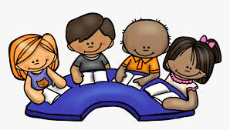
group
The group were excited to read together.

Slide 93
Do you remember this challenge word?

Slide 94
heard

Slide 95
heard
Definition – used ears to perceive sounds

Slide 96

heard
The audience heard a beautiful song.

Slide 97
Days of the week

Slide 98
Monday

Slide 99
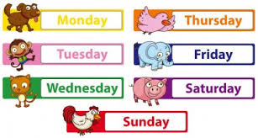
Monday

Slide 100
Tuesday

Slide 101
Tuesday

Slide 102
Wednesday

Slide 103
Wednesday

Slide 104
Thursday

Slide 105
Thursday

Slide 106
Friday

Slide 107
Friday

Slide 108
Saturday

Slide 109
Saturday

Slide 110
Sunday

Slide 111
Sunday

Slide 112
The prefix dis-

Slide 113
dis-
NOT

Slide 114
The prefixes un–, dis– and mis– have negative meanings.

Slide 115
The prefixes un–, dis– and mis– have negative meanings.
NOT

Slide 116
Most prefixes are added to the beginning of root words without any changes in spelling,

Slide 117
disobey

Slide 118
disobey n

Slide 119
disobey

Slide 120
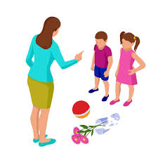
disobey dis + obey = disobey

Slide 121
disobey dis + obey = disobey
(verb)
Definition – not obey

Slide 122
The dog must not disobey me.

Slide 123
The dog must not _______ me.

Slide 124
The dog must not disobey me.

Slide 125
disbelieve

Slide 126
disbelieve n

Slide 127
disbelieve

Slide 128

disbelieve dis + believe = disbelieve

Slide 129
disbelieve dis + believe = disbelieve
(verb)
Definition – not believe

Slide 130
I disbelieve your excuse for being late.

Slide 131
I __________ your excuse for being late.

Slide 132
I disbelieve your excuse for being late.

Slide 133
disappear

Slide 134
disappear n

Slide 135
disappear

Slide 136

disappear dis + appear = disappear

Slide 137
disappear dis + appear = disappear
(verb)
Definition – stop being seen

Slide 138
Please don’t disappear on me.

Slide 139
Please don’t _________ on me.

Slide 140
Please don’t disappear on me.

Slide 141
disrepair

Slide 142
disrepair

Slide 143
disrepair

Slide 144
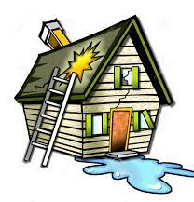
disrepair dis + repair = disrepair

Slide 145
disrepair dis + repair = disrepair
(verb)
Definition – poor and broken condition

Slide 146
The boat fell into disrepair.

Slide 147
The boat fell into _________.

Slide 148
The boat fell into disrepair.

Slide 149
Challenge words

Slide 150
centre

Slide 151
centre
Tom swam at the leisure centre.

Slide 152

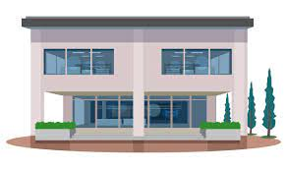
centre
Tom swam at the leisure centre.

Slide 153
Tom swam at the leisure centre.

Slide 154
Tom swam at the leisure ______.

Slide 155
Tom swam at the leisure centre.

Slide 156
century

Slide 157
century
A century is 100 years.

Slide 158

century
A century is 100 years.

Slide 159
A century is 100 years.

Slide 160
A _______ is 100 years.

Slide 161
A century is 100 years.

Slide 162
Let’s investigate and detect…

Slide 163
Look at this sentence.
Change the spellings that are incorrect.
Explain how each one is wrong and how to remember to get it right next time.
People tend to dissobey the law more on a Sataday and end up in jail for the rest of the centry.

Slide 164
People tend to dissobey the law more on a Sataday and end up in jail for the rest of the centry. disobey – one s not two dis + obey = disobey

Slide 165
People tend to dissobey the law more on a Sataday and end up in jail for the rest of the centry.
Saturday – ur not a in the middle u r loving Saturdays!

Slide 166
People tend to dissobey the law more on a Sataday and end up in jail for the rest of the centry. century – missing the u from Latin centuria

Slide 167
People tend to disobey the law more on a Saturday and end up in jail for the rest of the century.

Slide 168
Year 3 - Autumn 2
Week 6 - Wednesday
Notes:
Week 6 is a revisit and review week of the half term.
Each day revisits learning from one of the weeks in the half term.
Go through the words as a recap – explain the teaching rule again and children to write words that are missing from sentences into their books.
The main chunk of the lesson is to investigate and detect.
Sentences are given with the spellings from the session misspelt. Children to correct the spellings and explain where the sentence spellings went wrong and how they would support someone to get it right the next time.

Slide 170
Revisit and Review of A2 Week 3

Slide 171
Challenge words

Slide 172
Do you remember this challenge word?

Slide 173
arrive

Slide 174
arrive
Definition – reach a place at the end of a journey

Slide 175
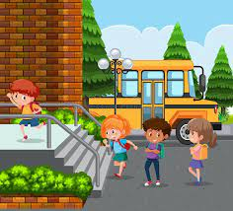
arrive
Definition – reach a place at the end of a journey

Slide 176
Do you remember this challenge word?

Slide 177
circle

Slide 178
circle
Definition – a round 2d shape

Slide 179

circle
Definition – a round 2d shape

Slide 180
Contractions

Slide 181
apostrophe (‘) to show missing letters

Slide 182
can’t

Slide 183
can’t

Slide 184
didn’t

Slide 185
didn’t

Slide 186
Let’s Teach and Practise

Slide 187
The prefix bi-

Slide 188
bi-

Slide 189
bi- meaning two or twice

Slide 190
bi- this prefix can just be added to the root word

Slide 191
bicycle

Slide 192
bicycle

Slide 193
bicycle

Slide 194
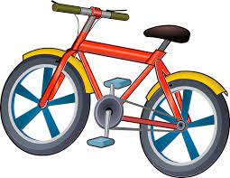
bicycle bi + cycle = bicycle

Slide 195
bicycle bi + cycle = bicycle
(noun)
Definition – a vehicle with two wheels

Slide 196
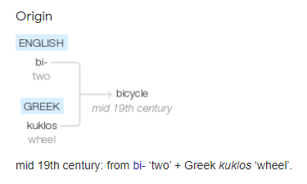

Slide 197
Most people can ride a bicycle.

Slide 198
Most people can ride a _______.

Slide 199
Most people can ride a bicycle.

Slide 200
bisects

Slide 201
bisects

Slide 202
bisects

Slide 203
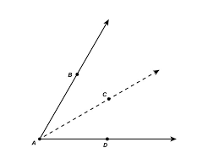
bisects bi + sects = bisects

Slide 204
bisects bi + sects = bisects
(verb)
Definition – divide into two

Slide 205
The line bisects the graph.

Slide 206
The line _______ the graph.

Slide 207
The line bisects the graph.

Slide 208
The prefix re-

Slide 209
re-

Slide 210
re- meaning back or again

Slide 211
re- this prefix can just be added to the root word

Slide 212
reappear

Slide 213
reappear

Slide 214
reappear

Slide 215
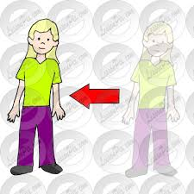
reappear re + appear = reappear

Slide 216
reappear re + appear = reappear
(verb)
Definition – appear again

Slide 217
The magician was able to reappear.

Slide 218
The magician was able to ________.

Slide 219
The magician was able to reappear.

Slide 220
repay

Slide 221
repay

Slide 222
repay

Slide 223
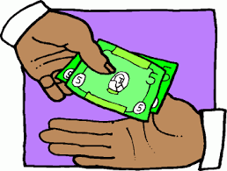
repay re + pay = repay

Slide 224
repay re + pay = repay
(verb)
Definition – pay back

Slide 225
The couple had to repay their mortgage early.

Slide 226
The couple had to _____ their mortgage early.

Slide 227
The couple had to repay their mortgage early.

Slide 228
More CHALLENGE words.

Slide 229
heart

Slide 230
heart
The heart is a muscle.

Slide 231
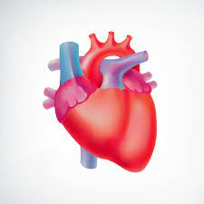
heart
The heart is a muscle.

Slide 232
The heart is a muscle.

Slide 233
The ______ is a muscle.

Slide 234
The heart is a muscle.

Slide 235
breath

Slide 236
breath
Your breath is warm on a window.

Slide 237
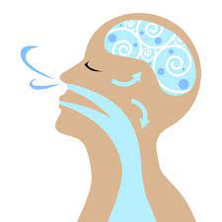
breath
Your breath is warm on a window.

Slide 238
Your breath is warm on a window.

Slide 239
Your ______ is warm on a window.

Slide 240
Your breath is warm on a window.

Slide 241
Let’s investigate and detect…

Slide 242
Look at this sentence.
Change the spellings that are incorrect.
Explain how each one is wrong and how to remember to get it right next time.
The magician was told to arive at 4pm, dissapear straight away and then re apear riding a bycicle.

Slide 243
The magician was told to arive at 4pm, dissapear straight away and then re apear riding a bycicle. arrive – missed an r challenge word

Slide 244
The magician was told to arive at 4pm, dissapear straight away and then re apear riding a bycicle. disappear – only 1 s but double p dis + appear = disappear

Slide 245
The magician was told to arive at 4pm, dissapear straight away and then re apear riding a bycicle. reappear – should be together re + appear = reappear

Slide 246
The magician was told to arive at 4pm, dissapear straight away and then re apear riding a bycicle. bicycle – y and i around the wrong way bi + cycle = bicycle

Slide 247
The magician was told to arrive at 4pm, disappear straight away and then reappear riding a bicycle.

Slide 248
Year 3 - Autumn 1
Week 6 - Thursday
Notes:
Week 6 is a revisit and review week of the half term.
Each day revisits learning from one of the weeks in the half term.
Go through the words as a recap – explain the teaching rule again and children to write words that are missing from sentences into their books.
The main chunk of the lesson is to investigate and detect.
Sentences are given with the spellings from the session misspelt. Children to correct the spellings and explain where the sentence spellings went wrong and how they would support someone to get it right the next time.

Slide 250
Revisit and Review of A2 Week 4

Slide 251
Challenge words

Slide 252
Do you remember this challenge word?

Slide 253
often

Slide 254
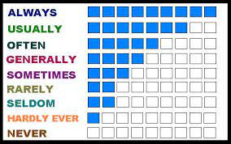
often
(adverb)
Definition – frequency / many times

Slide 255
often
I eat fruit often.

Slide 256
Do you remember this challenge word?

Slide 257
build

Slide 258
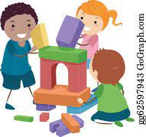
build
(verb)
Definition – make something

Slide 259
build
Together, we can build great things.

Slide 260
Possessive apostrophe

Slide 261
- ’s
Notes:
Sound of aI

Slide 262
Possessive apostrophe
Shows something belonging to someone.

Slide 263
the girl’s shoes

Slide 264
the girl’s shoes

Slide 265
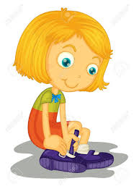
the girl’s shoes

Slide 266
the man’s shoes

Slide 267
the man’s shoes

Slide 268
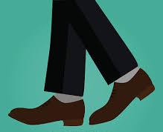
the man’s shoes

Slide 269
The prefix inter-

Slide 270
inter-

Slide 271
inter- meaning between or among.

Slide 272
inter- meaning between or among.
The prefix inter can just be added to a root word.

Slide 273
internet

Slide 274
internet

Slide 275
internet

Slide 276

internet inter + net = internet

Slide 277
internet inter + net = internet
(noun)
Definition – communication between people and places

Slide 278
Children must stay safe when using the internet.

Slide 279
Children must stay safe when using the ________.

Slide 280
Children must stay safe when using the internet.

Slide 281
interfere

Slide 282
interfere

Slide 283
interfere

Slide 284

interfere inter + fere = interfere

Slide 285
interfere inter + fere = interfere
(verb)
Definition – get involved in something without being a part of it

Slide 286
Please do not interfere with these results.

Slide 287
Please do not _________ with these results.

Slide 288
Please do not interfere with these results.

Slide 289
The prefix super-

Slide 290
super-

Slide 291
super- meaning above / best

Slide 292
super- meaning above / best
The prefix super- can just be added to a root word.

Slide 293
superman

Slide 294
superman

Slide 295
superman

Slide 296

superman super + man = superman

Slide 297
superman super + man = superman
(noun)
Definition – a character with great strength

Slide 298
Superman can fly around the world.

Slide 299
_________ can fly around the world.

Slide 300
Superman can fly around the world.

Slide 301
supernatural

Slide 302
supernatural

Slide 303
supernatural

Slide 304
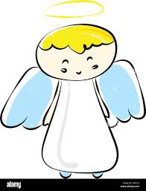
supernatural super + natural = supernatural

Slide 305
supernatural super + natural = supernatural
(noun)
Definition – being not explained by the laws of nature

Slide 306
Ghosts are said to be supernatural.

Slide 307
Ghosts are said to be ____________.

Slide 308
Ghosts are said to be supernatural.

Slide 309
More CHALLENGE words.

Slide 310
busy

Slide 311
busy
The busy shop opened early for Christmas.

Slide 312
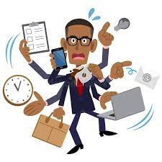
busy
The busy shop opened early for Christmas.

Slide 313
The busy shop opened early for Christmas.

Slide 314
The ____ shop opened early for Christmas.

Slide 315
The busy shop opened early for Christmas.

Slide 316
early

Slide 317
early
The busy shop opened early for Christmas.

Slide 318
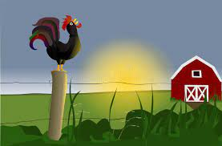
early
The busy shop opened early for Christmas.

Slide 319
The busy shop opened early for Christmas.

Slide 320
The busy shop opened _____ for Christmas.

Slide 321
The busy shop opened early for Christmas.

Slide 322
Let’s investigate and detect…

Slide 323
Look at this sentence.
Change the spellings that are incorrect.
Explain how each one is wrong and how to remember to get it right next time.
Chiden are ofon buzy using the intanet to find out more about Supaman films.

Slide 324
Chiden are ofon buzy using the intanet to find out more about Supaman films. children – missing l and r child is root word

Slide 325
Chiden are ofon buzy using the intanet to find out more about Supaman films. often – missing t and wrong choice of unstressed vowel challenge word

Slide 326
Chiden are ofon buzy using the intanet to find out more about Supaman films. busy – s not z challenge word

Slide 327
Chiden are ofon buzy using the intanet to find out more about Supaman films. internet – er not a inter + net = internet

Slide 328
Chiden are ofon buzy using the intanet to find out more about Supaman films.
Superman – er not a super + man = superman

Slide 329
Children are often busy using the internet to find out more about Superman films.

Slide 330
Year 3 - Autumn 2
Week 6 - Friday
Notes:
Week 6 is a revisit and review week of the half term.
Each day revisits learning from one of the weeks in the half term.
Go through the words as a recap – explain the teaching rule again and children to write words that are missing from sentences into their books.
The main chunk of the lesson is to investigate and detect.
Sentences are given with the spellings from the session misspelt. Children to correct the spellings and explain where the sentence spellings went wrong and how they would support someone to get it right the next time.

Slide 332
Revisit and Review of A2 Week 5

Slide 333
Challenge words

Slide 334
Do you remember this challenge word?

Slide 335
actual

Slide 336
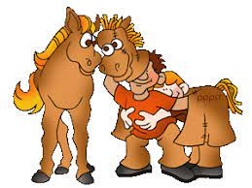
actual
(adjective)
Definition – real

Slide 337
actual
The actual horse was confused by the pantomime one.

Slide 338
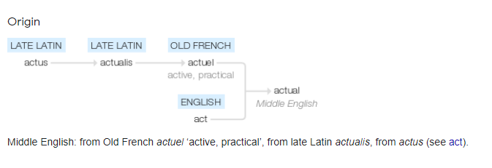

Slide 339
Challenge words

Slide 340
Do you remember this challenge word?

Slide 341
learn

Slide 342

learn
(verb)
Definition – gain knowledge or skill

Slide 343
learn
Everyone loves to learn new things.

Slide 344
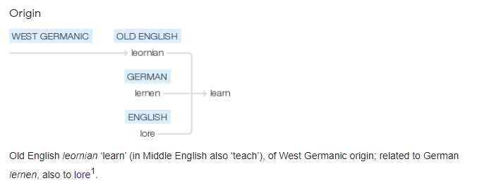

Slide 345
Can you remember this spelling rule?

Slide 346
Words ending
-ew ue u_e

Slide 347
-ue
Notes:
Sound of aI

Slide 348
blue

Slide 349
blue

Slide 350

blue

Slide 351
glue

Slide 352
glue

Slide 353

glue

Slide 354
Let’s Teach and Practise

Slide 355
The prefix auto-

Slide 356
auto -

Slide 357
auto - meaning self or own

Slide 358
auto - meaning self or own
The prefix auto- can be added to most root words without changes.

Slide 359
autopilot

Slide 360
autopilot

Slide 361
autopilot

Slide 362
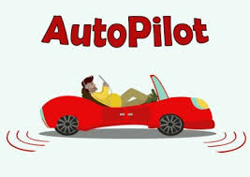
autopilot auto + pilot = autopilot

Slide 363
autopilot auto + pilot = autopilot
(noun)
Definition – device control the direction and speed of a vehicle

Slide 364
The plane was being flown on autopilot.

Slide 365
The plane was being flown on _________.

Slide 366
The plane was being flown on autopilot.

Slide 367
autograph

Slide 368
autograph

Slide 369
autograph

Slide 370

autograph auto + graph = autograph

Slide 371
autograph auto + graph = autograph
(noun)
Definition – someone signing their name

Slide 372
I got a singer’s autograph.

Slide 373
I got a singer’s _________.

Slide 374
I got a singer’s autograph.

Slide 375
The prefix anti-

Slide 376
anti -

Slide 377
anti - meaning against

Slide 378
auto - meaning against
The prefix anti- can be added to most root words without changes.

Slide 379
anticlockwise

Slide 380
anticlockwise

Slide 381
anticlockwise

Slide 382

anticlockwise anti + clockwise = anticlockwise

Slide 383
anticlockwise anti + clockwise = anticlockwise
(adverb)
Definition – moving against the way a clock goes

Slide 384
In Spain, they drive around roundabouts anticlockwise.

Slide 385
In Spain, they drive around roundabouts _____________.

Slide 386
In Spain, they drive around roundabouts anticlockwise.

Slide 387
antigravity

Slide 388
antigravity

Slide 389
antigravity

Slide 390
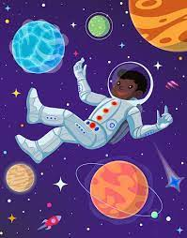
antigravity anti + gravity = antigravity

Slide 391
antigravity anti + gravity = antigravity
(noun)
Definition – a force working against gravity

Slide 392
Let’s investigate and detect…

Slide 393
Look back at your spellings from this half term and create a poster of the different spelling rules.
Make it bright and colourful showing different prefixes in different colours. Explain the different spelling rules and ideas for how to remember them.
The ones that are best at supporting spellings will go on the wall to help everyone.

