Slide 1
Spelling Y3
Mastering spellings: building on the foundations of phonics
Spring 1
Week 1

Slide 2
Year 3 - Spring 1
Week 1 - Monday

Slide 3
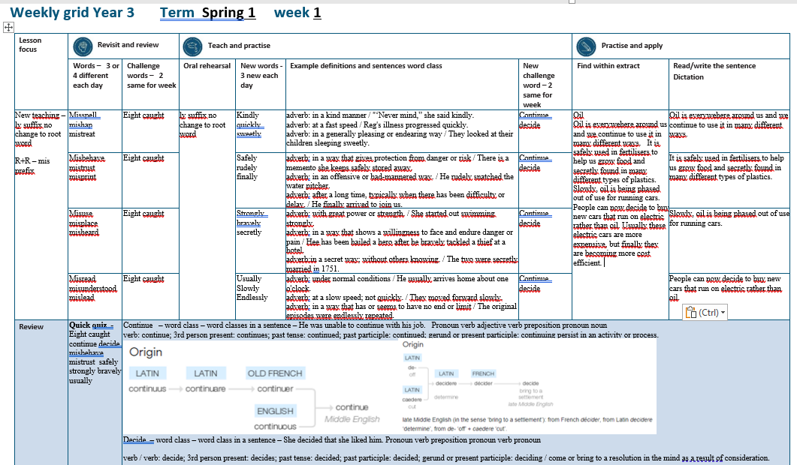

Slide 4
Let’s Revisit and Review…

Slide 5
Do you remember this challenge word?

Slide 6
eight

Slide 7
eight Definition – number cardinal number: eight equivalent to the product of two and four; one more than seven, or two less than ten; 8.

Slide 8
eight I am eight at my next birthday.

Slide 9
Do you remember this challenge word?

Slide 10
caught

Slide 11
caught verb past tense Definition – intercept and hold (something which has been thrown, propelled, or dropped)

Slide 12
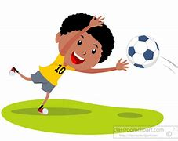
caught The goalie caught the ball.

Slide 13
The prefix mis-

Slide 14
mis-

Slide 15
mis- Like un–, the prefixes dis– and mis– have negative meanings.

Slide 16
misspell

Slide 17
misspell

Slide 18
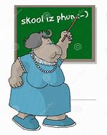
misspell

Slide 19
misshape

Slide 20
misshape

Slide 21
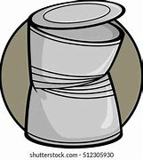
misshape

Slide 22
mistreat

Slide 23
mistreat

Slide 24
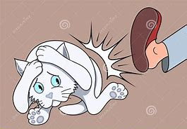
mistreat

Slide 25
Let’s Teach and Practise

Slide 26
The suffix -ly

Slide 27
-ly

Slide 28
-ly The suffix –ly is added to an adjective to form an adverb. The rules already learnt still apply. The suffix –ly starts with a consonant letter, so it is added straight on to most root words

Slide 29
kindly

Slide 30
kindly

Slide 31
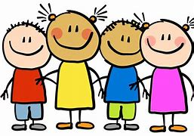
kindly

Slide 32
quickly

Slide 33
quickly

Slide 34
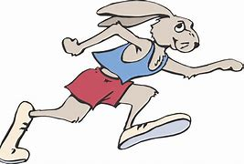
quickly

Slide 35
sweetly

Slide 36
sweetly

Slide 37
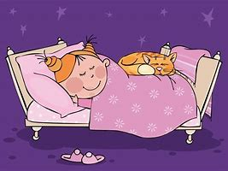
sweetly

Slide 38
kindly

Slide 39
kindly kind + ly = kindly

Slide 40
kindly kind + ly = kindly (adverb) Definition - in a kind manner

Slide 41
quickly

Slide 42
quickly quick + ly = quickly

Slide 43
quickly quick + ly = quickly (adverb) Definition - at a fast speed

Slide 44
sweetly

Slide 45
sweetly sweet + ly = sweetly

Slide 46
sweetly sweet + ly = sweetly (adverb) Definition - in a generally pleasing or endearing way

Slide 47
"Never mind,” she said kindly.

Slide 48
"Never mind,” she said ______.

Slide 49
"Never mind,” she said kindly.

Slide 50
Reg's illness progressed quickly.

Slide 51
Reg's illness progressed _______.

Slide 52
Reg's illness progressed quickly.

Slide 53
They looked at their children sleeping sweetly.

Slide 54
They looked at their children sleeping _______.

Slide 55
They looked at their children sleeping sweetly.

Slide 56
New CHALLENGE words.

Slide 57
continue

Slide 58
continue He was unable to continue with his job.

Slide 59
continue He was unable to continue with his job.

Slide 60
He was unable to ________ with his job.

Slide 61
He was unable to continue with his job.

Slide 62
decided

Slide 63
decided She decided that she liked him.

Slide 64
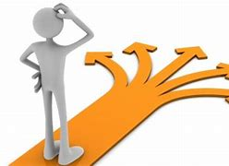
decided She decided that she liked him.

Slide 65
She decided that she liked him.

Slide 66
She _______ that she liked him.

Slide 67
She decided that she liked him.

Slide 68
Let’s Practise and Apply.

Slide 69
Can you spot the spelling rule words and the challenge words?

Slide 70
Oil Oil is everywhere around us and we continue to use it in many different ways. It is safely used in fertilisers to help us grow food and secretly found in many different types of plastics. Slowly, oil is being phased out of use for running cars. People can now decide to buy new cars that run on electric rather than oil. Usually, these electric cars are more expensive, but finally they are becoming more cost efficient.

Slide 71
Oil Oil is everywhere around us and we continue to use it in many different ways. It is safely used in fertilisers to help us grow food and secretly found in many different types of plastics. Slowly, oil is being phased out of use for running cars. People can now decide to buy new cars that run on electric rather than oil. Usually, these electric cars are more expensive, but finally they are becoming more cost efficient.

Slide 72
Write this sentence as I dictate it to you.
Notes:
Oil is everywhere around us and we continue to use it in many different ways.

Slide 73
Oil is everywhere around us and we continue to use it in many different ways.
Did you write it correctly?
Edit your work and make sure you have it correct.
Can you underline the spelling word that we have covered in this session?

Slide 74
Year 3 - Spring 1
Week 1 - Tuesday
Notes:
Revisit and review the words from previous teaching and challenge words – I say, we say, you say
Ask children to write words only in their spelling book
Introduce the new spelling rule
Children to write the new spelling rule words and challenge words into books when the sentences are shown with the spelling word missing.
Read the extract with the class as choral reading. Practise model of prosody etc.
Ask children to find the spelling words from the session in the text.
Then read allowed the chosen sentence for children to write fully in their books.
Show the extract and ask children to then edit their work to check they were correct in their dictation.

Slide 76
Let’s Revisit and Review…

Slide 77
Do you remember this challenge word?

Slide 78
eight

Slide 79
eight Definition – number cardinal number: eight equivalent to the product of two and four; one more than seven, or two less than ten; 8.

Slide 80
eight I am eight at my next birthday.

Slide 81
Do you remember this challenge word?

Slide 82
caught

Slide 83
caught verb past tense Definition – intercept and hold (something which has been thrown, propelled, or dropped)

Slide 84
caught The goalie caught the ball.

Slide 85
The prefix mis-

Slide 86
mis-

Slide 87
mis- Like un–, the prefixes dis– and mis– have negative meanings.

Slide 88
misbehave

Slide 89
misbehave

Slide 90
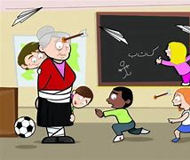
misbehave

Slide 91
mistrust

Slide 92
mistrust

Slide 93
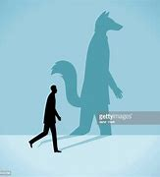
mistrust

Slide 94
misprint

Slide 95
misprint

Slide 96
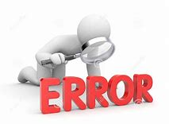
misprint

Slide 97
Let’s Teach and Practise

Slide 98
The suffix -ly

Slide 99
-ly

Slide 100
-ly The suffix –ly is added to an adjective to form an adverb. The rules already learnt still apply. The suffix –ly starts with a consonant letter, so it is added straight on to most root words

Slide 101
safely

Slide 102
safely

Slide 103
rudely

Slide 104
rudely

Slide 105
finally

Slide 106
finally

Slide 107
safely

Slide 108
safely safe + ly = safely

Slide 109
safely safe + ly = safely (adverb) Definition - in a way that gives protection from danger or risk

Slide 110
rudely

Slide 111
rudely rude + ly = rudely

Slide 112
rudely rude + ly = rudely (adverb) Definition - in an offensive or bad-mannered way

Slide 113
finally

Slide 114
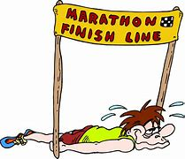
finally final + ly = finally

Slide 115
finally final + ly = finally (adverb) Definition - after a long time, typically when there has been difficulty or delay.

Slide 116
There is a memento she keeps safely stored away.

Slide 117
There is a memento she keeps ______ stored away.

Slide 118
There is a memento she keeps safely stored away.

Slide 119
He rudely snatched the water pitcher.

Slide 120
He ______ snatched the water pitcher.

Slide 121
He rudely snatched the water pitcher.

Slide 122
He finally arrived to join us.

Slide 123
He _______ arrived to join us.

Slide 124
He finally arrived to join us.

Slide 125
New CHALLENGE words.

Slide 126
continue

Slide 127
continue He was unable to continue with his job.

Slide 128
continue He was unable to continue with his job.

Slide 129
He was unable to ________ with his job.

Slide 130
He was unable to continue with his job.

Slide 131
decided

Slide 132
decided She decided that she liked him.

Slide 133
decided She decided that she liked him.

Slide 134
She decided that she liked him.

Slide 135
She _______ that she liked him.

Slide 136
She decided that she liked him.

Slide 137
Let’s Practise and Apply.

Slide 138
Can you spot the spelling rule words and the challenge words?

Slide 139
Oil Oil is everywhere around us and we continue to use it in many different ways. It is safely used in fertilisers to help us grow food and secretly found in many different types of plastics. Slowly, oil is being phased out of use for running cars. People can now decide to buy new cars that run on electric rather than oil. Usually, these electric cars are more expensive, but finally they are becoming more cost efficient.

Slide 140
Oil Oil is everywhere around us and we continue to use it in many different ways. It is safely used in fertilisers to help us grow food and secretly found in many different types of plastics. Slowly, oil is being phased out of use for running cars. People can now decide to buy new cars that run on electric rather than oil. Usually, these electric cars are more expensive, but finally they are becoming more cost efficient.

Slide 141
Write this sentence as I dictate it to you.
Notes:
It is safely used in fertilisers to help us grow food and secretly found in many different types of plastics.

Slide 142
It is safely used in fertilisers to help us grow food and secretly found in many different types of plastics.
Did you write it correctly?
Edit your work and make sure you have it correct.
Can you underline the spelling word that we have covered in this session?

Slide 143
Year 3 - Spring 1
Week 1 - Wednesday
Notes:
Revisit and review the words from previous teaching and challenge words – I say, we say, you say
Ask children to write words only in their spelling book
Introduce the new spelling rule
Children to write the new spelling rule words and challenge words into books when the sentences are shown with the spelling word missing.
Read the extract with the class as choral reading. Practise model of prosody etc.
Ask children to find the spelling words from the session in the text.
Then read allowed the chosen sentence for children to write fully in their books.
Show the extract and ask children to then edit their work to check they were correct in their dictation.

Slide 145
Let’s Revisit and Review…

Slide 146
Do you remember this challenge word?

Slide 147
eight

Slide 148
eight Definition – number cardinal number: eight equivalent to the product of two and four; one more than seven, or two less than ten; 8.

Slide 149
eight I am eight at my next birthday.

Slide 150
Do you remember this challenge word?

Slide 151
caught

Slide 152
caught verb past tense Definition – intercept and hold (something which has been thrown, propelled, or dropped)

Slide 153
caught The goalie caught the ball.

Slide 154
The prefix mis-

Slide 155
mis-

Slide 156
mis- Like un–, the prefixes dis– and mis– have negative meanings.

Slide 157
misuse

Slide 158
misuse

Slide 159
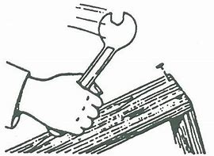
misuse

Slide 160
misplace

Slide 161
misplace

Slide 162
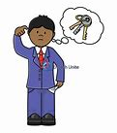
misplace

Slide 163
misheard

Slide 164
misheard

Slide 165
misheard

Slide 166
Let’s Teach and Practise

Slide 167
The suffix -ly

Slide 168
-ly

Slide 169
-ly The suffix –ly is added to an adjective to form an adverb. The rules already learnt still apply. The suffix –ly starts with a consonant letter, so it is added straight on to most root words

Slide 170
strongly

Slide 171
strongly

Slide 172
strongly

Slide 173
bravely

Slide 174
bravely

Slide 175
bravely

Slide 176
secretly

Slide 177
secretly

Slide 178
secretly

Slide 179
strongly

Slide 180
strongly strong + ly = strongly

Slide 181
strongly strong + ly = strongly (adverb) Definition - with great power or strength

Slide 182
bravely

Slide 183
bravely brave + ly = bravely

Slide 184
bravely brave + ly = bravely (adverb) Definition - in a way that shows a willingness to face and endure danger or pain

Slide 185
secretly

Slide 186
secretly secret + ly = secretly

Slide 187
secretly secret + ly = secretly (adverb) Definition - in a secret way; without others knowing

Slide 188
She started out swimming strongly.

Slide 189
She started out swimming _______.

Slide 190
She started out swimming strongly.

Slide 191
He has been hailed a hero after he bravely tackled a thief at a hotel.

Slide 192
He has been hailed a hero after he _______ tackled a thief at a hotel.

Slide 193
He has been hailed a hero after he bravely tackled a thief at a hotel.

Slide 194
The two were secretly married in 1751.

Slide 195
The two were ________ married in 1751.

Slide 196
The two were secretly married in 1751.

Slide 197
New CHALLENGE words.

Slide 198
continue

Slide 199
continue He was unable to continue with his job.

Slide 200
continue He was unable to continue with his job.

Slide 201
He was unable to ________ with his job.

Slide 202
He was unable to continue with his job.

Slide 203
decided

Slide 204
decided She decided that she liked him.

Slide 205
decided She decided that she liked him.

Slide 206
She decided that she liked him.

Slide 207
She _______ that she liked him.

Slide 208
She decided that she liked him.

Slide 209
Let’s Practise and Apply.

Slide 210
Can you spot the spelling rule words and the challenge words?

Slide 211
Oil Oil is everywhere around us and we continue to use it in many different ways. It is safely used in fertilisers to help us grow food and secretly found in many different types of plastics. Slowly, oil is being phased out of use for running cars. People can now decide to buy new cars that run on electric rather than oil. Usually, these electric cars are more expensive, but finally they are becoming more cost efficient.

Slide 212
Oil Oil is everywhere around us and we continue to use it in many different ways. It is safely used in fertilisers to help us grow food and secretly found in many different types of plastics. Slowly, oil is being phased out of use for running cars. People can now decide to buy new cars that run on electric rather than oil. Usually, these electric cars are more expensive, but finally they are becoming more cost efficient.

Slide 213
Write this sentence as I dictate it to you.
Notes:
Slowly, oil is being phased out of use for running cars.

Slide 214
Slowly, oil is being phased out of use for running cars.
Did you write it correctly?
Edit your work and make sure you have it correct.
Can you underline the spelling word that we have covered in this session?

Slide 215
Year 3 - Spring 1
Week 1 - Thursday
Notes:
Revisit and review the words from previous teaching and challenge words – I say, we say, you say
Ask children to write words only in their spelling book
Introduce the new spelling rule
Children to write the new spelling rule words and challenge words into books when the sentences are shown with the spelling word missing.
Read the extract with the class as choral reading. Practise model of prosody etc.
Ask children to find the spelling words from the session in the text.
Then read allowed the chosen sentence for children to write fully in their books.
Show the extract and ask children to then edit their work to check they were correct in their dictation.

Slide 217
Let’s Revisit and Review…

Slide 218
Do you remember this challenge word?

Slide 219
eight

Slide 220
eight Definition – number cardinal number: eight equivalent to the product of two and four; one more than seven, or two less than ten; 8.

Slide 221
eight I am eight at my next birthday.

Slide 222
Do you remember this challenge word?

Slide 223
caught

Slide 224
caught verb past tense Definition – intercept and hold (something which has been thrown, propelled, or dropped)

Slide 225
caught The goalie caught the ball.

Slide 226
The prefix mis-

Slide 227
mis-

Slide 228
mis- Like un–, the prefixes dis– and mis– have negative meanings.

Slide 229
misread

Slide 230
misread

Slide 231
misread

Slide 232
misunderstood

Slide 233
misunderstood

Slide 234
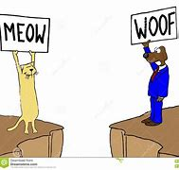
misunderstood

Slide 235
mislead

Slide 236
mislead

Slide 237
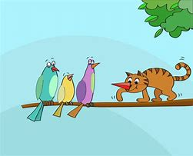
mislead

Slide 238
Let’s Teach and Practise

Slide 239
The suffix -ly

Slide 240
-ly

Slide 241
-ly The suffix –ly is added to an adjective to form an adverb. The rules already learnt still apply. The suffix –ly starts with a consonant letter, so it is added straight on to most root words

Slide 242
usually

Slide 243
usually

Slide 244
slowly

Slide 245
slowly

Slide 246
endlessly

Slide 247
endlessly

Slide 248
usually

Slide 249
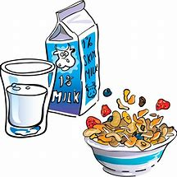
usually usual + ly = usually

Slide 250
usually usual + ly = usually (adverb) Definition - under normal conditions

Slide 251
slowly

Slide 252
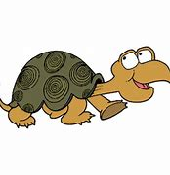
slowly slow + ly = slowly

Slide 253
slowly slow + ly = slowly (adverb) Definition - at a slow speed; not quickly

Slide 254
endlessly

Slide 255
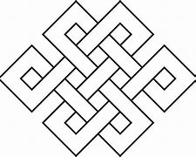
endlessly endless + ly = endlessly

Slide 256
endlessly endless + ly = endlessly (adverb) Definition - in a way that has or seems to have no end or limit

Slide 257
He usually arrives home about one o'clock.

Slide 258
He _______ arrives home about one o'clock.

Slide 259
He usually arrives home about one o'clock.

Slide 260
They moved forward slowly.

Slide 261
They moved forward ______.

Slide 262
They moved forward slowly.

Slide 263
The original episodes were endlessly repeated.

Slide 264
The original episodes were _________ repeated.

Slide 265
The original episodes were endlessly repeated.

Slide 266
New CHALLENGE words.

Slide 267
continue

Slide 268
continue He was unable to continue with his job.

Slide 269
continue He was unable to continue with his job.

Slide 270
He was unable to ________ with his job.

Slide 271
He was unable to continue with his job.

Slide 272
decided

Slide 273
decided She decided that she liked him.

Slide 274
decided She decided that she liked him.

Slide 275
She decided that she liked him.

Slide 276
She _______ that she liked him.

Slide 277
She decided that she liked him.

Slide 278
Let’s Practise and Apply.

Slide 279
Can you spot the spelling rule words and the challenge words?

Slide 280
Oil Oil is everywhere around us and we continue to use it in many different ways. It is safely used in fertilisers to help us grow food and secretly found in many different types of plastics. Slowly, oil is being phased out of use for running cars. People can now decide to buy new cars that run on electric rather than oil. Usually, these electric cars are more expensive, but finally they are becoming more cost efficient.

Slide 281
Oil Oil is everywhere around us and we continue to use it in many different ways. It is safely used in fertilisers to help us grow food and secretly found in many different types of plastics. Slowly, oil is being phased out of use for running cars. People can now decide to buy new cars that run on electric rather than oil. Usually, these electric cars are more expensive, but finally they are becoming more cost efficient.

Slide 282
Write this sentence as I dictate it to you.
Notes:
People can now decide to buy new cars that run on electric rather than oil.

Slide 283
People can now decide to buy new cars that run on electric rather than oil.
Did you write it correctly?
Edit your work and make sure you have it correct.
Can you underline the spelling word that we have covered in this session?

Slide 284
Year 3 - Spring 1
Week 1 - Friday
Notes:
Click through the slides for all the R+R words for the week (both the focus and the challenge words)
Click through the slides for all the new learning this week

Slide 286
Old challenge words…

Slide 287
eight

Slide 288
caught

Slide 289
Old spelling rule words…

Slide 290
misspell

Slide 291
mishap

Slide 292
mistreat

Slide 293
misbehave

Slide 294
mistrust

Slide 295
misprint

Slide 296
misuse

Slide 297
misplace

Slide 298
misheard

Slide 299
misread

Slide 300
misunderstood

Slide 301
mislead

Slide 302
New spelling rule words…

Slide 303
kindly

Slide 304
quickly

Slide 305
sweetly

Slide 306
safely

Slide 307
rudely

Slide 308
finally

Slide 309
strongly

Slide 310
bravely

Slide 311
secretly

Slide 312
usually

Slide 313
slowly

Slide 314
endlessly

Slide 315
New challenge words…

Slide 316
continue

Slide 317
decided

Slide 318
Quick Quiz time…
Notes:
Say these words for the quiz
Eight caught continue decide misbehave mistrust safely strongly bravely usually

Slide 319
Did you get them correct?
Edit your work.
eight caught continue decide misbehave mistrust safely strongly bravely usually

Slide 320
Word class time…

Slide 321
He was unable to continue with his job.
Notes:
Ask for these words to be classed

Slide 322
He was unable to continue with his job.
Pronoun verb adjective verb preposition pronoun noun
Notes:
Ask for these words to be classed

Slide 323
He was unable to continue with his job.
Pronoun verb adjective verb preposition pronoun noun
Notes:
Ask for these words to be classed

Slide 324
She decided that she liked him.
Notes:
Ask for these words to be classed

Slide 325
She decided that she liked him. Pronoun verb preposition pronoun verb pronoun

Slide 326
She decided that she liked him.
Pronoun verb preposition pronoun verb pronoun

Slide 327
Etymology
The history of a word….

Slide 328
continue (v.)
mid-14c., contynuen, "maintain, sustain, preserve;" late 14c., "go forward or onward; persevere in," from Old French continuer (13c.) and directly from Latin continuare "join together in uninterrupted succession, make or be continuous, do successively one after another," from continuus "joining, connecting with something; following one after another," from continere (intransitive) "to be uninterrupted," literally "to hang together" (see contain). Related: Continued; continuing.
Sense of "to carry on from the point of suspension" is from early 15c. Meaning "to remain in a state, place, or office" is from early 15c. Transitive sense of "to extend from one point to another" is from 1660s. Meaning "to postpone a hearing or trial" is from mid-15c.

Slide 329
decide (v.)
late 14c., "to settle a dispute, determine a controversy," from Old French decider, from Latin decidere "to decide, determine," literally "to cut off," from de "off" (see de-) + caedere "to cut" (from PIE root *kae-id- "to strike"). For Latin vowel change, see acquisition. Sense is of resolving difficulties "at a stroke." Meaning "to make up one's mind" is attested from 1830. Related: Decided; deciding.

Slide 330
Let’s investigate….
Create questions and mark schemes for these words.

