Slide 1
Spelling Y3
Mastering spellings: building on the foundations of phonics
Spring 1
Week 3

Slide 2
Year 3 - Spring 1
Week 3 - Monday

Slide 3
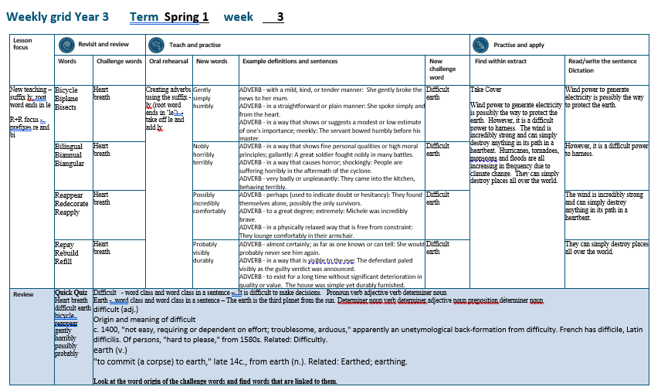

Slide 4
Let’s Revisit and Review…

Slide 5
Do you remember this challenge word?

Slide 6
heart

Slide 7
heart
NOUN
Definition – an organ in your chest that pumps the blood around your body.

Slide 8
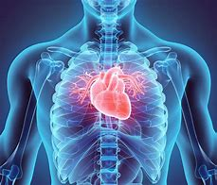
heart
NOUN
Definition – an organ in your chest that pumps the blood around your body.

Slide 9
Do you remember this challenge word?

Slide 10
breath

Slide 11
breath
NOUN
Definition – to take air into your lungs and send it out again through your nose or mouth

Slide 12
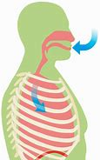
breath
NOUN
Definition – to take air into your lungs and send it out again through your nose or mouth

Slide 13
The prefix re-

Slide 14
re-

Slide 15
re- meaning again, back or it indicates repetition

Slide 16
The prefix bi-

Slide 17
bi-

Slide 18
bi- meaning two, having two, twice, double, doubly, twofold, once every two, etc., from Latin bi- "twice, double,"

Slide 19
bicycle

Slide 20
bicycle

Slide 21
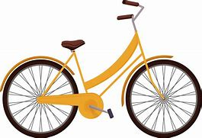
bicycle

Slide 22
biplane

Slide 23
biplane

Slide 24
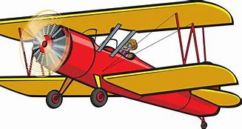
biplane

Slide 25
bisects

Slide 26
bisects

Slide 27
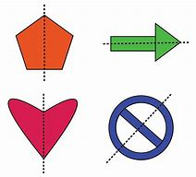
bisects

Slide 28
Let’s Teach and Practise

Slide 29
The suffix
-ly

Slide 30
-ly

Slide 31
-ly
Creating adverbs using the suffix –ly where the root word ends in ‘le’.
Rule – take off the ‘le’ and add ‘ly’

Slide 32
gently

Slide 33
gently

Slide 34
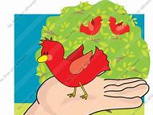
gently

Slide 35
simply

Slide 36
simply

Slide 37

simply

Slide 38
humbly

Slide 39
humbly

Slide 40
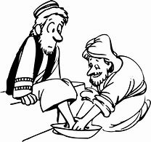
humbly

Slide 41
gently

Slide 42
gently gentle (–le) + ly = gently

Slide 43
gently gentle (–le) + ly = gently adverb
Definition - with a mild, kind, or tender manner

Slide 44
simply

Slide 45
simply simple (–le) + ly = simply

Slide 46
simply simple (–le) + ly = simply adverb
Definition - in a straightforward or plain manner

Slide 47
humbly

Slide 48
humbly humble (–le) + ly = humbly

Slide 49
humbly humble (–le) + ly = humbly adverb
Definition - in a way that shows or suggests a modest or low estimate of one's importance.

Slide 50
She gently broke the news to her mum.

Slide 51
She ______ broke the news to her mum.

Slide 52
She gently broke the news to her mum.

Slide 53
She spoke simply and from the heart.

Slide 54
She spoke ______ and from the heart.

Slide 55
She spoke simply and from the heart.

Slide 56
The servant bowed humbly before his master.

Slide 57
The servant bowed ______ before his master.

Slide 58
The servant bowed humbly before his master.

Slide 59
New CHALLENGE words.

Slide 60
difficult

Slide 61
difficult
It is difficult to make decisions.

Slide 62

difficult
It is difficult to make decisions.

Slide 63
It is difficult to make decisions.

Slide 64
It is _________ to make decisions.

Slide 65
It is difficult to make decisions.

Slide 66
earth

Slide 67
earth
The earth is the third planet from the sun.

Slide 68

earth
The earth is the third planet from the sun.

Slide 69
The earth is the third planet from the sun.

Slide 70
The _____ is the third planet from the sun.

Slide 71
The earth is the third planet from the sun.

Slide 72
Let’s Practise and Apply.

Slide 73
Can you spot the spelling rule words and the challenge words?

Slide 74
Take Cover
Wind power to generate electricity is possibly the way to protect the earth. However, it is a difficult power to harness. The wind is incredibly strong and can simply destroy anything in its path in a heartbeat. Hurricanes, tornadoes, monsoons and floods are all increasing in frequency due to climate change. They can simply destroy places all over the world.

Slide 75
Take Cover
Wind power to generate electricity is possibly the way to protect the earth. However, it is a difficult power to harness. The wind is incredibly strong and can simply destroy anything in its path in a heartbeat. Hurricanes, tornadoes, monsoons and floods are all increasing in frequency due to climate change. They can simply destroy places all over the world.

Slide 76
Write this sentence as I dictate it to you.
Notes:
Wind power to generate electricity is possibly the way to protect the earth.

Slide 77
Wind power to generate electricity is possibly the way to protect the earth.
Did you write it correctly?
Edit your work and make sure you have it correct.
Can you underline the spelling word that we have covered in this session?

Slide 78
Year 3 - Spring 1
Week 3 - Tuesday
Notes:
Revisit and review the words from previous teaching and challenge words – I say, we say, you say
Ask children to write words only in their spelling book
Introduce the new spelling rule
Children to write the new spelling rule words and challenge words into books when the sentences are shown with the spelling word missing.
Read the extract with the class as choral reading. Practise model of prosody etc.
Ask children to find the spelling words from the session in the text.
Then read allowed the chosen sentence for children to write fully in their books.
Show the extract and ask children to then edit their work to check they were correct in their dictation.

Slide 80
Let’s Revisit and Review…

Slide 81
Do you remember this challenge word?

Slide 82
heart

Slide 83
heart
NOUN
Definition – an organ in your chest that pumps the blood around your body.

Slide 84
heart
NOUN
Definition – an organ in your chest that pumps the blood around your body.

Slide 85
Do you remember this challenge word?

Slide 86
breath

Slide 87
breath
NOUN
Definition – to take air into your lungs and send it out again through your nose or mouth

Slide 88
breath
NOUN
Definition – to take air into your lungs and send it out again through your nose or mouth

Slide 89
The prefix re-

Slide 90
re-

Slide 91
re- meaning again, back or it indicates repetition

Slide 92
The prefix bi-

Slide 93
bi-

Slide 94
bi- meaning two, having two, twice, double, doubly, twofold, once every two, etc., from Latin bi- "twice, double,"

Slide 95
bilingual

Slide 96
bilingual

Slide 97

bilingual

Slide 98
biannual

Slide 99
biannual

Slide 100
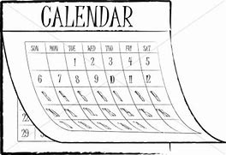
biannual

Slide 101
biangular

Slide 102
biangular

Slide 103

biangular

Slide 104
Let’s Teach and Practise

Slide 105
The suffix
-ly

Slide 106
-ly

Slide 107
-ly
Creating adverbs using the suffix –ly where the root word ends in ‘le’.
Rule – take off the ‘le’ and add ‘ly’

Slide 108
nobly

Slide 109
nobly

Slide 110
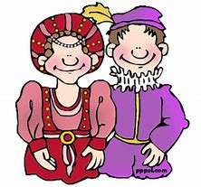
nobly

Slide 111
horribly

Slide 112
horribly

Slide 113
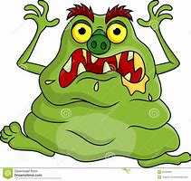
horribly

Slide 114
terribly

Slide 115
terribly

Slide 116

terribly

Slide 117
nobly

Slide 118
nobly noble (–le) + ly = nobly

Slide 119
nobly noble (–le) + ly = nobly adverb
Definition - in a way that shows fine personal qualities or high moral principles.

Slide 120
horribly

Slide 121
horribly horrible (–le) + ly = horribly

Slide 122
horribly horrible (–le) + ly = horribly adverb
Definition - in a way that causes horror.

Slide 123
terribly

Slide 124
terribly terrible (–le) + ly =terribly

Slide 125
terribly terrible (–le) + ly =terribly adverb
Definition - very badly or unpleasantly.

Slide 126
A great soldier fought nobly in many battles.

Slide 127
A great soldier fought _____ in many battles.

Slide 128
A great soldier fought nobly in many battles.

Slide 129
People are suffering horribly in the aftermath of the cyclone.

Slide 130
People are suffering ________ in the aftermath of the cyclone.

Slide 131
People are suffering horribly in the aftermath of the cyclone.

Slide 132
They came into the kitchen, behaving terribly.

Slide 133
They came into the kitchen, behaving ________.

Slide 134
They came into the kitchen, behaving terribly.

Slide 135
New CHALLENGE words.

Slide 136
difficult

Slide 137
difficult
It is difficult to make decisions.

Slide 138
difficult
It is difficult to make decisions.

Slide 139
It is difficult to make decisions.

Slide 140
It is _________ to make decisions.

Slide 141
It is difficult to make decisions.

Slide 142
earth

Slide 143
earth
The earth is the third planet from the sun.

Slide 144
earth
The earth is the third planet from the sun.

Slide 145
The earth is the third planet from the sun.

Slide 146
The _____ is the third planet from the sun.

Slide 147
The earth is the third planet from the sun.

Slide 148
Let’s Practise and Apply.

Slide 149
Can you spot the spelling rule words and the challenge words?

Slide 150
Take Cover
Wind power to generate electricity is possibly the way to protect the earth. However, it is a difficult power to harness. The wind is incredibly strong and can simply destroy anything in its path in a heartbeat. Hurricanes, tornadoes, monsoons and floods are all increasing in frequency due to climate change. They can simply destroy places all over the world.

Slide 151
Take Cover
Wind power to generate electricity is possibly the way to protect the earth. However, it is a difficult power to harness. The wind is incredibly strong and can simply destroy anything in its path in a heartbeat. Hurricanes, tornadoes, monsoons and floods are all increasing in frequency due to climate change. They can simply destroy places all over the world.

Slide 152
Write this sentence as I dictate it to you.
Notes:
However, it is a difficult power to harness.

Slide 153
However, it is a difficult power to harness.
Did you write it correctly?
Edit your work and make sure you have it correct.
Can you underline the spelling word that we have covered in this session?

Slide 154
Year 3 - Spring 1
Week 3 - Wednesday
Notes:
Revisit and review the words from previous teaching and challenge words – I say, we say, you say
Ask children to write words only in their spelling book
Introduce the new spelling rule
Children to write the new spelling rule words and challenge words into books when the sentences are shown with the spelling word missing.
Read the extract with the class as choral reading. Practise model of prosody etc.
Ask children to find the spelling words from the session in the text.
Then read allowed the chosen sentence for children to write fully in their books.
Show the extract and ask children to then edit their work to check they were correct in their dictation.

Slide 156
Let’s Revisit and Review…

Slide 157
Do you remember this challenge word?

Slide 158
heart

Slide 159
heart
NOUN
Definition – an organ in your chest that pumps the blood around your body.

Slide 160
heart
NOUN
Definition – an organ in your chest that pumps the blood around your body.

Slide 161
Do you remember this challenge word?

Slide 162
breath

Slide 163
breath
NOUN
Definition – to take air into your lungs and send it out again through your nose or mouth

Slide 164
breath
NOUN
Definition – to take air into your lungs and send it out again through your nose or mouth

Slide 165
The prefix re-

Slide 166
re-

Slide 167
re- meaning again, back or it indicates repetition

Slide 168
The prefix bi-

Slide 169
bi-

Slide 170
bi- meaning two, having two, twice, double, doubly, twofold, once every two, etc., from Latin bi- "twice, double,"

Slide 171
reappear

Slide 172
reappear

Slide 173
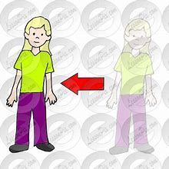
reappear

Slide 174
redecorate

Slide 175
redecorate

Slide 176
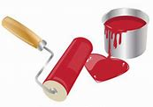
redecorate

Slide 177
reapply

Slide 178
reapply

Slide 179
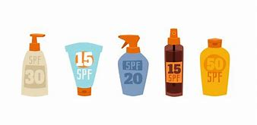
reapply

Slide 180
Let’s Teach and Practise

Slide 181
The suffix
-ly

Slide 182
-ly

Slide 183
-ly
Creating adverbs using the suffix –ly where the root word ends in ‘le’.
Rule – take off the ‘le’ and add ‘ly’

Slide 184
possibly

Slide 185
possibly

Slide 186
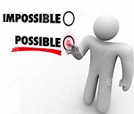
possibly

Slide 187
incredibly

Slide 188
incredibly

Slide 189

incredibly

Slide 190
comfortably

Slide 191
comfortably

Slide 192
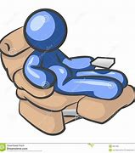
comfortably

Slide 193
possibly

Slide 194
possibly possible (–le) + ly = possibly

Slide 195
possibly possible (–le) + ly = possibly adverb
Definition - perhaps (used to indicate doubt or hesitancy)

Slide 196
incredibly

Slide 197
incredibly incredible (–le) + ly = incredibly

Slide 198
incredibly incredible (–le) + ly = incredibly adverb
Definition - to a great degree; extremely

Slide 199
comfortably

Slide 200
comfortably comfortable (–le) + ly = comfortably

Slide 201
comfortably comfortable (–le) + ly = comfortably adverb
Definition - in a physically relaxed way that is free from constraint.

Slide 202
They found themselves alone, possibly the only survivors.

Slide 203
They found themselves alone, ________ the only survivors.

Slide 204
They found themselves alone, possibly the only survivors.

Slide 205
Michele was incredibly brave.

Slide 206
Michele was __________ brave.

Slide 207
Michele was incredibly brave.

Slide 208
They lounge comfortably in their armchair.

Slide 209
They lounge ___________ in their armchair.

Slide 210
They lounge comfortably in their armchair.

Slide 211
New CHALLENGE words.

Slide 212
difficult

Slide 213
difficult
It is difficult to make decisions.

Slide 214
difficult
It is difficult to make decisions.

Slide 215
It is difficult to make decisions.

Slide 216
It is _________ to make decisions.

Slide 217
It is difficult to make decisions.

Slide 218
earth

Slide 219
earth
The earth is the third planet from the sun.

Slide 220
earth
The earth is the third planet from the sun.

Slide 221
The earth is the third planet from the sun.

Slide 222
The _____ is the third planet from the sun.

Slide 223
The earth is the third planet from the sun.

Slide 224
Let’s Practise and Apply.

Slide 225
Can you spot the spelling rule words and the challenge words?

Slide 226
Take Cover
Wind power to generate electricity is possibly the way to protect the earth. However, it is a difficult power to harness. The wind is incredibly strong and can simply destroy anything in its path in a heartbeat. Hurricanes, tornadoes, monsoons and floods are all increasing in frequency due to climate change. They can simply destroy places all over the world.

Slide 227
Take Cover
Wind power to generate electricity is possibly the way to protect the earth. However, it is a difficult power to harness. The wind is incredibly strong and can simply destroy anything in its path in a heartbeat. Hurricanes, tornadoes, monsoons and floods are all increasing in frequency due to climate change. They can simply destroy places all over the world.

Slide 228
Write this sentence as I dictate it to you.
Notes:
The wind is incredibly strong and can simply destroy anything in its path in a heartbeat.

Slide 229
The wind is incredibly strong and can simply destroy anything in its path in a heartbeat.
Did you write it correctly?
Edit your work and make sure you have it correct.
Can you underline the spelling word that we have covered in this session?

Slide 230
Year 3 - Spring 1
Week 3 - Thursday
Notes:
Revisit and review the words from previous teaching and challenge words – I say, we say, you say
Ask children to write words only in their spelling book
Introduce the new spelling rule
Children to write the new spelling rule words and challenge words into books when the sentences are shown with the spelling word missing.
Read the extract with the class as choral reading. Practise model of prosody etc.
Ask children to find the spelling words from the session in the text.
Then read allowed the chosen sentence for children to write fully in their books.
Show the extract and ask children to then edit their work to check they were correct in their dictation.

Slide 232
Let’s Revisit and Review…

Slide 233
Do you remember this challenge word?

Slide 234
heart

Slide 235
heart
NOUN
Definition – an organ in your chest that pumps the blood around your body.

Slide 236
heart
NOUN
Definition – an organ in your chest that pumps the blood around your body.

Slide 237
Do you remember this challenge word?

Slide 238
breath

Slide 239
breath
NOUN
Definition – to take air into your lungs and send it out again through your nose or mouth

Slide 240
breath
NOUN
Definition – to take air into your lungs and send it out again through your nose or mouth

Slide 241
The prefix re-

Slide 242
re-

Slide 243
re- meaning again, back or it indicates repetition

Slide 244
The prefix bi-

Slide 245
bi-

Slide 246
bi- meaning two, having two, twice, double, doubly, twofold, once every two, etc., from Latin bi- "twice, double,"

Slide 247
repay

Slide 248
repay

Slide 249
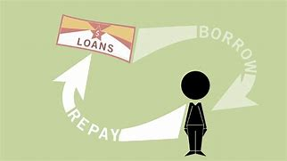
repay

Slide 250
rebuild

Slide 251
rebuild

Slide 252
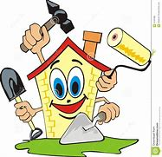
rebuild

Slide 253
refill

Slide 254
refill

Slide 255
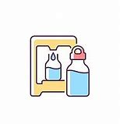
refill

Slide 256
Let’s Teach and Practise

Slide 257
The suffix
-ly

Slide 258
-ly

Slide 259
-ly
Creating adverbs using the suffix –ly where the root word ends in ‘le’.
Rule – take off the ‘le’ and add ‘ly’

Slide 260
probably

Slide 261
probably

Slide 262

probably

Slide 263
visibly

Slide 264
visibly

Slide 265
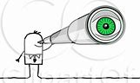
visibly

Slide 266
durably

Slide 267
durably

Slide 268
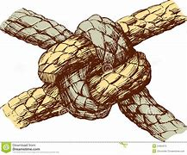
durably

Slide 269
probably

Slide 270
probably probable (–le) + ly = probably

Slide 271
probably probable (–le) + ly = probably adverb
Definition - almost certainly; as far as one knows or can tell.

Slide 272
visibly

Slide 273
visibly visible (–le) + ly = visibly

Slide 274
visibly visible (–le) + ly = visibly adverb
Definition - in a way that is visible to the eye.

Slide 275
durably

Slide 276
durably durable (–le) + ly = durably

Slide 277
durably durable (–le) + ly = durably adverb
Definition - to exist for a long time without significant deterioration in quality or value.

Slide 278
She would probably never see him again.

Slide 279
She would ________ never see him again.

Slide 280
She would probably never see him again.

Slide 281
The defendant paled visibly as the guilty verdict was announced.

Slide 282
The defendant paled _______ as the guilty verdict was announced.

Slide 283
The defendant paled visibly as the guilty verdict was announced.

Slide 284
The house was simple yet durably furnished.

Slide 285
The house was simple yet _______ furnished.

Slide 286
The house was simple yet durably furnished.

Slide 287
New CHALLENGE words.

Slide 288
difficult

Slide 289
difficult
It is difficult to make decisions.

Slide 290
difficult
It is difficult to make decisions.

Slide 291
It is difficult to make decisions.

Slide 292
It is _________ to make decisions.

Slide 293
It is difficult to make decisions.

Slide 294
earth

Slide 295
earth
The earth is the third planet from the sun.

Slide 296
earth
The earth is the third planet from the sun.

Slide 297
The earth is the third planet from the sun.

Slide 298
The _____ is the third planet from the sun.

Slide 299
The earth is the third planet from the sun.

Slide 300
Let’s Practise and Apply.

Slide 301
Can you spot the spelling rule words and the challenge words?

Slide 302
Take Cover
Wind power to generate electricity is possibly the way to protect the earth. However, it is a difficult power to harness. The wind is incredibly strong and can simply destroy anything in its path in a heartbeat. Hurricanes, tornadoes, monsoons and floods are all increasing in frequency due to climate change. They can simply destroy places all over the world.

Slide 303
Take Cover
Wind power to generate electricity is possibly the way to protect the earth. However, it is a difficult power to harness. The wind is incredibly strong and can simply destroy anything in its path in a heartbeat. Hurricanes, tornadoes, monsoons and floods are all increasing in frequency due to climate change. They can simply destroy places all over the world.

Slide 304
Write this sentence as I dictate it to you.
Notes:
They can simply destroy places all over the world.

Slide 305
They can simply destroy places all over the world.
Did you write it correctly?
Edit your work and make sure you have it correct.
Can you underline the spelling word that we have covered in this session?

Slide 306
Year 3 - Spring 1
Week 3 - Friday
Notes:
Click through the slides for all the R+R words for the week (both the focus and the challenge words)
Click through the slides for all the new learning this week

Slide 308
Old challenge words…

Slide 309
heart

Slide 310
breath

Slide 311
Old spelling rule words…

Slide 312
bicycle

Slide 313
biplane

Slide 314
bisects

Slide 315
bilingual

Slide 316
biannual

Slide 317
biangular

Slide 318
reappear

Slide 319
redecorate

Slide 320
reapply

Slide 321
repay

Slide 322
rebuild

Slide 323
refill

Slide 324
New spelling rule words…

Slide 325
gently

Slide 326
simply

Slide 327
humbly

Slide 328
nobly

Slide 329
horribly

Slide 330
terribly

Slide 331
possibly

Slide 332
incredibly

Slide 333
comfortably

Slide 334
probably

Slide 335
visibly

Slide 336
durably

Slide 337
New challenge words…

Slide 338
difficult

Slide 339
earth

Slide 340
Quick Quiz time…
Notes:
Say these words for the quiz
Heart breath difficult earth bicycle reappear gently horribly possibly probably

Slide 341
Did you get them correct?
Edit your work.
heart breath difficult earth bicycle reappear gently horribly possibly probably

Slide 342
Word class time…

Slide 343
It is difficult to make decisions
Notes:
Ask for these words to be classed

Slide 344
It is difficult to make decisions
Pronoun verb adjective verb determiner noun
Pronoun verb adjective verb determiner noun
Notes:
Ask for these words to be classed

Slide 345
It is difficult to make decisions
Pronoun verb adjective verb determiner noun
Pronoun verb adjective verb determiner noun
Notes:
Ask for these words to be classed

Slide 346
The earth is the third planet from the sun.
Notes:
Ask for these words to be classed

Slide 347
The earth is the third planet from the sun.
Determiner noun verb determiner adjective prepositions determiner noun

Slide 348
The earth is the third planet from the sun.
Determiner noun verb determiner adjective prepositions determiner noun

Slide 349
Etymology
The history of a word….

Slide 350
difficult (adj.)
Origin and meaning of difficult
c. 1400, "not easy, requiring or dependent on effort; troublesome, arduous," apparently an unetymological back-formation from difficulty. French has difficile, Latin difficilis. Of persons, "hard to please," from 1580s. Related: Difficultly.
earth (v.)
"to commit (a corpse) to earth," late 14c., from earth (n.). Related: Earthed; earthing.

Slide 351
Let’s investigate….
Word associations
Look at the word origin of the challenge words and find words that are linked to them.

Slide 352
Words associated with difficult…

Slide 353
Words associated with difficult…
Difficulty / brainteaser / arduous / tricky / herculean

Slide 354
Words associated with earth…

Slide 355
Words associated with earth…
Earth-bound / earthy / earthman / earthlight / earth-mother

