Slide 1
Spelling Y3
Mastering spellings: building on the foundations of phonics
Spring 1
Week 4

Slide 2
Year 3 - Spring 1
Week 4 - Monday

Slide 3
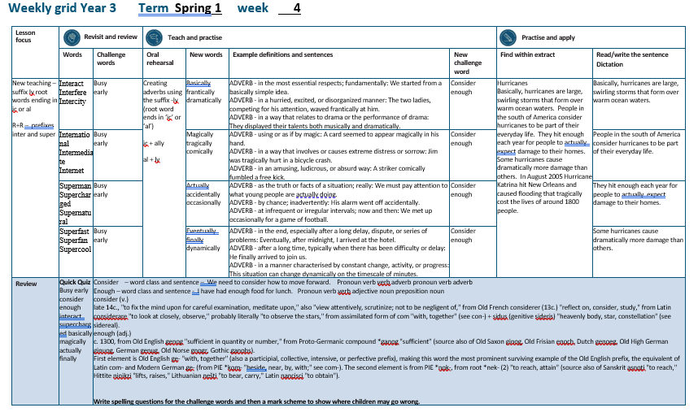

Slide 4
Let’s Revisit and Review…

Slide 5
Do you remember this challenge word?

Slide 6
busy

Slide 7
busy
The busy shop opened early for Christmas.

Slide 8
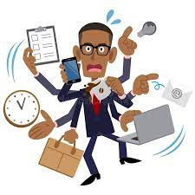
busy
The busy shop opened early for Christmas.

Slide 9
early

Slide 10
early
The busy shop opened early for Christmas.

Slide 11
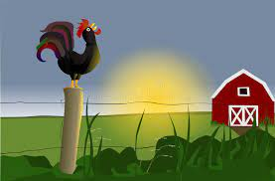
early
The busy shop opened early for Christmas.

Slide 12
The prefix inter-

Slide 13
inter-

Slide 14
inter- meaning between or among.

Slide 15
inter- meaning between or among.
The prefix inter can just be added to a root word.

Slide 16
interact

Slide 17

interact

Slide 18
interfere

Slide 19

interfere

Slide 20
intercity

Slide 21

intercity

Slide 22
Let’s Teach and Practise

Slide 23
The suffix
-ly

Slide 24
-ly

Slide 25
-ly
Creating adverbs using the suffix –ly where the root word ends in ‘ic’.
Rule – ic + ally

Slide 26
-ly
Creating adverbs using the suffix –ly where the root word ends in ‘al’.
Rule – al + ly

Slide 27
basically

Slide 28
basically

Slide 29

basically

Slide 30
frantically

Slide 31
frantically

Slide 32
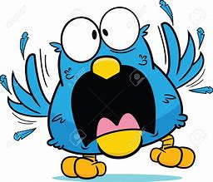
frantically

Slide 33
dramatically

Slide 34
dramatically

Slide 35
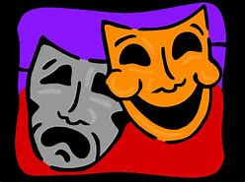
dramatically

Slide 36
basically

Slide 37
basically basic (al) + ly = basically

Slide 38
basically basic (al) + ly = basically adverb
Definition - in the most essential respects; fundamentally.

Slide 39
frantically

Slide 40
frantically frantic (al) + ly = frantically

Slide 41
frantically frantic (al) + ly = frantically adverb
Definition - in a hurried, excited, or disorganized manner.

Slide 42
dramatically

Slide 43
dramatically dramatic (al) + ly = dramatically

Slide 44
dramatically dramatic (al) + ly = dramatically adverb
Definition - in a way that relates to drama or the performance of drama.

Slide 45
We started from a basically simple idea.

Slide 46
We started from a _________ simple idea.

Slide 47
We started from a basically simple idea.

Slide 48
The two ladies, competing for his attention, waved frantically at him.

Slide 49
The two ladies, competing for his attention, waved ___________ at him.

Slide 50
The two ladies, competing for his attention, waved frantically at him.

Slide 51
They displayed their talents both musically and dramatically.

Slide 52
They displayed their talents both musically and ____________.

Slide 53
They displayed their talents both musically and dramatically.

Slide 54
New CHALLENGE words.

Slide 55
consider

Slide 56
consider
We need to consider how to move forward.

Slide 57

consider
We need to consider how to move forward.

Slide 58
We need to consider how to move forward.

Slide 59
We need to ________ how to move forward.

Slide 60
We need to consider how to move forward.

Slide 61
enough

Slide 62
enough
I have had enough food for lunch.

Slide 63
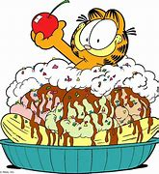
enough
I have had enough food for lunch.

Slide 64
I have had enough food for lunch.

Slide 65
I have had ______ food for lunch.

Slide 66
I have had enough food for lunch.

Slide 67
Let’s Practise and Apply.

Slide 68
Can you spot the spelling rule words and the challenge words?

Slide 69
Hurricanes
Basically, hurricanes are large, swirling storms that form over warm ocean waters. People in the south of America consider hurricanes to be part of their everyday life. They hit enough each year for people to actually expect damage to their homes. Some hurricanes cause dramatically more damage than others. In August 2005 Hurricane Katrina hit New Orleans and caused flooding that tragically cost the lives of around 1800 people.

Slide 70
Hurricanes
Basically, hurricanes are large, swirling storms that form over warm ocean waters. People in the south of America consider hurricanes to be part of their everyday life. They hit enough each year for people to actually expect damage to their homes. Some hurricanes cause dramatically more damage than others. In August 2005 Hurricane Katrina hit New Orleans and caused flooding that tragically cost the lives of around 1800 people.

Slide 71
Write this sentence as I dictate it to you.
Notes:
Basically, hurricanes are large, swirling storms that form over warm ocean waters.

Slide 72
Basically, hurricanes are large, swirling storms that form over warm ocean waters.
Did you write it correctly?
Edit your work and make sure you have it correct.
Can you underline the spelling word that we have covered in this session?

Slide 73
Year 3 - Spring 1
Week 4 - Tuesday
Notes:
Revisit and review the words from previous teaching and challenge words – I say, we say, you say
Ask children to write words only in their spelling book
Introduce the new spelling rule
Children to write the new spelling rule words and challenge words into books when the sentences are shown with the spelling word missing.
Read the extract with the class as choral reading. Practise model of prosody etc.
Ask children to find the spelling words from the session in the text.
Then read allowed the chosen sentence for children to write fully in their books.
Show the extract and ask children to then edit their work to check they were correct in their dictation.

Slide 75
Let’s Revisit and Review…

Slide 76
Do you remember this challenge word?

Slide 77
busy

Slide 78
busy
The busy shop opened early for Christmas.

Slide 79
busy
The busy shop opened early for Christmas.

Slide 80
early

Slide 81
early
The busy shop opened early for Christmas.

Slide 82
early
The busy shop opened early for Christmas.

Slide 83
The prefix inter-

Slide 84
inter-

Slide 85
inter- meaning between or among.

Slide 86
inter- meaning between or among.
The prefix inter can just be added to a root word.

Slide 87
international

Slide 88
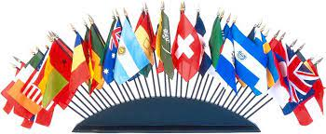
international

Slide 89
intermediate

Slide 90
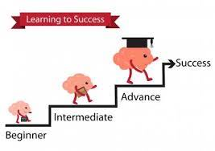
intermediate

Slide 91
internet

Slide 92

internet

Slide 93
Let’s Teach and Practise

Slide 94
The suffix
-ly

Slide 95
-ly

Slide 96
-ly
Creating adverbs using the suffix –ly where the root word ends in ‘ic’.
Rule – ic + ally

Slide 97
-ly
Creating adverbs using the suffix –ly where the root word ends in ‘al’.
Rule – al + ly

Slide 98
magically

Slide 99
magically

Slide 100

magically

Slide 101
tragically

Slide 102
tragically

Slide 103
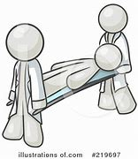
tragically

Slide 104
comically

Slide 105
comically

Slide 106
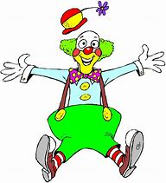
comically

Slide 107
magically

Slide 108
magically magic (al) + ly = magically

Slide 109
magically magic (al) + ly = magically adverb
Definition - using or as if by magic.

Slide 110
tragically

Slide 111
tragically tragic (al) + ly = tragically

Slide 112
tragically tragic (al) + ly = tragically adverb
Definition - in a way that involves or causes extreme distress or sorrow.

Slide 113
comically

Slide 114
comically comic (al) + ly = comically

Slide 115
comically comic (al) + ly = comically adverb
Definition - in an amusing, ludicrous, or absurd way.

Slide 116
A card seemed to appear magically in his hand.

Slide 117
A card seemed to appear _________ in his hand.

Slide 118
A card seemed to appear magically in his hand.

Slide 119
Jim was tragically hurt in a bicycle crash.

Slide 120
Jim was _________ hurt in a bicycle crash.

Slide 121
Jim was tragically hurt in a bicycle crash.

Slide 122
A striker comically fumbled a free kick.

Slide 123
A striker _________ fumbled a free kick.

Slide 124
A striker comically fumbled a free kick.

Slide 125
New CHALLENGE words.

Slide 126
consider

Slide 127
consider
We need to consider how to move forward.

Slide 128
consider
We need to consider how to move forward.

Slide 129
We need to consider how to move forward.

Slide 130
We need to ________ how to move forward.

Slide 131
We need to consider how to move forward.

Slide 132
enough

Slide 133
enough
I have had enough food for lunch.

Slide 134
enough
I have had enough food for lunch.

Slide 135
I have had enough food for lunch.

Slide 136
I have had ______ food for lunch.

Slide 137
I have had enough food for lunch.

Slide 138
Let’s Practise and Apply.

Slide 139
Can you spot the spelling rule words and the challenge words?

Slide 140
Hurricanes
Basically, hurricanes are large, swirling storms that form over warm ocean waters. People in the south of America consider hurricanes to be part of their everyday life. They hit enough each year for people to actually expect damage to their homes. Some hurricanes cause dramatically more damage than others. In August 2005 Hurricane Katrina hit New Orleans and caused flooding that tragically cost the lives of around 1800 people.

Slide 141
Hurricanes
Basically, hurricanes are large, swirling storms that form over warm ocean waters. People in the south of America consider hurricanes to be part of their everyday life. They hit enough each year for people to actually expect damage to their homes. Some hurricanes cause dramatically more damage than others. In August 2005 Hurricane Katrina hit New Orleans and caused flooding that tragically cost the lives of around 1800 people.

Slide 142
Write this sentence as I dictate it to you.
Notes:
People in the south of America consider hurricanes to be part of their everyday life.

Slide 143
People in the south of America consider hurricanes to be part of their everyday life.
Did you write it correctly?
Edit your work and make sure you have it correct.
Can you underline the spelling word that we have covered in this session?

Slide 144
Year 3 - Spring 1
Week 4 - Wednesday

Slide 146
Let’s Revisit and Review…

Slide 147
Do you remember this challenge word?

Slide 148
busy

Slide 149
busy
The busy shop opened early for Christmas.

Slide 150
busy
The busy shop opened early for Christmas.

Slide 151
early

Slide 152
early
The busy shop opened early for Christmas.

Slide 153
early
The busy shop opened early for Christmas.

Slide 154
The prefix super-

Slide 155
super-

Slide 156
super- meaning above / best

Slide 157
super- meaning above / best
The prefix super- can just be added to a root word.

Slide 158
superman

Slide 159

superman

Slide 160
supercharged

Slide 161
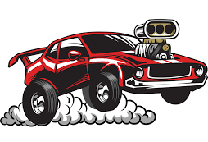
supercharged

Slide 162
supernatural

Slide 163
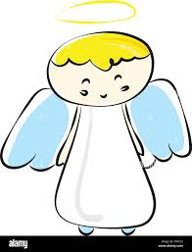
supernatural

Slide 164
Let’s Teach and Practise

Slide 165
The suffix
-ly

Slide 166
-ly

Slide 167
-ly
Creating adverbs using the suffix –ly where the root word ends in ‘ic’.
Rule – ic + ally

Slide 168
-ly
Creating adverbs using the suffix –ly where the root word ends in ‘al’.
Rule – al + ly

Slide 169
actually

Slide 170
actually

Slide 171

actually

Slide 172
accidentally

Slide 173
accidentally

Slide 174
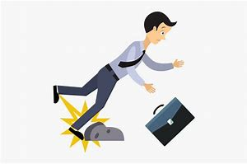
accidentally

Slide 175
occasionally

Slide 176
occasionally

Slide 177

occasionally

Slide 178
actually

Slide 179
actually actual + ly = actually

Slide 180
actually actual + ly = actually adverb
Definition - as the truth or facts of a situation.

Slide 181
accidentally

Slide 182
accidentally accidental + ly = accidentally

Slide 183
accidentally accidental + ly = accidentally adverb
Definition - by chance; inadvertently.

Slide 184
occasionally

Slide 185
occasionally occasional + ly = occasionally

Slide 186
occasionally occasional + ly = occasionally adverb
Definition - at infrequent or irregular intervals.

Slide 187
We must pay attention to what young people are actually doing.

Slide 188
We must pay attention to what young people are ________ doing.

Slide 189
We must pay attention to what young people are actually doing.

Slide 190
His alarm went off accidentally.

Slide 191
His alarm went off ____________.

Slide 192
His alarm went off accidentally.

Slide 193
We met up occasionally for a game of football.

Slide 194
We met up ____________ for a game of football.

Slide 195
We met up occasionally for a game of football.

Slide 196
New CHALLENGE words.

Slide 197
consider

Slide 198
consider
We need to consider how to move forward.

Slide 199
consider
We need to consider how to move forward.

Slide 200
We need to consider how to move forward.

Slide 201
We need to ________ how to move forward.

Slide 202
We need to consider how to move forward.

Slide 203
enough

Slide 204
enough
I have had enough food for lunch.

Slide 205
enough
I have had enough food for lunch.

Slide 206
I have had enough food for lunch.

Slide 207
I have had ______ food for lunch.

Slide 208
I have had enough food for lunch.

Slide 209
Let’s Practise and Apply.

Slide 210
Can you spot the spelling rule words and the challenge words?

Slide 211
Hurricanes
Basically, hurricanes are large, swirling storms that form over warm ocean waters. People in the south of America consider hurricanes to be part of their everyday life. They hit enough each year for people to actually expect damage to their homes. Some hurricanes cause dramatically more damage than others. In August 2005 Hurricane Katrina hit New Orleans and caused flooding that tragically cost the lives of around 1800 people.

Slide 212
Hurricanes
Basically, hurricanes are large, swirling storms that form over warm ocean waters. People in the south of America consider hurricanes to be part of their everyday life. They hit enough each year for people to actually expect damage to their homes. Some hurricanes cause dramatically more damage than others. In August 2005 Hurricane Katrina hit New Orleans and caused flooding that tragically cost the lives of around 1800 people.

Slide 213
Write this sentence as I dictate it to you.
Notes:
They hit enough each year for people to actually expect damage to their homes.

Slide 214
They hit enough each year for people to actually expect damage to their homes.
Did you write it correctly?
Edit your work and make sure you have it correct.
Can you underline the spelling word that we have covered in this session?

Slide 215
Year 3 - Spring 1
Week 4 - Thursday

Slide 217
Let’s Revisit and Review…

Slide 218
Do you remember this challenge word?

Slide 219
busy

Slide 220
busy
The busy shop opened early for Christmas.

Slide 221
busy
The busy shop opened early for Christmas.

Slide 222
early

Slide 223
early
The busy shop opened early for Christmas.

Slide 224
early
The busy shop opened early for Christmas.

Slide 225
The prefix super-

Slide 226
super-

Slide 227
super- meaning above / best

Slide 228
super- meaning above / best
The prefix super- can just be added to a root word.

Slide 229
superfast

Slide 230

superfast

Slide 231
superfan

Slide 232

superfan

Slide 233
supercool

Slide 234
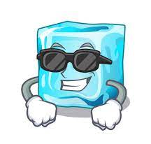
supercool

Slide 235
Let’s Teach and Practise

Slide 236
The suffix
-ly

Slide 237
-ly

Slide 238
-ly
Creating adverbs using the suffix –ly where the root word ends in ‘ic’.
Rule – ic + ally

Slide 239
-ly
Creating adverbs using the suffix –ly where the root word ends in ‘al’.
Rule – al + ly

Slide 240
eventually

Slide 241
eventually

Slide 242
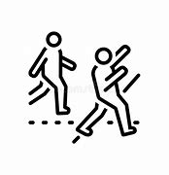
eventually

Slide 243
finally

Slide 244
finally

Slide 245

finally

Slide 246
dynamically

Slide 247
dynamically

Slide 248

dynamically

Slide 249
eventually

Slide 250
eventually eventual + ly = eventually

Slide 251
eventually eventual + ly = eventually adverb
Definition - in the end, especially after a long delay, dispute, or series of problems.

Slide 252
finally

Slide 253
finally final + ly = finally

Slide 254
finally final + ly = finally adverb
Definition - after a long time, typically when there has been difficulty or delay.

Slide 255
dynamically

Slide 256
dynamically dynamic (al) + ly = dynamically

Slide 257
dynamically dynamic (al) + ly = dynamically adverb
Definition - in a manner characterised by constant change, activity, or progress.

Slide 258
Eventually, after midnight, I arrived at the hotel.

Slide 259
__________, after midnight, I arrived at the hotel.

Slide 260
Eventually, after midnight, I arrived at the hotel.

Slide 261
He finally arrived to join us.

Slide 262
He _______ arrived to join us.

Slide 263
He finally arrived to join us.

Slide 264
This situation can change dynamically on the timescale of minutes.

Slide 265
This situation can change ___________ on the timescale of minutes.

Slide 266
This situation can change dynamically on the timescale of minutes.

Slide 267
New CHALLENGE words.

Slide 268
consider

Slide 269
consider
We need to consider how to move forward.

Slide 270
consider
We need to consider how to move forward.

Slide 271
We need to consider how to move forward.

Slide 272
We need to ________ how to move forward.

Slide 273
We need to consider how to move forward.

Slide 274
enough

Slide 275
enough
I have had enough food for lunch.

Slide 276
enough
I have had enough food for lunch.

Slide 277
I have had enough food for lunch.

Slide 278
I have had ______ food for lunch.

Slide 279
I have had enough food for lunch.

Slide 280
Let’s Practise and Apply.

Slide 281
Can you spot the spelling rule words and the challenge words?

Slide 282
Hurricanes
Basically, hurricanes are large, swirling storms that form over warm ocean waters. People in the south of America consider hurricanes to be part of their everyday life. They hit enough each year for people to actually expect damage to their homes. Some hurricanes cause dramatically more damage than others. In August 2005 Hurricane Katrina hit New Orleans and caused flooding that tragically cost the lives of around 1800 people.

Slide 283
Hurricanes
Basically, hurricanes are large, swirling storms that form over warm ocean waters. People in the south of America consider hurricanes to be part of their everyday life. They hit enough each year for people to actually expect damage to their homes. Some hurricanes cause dramatically more damage than others. In August 2005 Hurricane Katrina hit New Orleans and caused flooding that tragically cost the lives of around 1800 people.

Slide 284
Write this sentence as I dictate it to you.
Notes:
Some hurricanes cause dramatically more damage than others.

Slide 285
Some hurricanes cause dramatically more damage than others.
Did you write it correctly?
Edit your work and make sure you have it correct.
Can you underline the spelling word that we have covered in this session?

Slide 286
Year 3 - Spring 1
Week 4 - Friday
Notes:
Click through the slides for all the R+R words for the week (both the focus and the challenge words)
Click through the slides for all the new learning this week

Slide 288
Old challenge words…

Slide 289
busy

Slide 290
early

Slide 291
Old spelling rule words…

Slide 292
interact

Slide 293
interfere

Slide 294
intercity

Slide 295
international

Slide 296
intermediate

Slide 297
internet

Slide 298
superman

Slide 299
supercharged

Slide 300
supernatural

Slide 301
superfast

Slide 302
superfan

Slide 303
supercool

Slide 304
New spelling rule words…

Slide 305
basically

Slide 306
frantically

Slide 307
dramatically

Slide 308
magically

Slide 309
tragically

Slide 310
comically

Slide 311
actually

Slide 312
accidentially

Slide 313
occasionally

Slide 314
eventually

Slide 315
finally

Slide 316
dynamically

Slide 317
New challenge words…

Slide 318
consider

Slide 319
enough

Slide 320
Quick Quiz time…
Notes:
Say these words for the quiz
Busy early consider enough interact supercharged basically magically actually finally

Slide 321
Did you get them correct?
Edit your work.
busy early consider enough interact supercharged basically magically actually finally

Slide 322
Word class time…

Slide 323
We need to consider how to move forward.
Notes:
Ask for these words to be classed

Slide 324
We need to consider how to move forward.
Pronoun verb verb adverb pronoun verb adverb
Notes:
Ask for these words to be classed

Slide 325
We need to consider how to move forward.
Pronoun verb verb adverb pronoun verb adverb
Notes:
Ask for these words to be classed

Slide 326
I have had enough food for lunch.
Notes:
Ask for these words to be classed

Slide 327
I have had enough food for lunch.
Pronoun verb verb adjective noun preposition noun

Slide 328
I have had enough food for lunch.
Pronoun verb verb adjective noun preposition noun

Slide 329
Etymology
The history of a word….

Slide 330
consider (v.)
late 14c., "to fix the mind upon for careful examination, meditate upon," also "view attentively, scrutinize; not to be negligent of," from Old French considerer (13c.) "reflect on, consider, study," from Latin considerare "to look at closely, observe," probably literally "to observe the stars," from assimilated form of com "with, together" (see con-) + sidus (genitive sideris) "heavenly body, star, constellation" (see sidereal).
enough (adj.)
c. 1300, from Old English genog "sufficient in quantity or number," from Proto-Germanic compound *ganog "sufficient" (source also of Old Saxon ginog, Old Frisian enoch, Dutch genoeg, Old High German ginuog, German genug, Old Norse gnogr, Gothic ganohs).
First element is Old English ge- "with, together" (also a participial, collective, intensive, or perfective prefix), making this word the most prominent surviving example of the Old English prefix, the equivalent of Latin com- and Modern German ge- (from PIE *kom- "beside, near, by, with;" see com-). The second element is from PIE *nok-, from root *nek- (2) "to reach, attain" (source also of Sanskrit asnoti "to reach," Hittite ninikzi "lifts, raises," Lithuanian nešti "to bear, carry," Latin nancisci "to obtain").

Slide 331
Let’s investigate….
Write spelling questions for the challenge words and then a mark scheme to show where children may go wrong.

Slide 332
Spelling question for ‘consider’…

Slide 333
Spelling question for ‘enough’…

