Slide 1
Spelling Y3
Mastering spellings: building on the foundations of phonics
Spring 1
Week 5

Slide 2
Year 3 - Spring 1
Week 5 - Monday

Slide 3
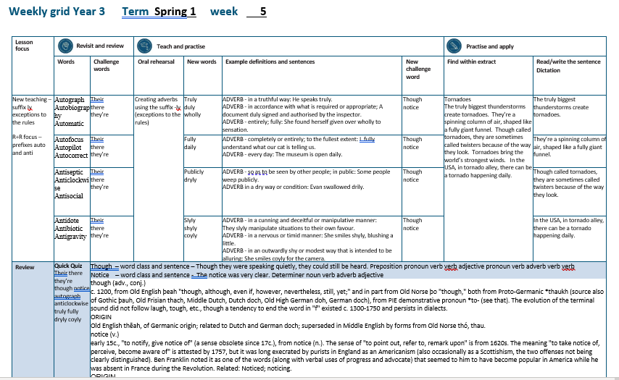

Slide 4
Let’s Revisit and Review…

Slide 5
Do you remember these challenge words?

Slide 6
their

Slide 7
their
It was their ball.

Slide 8
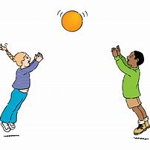
their
It was their ball.

Slide 9
there

Slide 10
there
Over there it was raining.

Slide 11
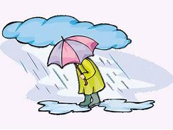
there
Over there it was raining.

Slide 12
they’re

Slide 13
they’re
They’re happy.

Slide 14
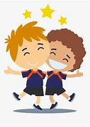
they’re
They’re happy.

Slide 15
The prefix auto-

Slide 16
auto -

Slide 17
auto - meaning self or own

Slide 18
auto - meaning self or own
The prefix auto- can be added to most root words without changes.

Slide 19
autograph

Slide 20
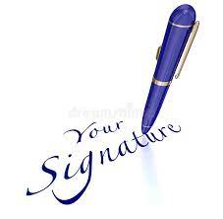
autograph

Slide 21
autobiography

Slide 22
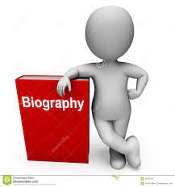
autobiography

Slide 23
automatic

Slide 24
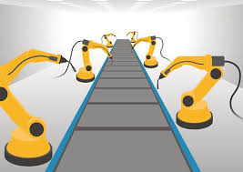
automatic

Slide 25
Let’s Teach and Practise

Slide 26
The suffix
-ly

Slide 27
-ly

Slide 28
-ly exceptions to the previous rules

Slide 29
truly

Slide 30
truly

Slide 31

truly

Slide 32
duly

Slide 33
duly

Slide 34

duly

Slide 35
wholly

Slide 36
wholly

Slide 37
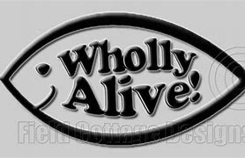
wholly

Slide 38
truly

Slide 39
truly true (-e) + ly = truly

Slide 40
truly true (-e) + ly = truly adverb
Definition - in a truthful way.

Slide 41
duly

Slide 42
Duly due (-e) + ly = duly

Slide 43
Duly due (-e) + ly = duly adverb
Definition -in accordance with what is required or appropriate.

Slide 44
wholly

Slide 45
wholly whole (-e) + ly = wholly

Slide 46
wholly whole (-e) + ly = wholly adverb
Definition – entirely / fully.

Slide 47
He speaks truly.

Slide 48
He speaks _____.

Slide 49
He speaks truly.

Slide 50
A document was duly signed and authorised by the inspector.

Slide 51
A document was ____ signed and authorised by the inspector.

Slide 52
A document was duly signed and authorised by the inspector.

Slide 53
She found herself given over wholly to sensation.

Slide 54
She found herself given over ______ to sensation.

Slide 55
She found herself given over wholly to sensation.

Slide 56
New CHALLENGE words.

Slide 57
though

Slide 58
though
Though they were speaking quietly, they could still be heard.

Slide 59
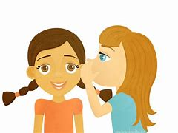
though
Though they were speaking quietly, they could still be heard.

Slide 60
Though they were speaking quietly, they could still be heard.

Slide 61
______ they were speaking quietly, they could still be heard.

Slide 62
Though they were speaking quietly, they could still be heard.

Slide 63
notice

Slide 64
notice
The notice was very clear.

Slide 65
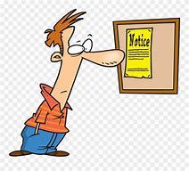
notice
The notice was very clear.

Slide 66
The notice was very clear.

Slide 67
The ______ was very clear.

Slide 68
The notice was very clear.

Slide 69
Let’s Practise and Apply.

Slide 70
Can you spot the spelling rule words and the challenge words?

Slide 71
Tornadoes
The truly biggest thunderstorms create tornadoes. They’re a spinning column of air, shaped like a fully giant funnel. Though called tornadoes, they are sometimes called twisters because of the way they look. Tornadoes bring the world’s strongest winds. In the USA, in tornado alley, there can be a tornado happening daily.

Slide 72
Tornadoes
The truly biggest thunderstorms create tornadoes. They’re a spinning column of air, shaped like a fully giant funnel. Though called tornadoes, they are sometimes called twisters because of the way they look. Tornadoes bring the world’s strongest winds. In the USA, in tornado alley, there can be a tornado happening daily.

Slide 73
Write this sentence as I dictate it to you.
Notes:
The truly biggest thunderstorms create tornadoes.

Slide 74
The truly biggest thunderstorms create tornadoes.
Did you write it correctly?
Edit your work and make sure you have it correct.
Can you underline the spelling word that we have covered in this session?

Slide 75
Year 3 - Spring 1
Week 5 - Tuesday
Notes:
Revisit and review the words from previous teaching and challenge words – I say, we say, you say
Ask children to write words only in their spelling book
Introduce the new spelling rule
Children to write the new spelling rule words and challenge words into books when the sentences are shown with the spelling word missing.
Read the extract with the class as choral reading. Practise model of prosody etc.
Ask children to find the spelling words from the session in the text.
Then read allowed the chosen sentence for children to write fully in their books.
Show the extract and ask children to then edit their work to check they were correct in their dictation.

Slide 77
Let’s Revisit and Review…

Slide 78
Do you remember these challenge words?

Slide 79
their

Slide 80
their
It was their ball.

Slide 81
their
It was their ball.

Slide 82
there

Slide 83
there
Over there it was raining.

Slide 84
there
Over there it was raining.

Slide 85
they’re

Slide 86
they’re
They’re happy.

Slide 87
they’re
They’re happy.

Slide 88
The prefix auto-

Slide 89
auto -

Slide 90
auto - meaning self or own

Slide 91
auto - meaning self or own
The prefix auto- can be added to most root words without changes.

Slide 92
autofocus

Slide 93
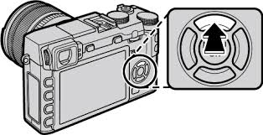
autofocus

Slide 94
autopilot

Slide 95
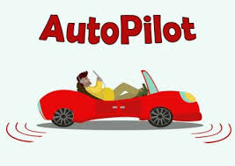
autopilot

Slide 96
autocorrect

Slide 97

autocorrect

Slide 98
Let’s Teach and Practise

Slide 99
The suffix
-ly

Slide 100
-ly

Slide 101
-ly exceptions to the previous rules

Slide 102
fully

Slide 103
fully

Slide 104
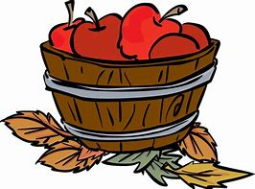
fully

Slide 105
daily

Slide 106
daily

Slide 107
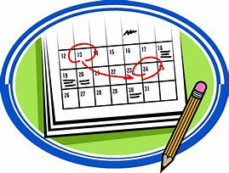
daily

Slide 108
fully

Slide 109
fully full (-l) + ly = fully

Slide 110
fully full (-l) + ly = fully adverb
Definition - completely or entirely; to the fullest extent.

Slide 111
duly

Slide 112
daily day (-y +i) + ly = daily

Slide 113
daily day (-y +i) + ly = daily adverb
Definition - every day.

Slide 114
I fully understand what our cat is telling us.

Slide 115
I _____ understand what our cat is telling us.

Slide 116
I fully understand what our cat is telling us.

Slide 117
The museum is open daily.

Slide 118
The museum is open _____.

Slide 119
The museum is open daily.

Slide 120
New CHALLENGE words.

Slide 121
though

Slide 122
though
Though they were speaking quietly, they could still be heard.

Slide 123
though
Though they were speaking quietly, they could still be heard.

Slide 124
Though they were speaking quietly, they could still be heard.

Slide 125
______ they were speaking quietly, they could still be heard.

Slide 126
Though they were speaking quietly, they could still be heard.

Slide 127
notice

Slide 128
notice
The notice was very clear.

Slide 129
notice
The notice was very clear.

Slide 130
The notice was very clear.

Slide 131
The ______ was very clear.

Slide 132
The notice was very clear.

Slide 133
Let’s Practise and Apply.

Slide 134
Can you spot the spelling rule words and the challenge words?

Slide 135
Tornadoes
The truly biggest thunderstorms create tornadoes. They’re a spinning column of air, shaped like a fully giant funnel. Though called tornadoes, they are sometimes called twisters because of the way they look. Tornadoes bring the world’s strongest winds. In the USA, in tornado alley, there can be a tornado happening daily.

Slide 136
Tornadoes
The truly biggest thunderstorms create tornadoes. They’re a spinning column of air, shaped like a fully giant funnel. Though called tornadoes, they are sometimes called twisters because of the way they look. Tornadoes bring the world’s strongest winds. In the USA, in tornado alley, there can be a tornado happening daily.

Slide 137
Write this sentence as I dictate it to you.
Notes:
They’re a spinning column of air, shaped like a fully giant funnel.

Slide 138
They’re a spinning column of air, shaped like a fully giant funnel.
Did you write it correctly?
Edit your work and make sure you have it correct.
Can you underline the spelling word that we have covered in this session?

Slide 139
Year 3 - Spring 1
Week 5 - Wednesday
Notes:
Revisit and review the words from previous teaching and challenge words – I say, we say, you say
Ask children to write words only in their spelling book
Introduce the new spelling rule
Children to write the new spelling rule words and challenge words into books when the sentences are shown with the spelling word missing.
Read the extract with the class as choral reading. Practise model of prosody etc.
Ask children to find the spelling words from the session in the text.
Then read allowed the chosen sentence for children to write fully in their books.
Show the extract and ask children to then edit their work to check they were correct in their dictation.

Slide 141
Let’s Revisit and Review…

Slide 142
Do you remember these challenge words?

Slide 143
their

Slide 144
their
It was their ball.

Slide 145
their
It was their ball.

Slide 146
there

Slide 147
there
Over there it was raining.

Slide 148
there
Over there it was raining.

Slide 149
they’re

Slide 150
they’re
They’re happy.

Slide 151
they’re
They’re happy.

Slide 152
The prefix anti-

Slide 153
anti -

Slide 154
anti - meaning against

Slide 155
auto - meaning against
The prefix anti- can be added to most root words without changes.

Slide 156
antiseptic

Slide 157

antiseptic

Slide 158
anticlockwise

Slide 159

anticlockwise

Slide 160
antisocial

Slide 161

antisocial

Slide 162
Let’s Teach and Practise

Slide 163
The suffix
-ly

Slide 164
-ly

Slide 165
-ly exceptions to the previous rules

Slide 166
publicly

Slide 167
publicly

Slide 168
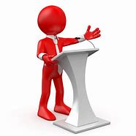
publicly

Slide 169
dryly

Slide 170
dryly

Slide 171
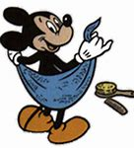
dryly

Slide 172
publicly

Slide 173
publicly public + ly = publicly

Slide 174
publicly public + ly = publicly adverb
Definition - so as to be seen by other people; in public.

Slide 175
dryly

Slide 176
dryly dry + ly = dryly

Slide 177
dryly dry + ly = dryly adverb
Definition - in a dry way or condition.

Slide 178
Some people weep publicly.

Slide 179
Some people weep ________.

Slide 180
Some people weep publicly.

Slide 181
Evan swallowed dryly.

Slide 182
Evan swallowed _____.

Slide 183
Evan swallowed dryly.

Slide 184
New CHALLENGE words.

Slide 185
though

Slide 186
though
Though they were speaking quietly, they could still be heard.

Slide 187
though
Though they were speaking quietly, they could still be heard.

Slide 188
Though they were speaking quietly, they could still be heard.

Slide 189
______ they were speaking quietly, they could still be heard.

Slide 190
Though they were speaking quietly, they could still be heard.

Slide 191
notice

Slide 192
notice
The notice was very clear.

Slide 193
notice
The notice was very clear.

Slide 194
The notice was very clear.

Slide 195
The ______ was very clear.

Slide 196
The notice was very clear.

Slide 197
Let’s Practise and Apply.

Slide 198
Can you spot the spelling rule words and the challenge words?

Slide 199
Tornadoes
The truly biggest thunderstorms create tornadoes. They’re a spinning column of air, shaped like a fully giant funnel. Though called tornadoes, they are sometimes called twisters because of the way they look. Tornadoes bring the world’s strongest winds. In the USA, in tornado alley, there can be a tornado happening daily.

Slide 200
Tornadoes
The truly biggest thunderstorms create tornadoes. They’re a spinning column of air, shaped like a fully giant funnel. Though called tornadoes, they are sometimes called twisters because of the way they look. Tornadoes bring the world’s strongest winds. In the USA, in tornado alley, there can be a tornado happening daily.

Slide 201
Write this sentence as I dictate it to you.
Notes:
Though called tornadoes, they are sometimes called twisters because of the way they look.

Slide 202
Though called tornadoes, they are sometimes called twisters because of the way they look.
Did you write it correctly?
Edit your work and make sure you have it correct.
Can you underline the spelling word that we have covered in this session?

Slide 203
Year 3 - Spring 1
Week 5 - Thursday
Notes:
Revisit and review the words from previous teaching and challenge words – I say, we say, you say
Ask children to write words only in their spelling book
Introduce the new spelling rule
Children to write the new spelling rule words and challenge words into books when the sentences are shown with the spelling word missing.
Read the extract with the class as choral reading. Practise model of prosody etc.
Ask children to find the spelling words from the session in the text.
Then read allowed the chosen sentence for children to write fully in their books.
Show the extract and ask children to then edit their work to check they were correct in their dictation.

Slide 205
Let’s Revisit and Review…

Slide 206
Do you remember these challenge words?

Slide 207
their

Slide 208
their
It was their ball.

Slide 209
their
It was their ball.

Slide 210
there

Slide 211
there
Over there it was raining.

Slide 212
there
Over there it was raining.

Slide 213
they’re

Slide 214
they’re
They’re happy.

Slide 215
they’re
They’re happy.

Slide 216
anti - meaning against

Slide 217
auto - meaning against
The prefix anti- can be added to most root words without changes.

Slide 218
antidote

Slide 219

antidote

Slide 220
antibiotic

Slide 221

antibiotic

Slide 222
antigravity

Slide 223
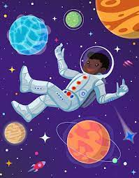
antigravity

Slide 224
Let’s Teach and Practise

Slide 225
The suffix
-ly

Slide 226
-ly

Slide 227
-ly exceptions to the previous rules

Slide 228
slyly

Slide 229
slyly

Slide 230
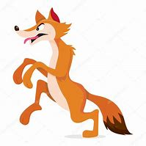
slyly

Slide 231
shyly

Slide 232
shyly

Slide 233

shyly

Slide 234
coyly

Slide 235
coyly

Slide 236
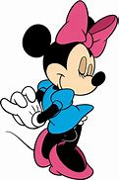
coyly

Slide 237
slyly

Slide 238
slyly sly + ly = slyly

Slide 239
slyly sly + ly = slyly adverb
Definition - in a cunning and deceitful or manipulative manner.

Slide 240
shyly

Slide 241
shyly shy + ly = shyly

Slide 242
shyly shy + ly = shyly adverb
Definition - in a nervous or timid manner.

Slide 243
coyly

Slide 244
coyly coy + ly = coyly

Slide 245
coyly coy + ly = coyly adverb
Definition -in an outwardly shy or modest way that is intended to be alluring.

Slide 246
They slyly manipulate situations to their own favour.

Slide 247
They _____ manipulate situations to their own favour.

Slide 248
They slyly manipulate situations to their own favour.

Slide 249
She smiles _____, blushing a little.

Slide 250
She smiles shyly, blushing a little.

Slide 251
She smiles shyly, blushing a little.

Slide 252
She smiles coyly for the camera.

Slide 253
She smiles _____ for the camera.

Slide 254
She smiles coyly for the camera.

Slide 255
New CHALLENGE words.

Slide 256
though

Slide 257
though
Though they were speaking quietly, they could still be heard.

Slide 258
though
Though they were speaking quietly, they could still be heard.

Slide 259
Though they were speaking quietly, they could still be heard.

Slide 260
______ they were speaking quietly, they could still be heard.

Slide 261
Though they were speaking quietly, they could still be heard.

Slide 262
notice

Slide 263
notice
The notice was very clear.

Slide 264
notice
The notice was very clear.

Slide 265
The notice was very clear.

Slide 266
The ______ was very clear.

Slide 267
The notice was very clear.

Slide 268
Let’s Practise and Apply.

Slide 269
Can you spot the spelling rule words and the challenge words?

Slide 270
Tornadoes
The truly biggest thunderstorms create tornadoes. They’re a spinning column of air, shaped like a fully giant funnel. Though called tornadoes, they are sometimes called twisters because of the way they look. Tornadoes bring the world’s strongest winds. In the USA, in tornado alley, there can be a tornado happening daily.

Slide 271
Tornadoes
The truly biggest thunderstorms create tornadoes. They’re a spinning column of air, shaped like a fully giant funnel. Though called tornadoes, they are sometimes called twisters because of the way they look. Tornadoes bring the world’s strongest winds. In the USA, in tornado alley, there can be a tornado happening daily.

Slide 272
Write this sentence as I dictate it to you.
Notes:
In the USA, in tornado alley, there can be a tornado happening daily.

Slide 273
In the USA, in tornado alley, there can be a tornado happening daily.
Did you write it correctly?
Edit your work and make sure you have it correct.
Can you underline the spelling word that we have covered in this session?

Slide 274
Year 3 - Spring 1
Week 5 - Friday
Notes:
Click through the slides for all the R+R words for the week (both the focus and the challenge words)
Click through the slides for all the new learning this week

Slide 276
Old challenge words…

Slide 277
their

Slide 278
there

Slide 279
they’re

Slide 280
Old spelling rule words…

Slide 281
autograph

Slide 282
autobiography

Slide 283
automatic

Slide 284
autofocus

Slide 285
autopilot

Slide 286
autocorrect

Slide 287
antiseptic

Slide 288
anticlockwise

Slide 289
antisocial

Slide 290
antidote

Slide 291
antibiotic

Slide 292
antigravity

Slide 293
New spelling rule words…

Slide 294
truly

Slide 295
duly

Slide 296
wholly

Slide 297
fully

Slide 298
daily

Slide 299
publicly

Slide 300
dryly

Slide 301
slyly

Slide 302
shyly

Slide 303
coyly

Slide 304
New challenge words…

Slide 305
though

Slide 306
notice

Slide 307
Quick Quiz time…
Notes:
Say these words for the quiz
Their there they’re though notice autograph anticlockwise truly fully dryly coyly

Slide 308
Did you get them correct?
Edit your work.
their there they’re though notice autograph anticlockwise truly fully dryly coyly

Slide 309
Word class time…

Slide 310
Though they were speaking quietly, they could still be heard.
Notes:
Ask for these words to be classed

Slide 311
Though they were speaking quietly, they could still be heard.
preposition pronoun verb verb adjective pronounadverb verb verb
Notes:
Ask for these words to be classed

Slide 312
Though they were speaking quietly, they could still be heard.
preposition pronoun verb verb adjective pronounadverb verb verb
Notes:
Ask for these words to be classed

Slide 313
The notice was very clear.
Notes:
Ask for these words to be classed

Slide 314
The notice was very clear.
Determiner noun verb adverb adjective

Slide 315
The notice was very clear.
Determiner noun verb adverb adjective

Slide 316
Etymology
The history of a word….

Slide 317
though (adv., conj.)
c. 1200, from Old English þeah "though, although, even if, however, nevertheless, still, yet;" and in part from Old Norse þo "though," both from Proto-Germanic *thaukh (source also of Gothic þauh, Old Frisian thach, Middle Dutch, Dutch doch, Old High German doh, German doch), from PIE demonstrative pronoun *to- (see that). The evolution of the terminal sound did not follow laugh, tough, etc., though a tendency to end the word in "f" existed c. 1300-1750 and persists in dialects.
ORIGIN
Old English thēah, of Germanic origin; related to Dutch and German doch; superseded in Middle English by forms from Old Norse thó, thau.
notice (v.)
early 15c., "to notify, give notice of" (a sense obsolete since 17c.), from notice (n.). The sense of "to point out, refer to, remark upon" is from 1620s. The meaning "to take notice of, perceive, become aware of" is attested by 1757, but it was long execrated by purists in England as an Americanism (also occasionally as a Scottishism, the two offenses not being clearly distinguished). Ben Franklin noted it as one of the words (along with verbal uses of progress and advocate) that seemed to him to have become popular in America while he was absent in France during the Revolution. Related: Noticed; noticing.
ORIGIN
late Middle English (in notice): from Old French, from Latin notitia ‘being known’, from notus ‘known’ (see notion).

Slide 318
Let’s investigate….
Find synonyms and antonyms of the challenge words.

Slide 319
Synonyms and antonyms for ‘though’…

Slide 320
Synonyms and antonyms for ‘notice’…

