Slide 1
Spelling Y3
Mastering spellings: building on the foundations of phonics
Spring 1
Week 6

Slide 2
Year 3 - Spring 1
Week 6 - Monday

Slide 3
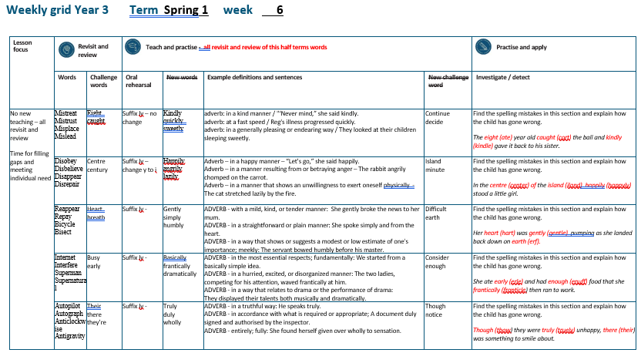

Slide 4
Let’s Revisit and Review…

Slide 5
Do you remember this challenge word?

Slide 6
eight

Slide 7
eight
Definition – number cardinal number: eight equivalent to the product of two and four; one more than seven, or two less than ten; 8.

Slide 8

eight
I am eight at my next birthday.

Slide 9
Do you remember this challenge word?

Slide 10
caught

Slide 11
caught verb past tense
Definition – intercept and hold (something which has been thrown, propelled, or dropped)

Slide 12
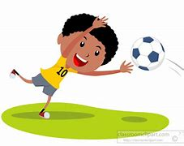
caught
The goalie caught the ball.

Slide 13
The prefix mis-

Slide 14
mis-

Slide 15
mis-
Like un–, the prefixes dis– and mis– have negative meanings.

Slide 16
misspell

Slide 17
misspell

Slide 18
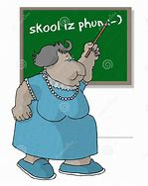
misspell

Slide 19
misshape

Slide 20
misshape

Slide 21
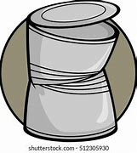
misshape

Slide 22
mistreat

Slide 23
mistreat

Slide 24
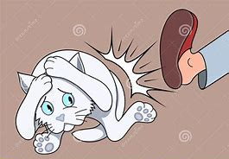
mistreat

Slide 25
Let’s Teach and Practise

Slide 26
The suffix
-ly

Slide 27
-ly

Slide 28
-ly
The suffix –ly is added to an adjective to form an adverb. The rules already learnt still apply.
The suffix –ly starts with a consonant letter, so it is added straight on to most root words

Slide 29
kindly

Slide 30
kindly

Slide 31
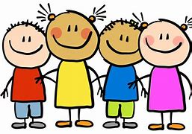
kindly

Slide 32
quickly

Slide 33
quickly

Slide 34
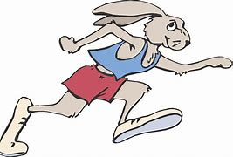
quickly

Slide 35
sweetly

Slide 36
sweetly

Slide 37
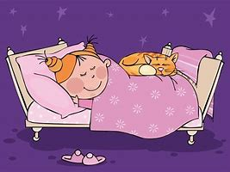
sweetly

Slide 38
"Never mind,” she said kindly.

Slide 39
"Never mind,” she said ______.

Slide 40
"Never mind,” she said kindly.

Slide 41
Reg's illness progressed quickly.

Slide 42
Reg's illness progressed _______.

Slide 43
Reg's illness progressed quickly.

Slide 44
They looked at their children sleeping sweetly.

Slide 45
They looked at their children sleeping _______.

Slide 46
They looked at their children sleeping sweetly.

Slide 47
New CHALLENGE words.

Slide 48
continue

Slide 49
continue
He was unable to continue with his job.

Slide 50

continue
He was unable to continue with his job.

Slide 51
He was unable to ________ with his job.

Slide 52
He was unable to continue with his job.

Slide 53
decided

Slide 54
decided
She decided that she liked him.

Slide 55

decided
She decided that she liked him.

Slide 56
She decided that she liked him.

Slide 57
She _______ that she liked him.

Slide 58
She decided that she liked him.

Slide 59
Let’s investigate.

Slide 60
Can you spot the spelling errors in these sentences?
Write the correct spelling and explain where they went wrong.

Slide 61
The ate year old cort the ball and kindle gave it back to his sister.

Slide 62
The ate year old cort the ball and kindle gave it back to his sister. ate – eight not the verb ‘to eat’ but the number 8

Slide 63
The ate year old cort the ball and kindle gave it back to his sister. cort – caught not the ‘or’ but the ‘augh’

Slide 64
The ate year old cort the ball and kindle gave it back to his sister. kindle – kindly not ‘le’ but ‘ly’

Slide 65
The eight year old caught the ball and kindly gave it back to his sister.

Slide 66
Year 3 - Spring 1
Week 6 - Tuesday

Slide 68
Let’s Revisit and Review…

Slide 69
Do you remember this challenge word?

Slide 70
centre

Slide 71
centre
NOUN
Definition – the point that is equally distant from every point on the circumference of a circle or sphere.

Slide 72

centre
NOUN
Definition – the point that is equally distant from every point on the circumference of a circle or sphere.

Slide 73
Do you remember this challenge word?

Slide 74
century

Slide 75
century
NOUN
Definition – a period of one hundred years

Slide 76
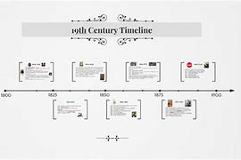
century
NOUN
Definition – a period of one hundred years

Slide 77
The prefix dis-

Slide 78
dis-

Slide 79
dis-
Like un–, the prefixes dis– and mis– have negative meanings.

Slide 80
dislike

Slide 81
dislike

Slide 82

dislike

Slide 83
disobey

Slide 84
disobey

Slide 85
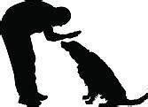
disobey

Slide 86
discolour

Slide 87
discolour

Slide 88
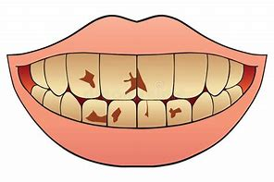
discolour

Slide 89
Let’s Teach and Practise

Slide 90
The suffix
-ly

Slide 91
-ly

Slide 92
-ly
Creating adverbs using the suffix –ly where the root word ends in ‘y’ with more than one syllable.
Rule – change the ‘y’ to and ‘i’ and add ‘ly’

Slide 93
happily

Slide 94
happily

Slide 95
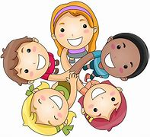
happily

Slide 96
angrily

Slide 97
angrily

Slide 98

angrily

Slide 99
lazily

Slide 100
lazily

Slide 101
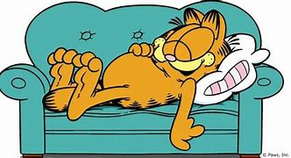
lazily

Slide 102
“Let’s go,” she said happily.

Slide 103
“Let’s go,” she said _______.

Slide 104
“Let’s go,” she said happily.

Slide 105
The rabbit angrily chomped on the carrot.

Slide 106
The rabbit _______ chomped on the carrot.

Slide 107
The rabbit angrily chomped on the carrot.

Slide 108
The cat stretched lazily by the fire.

Slide 109
The cat stretched ______ by the fire.

Slide 110
The cat stretched lazily by the fire.

Slide 111
New CHALLENGE words.

Slide 112
island

Slide 113
island
The pirates landed on an island in search of treasure.

Slide 114

island
The pirates landed on an island in search of treasure.

Slide 115
The pirates landed on an island in search of treasure.

Slide 116
The pirates landed on an ______ in search of treasure.

Slide 117
The pirates landed on an island in search of treasure.

Slide 118
minute

Slide 119
minute
The minute hand ticked by slowing during exam.

Slide 120
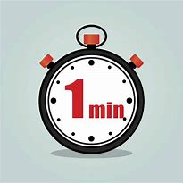
minute
The minute hand ticked by slowing during exam.

Slide 121
The minute hand ticked by slowing during exam.

Slide 122
The ______ hand ticked by slowing during exam.

Slide 123
The minute hand ticked by slowing during exam.

Slide 124
Let’s investigate.

Slide 125
Can you spot the spelling errors in these sentences?
Write the correct spelling and explain where they went wrong.

Slide 126
In the center of the iland, happily happyly stood a little girl.

Slide 127
In the center of the iland, happily happyly stood a little girl. center – centre not the American ending

Slide 128
In the center of the iland, happily happyly stood a little girl. iland – island remember the silent ‘s’

Slide 129
In the center of the iland, happily happyly stood a little girl. happyly – happily change the y to an i and add ‘ly’

Slide 130
In the centre of the island, happily stood a little girl.

Slide 131
Year 3 - Spring 1
Week 6 - Wednesday

Slide 133
Let’s Revisit and Review…

Slide 134
Do you remember this challenge word?

Slide 135
heart

Slide 136
heart
NOUN
Definition – an organ in your chest that pumps the blood around your body.

Slide 137
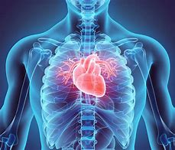
heart
NOUN
Definition – an organ in your chest that pumps the blood around your body.

Slide 138
Do you remember this challenge word?

Slide 139
breath

Slide 140
breath
NOUN
Definition – to take air into your lungs and send it out again through your nose or mouth

Slide 141
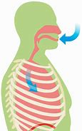
breath
NOUN
Definition – to take air into your lungs and send it out again through your nose or mouth

Slide 142
The prefix bi-

Slide 143
bi-

Slide 144
bi- meaning two, having two, twice, double, doubly, twofold, once every two, etc., from Latin bi- "twice, double,"

Slide 145
bicycle

Slide 146
bicycle

Slide 147
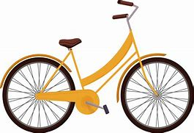
bicycle

Slide 148
biplane

Slide 149
biplane

Slide 150
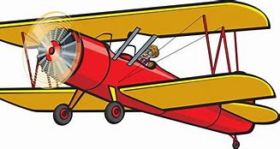
biplane

Slide 151
bisects

Slide 152
bisects

Slide 153
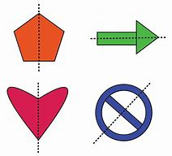
bisects

Slide 154
Let’s Teach and Practise

Slide 155
The suffix
-ly

Slide 156
-ly

Slide 157
-ly
Creating adverbs using the suffix –ly where the root word ends in ‘le’.
Rule – take off the ‘le’ and add ‘ly’

Slide 158
gently

Slide 159
gently

Slide 160
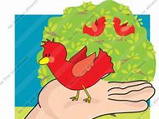
gently

Slide 161
simply

Slide 162
simply

Slide 163

simply

Slide 164
humbly

Slide 165
humbly

Slide 166
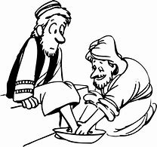
humbly

Slide 167
She gently broke the news to her mum.

Slide 168
She ______ broke the news to her mum.

Slide 169
She gently broke the news to her mum.

Slide 170
She spoke simply and from the heart.

Slide 171
She spoke ______ and from the heart.

Slide 172
She spoke simply and from the heart.

Slide 173
The servant bowed humbly before his master.

Slide 174
The servant bowed ______ before his master.

Slide 175
The servant bowed humbly before his master.

Slide 176
New CHALLENGE words.

Slide 177
difficult

Slide 178
difficult
It is difficult to make decisions.

Slide 179

difficult
It is difficult to make decisions.

Slide 180
It is difficult to make decisions.

Slide 181
It is _________ to make decisions.

Slide 182
It is difficult to make decisions.

Slide 183
earth

Slide 184
earth
The earth is the third planet from the sun.

Slide 185

earth
The earth is the third planet from the sun.

Slide 186
The earth is the third planet from the sun.

Slide 187
The _____ is the third planet from the sun.

Slide 188
The earth is the third planet from the sun.

Slide 189
Let’s investigate.

Slide 190
Can you spot the spelling errors in these sentences?
Write the correct spelling and explain where they went wrong.

Slide 191
Her hart was gentle pumping as she landed back down on erf.

Slide 192
Her hart was gentle pumping as she landed back down on erf. hart – heart missing the ‘e’

Slide 193
Her hart was gentle pumping as she landed back down on erf. gentle – gently not the ‘le’ but the ‘ly’ suffix

Slide 194
Her hart was gentle pumping as she landed back down on erf. erf – earth not ‘f’ but ‘th’ final sound

Slide 195
Her heart was gently pumping as she landed back down on earth.

Slide 196
Year 3 - Spring 1
Week 6 - Thursday

Slide 198
Let’s Revisit and Review…

Slide 199
Do you remember this challenge word?

Slide 200
busy

Slide 201
busy
The busy shop opened early for Christmas.

Slide 202
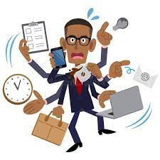
busy
The busy shop opened early for Christmas.

Slide 203
early

Slide 204
early
The busy shop opened early for Christmas.

Slide 205
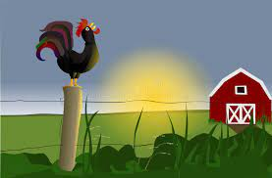
early
The busy shop opened early for Christmas.

Slide 206
The prefix inter-

Slide 207
inter-

Slide 208
inter- meaning between or among.

Slide 209
inter- meaning between or among.
The prefix inter can just be added to a root word.

Slide 210
interact

Slide 211

interact

Slide 212
interfere

Slide 213

interfere

Slide 214
intercity

Slide 215

intercity

Slide 216
Let’s Teach and Practise

Slide 217
The suffix
-ly

Slide 218
-ly

Slide 219
-ly
Creating adverbs using the suffix –ly where the root word ends in ‘ic’.
Rule – ic + ally

Slide 220
-ly
Creating adverbs using the suffix –ly where the root word ends in ‘al’.
Rule – al + ly

Slide 221
basically

Slide 222
basically

Slide 223

basically

Slide 224
frantically

Slide 225
frantically

Slide 226
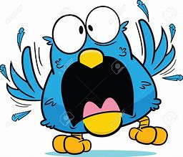
frantically

Slide 227
dramatically

Slide 228
dramatically

Slide 229
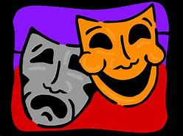
dramatically

Slide 230
We started from a basically simple idea.

Slide 231
We started from a _________ simple idea.

Slide 232
We started from a basically simple idea.

Slide 233
The two ladies, competing for his attention, waved frantically at him.

Slide 234
The two ladies, competing for his attention, waved ___________ at him.

Slide 235
The two ladies, competing for his attention, waved frantically at him.

Slide 236
They displayed their talents both musically and dramatically.

Slide 237
They displayed their talents both musically and ____________.

Slide 238
They displayed their talents both musically and dramatically.

Slide 239
New CHALLENGE words.

Slide 240
consider

Slide 241
consider
We need to consider how to move forward.

Slide 242
consider
We need to consider how to move forward.

Slide 243
We need to consider how to move forward.

Slide 244
We need to ________ how to move forward.

Slide 245
We need to consider how to move forward.

Slide 246
enough

Slide 247
enough
I have had enough food for lunch.

Slide 248
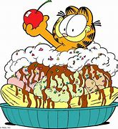
enough
I have had enough food for lunch.

Slide 249
I have had enough food for lunch.

Slide 250
I have had ______ food for lunch.

Slide 251
I have had enough food for lunch.

Slide 252
Let’s investigate.

Slide 253
Can you spot the spelling errors in these sentences?
Write the correct spelling and explain where they went wrong.

Slide 254
She ate erle and had enuff food that she franticle then ran to work.

Slide 255
She ate erle and had enuff food that she franticle then ran to work. erle – early not the ‘le’ buy the ‘ly’ final sound.

Slide 256
She ate erle and had enuff food that she franticle then ran to work. enuff – enough not the ‘ff’ but the ‘ough’ final sound

Slide 257
She ate erle and had enuff food that she frantically franticle then ran to work. franticle – frantically ending in ‘ic’ = add ‘al’ and ‘ly’

Slide 258
She ate early and had enough food that she frantically then ran to work.

Slide 259
Year 3 - Spring 1
Week 6 - Friday

Slide 261
Let’s Revisit and Review…

Slide 262
Do you remember these challenge words?

Slide 263
their

Slide 264
their
It was their ball.

Slide 265
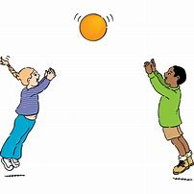
their
It was their ball.

Slide 266
there

Slide 267
there
Over there it was raining.

Slide 268
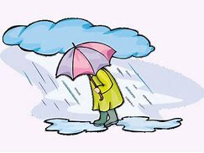
there
Over there it was raining.

Slide 269
they’re

Slide 270
they’re
They’re happy.

Slide 271
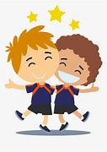
they’re
They’re happy.

Slide 272
The prefix auto-

Slide 273
auto -

Slide 274
auto - meaning self or own

Slide 275
auto - meaning self or own
The prefix auto- can be added to most root words without changes.

Slide 276
autograph

Slide 277

autograph

Slide 278
autobiography

Slide 279

autobiography

Slide 280
automatic

Slide 281
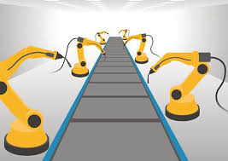
automatic

Slide 282
Let’s Teach and Practise

Slide 283
The suffix
-ly

Slide 284
-ly

Slide 285
-ly exceptions to the previous rules

Slide 286
truly

Slide 287
truly

Slide 288

truly

Slide 289
duly

Slide 290
duly

Slide 291

duly

Slide 292
wholly

Slide 293
wholly

Slide 294

wholly

Slide 295
He speaks truly.

Slide 296
He speaks _____.

Slide 297
He speaks truly.

Slide 298
A document was duly signed and authorised by the inspector.

Slide 299
A document was ____ signed and authorised by the inspector.

Slide 300
A document was duly signed and authorised by the inspector.

Slide 301
She found herself given over wholly to sensation.

Slide 302
She found herself given over ______ to sensation.

Slide 303
She found herself given over wholly to sensation.

Slide 304
New CHALLENGE words.

Slide 305
though

Slide 306
though
Though they were speaking quietly, they could still be heard.

Slide 307
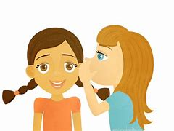
though
Though they were speaking quietly, they could still be heard.

Slide 308
Though they were speaking quietly, they could still be heard.

Slide 309
______ they were speaking quietly, they could still be heard.

Slide 310
Though they were speaking quietly, they could still be heard.

Slide 311
notice

Slide 312
notice
The notice was very clear.

Slide 313
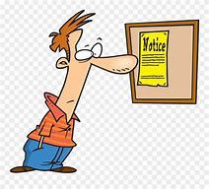
notice
The notice was very clear.

Slide 314
The notice was very clear.

Slide 315
The ______ was very clear.

Slide 316
The notice was very clear.

Slide 317
Let’s investigate.

Slide 318
Can you spot the spelling errors in these sentences?
Write the correct spelling and explain where they went wrong.

Slide 319
Thow they were truely unhappy, their was something to smile about.

Slide 320
Thow they were truely unhappy, their was something to smile about. thow – though final sound ‘ough’ not ‘ow’

Slide 321
Thow they were truely unhappy, their was something to smile about. truely – truly exception to the rule – remove the ‘e’

Slide 322
Thow they were truely unhappy, their was something to smile about. their – there not the their meaning belonging to someone

Slide 323
Though they were truly unhappy, there was something to smile about.

