Slide 1
Spelling Y3
Mastering spellings: building on the foundations of phonics
Spring 2
Week 6

Slide 2
Year 3 - Spring 2
Week 6 - Monday

Slide 3
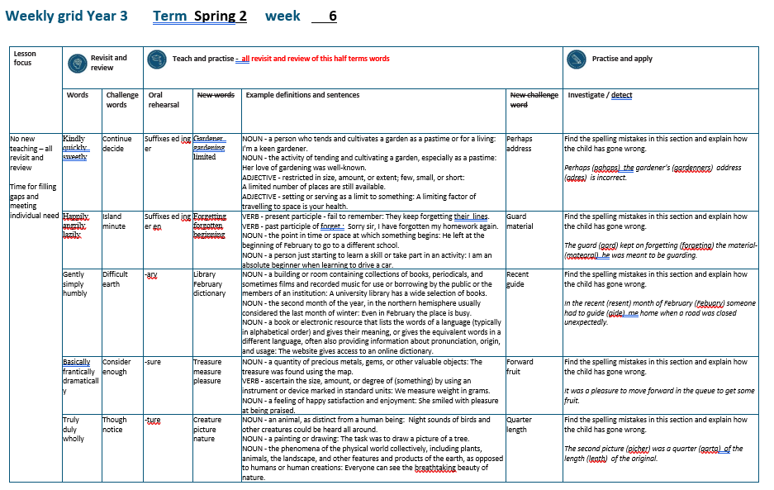

Slide 4
Let’s Revisit and Review…

Slide 5
Do you remember this challenge word?

Slide 6

VERB
continue
Definition -persist in an activity or process

Slide 7
He was unable to continue with his job.
________

Slide 8
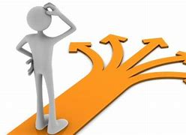
VERB
decided
Definition - come or bring to a resolution in the mind as a result of consideration

Slide 9
She decided that she liked him.
_______

Slide 10
The suffix
-ly

Slide 11
-ly

Slide 12
-ly
The suffix –ly is added to an adjective to form an adverb. The rules already learnt still apply.
The suffix –ly starts with a consonant letter, so it is added straight on to most root words

Slide 13
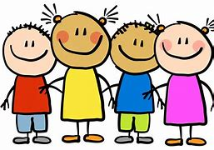
kindly

Slide 14
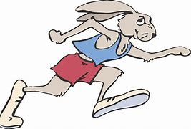
quickly

Slide 15
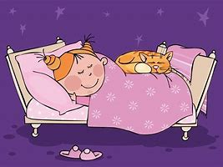
sweetly

Slide 16
Let’s Teach and Practise

Slide 17
Adding suffixes beginning with a vowel (er/ed/ing) to words with more than one syllable

Slide 18
Unstressed last syllable –
DO NOT double the final consonant

Slide 19
-er
-ed
-ing

Slide 20
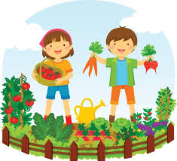
gardener

Slide 21
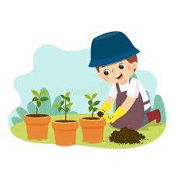
gardening

Slide 22

limited

Slide 23
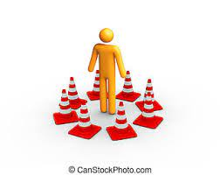
limiting

Slide 24
gardener
garden + er = gardener
NOUN
Definition - a person who tends and cultivates a garden as a pastime or for a living

Slide 25
gardening
garden + ing = gardening
NOUN
Definition - the activity of tending and cultivating a garden, especially as a pastime

Slide 26
limited
limit +ed = limited
ADJECTIVE
Definition - restricted in size, amount, or extent; few, small, or short

Slide 27
limiting
limit +ing = limiting
ADJECTIVE
Definition - setting or serving as a limit to something

Slide 28
I'm a keen gardener.
________

Slide 29
Her love of gardening was well-known.
_________

Slide 30
A limited number of places are still available.
______

Slide 31
A limiting factor of travelling to space is your health.
________

Slide 32
New CHALLENGE words.

Slide 33
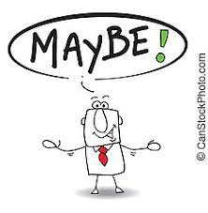
perhaps
ADVERB
Definition - used to express uncertainty or possibility

Slide 34
Perhaps I should have turned left.
_______

Slide 35

address
NOUN
Definition - the particulars of the place where someone lives or an organisation is situated

Slide 36
They gave their neighbour their new address.
_______

Slide 37
Let’s investigate.

Slide 38
Can you spot the spelling errors in these sentences?
Write the correct spelling and explain where they went wrong.

Slide 39
pahaps the gardenners adres is incorrect.

Slide 40
pahaps the gardenners adres is incorrect.

Slide 41
pahaps the gardenners adres is incorrect.
Perhaps – ‘er’ not ‘a’

Slide 42
pahaps the gardenners adres is incorrect. gardener’s – no need to double consonant ‘n’

Slide 43
pahaps the gardenners adres is incorrect. address – double ‘d’ and ‘s’

Slide 44
Perhaps the gardener’s address is incorrect.

Slide 45
Year 3 - Spring 2
Week 6 - Tuesday

Slide 46
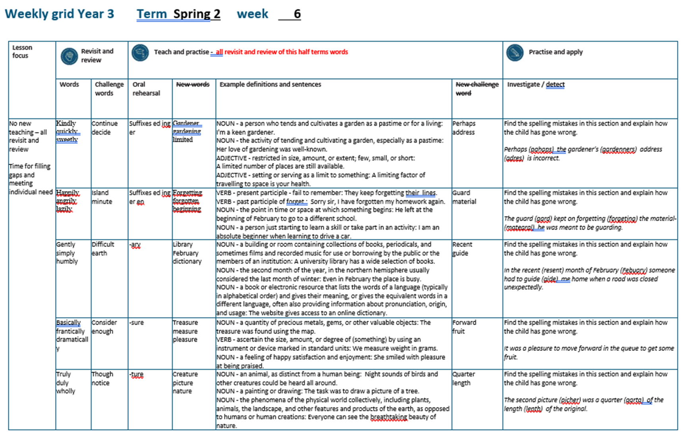

Slide 47
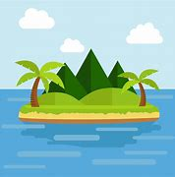
NOUN
island
Definition -a piece of land surrounded by water

Slide 48
The pirates landed on an island in search of treasure.
______

Slide 49
NOUN
minute
Definition - a period of time equal to sixty seconds or a sixtieth of an hour

Slide 50
The minute hand ticked by slowing during exam.
______

Slide 51
The suffix
-ly

Slide 52
-ly

Slide 53
-ly
Creating adverbs using the suffix –ly where the root word ends in ‘y’ with more than one syllable.
Rule – change the ‘y’ to and ‘i’ and add ‘ly’

Slide 54
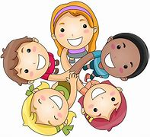
happily

Slide 55
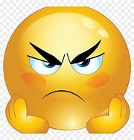
angrily

Slide 56
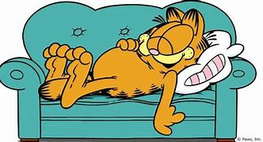
lazily

Slide 57
Let’s Teach and Practise

Slide 58
Adding suffixes beginning with a vowel (er/ed/en/ing) to words with more than one syllable

Slide 59
stressed last syllable – double the final consonant

Slide 60
-er
-ed
-ing
-en

Slide 61
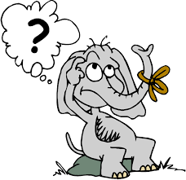
forgetting

Slide 62
forgotten

Slide 63
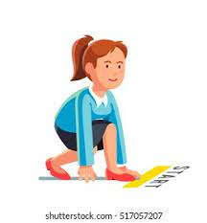
beginning

Slide 64
beginner

Slide 65
forgetting
forget + t + ing = forgetting
VERB
Definition - present participle - fail to remember

Slide 66
forgotten
forgot + t + en = forgotten
VERB
Definition - past participle - fail to remember

Slide 67
beginning
begin +n + ing = beginning
NOUN
Definition - the point in time or space at which something begins

Slide 68
beginner
begin +n +er = beginner
NOUN
Definition - a person just starting to learn a skill or take part in an activity

Slide 69
They keep forgetting their lines.
__________

Slide 70
Sorry sir, I have forgotten my homework again.
_________

Slide 71
He left at the beginning of February to go to a different school.
_________

Slide 72
I am an absolute beginner when learning to drive a car.
________

Slide 73
New CHALLENGE words.

Slide 74
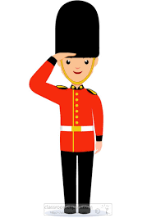
guard
NOUN
Definition - a person who keeps watch, especially a soldier or other person assigned to protect a person or to control access to a place

Slide 75
A security guard works in the local bank.
_____

Slide 76
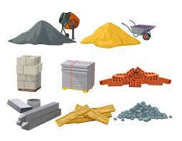
material
NOUN
Definition - the matter from which a thing is or can be made

Slide 77
The coat material was bright red.
________

Slide 78
Let’s investigate.

Slide 79
Can you spot the spelling errors in these sentences?
Write the correct spelling and explain where they went wrong.

Slide 80
The gard kept on forgeting the matearal he was meant to be guarding.

Slide 81
The gard kept on forgeting the matearal he was meant to be guarding.

Slide 82
The gard kept on forgeting the matearal he was meant to be guarding. guard – ‘u’ missing

Slide 83
The gard kept on forgeting the matearal he was meant to be guarding. forgetting – double consonant ‘t’

Slide 84
The gard kept on forgeting the matearal he was meant to be guarding. material – ‘ial’

Slide 85
The guard kept on forgetting the material he was meant to be guarding.

Slide 86
Year 3 - Spring 2
Week 6 - Wednesday

Slide 88
Let’s Revisit and Review…

Slide 89
Do you remember this challenge word?

Slide 90
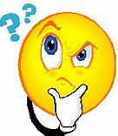
ADJECTIVE
difficult
Definition -needing much effort or skill to accomplish, deal with, or understand

Slide 91
It is difficult to make decisions.
_________

Slide 92

NOUN
Earth
Definition - the planet on which we live; the world

Slide 93
The earth is the third planet from the sun.
_____

Slide 94
The suffix
-ly

Slide 95
-ly

Slide 96
-ly
Creating adverbs using the suffix –ly where the root word ends in ‘le’.
Rule – take off the ‘le’ and add ‘ly’

Slide 97
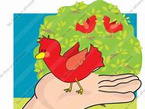
gently

Slide 98

simply

Slide 99
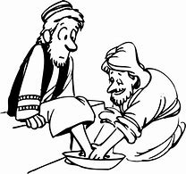
humbly

Slide 100
Let’s Teach and Practise

Slide 101
Words ending in -ary can be nouns, adjectives or both.

Slide 102
If the part of the word before the ending isn’t a recognisable English word in itself, then it’s often the case that the ending will be -ary

Slide 103
-ary

Slide 104
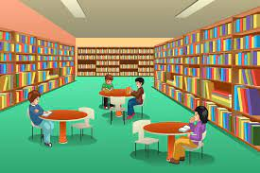
library

Slide 105
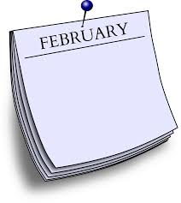
February

Slide 106
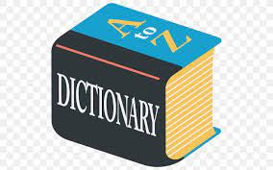
dictionary

Slide 107
library
NOUN
Definition - a building or room containing collections of books, periodicals, and sometimes films and recorded music for use or borrowing by the public or the members of an institution

Slide 108
February
NOUN
Definition - the second month of the year, in the northern hemisphere usually considered the last month of winter

Slide 109
dictionary
NOUN
Definition - a book or electronic resource that lists the words of a language (typically in alphabetical order) and gives their meaning, or gives the equivalent words in a different language, often also providing information about pronunciation, origin, and usage

Slide 110
A university library has a wide selection of books.
_______

Slide 111
Even in February the place is busy.
________

Slide 112
The website gives access to an online dictionary.
__________

Slide 113
New CHALLENGE words.

Slide 114

recent
ADJECTIVE
Definition - having happened, begun, or been done not long ago; belonging to a past period comparatively close to the present

Slide 115
The recent newsletter is on the website.
______

Slide 116
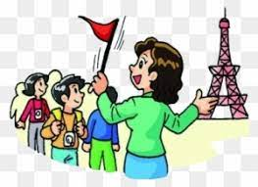
guide
VERB
Definition - show or indicate the way to someone

Slide 117
I will guide you to your seat in the theatre.
_____

Slide 118
Let’s investigate.

Slide 119
Can you spot the spelling errors in these sentences?
Write the correct spelling and explain where they went wrong.

Slide 120
In the resent month of Febuary someone had to gide me home when a road was closed unexpectedly.

Slide 121
In the resent month of Febuary someone had to gide me home when a road was closed unexpectedly.

Slide 122
In the resent month of Febuary someone had to gide me home when a road was closed unexpectedly. recent – ‘c’ not ‘s’

Slide 123
In the resent month of Febuary someone had to gide me home when a road was closed unexpectedly.
February – ‘r’ missing

Slide 124
In the resent month of Febuary someone had to gide me home when a road was closed unexpectedly. guide – ‘u’ missing

Slide 125
In the recent month of February someone had to guide me home when a road was closed unexpectedly.

Slide 126
Year 3 - Spring 2
Week 6 - Thursday

Slide 128
Let’s Revisit and Review…

Slide 129
Do you remember this challenge word?

Slide 130
VERB
consider
Definition -think carefully about (something), typically before making a decision

Slide 131
We need to consider how to move forward.
________

Slide 132
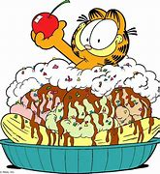
DETERMINER
enough
Definition - as much or as many as required

Slide 133
I have had enough food for lunch.
______

Slide 134
The suffix
-ly

Slide 135
-ly

Slide 136
-ly
Creating adverbs using the suffix –ly where the root word ends in ‘ic’.
Rule – ic + ally

Slide 137
-ly
Creating adverbs using the suffix –ly where the root word ends in ‘al’.
Rule – al + ly

Slide 138
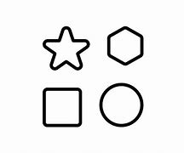
basically

Slide 139
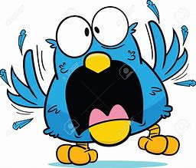
frantically

Slide 140
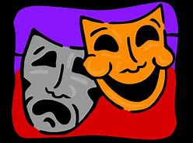
dramatically

Slide 141
Let’s Teach and Practise

Slide 142
Words ending in -sure

Slide 143
Listen carefully to hear the sure sound or the ture sound at the end.
If the root word ends in CH, like teach, then you need to use ER at the end to spell 'teacher'

Slide 144
-sure

Slide 145
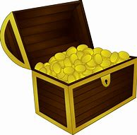
treasure

Slide 146
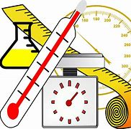
measure

Slide 147

pleasure

Slide 148
treasure
NOUN
Definition - a quantity of precious metals, gems, or other valuable objects

Slide 149
measure
VERB
Definition - ascertain the size, amount, or degree of (something) by using an instrument or device marked in standard units

Slide 150
pleasure
NOUN
Definition - a feeling of happy satisfaction and enjoyment

Slide 151
The treasure was found using the map.
_________

Slide 152
We measure weight in grams.
________

Slide 153
She smiled with pleasure at being praised.
________

Slide 154
New CHALLENGE words.

Slide 155
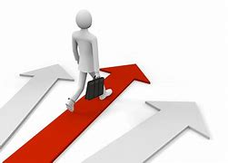
forward
ADVERB
Definition - in the direction that one is facing or travelling; towards the front

Slide 156
He started the engine and the car moved forward.
_______

Slide 157
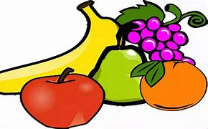
fruit
NOUN
Definition - the sweet and fleshy product of a tree or other plant that contains seed and can be eaten as food

Slide 158
Eat fresh fruit and vegetables.
_____

Slide 159
Let’s investigate.

Slide 160
Can you spot the spelling errors in these sentences?
Write the correct spelling and explain where they went wrong.

Slide 161
It was a pleature to move fourward in the queue to get some frute.

Slide 162
It was a pleature to move fourward in the queue to get some frute.

Slide 163
It was a pleature to move fourward in the queue to get some frute. pleasure – ‘sure’

Slide 164
It was a pleature to move fourward in the queue to get some frute. forward – ‘for’

Slide 165
It was a pleature to move fourward in the queue to get some frute. fruit – ‘ui’

Slide 166
It was a pleasure to move forward in the queue to get some fruit.

Slide 167
Year 3 - Spring 2
Week 6 - Friday

Slide 169
Let’s Revisit and Review…

Slide 170
Do you remember these challenge words?

Slide 171
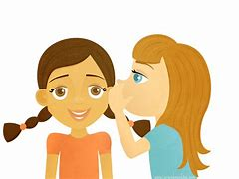
CONJUNCTION
though
Definition -despite the fact that

Slide 172
Though they were speaking quietly, they could still be heard.
______

Slide 173
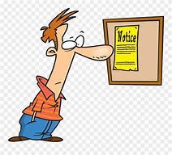
NOUN
notice
Definition - a displayed sheet or placard giving news or information

Slide 174
The notice was very clear.
______

Slide 175
The suffix
-ly

Slide 176
-ly

Slide 177
-ly exceptions to the previous rules

Slide 178

truly

Slide 179

duly

Slide 180

wholly

Slide 181
Let’s Teach and Practise

Slide 182
Words ending in -ture

Slide 183
Listen carefully to hear the sure sound or the ture sound at the end.
If the root word ends in CH, like teach, then you need to use ER at the end to spell 'teacher'

Slide 184
-ture

Slide 185
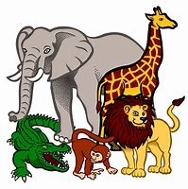
creature

Slide 186
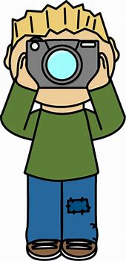
picture

Slide 187
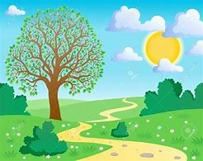
nature

Slide 188
creature
NOUN
Definition - an animal, as distinct from a human being

Slide 189
picture
NOUN
Definition - a painting, photo or drawing

Slide 190
nature
NOUN
Definition - the phenomena of the physical world collectively, including plants, animals, the landscape, and other features and products of the earth, as opposed to humans or human creations

Slide 191
Night sounds of birds and other creatures could be heard all around.
_________

Slide 192
The task was to draw a picture of a tree.
_______

Slide 193
Everyone can see the breath-taking beauty of nature.
______

Slide 194
New CHALLENGE words.

Slide 195
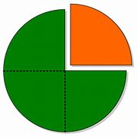
quarter
NOUN
Definition - each of four equal or corresponding parts into which something is or can be divided

Slide 196
She cut the apple into quarters.
________

Slide 197
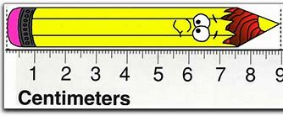
length
NOUN
Definition - the measurement or extent of something from end to end

Slide 198
The fish reaches a huge length.
______

Slide 199
Let’s investigate.

Slide 200
Can you spot the spelling errors in these sentences?
Write the correct spelling and explain where they went wrong.

Slide 201
The second picher was a qarta of the lenth of the original.

Slide 202
The second picher was a qarta of the lenth of the original.

Slide 203
The second picher was a qarta of the lenth of the original. picture - ‘ture’

Slide 204
The second picher was a qarta of the lenth of the original. quarter – ‘qu’ and ‘er’

Slide 205
The second picher was a qarta of the lenth of the original. length - gth

Slide 206
The second picture was a quarter of the length of the original.

