Slide 1
Spelling Y3
Mastering spellings: building on the foundations of phonics
Summer 1
Week 1

Slide 2
Year 3 - Summer 1
Week 1 - Monday

Slide 3
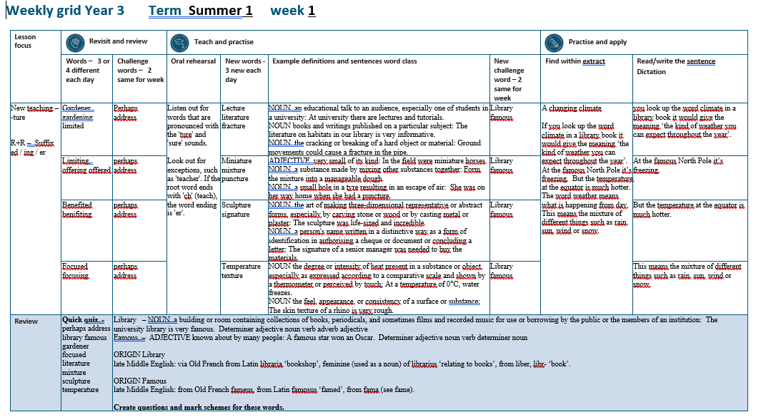

Slide 4
Let’s Revisit and Review…

Slide 5
Do you remember this challenge word?

Slide 6
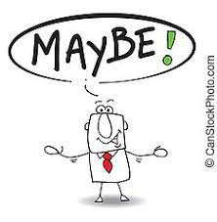
perhaps
ADVERB
Definition - used to express uncertainty or possibility

Slide 7
Perhaps I should have turned left.
_______

Slide 8

address
NOUN
Definition - the particulars of the place where someone lives or an organisation is situated

Slide 9
They gave their neighbour their new address.
_______

Slide 10
Adding suffixes beginning with a vowel (er/ed/ing) to words with more than one syllable

Slide 11
Unstressed last syllable –
DO NOT double the final consonant

Slide 12
-er
-ed
-ing

Slide 13
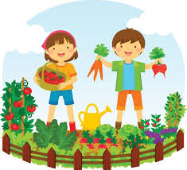
gardener

Slide 14
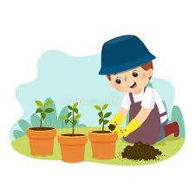
gardening

Slide 15

limited

Slide 16
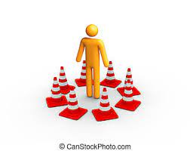
limiting

Slide 17
Let’s Teach and Practise

Slide 18
Adding -ture

Slide 19
Listen out for words that are pronounced with the 'ture' and 'sure' sounds.
Look out for exceptions, such as 'teacher'. If the root word ends with 'ch' (teach), the word ending is 'er'.

Slide 20
-ture

Slide 21

lecture

Slide 22

literature

Slide 23

fracture

Slide 24
lecture
NOUN
Definition - an educational talk to an audience, especially one of students in a university

Slide 25
literature
NOUN
Definition - books and writings published on a particular subject

Slide 26
fracture
NOUN
Definition - the cracking or breaking of a hard object or material

Slide 27
At university, there are lectures and tutorials.
________

Slide 28
The literature on habitats in our library is very informative.
__________

Slide 29
Ground movements could cause a fracture in the pipe.
________

Slide 30
New CHALLENGE words.

Slide 31

library
NOUN
Definition - a building or room containing collections of books, periodicals, and sometimes films and recorded music for use or borrowing by the public or the members of an institution

Slide 32
The university library is very famous.
_______

Slide 33

famous
ADJECTIVE
Definition - known about by many people

Slide 34
A famous star won an Oscar.
______

Slide 35
Let’s Practise and Apply.

Slide 36
Can you spot the spelling rule words and the challenge words?

Slide 37
A changing climate
If you look up the word climate in a library book it would give the meaning ‘the kind of weather you can expect throughout the year’. At the famous North Pole it’s freezing. But the temperature at the equator is much hotter. The word weather means what is happening from day to day. This means the mixture of different things such as rain, sun, wind or snow.

Slide 38
A changing climate
If you look up the word climate in a library book it would give the meaning ‘the kind of weather you can expect throughout the year’. At the famous North Pole it’s freezing. But the temperature at the equator is much hotter. The word weather means what is happening from day to day. This means the mixture of different things such as rain, sun, wind or snow.

Slide 39
Write this sentence as I dictate it to you.
Notes:
Look up the word climate in a library book.

Slide 40
Look up the word climate in a library book.
Did you write it correctly?
Edit your work and make sure you have it correct.
Can you underline the spelling word that we have covered in this session?

Slide 41
Year 3 - Summer 1
Week 1 - Tuesday
Notes:
Revisit and review the words from previous teaching and challenge words – I say, we say, you say
Ask children to write words only in their spelling book
Introduce the new spelling rule
Children to write the new spelling rule words and challenge words into books when the sentences are shown with the spelling word missing.
Read the extract with the class as choral reading. Practise model of prosody etc.
Ask children to find the spelling words from the session in the text.
Then read allowed the chosen sentence for children to write fully in their books.
Show the extract and ask children to then edit their work to check they were correct in their dictation.

Slide 43
Let’s Revisit and Review…

Slide 44
Do you remember this challenge word?

Slide 45
perhaps
ADVERB
Definition - used to express uncertainty or possibility

Slide 46
Perhaps I should have turned left.
_______

Slide 47
address
NOUN
Definition - the particulars of the place where someone lives or an organisation is situated

Slide 48
They gave their neighbour their new address.
_______

Slide 49
Adding suffixes beginning with a vowel (er/ed/ing) to words with more than one syllable

Slide 50
Unstressed last syllable –
DO NOT double the final consonant

Slide 51
-er
-ed
-ing

Slide 52
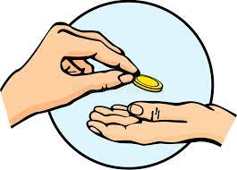
offering

Slide 53

offered

Slide 54
Let’s Teach and Practise

Slide 55
Adding -ture

Slide 56
Listen out for words that are pronounced with the 'ture' and 'sure' sounds.
Look out for exceptions, such as 'teacher'. If the root word ends with 'ch' (teach), the word ending is 'er'.

Slide 57
-ture

Slide 58
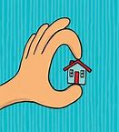
miniature

Slide 59
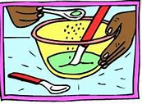
mixture

Slide 60
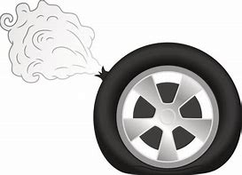
puncture

Slide 61
miniature
ADJECTIVE
Definition - very small of its kind

Slide 62
mixture
NOUN
Definition - a substance made by mixing other substances together

Slide 63
puncture
NOUN
Definition - a small hole in a tyre resulting in an escape of air

Slide 64
In the field were miniature horses.
_________

Slide 65
Form the mixture into a manageable dough.
_______

Slide 66
She was on her way home when she had a puncture.
________

Slide 67
New CHALLENGE words.

Slide 68
library
NOUN
Definition - a building or room containing collections of books, periodicals, and sometimes films and recorded music for use or borrowing by the public or the members of an institution

Slide 69
The university library is very famous.
_______

Slide 70
famous
ADJECTIVE
Definition - known about by many people

Slide 71
A famous star won an Oscar.
______

Slide 72
Let’s Practise and Apply.

Slide 73
Can you spot the spelling rule words and the challenge words?

Slide 74
A changing climate
If you look up the word climate in a library book it would give the meaning ‘the kind of weather you can expect throughout the year’. At the famous North Pole it’s freezing. But the temperature at the equator is much hotter. The word weather means what is happening from day to day. This means the mixture of different things such as rain, sun, wind or snow.

Slide 75
A changing climate
If you look up the word climate in a library book it would give the meaning ‘the kind of weather you can expect throughout the year’. At the famous North Pole it’s freezing. But the temperature at the equator is much hotter. The word weather means what is happening from day to day. This means the mixture of different things such as rain, sun, wind or snow.

Slide 76
Write this sentence as I dictate it to you.
Notes:
At the famous North Pole it’s freezing.

Slide 77
At the famous North Pole it’s freezing.
Did you write it correctly?
Edit your work and make sure you have it correct.
Can you underline the spelling word that we have covered in this session?

Slide 78
Year 3 - Summer 1
Week 1 - Wednesday
Notes:
Revisit and review the words from previous teaching and challenge words – I say, we say, you say
Ask children to write words only in their spelling book
Introduce the new spelling rule
Children to write the new spelling rule words and challenge words into books when the sentences are shown with the spelling word missing.
Read the extract with the class as choral reading. Practise model of prosody etc.
Ask children to find the spelling words from the session in the text.
Then read allowed the chosen sentence for children to write fully in their books.
Show the extract and ask children to then edit their work to check they were correct in their dictation.

Slide 80
Let’s Revisit and Review…

Slide 81
Do you remember this challenge word?

Slide 82
perhaps
ADVERB
Definition - used to express uncertainty or possibility

Slide 83
Perhaps I should have turned left.
_______

Slide 84
address
NOUN
Definition - the particulars of the place where someone lives or an organisation is situated

Slide 85
They gave their neighbour their new address.
_______

Slide 86
Adding suffixes beginning with a vowel (er/ed/ing) to words with more than one syllable

Slide 87
Unstressed last syllable –
DO NOT double the final consonant

Slide 88
-er
-ed
-ing

Slide 89

benefited

Slide 90
benefiting

Slide 91
Let’s Teach and Practise

Slide 92
Adding -ture

Slide 93
Listen out for words that are pronounced with the 'ture' and 'sure' sounds.
Look out for exceptions, such as 'teacher'. If the root word ends with 'ch' (teach), the word ending is 'er'.

Slide 94
-ture

Slide 95
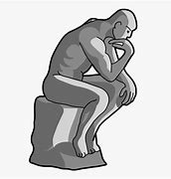
sculpture

Slide 96

signature

Slide 97
sculpture
NOUN
Definition - the art of making three-dimensional representative or abstract forms, especially by carving stone or wood or by casting metal or plaster

Slide 98
signature
NOUN
Definition - a person's name written in a distinctive way as a form of identification in authorising a cheque or document or concluding a letter

Slide 99
The sculpture was life-sized and incredible.
_________

Slide 100
The signature of a senior manager was needed to buy the materials.
_________

Slide 101
New CHALLENGE words.

Slide 102
library
NOUN
Definition - a building or room containing collections of books, periodicals, and sometimes films and recorded music for use or borrowing by the public or the members of an institution

Slide 103
The university library is very famous.
_______

Slide 104
famous
ADJECTIVE
Definition - known about by many people

Slide 105
A famous star won an Oscar.
______

Slide 106
Let’s Practise and Apply.

Slide 107
Can you spot the spelling rule words and the challenge words?

Slide 108
A changing climate
If you look up the word climate in a library book it would give the meaning ‘the kind of weather you can expect throughout the year’. At the famous North Pole it’s freezing. But the temperature at the equator is much hotter. The word weather means what is happening from day to day. This means the mixture of different things such as rain, sun, wind or snow.

Slide 109
A changing climate
If you look up the word climate in a library book it would give the meaning ‘the kind of weather you can expect throughout the year’. At the famous North Pole it’s freezing. But the temperature at the equator is much hotter. The word weather means what is happening from day to day. This means the mixture of different things such as rain, sun, wind or snow.

Slide 110
Write this sentence as I dictate it to you.
Notes:
But the temperature at the equator is much hotter.

Slide 111
But the temperature at the equator is much hotter.
Did you write it correctly?
Edit your work and make sure you have it correct.
Can you underline the spelling word that we have covered in this session?

Slide 112
Year 3 - Summer 1
Week 1 - Thursday
Notes:
Revisit and review the words from previous teaching and challenge words – I say, we say, you say
Ask children to write words only in their spelling book
Introduce the new spelling rule
Children to write the new spelling rule words and challenge words into books when the sentences are shown with the spelling word missing.
Read the extract with the class as choral reading. Practise model of prosody etc.
Ask children to find the spelling words from the session in the text.
Then read allowed the chosen sentence for children to write fully in their books.
Show the extract and ask children to then edit their work to check they were correct in their dictation.

Slide 114
Let’s Revisit and Review…

Slide 115
Do you remember this challenge word?

Slide 116
perhaps
ADVERB
Definition - used to express uncertainty or possibility

Slide 117
Perhaps I should have turned left.
_______

Slide 118
address
NOUN
Definition - the particulars of the place where someone lives or an organisation is situated

Slide 119
They gave their neighbour their new address.
_______

Slide 120
Adding suffixes beginning with a vowel (er/ed/ing) to words with more than one syllable

Slide 121
Unstressed last syllable –
DO NOT double the final consonant

Slide 122
-er
-ed
-ing

Slide 123

focused

Slide 124
focusing

Slide 125
Let’s Teach and Practise

Slide 126
Adding -ture

Slide 127
Listen out for words that are pronounced with the 'ture' and 'sure' sounds.
Look out for exceptions, such as 'teacher'. If the root word ends with 'ch' (teach), the word ending is 'er'.

Slide 128
-ture

Slide 129
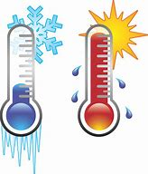
temperature

Slide 130
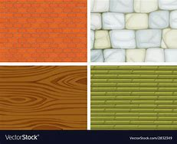
texture

Slide 131
temperature
NOUN
Definition - the degree or intensity of heat present in a substance or object, especially as expressed according to a comparative scale and shown by a thermometer or perceived by touch

Slide 132
texture
NOUN
Definition - the feel, appearance, or consistency of a surface or substance

Slide 133
At a temperature of 0°C, water freezes.
___________

Slide 134
The skin texture of a rhino is very rough.
_______

Slide 135
New CHALLENGE words.

Slide 136
library
NOUN
Definition - a building or room containing collections of books, periodicals, and sometimes films and recorded music for use or borrowing by the public or the members of an institution

Slide 137
The university library is very famous.
_______

Slide 138
famous
ADJECTIVE
Definition - known about by many people

Slide 139
A famous star won an Oscar.
______

Slide 140
Let’s Practise and Apply.

Slide 141
Can you spot the spelling rule words and the challenge words?

Slide 142
A changing climate
If you look up the word climate in a library book it would give the meaning ‘the kind of weather you can expect throughout the year’. At the famous North Pole it’s freezing. But the temperature at the equator is much hotter. The word weather means what is happening from day to day. This means the mixture of different things such as rain, sun, wind or snow.

Slide 143
A changing climate
If you look up the word climate in a library book it would give the meaning ‘the kind of weather you can expect throughout the year’. At the famous North Pole it’s freezing. But the temperature at the equator is much hotter. The word weather means what is happening from day to day. This means the mixture of different things such as rain, sun, wind or snow.

Slide 144
Write this sentence as I dictate it to you.
Notes:
This means the mixture of different things such as rain, sun, wind or snow.

Slide 145
This means the mixture of different things such as rain, sun, wind or snow.
Did you write it correctly?
Edit your work and make sure you have it correct.
Can you underline the spelling word that we have covered in this session?

Slide 146
Year 3 - Summer 1
Week 1 - Friday
Notes:
Click through the slides for all the R+R words for the week (both the focus and the challenge words)
Click through the slides for all the new learning this week

Slide 148
Old challenge words…

Slide 149
perhaps

Slide 150
address

Slide 151
Old spelling rule words…

Slide 152
gardener

Slide 153
gardening

Slide 154
limited

Slide 155
limiting

Slide 156
offering

Slide 157
offered

Slide 158
benefited

Slide 159
benefiting

Slide 160
focused

Slide 161
focusing

Slide 162
New spelling rule words…

Slide 163
lecture

Slide 164
literature

Slide 165
fracture

Slide 166
miniature

Slide 167
mixture

Slide 168
puncture

Slide 169
sculpture

Slide 170
signature

Slide 171
temperature

Slide 172
texture

Slide 173
New challenge words…

Slide 174
library

Slide 175
famous

Slide 176
Quick Quiz time…
Notes:
Say these words for the quiz
perhaps address library famous gardener focused literature mixture sculpture temperature

Slide 177
Did you get them correct?
Edit your work.
perhaps address library famous gardener focused literature mixture sculpture temperature

Slide 178
Word class time…

Slide 179
The university library is very famous.
Determiner adjective noun verb adverb adjective
Notes:
Ask for these words to be classed

Slide 180
A famous star won an Oscar.
Determiner adjective noun verb determiner noun
Notes:
Ask for these words to be classed

Slide 181
Etymology
The history of a word….

Slide 182
ORIGIN Library
late Middle English: via Old French from Latin libraria ‘bookshop’, feminine (used as a noun) of librarius ‘relating to books’, from liber, libr- ‘book’.
ORIGIN Famous
late Middle English: from Old French fameus, from Latin famosus ‘famed’, from fama (see fame).

Slide 183
Let’s investigate….
Create questions and mark schemes for these words.

