Slide 1
Spelling Y3
Mastering spellings: building on the foundations of phonics
Summer 1
Week 2

Slide 2
Year 3 - Summer 1
Week 2 - Monday

Slide 4
Let’s Revisit and Review…

Slide 5
Do you remember this challenge word?

Slide 6
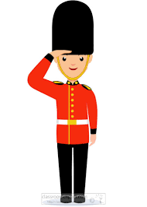
guard
NOUN
Definition - a person who keeps watch, especially a soldier or other person assigned to protect a person or to control access to a place

Slide 7
A security guard works in the local bank.
_____

Slide 8
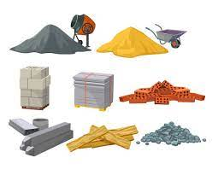
material
NOUN
Definition - the matter from which a thing is or can be made

Slide 9
The coat material was bright red.
________

Slide 10
Adding suffixes beginning with a vowel (er/ed/en/ing) to words with more than one syllable

Slide 11
stressed last syllable – double the final consonant

Slide 12
-er -ed -ing -en

Slide 13
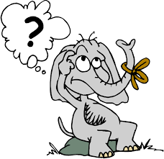
forgetting

Slide 14
forgotten

Slide 15
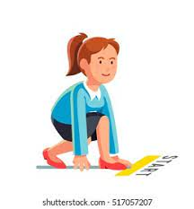
beginning

Slide 16
beginner

Slide 17
Let’s Teach and Practise

Slide 18
Homophones

Slide 19
homophones = same sound homo- same phone – sound

Slide 20
homophones

Slide 21
here

Slide 22
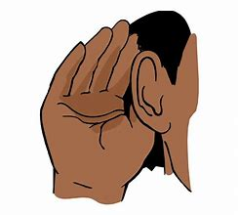
hear

Slide 23
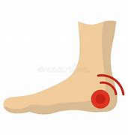
heel

Slide 24
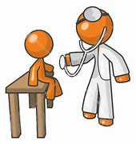
heal

Slide 25
hear
ADVERB
Definition - in, at, or to this place or position

Slide 26
hear
VERB
Definition - perceive with the ear the sound made by (someone or something):

Slide 27
heel
NOUN
Definition - the back part of the human foot below the ankle

Slide 28
heal
VERB
Definition - cause (a wound, injury, or person) to become sound or healthy again

Slide 29
They have lived here most of their lives.
____

Slide 30
He did not hear very well.
____

Slide 31
The heel of the shoe was worn away.
____

Slide 32
His concern is to heal sick people.
____

Slide 33
New CHALLENGE words.

Slide 34
describe
VERB
Definition - give a detailed account in words of

Slide 35
Describe your best friend in detail.
________

Slide 36
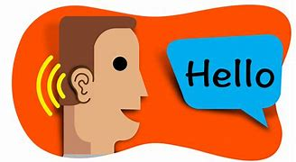
mention
VERB
Definition - refer to (something) briefly and without going into detail

Slide 37
Mention me to your teacher.
_______

Slide 38
Let’s Practise and Apply.

Slide 39
Can you spot the spelling rule words and the challenge words?

Slide 40
A changing climate All around the world, we describe the climate as being different. We need to mention that in some places it is cool and wet. Here plants and animals have adapted to these conditions. Some places are boiling hot and dry. But wherever we are, we know the kind of weather to expect. Or at least, we used to. Today, we know that everywhere, the main climate is changing. The problem is, we don’t know exactly how much or when. We don’t even know for sure what will happen where.

Slide 41
A changing climate All around the world, we describe the climate as being different. We need to mention that in some places it is cool and wet. Here plants and animals have adapted to these conditions. Some places are boiling hot and dry. But wherever we are, we know the kind of weather to expect. Or at least, we used to. Today, we know that everywhere, the main climate is changing. The problem is, we don’t know exactly how much or when. We don’t even know for sure what will happen where.

Slide 42
Write this sentence as I dictate it to you.
Notes:
All around the world, we describe the climate as being different.

Slide 43
All around the world, we describe the climate as being different.
Did you write it correctly?
Edit your work and make sure you have it correct.
Can you underline the spelling word that we have covered in this session?

Slide 44
Year 3 - Summer 1
Week 2 - Tuesday
Notes:
Revisit and review the words from previous teaching and challenge words – I say, we say, you say
Ask children to write words only in their spelling book
Introduce the new spelling rule
Children to write the new spelling rule words and challenge words into books when the sentences are shown with the spelling word missing.
Read the extract with the class as choral reading. Practise model of prosody etc.
Ask children to find the spelling words from the session in the text.
Then read allowed the chosen sentence for children to write fully in their books.
Show the extract and ask children to then edit their work to check they were correct in their dictation.

Slide 46
Let’s Revisit and Review…

Slide 47
Do you remember this challenge word?

Slide 48
guard
NOUN
Definition - a person who keeps watch, especially a soldier or other person assigned to protect a person or to control access to a place

Slide 49
A security guard works in the local bank.
_____

Slide 50
material
NOUN
Definition - the matter from which a thing is or can be made

Slide 51
The coat material was bright red.
________

Slide 52
Adding suffixes beginning with a vowel (er/ed/en/ing) to words with more than one syllable

Slide 53
stressed last syllable – double the final consonant

Slide 54
-er -ed -ing -en

Slide 55
preferred

Slide 56
preferring

Slide 57
Let’s Teach and Practise

Slide 58
Homophones

Slide 59
homophones = same sound homo- same phone – sound

Slide 60
homophones

Slide 61
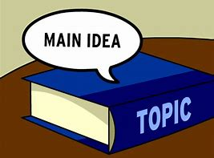
main

Slide 62
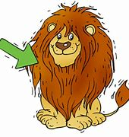
mane

Slide 63
mail

Slide 64
male

Slide 65
main
ADJECTIVE
Definition - chief in size or importance

Slide 66
mane
NOUN
Definition - a growth of long hair on the neck of a horse, lion, or other mammal

Slide 67
mail
NOUN
Definition - letters and parcels sent by post

Slide 68
male
ADJECTIVE
Definition - of or denoting the sex that usually produces sperm, with which a female may be fertilized or inseminated to produce offspring

Slide 69
The main road was congested.
____

Slide 70
The horse was rushing about in the field, tossing its mane.
____

Slide 71
I did not receive any mail.
____

Slide 72
The new puppy was male.
____

Slide 73
New CHALLENGE words.

Slide 74
describe
VERB
Definition - give a detailed account in words of

Slide 75
Describe your best friend in detail.
________

Slide 76
mention
VERB
Definition - refer to (something) briefly and without going into detail

Slide 77
Mention me to your teacher.
_______

Slide 78
Let’s Practise and Apply.

Slide 79
Can you spot the spelling rule words and the challenge words?

Slide 80
A changing climate All around the world, we describe the climate as being different. We need to mention that in some places it is cool and wet. Here plants and animals have adapted to these conditions. Some places are boiling hot and dry. But wherever we are, we know the kind of weather to expect. Or at least, we used to. Today, we know that everywhere, the main climate is changing. The problem is, we don’t know exactly how much or when. We don’t even know for sure what will happen where.

Slide 81
A changing climate All around the world, we describe the climate as being different. We need to mention that in some places it is cool and wet. Here plants and animals have adapted to these conditions. Some places are boiling hot and dry. But wherever we are, we know the kind of weather to expect. Or at least, we used to. Today, we know that everywhere, the main climate is changing. The problem is, we don’t know exactly how much or when. We don’t even know for sure what will happen where.

Slide 82
Write this sentence as I dictate it to you.
Notes:
We need to mention that in some places it is cool and wet.

Slide 83
We need to mention that in some places it is cool and wet.
Did you write it correctly?
Edit your work and make sure you have it correct.
Can you underline the spelling word that we have covered in this session?

Slide 84
Year 3 - Summer 1
Week 2 - Wednesday
Notes:
Revisit and review the words from previous teaching and challenge words – I say, we say, you say
Ask children to write words only in their spelling book
Introduce the new spelling rule
Children to write the new spelling rule words and challenge words into books when the sentences are shown with the spelling word missing.
Read the extract with the class as choral reading. Practise model of prosody etc.
Ask children to find the spelling words from the session in the text.
Then read allowed the chosen sentence for children to write fully in their books.
Show the extract and ask children to then edit their work to check they were correct in their dictation.

Slide 86
Let’s Revisit and Review…

Slide 87
Do you remember this challenge word?

Slide 88
guard
NOUN
Definition - a person who keeps watch, especially a soldier or other person assigned to protect a person or to control access to a place

Slide 89
A security guard works in the local bank.
_____

Slide 90
material
NOUN
Definition - the matter from which a thing is or can be made

Slide 91
The coat material was bright red.
________

Slide 92
Adding suffixes beginning with a vowel (er/ed/en/ing) to words with more than one syllable

Slide 93
stressed last syllable – double the final consonant

Slide 94
-er -ed -ing -en

Slide 95
occurred

Slide 96
occurring

Slide 97
Let’s Teach and Practise

Slide 98
Homophones

Slide 99
homophones = same sound homo- same phone – sound

Slide 100
homophones

Slide 101
knot

Slide 102
not

Slide 103
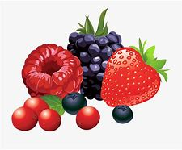
berry

Slide 104
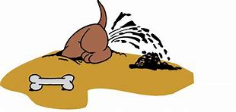
bury

Slide 105
knot
NOUN
Definition - a fastening made by looping a piece of string, rope, or something similar on itself and tightening it

Slide 106
not
ADVERB
Definition - used with an auxiliary verb or ‘be’ to form the negative

Slide 107
berry
NOUN
Definition - a small roundish juicy fruit without a stone

Slide 108
bury
VERB
Definition - put or hide underground

Slide 109
Tie a knot at the end of the cord.
____

Slide 110
They would not say what the surprise was.
___

Slide 111
The berry was juicy and sweet to eat.
_____

Slide 112
They decided to bury the box in the back garden.
____

Slide 113
New CHALLENGE words.

Slide 114
describe
VERB
Definition - give a detailed account in words of

Slide 115
Describe your best friend in detail.
________

Slide 116
mention
VERB
Definition - refer to (something) briefly and without going into detail

Slide 117
Mention me to your teacher.
_______

Slide 118
Let’s Practise and Apply.

Slide 119
Can you spot the spelling rule words and the challenge words?

Slide 120
A changing climate All around the world, we describe the climate as being different. We need to mention that in some places it is cool and wet. Here plants and animals have adapted to these conditions. Some places are boiling hot and dry. But wherever we are, we know the kind of weather to expect. Or at least, we used to. Today, we know that everywhere, the main climate is changing. The problem is, we don’t know exactly how much or when. We don’t even know for sure what will happen where.

Slide 121
A changing climate All around the world, we describe the climate as being different. We need to mention that in some places it is cool and wet. Here plants and animals have adapted to these conditions. Some places are boiling hot and dry. But wherever we are, we know the kind of weather to expect. Or at least, we used to. Today, we know that everywhere, the main climate is changing. The problem is, we don’t know exactly how much or when. We don’t even know for sure what will happen where.

Slide 122
Write this sentence as I dictate it to you.
Notes:
Here plants and animals have adapted to these conditions.

Slide 123
Here plants and animals have adapted to these conditions.
Did you write it correctly?
Edit your work and make sure you have it correct.
Can you underline the spelling word that we have covered in this session?

Slide 124
Year 3 - Summer 1
Week 2 - Thursday
Notes:
Revisit and review the words from previous teaching and challenge words – I say, we say, you say
Ask children to write words only in their spelling book
Introduce the new spelling rule
Children to write the new spelling rule words and challenge words into books when the sentences are shown with the spelling word missing.
Read the extract with the class as choral reading. Practise model of prosody etc.
Ask children to find the spelling words from the session in the text.
Then read allowed the chosen sentence for children to write fully in their books.
Show the extract and ask children to then edit their work to check they were correct in their dictation.

Slide 126
Let’s Revisit and Review…

Slide 127
Do you remember this challenge word?

Slide 128
guard
NOUN
Definition - a person who keeps watch, especially a soldier or other person assigned to protect a person or to control access to a place

Slide 129
A security guard works in the local bank.
_____

Slide 130
material
NOUN
Definition - the matter from which a thing is or can be made

Slide 131
The coat material was bright red.
________

Slide 132
Adding suffixes beginning with a vowel (er/ed/en/ing) to words with more than one syllable

Slide 133
stressed last syllable – double the final consonant

Slide 134
-er -ed -ing -en

Slide 135
forbidden

Slide 136
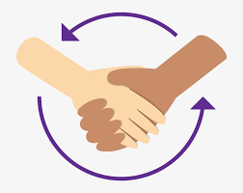
committed

Slide 137
Let’s Teach and Practise

Slide 138
Homophones

Slide 139
homophones = same sound homo- same phone – sound

Slide 140
homophones

Slide 141
break

Slide 142
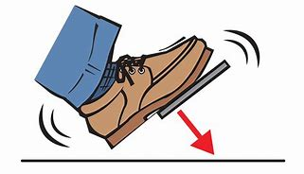
brake

Slide 143
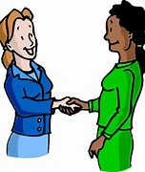
meet

Slide 144
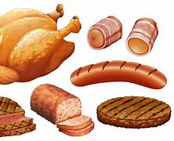
meat

Slide 145
break
VERB
Definition - separate or cause to separate into pieces as a result of a blow, shock, or strain

Slide 146
brake
NOUN
Definition - a device for slowing or stopping a moving vehicle, typically by applying pressure to the wheels

Slide 147
meet
VERB
Definition - arrange or happen to come into the presence or company of (someone)

Slide 148
meat
NOUN
Definition - the flesh of an animal, typically a mammal or bird, as food (the flesh of domestic fowls is sometimes distinguished as poultry)

Slide 149
The branch could break easily if we swing on it.
_____

Slide 150
He slammed on his brake to stop his bike.
_____

Slide 151
Let’s meet next week for lunch.
_____

Slide 152
Place meat and poultry in the refrigerator immediately.
____

Slide 153
New CHALLENGE words.

Slide 154
describe
VERB
Definition - give a detailed account in words of

Slide 155
Describe your best friend in detail.
________

Slide 156
mention
VERB
Definition - refer to (something) briefly and without going into detail

Slide 157
Mention me to your teacher.
_______

Slide 158
Let’s Practise and Apply.

Slide 159
Can you spot the spelling rule words and the challenge words?

Slide 160
A changing climate All around the world, we describe the climate as being different. We need to mention that in some places it is cool and wet. Here plants and animals have adapted to these conditions. Some places are boiling hot and dry. But wherever we are, we know the kind of weather to expect. Or at least, we used to. Today, we know that everywhere, the main climate is changing. The problem is, we don’t know exactly how much or when. We don’t even know for sure what will happen where.

Slide 161
A changing climate All around the world, we describe the climate as being different. We need to mention that in some places it is cool and wet. Here plants and animals have adapted to these conditions. Some places are boiling hot and dry. But wherever we are, we know the kind of weather to expect. Or at least, we used to. Today, we know that everywhere, the main climate is changing. The problem is, we don’t know exactly how much or when. We don’t even know for sure what will happen where.

Slide 162
Write this sentence as I dictate it to you.
Notes:
Today, we know that everywhere, the main climate is changing.

Slide 163
Today, we know that everywhere, the main climate is changing.
Did you write it correctly?
Edit your work and make sure you have it correct.
Can you underline the spelling word that we have covered in this session?

Slide 164
Year 3 - Summer 1
Week 2 - Friday
Notes:
Click through the slides for all the R+R words for the week (both the focus and the challenge words)
Click through the slides for all the new learning this week

Slide 166
Old challenge words…

Slide 167
guard

Slide 168
material

Slide 169
Old spelling rule words…

Slide 170
forgetting

Slide 171
forgotten

Slide 172
beginning

Slide 173
beginner

Slide 174
preferred

Slide 175
preferring

Slide 176
occurred

Slide 177
occurring

Slide 178
forbidden

Slide 179
committed

Slide 180
New spelling rule words…

Slide 181
here

Slide 182
hear

Slide 183
heel

Slide 184
heal

Slide 185
main

Slide 186
mane

Slide 187
mail

Slide 188
male

Slide 189
knot

Slide 190
not

Slide 191
berry

Slide 192
bury

Slide 193
break

Slide 194
brake

Slide 195
meet

Slide 196
meat

Slide 197
New challenge words…

Slide 198
describe

Slide 199
mention

Slide 200
Quick Quiz time…
Notes:
Say these words for the quiz
guard material describe mention beginning occurred here main knot break

Slide 201
Did you get them correct?
Edit your work.
guard material describe mention beginning occurred here main knot break

Slide 202
Word class time…

Slide 203
Describe your best friend in detail.
Verb determiner adjective noun verb noun
Notes:
Ask for these words to be classed

Slide 204
Mention me to your teacher.
Verb pronoun preposition determiner noun
Notes:
Ask for these words to be classed

Slide 205
Etymology
The history of a word….

Slide 206
Describe
ORIGIN
late Middle English: from Latin describere, from de- ‘down’ + scribere ‘write’.
Mention
ORIGIN
Middle English (originally in make mention of): via Old French from Latin mentio(n-); related to mind.

Slide 207
Let’s investigate….
Find antonyms and synonyms of the challenge words.

