Slide 1
Spelling Y3
Mastering spellings: building on the foundations of phonics
Summer 1
Week 3

Slide 2
Year 3 - Summer 1
Week 3 - Monday

Slide 3
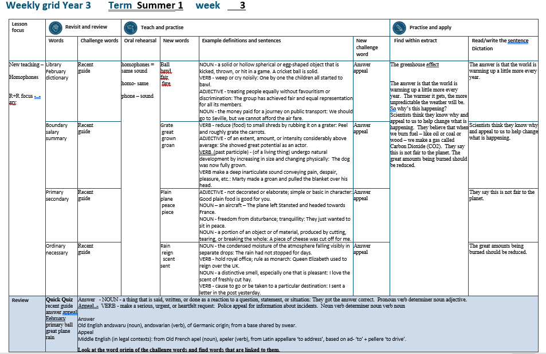

Slide 4
Let’s Revisit and Review…

Slide 5
Do you remember this challenge word?

Slide 6

recent
ADJECTIVE
Definition - having happened, begun, or been done not long ago; belonging to a past period comparatively close to the present

Slide 7
The recent newsletter is on the website.
______

Slide 8
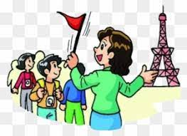
guide
VERB
Definition - show or indicate the way to someone

Slide 9
I will guide you to your seat in the theatre.
_____

Slide 10
Words ending in -ary can be nouns, adjectives or both.

Slide 11
If the part of the word before the ending isn’t a recognisable English word in itself, then it’s often the case that the ending will be -ary

Slide 12
-ary

Slide 13
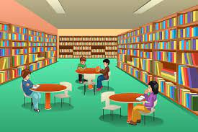
library

Slide 14
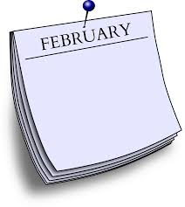
February

Slide 15
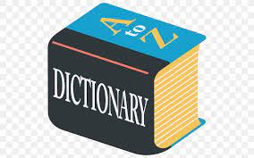
dictionary

Slide 16
Let’s Teach and Practise

Slide 17
Homophones

Slide 18
homophones = same sound homo- same phone – sound

Slide 19
homophones

Slide 20
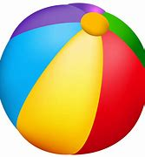
ball

Slide 21
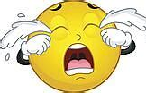
bawl

Slide 22
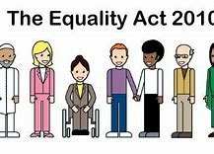
fair

Slide 23
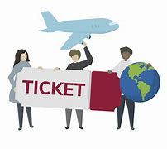
fare

Slide 24
ball
NOUN
Definition - a solid or hollow spherical or egg-shaped object that is kicked, thrown, or hit in a game

Slide 25
bawl
VERB
Definition - weep or cry noisily

Slide 26
fair
ADJECTIVE
Definition - treating people equally without favouritism or discrimination

Slide 27
fare
NOUN
Definition - the money paid for a journey on public transport

Slide 28
A cricket ball is solid.
____

Slide 29
One by one the children all started to bawl.
____

Slide 30
The group has achieved fair and equal representation for all its members.
____

Slide 31
We should go to Seville, but we cannot afford the air fare.
____

Slide 32
New CHALLENGE words.

Slide 33

answer
NOUN
Definition - a thing that is said, written, or done as a reaction to a question, statement, or situation

Slide 34
They got the answer correct.
______

Slide 35
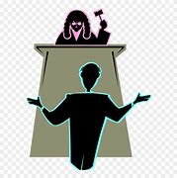
appeal
VERB
Definition - make a serious, urgent, or heartfelt request

Slide 36
Police appeal for information about incidents.
______

Slide 37
Let’s Practise and Apply.

Slide 38
Can you spot the spelling rule words and the challenge words?

Slide 39
The greenhouse effect
The answer is that the world is warming up a little more every year. The warmer it gets, the more unpredictable the weather will be. So why’s this happening? Scientists think they know why and appeal to us to help change what is happening. They believe that when we burn fuel – like oil or coal or wood – we make a gas called Carbon Dioxide (CO2). They say this is not fair to the planet. The great amounts being burned should be reduced.

Slide 40
The greenhouse effect
The answer is that the world is warming up a little more every year. The warmer it gets, the more unpredictable the weather will be. So why’s this happening? Scientists think they know why and appeal to us to help change what is happening. They believe that when we burn fuel – like oil or coal or wood – we make a gas called Carbon Dioxide (CO2). They say this is not fair to the planet. The great amounts being burned should be reduced.

Slide 41
Write this sentence as I dictate it to you.
Notes:
The answer is that the world is warming up a little more every year.

Slide 42
The answer is that the world is warming up a little more every year.
Did you write it correctly?
Edit your work and make sure you have it correct.
Can you underline the spelling word that we have covered in this session?

Slide 43
Year 3 - Summer 1
Week 3 - Tuesday
Notes:
Revisit and review the words from previous teaching and challenge words – I say, we say, you say
Ask children to write words only in their spelling book
Introduce the new spelling rule
Children to write the new spelling rule words and challenge words into books when the sentences are shown with the spelling word missing.
Read the extract with the class as choral reading. Practise model of prosody etc.
Ask children to find the spelling words from the session in the text.
Then read allowed the chosen sentence for children to write fully in their books.
Show the extract and ask children to then edit their work to check they were correct in their dictation.

Slide 45
Let’s Revisit and Review…

Slide 46
Do you remember this challenge word?

Slide 47
recent
ADJECTIVE
Definition - having happened, begun, or been done not long ago; belonging to a past period comparatively close to the present

Slide 48
The recent newsletter is on the website.
______

Slide 49
guide
VERB
Definition - show or indicate the way to someone

Slide 50
I will guide you to your seat in the theatre.
_____

Slide 51
Words ending in -ary can be nouns, adjectives or both.

Slide 52
If the part of the word before the ending isn’t a recognisable English word in itself, then it’s often the case that the ending will be -ary

Slide 53
-ary

Slide 54
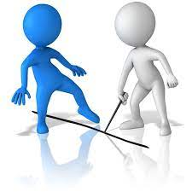
boundary

Slide 55
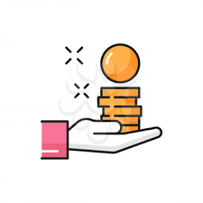
salary

Slide 56
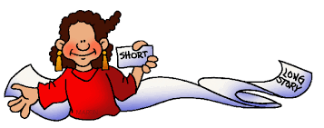
summary

Slide 57
Let’s Teach and Practise

Slide 58
Homophones

Slide 59
homophones = same sound homo- same phone – sound

Slide 60
homophones

Slide 61

great

Slide 62
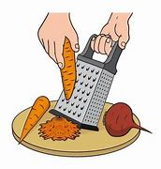
grate

Slide 63
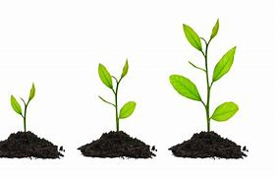
grown

Slide 64
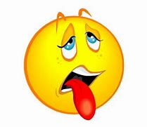
groan

Slide 65
great
ADJECTIVE
Definition - of an extent, amount, or intensity considerably above average

Slide 66
grate
VERB
Definition - reduce (food) to small shreds by rubbing it on a grater

Slide 67
grown
VERB
Definition - (past participle) - (of a living thing) undergo natural development by increasing in size and changing physically

Slide 68
groan
VERB
Definition - make a deep inarticulate sound conveying pain, despair, pleasure, etc

Slide 69
Peel and roughly grate the carrots.
_____

Slide 70
She showed great potential as an actor.
_____

Slide 71
The dog was now fully grown.
_____

Slide 72
Marty made a groan and pulled the blanket over his head.
_____

Slide 73
New CHALLENGE words.

Slide 74
answer
NOUN
Definition - a thing that is said, written, or done as a reaction to a question, statement, or situation

Slide 75
They got the answer correct.
______

Slide 76
appeal
VERB
Definition - make a serious, urgent, or heartfelt request

Slide 77
Police appeal for information about incidents.
______

Slide 78
Let’s Practise and Apply.

Slide 79
Can you spot the spelling rule words and the challenge words?

Slide 80
The greenhouse effect
The answer is that the world is warming up a little more every year. The warmer it gets, the more unpredictable the weather will be. So why’s this happening? Scientists think they know why and appeal to us to help change what is happening. They believe that when we burn fuel – like oil or coal or wood – we make a gas called Carbon Dioxide (CO2). They say this is not fair to the planet. The great amounts being burned should be reduced.

Slide 81
The greenhouse effect
The answer is that the world is warming up a little more every year. The warmer it gets, the more unpredictable the weather will be. So why’s this happening? Scientists think they know why and appeal to us to help change what is happening. They believe that when we burn fuel – like oil or coal or wood – we make a gas called Carbon Dioxide (CO2). They say this is not fair to the planet. The great amounts being burned should be reduced.

Slide 82
Write this sentence as I dictate it to you.
Notes:
Scientists think they know why and appeal to us to help change what is happening.

Slide 83
Scientists think they know why and appeal to us to help change what is happening.
Did you write it correctly?
Edit your work and make sure you have it correct.
Can you underline the spelling word that we have covered in this session?

Slide 84
Year 3 - Summer 1
Week 3 - Wednesday
Notes:
Revisit and review the words from previous teaching and challenge words – I say, we say, you say
Ask children to write words only in their spelling book
Introduce the new spelling rule
Children to write the new spelling rule words and challenge words into books when the sentences are shown with the spelling word missing.
Read the extract with the class as choral reading. Practise model of prosody etc.
Ask children to find the spelling words from the session in the text.
Then read allowed the chosen sentence for children to write fully in their books.
Show the extract and ask children to then edit their work to check they were correct in their dictation.

Slide 86
Let’s Revisit and Review…

Slide 87
Do you remember this challenge word?

Slide 88
recent
ADJECTIVE
Definition - having happened, begun, or been done not long ago; belonging to a past period comparatively close to the present

Slide 89
The recent newsletter is on the website.
______

Slide 90
guide
VERB
Definition - show or indicate the way to someone

Slide 91
I will guide you to your seat in the theatre.
_____

Slide 92
Words ending in -ary can be nouns, adjectives or both.

Slide 93
If the part of the word before the ending isn’t a recognisable English word in itself, then it’s often the case that the ending will be -ary

Slide 94
-ary

Slide 95

primary

Slide 96

secondary

Slide 97
Let’s Teach and Practise

Slide 98
Homophones

Slide 99
homophones = same sound homo- same phone – sound

Slide 100
homophones

Slide 101

plain

Slide 102
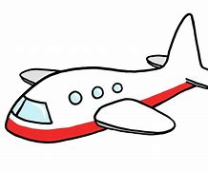
plane

Slide 103
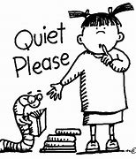
peace

Slide 104

piece

Slide 105
plain
ADJECTIVE
Definition - not decorated or elaborate

Slide 106
plane
NOUN
Definition - an aircraft

Slide 107
peace
NOUN
Definition - freedom from disturbance; tranquillity

Slide 108
piece
NOUN
Definition - a portion of an object or of material, produced by cutting, tearing, or breaking the whole

Slide 109
Plain food is good for you.
_____

Slide 110
The plane left Stansted and headed towards France.
_____

Slide 111
They just wanted to sit in peace.
_____

Slide 112
A piece of cheese was cut off for me.
_____

Slide 113
New CHALLENGE words.

Slide 114
answer
NOUN
Definition - a thing that is said, written, or done as a reaction to a question, statement, or situation

Slide 115
They got the answer correct.
______

Slide 116
appeal
VERB
Definition - make a serious, urgent, or heartfelt request

Slide 117
Police appeal for information about incidents.
______

Slide 118
Let’s Practise and Apply.

Slide 119
Can you spot the spelling rule words and the challenge words?

Slide 120
The greenhouse effect
The answer is that the world is warming up a little more every year. The warmer it gets, the more unpredictable the weather will be. So why’s this happening? Scientists think they know why and appeal to us to help change what is happening. They believe that when we burn fuel – like oil or coal or wood – we make a gas called Carbon Dioxide (CO2). They say this is not fair to the planet. The great amounts being burned should be reduced.

Slide 121
The greenhouse effect
The answer is that the world is warming up a little more every year. The warmer it gets, the more unpredictable the weather will be. So why’s this happening? Scientists think they know why and appeal to us to help change what is happening. They believe that when we burn fuel – like oil or coal or wood – we make a gas called Carbon Dioxide (CO2). They say this is not fair to the planet. The great amounts being burned should be reduced.

Slide 122
Write this sentence as I dictate it to you.
Notes:
They say this is not fair to the planet.

Slide 123
They say this is not fair to the planet.
Did you write it correctly?
Edit your work and make sure you have it correct.
Can you underline the spelling word that we have covered in this session?

Slide 124
Year 3 - Summer 1
Week 3 - Thursday
Notes:
Revisit and review the words from previous teaching and challenge words – I say, we say, you say
Ask children to write words only in their spelling book
Introduce the new spelling rule
Children to write the new spelling rule words and challenge words into books when the sentences are shown with the spelling word missing.
Read the extract with the class as choral reading. Practise model of prosody etc.
Ask children to find the spelling words from the session in the text.
Then read allowed the chosen sentence for children to write fully in their books.
Show the extract and ask children to then edit their work to check they were correct in their dictation.

Slide 126
Let’s Revisit and Review…

Slide 127
Do you remember this challenge word?

Slide 128
recent
ADJECTIVE
Definition - having happened, begun, or been done not long ago; belonging to a past period comparatively close to the present

Slide 129
The recent newsletter is on the website.
______

Slide 130
guide
VERB
Definition - show or indicate the way to someone

Slide 131
I will guide you to your seat in the theatre.
_____

Slide 132
Words ending in -ary can be nouns, adjectives or both.

Slide 133
If the part of the word before the ending isn’t a recognisable English word in itself, then it’s often the case that the ending will be -ary

Slide 134
-ary

Slide 135
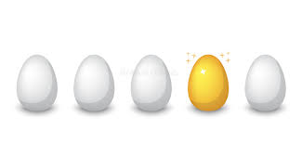
ordinary

Slide 136
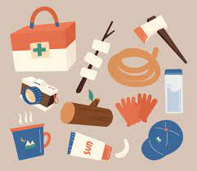
necessary

Slide 137
Let’s Teach and Practise

Slide 138
Homophones

Slide 139
homophones = same sound homo- same phone – sound

Slide 140
homophones

Slide 141
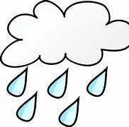
rain

Slide 142

reign

Slide 143
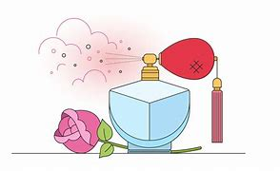
scent

Slide 144
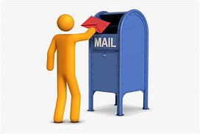
sent

Slide 145
rain
NOUN
Definition - the condensed moisture of the atmosphere falling visibly in separate drops

Slide 146
reign
VERB
Definition - hold royal office; rule as monarch

Slide 147
scent
NOUN
Definition - a distinctive smell, especially one that is pleasant

Slide 148
sent
VERB
Definition - cause to go or be taken to a particular destination

Slide 149
The rain had not stopped for days.
____

Slide 150
Queen Elizabeth used to reign over the UK.
_____

Slide 151
I love the scent of freshly cut hay.
_____

Slide 152
I sent a letter in the post yesterday.
____

Slide 153
New CHALLENGE words.

Slide 154
answer
NOUN
Definition - a thing that is said, written, or done as a reaction to a question, statement, or situation

Slide 155
They got the answer correct.
______

Slide 156
appeal
VERB
Definition - make a serious, urgent, or heartfelt request

Slide 157
Police appeal for information about incidents.
______

Slide 158
Let’s Practise and Apply.

Slide 159
Can you spot the spelling rule words and the challenge words?

Slide 160
The greenhouse effect
The answer is that the world is warming up a little more every year. The warmer it gets, the more unpredictable the weather will be. So why’s this happening? Scientists think they know why and appeal to us to help change what is happening. They believe that when we burn fuel – like oil or coal or wood – we make a gas called Carbon Dioxide (CO2). They say this is not fair to the planet. The great amounts being burned should be reduced.

Slide 161
The greenhouse effect
The answer is that the world is warming up a little more every year. The warmer it gets, the more unpredictable the weather will be. So why’s this happening? Scientists think they know why and appeal to us to help change what is happening. They believe that when we burn fuel – like oil or coal or wood – we make a gas called Carbon Dioxide (CO2). They say this is not fair to the planet. The great amounts being burned should be reduced.

Slide 162
Write this sentence as I dictate it to you.
Notes:
The great amounts being burned should be reduced.

Slide 163
The great amounts being burned should be reduced.
Did you write it correctly?
Edit your work and make sure you have it correct.
Can you underline the spelling word that we have covered in this session?

Slide 164
Year 3 - Summer 1
Week 3 - Friday
Notes:
Click through the slides for all the R+R words for the week (both the focus and the challenge words)
Click through the slides for all the new learning this week

Slide 166
Old challenge words…

Slide 167
guide

Slide 168
recent

Slide 169
Old spelling rule words…

Slide 170
library

Slide 171
dictionary

Slide 172
February

Slide 173
boundary

Slide 174
salary

Slide 175
summary

Slide 176
primary

Slide 177
secondary

Slide 178
ordinary

Slide 179
necessary

Slide 180
New spelling rule words…

Slide 181
ball

Slide 182
bawl

Slide 183
fair

Slide 184
fare

Slide 185
great

Slide 186
grate

Slide 187
grown

Slide 188
groan

Slide 189
plain

Slide 190
plane

Slide 191
peace

Slide 192
piece

Slide 193
rain

Slide 194
reign

Slide 195
sent

Slide 196
scent

Slide 197
New challenge words…

Slide 198
answer

Slide 199
appeal

Slide 200
Quick Quiz time…
Notes:
Say these words for the quiz
recent guide answer appeal February primary ball great plane rain

Slide 201
Did you get them correct?
Edit your work.
recent guide answer appeal February primary ball great plane rain

Slide 202
Word class time…

Slide 203
They got the answer correct.
Pronoun verb determiner noun adjective
Notes:
Ask for these words to be classed

Slide 204
Police appeal for information about incidents.
Noun verb determiner noun verb noun
Notes:
Ask for these words to be classed

Slide 205
Etymology
The history of a word….

Slide 206
Answer
Old English andswaru (noun), andswarian (verb), of Germanic origin; from a base shared by swear.
Appeal
Middle English (in legal contexts): from Old French apel (noun), apeler (verb), from Latin appellare ‘to address’, based on ad- ‘to’ + pellere ‘to drive’.

Slide 207
Let’s investigate….
Look at the word origin of the challenge words and find words that are linked to them.

