Slide 1
Spelling Y3
Mastering spellings: building on the foundations of phonics
Summer 1
Week 4

Slide 2
Year 3 - Summer 1
Week 4 - Monday

Slide 3
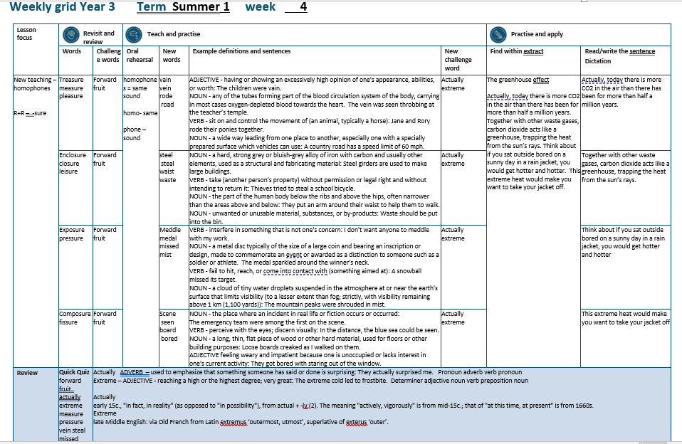

Slide 4
Let’s Revisit and Review…

Slide 5
Do you remember this challenge word?

Slide 6
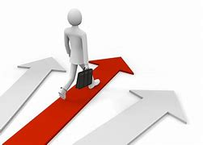
forward
ADVERB
Definition - in the direction that one is facing or travelling; towards the front

Slide 7
He started the engine and the car moved forward.
_______

Slide 8
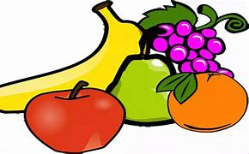
fruit
NOUN
Definition - the sweet and fleshy product of a tree or other plant that contains seed and can be eaten as food

Slide 9
Eat fresh fruit and vegetables.
_____

Slide 10
Words ending in -sure

Slide 11
Listen carefully to hear the sure sound or the ture sound at the end.
If the root word ends in CH, like teach, then you need to use ER at the end to spell 'teacher'

Slide 12
-sure

Slide 13
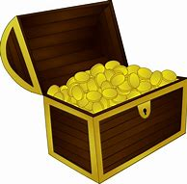
treasure

Slide 14
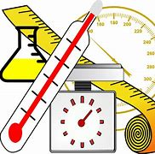
measure

Slide 15

pleasure

Slide 16
Let’s Teach and Practise

Slide 17
Homophones

Slide 18
homophones = same sound homo- same phone – sound

Slide 19
homophones

Slide 20
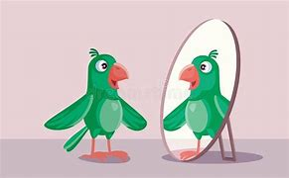
vain

Slide 21
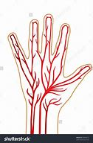
vein

Slide 22
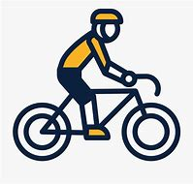
rode

Slide 23
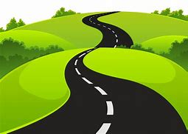
road

Slide 24
vain
ADJECTIVE
Definition - having or showing an excessively high opinion of one's appearance, abilities, or worth

Slide 25
vein
NOUN
Definition - any of the tubes forming part of the blood circulation system of the body, carrying in most cases oxygen-depleted blood towards the heart

Slide 26
rode
VERB
Definition - sit on and control the movement of (an animal, typically a horse)

Slide 27
road
NOUN
Definition - a wide way leading from one place to another, especially one with a specially prepared surface which vehicles can use

Slide 28
The parrot was vain.
____

Slide 29
The vein was seen throbbing at the teacher’s temple.
____

Slide 30
Jane and Rory rode their ponies together.
____

Slide 31
A country road has a speed limit of 60 mph.
____

Slide 32
New CHALLENGE words.

Slide 33
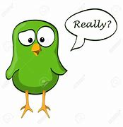
actually
ADVERB
Definition - used to emphasise that something someone has said or done is surprising

Slide 34
They actually surprised me.
________

Slide 35
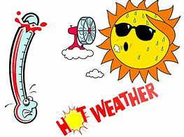
extreme
ADJECTIVE
Definition - reaching a high or the highest degree; very great

Slide 36
The extreme cold led to frostbite.
_______

Slide 37
Let’s Practise and Apply.

Slide 38
Can you spot the spelling rule words and the challenge words?

Slide 39
The greenhouse effect
Actually, today there is more CO2 in the air than there has been for more than half a million years. Together with other waste gases, carbon dioxide acts like a greenhouse, trapping the heat from the sun’s rays. Think about if you sat outside bored on a sunny day in a rain jacket, you would get hotter and hotter. This extreme heat would make you want to take your jacket off.

Slide 40
The greenhouse effect
Actually, today there is more CO2 in the air than there has been for more than half a million years. Together with other waste gases, carbon dioxide acts like a greenhouse, trapping the heat from the sun’s rays. Think about if you sat outside bored on a sunny day in a rain jacket, you would get hotter and hotter. This extreme heat would make you want to take your jacket off.

Slide 41
Write this sentence as I dictate it to you.
Notes:
Actually, today there is more CO2 in the air than there has been for more than half a million years.

Slide 42
Actually, today there is more CO2 in the air than there has been for more than half a million years.
Did you write it correctly?
Edit your work and make sure you have it correct.
Can you underline the spelling word that we have covered in this session?

Slide 43
Year 3 - Summer 1
Week 4 - Tuesday
Notes:
Revisit and review the words from previous teaching and challenge words – I say, we say, you say
Ask children to write words only in their spelling book
Introduce the new spelling rule
Children to write the new spelling rule words and challenge words into books when the sentences are shown with the spelling word missing.
Read the extract with the class as choral reading. Practise model of prosody etc.
Ask children to find the spelling words from the session in the text.
Then read allowed the chosen sentence for children to write fully in their books.
Show the extract and ask children to then edit their work to check they were correct in their dictation.

Slide 45
Let’s Revisit and Review…

Slide 46
Do you remember this challenge word?

Slide 47
forward
ADVERB
Definition - in the direction that one is facing or travelling; towards the front

Slide 48
He started the engine and the car moved forward.
_______

Slide 49
fruit
NOUN
Definition - the sweet and fleshy product of a tree or other plant that contains seed and can be eaten as food

Slide 50
Eat fresh fruit and vegetables.
_____

Slide 51
Words ending in -sure

Slide 52
Listen carefully to hear the sure sound or the ture sound at the end.
If the root word ends in CH, like teach, then you need to use ER at the end to spell 'teacher'

Slide 53
-sure

Slide 54
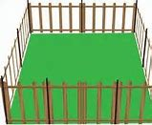
enclosure

Slide 55
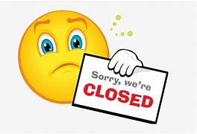
closure

Slide 56
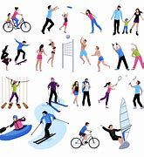
leisure

Slide 57
Let’s Teach and Practise

Slide 58
Homophones

Slide 59
homophones = same sound homo- same phone – sound

Slide 60
homophones

Slide 61
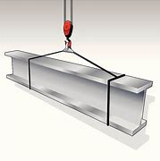
steel

Slide 62
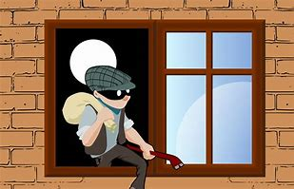
steal

Slide 63
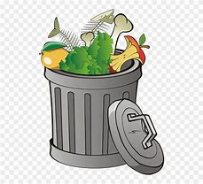
waste

Slide 64
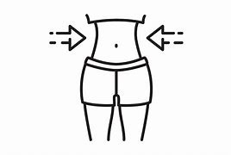
waist

Slide 65
steel
NOUN
Definition - a hard, strong grey or bluish-grey alloy of iron with carbon and usually other elements, used as a structural and fabricating material

Slide 66
steal
VERB
Definition - take (another person's property) without permission or legal right and without intending to return it

Slide 67
waste
NOUN
Definition - unwanted or unusable material, substances, or by-products

Slide 68
road
NOUN
Definition - the part of the human body below the ribs and above the hips, often narrower than the areas above and below

Slide 69
Steel is used to make large buildings.
_____

Slide 70
Thieves tried to steal a school bicycle.
_____

Slide 71
Waste should be put into the bin.
_____

Slide 72
They put an arm around their waist to help them to walk.
_____

Slide 73
New CHALLENGE words.

Slide 74
actually
ADVERB
Definition - used to emphasise that something someone has said or done is surprising

Slide 75
They actually surprised me.
________

Slide 76
extreme
ADJECTIVE
Definition - reaching a high or the highest degree; very great

Slide 77
The extreme cold led to frostbite.
_______

Slide 78
Let’s Practise and Apply.

Slide 79
Can you spot the spelling rule words and the challenge words?

Slide 80
The greenhouse effect
Actually, today there is more CO2 in the air than there has been for more than half a million years. Together with other waste gases, carbon dioxide acts like a greenhouse, trapping the heat from the sun’s rays. Think about if you sat outside bored on a sunny day in a rain jacket, you would get hotter and hotter. This extreme heat would make you want to take your jacket off.

Slide 81
The greenhouse effect
Actually, today there is more CO2 in the air than there has been for more than half a million years. Together with other waste gases, carbon dioxide acts like a greenhouse, trapping the heat from the sun’s rays. Think about if you sat outside bored on a sunny day in a rain jacket, you would get hotter and hotter. This extreme heat would make you want to take your jacket off.

Slide 82
Write this sentence as I dictate it to you.
Notes:
Together with other waste gases, carbon dioxide acts like a greenhouse, trapping the heat from the sun’s rays.

Slide 83
Together with other waste gases, carbon dioxide acts like a greenhouse, trapping the heat from the sun’s rays.
Did you write it correctly?
Edit your work and make sure you have it correct.
Can you underline the spelling word that we have covered in this session?

Slide 84
Year 3 - Summer 1
Week 4 - Wednesday
Notes:
Revisit and review the words from previous teaching and challenge words – I say, we say, you say
Ask children to write words only in their spelling book
Introduce the new spelling rule
Children to write the new spelling rule words and challenge words into books when the sentences are shown with the spelling word missing.
Read the extract with the class as choral reading. Practise model of prosody etc.
Ask children to find the spelling words from the session in the text.
Then read allowed the chosen sentence for children to write fully in their books.
Show the extract and ask children to then edit their work to check they were correct in their dictation.

Slide 86
Let’s Revisit and Review…

Slide 87
Do you remember this challenge word?

Slide 88
forward
ADVERB
Definition - in the direction that one is facing or travelling; towards the front

Slide 89
He started the engine and the car moved forward.
_______

Slide 90
fruit
NOUN
Definition - the sweet and fleshy product of a tree or other plant that contains seed and can be eaten as food

Slide 91
Eat fresh fruit and vegetables.
_____

Slide 92
Words ending in -sure

Slide 93
Listen carefully to hear the sure sound or the ture sound at the end.
If the root word ends in CH, like teach, then you need to use ER at the end to spell 'teacher'

Slide 94
-sure

Slide 95
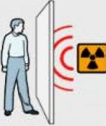
exposure

Slide 96
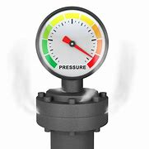
pressure

Slide 97
Let’s Teach and Practise

Slide 98
Homophones

Slide 99
homophones = same sound homo- same phone – sound

Slide 100
homophones

Slide 101
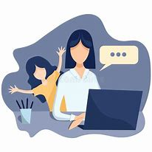
meddle

Slide 102
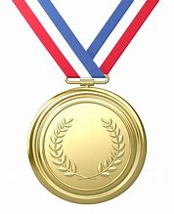
medal

Slide 103
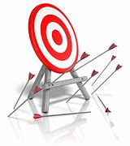
missed

Slide 104
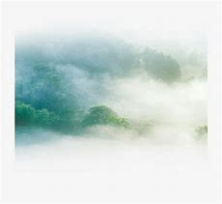
mist

Slide 105
meddle
VERB
Definition - interfere in something that is not one's concern

Slide 106
medal
NOUN
Definition - a metal disc typically of the size of a large coin and bearing an inscription or design, made to commemorate an event or awarded as a distinction to someone such as a soldier or athlete

Slide 107
missed
VERB
Definition - - fail to hit, reach, or come into contact with (something aimed at)

Slide 108
mist
NOUN
Definition - a cloud of tiny water droplets suspended in the atmosphere at or near the earth's surface that limits visibility (to a lesser extent than fog; strictly, with visibility remaining above 1 km (1,100 yards)

Slide 109
I don't want anyone to meddle with my work.
______

Slide 110
The medal sparkled around the winner’s neck.
_____

Slide 111
A snowball missed its target.
______

Slide 112
The mountain peaks were shrouded in mist.
____

Slide 113
New CHALLENGE words.

Slide 114
actually
ADVERB
Definition - used to emphasise that something someone has said or done is surprising

Slide 115
They actually surprised me.
________

Slide 116
extreme
ADJECTIVE
Definition - reaching a high or the highest degree; very great

Slide 117
The extreme cold led to frostbite.
_______

Slide 118
Let’s Practise and Apply.

Slide 119
Can you spot the spelling rule words and the challenge words?

Slide 120
The greenhouse effect
Actually, today there is more CO2 in the air than there has been for more than half a million years. Together with other waste gases, carbon dioxide acts like a greenhouse, trapping the heat from the sun’s rays. Think about if you sat outside bored on a sunny day in a rain jacket, you would get hotter and hotter. This extreme heat would make you want to take your jacket off.

Slide 121
The greenhouse effect
Actually, today there is more CO2 in the air than there has been for more than half a million years. Together with other waste gases, carbon dioxide acts like a greenhouse, trapping the heat from the sun’s rays. Think about if you sat outside bored on a sunny day in a rain jacket, you would get hotter and hotter. This extreme heat would make you want to take your jacket off.

Slide 122
Write this sentence as I dictate it to you.
Notes:
Think about if you sat outside bored on a sunny day in a rain jacket, you would get hotter and hotter.

Slide 123
Think about if you sat outside bored on a sunny day in a rain jacket, you would get hotter and hotter.
Did you write it correctly?
Edit your work and make sure you have it correct.
Can you underline the spelling word that we have covered in this session?

Slide 124
Year 3 - Summer 1
Week 4 - Thursday
Notes:
Revisit and review the words from previous teaching and challenge words – I say, we say, you say
Ask children to write words only in their spelling book
Introduce the new spelling rule
Children to write the new spelling rule words and challenge words into books when the sentences are shown with the spelling word missing.
Read the extract with the class as choral reading. Practise model of prosody etc.
Ask children to find the spelling words from the session in the text.
Then read allowed the chosen sentence for children to write fully in their books.
Show the extract and ask children to then edit their work to check they were correct in their dictation.

Slide 126
Let’s Revisit and Review…

Slide 127
Do you remember this challenge word?

Slide 128
forward
ADVERB
Definition - in the direction that one is facing or travelling; towards the front

Slide 129
He started the engine and the car moved forward.
_______

Slide 130
fruit
NOUN
Definition - the sweet and fleshy product of a tree or other plant that contains seed and can be eaten as food

Slide 131
Eat fresh fruit and vegetables.
_____

Slide 132
Words ending in -sure

Slide 133
Listen carefully to hear the sure sound or the ture sound at the end.
If the root word ends in CH, like teach, then you need to use ER at the end to spell 'teacher'

Slide 134
-sure

Slide 135

composure

Slide 136
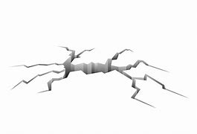
fissure

Slide 137
Let’s Teach and Practise

Slide 138
Homophones

Slide 139
homophones = same sound homo- same phone – sound

Slide 140
homophones

Slide 141
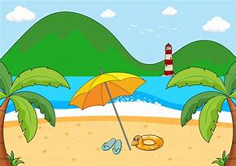
scene

Slide 142

seen

Slide 143
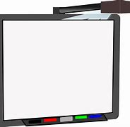
board

Slide 144
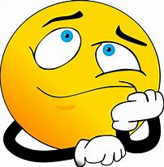
bored

Slide 145
scene
NOUN
Definition - the place where an incident in real life or fiction occurs or occurred

Slide 146
seen
VERB
Definition - perceive with the eyes; discern visually

Slide 147
board
NOUN
Definition - a long, thin, flat piece of wood or other hard material, used for floors or other building purposes or for writing on

Slide 148
bored
ADJECTIVE
Definition - feeling weary and impatient because one is unoccupied or lacks interest in one's current activity

Slide 149
The emergency team were among the first on the scene.
_____

Slide 150
In the distance, the blue sea could be seen.
____

Slide 151
Loose boards creaked as I walked on them.
______

Slide 152
They got bored with staring out of the window.
_____

Slide 153
New CHALLENGE words.

Slide 154
actually
ADVERB
Definition - used to emphasise that something someone has said or done is surprising

Slide 155
They actually surprised me.
________

Slide 156
extreme
ADJECTIVE
Definition - reaching a high or the highest degree; very great

Slide 157
The extreme cold led to frostbite.
_______

Slide 158
Let’s Practise and Apply.

Slide 159
Can you spot the spelling rule words and the challenge words?

Slide 160
The greenhouse effect
Actually, today there is more CO2 in the air than there has been for more than half a million years. Together with other waste gases, carbon dioxide acts like a greenhouse, trapping the heat from the sun’s rays. Think about if you sat outside bored on a sunny day in a rain jacket, you would get hotter and hotter. This extreme heat would make you want to take your jacket off.

Slide 161
The greenhouse effect
Actually, today there is more CO2 in the air than there has been for more than half a million years. Together with other waste gases, carbon dioxide acts like a greenhouse, trapping the heat from the sun’s rays. Think about if you sat outside bored on a sunny day in a rain jacket, you would get hotter and hotter. This extreme heat would make you want to take your jacket off.

Slide 162
Write this sentence as I dictate it to you.
Notes:
This extreme heat would make you want to take your jacket off.

Slide 163
This extreme heat would make you want to take your jacket off.
Did you write it correctly?
Edit your work and make sure you have it correct.
Can you underline the spelling word that we have covered in this session?

Slide 164
Year 3 - Summer 1
Week 4 - Friday
Notes:
Click through the slides for all the R+R words for the week (both the focus and the challenge words)
Click through the slides for all the new learning this week

Slide 166
Old challenge words…

Slide 167
forward

Slide 168
fruit

Slide 169
Old spelling rule words…

Slide 170
treasure

Slide 171
measure

Slide 172
pleasure

Slide 173
enclosure

Slide 174
closure

Slide 175
leisure

Slide 176
exposure

Slide 177
pressure

Slide 178
composure

Slide 179
fissure

Slide 180
New spelling rule words…

Slide 181
vain

Slide 182
vein

Slide 183
rode

Slide 184
road

Slide 185
steel

Slide 186
steal

Slide 187
waste

Slide 188
waist

Slide 189
meddle

Slide 190
medal

Slide 191
missed

Slide 192
mist

Slide 193
scene

Slide 194
seen

Slide 195
board

Slide 196
bored

Slide 197
New challenge words…

Slide 198
actually

Slide 199
extreme

Slide 200
Quick Quiz time…
Notes:
Say these words for the quiz
forward fruit actually extreme measure pressure vein steal missed bored

Slide 201
Did you get them correct?
Edit your work.
forward fruit actually extreme measure pressure vein steal missed bored

Slide 202
Word class time…

Slide 203
They actually surprised me.
Pronoun adverb verb pronoun
Notes:
Ask for these words to be classed

Slide 204
The extreme cold led to frostbite.
Determiner adjective noun verb preposition noun
Notes:
Ask for these words to be classed

Slide 205
Etymology
The history of a word….

Slide 206
Actually
early 15c., "in fact, in reality" (as opposed to "in possibility"), from actual + -ly (2). The meaning "actively, vigorously" is from mid-15c.; that of "at this time, at present" is from 1660s.
Extreme
late Middle English: via Old French from Latin extremus ‘outermost, utmost’, superlative of exterus ‘outer’.

Slide 207
Let’s investigate….
Write spelling questions for the challenge words and then a mark scheme to show where children may go wrong.

