Slide 1
Spelling Y3
Mastering spellings: building on the foundations of phonics
Summer 1
Week 5

Slide 2
Year 3 - Summer 1
Week 5 - Monday

Slide 3
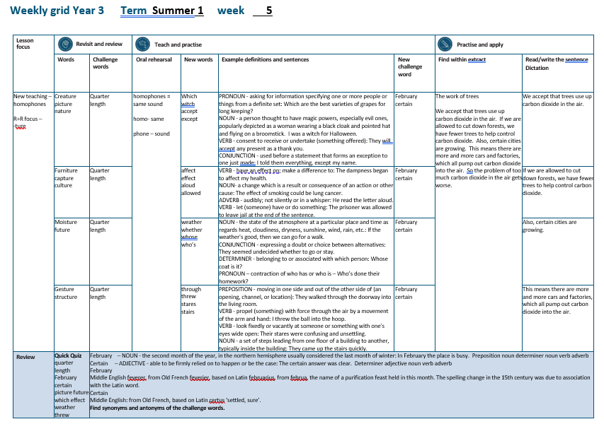

Slide 4
Let’s Revisit and Review…

Slide 5
Do you remember this challenge word?

Slide 6
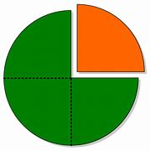
quarter
NOUN
Definition - each of four equal or corresponding parts into which something is or can be divided

Slide 7
She cut the apple into quarters.
________

Slide 8
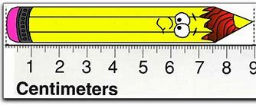
length
NOUN
Definition - the measurement or extent of something from end to end

Slide 9
The fish reaches a huge length.
______

Slide 10
Words ending in -ture

Slide 11
Listen carefully to hear the sure sound or the ture sound at the end.
If the root word ends in CH, like teach, then you need to use ER at the end to spell 'teacher'

Slide 12
-ture

Slide 13
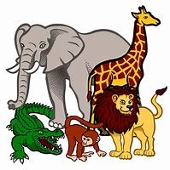
creature

Slide 14

picture

Slide 15
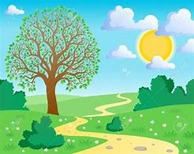
nature

Slide 16
Let’s Teach and Practise

Slide 17
Homophones

Slide 18
homophones = same sound homo- same phone – sound

Slide 19
homophones

Slide 20

which

Slide 21
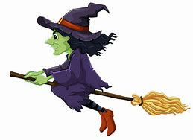
witch

Slide 22
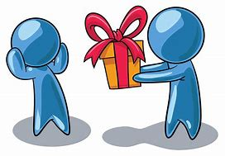
accept

Slide 23

except

Slide 24
which
PRONOUN
Definition - asking for information specifying one or more people or things from a definite set

Slide 25
witch
NOUN
Definition - a person thought to have magic powers, especially evil ones, popularly depicted as a woman wearing a black cloak and pointed hat and flying on a broomstick

Slide 26
accept
VERB
Definition - consent to receive or undertake (something offered)

Slide 27
except
CONJUNCTION
Definition - used before a statement that forms an exception to one just made

Slide 28
Which are the best varieties of grapes for long keeping?
_____

Slide 29
I was a witch for Halloween.
_____

Slide 30
They will accept any present as a thank you.
______

Slide 31
I told them everything, except my name.
______

Slide 32
New CHALLENGE words.

Slide 33

February
NOUN
Definition - the second month of the year, in the northern hemisphere usually considered the last month of winter

Slide 34
In February the place is busy.
________

Slide 35

certain
ADJECTIVE
Definition - able to be firmly relied on to happen or be the case

Slide 36
The certain answer was clear.
_______

Slide 37
Let’s Practise and Apply.

Slide 38
Can you spot the spelling rule words and the challenge words?

Slide 39
The work of trees
We accept that trees use up carbon dioxide in the air. If we are allowed to cut down forests, we have fewer trees to help control carbon dioxide. Also, certain cities are growing. This means there are more and more cars and factories, which all pump out carbon dioxide into the air. So the problem of too much carbon dioxide in the air gets worse.

Slide 40
The work of trees
We accept that trees use up carbon dioxide in the air. If we are allowed to cut down forests, we have fewer trees to help control carbon dioxide. Also, certain cities are growing. This means there are more and more cars and factories, which all pump out carbon dioxide into the air. So the problem of too much carbon dioxide in the air gets worse.

Slide 41
Write this sentence as I dictate it to you.
Notes:
We accept that trees use up carbon dioxide in the air.

Slide 42
We accept that trees use up carbon dioxide in the air.
Did you write it correctly?
Edit your work and make sure you have it correct.
Can you underline the spelling word that we have covered in this session?

Slide 43
Year 3 - Summer 1
Week 5 - Tuesday
Notes:
Revisit and review the words from previous teaching and challenge words – I say, we say, you say
Ask children to write words only in their spelling book
Introduce the new spelling rule
Children to write the new spelling rule words and challenge words into books when the sentences are shown with the spelling word missing.
Read the extract with the class as choral reading. Practise model of prosody etc.
Ask children to find the spelling words from the session in the text.
Then read allowed the chosen sentence for children to write fully in their books.
Show the extract and ask children to then edit their work to check they were correct in their dictation.

Slide 45
Let’s Revisit and Review…

Slide 46
Do you remember this challenge word?

Slide 47
quarter
NOUN
Definition - each of four equal or corresponding parts into which something is or can be divided

Slide 48
She cut the apple into quarters.
________

Slide 49
length
NOUN
Definition - the measurement or extent of something from end to end

Slide 50
The fish reaches a huge length.
______

Slide 51
Words ending in -ture

Slide 52
Listen carefully to hear the sure sound or the ture sound at the end.
If the root word ends in CH, like teach, then you need to use ER at the end to spell 'teacher'

Slide 53
-ture

Slide 54
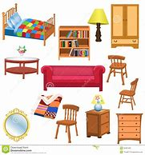
furniture

Slide 55
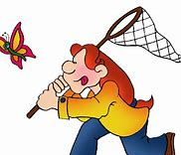
capture

Slide 56
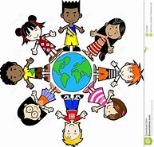
culture

Slide 57
Let’s Teach and Practise

Slide 58
Homophones

Slide 59
homophones = same sound homo- same phone – sound

Slide 60
homophones

Slide 61
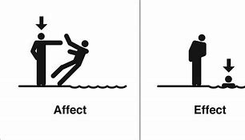
affect

Slide 62
effect

Slide 63
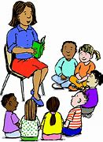
aloud

Slide 64

allowed

Slide 65
affect
VERB
Definition - have an effect on; make a difference to

Slide 66
effect
NOUN
Definition - a change which is a result or consequence of an action or other cause

Slide 67
aloud
ADVERB
Definition - audibly; not silently or in a whisper

Slide 68
allowed
VERB
Definition - let (someone) have or do something

Slide 69
The dampness began to affect my health.
______

Slide 70
The effect of smoking could be lung cancer.
______

Slide 71
He read the letter aloud.
_____

Slide 72
The prisoner was allowed to leave jail at the end of the sentence.
_______

Slide 73
New CHALLENGE words.

Slide 74
February
NOUN
Definition - the second month of the year, in the northern hemisphere usually considered the last month of winter

Slide 75
In February the place is busy.
________

Slide 76
certain
ADJECTIVE
Definition - able to be firmly relied on to happen or be the case

Slide 77
The certain answer was clear.
_______

Slide 78
Let’s Practise and Apply.

Slide 79
Can you spot the spelling rule words and the challenge words?

Slide 80
The work of trees
We accept that trees use up carbon dioxide in the air. If we are allowed to cut down forests, we have fewer trees to help control carbon dioxide. Also, certain cities are growing. This means there are more and more cars and factories, which all pump out carbon dioxide into the air. So the problem of too much carbon dioxide in the air gets worse.

Slide 81
The work of trees
We accept that trees use up carbon dioxide in the air. If we are allowed to cut down forests, we have fewer trees to help control carbon dioxide. Also, certain cities are growing. This means there are more and more cars and factories, which all pump out carbon dioxide into the air. So the problem of too much carbon dioxide in the air gets worse.

Slide 82
Write this sentence as I dictate it to you.
Notes:
If we are allowed to cut down forests, we have fewer trees to help control carbon dioxide.

Slide 83
If we are allowed to cut down forests, we have fewer trees to help control carbon dioxide.
Did you write it correctly?
Edit your work and make sure you have it correct.
Can you underline the spelling word that we have covered in this session?

Slide 84
Year 3 - Summer 1
Week 5 - Wednesday
Notes:
Revisit and review the words from previous teaching and challenge words – I say, we say, you say
Ask children to write words only in their spelling book
Introduce the new spelling rule
Children to write the new spelling rule words and challenge words into books when the sentences are shown with the spelling word missing.
Read the extract with the class as choral reading. Practise model of prosody etc.
Ask children to find the spelling words from the session in the text.
Then read allowed the chosen sentence for children to write fully in their books.
Show the extract and ask children to then edit their work to check they were correct in their dictation.

Slide 86
Let’s Revisit and Review…

Slide 87
Do you remember this challenge word?

Slide 88
quarter
NOUN
Definition - each of four equal or corresponding parts into which something is or can be divided

Slide 89
She cut the apple into quarters.
________

Slide 90
length
NOUN
Definition - the measurement or extent of something from end to end

Slide 91
The fish reaches a huge length.
______

Slide 92
Words ending in -ture

Slide 93
Listen carefully to hear the sure sound or the ture sound at the end.
If the root word ends in CH, like teach, then you need to use ER at the end to spell 'teacher'

Slide 94
-ture

Slide 95

moisture

Slide 96
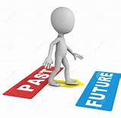
future

Slide 97
Let’s Teach and Practise

Slide 98
Homophones

Slide 99
homophones = same sound homo- same phone – sound

Slide 100
homophones

Slide 101
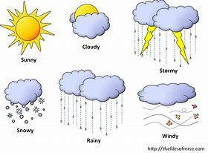
weather

Slide 102

whether

Slide 103
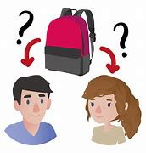
whose

Slide 104

who’s

Slide 105
weather
NOUN
Definition - the state of the atmosphere at a particular place and time as regards heat, cloudiness, dryness, sunshine, wind, rain, etc.

Slide 106
whether
CONJUNCTION
Definition - expressing a doubt or choice between alternatives

Slide 107
whose
DETERMINER
Definition - belonging to or associated with which person

Slide 108
who’s
PRONOUN
Definition - contraction of who has or who is

Slide 109
If the weather is good, then we can go for a walk.
_______

Slide 110
They seemed undecided whether to go or stay.
_______

Slide 111
Whose coat is it?
_____

Slide 112
Who’s done their homework?
____

Slide 113
New CHALLENGE words.

Slide 114
February
NOUN
Definition - the second month of the year, in the northern hemisphere usually considered the last month of winter

Slide 115
In February the place is busy.
________

Slide 116
certain
ADJECTIVE
Definition - able to be firmly relied on to happen or be the case

Slide 117
The certain answer was clear.
_______

Slide 118
Let’s Practise and Apply.

Slide 119
Can you spot the spelling rule words and the challenge words?

Slide 120
The work of trees
We accept that trees use up carbon dioxide in the air. If we are allowed to cut down forests, we have fewer trees to help control carbon dioxide. Also, certain cities are growing. This means there are more and more cars and factories, which all pump out carbon dioxide into the air. So the problem of too much carbon dioxide in the air gets worse.

Slide 121
The work of trees
We accept that trees use up carbon dioxide in the air. If we are allowed to cut down forests, we have fewer trees to help control carbon dioxide. Also, certain cities are growing. This means there are more and more cars and factories, which all pump out carbon dioxide into the air. So the problem of too much carbon dioxide in the air gets worse.

Slide 122
Write this sentence as I dictate it to you.
Notes:
Also, certain cities are growing.

Slide 123
Also, certain cities are growing.
Did you write it correctly?
Edit your work and make sure you have it correct.
Can you underline the spelling word that we have covered in this session?

Slide 124
Year 3 - Summer 1
Week 5 - Thursday
Notes:
Revisit and review the words from previous teaching and challenge words – I say, we say, you say
Ask children to write words only in their spelling book
Introduce the new spelling rule
Children to write the new spelling rule words and challenge words into books when the sentences are shown with the spelling word missing.
Read the extract with the class as choral reading. Practise model of prosody etc.
Ask children to find the spelling words from the session in the text.
Then read allowed the chosen sentence for children to write fully in their books.
Show the extract and ask children to then edit their work to check they were correct in their dictation.

Slide 126
Let’s Revisit and Review…

Slide 127
Do you remember this challenge word?

Slide 128
quarter
NOUN
Definition - each of four equal or corresponding parts into which something is or can be divided

Slide 129
She cut the apple into quarters.
________

Slide 130
length
NOUN
Definition - the measurement or extent of something from end to end

Slide 131
The fish reaches a huge length.
______

Slide 132
Words ending in -ture

Slide 133
Listen carefully to hear the sure sound or the ture sound at the end.
If the root word ends in CH, like teach, then you need to use ER at the end to spell 'teacher'

Slide 134
-ture

Slide 135

gesture

Slide 136
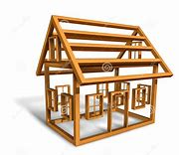
structure

Slide 137
Let’s Teach and Practise

Slide 138
Homophones

Slide 139
homophones = same sound homo- same phone – sound

Slide 140
homophones

Slide 141

through

Slide 142
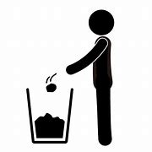
threw

Slide 143
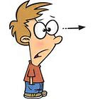
stares

Slide 144
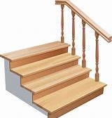
stairs

Slide 145
through
PREPOSITION
Definition - moving in one side and out of the other side of (an opening, channel, or location)

Slide 146
threw
VERB
Definition - propel (something) with force through the air by a movement of the arm and hand

Slide 147
stares
VERB
Definition - look fixedly or vacantly at someone or something with one's eyes wide open

Slide 148
stairs
NOUN
Definition - a set of steps leading from one floor of a building to another, typically inside the building

Slide 149
They walked through the doorway into the living room.
_______

Slide 150
I threw the ball into the hoop.
_____

Slide 151
Their stares were confusing and unsettling.
______

Slide 152
They came up the stairs quickly.
______

Slide 153
New CHALLENGE words.

Slide 154
February
NOUN
Definition - the second month of the year, in the northern hemisphere usually considered the last month of winter

Slide 155
In February the place is busy.
________

Slide 156
certain
ADJECTIVE
Definition - able to be firmly relied on to happen or be the case

Slide 157
The certain answer was clear.
_______

Slide 158
Let’s Practise and Apply.

Slide 159
Can you spot the spelling rule words and the challenge words?

Slide 160
The work of trees
We accept that trees use up carbon dioxide in the air. If we are allowed to cut down forests, we have fewer trees to help control carbon dioxide. Also, certain cities are growing. This means there are more and more cars and factories, which all pump out carbon dioxide into the air. So the problem of too much carbon dioxide in the air gets worse.

Slide 161
The work of trees
We accept that trees use up carbon dioxide in the air. If we are allowed to cut down forests, we have fewer trees to help control carbon dioxide. Also, certain cities are growing. This means there are more and more cars and factories, which all pump out carbon dioxide into the air. So the problem of too much carbon dioxide in the air gets worse.

Slide 162
Write this sentence as I dictate it to you.
Notes:
This means there are more and more cars and factories, which all pump out carbon dioxide into the air.

Slide 163
This means there are more and more cars and factories, which all pump out carbon dioxide into the air.
Did you write it correctly?
Edit your work and make sure you have it correct.
Can you underline the spelling word that we have covered in this session?

Slide 164
Year 3 - Summer 1
Week 5 - Friday
Notes:
Click through the slides for all the R+R words for the week (both the focus and the challenge words)
Click through the slides for all the new learning this week

Slide 166
Old challenge words…

Slide 167
quarter

Slide 168
length

Slide 169
Old spelling rule words…

Slide 170
creature

Slide 171
picture

Slide 172
nature

Slide 173
furniture

Slide 174
capture

Slide 175
culture

Slide 176
moisture

Slide 177
future

Slide 178
gesture

Slide 179
structure

Slide 180
New spelling rule words…

Slide 181
which

Slide 182
witch

Slide 183
accept

Slide 184
except

Slide 185
affect

Slide 186
effect

Slide 187
allowed

Slide 188
aloud

Slide 189
weather

Slide 190
whether

Slide 191
whose

Slide 192
who’s

Slide 193
through

Slide 194
threw

Slide 195
stares

Slide 196
stairs

Slide 197
New challenge words…

Slide 198
February

Slide 199
certain

Slide 200
Quick Quiz time…
Notes:
Say these words for the quiz
quarter length February certain picture future which effect weather threw

Slide 201
Did you get them correct?
Edit your work.
quarter length February certain picture future which effect weather threw

Slide 202
Word class time…

Slide 203
In February the place is busy.
Preposition noun determiner noun verb adverb
Notes:
Ask for these words to be classed

Slide 204
The certain answer was clear.
Determiner adjective noun verb adverb
Notes:
Ask for these words to be classed

Slide 205
Etymology
The history of a word….

Slide 206
February
Middle English feverer, from Old French feverier, based on Latin februarius, from februa, the name of a purification feast held in this month. The spelling change in the 15th century was due to association with the Latin word.
Certain
Middle English: from Old French, based on Latin certus ‘settled, sure’.

Slide 207
Let’s investigate….
Find synonyms and antonyms of the challenge words.

