Slide 1
Spelling Y3
Mastering spellings: building on the foundations of phonics
Summer 1
Week 6

Slide 2
Year 3 - Summer 1
Week 6 - Monday

Slide 3
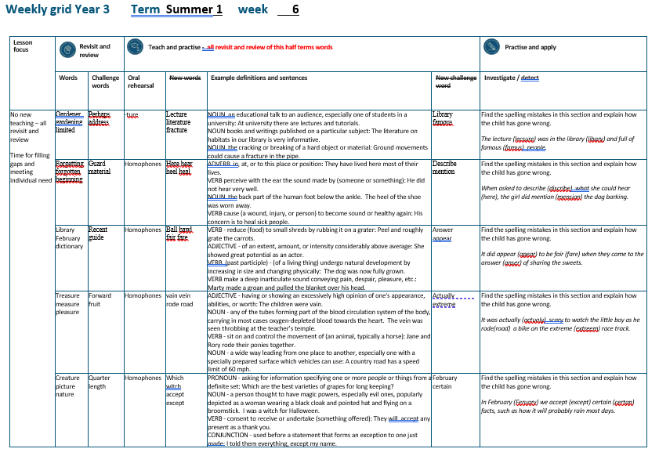

Slide 4
Let’s Revisit and Review…

Slide 5
Do you remember this challenge word?

Slide 6
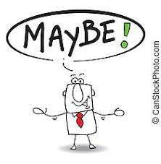
perhaps
ADVERB
Definition - used to express uncertainty or possibility

Slide 7
Perhaps I should have turned left.
_______

Slide 8

address
NOUN
Definition - the particulars of the place where someone lives or an organisation is situated

Slide 9
They gave their neighbour their new address.
_______

Slide 10
Adding suffixes beginning with a vowel (er/ed/ing) to words with more than one syllable

Slide 11
Unstressed last syllable –
DO NOT double the final consonant

Slide 12
-er
-ed
-ing

Slide 13
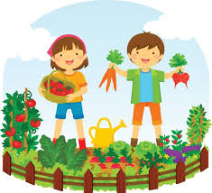
gardener

Slide 14
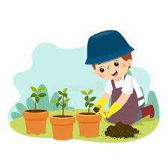
gardening

Slide 15

limited

Slide 16
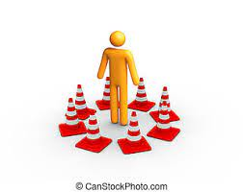
limiting

Slide 17
Let’s Teach and Practise

Slide 18
Adding -ture

Slide 19
Listen out for words that are pronounced with the 'ture' and 'sure' sounds.
Look out for exceptions, such as 'teacher'. If the root word ends with 'ch' (teach), the word ending is 'er'.

Slide 20
-ture

Slide 21
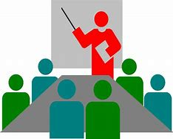
lecture

Slide 22

literature

Slide 23

fracture

Slide 24
lecture
NOUN
Definition - an educational talk to an audience, especially one of students in a university

Slide 25
literature
NOUN
Definition - books and writings published on a particular subject

Slide 26
fracture
NOUN
Definition - the cracking or breaking of a hard object or material

Slide 27
At university, there are lectures and tutorials.
________

Slide 28
The literature on habitats in our library is very informative.
__________

Slide 29
Ground movements could cause a fracture in the pipe.
________

Slide 30
New CHALLENGE words.

Slide 31

library
NOUN
Definition - a building or room containing collections of books, periodicals, and sometimes films and recorded music for use or borrowing by the public or the members of an institution

Slide 32
The university library is very famous.
_______

Slide 33

famous
ADJECTIVE
Definition - known about by many people

Slide 34
A famous star won an Oscar.
______

Slide 35
Let’s investigate.

Slide 36
Can you spot the spelling errors in these sentences?
Write the correct spelling and explain where they went wrong.

Slide 37
The lecsure was in the libary and full of famus people.

Slide 38
The lecsure was in the libary and full of famus people.

Slide 39
The lecsure was in the libary and full of famus people. lecture - ‘ture’ not ‘sure’

Slide 40
The lecsure was in the libary and full of famus people. library – ‘r’ missing

Slide 41
The lecsure was in the libary and full of famus people. famous – ‘o’ missing

Slide 42
The lecture was in the library and full of famous people.

Slide 43
Year 3 - Summer 1
Week 6 - Tuesday

Slide 45
Let’s Revisit and Review…

Slide 46
Do you remember this challenge word?

Slide 47
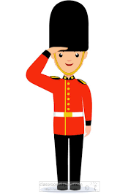
guard
NOUN
Definition - a person who keeps watch, especially a soldier or other person assigned to protect a person or to control access to a place

Slide 48
A security guard works in the local bank.
_____

Slide 49
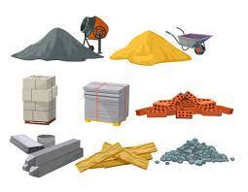
material
NOUN
Definition - the matter from which a thing is or can be made

Slide 50
The coat material was bright red.
________

Slide 51
Adding suffixes beginning with a vowel (er/ed/en/ing) to words with more than one syllable

Slide 52
stressed last syllable – double the final consonant

Slide 53
-er
-ed
-ing
-en

Slide 54
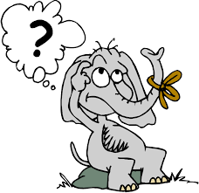
forgetting

Slide 55
forgotten

Slide 56
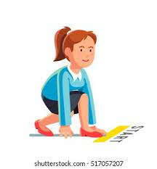
beginning

Slide 57
beginner

Slide 58
Let’s Teach and Practise

Slide 59
Homophones

Slide 60
homophones = same sound homo- same phone – sound

Slide 61
homophones

Slide 62

here

Slide 63
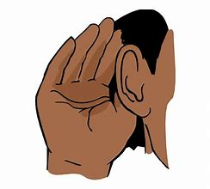
hear

Slide 64
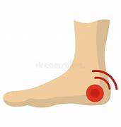
heel

Slide 65
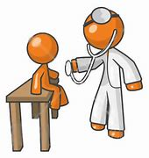
heal

Slide 66
hear
ADVERB
Definition - in, at, or to this place or position

Slide 67
hear
VERB
Definition - perceive with the ear the sound made by (someone or something):

Slide 68
heel
NOUN
Definition - the back part of the human foot below the ankle

Slide 69
heal
VERB
Definition - cause (a wound, injury, or person) to become sound or healthy again

Slide 70
They have lived here most of their lives.
____

Slide 71
He did not hear very well.
____

Slide 72
The heel of the shoe was worn away.
____

Slide 73
His concern is to heal sick people.
____

Slide 74
New CHALLENGE words.

Slide 75

describe
VERB
Definition - give a detailed account in words of

Slide 76
Describe your best friend in detail.
________

Slide 77
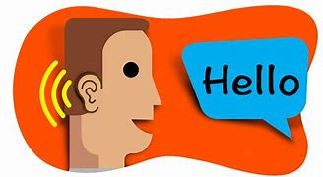
mention
VERB
Definition - refer to (something) briefly and without going into detail

Slide 78
Mention me to your teacher.
_______

Slide 79
Let’s investigate.

Slide 80
Can you spot the spelling errors in these sentences?
Write the correct spelling and explain where they went wrong.

Slide 81
When asked to discribe what she could here, the girl did mension the dog barking.

Slide 82
When asked to discribe what she could here, the girl did mension the dog barking. describe – ‘e’ not ‘i’

Slide 83
When asked to discribe what she could here, the girl did mension the dog barking. hear – incorrect homophone used

Slide 84
When asked to discribe what she could here, the girl did mension the dog barking. mention – ‘tion’ not ‘sion’

Slide 85
When asked to describe what she could hear, the girl did mention the dog barking.

Slide 86
Year 3 - Summer 1
Week 6 - Wednesday

Slide 88
Let’s Revisit and Review…

Slide 89
Do you remember this challenge word?

Slide 90

recent
ADJECTIVE
Definition - having happened, begun, or been done not long ago; belonging to a past period comparatively close to the present

Slide 91
The recent newsletter is on the website.
______

Slide 92
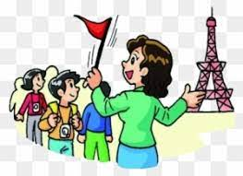
guide
VERB
Definition - show or indicate the way to someone

Slide 93
I will guide you to your seat in the theatre.
_____

Slide 94
Words ending in -ary can be nouns, adjectives or both.

Slide 95
If the part of the word before the ending isn’t a recognisable English word in itself, then it’s often the case that the ending will be -ary

Slide 96
-ary

Slide 97
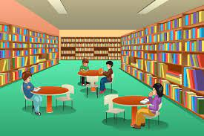
library

Slide 98

February

Slide 99
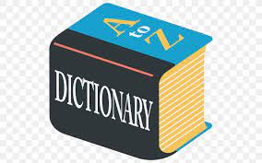
dictionary

Slide 100
Let’s Teach and Practise

Slide 101
Homophones

Slide 102
homophones = same sound homo- same phone – sound

Slide 103
homophones

Slide 104

ball

Slide 105
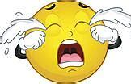
bawl

Slide 106
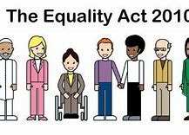
fair

Slide 107

fare

Slide 108
ball
NOUN
Definition - a solid or hollow spherical or egg-shaped object that is kicked, thrown, or hit in a game

Slide 109
bawl
VERB
Definition - weep or cry noisily

Slide 110
fair
ADJECTIVE
Definition - treating people equally without favouritism or discrimination

Slide 111
fare
NOUN
Definition - the money paid for a journey on public transport

Slide 112
A cricket ball is solid.
____

Slide 113
One by one the children all started to bawl.
____

Slide 114
The group has achieved fair and equal representation for all its members.
____

Slide 115
We should go to Seville, but we cannot afford the air fare.
____

Slide 116
New CHALLENGE words.

Slide 117

answer
NOUN
Definition - a thing that is said, written, or done as a reaction to a question, statement, or situation

Slide 118
They got the answer correct.
______

Slide 119

appeal
VERB
Definition - make a serious, urgent, or heartfelt request

Slide 120
Police appeal for information about incidents.
______

Slide 121
Let’s investigate.

Slide 122
Can you spot the spelling errors in these sentences?
Write the correct spelling and explain where they went wrong.

Slide 123
It did apear to be fare when they came to the anser of sharing the sweets.

Slide 124
It did apear to be fare when they came to the anser of sharing the sweets.

Slide 125
It did apear to be fare when they came to the anser of sharing the sweets. appear – missed the double ‘p’

Slide 126
It did apear to be fare when they came to the anser of sharing the sweets. fair – incorrect homophone used

Slide 127
It did apear to be fare when they came to the anser of sharing the sweets. answer – missed ‘w’

Slide 128
It did appear to be fair when they came to the answer of sharing the sweets.

Slide 129
Year 3 - Summer 1
Week 6 - Thursday

Slide 131
Let’s Revisit and Review…

Slide 132
Do you remember this challenge word?

Slide 133

forward
ADVERB
Definition - in the direction that one is facing or travelling; towards the front

Slide 134
He started the engine and the car moved forward.
_______

Slide 135
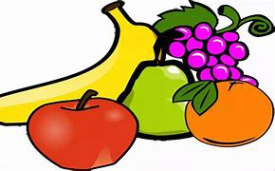
fruit
NOUN
Definition - the sweet and fleshy product of a tree or other plant that contains seed and can be eaten as food

Slide 136
Eat fresh fruit and vegetables.
_____

Slide 137
Words ending in -sure

Slide 138
Listen carefully to hear the sure sound or the ture sound at the end.
If the root word ends in CH, like teach, then you need to use ER at the end to spell 'teacher'

Slide 139
-sure

Slide 140
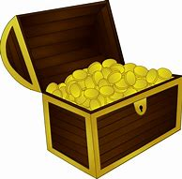
treasure

Slide 141

measure

Slide 142

pleasure

Slide 143
Let’s Teach and Practise

Slide 144
Homophones

Slide 145
homophones = same sound homo- same phone – sound

Slide 146
homophones

Slide 147
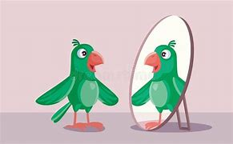
vain

Slide 148
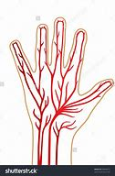
vein

Slide 149

rode

Slide 150

road

Slide 151
vain
ADJECTIVE
Definition - having or showing an excessively high opinion of one's appearance, abilities, or worth

Slide 152
vein
NOUN
Definition - any of the tubes forming part of the blood circulation system of the body, carrying in most cases oxygen-depleted blood towards the heart

Slide 153
rode
VERB
Definition - sit on and control the movement of (an animal, typically a horse)

Slide 154
road
NOUN
Definition - a wide way leading from one place to another, especially one with a specially prepared surface which vehicles can use

Slide 155
The parrot was vain.
____

Slide 156
The vein was seen throbbing at the teacher’s temple.
____

Slide 157
Jane and Rory rode their ponies together.
____

Slide 158
A country road has a speed limit of 60 mph.
____

Slide 159
New CHALLENGE words.

Slide 160

actually
ADVERB
Definition - used to emphasise that something someone has said or done is surprising

Slide 161
They actually surprised me.
________

Slide 162
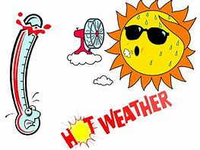
extreme
ADJECTIVE
Definition - reaching a high or the highest degree; very great

Slide 163
The extreme cold led to frostbite.
_______

Slide 164
Let’s investigate.

Slide 165
Can you spot the spelling errors in these sentences?
Write the correct spelling and explain where they went wrong.

Slide 166
It was actualy scary to watch the little boy as he road a bike on the extreem race track.

Slide 167
It was actualy scary to watch the little boy as he road a bike on the extreem race track.

Slide 168
It was actualy scary to watch the little boy as he road a bike on the extreem race track. actually – missed ‘l’

Slide 169
It was actualy scary to watch the little boy as he road a bike on the extreem race track. rode – incorrect homophone used

Slide 170
It was actualy scary to watch the little boy as he road a bike on the extreem race track. extreme – ‘eme’ not ‘eem’

Slide 171
It was actually scary to watch the little boy as he rode a bike on the extreme race track.

Slide 172
Year 3 - Summer 1
Week 6 - Friday

Slide 174
Let’s Revisit and Review…

Slide 175
Do you remember these challenge words?

Slide 176
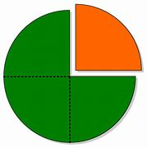
quarter
NOUN
Definition - each of four equal or corresponding parts into which something is or can be divided

Slide 177
She cut the apple into quarters.
________

Slide 178
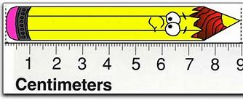
length
NOUN
Definition - the measurement or extent of something from end to end

Slide 179
The fish reaches a huge length.
______

Slide 180
Words ending in -ture

Slide 181
Listen carefully to hear the sure sound or the ture sound at the end.
If the root word ends in CH, like teach, then you need to use ER at the end to spell 'teacher'

Slide 182
-ture

Slide 183
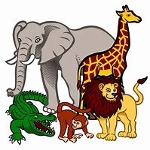
creature

Slide 184

picture

Slide 185

nature

Slide 186
Let’s Teach and Practise

Slide 187
Homophones

Slide 188
homophones = same sound homo- same phone – sound

Slide 189
homophones

Slide 190

which

Slide 191
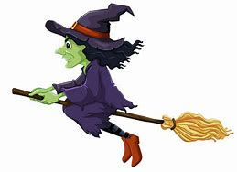
witch

Slide 192
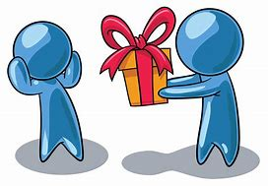
accept

Slide 193

except

Slide 194
which
PRONOUN
Definition - asking for information specifying one or more people or things from a definite set

Slide 195
witch
NOUN
Definition - a person thought to have magic powers, especially evil ones, popularly depicted as a woman wearing a black cloak and pointed hat and flying on a broomstick

Slide 196
accept
VERB
Definition - consent to receive or undertake (something offered)

Slide 197
except
CONJUNCTION
Definition - used before a statement that forms an exception to one just made

Slide 198
Which are the best varieties of grapes for long keeping?
_____

Slide 199
I was a witch for Halloween.
_____

Slide 200
They will accept any present as a thank you.
______

Slide 201
I told them everything, except my name.
______

Slide 202
New CHALLENGE words.

Slide 203

February
NOUN
Definition - the second month of the year, in the northern hemisphere usually considered the last month of winter

Slide 204
In February the place is busy.
________

Slide 205

certain
ADJECTIVE
Definition - able to be firmly relied on to happen or be the case

Slide 206
The certain answer was clear.
_______

Slide 207
Let’s investigate.

Slide 208
Can you spot the spelling errors in these sentences?
Write the correct spelling and explain where they went wrong.

Slide 209
In Febuary except certan facts, such as how it will probably rain most days.

Slide 210
In Febuary except certan facts, such as how it will probably rain most days.

Slide 211
In Febuary except certan facts, such as how it will probably rain most days.
February – ‘r’ missed

Slide 212
In Febuary except certan facts, such as how it will probably rain most days. accept – incorrect homophone used

Slide 213
In Febuary except certan facts, such as how it will probably rain most days. certain - missing ‘i’

Slide 214
In February we accept certain facts, such as how it will probably rain most days.

