Slide 1
Spelling Y4
Mastering spellings: building on the foundations of phonics
Autumn 2
Week 1

Slide 2
Year 4 - Autumn 2
Week 1 - Monday

Slide 3
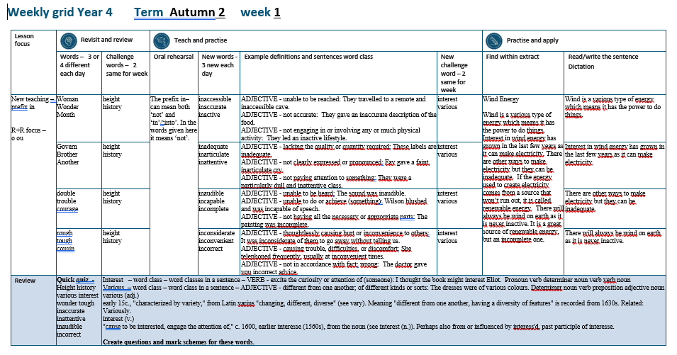

Slide 4
Let’s Revisit and Review…

Slide 5
Do you remember this challenge word?

Slide 6
height

Slide 7
height
Definition – NOUN the measurement of someone or something from head to foot or from base to top.

Slide 8
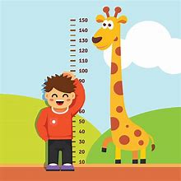
height
Definition – NOUN the measurement of someone or something from head to foot or from base to top.

Slide 9
Do you remember this challenge word?

Slide 10
history

Slide 11
history noun
Definition – the study of past events

Slide 12
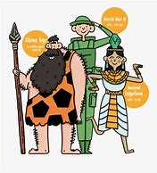
history noun
Definition – the study of past events

Slide 13
‘O’

Slide 14
woman

Slide 15
woman

Slide 16
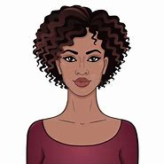
woman

Slide 17
wonder

Slide 18
wonder

Slide 19

wonder

Slide 20
month

Slide 21
month

Slide 22
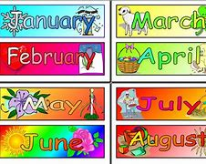
month

Slide 23
Let’s Teach and Practise

Slide 24
The prefix
- in

Slide 25
in-

Slide 26
in- meaning ‘not’

Slide 27
inaccessible

Slide 28
inaccessible

Slide 29

inaccessible

Slide 30
inaccurate

Slide 31
inaccurate

Slide 32

inaccurate

Slide 33
inactive

Slide 34
inactive

Slide 35

inactive

Slide 36
inaccessible

Slide 37
inaccessible in + accessible = inaccessible

Slide 38
inaccessible in + accessible = inaccessible
ADJECTIVE –
Definition - unable to be reached.

Slide 39
inaccurate

Slide 40
inaccurate in + accurate = inaccurate

Slide 41
inaccurate in + accurate = inaccurate
ADJECTIVE
Definition - not accurate.

Slide 42
inactive

Slide 43
inactive in + active = inactive

Slide 44
inactive in + active = inactive
ADJECTIVE
Definition - not engaging in or involving any or much physical activity.

Slide 45
They travelled to a remote and inaccessible cave.

Slide 46
They travelled to a remote and ____________ cave.

Slide 47
They travelled to a remote and inaccessible cave.

Slide 48
They gave an inaccurate description of the food.

Slide 49
They gave an __________ description of the food.

Slide 50
They gave an inaccurate description of the food.

Slide 51
They led an inactive lifestyle.

Slide 52
They led an ________ lifestyle.

Slide 53
They led an inactive lifestyle.

Slide 54
New CHALLENGE words.

Slide 55
interest

Slide 56
interest
I thought the book might interest Eliot.

Slide 57

interest
I thought the book might interest Eliot.

Slide 58
I thought the book might interest Eliot.

Slide 59
I thought the book might ________ Eliot.

Slide 60
I thought the book might interest Eliot.

Slide 61
various

Slide 62
various
The dresses were of various colours.

Slide 63
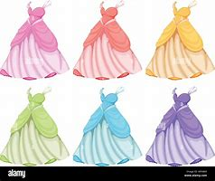
various
The dresses were of various colours.

Slide 64
The dresses were of various colours.

Slide 65
The dresses were of _______ colours.

Slide 66
The dresses were of various colours.

Slide 67
Let’s Practise and Apply.

Slide 68
Can you spot the spelling rule words and the challenge words?

Slide 69
Wind Energy
Wind is a various type of energy which means it has the power to do things. Interest in wind energy has grown in the last few years as it can make electricity. There are other ways to make electricity but they can be inadequate. If the energy used to create electricity comes from a source that won’t run out, it is called renewable energy. There will always be wind on earth as it is never inactive. It is a great source of renewable energy, but an incomplete one.

Slide 70
Wind Energy
Wind is a various type of energy which means it has the power to do things. Interest in wind energy has grown in the last few years as it can make electricity. There are other ways to make electricity but they can be inadequate. If the energy used to create electricity comes from a source that won’t run out, it is called renewable energy. There will always be wind on earth as it is never inactive. It is a great source of renewable energy, but an incomplete one.

Slide 71
Write this sentence as I dictate it to you.
Notes:
Wind is a various type of energy which means it has the power to do things.

Slide 72
Wind is a various type of energy which means it has the power to do things.
Did you write it correctly?
Edit your work and make sure you have it correct.
Can you underline the spelling word that we have covered in this session?

Slide 73
Year 4 - Autumn 2
Week 1 - Tuesday
Notes:
Revisit and review the words from previous teaching and challenge words – I say, we say, you say
Ask children to write words only in their spelling book
Introduce the new spelling rule
Children to write the new spelling rule words and challenge words into books when the sentences are shown with the spelling word missing.
Read the extract with the class as choral reading. Practise model of prosody etc.
Ask children to find the spelling words from the session in the text.
Then read allowed the chosen sentence for children to write fully in their books.
Show the extract and ask children to then edit their work to check they were correct in their dictation.

Slide 75
Let’s Revisit and Review…

Slide 76
Do you remember this challenge word?

Slide 77
height

Slide 78
height
Definition – NOUN the measurement of someone or something from head to foot or from base to top.

Slide 79
height
Definition – NOUN the measurement of someone or something from head to foot or from base to top.

Slide 80
Do you remember this challenge word?

Slide 81
history

Slide 82
history noun
Definition – the study of past events

Slide 83
history noun
Definition – the study of past events

Slide 84
‘O’

Slide 85
govern

Slide 86
govern

Slide 87

govern

Slide 88
brother

Slide 89
brother

Slide 90
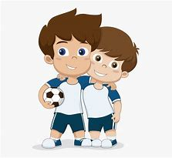
brother

Slide 91
another

Slide 92
another

Slide 93
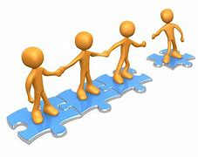
another

Slide 94
Let’s Teach and Practise

Slide 95
The prefix
- in

Slide 96
in-

Slide 97
in- meaning ‘not’

Slide 98
inadequate

Slide 99
inadequate

Slide 100
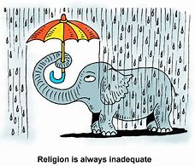
inadequate

Slide 101
inarticulate

Slide 102
inarticulate

Slide 103

inarticulate

Slide 104
inattentive

Slide 105
inattentive

Slide 106
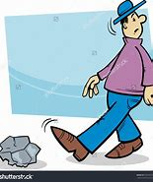
inattentive

Slide 107
inadequate

Slide 108
inadequate in + adequate = inadequate

Slide 109
inadequate in + adequate = inadequate
ADJECTIVE
Definition - lacking the quality or quantity required.

Slide 110
inarticulate

Slide 111
inarticulate in + articulate = inarticulate

Slide 112
inarticulate in + articulate = inarticulate
ADJECTIVE
Definition - not clearly expressed or pronounced.

Slide 113
inattentive

Slide 114
inattentive in + attentive = inattentive

Slide 115
inattentive in + attentive = inattentive
ADJECTIVE
Definition- not paying attention to something.

Slide 116
These labels are inadequate.

Slide 117
These labels are __________.

Slide 118
These labels are inadequate.

Slide 119
Fay gave a faint, inarticulate cry.

Slide 120
Fay gave a faint, ____________ cry.

Slide 121
Fay gave a faint, inarticulate cry.

Slide 122
They were a particularly dull and inattentive class.

Slide 123
They were a particularly dull and ___________ class.

Slide 124
They were a particularly dull and inattentive class.

Slide 125
New CHALLENGE words.

Slide 126
interest

Slide 127
interest
I thought the book might interest Eliot.

Slide 128
interest
I thought the book might interest Eliot.

Slide 129
I thought the book might interest Eliot.

Slide 130
I thought the book might ________ Eliot.

Slide 131
I thought the book might interest Eliot.

Slide 132
various

Slide 133
various
The dresses were of various colours.

Slide 134
various
The dresses were of various colours.

Slide 135
The dresses were of various colours.

Slide 136
The dresses were of _______ colours.

Slide 137
The dresses were of various colours.

Slide 138
Let’s Practise and Apply.

Slide 139
Can you spot the spelling rule words and the challenge words?

Slide 140
Wind Energy
Wind is a various type of energy which means it has the power to do things. Interest in wind energy has grown in the last few years as it can make electricity. There are other ways to make electricity but they can be inadequate. If the energy used to create electricity comes from a source that won’t run out, it is called renewable energy. There will always be wind on earth as it is never inactive. It is a great source of renewable energy, but an incomplete one.

Slide 141
Wind Energy
Wind is a various type of energy which means it has the power to do things. Interest in wind energy has grown in the last few years as it can make electricity. There are other ways to make electricity but they can be inadequate. If the energy used to create electricity comes from a source that won’t run out, it is called renewable energy. There will always be wind on earth as it is never inactive. It is a great source of renewable energy, but an incomplete one.

Slide 142
Write this sentence as I dictate it to you.
Notes:
Interest in wind energy has grown in the last few years as it can make electricity.

Slide 143
Interest in wind energy has grown in the last few years as it can make electricity.
Did you write it correctly?
Edit your work and make sure you have it correct.
Can you underline the spelling word that we have covered in this session?

Slide 144
Year 4 - Autumn 2
Week 1 - Wednesday
Notes:
Revisit and review the words from previous teaching and challenge words – I say, we say, you say
Ask children to write words only in their spelling book
Introduce the new spelling rule
Children to write the new spelling rule words and challenge words into books when the sentences are shown with the spelling word missing.
Read the extract with the class as choral reading. Practise model of prosody etc.
Ask children to find the spelling words from the session in the text.
Then read allowed the chosen sentence for children to write fully in their books.
Show the extract and ask children to then edit their work to check they were correct in their dictation.

Slide 146
Let’s Revisit and Review…

Slide 147
Do you remember this challenge word?

Slide 148
height

Slide 149
height
Definition – NOUN the measurement of someone or something from head to foot or from base to top.

Slide 150
height
Definition – NOUN the measurement of someone or something from head to foot or from base to top.

Slide 151
Do you remember this challenge word?

Slide 152
history

Slide 153
history noun
Definition – the study of past events

Slide 154
history noun
Definition – the study of past events

Slide 155
‘OU’

Slide 156
double

Slide 157
double

Slide 158

double

Slide 159
trouble

Slide 160
trouble

Slide 161

trouble

Slide 162
courage

Slide 163
courage

Slide 164

courage

Slide 165
Let’s Teach and Practise

Slide 166
The prefix
- in

Slide 167
in-

Slide 168
in- meaning ‘not’

Slide 169
inaudible

Slide 170
inaudible

Slide 171
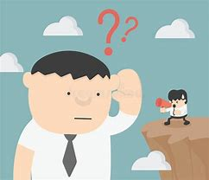
inaudible

Slide 172
incapable

Slide 173
incapable

Slide 174

incapable

Slide 175
incomplete

Slide 176
incomplete

Slide 177
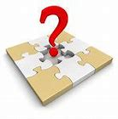
incomplete

Slide 178
inaudible

Slide 179
inaudible in + audible = inaudible

Slide 180
inaudible in + audible = inaudible
ADJECTIVE
Definition - unable to be heard.

Slide 181
incapable

Slide 182
incapable in + capable = incapable

Slide 183
incapable in + capable = incapable
ADJECTIVE
Definition - unable to do or achieve (something).

Slide 184
incomplete

Slide 185
incomplete in + complete = incomplete

Slide 186
incomplete in + complete = incomplete
ADJECTIVE
Definition - not having all the necessary or appropriate parts.

Slide 187
The sound was inaudible.

Slide 188
The sound was _________.

Slide 189
The sound was inaudible.

Slide 190
Wilson blushed and was incapable of speech.

Slide 191
Wilson blushed and was _________ of speech.

Slide 192
Wilson blushed and was incapable of speech.

Slide 193
The painting was incomplete.

Slide 194
The painting was __________.

Slide 195
The painting was incomplete.

Slide 196
New CHALLENGE words.

Slide 197
interest

Slide 198
interest
I thought the book might interest Eliot.

Slide 199
interest
I thought the book might interest Eliot.

Slide 200
I thought the book might interest Eliot.

Slide 201
I thought the book might ________ Eliot.

Slide 202
I thought the book might interest Eliot.

Slide 203
various

Slide 204
various
The dresses were of various colours.

Slide 205
various
The dresses were of various colours.

Slide 206
The dresses were of various colours.

Slide 207
The dresses were of _______ colours.

Slide 208
The dresses were of various colours.

Slide 209
Let’s Practise and Apply.

Slide 210
Can you spot the spelling rule words and the challenge words?

Slide 211
Wind Energy
Wind is a various type of energy which means it has the power to do things. Interest in wind energy has grown in the last few years as it can make electricity. There are other ways to make electricity but they can be inadequate. If the energy used to create electricity comes from a source that won’t run out, it is called renewable energy. There will always be wind on earth as it is never inactive. It is a great source of renewable energy, but an incomplete one.

Slide 212
Wind Energy
Wind is a various type of energy which means it has the power to do things. Interest in wind energy has grown in the last few years as it can make electricity. There are other ways to make electricity but they can be inadequate. If the energy used to create electricity comes from a source that won’t run out, it is called renewable energy. There will always be wind on earth as it is never inactive. It is a great source of renewable energy, but an incomplete one.

Slide 213
Write this sentence as I dictate it to you.
Notes:
There are other ways to make electricity, but they can be inadequate.

Slide 214
There are other ways to make electricity, but they can be inadequate.
Did you write it correctly?
Edit your work and make sure you have it correct.
Can you underline the spelling word that we have covered in this session?

Slide 215
Year 4 - Autumn 2
Week 1 - Thursday
Notes:
Revisit and review the words from previous teaching and challenge words – I say, we say, you say
Ask children to write words only in their spelling book
Introduce the new spelling rule
Children to write the new spelling rule words and challenge words into books when the sentences are shown with the spelling word missing.
Read the extract with the class as choral reading. Practise model of prosody etc.
Ask children to find the spelling words from the session in the text.
Then read allowed the chosen sentence for children to write fully in their books.
Show the extract and ask children to then edit their work to check they were correct in their dictation.

Slide 217
Let’s Revisit and Review…

Slide 218
Do you remember this challenge word?

Slide 219
height

Slide 220
height
Definition – NOUN the measurement of someone or something from head to foot or from base to top.

Slide 221
height
Definition – NOUN the measurement of someone or something from head to foot or from base to top.

Slide 222
Do you remember this challenge word?

Slide 223
history

Slide 224
history noun
Definition – the study of past events

Slide 225
history noun
Definition – the study of past events

Slide 226
‘OU’

Slide 227
rough

Slide 228
rough

Slide 229
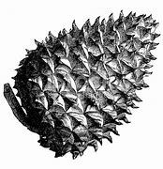
rough

Slide 230
tough

Slide 231
tough

Slide 232

tough

Slide 233
cousin

Slide 234
cousin

Slide 235
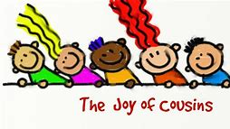
cousin

Slide 236
Let’s Teach and Practise

Slide 237
The prefix
- in

Slide 238
in-

Slide 239
in- meaning ‘not’

Slide 240
inconsiderate

Slide 241
inconsiderate

Slide 242
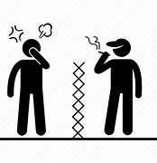
inconsiderate

Slide 243
inconvenient

Slide 244
inconvenient

Slide 245
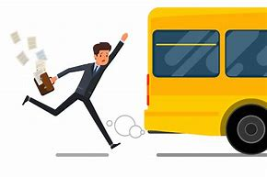
inconvenient

Slide 246
incorrect

Slide 247
incorrect

Slide 248

incorrect

Slide 249
inconsiderate

Slide 250
inconsiderate in + considerate = inconsiderate

Slide 251
inconsiderate in + considerate = inconsiderate
ADJECTIVE
Definition - thoughtlessly causing hurt or inconvenience to others.

Slide 252
inconvenient

Slide 253
inconvenient in + convenient = inconvenient

Slide 254
inconvenient in + convenient = inconvenient
ADJECTIVE
Definition - causing trouble, difficulties, or discomfort.

Slide 255
incorrect

Slide 256
incorrect in + correct = incorrect

Slide 257
incorrect in + correct = incorrect
ADJECTIVE - not in accordance with fact; wrong.

Slide 258
It was inconsiderate of them to go away without telling us.

Slide 259
It was _____________ of them to go away without telling us.

Slide 260
It was inconsiderate of them to go away without telling us.

Slide 261
She telephoned frequently, usually at inconvenient times.

Slide 262
She telephoned frequently, usually at ____________ times.

Slide 263
She telephoned frequently, usually at inconvenient times.

Slide 264
The doctor gave you incorrect advice.

Slide 265
The doctor gave you _________ advice.

Slide 266
The doctor gave you incorrect advice.

Slide 267
New CHALLENGE words.

Slide 268
interest

Slide 269
interest
I thought the book might interest Eliot.

Slide 270
interest
I thought the book might interest Eliot.

Slide 271
I thought the book might interest Eliot.

Slide 272
I thought the book might ________ Eliot.

Slide 273
I thought the book might interest Eliot.

Slide 274
various

Slide 275
various
The dresses were of various colours.

Slide 276
various
The dresses were of various colours.

Slide 277
The dresses were of various colours.

Slide 278
The dresses were of _______ colours.

Slide 279
The dresses were of various colours.

Slide 280
Let’s Practise and Apply.

Slide 281
Can you spot the spelling rule words and the challenge words?

Slide 282
Wind Energy
Wind is a various type of energy which means it has the power to do things. Interest in wind energy has grown in the last few years as it can make electricity. There are other ways to make electricity but they can be inadequate. If the energy used to create electricity comes from a source that won’t run out, it is called renewable energy. There will always be wind on earth as it is never inactive. It is a great source of renewable energy, but an incomplete one.

Slide 283
Wind Energy
Wind is a various type of energy which means it has the power to do things. Interest in wind energy has grown in the last few years as it can make electricity. There are other ways to make electricity but they can be inadequate. If the energy used to create electricity comes from a source that won’t run out, it is called renewable energy. There will always be wind on earth as it is never inactive. It is a great source of renewable energy, but an incomplete one.

Slide 284
Write this sentence as I dictate it to you.
Notes:
There will always be wind on earth as it is never inactive.

Slide 285
There will always be wind on earth as it is never inactive.
Did you write it correctly?
Edit your work and make sure you have it correct.
Can you underline the spelling word that we have covered in this session?

Slide 286
Year 4 - Autumn 2
Week 1 - Friday
Notes:
Click through the slides for all the R+R words for the week (both the focus and the challenge words)
Click through the slides for all the new learning this week

Slide 288
Old challenge words…

Slide 289
height

Slide 290
history

Slide 291
Old spelling rule words…

Slide 292
woman

Slide 293
wonder

Slide 294
month

Slide 295
govern

Slide 296
brother

Slide 297
another

Slide 298
double

Slide 299
trouble

Slide 300
courage

Slide 301
rough

Slide 302
tough

Slide 303
cousin

Slide 304
New spelling rule words…

Slide 305
inaccessible

Slide 306
inaccurate

Slide 307
inactive

Slide 308
inadequate

Slide 309
inarticulate

Slide 310
inattentive

Slide 311
inaudible

Slide 312
incapable

Slide 313
incomplete

Slide 314
inconsiderate

Slide 315
inconvenient

Slide 316
incorrect

Slide 317
New challenge words…

Slide 318
interest

Slide 319
various

Slide 320
Quick Quiz time…
Notes:
Say these words for the quiz
Height history various interest wonder tough inaccurate inattentive inaudible incorrect

Slide 321
Did you get them correct?
Edit your work.
height history various interest wonder tough inaccurate inattentive inaudible incorrect

Slide 322
Word class time…

Slide 323
I thought the book might interest Eliot.
Notes:
Ask for these words to be classed

Slide 324
I thought the book might interest Eliot.
Pronoun verb determiner noun verb verb noun
Notes:
Ask for these words to be classed

Slide 325
I thought the book might interest Eliot.
Pronoun verb determiner noun verb verb noun
Notes:
Ask for these words to be classed

Slide 326
The dresses were of various colours.
Notes:
Ask for these words to be classed

Slide 327
The dresses were of various colours.
Deternimer noun verb preposition adjective noun

Slide 328
The dresses were of various colours.
Deternimer noun verb preposition adjective noun

Slide 329
Etymology
The history of a word….

Slide 330
various (adj.)
early 15c., "characterized by variety," from Latin varius "changing, different, diverse" (see vary). Meaning "different from one another, having a diversity of features" is recorded from 1630s. Related: Variously.
interest (v.)
"cause to be interested, engage the attention of," c. 1600, earlier interesse (1560s), from the noun (see interest (n.)). Perhaps also from or influenced by interess'd, past participle of interesse.

Slide 331
Let’s investigate….
Create questions and mark schemes for these words.

