Slide 1
Spelling Y4
Mastering spellings: building on the foundations of phonics
Autumn 2
Week 2

Slide 2
Year 4 - Autumn 2
Week 2 - Monday

Slide 3
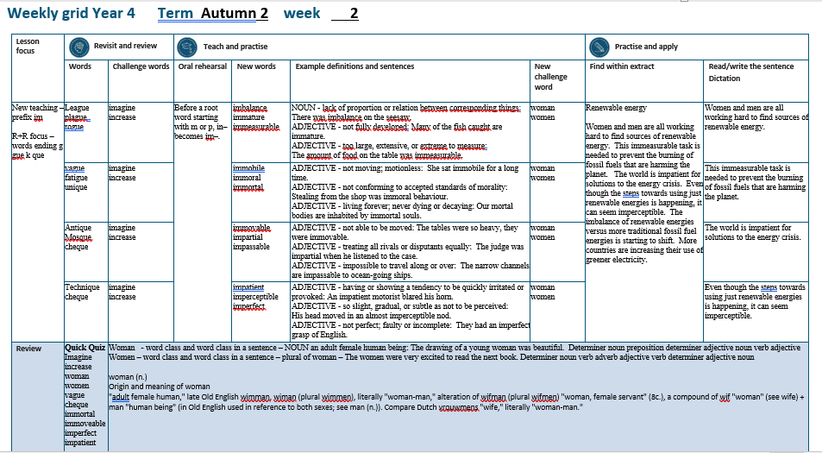

Slide 4
Let’s Revisit and Review…

Slide 5
Do you remember this challenge word?

Slide 6
imagine

Slide 7
imagine
Definition – VERB believe (something unreal or untrue) to exist or be so

Slide 8

imagine
Definition – VERB believe (something unreal or untrue) to exist or be so

Slide 9
Do you remember this challenge word?

Slide 10
increase

Slide 11
increase
VERB
Definition – become or make greater in size, amount, or degree.

Slide 12
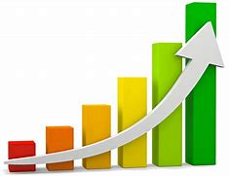
increase
VERB
Definition – become or make greater in size, amount, or degree.

Slide 13
‘gue’

Slide 14
league

Slide 15
league

Slide 16
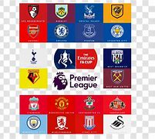
league

Slide 17
plague

Slide 18
plague

Slide 19

plague

Slide 20
rogue

Slide 21
rogue

Slide 22
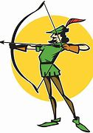
rogue

Slide 23
Let’s Teach and Practise

Slide 24
The prefix
- im

Slide 25
im-

Slide 26
im- meaning ‘not’

Slide 27
im- meaning ‘not’
Before a root word starting with m or p, in– becomes im–.

Slide 28
imbalance

Slide 29
imbalance

Slide 30
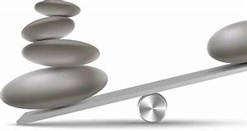
imbalance

Slide 31
immature

Slide 32
immature

Slide 33
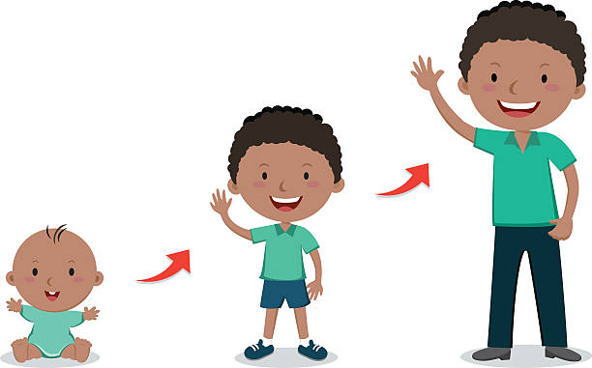
immature

Slide 34
immeasurable

Slide 35
immeasurable

Slide 36

immeasurable

Slide 37
imbalance

Slide 38
imbalance im + balance = imbalance

Slide 39
imbalance im + balance = imbalance
NOUN
Definition - lack of proportion or relation between corresponding things.

Slide 40
immature

Slide 41
immature im + mature = immature

Slide 42
immature im + mature = immature
ADJECTIVE
Definition - not fully developed.

Slide 43
immeasurable

Slide 44
immeasurable im + measurable = immeasurable

Slide 45
immeasurable im + measurable = immeasurable
ADJECTIVE
Definition - too large, extensive, or extreme to measure.

Slide 46
There was imbalance on the seesaw.

Slide 47
There was _________ on the seesaw.

Slide 48
There was imbalance on the seesaw.

Slide 49
Many of the fish caught are immature.

Slide 50
Many of the fish caught are ________.

Slide 51
Many of the fish caught are immature.

Slide 52
The amount of food on the table was immeasurable.

Slide 53
The amount of food on the table was ____________.

Slide 54
The amount of food on the table was immeasurable.

Slide 55
New CHALLENGE words.

Slide 56
woman

Slide 57
woman
The drawing of the young woman was beautiful.

Slide 58

woman
The drawing of the young woman was beautiful.

Slide 59
The drawing of the young woman was beautiful.

Slide 60
The drawing of the young ______ was beautiful.

Slide 61
The drawing of the young woman was beautiful.

Slide 62
women

Slide 63
women
The women were very excited to read the next book.

Slide 64
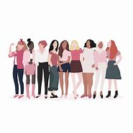
women
The women were very excited to read the next book.

Slide 65
The women were very excited to read the next book.

Slide 66
The _____ were very excited to read the next book.

Slide 67
The women were very excited to read the next book.

Slide 68
Let’s Practise and Apply.

Slide 69
Can you spot the spelling rule words and the challenge words?

Slide 70
Renewable energy
Women and men are all working hard to find sources of renewable energy. This immeasurable task is needed to prevent the burning of fossil fuels that are harming the planet. The world is impatient for solutions to the energy crisis. Even though the steps towards using just renewable energies is happening, it can seem imperceptible. The imbalance of renewable energies versus more traditional fossil fuel energies is starting to shift. More countries are increasing their use of greener electricity.

Slide 71
Renewable energy
Women and men are all working hard to find sources of renewable energy. This immeasurable task is needed to prevent the burning of fossil fuels that are harming the planet. The world is impatient for solutions to the energy crisis. Even though the steps towards using just renewable energies is happening, it can seem imperceptible. The imbalance of renewable energies versus more traditional fossil fuel energies is starting to shift. More countries are increasing their use of greener electricity.

Slide 72
Write this sentence as I dictate it to you.
Notes:
Women and men are all working hard to find sources of renewable energy.

Slide 73
Women and men are all working hard to find sources of renewable energy.
Did you write it correctly?
Edit your work and make sure you have it correct.
Can you underline the spelling word that we have covered in this session?

Slide 74
Year 4 - Autumn 2
Week 2 - Tuesday
Notes:
Revisit and review the words from previous teaching and challenge words – I say, we say, you say
Ask children to write words only in their spelling book
Introduce the new spelling rule
Children to write the new spelling rule words and challenge words into books when the sentences are shown with the spelling word missing.
Read the extract with the class as choral reading. Practise model of prosody etc.
Ask children to find the spelling words from the session in the text.
Then read allowed the chosen sentence for children to write fully in their books.
Show the extract and ask children to then edit their work to check they were correct in their dictation.

Slide 76
Let’s Revisit and Review…

Slide 77
Do you remember this challenge word?

Slide 78
imagine

Slide 79
imagine
Definition – VERB believe (something unreal or untrue) to exist or be so

Slide 80
imagine
Definition – VERB believe (something unreal or untrue) to exist or be so

Slide 81
Do you remember this challenge word?

Slide 82
increase

Slide 83
increase
VERB
Definition – become or make greater in size, amount, or degree.

Slide 84
increase
VERB
Definition – become or make greater in size, amount, or degree.

Slide 85
‘gue’

Slide 86
vague

Slide 87
vague

Slide 88
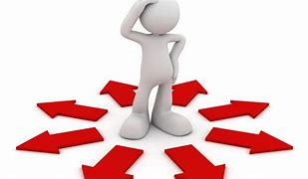
vague

Slide 89
fatigue

Slide 90
fatigue

Slide 91

fatigue

Slide 92
rogue

Slide 93
Let’s Teach and Practise

Slide 94
The prefix
- im

Slide 95
im-

Slide 96
im- meaning ‘not’

Slide 97
im- meaning ‘not’
Before a root word starting with m or p, in– becomes im–.

Slide 98
immobile

Slide 99
immobile

Slide 100
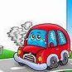
immobile

Slide 101
immoral

Slide 102
immoral

Slide 103

immoral

Slide 104
immortal

Slide 105
immoral

Slide 106

immoral

Slide 107
immobile

Slide 108
immobile im + mobile = immobile

Slide 109
immobile im + mobile = immobile
ADJECTIVE
Definition - not moving; motionless.

Slide 110
immoral

Slide 111
immoral im + moral = immoral

Slide 112
immoral im + moral = immoral
ADJECTIVE
Definition - not conforming to accepted standards of morality.

Slide 113
immortal

Slide 114
immortal im + mortal = immortal

Slide 115
immortal im + mortal = immortal
ADJECTIVE
Definition - living forever; never dying or decaying.

Slide 116
She sat immobile for a long time.

Slide 117
She sat ________ for a long time.

Slide 118
She sat immobile for a long time.

Slide 119
Stealing from the shop was immoral behaviour.

Slide 120
Stealing from the shop was _______ behaviour.

Slide 121
Stealing from the shop was immoral behaviour.

Slide 122
Our mortal bodies are inhabited by immortal souls.

Slide 123
Our mortal bodies are inhabited by ________ souls.

Slide 124
Our mortal bodies are inhabited by immortal souls.

Slide 125
New CHALLENGE words.

Slide 126
woman

Slide 127
woman
The drawing of the young woman was beautiful.

Slide 128
woman
The drawing of the young woman was beautiful.

Slide 129
The drawing of the young woman was beautiful.

Slide 130
The drawing of the young ______ was beautiful.

Slide 131
The drawing of the young woman was beautiful.

Slide 132
women

Slide 133
women
The women were very excited to read the next book.

Slide 134
women
The women were very excited to read the next book.

Slide 135
The women were very excited to read the next book.

Slide 136
The _____ were very excited to read the next book.

Slide 137
The women were very excited to read the next book.

Slide 138
Let’s Practise and Apply.

Slide 139
Can you spot the spelling rule words and the challenge words?

Slide 140
Renewable energy
Women and men are all working hard to find sources of renewable energy. This immeasurable task is needed to prevent the burning of fossil fuels that are harming the planet. The world is impatient for solutions to the energy crisis. Even though the steps towards using just renewable energies is happening, it can seem imperceptible. The imbalance of renewable energies versus more traditional fossil fuel energies is starting to shift. More countries are increasing their use of greener electricity.

Slide 141
Renewable energy
Women and men are all working hard to find sources of renewable energy. This immeasurable task is needed to prevent the burning of fossil fuels that are harming the planet. The world is impatient for solutions to the energy crisis. Even though the steps towards using just renewable energies is happening, it can seem imperceptible. The imbalance of renewable energies versus more traditional fossil fuel energies is starting to shift. More countries are increasing their use of greener electricity.

Slide 142
Write this sentence as I dictate it to you.
Notes:
This immeasurable task is needed to prevent the burning of fossil fuels that are harming the planet.

Slide 143
This immeasurable task is needed to prevent the burning of fossil fuels that are harming the planet.
Did you write it correctly?
Edit your work and make sure you have it correct.
Can you underline the spelling word that we have covered in this session?

Slide 144
Year 4 - Autumn 2
Week 2 - Wednesday
Notes:
Revisit and review the words from previous teaching and challenge words – I say, we say, you say
Ask children to write words only in their spelling book
Introduce the new spelling rule
Children to write the new spelling rule words and challenge words into books when the sentences are shown with the spelling word missing.
Read the extract with the class as choral reading. Practise model of prosody etc.
Ask children to find the spelling words from the session in the text.
Then read allowed the chosen sentence for children to write fully in their books.
Show the extract and ask children to then edit their work to check they were correct in their dictation.

Slide 146
Let’s Revisit and Review…

Slide 147
Do you remember this challenge word?

Slide 148
imagine

Slide 149
imagine
Definition – VERB believe (something unreal or untrue) to exist or be so

Slide 150
imagine
Definition – VERB believe (something unreal or untrue) to exist or be so

Slide 151
Do you remember this challenge word?

Slide 152
increase

Slide 153
increase
VERB
Definition – become or make greater in size, amount, or degree.

Slide 154
increase
VERB
Definition – become or make greater in size, amount, or degree.

Slide 155
‘que’

Slide 156
unique

Slide 157
unique

Slide 158
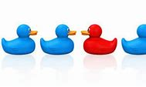
unique

Slide 159
antique

Slide 160
antique

Slide 161
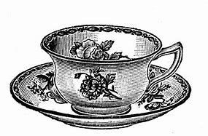
antique

Slide 162
mosque

Slide 163
mosque

Slide 164
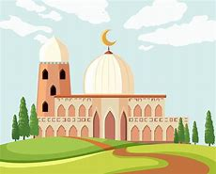
mosque

Slide 165
Let’s Teach and Practise

Slide 166
The prefix
- im

Slide 167
im-

Slide 168
im- meaning ‘not’

Slide 169
im- meaning ‘not’
Before a root word starting with m or p, in– becomes im–.

Slide 170
immovable

Slide 171
immovable

Slide 172
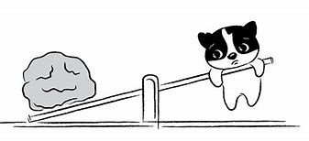
immovable

Slide 173
impartial

Slide 174
impartial

Slide 175
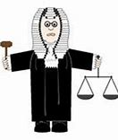
impartial

Slide 176
impassable

Slide 177
impassable

Slide 178
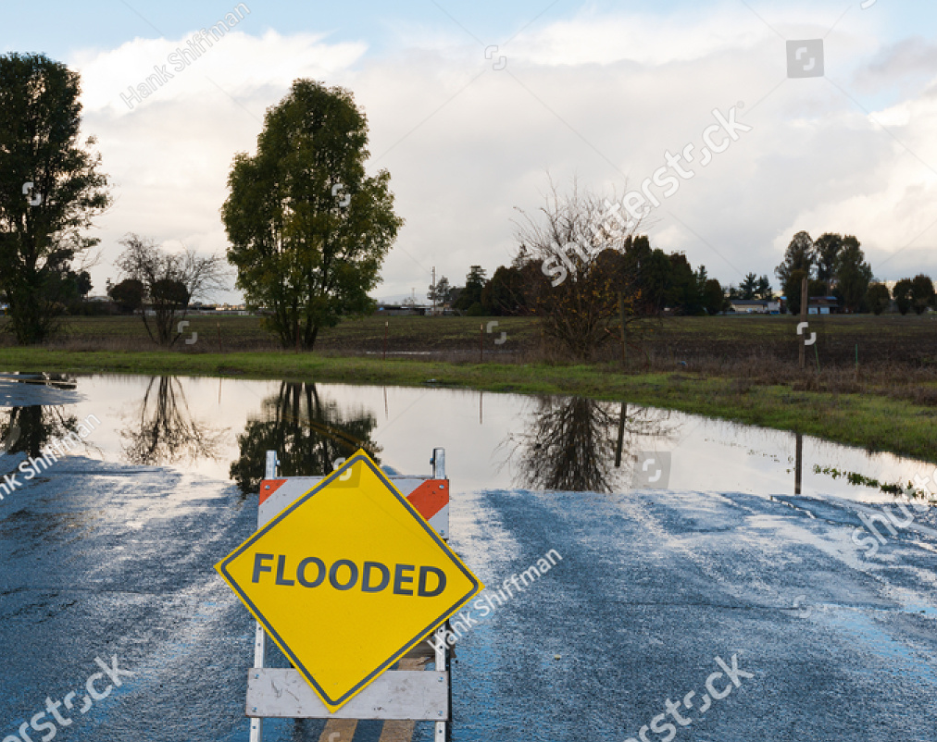
impassable

Slide 179
immovable

Slide 180
immovable im + movable = immovable

Slide 181
immovable im + movable = immovable
ADJECTIVE
Definition - not able to be moved.

Slide 182
impartial

Slide 183
impartial im + partial = impartial

Slide 184
impartial im + partial = impartial
ADJECTIVE
Definition - treating all rivals or disputants equally.

Slide 185
impassable

Slide 186
impassable im + passable = impassable

Slide 187
impassable im + passable = impassable
ADJECTIVE
Definition - impossible to travel along or over.

Slide 188
The tables were so heavy, they were immovable.

Slide 189
The tables were so heavy, they were _________.

Slide 190
The tables were so heavy, they were immovable.

Slide 191
The judge was impartial when he listened to the case.

Slide 192
The judge was _________ when he listened to the case.

Slide 193
The narrow channels are impassable to ocean-going ships.

Slide 194
The narrow channels are __________ to ocean-going ships.

Slide 195
The narrow channels are impassable to ocean-going ships.

Slide 196
New CHALLENGE words.

Slide 197
woman

Slide 198
woman
The drawing of the young woman was beautiful.

Slide 199
woman
The drawing of the young woman was beautiful.

Slide 200
The drawing of the young woman was beautiful.

Slide 201
The drawing of the young ______ was beautiful.

Slide 202
The drawing of the young woman was beautiful.

Slide 203
women

Slide 204
women
The women were very excited to read the next book.

Slide 205
women
The women were very excited to read the next book.

Slide 206
The women were very excited to read the next book.

Slide 207
The _____ were very excited to read the next book.

Slide 208
The women were very excited to read the next book.

Slide 209
Let’s Practise and Apply.

Slide 210
Can you spot the spelling rule words and the challenge words?

Slide 211
Renewable energy
Women and men are all working hard to find sources of renewable energy. This immeasurable task is needed to prevent the burning of fossil fuels that are harming the planet. The world is impatient for solutions to the energy crisis. Even though the steps towards using just renewable energies is happening, it can seem imperceptible. The imbalance of renewable energies versus more traditional fossil fuel energies is starting to shift. More countries are increasing their use of greener electricity.

Slide 212
Renewable energy
Women and men are all working hard to find sources of renewable energy. This immeasurable task is needed to prevent the burning of fossil fuels that are harming the planet. The world is impatient for solutions to the energy crisis. Even though the steps towards using just renewable energies is happening, it can seem imperceptible. The imbalance of renewable energies versus more traditional fossil fuel energies is starting to shift. More countries are increasing their use of greener electricity.

Slide 213
Write this sentence as I dictate it to you.
Notes:
The world is impatient for solutions to the energy crisis.

Slide 214
The world is impatient for solutions to the energy crisis.
Did you write it correctly?
Edit your work and make sure you have it correct.
Can you underline the spelling word that we have covered in this session?

Slide 215
Year 4 - Autumn 2
Week 2 - Thursday
Notes:
Revisit and review the words from previous teaching and challenge words – I say, we say, you say
Ask children to write words only in their spelling book
Introduce the new spelling rule
Children to write the new spelling rule words and challenge words into books when the sentences are shown with the spelling word missing.
Read the extract with the class as choral reading. Practise model of prosody etc.
Ask children to find the spelling words from the session in the text.
Then read allowed the chosen sentence for children to write fully in their books.
Show the extract and ask children to then edit their work to check they were correct in their dictation.

Slide 217
Let’s Revisit and Review…

Slide 218
Do you remember this challenge word?

Slide 219
imagine

Slide 220
imagine
Definition – VERB believe (something unreal or untrue) to exist or be so

Slide 221
imagine
Definition – VERB believe (something unreal or untrue) to exist or be so

Slide 222
Do you remember this challenge word?

Slide 223
increase

Slide 224
increase
VERB
Definition – become or make greater in size, amount, or degree.

Slide 225
increase
VERB
Definition – become or make greater in size, amount, or degree.

Slide 226
‘que’

Slide 227
technique

Slide 228
technique

Slide 229

technique

Slide 230
cheque

Slide 231
cheque

Slide 232

cheque

Slide 233
Let’s Teach and Practise

Slide 234
The prefix
- im

Slide 235
im-

Slide 236
im- meaning ‘not’

Slide 237
im- meaning ‘not’
Before a root word starting with m or p, in– becomes im–.

Slide 238
impatient

Slide 239
impatient

Slide 240

impatient

Slide 241
imperceptible

Slide 242
imperceptible

Slide 243

imperceptible

Slide 244
imperfect

Slide 245
imperfect

Slide 246
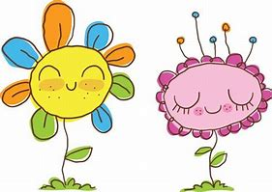
imperfect

Slide 247
impatient

Slide 248
impatient im + patient = impatient

Slide 249
impatient im + patient = impatient
ADJECTIVE
Definition - having or showing a tendency to be quickly irritated or provoked.

Slide 250
imperceptible

Slide 251
imperceptible im + perceptible = imperceptible

Slide 252
imperceptible im + perceptible = imperceptible
ADJECTIVE
Definition - so slight, gradual, or subtle as not to be perceived.

Slide 253
imperfect

Slide 254
imperfect im + perfect = imperfect

Slide 255
imperfect im + perfect = imperfect
ADJECTIVE
Definition - not perfect; faulty or incomplete.

Slide 256
An impatient motorist blared his horn.

Slide 257
An _________ motorist blared his horn.

Slide 258
An impatient motorist blared his horn.

Slide 259
His head moved in an almost imperceptible nod.

Slide 260
His head moved in an almost _____________ nod.

Slide 261
His head moved in an almost imperceptible nod.

Slide 262
They had an imperfect grasp of English.

Slide 263
They had an _________ grasp of English.

Slide 264
They had an imperfect grasp of English.

Slide 265
New CHALLENGE words.

Slide 266
woman

Slide 267
woman
The drawing of the young woman was beautiful.

Slide 268
woman
The drawing of the young woman was beautiful.

Slide 269
The drawing of the young woman was beautiful.

Slide 270
The drawing of the young ______ was beautiful.

Slide 271
The drawing of the young woman was beautiful.

Slide 272
women

Slide 273
women
The women were very excited to read the next book.

Slide 274
women
The women were very excited to read the next book.

Slide 275
The women were very excited to read the next book.

Slide 276
The _____ were very excited to read the next book.

Slide 277
The women were very excited to read the next book.

Slide 278
Let’s Practise and Apply.

Slide 279
Can you spot the spelling rule words and the challenge words?

Slide 280
Renewable energy
Women and men are all working hard to find sources of renewable energy. This immeasurable task is needed to prevent the burning of fossil fuels that are harming the planet. The world is impatient for solutions to the energy crisis. Even though the steps towards using just renewable energies is happening, it can seem imperceptible. The imbalance of renewable energies versus more traditional fossil fuel energies is starting to shift. More countries are increasing their use of greener electricity.

Slide 281
Renewable energy
Women and men are all working hard to find sources of renewable energy. This immeasurable task is needed to prevent the burning of fossil fuels that are harming the planet. The world is impatient for solutions to the energy crisis. Even though the steps towards using just renewable energies is happening, it can seem imperceptible. The imbalance of renewable energies versus more traditional fossil fuel energies is starting to shift. More countries are increasing their use of greener electricity.

Slide 282
Write this sentence as I dictate it to you.
Notes:
Even though the steps towards using just renewable energies is happening, it can seem imperceptible.

Slide 283
Even though the steps towards using just renewable energies is happening, it can seem imperceptible.
Did you write it correctly?
Edit your work and make sure you have it correct.
Can you underline the spelling word that we have covered in this session?

Slide 284
Year 4 - Autumn 2
Week 2 - Friday
Notes:
Click through the slides for all the R+R words for the week (both the focus and the challenge words)
Click through the slides for all the new learning this week

Slide 286
Old challenge words…

Slide 287
imagine

Slide 288
increase

Slide 289
Old spelling rule words…

Slide 290
league

Slide 291
plague

Slide 292
rogue

Slide 293
vague

Slide 294
fatigue

Slide 295
unique

Slide 296
antique

Slide 297
mosque

Slide 298
technique

Slide 299
cheque

Slide 300
New spelling rule words…

Slide 301
imbalance

Slide 302
immature

Slide 303
immeasurable

Slide 304
immobile

Slide 305
immoral

Slide 306
immortal

Slide 307
immoveable

Slide 308
immpartial

Slide 309
impassable

Slide 310
impatient

Slide 311
imperceptible

Slide 312
imperfect

Slide 313
New challenge words…

Slide 314
woman

Slide 315
women

Slide 316
Quick Quiz time…
Notes:
Say these words for the quiz
Imagine increase woman women vague cheque immortal immoveable imperfect impatient

Slide 317
Did you get them correct?
Edit your work.
imagine increase woman women vague cheque immortal immoveable imperfect impatient

Slide 318
Word class time…

Slide 319
The drawing of a young woman was beautiful.
Notes:
Ask for these words to be classed

Slide 320
The drawing of a young woman was beautiful.
Determiner noun preposition determiner adjective noun verb adjective
Notes:
Ask for these words to be classed

Slide 321
The drawing of a young woman was beautiful.
Determiner noun preposition determiner adjective noun verb adjective
Notes:
Ask for these words to be classed

Slide 322
The women were very excited to read the next book.
Notes:
Ask for these words to be classed

Slide 323
The women were very excited to read the next book.
Determiner noun verb adverb adjective verb determiner adjective noun

Slide 324
The women were very excited to read the next book.
Determiner noun verb adverb adjective verb determiner adjective noun

Slide 325
Etymology
The history of a word….

Slide 326
woman (n.)
Origin and meaning of woman
"adult female human," late Old English wimman, wiman (plural wimmen), literally "woman-man," alteration of wifman (plural wifmen) "woman, female servant" (8c.), a compound of wif "woman" (see wife) + man "human being" (in Old English used in reference to both sexes; see man (n.)). Compare Dutch vrouwmens "wife," literally "woman-man."

Slide 327
Let’s investigate….
Find antonyms and synonyms of the woman.

