Slide 1
Spelling Y4
Mastering spellings: building on the foundations of phonics
Autumn 2
Week 3

Slide 2
Year 4 - Autumn 2
Week 3 - Monday

Slide 3
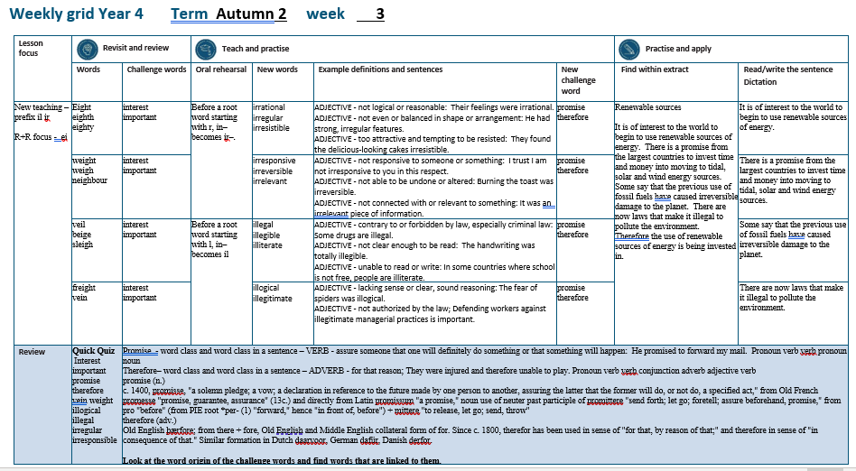

Slide 4
Let’s Revisit and Review…

Slide 5
Do you remember this challenge word?

Slide 6
interest

Slide 7
interest
Definition – NOUN the feeling of wanting to know or learn about something or someone.

Slide 8
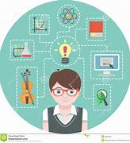
interest
Definition – NOUN the feeling of wanting to know or learn about something or someone.

Slide 9
Do you remember this challenge word?

Slide 10
important

Slide 11
important
ADJECTIVE
Definition – of great significance.

Slide 12

important
ADJECTIVE
Definition – of great significance.

Slide 13
‘ei’

Slide 14
eight

Slide 15
eight

Slide 16
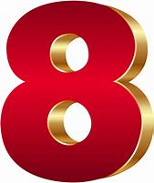
eight

Slide 17
eighth

Slide 18
eighth

Slide 19
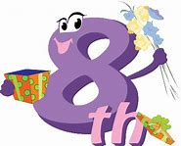
eighth

Slide 20
eighty

Slide 21
eighty

Slide 22

eighty

Slide 23
Let’s Teach and Practise

Slide 24
The prefix
- ir

Slide 25
ir-

Slide 26
ir- meaning ‘not’

Slide 27
ir- meaning ‘not’
Before a root word starting with r, in– becomes ir–.

Slide 28
irrational

Slide 29
irrational

Slide 30
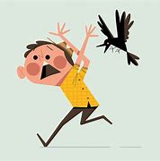
irrational

Slide 31
irregular

Slide 32
irregular

Slide 33

irregular

Slide 34
irresistible

Slide 35
irresistible

Slide 36
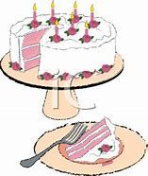
irresistible

Slide 37
irrational

Slide 38
irrational ir + rational = irrational

Slide 39
irrational ir + rational = irrational
ADJECTIVE
Definition - not logical or reasonable.

Slide 40
irregular

Slide 41
irregular ir + regular = irregular

Slide 42
irregular ir + regular = irregular
ADJECTIVE
Definition - not even or balanced in shape or arrangement.

Slide 43
irresistible

Slide 44
irresistible ir + resistible = irresistible

Slide 45
irresistible ir + resistible = irresistible
ADJECTIVE
Definition - too attractive and tempting to be resisted.

Slide 46
Their fear was irrational.

Slide 47
Their fear was __________.

Slide 48
Their fear was irrational.

Slide 49
He had strong, irregular features.

Slide 50
He had strong, _________ features.

Slide 51
He had strong, irregular features.

Slide 52
They found the delicious-looking cakes irresistible.

Slide 53
They found the delicious-looking cakes ____________.

Slide 54
They found the delicious-looking cakes irresistible.

Slide 55
New CHALLENGE words.

Slide 56
promise

Slide 57
promise
He promised to forward my mail

Slide 58

promise
He promised to forward my mail

Slide 59
He promised to forward my mail

Slide 60
He ________ to forward my mail

Slide 61
He promised to forward my mail

Slide 62
therefore

Slide 63
therefore
They were injured and therefore unable to play.

Slide 64

therefore
They were injured and therefore unable to play.

Slide 65
They were injured and therefore unable to play.

Slide 66
They were injured and _________ unable to play.

Slide 67
They were injured and therefore unable to play.

Slide 68
Let’s Practise and Apply.

Slide 69
Can you spot the spelling rule words and the challenge words?

Slide 70
Renewable sources
It is of interest to the world to begin to use renewable sources of energy. There is a promise from the largest countries to invest time and money into moving to tidal, solar and wind energy sources. Some say that the previous use of fossil fuels have caused irreversible damage to the planet. There are now laws that make it illegal to pollute the environment. Therefore, the use of renewable sources of energy is being invested in.

Slide 71
Renewable sources
It is of interest to the world to begin to use renewable sources of energy. There is a promise from the largest countries to invest time and money into moving to tidal, solar and wind energy sources. Some say that the previous use of fossil fuels have caused irreversible damage to the planet. There are now laws that make it illegal to pollute the environment. Therefore, the use of renewable sources of energy is being invested in.

Slide 72
Write this sentence as I dictate it to you.
Notes:
It is of interest to the world to begin to use renewable sources of energy.

Slide 73
It is of interest to the world to begin to use renewable sources of energy.
Did you write it correctly?
Edit your work and make sure you have it correct.
Can you underline the spelling word that we have covered in this session?

Slide 74
Year 4 - Autumn 2
Week 3 - Tuesday
Notes:
Revisit and review the words from previous teaching and challenge words – I say, we say, you say
Ask children to write words only in their spelling book
Introduce the new spelling rule
Children to write the new spelling rule words and challenge words into books when the sentences are shown with the spelling word missing.
Read the extract with the class as choral reading. Practise model of prosody etc.
Ask children to find the spelling words from the session in the text.
Then read allowed the chosen sentence for children to write fully in their books.
Show the extract and ask children to then edit their work to check they were correct in their dictation.

Slide 76
Let’s Revisit and Review…

Slide 77
Do you remember this challenge word?

Slide 78
interest

Slide 79
interest
Definition – NOUN the feeling of wanting to know or learn about something or someone.

Slide 80
interest
Definition – NOUN the feeling of wanting to know or learn about something or someone.

Slide 81
Do you remember this challenge word?

Slide 82
important

Slide 83
important
ADJECTIVE
Definition – of great significance.

Slide 84
important
ADJECTIVE
Definition – of great significance.

Slide 85
‘ei’

Slide 86
weight

Slide 87
weight

Slide 88
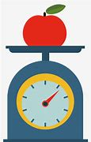
weight

Slide 89
weigh

Slide 90
weigh

Slide 91
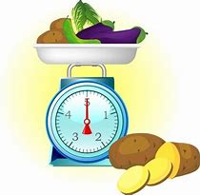
weigh

Slide 92
neighbour

Slide 93
neighbour

Slide 94

neighbour

Slide 95
Let’s Teach and Practise

Slide 96
The prefix
- ir

Slide 97
ir-

Slide 98
ir- meaning ‘not’

Slide 99
ir- meaning ‘not’
Before a root word starting with r, in– becomes ir–.

Slide 100
irresponsive

Slide 101
irresponsive

Slide 102
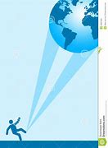
irresponsive

Slide 103
irreversible

Slide 104
irreversible

Slide 105
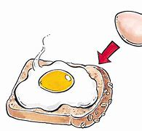
irreversible

Slide 106
irrelevant

Slide 107
irrelevant

Slide 108
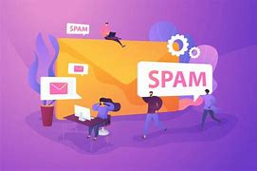
irrelevant

Slide 109
irresponsive

Slide 110
irresponsive ir + responsive = irresponsive

Slide 111
irresponsive ir + responsive = irresponsive
ADJECTIVE
Definition - not responsive to someone or something.

Slide 112
irreversible

Slide 113
irreversible ir + reversible = irreversible

Slide 114
irreversible ir + reversible = irreversible
ADJECTIVE
Definition - not able to be undone or altered.

Slide 115
irrelevent

Slide 116
irrelevant ir + relevant = irrelevant

Slide 117
irrelevant ir + relevant = irrelevant
ADJECTIVE
Definition - not connected with or relevant to something.

Slide 118
I trust I am not irresponsive to you in this respect.

Slide 119
I trust I am not ____________ to you in this respect.

Slide 120
I trust I am not irresponsive to you in this respect.

Slide 121
Burning the toast was irreversible.

Slide 122
Burning the toast was ____________.

Slide 123
Burning the toast was irreversible.

Slide 124
It was an irrelevant piece of information.

Slide 125
It was an __________ piece of information.

Slide 126
It was an irrelevant piece of information.

Slide 127
New CHALLENGE words.

Slide 128
promise

Slide 129
promise
He promised to forward my mail

Slide 130
promise
He promised to forward my mail

Slide 131
He promised to forward my mail

Slide 132
He ________ to forward my mail

Slide 133
He promised to forward my mail

Slide 134
therefore

Slide 135
therefore
They were injured and therefore unable to play.

Slide 136
therefore
They were injured and therefore unable to play.

Slide 137
They were injured and therefore unable to play.

Slide 138
They were injured and _________ unable to play.

Slide 139
They were injured and therefore unable to play.

Slide 140
Let’s Practise and Apply.

Slide 141
Can you spot the spelling rule words and the challenge words?

Slide 142
Renewable sources
It is of interest to the world to begin to use renewable sources of energy. There is a promise from the largest countries to invest time and money into moving to tidal, solar and wind energy sources. Some say that the previous use of fossil fuels have caused irreversible damage to the planet. There are now laws that make it illegal to pollute the environment. Therefore, the use of renewable sources of energy is being invested in.

Slide 143
Renewable sources
It is of interest to the world to begin to use renewable sources of energy. There is a promise from the largest countries to invest time and money into moving to tidal, solar and wind energy sources. Some say that the previous use of fossil fuels have caused irreversible damage to the planet. There are now laws that make it illegal to pollute the environment. Therefore, the use of renewable sources of energy is being invested in.

Slide 144
Write this sentence as I dictate it to you.
Notes:
There is a promise from the largest countries to invest time and money into moving to tidal, solar and wind energy sources.

Slide 145
There is a promise from the largest countries to invest time and money into moving to tidal, solar and wind energy sources.
Did you write it correctly?
Edit your work and make sure you have it correct.
Can you underline the spelling word that we have covered in this session?

Slide 146
Year 4 - Autumn 2
Week 3 - Wednesday
Notes:
Revisit and review the words from previous teaching and challenge words – I say, we say, you say
Ask children to write words only in their spelling book
Introduce the new spelling rule
Children to write the new spelling rule words and challenge words into books when the sentences are shown with the spelling word missing.
Read the extract with the class as choral reading. Practise model of prosody etc.
Ask children to find the spelling words from the session in the text.
Then read allowed the chosen sentence for children to write fully in their books.
Show the extract and ask children to then edit their work to check they were correct in their dictation.

Slide 148
Let’s Revisit and Review…

Slide 149
Do you remember this challenge word?

Slide 150
interest

Slide 151
interest
Definition – NOUN the feeling of wanting to know or learn about something or someone.

Slide 152
interest
Definition – NOUN the feeling of wanting to know or learn about something or someone.

Slide 153
Do you remember this challenge word?

Slide 154
important

Slide 155
important
ADJECTIVE
Definition – of great significance.

Slide 156
important
ADJECTIVE
Definition – of great significance.

Slide 157
‘ei’

Slide 158
veil

Slide 159
veil

Slide 160

veil

Slide 161
beige

Slide 162
beige

Slide 163
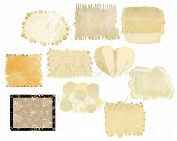
beige

Slide 164
sleigh

Slide 165
sleigh

Slide 166
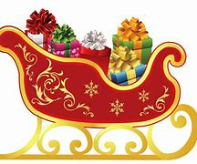
sleigh

Slide 167
Let’s Teach and Practise

Slide 168
The prefix
- il

Slide 169
il-

Slide 170
il- meaning ‘not’

Slide 171
ir- meaning ‘not’
Before a root word starting with l, in– becomes il–.

Slide 172
illegal

Slide 173
illegal

Slide 174

illegal

Slide 175
illegible

Slide 176
illegible

Slide 177
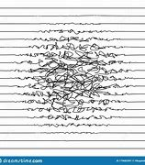
illegible

Slide 178
illiterate

Slide 179
illiterate

Slide 180

illiterate

Slide 181
illegal

Slide 182
illegal il + legal = illegal

Slide 183
illegal il + legal = illegal
ADJECTIVE
Definition - contrary to or forbidden by law, especially criminal law.

Slide 184
illegible

Slide 185
illegible il + legible = illegible

Slide 186
illegible il + legible = illegible
ADJECTIVE
Definition - not clear enough to be read.

Slide 187
illiterate

Slide 188
illiterate il + literate = illiterate

Slide 189
illiterate il + literate = illiterate
ADJECTIVE
Definition - unable to read or write.

Slide 190
Some drugs are illegal.

Slide 191
Some drugs are _______.

Slide 192
Some drugs are illegal.

Slide 193
The handwriting was totally illegible.

Slide 194
The handwriting was totally _________.

Slide 195
The handwriting was totally illegible.

Slide 196
In some countries where school is not free, people are illiterate.

Slide 197
In some countries where school is not free, people are __________.

Slide 198
In some countries where school is not free, people are illiterate.

Slide 199
New CHALLENGE words.

Slide 200
promise

Slide 201
promise
He promised to forward my mail

Slide 202
promise
He promised to forward my mail

Slide 203
He promised to forward my mail

Slide 204
He ________ to forward my mail

Slide 205
He promised to forward my mail

Slide 206
therefore

Slide 207
therefore
They were injured and therefore unable to play.

Slide 208
therefore
They were injured and therefore unable to play.

Slide 209
They were injured and therefore unable to play.

Slide 210
They were injured and _________ unable to play.

Slide 211
They were injured and therefore unable to play.

Slide 212
Let’s Practise and Apply.

Slide 213
Can you spot the spelling rule words and the challenge words?

Slide 214
Renewable sources
It is of interest to the world to begin to use renewable sources of energy. There is a promise from the largest countries to invest time and money into moving to tidal, solar and wind energy sources. Some say that the previous use of fossil fuels have caused irreversible damage to the planet. There are now laws that make it illegal to pollute the environment. Therefore, the use of renewable sources of energy is being invested in.

Slide 215
Renewable sources
It is of interest to the world to begin to use renewable sources of energy. There is a promise from the largest countries to invest time and money into moving to tidal, solar and wind energy sources. Some say that the previous use of fossil fuels have caused irreversible damage to the planet. There are now laws that make it illegal to pollute the environment. Therefore, the use of renewable sources of energy is being invested in.

Slide 216
Write this sentence as I dictate it to you.
Notes:
Some say that the previous use of fossil fuels have caused irreversible damage to the planet.

Slide 217
Some say that the previous use of fossil fuels have caused irreversible damage to the planet.
Did you write it correctly?
Edit your work and make sure you have it correct.
Can you underline the spelling word that we have covered in this session?

Slide 218
Year 4 - Autumn 2
Week 3 - Thursday
Notes:
Revisit and review the words from previous teaching and challenge words – I say, we say, you say
Ask children to write words only in their spelling book
Introduce the new spelling rule
Children to write the new spelling rule words and challenge words into books when the sentences are shown with the spelling word missing.
Read the extract with the class as choral reading. Practise model of prosody etc.
Ask children to find the spelling words from the session in the text.
Then read allowed the chosen sentence for children to write fully in their books.
Show the extract and ask children to then edit their work to check they were correct in their dictation.

Slide 220
Let’s Revisit and Review…

Slide 221
Do you remember this challenge word?

Slide 222
interest

Slide 223
interest
Definition – NOUN the feeling of wanting to know or learn about something or someone.

Slide 224
interest
Definition – NOUN the feeling of wanting to know or learn about something or someone.

Slide 225
Do you remember this challenge word?

Slide 226
important

Slide 227
important
ADJECTIVE
Definition – of great significance.

Slide 228
important
ADJECTIVE
Definition – of great significance.

Slide 229
‘ei’

Slide 230
freight

Slide 231
freight

Slide 232
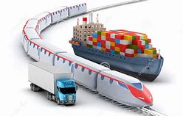
freight

Slide 233
vein

Slide 234
vein

Slide 235
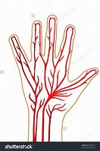
vein

Slide 236
Let’s Teach and Practise

Slide 237
The prefix
- il

Slide 238
il-

Slide 239
il- meaning ‘not’

Slide 240
il- meaning ‘not’
Before a root word starting with l, in– becomes il–.

Slide 241
illogical

Slide 242
illogical

Slide 243
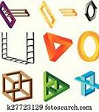
illogical

Slide 244
illegitimate

Slide 245
illegitimate

Slide 246

illegitimate

Slide 247
illogical

Slide 248
illogical il + logical = illogical

Slide 249
illogical il + logical = illogical
ADJECTIVE
Definition - lacking sense or clear, sound reasoning.

Slide 250
illegitimate

Slide 251
illegitimate il + legitimate = illegitimate

Slide 252
illegitimate il + legitimate = illegitimate
ADJECTIVE - not authorised by the law.

Slide 253
The fear of spiders was illogical.

Slide 254
The fear of spiders was _________.

Slide 255
The fear of spiders was illogical.

Slide 256
Defending workers against illegitimate managerial practices is important.

Slide 257
Defending workers against ____________ managerial practices is important.

Slide 258
Defending workers against illegitimate managerial practices is important.

Slide 259
New CHALLENGE words.

Slide 260
promise

Slide 261
promise
He promised to forward my mail

Slide 262
promise
He promised to forward my mail

Slide 263
He promised to forward my mail

Slide 264
He ________ to forward my mail

Slide 265
He promised to forward my mail

Slide 266
therefore

Slide 267
therefore
They were injured and therefore unable to play.

Slide 268
therefore
They were injured and therefore unable to play.

Slide 269
They were injured and therefore unable to play.

Slide 270
They were injured and _________ unable to play.

Slide 271
They were injured and therefore unable to play.

Slide 272
Let’s Practise and Apply.

Slide 273
Can you spot the spelling rule words and the challenge words?

Slide 274
Renewable sources
It is of interest to the world to begin to use renewable sources of energy. There is a promise from the largest countries to invest time and money into moving to tidal, solar and wind energy sources. Some say that the previous use of fossil fuels have caused irreversible damage to the planet. There are now laws that make it illegal to pollute the environment. Therefore, the use of renewable sources of energy is being invested in.

Slide 275
Renewable sources
It is of interest to the world to begin to use renewable sources of energy. There is a promise from the largest countries to invest time and money into moving to tidal, solar and wind energy sources. Some say that the previous use of fossil fuels have caused irreversible damage to the planet. There are now laws that make it illegal to pollute the environment. Therefore, the use of renewable sources of energy is being invested in.

Slide 276
Write this sentence as I dictate it to you.
Notes:
There are now laws that make it illegal to pollute the environment.

Slide 277
There are now laws that make it illegal to pollute the environment.
Did you write it correctly?
Edit your work and make sure you have it correct.
Can you underline the spelling word that we have covered in this session?

Slide 278
Year 4 - Autumn 2
Week 3 - Friday
Notes:
Click through the slides for all the R+R words for the week (both the focus and the challenge words)
Click through the slides for all the new learning this week

Slide 280
Old challenge words…

Slide 281
interest

Slide 282
important

Slide 283
Old spelling rule words…

Slide 284
eight

Slide 285
eighth

Slide 286
eighty

Slide 287
weight

Slide 288
weigh

Slide 289
neighbour

Slide 290
veil

Slide 291
beige

Slide 292
sleigh

Slide 293
freight

Slide 294
vein

Slide 295
New spelling rule words…

Slide 296
irrational

Slide 297
irregular

Slide 298
irresistible

Slide 299
irresponsive

Slide 300
irreversible

Slide 301
irrelevant

Slide 302
illegal

Slide 303
illegible

Slide 304
illiterate

Slide 305
illogical

Slide 306
illegitimate

Slide 307
New challenge words…

Slide 308
promise

Slide 309
therefore

Slide 310
Quick Quiz time…
Notes:
Say these words for the quiz
Interest important promise therefore vein weight illogical illegal irregular irresponsible

Slide 311
Did you get them correct?
Edit your work.
interest important promise therefore vein weight illogical illegal irregular irresponsible

Slide 312
Word class time…

Slide 313
He promised to forward my mail.
Notes:
Ask for these words to be classed

Slide 314
He promised to forward my mail.
Pronoun verb verb pronoun noun
Notes:
Ask for these words to be classed

Slide 315
He promised to forward my mail.
Pronoun verb verb pronoun noun
Notes:
Ask for these words to be classed

Slide 316
They were injured and therefore unable to play.
Notes:
Ask for these words to be classed

Slide 317
They were injured and therefore unable to play.
pronoun verb verb conjunction adverb adjective verb

Slide 318
They were injured and therefore unable to play.
pronoun verb verb conjunction adverb adjective verb

Slide 319
Etymology
The history of a word….

Slide 320
promise (n.)
c. 1400, promisse, "a solemn pledge; a vow; a declaration in reference to the future made by one person to another, assuring the latter that the former will do, or not do, a specified act," from Old French promesse "promise, guarantee, assurance" (13c.) and directly from Latin promissum "a promise," noun use of neuter past participle of promittere "send forth; let go; foretell; assure beforehand, promise," from pro "before" (from PIE root *per- (1) "forward," hence "in front of, before") + mittere "to release, let go; send, throw“
therefore (adv.)
Old English þærfore; from there + fore, Old English and Middle English collateral form of for. Since c. 1800, therefor has been used in sense of "for that, by reason of that;" and therefore in sense of "in consequence of that." Similar formation in Dutch daarvoor, German dafür, Danish derfor.

Slide 321
Let’s investigate….
Look at the word origin of the ‘promise’ and ‘therefore’ and find words that are linked to them.

