Slide 1
Spelling Y4
Mastering spellings: building on the foundations of phonics
Autumn 2
Week 4

Slide 2
Year 4 - Autumn 2
Week 4 - Monday

Slide 3
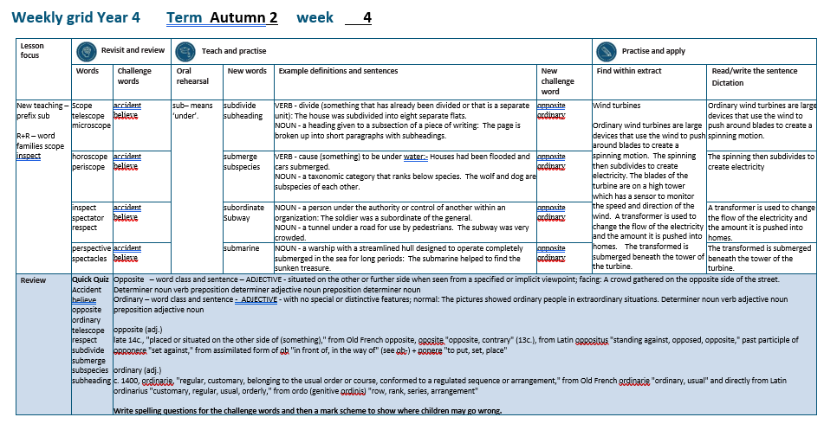

Slide 4
Let’s Revisit and Review…

Slide 5
Do you remember this challenge word?

Slide 6
accident

Slide 7
accident
Definition – NOUN an unfortunate incident that happens unexpectedly resulting in damage or injury

Slide 8
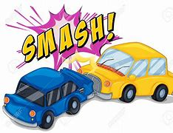
accident
Definition – NOUN an unfortunate incident that happens unexpectedly resulting in damage or injury

Slide 9
Do you remember this challenge word?

Slide 10
believe

Slide 11
believe
VERB
Definition – accept that (something) is true, especially without proof

Slide 12
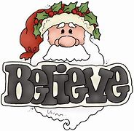
believe
VERB
Definition – accept that (something) is true, especially without proof

Slide 13
‘scope’

Slide 14
scope

Slide 15
scope

Slide 16
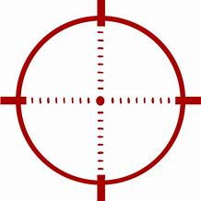
scope

Slide 17
telescope

Slide 18
telescope

Slide 19
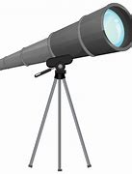
telescope

Slide 20
mircoscope

Slide 21
microscope

Slide 22
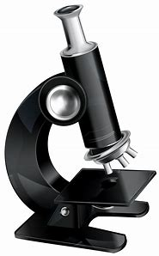
microscope

Slide 23
Let’s Teach and Practise

Slide 24
The prefix
- sub

Slide 25
sub-

Slide 26
sub- meaning ‘under’

Slide 27
sub- meaning ‘under’ add straight to the root word

Slide 28
subdivide

Slide 29
subdivide

Slide 30
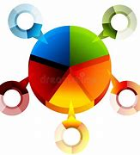
subdivide

Slide 31
subheading

Slide 32
subheading

Slide 33
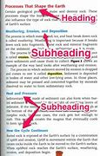
subheading

Slide 34
subdivide

Slide 35
subdivide sub + divide = subdivide

Slide 36
subdivide sub + divide = subdivide
VERB
Definition - divide something that has already been divided.

Slide 37
subheading

Slide 38
subheading sub + heading = subheading

Slide 39
subheading sub + heading = subheading
NOUN
Definition - a heading given to a subsection of a piece of writing.

Slide 40
The house was subdivided into eight separate flats.

Slide 41
The house was __________ into eight separate flats.

Slide 42
The house was subdivided into eight separate flats.

Slide 43
The page is broken up into short paragraphs with subheadings.

Slide 44
The page is broken up into short paragraphs with ___________.

Slide 45
The page is broken up into short paragraphs with subheadings.

Slide 46
New CHALLENGE words.

Slide 47
opposite

Slide 48
opposite
A crowd gathered on the opposite side of the street.

Slide 49
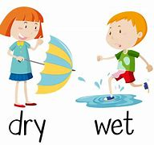
opposite
A crowd gathered on the opposite side of the street.

Slide 50
A crowd gathered on the opposite side of the street.

Slide 51
A crowd gathered on the ________ side of the street.

Slide 52
A crowd gathered on the opposite side of the street.

Slide 53
ordinary

Slide 54
ordinary
The pictures showed ordinary people in extraordinary situations

Slide 55
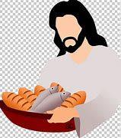
ordinary
The pictures showed ordinary people in extraordinary situations

Slide 56
The pictures showed ordinary people in extraordinary situations

Slide 57
The pictures showed _________ people in extra________ situations

Slide 58
The pictures showed ordinary people in extraordinary situations

Slide 59
Let’s Practise and Apply.

Slide 60
Can you spot the spelling rule words and the challenge words?

Slide 61
Wind turbines
Ordinary wind turbines are large devices that use the wind to push around blades to create a spinning motion. The spinning then subdivides to create electricity. The blades of the turbine are on a high tower which has a sensor to monitor the speed and direction of the wind. A transformer is used to create an opposite flow of electricity and the amount it is pushed into homes. The transformer is submerged beneath the tower of the turbine.

Slide 62
Wind turbines
Ordinary wind turbines are large devices that use the wind to push around blades to create a spinning motion. The spinning then subdivides to create electricity. The blades of the turbine are on a high tower which has a sensor to monitor the speed and direction of the wind. A transformer is used to create an opposite flow of electricity and the amount it is pushed into homes. The transformer is submerged beneath the tower of the turbine.

Slide 63
Write this sentence as I dictate it to you.
Notes:
Ordinary wind turbines are large devices that use the wind to push around blades to create a spinning motion.

Slide 64
Ordinary wind turbines are large devices that use the wind to push around blades to create a spinning motion.
Did you write it correctly?
Edit your work and make sure you have it correct.
Can you underline the spelling word that we have covered in this session?

Slide 65
Year 4 - Autumn 2
Week 4 - Tuesday
Notes:
Revisit and review the words from previous teaching and challenge words – I say, we say, you say
Ask children to write words only in their spelling book
Introduce the new spelling rule
Children to write the new spelling rule words and challenge words into books when the sentences are shown with the spelling word missing.
Read the extract with the class as choral reading. Practise model of prosody etc.
Ask children to find the spelling words from the session in the text.
Then read allowed the chosen sentence for children to write fully in their books.
Show the extract and ask children to then edit their work to check they were correct in their dictation.

Slide 67
Let’s Revisit and Review…

Slide 68
Do you remember this challenge word?

Slide 69
accident

Slide 70
accident
Definition – NOUN an unfortunate incident that happens unexpectedly resulting in damage or injury

Slide 71
accident
Definition – NOUN an unfortunate incident that happens unexpectedly resulting in damage or injury

Slide 72
Do you remember this challenge word?

Slide 73
believe

Slide 74
believe
VERB
Definition – accept that (something) is true, especially without proof

Slide 75
believe
VERB
Definition – accept that (something) is true, especially without proof

Slide 76
‘scope’

Slide 77
horoscope

Slide 78
horoscope

Slide 79
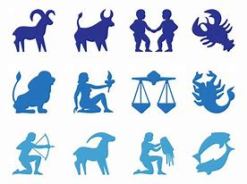
horoscope

Slide 80
periscope

Slide 81
periscope

Slide 82

periscope

Slide 83
Let’s Teach and Practise

Slide 84
The prefix
- sub

Slide 85
sub-

Slide 86
sub- meaning ‘under’

Slide 87
sub- meaning ‘under’ add straight to the root word

Slide 88
submerge

Slide 89
submerge

Slide 90
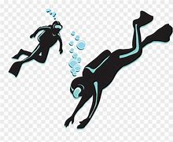
submerge

Slide 91
subspecies

Slide 92
subspecies

Slide 93
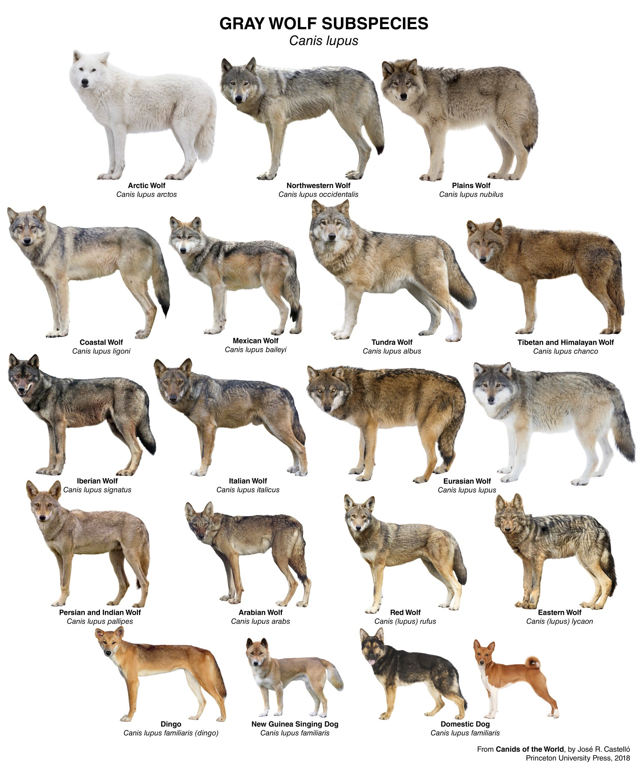
subspecies

Slide 94
submerge

Slide 95
submerge sub + merge = submerge

Slide 96
submerge sub + merge = submerge
VERB
Definition- cause (something) to be under water.

Slide 97
subspecies

Slide 98
subspecies sub + species = subspecies

Slide 99
subspecies sub + species = subspecies
NOUN
Definition - a taxonomic category that ranks below species.

Slide 100
Houses had been flooded and cars submerged.

Slide 101
Houses had been flooded and cars _________.

Slide 102
Houses had been flooded and cars submerged.

Slide 103
The wolf and dog are subspecies of each other.

Slide 104
The wolf and dog are ___________ of each other.

Slide 105
The wolf and dog are subspecies of each other.

Slide 106
New CHALLENGE words.

Slide 107
opposite

Slide 108
opposite
A crowd gathered on the opposite side of the street.

Slide 109
opposite
A crowd gathered on the opposite side of the street.

Slide 110
A crowd gathered on the opposite side of the street.

Slide 111
A crowd gathered on the ________ side of the street.

Slide 112
A crowd gathered on the opposite side of the street.

Slide 113
ordinary

Slide 114
ordinary
The pictures showed ordinary people in extraordinary situations

Slide 115
ordinary
The pictures showed ordinary people in extraordinary situations

Slide 116
The pictures showed ordinary people in extraordinary situations

Slide 117
The pictures showed _________ people in extra________ situations

Slide 118
The pictures showed ordinary people in extraordinary situations

Slide 119
Let’s Practise and Apply.

Slide 120
Can you spot the spelling rule words and the challenge words?

Slide 121
Wind turbines
Ordinary wind turbines are large devices that use the wind to push around blades to create a spinning motion. The spinning then subdivides to create electricity. The blades of the turbine are on a high tower which has a sensor to monitor the speed and direction of the wind. A transformer is used to create an opposite flow of electricity and the amount it is pushed into homes. The transformer is submerged beneath the tower of the turbine.

Slide 122
Wind turbines
Ordinary wind turbines are large devices that use the wind to push around blades to create a spinning motion. The spinning then subdivides to create electricity. The blades of the turbine are on a high tower which has a sensor to monitor the speed and direction of the wind. A transformer is used to create an opposite flow of electricity and the amount it is pushed into homes. The transformer is submerged beneath the tower of the turbine.

Slide 123
Write this sentence as I dictate it to you.
Notes:
The spinning then subdivides to create electricity.

Slide 124
The spinning then subdivides to create electricity.
Did you write it correctly?
Edit your work and make sure you have it correct.
Can you underline the spelling word that we have covered in this session?

Slide 125
Year 4 - Autumn 2
Week 4 - Wednesday
Notes:
Revisit and review the words from previous teaching and challenge words – I say, we say, you say
Ask children to write words only in their spelling book
Introduce the new spelling rule
Children to write the new spelling rule words and challenge words into books when the sentences are shown with the spelling word missing.
Read the extract with the class as choral reading. Practise model of prosody etc.
Ask children to find the spelling words from the session in the text.
Then read allowed the chosen sentence for children to write fully in their books.
Show the extract and ask children to then edit their work to check they were correct in their dictation.

Slide 127
Let’s Revisit and Review…

Slide 128
Do you remember this challenge word?

Slide 129
accident

Slide 130
accident
Definition – NOUN an unfortunate incident that happens unexpectedly resulting in damage or injury

Slide 131
accident
Definition – NOUN an unfortunate incident that happens unexpectedly resulting in damage or injury

Slide 132
Do you remember this challenge word?

Slide 133
believe

Slide 134
believe
VERB
Definition – accept that (something) is true, especially without proof

Slide 135
believe
VERB
Definition – accept that (something) is true, especially without proof

Slide 136
‘spect’

Slide 137
‘spect’ to see

Slide 138
inspect

Slide 139
inspect

Slide 140
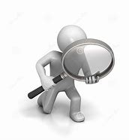
inspect

Slide 141
spectator

Slide 142
spectator

Slide 143
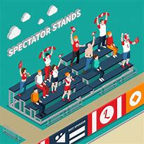
spectator

Slide 144
respect

Slide 145
respect

Slide 146
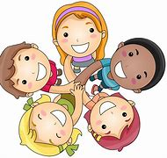
respect

Slide 147
Let’s Teach and Practise

Slide 148
The prefix
- sub

Slide 149
sub-

Slide 150
sub- meaning ‘under’

Slide 151
sub- meaning ‘under’ add straight to the root word

Slide 152
subordinate

Slide 153
subordinate

Slide 154
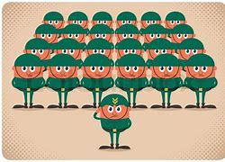
subordinate

Slide 155
subway

Slide 156
subway

Slide 157
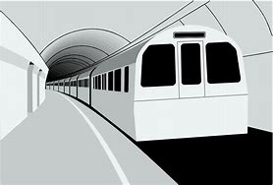
subway

Slide 158
subordinate

Slide 159
subordinate sub + ordinate = subordinate

Slide 160
subordinate sub + ordinate = subordinate
NOUN
Definition - a person under the authority or control of another within an organization.

Slide 161
subway

Slide 162
subway sub + way = subway

Slide 163
subway sub + way = subway
NOUN
Definition - a tunnel under a road for use by pedestrians or trains.

Slide 164
The soldier was a subordinate of the general.

Slide 165
The soldier was a ___________ of the general.

Slide 166
The soldier was a subordinate of the general.

Slide 167
The subway was very crowded.

Slide 168
The ______ was very crowded.

Slide 169
The subway was very crowded.

Slide 170
New CHALLENGE words.

Slide 171
opposite

Slide 172
opposite
A crowd gathered on the opposite side of the street.

Slide 173
opposite
A crowd gathered on the opposite side of the street.

Slide 174
A crowd gathered on the opposite side of the street.

Slide 175
A crowd gathered on the ________ side of the street.

Slide 176
A crowd gathered on the opposite side of the street.

Slide 177
ordinary

Slide 178
ordinary
The pictures showed ordinary people in extraordinary situations

Slide 179
ordinary
The pictures showed ordinary people in extraordinary situations

Slide 180
The pictures showed ordinary people in extraordinary situations

Slide 181
The pictures showed _________ people in extra________ situations

Slide 182
The pictures showed ordinary people in extraordinary situations

Slide 183
Let’s Practise and Apply.

Slide 184
Can you spot the spelling rule words and the challenge words?

Slide 185
Wind turbines
Ordinary wind turbines are large devices that use the wind to push around blades to create a spinning motion. The spinning then subdivides to create electricity. The blades of the turbine are on a high tower which has a sensor to monitor the speed and direction of the wind. A transformer is used to create an opposite flow of electricity and the amount it is pushed into homes. The transformer is submerged beneath the tower of the turbine.

Slide 186
Wind turbines
Ordinary wind turbines are large devices that use the wind to push around blades to create a spinning motion. The spinning then subdivides to create electricity. The blades of the turbine are on a high tower which has a sensor to monitor the speed and direction of the wind. A transformer is used to create an opposite flow of electricity and the amount it is pushed into homes. The transformer is submerged beneath the tower of the turbine.

Slide 187
Write this sentence as I dictate it to you.
Notes:
A transformer is used to create an opposite flow of electricity and the amount it is pushed into homes.

Slide 188
A transformer is used to create an opposite flow of electricity and the amount it is pushed into homes.
Did you write it correctly?
Edit your work and make sure you have it correct.
Can you underline the spelling word that we have covered in this session?

Slide 189
Year 4 - Autumn 2
Week 4 - Thursday
Notes:
Revisit and review the words from previous teaching and challenge words – I say, we say, you say
Ask children to write words only in their spelling book
Introduce the new spelling rule
Children to write the new spelling rule words and challenge words into books when the sentences are shown with the spelling word missing.
Read the extract with the class as choral reading. Practise model of prosody etc.
Ask children to find the spelling words from the session in the text.
Then read allowed the chosen sentence for children to write fully in their books.
Show the extract and ask children to then edit their work to check they were correct in their dictation.

Slide 191
Let’s Revisit and Review…

Slide 192
Do you remember this challenge word?

Slide 193
accident

Slide 194
accident
Definition – NOUN an unfortunate incident that happens unexpectedly resulting in damage or injury

Slide 195
accident
Definition – NOUN an unfortunate incident that happens unexpectedly resulting in damage or injury

Slide 196
Do you remember this challenge word?

Slide 197
believe

Slide 198
believe
VERB
Definition – accept that (something) is true, especially without proof

Slide 199
believe
VERB
Definition – accept that (something) is true, especially without proof

Slide 200
‘spect’

Slide 201
‘spect’ to see

Slide 202
perspective

Slide 203
perspective

Slide 204
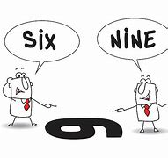
perspective

Slide 205
spectacles

Slide 206
spectacles

Slide 207

spectacles

Slide 208
Let’s Teach and Practise

Slide 209
The prefix
- sub

Slide 210
sub-

Slide 211
sub- meaning ‘under’

Slide 212
sub- meaning ‘under’ add straight to the root word

Slide 213
submarine

Slide 214
submarine

Slide 215
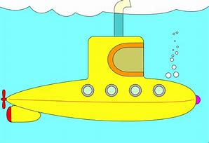
submarine

Slide 216
submarine sub + marine = submarine

Slide 217
submarine sub + marine = submarine
NOUN
Definition - a warship that operates completely submerged in the sea.

Slide 218
The submarine helped to find the sunken treasure.

Slide 219
The __________ helped to find the sunken treasure.

Slide 220
The submarine helped to find the sunken treasure.

Slide 221
New CHALLENGE words.

Slide 222
opposite

Slide 223
opposite
A crowd gathered on the opposite side of the street.

Slide 224
opposite
A crowd gathered on the opposite side of the street.

Slide 225
A crowd gathered on the opposite side of the street.

Slide 226
A crowd gathered on the ________ side of the street.

Slide 227
A crowd gathered on the opposite side of the street.

Slide 228
ordinary

Slide 229
ordinary
The pictures showed ordinary people in extraordinary situations

Slide 230
ordinary
The pictures showed ordinary people in extraordinary situations

Slide 231
The pictures showed ordinary people in extraordinary situations

Slide 232
The pictures showed _________ people in extra________ situations

Slide 233
The pictures showed ordinary people in extraordinary situations

Slide 234
Let’s Practise and Apply.

Slide 235
Can you spot the spelling rule words and the challenge words?

Slide 236
Wind turbines
Ordinary wind turbines are large devices that use the wind to push around blades to create a spinning motion. The spinning then subdivides to create electricity. The blades of the turbine are on a high tower which has a sensor to monitor the speed and direction of the wind. A transformer is used to create an opposite flow of electricity and the amount it is pushed into homes. The transformer is submerged beneath the tower of the turbine.

Slide 237
Wind turbines
Ordinary wind turbines are large devices that use the wind to push around blades to create a spinning motion. The spinning then subdivides to create electricity. The blades of the turbine are on a high tower which has a sensor to monitor the speed and direction of the wind. A transformer is used to create an opposite flow of electricity and the amount it is pushed into homes. The transformer is submerged beneath the tower of the turbine.

Slide 238
Write this sentence as I dictate it to you.
Notes:
The transformer is submerged beneath the tower of the turbine.

Slide 239
The transformer is submerged beneath the tower of the turbine.
Did you write it correctly?
Edit your work and make sure you have it correct.
Can you underline the spelling word that we have covered in this session?

Slide 240
Year 4 - Autumn 2
Week 4 - Friday
Notes:
Click through the slides for all the R+R words for the week (both the focus and the challenge words)
Click through the slides for all the new learning this week

Slide 242
Old challenge words…

Slide 243
accident

Slide 244
believe

Slide 245
Old spelling rule words…

Slide 246
scope

Slide 247
telescope

Slide 248
microscope

Slide 249
horoscope

Slide 250
periscope

Slide 251
inspect

Slide 252
spectator

Slide 253
respect

Slide 254
perspective

Slide 255
spectacles

Slide 256
New spelling rule words…

Slide 257
subdivide

Slide 258
subheading

Slide 259
submerge

Slide 260
subspecies

Slide 261
subordinate

Slide 262
subway

Slide 263
submarine

Slide 264
New challenge words…

Slide 265
opposite

Slide 266
ordinary

Slide 267
Quick Quiz time…
Notes:
Say these words for the quiz
Accident believe opposite ordinary telescope respect subdivide submerge subspecies subheading

Slide 268
Did you get them correct?
Edit your work.
accident believe opposite ordinary telescope respect subdivide submerge subspecies subheading

Slide 269
Word class time…

Slide 270
A crowd gathered on the opposite side of the street.
Notes:
Ask for these words to be classed

Slide 271
A crowd gathered on the opposite side of the street.
Determiner noun verb preposition determiner adjective noun preposition determiner noun
Notes:
Ask for these words to be classed

Slide 272
A crowd gathered on the opposite side of the street.
Determiner noun verb preposition determiner adjective noun preposition determiner noun
Notes:
Ask for these words to be classed

Slide 273
The pictures showed ordinary people in extraordinary situations.
Notes:
Ask for these words to be classed

Slide 274
The pictures showed ordinary people in extraordinary situations.
Determiner noun verb adjective noun preposition adjective noun

Slide 275
The pictures showed ordinary people in extraordinary situations.
Determiner noun verb adjective noun preposition adjective noun

Slide 276
Etymology
The history of a word….

Slide 277
opposite (adj.)
late 14c., "placed or situated on the other side of (something)," from Old French opposite, oposite "opposite, contrary" (13c.), from Latin oppositus "standing against, opposed, opposite," past participle of opponere "set against," from assimilated form of ob "in front of, in the way of" (see ob-) + ponere "to put, set, place"
ordinary (adj.)
c. 1400, ordinarie, "regular, customary, belonging to the usual order or course, conformed to a regulated sequence or arrangement," from Old French ordinarie "ordinary, usual" and directly from Latin ordinarius "customary, regular, usual, orderly," from ordo (genitive ordinis) "row, rank, series, arrangement"

Slide 278
Let’s investigate….
Write spelling questions for the challenge words and then a mark scheme to show where children may go wrong.

