Slide 1
Spelling Y4
Mastering spellings: building on the foundations of phonics
Autumn 2
Week 5

Slide 2
Year 4 - Autumn 2
Week 5 - Monday

Slide 3
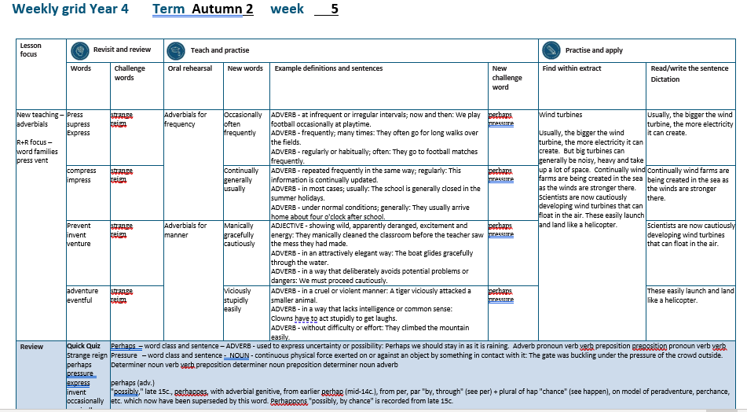

Slide 4
Let’s Revisit and Review…

Slide 5
Do you remember this challenge word?

Slide 6
strange

Slide 7
strange
Definition – ADJECTIVE unusual or surprising

Slide 8
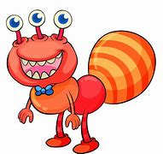
strange
Definition – ADJECTIVE unusual or surprising

Slide 9
Do you remember this challenge word?

Slide 10
reign

Slide 11
reign
VERB
Definition – hold royal office

Slide 12

reign
VERB
Definition – hold royal office

Slide 13
‘press’

Slide 14
press

Slide 15
press

Slide 16

press

Slide 17
supress

Slide 18
supress

Slide 19

supress

Slide 20
express

Slide 21

express

Slide 22
Let’s Teach and Practise

Slide 23
Adverbials for frequency

Slide 24
adverbials-

Slide 25
Adverbials - saying the how, where or when of the verb

Slide 26
Adverbials – frequency how often

Slide 27
occasionally

Slide 28
occasionally

Slide 29
occasionally
ADVERB
Definition - at infrequent or irregular intervals; now and then.

Slide 30
often

Slide 31
often

Slide 32
often
ADVERB
Definition - frequently; many times.

Slide 33
frequently

Slide 34
frequently

Slide 35
frequently
ADVERB
Definition - regularly or habitually; often.

Slide 36
We play football occasionally at playtime.

Slide 37
We play football ____________ at playtime.

Slide 38
We play football occasionally at playtime.

Slide 39
They often go for long walks over the fields.

Slide 40
They _____ go for long walks over the fields.

Slide 41
They often go for long walks over the fields.

Slide 42
They go to football matches frequently.

Slide 43
They go to football matches __________.

Slide 44
They go to football matches frequently.

Slide 45
New CHALLENGE words.

Slide 46
perhaps

Slide 47
perhaps
Perhaps we should stay in as it is raining.

Slide 48
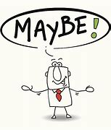
perhaps
Perhaps we should stay in as it is raining.

Slide 49
Perhaps we should stay in as it is raining.

Slide 50
_______ we should stay in as it is raining.

Slide 51
Perhaps we should stay in as it is raining.

Slide 52
pressure

Slide 53
pressure
The gate was buckling under the pressure of the crowd outside.

Slide 54
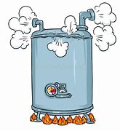
pressure
The gate was buckling under the pressure of the crowd outside.

Slide 55
The gate was buckling under the pressure of the crowd outside.

Slide 56
The gate was buckling under the ________ of the crowd outside.

Slide 57
The gate was buckling under the pressure of the crowd outside.

Slide 58
Let’s Practise and Apply.

Slide 59
Can you spot the spelling rule words and the challenge words?

Slide 60
Wind turbines
Usually, the bigger the wind turbine, the more electricity it can create. But big turbines can generally be noisy, heavy and take up a lot of space. Continually wind farms are being created in the sea as the winds are stronger there. Scientists are now cautiously developing wind turbines that can float in the air. These easily launch and land like a helicopter.

Slide 61
Wind turbines
Usually, the bigger the wind turbine, the more electricity it can create. But big turbines can generally be noisy, heavy and take up a lot of space. Continually wind farms are being created in the sea as the winds are stronger there. Scientists are now cautiously developing wind turbines that can float in the air. These easily launch and land like a helicopter.

Slide 62
Write this sentence as I dictate it to you.
Notes:
Usually, the bigger the wind turbine, the more electricity it can create.

Slide 63
Usually, the bigger the wind turbine, the more electricity it can create.
Did you write it correctly?
Edit your work and make sure you have it correct.
Can you underline the spelling word that we have covered in this session?

Slide 64
Year 4 - Autumn 2
Week 5 - Tuesday
Notes:
Revisit and review the words from previous teaching and challenge words – I say, we say, you say
Ask children to write words only in their spelling book
Introduce the new spelling rule
Children to write the new spelling rule words and challenge words into books when the sentences are shown with the spelling word missing.
Read the extract with the class as choral reading. Practise model of prosody etc.
Ask children to find the spelling words from the session in the text.
Then read allowed the chosen sentence for children to write fully in their books.
Show the extract and ask children to then edit their work to check they were correct in their dictation.

Slide 66
Let’s Revisit and Review…

Slide 67
Do you remember this challenge word?

Slide 68
strange

Slide 69
strange
Definition – ADJECTIVE unusual or surprising

Slide 70
strange
Definition – ADJECTIVE unusual or surprising

Slide 71
Do you remember this challenge word?

Slide 72
reign

Slide 73
reign
VERB
Definition – hold royal office

Slide 74
reign
VERB
Definition – hold royal office

Slide 75
‘press’

Slide 76
compress

Slide 77
compress

Slide 78
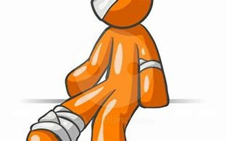
compress

Slide 79
impress

Slide 80
impress

Slide 81

impress

Slide 82
Let’s Teach and Practise

Slide 83
Adverbials for frequency

Slide 84
adverbials-

Slide 85
Adverbials - saying the how, where or when of the verb

Slide 86
Adverbials – frequency how often

Slide 87
continually

Slide 88
continually

Slide 89
continually
ADVERB
Definition - repeated frequently in the same way; regularly.

Slide 90
generally

Slide 91
generally

Slide 92
generally
ADVERB
Definition - in most cases; usually.

Slide 93
usually

Slide 94
usually

Slide 95
usually
ADVERB
Definition - under normal conditions; generally.

Slide 96
This information is continually updated.

Slide 97
This information is ___________ updated.

Slide 98
This information is continually updated.

Slide 99
The school is generally closed in the summer holidays.

Slide 100
The school is _________ closed in the summer holidays.

Slide 101
The school is generally closed in the summer holidays.

Slide 102
They usually arrive home about four o'clock after school.

Slide 103
They _______ arrive home about four o'clock after school.

Slide 104
They usually arrive home about four o'clock after school.

Slide 105
New CHALLENGE words.

Slide 106
perhaps

Slide 107
perhaps
Perhaps we should stay in as it is raining.

Slide 108
perhaps
Perhaps we should stay in as it is raining.

Slide 109
Perhaps we should stay in as it is raining.

Slide 110
_______ we should stay in as it is raining.

Slide 111
Perhaps we should stay in as it is raining.

Slide 112
pressure

Slide 113
pressure
The gate was buckling under the pressure of the crowd outside.

Slide 114
pressure
The gate was buckling under the pressure of the crowd outside.

Slide 115
The gate was buckling under the pressure of the crowd outside.

Slide 116
The gate was buckling under the ________ of the crowd outside.

Slide 117
The gate was buckling under the pressure of the crowd outside.

Slide 118
Let’s Practise and Apply.

Slide 119
Can you spot the spelling rule words and the challenge words?

Slide 120
Wind turbines
Usually, the bigger the wind turbine, the more electricity it can create. But big turbines can generally be noisy, heavy and take up a lot of space. Continually wind farms are being created in the sea as the winds are stronger there. Scientists are now cautiously developing wind turbines that can float in the air. These easily launch and land like a helicopter.

Slide 121
Wind turbines
Usually, the bigger the wind turbine, the more electricity it can create. But big turbines can generally be noisy, heavy and take up a lot of space. Continually wind farms are being created in the sea as the winds are stronger there. Scientists are now cautiously developing wind turbines that can float in the air. These easily launch and land like a helicopter.

Slide 122
Write this sentence as I dictate it to you.
Notes:
But big turbines can generally be noisy, heavy and take up a lot of space.

Slide 123
But big turbines can generally be noisy, heavy and take up a lot of space.
Did you write it correctly?
Edit your work and make sure you have it correct.
Can you underline the spelling word that we have covered in this session?

Slide 124
Year 4 - Autumn 2
Week 5 - Wednesday
Notes:
Revisit and review the words from previous teaching and challenge words – I say, we say, you say
Ask children to write words only in their spelling book
Introduce the new spelling rule
Children to write the new spelling rule words and challenge words into books when the sentences are shown with the spelling word missing.
Read the extract with the class as choral reading. Practise model of prosody etc.
Ask children to find the spelling words from the session in the text.
Then read allowed the chosen sentence for children to write fully in their books.
Show the extract and ask children to then edit their work to check they were correct in their dictation.

Slide 126
Let’s Revisit and Review…

Slide 127
Do you remember this challenge word?

Slide 128
strange

Slide 129
strange
Definition – ADJECTIVE unusual or surprising

Slide 130
strange
Definition – ADJECTIVE unusual or surprising

Slide 131
Do you remember this challenge word?

Slide 132
reign

Slide 133
reign
VERB
Definition – hold royal office

Slide 134
reign
VERB
Definition – hold royal office

Slide 135
‘vent’

Slide 136
prevent

Slide 137
prevent

Slide 138

prevent

Slide 139
invent

Slide 140
invent

Slide 141

invent

Slide 142
venture

Slide 143
venture

Slide 144
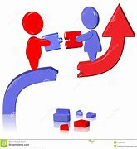
venture

Slide 145
Let’s Teach and Practise

Slide 146
Adverbials for manner

Slide 147
adverbials-

Slide 148
Adverbials - saying the how, where or when of the verb

Slide 149
Adverbials – manner how

Slide 150
manically

Slide 151
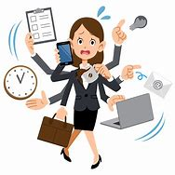
manically

Slide 152
manically
ADVERB
Definition - showing wild, apparently deranged, excitement and energy.

Slide 153
gracefully

Slide 154

gracefully

Slide 155
gracefully
ADVERB
Definition - in an attractively elegant way.

Slide 156
cautiously

Slide 157
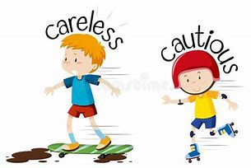
cautiously

Slide 158
cautiously
ADVERB
Definition - in a way that deliberately avoids potential problems or dangers.

Slide 159
They manically cleaned the classroom before the teacher saw the mess they had made.

Slide 160
They _________ cleaned the classroom before the teacher saw the mess they had made.

Slide 161
They manically cleaned the classroom before the teacher saw the mess they had made.

Slide 162
The boat glides gracefully through the water.

Slide 163
The boat glides __________ through the water.

Slide 164
The boat glides gracefully through the water.

Slide 165
We must proceed cautiously.

Slide 166
We must proceed __________.

Slide 167
We must proceed cautiously.

Slide 168
New CHALLENGE words.

Slide 169
perhaps

Slide 170
perhaps
Perhaps we should stay in as it is raining.

Slide 171
perhaps
Perhaps we should stay in as it is raining.

Slide 172
Perhaps we should stay in as it is raining.

Slide 173
_______ we should stay in as it is raining.

Slide 174
Perhaps we should stay in as it is raining.

Slide 175
pressure

Slide 176
pressure
The gate was buckling under the pressure of the crowd outside.

Slide 177
pressure
The gate was buckling under the pressure of the crowd outside.

Slide 178
The gate was buckling under the pressure of the crowd outside.

Slide 179
The gate was buckling under the ________ of the crowd outside.

Slide 180
The gate was buckling under the pressure of the crowd outside.

Slide 181
Let’s Practise and Apply.

Slide 182
Can you spot the spelling rule words and the challenge words?

Slide 183
Wind turbines
Usually, the bigger the wind turbine, the more electricity it can create. But big turbines can generally be noisy, heavy and take up a lot of space. Continually wind farms are being created in the sea as the winds are stronger there. Scientists are now cautiously developing wind turbines that can float in the air. These easily launch and land like a helicopter.

Slide 184
Wind turbines
Usually, the bigger the wind turbine, the more electricity it can create. But big turbines can generally be noisy, heavy and take up a lot of space. Continually wind farms are being created in the sea as the winds are stronger there. Scientists are now cautiously developing wind turbines that can float in the air. These easily launch and land like a helicopter.

Slide 185
Write this sentence as I dictate it to you.
Notes:
Continually wind farms are being created in the sea as the winds are stronger there.

Slide 186
Continually wind farms are being created in the sea as the winds are stronger there.
Did you write it correctly?
Edit your work and make sure you have it correct.
Can you underline the spelling word that we have covered in this session?

Slide 187
Year 4 - Autumn 2
Week 5 - Thursday
Notes:
Revisit and review the words from previous teaching and challenge words – I say, we say, you say
Ask children to write words only in their spelling book
Introduce the new spelling rule
Children to write the new spelling rule words and challenge words into books when the sentences are shown with the spelling word missing.
Read the extract with the class as choral reading. Practise model of prosody etc.
Ask children to find the spelling words from the session in the text.
Then read allowed the chosen sentence for children to write fully in their books.
Show the extract and ask children to then edit their work to check they were correct in their dictation.

Slide 189
Let’s Revisit and Review…

Slide 190
Do you remember this challenge word?

Slide 191
strange

Slide 192
strange
Definition – ADJECTIVE unusual or surprising

Slide 193
strange
Definition – ADJECTIVE unusual or surprising

Slide 194
Do you remember this challenge word?

Slide 195
reign

Slide 196
reign
VERB
Definition – hold royal office

Slide 197
reign
VERB
Definition – hold royal office

Slide 198
‘vent’

Slide 199
adventure

Slide 200
adventure

Slide 201
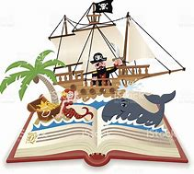
adventure

Slide 202
eventful

Slide 203
eventful

Slide 204

eventful

Slide 205
Let’s Teach and Practise

Slide 206
Adverbials for frequency

Slide 207
adverbials-

Slide 208
Adverbials - saying the how, where or when of the verb

Slide 209
Adverbials – meaning how

Slide 210
viciously

Slide 211

viciously

Slide 212
viciously
ADVERB
Definition - in a cruel or violent manner.

Slide 213
stupidly

Slide 214
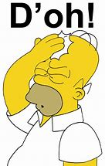
stupidly

Slide 215
stupidly
ADVERB
Definition - in a way that lacks intelligence or common sense.

Slide 216
easily

Slide 217
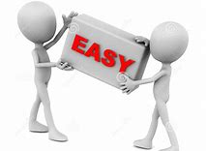
easily

Slide 218
easily
ADVERB
Definition - without difficulty or effort.

Slide 219
A tiger viciously attacked a smaller animal.

Slide 220
A tiger _________ attacked a smaller animal.

Slide 221
A tiger viciously attacked a smaller animal.

Slide 222
Clowns have to act stupidly to get laughs.

Slide 223
Clowns have to act ________ to get laughs.

Slide 224
Clowns have to act stupidly to get laughs.

Slide 225
They climbed the mountain easily.

Slide 226
They climbed the mountain ______.

Slide 227
They climbed the mountain easily.

Slide 228
New CHALLENGE words.

Slide 229
perhaps

Slide 230
perhaps
Perhaps we should stay in as it is raining.

Slide 231
perhaps
Perhaps we should stay in as it is raining.

Slide 232
Perhaps we should stay in as it is raining.

Slide 233
_______ we should stay in as it is raining.

Slide 234
Perhaps we should stay in as it is raining.

Slide 235
pressure

Slide 236
pressure
The gate was buckling under the pressure of the crowd outside.

Slide 237
pressure
The gate was buckling under the pressure of the crowd outside.

Slide 238
The gate was buckling under the pressure of the crowd outside.

Slide 239
The gate was buckling under the ________ of the crowd outside.

Slide 240
The gate was buckling under the pressure of the crowd outside.

Slide 241
Let’s Practise and Apply.

Slide 242
Can you spot the spelling rule words and the challenge words?

Slide 243
Wind turbines
Usually, the bigger the wind turbine, the more electricity it can create. But big turbines can generally be noisy, heavy and take up a lot of space. Continually wind farms are being created in the sea as the winds are stronger there. Scientists are now cautiously developing wind turbines that can float in the air. These easily launch and land like a helicopter.

Slide 244
Wind turbines
Usually, the bigger the wind turbine, the more electricity it can create. But big turbines can generally be noisy, heavy and take up a lot of space. Continually wind farms are being created in the sea as the winds are stronger there. Scientists are now cautiously developing wind turbines that can float in the air. These easily launch and land like a helicopter.

Slide 245
Write this sentence as I dictate it to you.
Notes:
Scientists are now cautiously developing wind turbines that can float in the air.

Slide 246
Scientists are now cautiously developing wind turbines that can float in the air.
Did you write it correctly?
Edit your work and make sure you have it correct.
Can you underline the spelling word that we have covered in this session?

Slide 247
Year 4 - Autumn 2
Week 5 - Friday
Notes:
Click through the slides for all the R+R words for the week (both the focus and the challenge words)
Click through the slides for all the new learning this week

Slide 249
Old challenge words…

Slide 250
strange

Slide 251
reign

Slide 252
Old spelling rule words…

Slide 253
press

Slide 254
supress

Slide 255
express

Slide 256
compress

Slide 257
impress

Slide 258
prevent

Slide 259
invent

Slide 260
venture

Slide 261
adventure

Slide 262
eventful

Slide 263
New spelling rule words…

Slide 264
occasionally

Slide 265
often

Slide 266
frequently

Slide 267
continually

Slide 268
generally

Slide 269
usually

Slide 270
manically

Slide 271
gracefully

Slide 272
cautiously

Slide 273
viciously

Slide 274
stupidly

Slide 275
easily

Slide 276
New challenge words…

Slide 277
perhaps

Slide 278
pressure

Slide 279
Quick Quiz time…
Notes:
Say these words for the quiz
Strange reign perhaps pressure express invent occasionally manically usually stupidly

Slide 280
Did you get them correct?
Edit your work.
strange reign perhaps pressure express invent occasionally manically usually stupidly

Slide 281
Word class time…

Slide 282
Perhaps we should stay in as it is raining.
Notes:
Ask for these words to be classed

Slide 283
Perhaps we should stay in as it is raining.
Adverb pronoun verb verb preposition preposition pronoun verb verb
Notes:
Ask for these words to be classed

Slide 284
Perhaps we should stay in as it is raining.
Adverb pronoun verb verb preposition preposition pronoun verb verb
Notes:
Ask for these words to be classed

Slide 285
The gate was buckling under the pressure of the crowd outside.
Notes:
Ask for these words to be classed

Slide 286
The gate was buckling under the pressure of the crowd outside.
Determiner noun verb verb preposition determiner noun preposition determiner noun adverb

Slide 287
The gate was buckling under the pressure of the crowd outside.
Determiner noun verb verb preposition determiner noun preposition determiner noun adverb

Slide 288
Etymology
The history of a word….

Slide 289
perhaps (adv.)
"possibly," late 15c., perhappes, with adverbial genitive, from earlier perhap (mid-14c.), from per, par "by, through" (see per) + plural of hap "chance" (see happen), on model of peradventure, perchance, etc. which now have been superseded by this word. Perhappons "possibly, by chance" is recorded from late 15c.
pressure (n.)
late 14c., "suffering, anguish; act or fact of pressing on the mind or heart," from Old French presseure "oppression; torture; anguish; press" (for wine or cheeses), "instrument of torture" (12c.) and directly from Latin pressura "action of pressing," from pressus, past participle of premere "to press, hold fast, cover, crowd, compress" (from PIE root *per- (4) "to strike").

Slide 290
Let’s investigate….
Find synonyms and antonyms of the challenge words.

