Slide 1
Spelling Y4
Mastering spellings: building on the foundations of phonics
Autumn 2
Week 6

Slide 2
Year 4 - Autumn 2
Week 6 - Monday

Slide 3
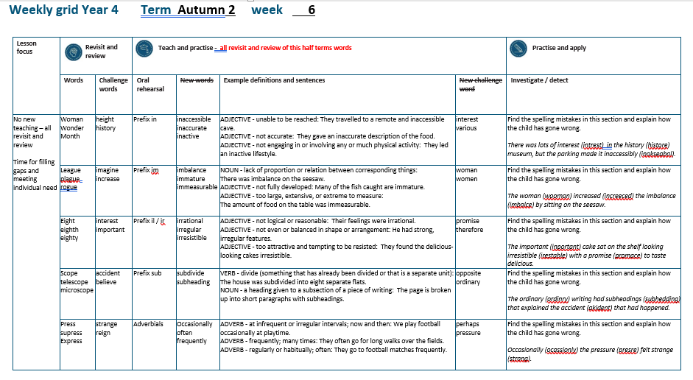

Slide 4
Let’s Revisit and Review…

Slide 5
Do you remember this challenge word?

Slide 6
height

Slide 7
height
Definition – NOUN the measurement of someone or something from head to foot or from base to top.

Slide 8
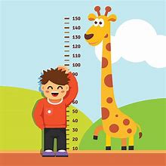
height
Definition – NOUN the measurement of someone or something from head to foot or from base to top.

Slide 9
Do you remember this challenge word?

Slide 10
history

Slide 11
history noun
Definition – the study of past events

Slide 12
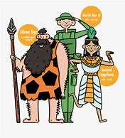
history noun
Definition – the study of past events

Slide 13
‘O’

Slide 14
woman

Slide 15
woman

Slide 16
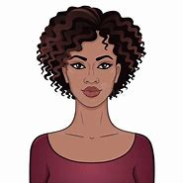
woman

Slide 17
wonder

Slide 18
wonder

Slide 19

wonder

Slide 20
month

Slide 21
month

Slide 22
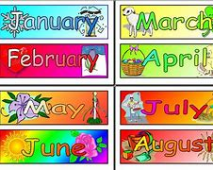
month

Slide 23
Let’s Teach and Practise

Slide 24
The prefix
- in

Slide 25
in-

Slide 26
in- meaning ‘not’

Slide 27
inaccessible

Slide 28
inaccessible

Slide 29

inaccessible

Slide 30
inaccurate

Slide 31
inaccurate

Slide 32

inaccurate

Slide 33
inactive

Slide 34
inactive

Slide 35
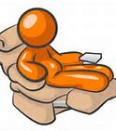
inactive

Slide 36
inaccessible

Slide 37
inaccessible in + accessible = inaccessible

Slide 38
inaccessible in + accessible = inaccessible
ADJECTIVE –
Definition - unable to be reached.

Slide 39
inaccurate

Slide 40
inaccurate in + accurate = inaccurate

Slide 41
inaccurate in + accurate = inaccurate
ADJECTIVE
Definition - not accurate.

Slide 42
inactive

Slide 43
inactive in + active = inactive

Slide 44
inactive in + active = inactive
ADJECTIVE
Definition - not engaging in or involving any or much physical activity.

Slide 45
They travelled to a remote and inaccessible cave.

Slide 46
They travelled to a remote and ____________ cave.

Slide 47
They travelled to a remote and inaccessible cave.

Slide 48
They gave an inaccurate description of the food.

Slide 49
They gave an __________ description of the food.

Slide 50
They gave an inaccurate description of the food.

Slide 51
They led an inactive lifestyle.

Slide 52
They led an ________ lifestyle.

Slide 53
They led an inactive lifestyle.

Slide 54
New CHALLENGE words.

Slide 55
interest

Slide 56
interest
I thought the book might interest Eliot.

Slide 57

interest
I thought the book might interest Eliot.

Slide 58
I thought the book might interest Eliot.

Slide 59
I thought the book might ________ Eliot.

Slide 60
I thought the book might interest Eliot.

Slide 61
various

Slide 62
various
The dresses were of various colours.

Slide 63
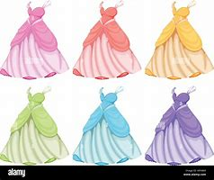
various
The dresses were of various colours.

Slide 64
The dresses were of various colours.

Slide 65
The dresses were of _______ colours.

Slide 66
The dresses were of various colours.

Slide 67
Let’s investigate.

Slide 68
Can you spot the spelling errors in these sentences?
Write the correct spelling and explain where they went wrong.

Slide 69
There was lots of intrest in the histore museum, but the parking made it inakseabal.

Slide 70
There was lots of intrest in the histore museum, but the parking made it inakseabal. intrest – interest missing the silent vowel

Slide 71
There was lots of intrest in the histore museum, but the parking made it inakseabal. histore – history
‘y’ as ‘e’ sound

Slide 72
There was lots of intrest in the histore museum, but the parking made it inakseabal. inakseabal – inaccessible

Slide 73
There was lots of interest in the history museum, but the parking made it inaccessibly.

Slide 74
Year 4 - Autumn 2
Week 6 - Tuesday

Slide 76
Let’s Revisit and Review…

Slide 77
Do you remember this challenge word?

Slide 78
imagine

Slide 79
imagine
Definition – VERB believe (something unreal or untrue) to exist or be so

Slide 80

imagine
Definition – VERB believe (something unreal or untrue) to exist or be so

Slide 81
Do you remember this challenge word?

Slide 82
increase

Slide 83
increase
VERB
Definition – become or make greater in size, amount, or degree.

Slide 84
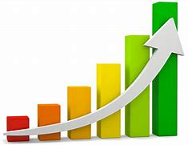
increase
VERB
Definition – become or make greater in size, amount, or degree.

Slide 85
‘gue’

Slide 86
league

Slide 87
league

Slide 88
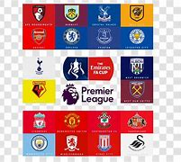
league

Slide 89
plague

Slide 90
plague

Slide 91
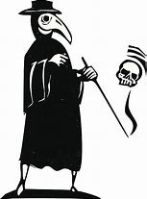
plague

Slide 92
rogue

Slide 93
rogue

Slide 94
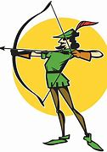
rogue

Slide 95
Let’s Teach and Practise

Slide 96
The prefix
- im

Slide 97
im-

Slide 98
im- meaning ‘not’

Slide 99
im- meaning ‘not’
Before a root word starting with m or p, in– becomes im–.

Slide 100
imbalance

Slide 101
imbalance

Slide 102
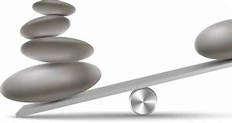
imbalance

Slide 103
immature

Slide 104
immature

Slide 105
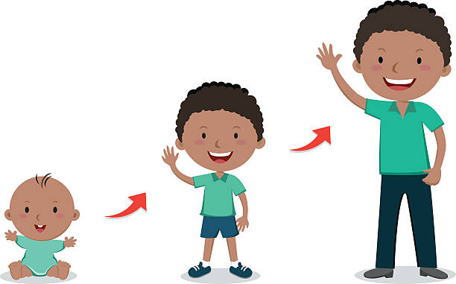
immature

Slide 106
immeasurable

Slide 107
immeasurable

Slide 108

immeasurable

Slide 109
imbalance

Slide 110
imbalance im + balance = imbalance

Slide 111
imbalance im + balance = imbalance
NOUN
Definition - lack of proportion or relation between corresponding things.

Slide 112
immature

Slide 113
immature im + mature = immature

Slide 114
immature im + mature = immature
ADJECTIVE
Definition - not fully developed.

Slide 115
immeasurable

Slide 116
immeasurable im + measurable = immeasurable

Slide 117
immeasurable im + measurable = immeasurable
ADJECTIVE
Definition - too large, extensive, or extreme to measure.

Slide 118
There was imbalance on the seesaw.

Slide 119
There was _________ on the seesaw.

Slide 120
There was imbalance on the seesaw.

Slide 121
Many of the fish caught are immature.

Slide 122
Many of the fish caught are ________.

Slide 123
Many of the fish caught are immature.

Slide 124
The amount of food on the table was immeasurable.

Slide 125
The amount of food on the table was ____________.

Slide 126
The amount of food on the table was immeasurable.

Slide 127
New CHALLENGE words.

Slide 128
woman

Slide 129
woman
The drawing of the young woman was beautiful.

Slide 130
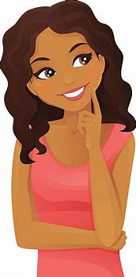
woman
The drawing of the young woman was beautiful.

Slide 131
The drawing of the young woman was beautiful.

Slide 132
The drawing of the young ______ was beautiful.

Slide 133
The drawing of the young woman was beautiful.

Slide 134
women

Slide 135
women
The women were very excited to read the next book.

Slide 136
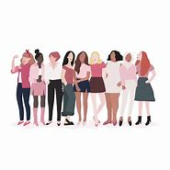
women
The women were very excited to read the next book.

Slide 137
The women were very excited to read the next book.

Slide 138
The _____ were very excited to read the next book.

Slide 139
The women were very excited to read the next book.

Slide 140
Let’s investigate.

Slide 141
Can you spot the spelling errors in these sentences?
Write the correct spelling and explain where they went wrong.

Slide 142
The wooman increeced the imbalce by sitting on the seesaw.

Slide 143
The wooman increeced the imbalce by sitting on the seesaw. wooman – woman long vowel sound ‘o’

Slide 144
The wooman increeced the imbalce by sitting on the seesaw. increeced – increased
‘ea’ not ‘ee’ and ‘s’ not ‘c’

Slide 145
The wooman increeced the imbalce by sitting on the seesaw. imbalce – imbalance

Slide 146
The woman increased the imbalance by sitting on the seesaw.

Slide 147
Year 4 - Autumn 2
Week 6 - Wednesday

Slide 149
Let’s Revisit and Review…

Slide 150
Do you remember this challenge word?

Slide 151
interest

Slide 152
interest
Definition – NOUN the feeling of wanting to know or learn about something or someone.

Slide 153

interest
Definition – NOUN the feeling of wanting to know or learn about something or someone.

Slide 154
Do you remember this challenge word?

Slide 155
important

Slide 156
important
ADJECTIVE
Definition – of great significance.

Slide 157

important
ADJECTIVE
Definition – of great significance.

Slide 158
‘ei’

Slide 159
eight

Slide 160
eight

Slide 161

eight

Slide 162
eighth

Slide 163
eighth

Slide 164
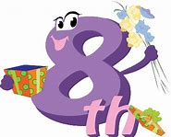
eighth

Slide 165
eighty

Slide 166
eighty

Slide 167

eighty

Slide 168
Let’s Teach and Practise

Slide 169
The prefix
- ir

Slide 170
ir-

Slide 171
ir- meaning ‘not’

Slide 172
ir- meaning ‘not’
Before a root word starting with r, in– becomes ir–.

Slide 173
irrational

Slide 174
irrational

Slide 175
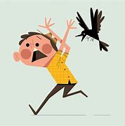
irrational

Slide 176
irregular

Slide 177
irregular

Slide 178

irregular

Slide 179
irresistible

Slide 180
irresistible

Slide 181
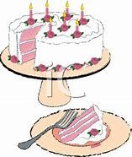
irresistible

Slide 182
irrational

Slide 183
irrational ir + rational = irrational

Slide 184
irrational ir + rational = irrational
ADJECTIVE
Definition - not logical or reasonable.

Slide 185
irregular

Slide 186
irregular ir + regular = irregular

Slide 187
irregular ir + regular = irregular
ADJECTIVE
Definition - not even or balanced in shape or arrangement.

Slide 188
irresistible

Slide 189
irresistible ir + resistible = irresistible

Slide 190
irresistible ir + resistible = irresistible
ADJECTIVE
Definition - too attractive and tempting to be resisted.

Slide 191
Their fear was irrational.

Slide 192
Their fear was __________.

Slide 193
Their fear was irrational.

Slide 194
He had strong, irregular features.

Slide 195
He had strong, _________ features.

Slide 196
He had strong, irregular features.

Slide 197
They found the delicious-looking cakes irresistible.

Slide 198
They found the delicious-looking cakes ____________.

Slide 199
They found the delicious-looking cakes irresistible.

Slide 200
New CHALLENGE words.

Slide 201
promise

Slide 202
promise
He promised to forward my mail

Slide 203

promise
He promised to forward my mail

Slide 204
He promised to forward my mail

Slide 205
He ________ to forward my mail

Slide 206
He promised to forward my mail

Slide 207
therefore

Slide 208
therefore
They were injured and therefore unable to play.

Slide 209

therefore
They were injured and therefore unable to play.

Slide 210
They were injured and therefore unable to play.

Slide 211
They were injured and _________ unable to play.

Slide 212
They were injured and therefore unable to play.

Slide 213
Let’s investigate.

Slide 214
Can you spot the spelling errors in these sentences?
Write the correct spelling and explain where they went wrong.

Slide 215
The inportant cake sat on the shelf looking irestable with a promace to taste delicious.

Slide 216
The inportant cake sat on the shelf looking irestable with a promace to taste delicious. inportant – important
‘in’ becomes ‘im’ when root starts with ‘p’

Slide 217
The inportant cake sat on the shelf looking irestable with a promace to taste delicious. irestable – irresistible
‘ir’ added to root starting ‘r’

Slide 218
The inportant cake sat on the shelf looking irestable with a promace to taste delicious. promace – promise

Slide 219
The important cake sat on the shelf looking irresistible with a promise to taste delicious.

Slide 220
Year 4 - Autumn 2
Week 6 - Thursday

Slide 222
Let’s Revisit and Review…

Slide 223
Do you remember this challenge word?

Slide 224
accident

Slide 225
accident
Definition – NOUN an unfortunate incident that happens unexpectedly resulting in damage or injury

Slide 226
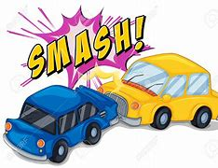
accident
Definition – NOUN an unfortunate incident that happens unexpectedly resulting in damage or injury

Slide 227
Do you remember this challenge word?

Slide 228
believe

Slide 229
believe
VERB
Definition – accept that (something) is true, especially without proof

Slide 230
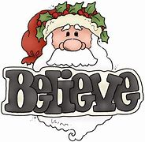
believe
VERB
Definition – accept that (something) is true, especially without proof

Slide 231
‘scope’

Slide 232
scope

Slide 233
scope

Slide 234

scope

Slide 235
telescope

Slide 236
telescope

Slide 237
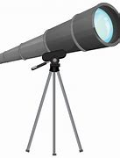
telescope

Slide 238
mircoscope

Slide 239
microscope

Slide 240
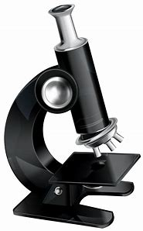
microscope

Slide 241
Let’s Teach and Practise

Slide 242
The prefix
- sub

Slide 243
sub-

Slide 244
sub- meaning ‘under’

Slide 245
sub- meaning ‘under’ add straight to the root word

Slide 246
subdivide

Slide 247
subdivide

Slide 248
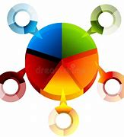
subdivide

Slide 249
subheading

Slide 250
subheading

Slide 251
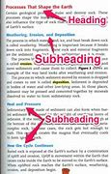
subheading

Slide 252
subdivide

Slide 253
subdivide sub + divide = subdivide

Slide 254
subdivide sub + divide = subdivide
VERB
Definition - divide something that has already been divided.

Slide 255
subheading

Slide 256
subheading sub + heading = subheading

Slide 257
subheading sub + heading = subheading
NOUN
Definition - a heading given to a subsection of a piece of writing.

Slide 258
The house was subdivided into eight separate flats.

Slide 259
The house was __________ into eight separate flats.

Slide 260
The house was subdivided into eight separate flats.

Slide 261
The page is broken up into short paragraphs with subheadings.

Slide 262
The page is broken up into short paragraphs with ___________.

Slide 263
The page is broken up into short paragraphs with subheadings.

Slide 264
New CHALLENGE words.

Slide 265
opposite

Slide 266
opposite
A crowd gathered on the opposite side of the street.

Slide 267
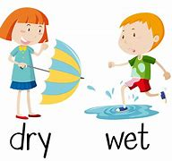
opposite
A crowd gathered on the opposite side of the street.

Slide 268
A crowd gathered on the opposite side of the street.

Slide 269
A crowd gathered on the ________ side of the street.

Slide 270
A crowd gathered on the opposite side of the street.

Slide 271
ordinary

Slide 272
ordinary
The pictures showed ordinary people in extraordinary situations

Slide 273
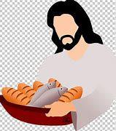
ordinary
The pictures showed ordinary people in extraordinary situations

Slide 274
The pictures showed ordinary people in extraordinary situations

Slide 275
The pictures showed _________ people in extra________ situations

Slide 276
The pictures showed ordinary people in extraordinary situations

Slide 277
Let’s investigate.

Slide 278
Can you spot the spelling errors in these sentences?
Write the correct spelling and explain where they went wrong.

Slide 279
The ordinry writing had subhedding that explained the akident that had happened.

Slide 280
The ordinry writing had subhedding that explained the akident that had happened. ordinry – ordinary missing the silent vowel

Slide 281
The ordinry writing had subhedding that explained the akident that had happened. subhedding – subheading
‘head’

Slide 282
The ordinry writing had subhedding that explained the akident that had happened. akident – accident

Slide 283
The ordinary writing had subheadings that explained the accident that had happened.

Slide 284
Year 4 - Autumn 2
Week 6 - Friday

Slide 286
Let’s Revisit and Review…

Slide 287
Do you remember this challenge word?

Slide 288
strange

Slide 289
strange
Definition – ADJECTIVE unusual or surprising

Slide 290
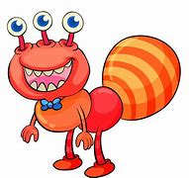
strange
Definition – ADJECTIVE unusual or surprising

Slide 291
Do you remember this challenge word?

Slide 292
reign

Slide 293
reign
VERB
Definition – hold royal office

Slide 294

reign
VERB
Definition – hold royal office

Slide 295
‘press’

Slide 296
press

Slide 297
press

Slide 298

press

Slide 299
supress

Slide 300
supress

Slide 301
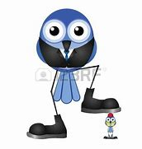
supress

Slide 302
express

Slide 303

express

Slide 304
Let’s Teach and Practise

Slide 305
Adverbials for frequency

Slide 306
adverbials-

Slide 307
Adverbials - saying the how, where or when of the verb

Slide 308
Adverbials – frequency how often

Slide 309
occasionally

Slide 310
occasionally

Slide 311
occasionally
ADVERB
Definition - at infrequent or irregular intervals; now and then.

Slide 312
often

Slide 313
often

Slide 314
often
ADVERB
Definition - frequently; many times.

Slide 315
frequently

Slide 316
frequently

Slide 317
frequently
ADVERB
Definition - regularly or habitually; often.

Slide 318
We play football occasionally at playtime.

Slide 319
We play football ____________ at playtime.

Slide 320
We play football occasionally at playtime.

Slide 321
They often go for long walks over the fields.

Slide 322
They _____ go for long walks over the fields.

Slide 323
They often go for long walks over the fields.

Slide 324
They go to football matches frequently.

Slide 325
They go to football matches __________.

Slide 326
They go to football matches frequently.

Slide 327
New CHALLENGE words.

Slide 328
perhaps

Slide 329
perhaps
Perhaps we should stay in as it is raining.

Slide 330
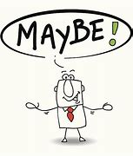
perhaps
Perhaps we should stay in as it is raining.

Slide 331
Perhaps we should stay in as it is raining.

Slide 332
_______ we should stay in as it is raining.

Slide 333
Perhaps we should stay in as it is raining.

Slide 334
pressure

Slide 335
pressure
The gate was buckling under the pressure of the crowd outside.

Slide 336
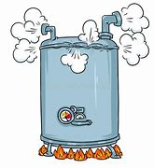
pressure
The gate was buckling under the pressure of the crowd outside.

Slide 337
The gate was buckling under the pressure of the crowd outside.

Slide 338
The gate was buckling under the ________ of the crowd outside.

Slide 339
The gate was buckling under the pressure of the crowd outside.

Slide 340
Let’s investigate.

Slide 341
Can you spot the spelling errors in these sentences?
Write the correct spelling and explain where they went wrong.

Slide 342
Ocassionly the presre felt strang.

Slide 343
Ocassionly the presre felt strang. ocassionly – occasionally

Slide 344
Ocassionly the presre felt strang. presre – pressure

Slide 345
Ocassionly the presre felt strang. strang – strange

Slide 346
Occasionally the pressure felt strange.

