Slide 1
Spelling Y4
Mastering spellings: building on the foundations of phonics
Autumn 1
Week 6

Slide 2
Year 4 - Autumn 1
Week 6 - Monday

Slide 3
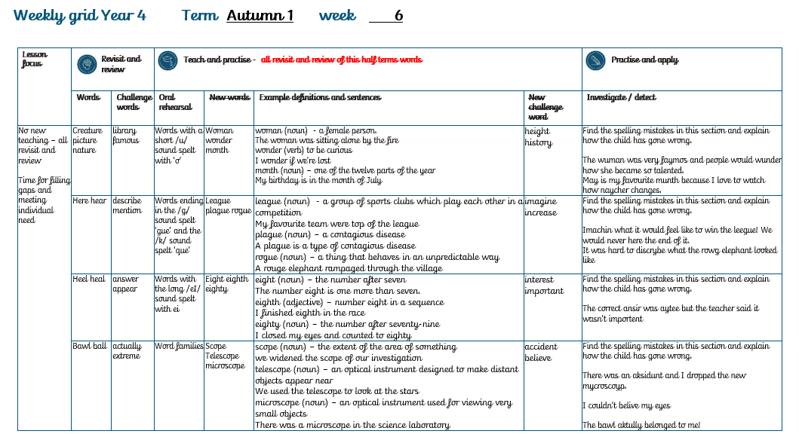

Slide 4
Let’s Revisit and Review…

Slide 5
Do you remember this challenge word?

Slide 6

library
NOUN
Definition – a building or room containing a collection of books

Slide 7
We visited the local library to pick up some new books.
_______

Slide 8

famous
ADJECTIVE
Definition – known about by a great number of people

Slide 9
It was her dream to become a famous athlete
______

Slide 10
The suffix
-ture

Slide 11
ture

Slide 12
creature

Slide 13
picture

Slide 14
nature

Slide 15
furniture

Slide 16
Let’s Teach and Practise

Slide 17
Words with a short /u/ sound spelt with ‘o’

Slide 18

woman

Slide 19

wonder

Slide 20
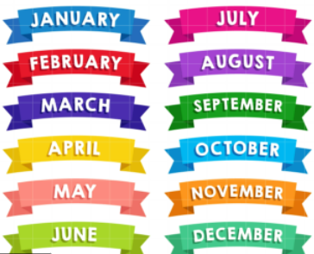
month

Slide 21

govern

Slide 22
Definition - a female person
woman
(noun)

Slide 23
Definition - to be curious
wonder
(verb)

Slide 24
Definition - one of the twelve parts of the year
month
(noun)

Slide 25
Definition - conduct the policy, actions, and affairs of a state with authority
govern
(verb)

Slide 26
The woman was sitting alone by the fire.
_____

Slide 27
I wonder if we’re lost.
______

Slide 28
My birthday is in the month of July.
_____

Slide 29
It was her job to govern the country.
______

Slide 30
New CHALLENGE words.

Slide 31
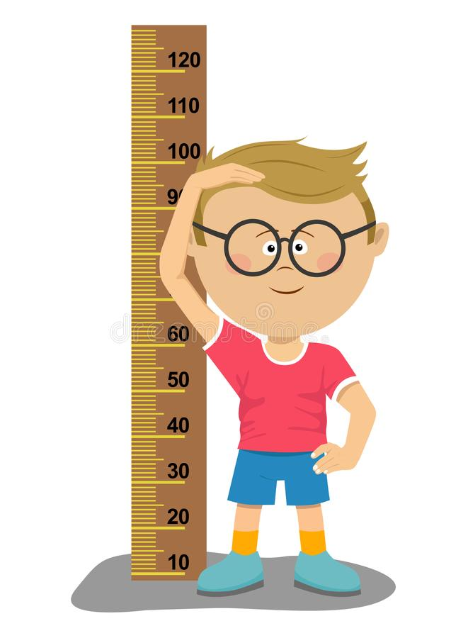
height
NOUN
Definition - the measurement of someone or something from head to foot or from base to top

Slide 32
The ride had a height requirement
______

Slide 33
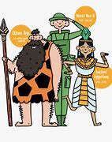
history
NOUN
Definition - the study of past events, particularly in human affairs

Slide 34
I love to study history at school.
_______

Slide 35
Let’s investigate.

Slide 36
Can you spot the spelling errors in these sentences?
Write the correct spelling and explain where they went wrong.

Slide 37
The wuman was very faymos and people would wunder how she became so talented.

Slide 38
The wuman was very faymos and people would wunder how she became so talented. woman - /u/ sound spelt with a ‘o’

Slide 39
The wuman was very faymos and people would wunder how she became so talented. famous – ‘a’ not ‘ay’
‘ou’ not ‘o’

Slide 40
The wuman was very faymos and people would wunder how she became so talented. wonder- /u/ sound spelt with a ‘o’

Slide 41
The woman was very famous and people would wonder how she became so talented.

Slide 42
Year 4 - Autumn 1
Week 6 - Tuesday

Slide 44
Let’s Revisit and Review…

Slide 45
Do you remember this challenge word?

Slide 46
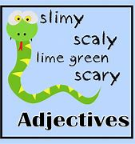
Definition – give a detailed account in words of
describe
VERB

Slide 47
Could you describe what it looked like?
________

Slide 48

Definition – refer to something briefly without going into detail
mention
VERB

Slide 49
He forgot to mention it.
_______

Slide 50
Homophones

Slide 51
Homophones
Words which sound the same but have different spellings, meanings or origins

Slide 52
here

Slide 53
hear

Slide 54
Let’s Teach and Practise

Slide 55
Words ending in the /g/ sound spelt ‘gue’

Slide 56
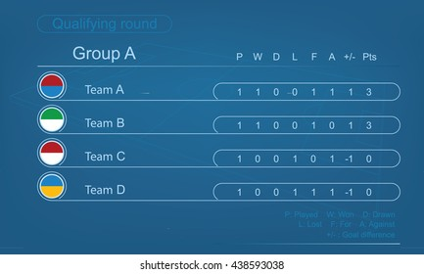
league

Slide 57
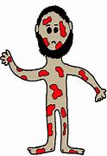
plague

Slide 58
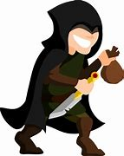
rogue

Slide 59
Definition - a group of sports clubs which play each other in a competition
league
(noun)

Slide 60
Definition - a contagious disease
plague
(noun)

Slide 61
Definition - a thing that behaves in an unpredictable way
rogue
(adjective)

Slide 62
My favourite team were top of the league.
______

Slide 63
A plague is a type of contagious disease.
______

Slide 64
A rogue elephant rampaged through the village.
_____

Slide 65
New CHALLENGE words.

Slide 66

Definition - believe (something unreal or untrue) to exist or be so
imagine
VERB

Slide 67
Imagine a perfect blue sky.
_______

Slide 68

Definition - become or make greater in size, amount, or degree
increase
VERB

Slide 69
I must increase the volume
________

Slide 70
Let’s investigate.

Slide 71
Can you spot the spelling errors in these sentences?
Write the correct spelling and explain where they went wrong.

Slide 72
Imachin what it would feel like to win the leegue! We would never here the end of it.

Slide 73
Imachin what it would feel like to win the leegue! We would never here the end of it.
Imagine
/j/ sound spelt with ‘g’ not a ‘ch’ sound
‘e’ on the end is silent

Slide 74
Imachin what it would feel like to win the leegue! We would never here the end of it. league – ‘ea’ for /ee/ sound

Slide 75
Imachin what it would feel like to win the leegue! We would never here the end of it.
Hear – homophone hear with your ear

Slide 76
Imagine what it would feel like to win the league! We would never hear the end of it.

Slide 77
Year 4 - Autumn 1
Week 6 - Wednesday

Slide 79
Let’s Revisit and Review…

Slide 80
Do you remember this challenge word?

Slide 81
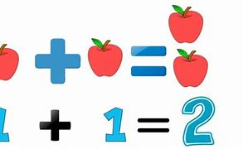
Definition – a thing that is said, written or done in response to a question
answer
NOUN

Slide 82
I put my hand up to answer the question.
______

Slide 83
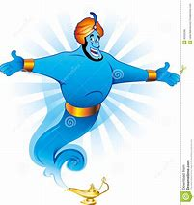
Definition – come into sight
appear
VERB

Slide 84
The class waited for their teacher to appear.
______

Slide 85
Homophones

Slide 86
Homophones
Words which sound the same but have different spellings, meanings or origins

Slide 87
heel

Slide 88
heal

Slide 89
Let’s Teach and Practise

Slide 90
Words with the long /eI/ sound spelt with ei

Slide 91

eight

Slide 92
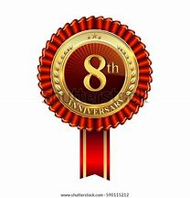
eighth

Slide 93

eighty

Slide 94
Definition- the number after seven
eight
(noun)

Slide 95
Definition – coming after 7th in the race
eighth
(adjective)

Slide 96
Definition - the number after seventy-nine
eighty
(noun)

Slide 97
The number eight is one more than seven.
_____

Slide 98
I finished eighth in the race.
______

Slide 99
I closed my eyes and counted to eighty.
______

Slide 100
New CHALLENGE words.

Slide 101

Definition - the feeling of wanting to know or learn about something or someone
interest
NOUN

Slide 102
I have an interest in music.
________

Slide 103

Definition - of great significance or value
important
ADJECTIVE

Slide 104
She went to an important meeting
__________

Slide 105
Let’s investigate.

Slide 106
Can you spot the spelling errors in these sentences?
Write the correct spelling and explain where they went wrong.

Slide 107
The correct ansir was aytee but the teacher said it wasn’t importent.

Slide 108
The correct ansir was aytee but the teacher said it wasn’t importent. answer – ‘we’ not ‘i’ say it like it’s spelt – an - swer

Slide 109
The correct ansir was aytee but the teacher said it wasn’t importent. eighty – ‘eigh’ not ‘ay’ ‘ty’ not ‘tee’ – common at end of words

Slide 110
The correct ansir was aytee but the teacher said it wasn’t importent. important – ‘ant’ not ‘ent’

Slide 111
The correct answer was eighty but the teacher said it wasn’t important.

Slide 112
Year 4 - Autumn 1
Week 6 - Thursday

Slide 114
Let’s Revisit and Review…

Slide 115
Do you remember this challenge word?

Slide 116
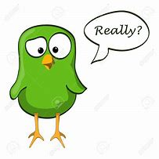
Definition – in fact or really
actually
ADVERB

Slide 117
I didn’t actually see her – I just heard her voice.
________

Slide 118
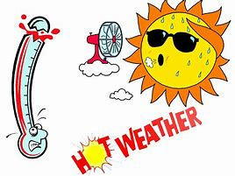
Definition – very great
extreme
ADJECTIVE

Slide 119
The weather forecast was for extreme heat.
_______

Slide 120
Homophones

Slide 121
Homophones
Words which sound the same but have different spellings, meanings or origins

Slide 122
ball

Slide 123
bawl

Slide 124
Let’s Teach and Practise

Slide 125
Root word family: scope meaning to ‘see’ from Greek

Slide 126

scope

Slide 127

telescope

Slide 128
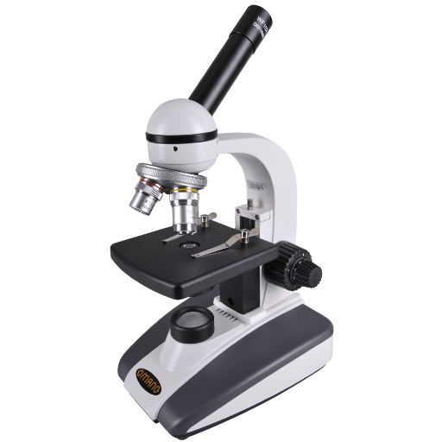
microscope

Slide 129
Definition - the extent of the area of something
scope
(noun)

Slide 130
Definition - an optical instrument designed to make distant objects appear near
telescope
(noun)

Slide 131
Definition - an optical instrument used for viewing very small objects
microscope
(noun)

Slide 132
We widened the scope of our investigation.
_____

Slide 133
We used the telescope to look at the stars.
_________

Slide 134
There was a microscope in the science laboratory.
__________

Slide 135
New CHALLENGE words.

Slide 136
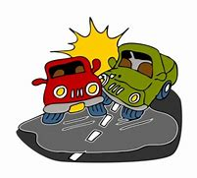
Definition - an unfortunate incident that happens unexpectedly and unintentionally, typically resulting in damage or injury
accident
NOUN

Slide 137
Luckily I avoided having a nasty accident.
________

Slide 138

Definition - accept that (something) is true, especially without proof
believe
VERB

Slide 139
I couldn’t believe my eyes!
_______

Slide 140
Let’s investigate.

Slide 141
Can you spot the spelling errors in these sentences?
Write the correct spelling and explain where they went wrong.

Slide 142
There was an aksidunt and I dropped the new mycroscoyp.

Slide 143
There was an aksidunt and I dropped the new mycroscoyp. accident – double c
‘ent’ not ‘unt’

Slide 144
There was an aksidunt and I dropped the new mycroscoyp.
Microscope – ‘mi’ not ‘my’ split digraph ‘o_e’ not ‘oy’

Slide 145
There was an accident and I dropped the new microscope.

Slide 146
I couldn’t belive my eyes! believe – ‘ie’ not ‘i’ belive = be+live

Slide 147
I couldn’t believe my eyes!

Slide 148
Year 4 - Autumn 1
Week 6 - Friday

Slide 150
Let’s Revisit and Review…

Slide 151
Do you remember this challenge word?

Slide 152

February
NOUN
Definition - the second month of the year, in the northern hemisphere usually considered the last month of winter

Slide 153
In February the place is busy.
________

Slide 154

certain
ADJECTIVE
Definition - able to be firmly relied on to happen or be the case

Slide 155
The certain answer was clear.
_______

Slide 156
Homophones

Slide 157
homophones = same sound homo- same phone – sound

Slide 158
homophones

Slide 159

which

Slide 160
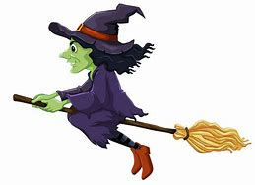
witch

Slide 161
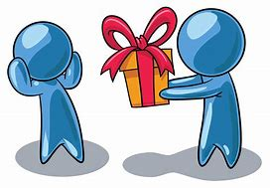
accept

Slide 162

except

Slide 163
Let’s Teach and Practise

Slide 164
Root word family: press meaning to ‘squeeze’ from Latin

Slide 165

press

Slide 166
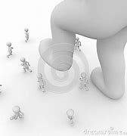
suppress

Slide 167

express

Slide 168
Definition - to move or change the shape of something by applying a force
press
(verb)

Slide 169
Definition -prevent the development or action of something
suppress
(verb)

Slide 170
Definition - to convey a thought or feeling by words, gestures or conduct
express
(verb)

Slide 171
Press the button to turn on the music.
_____

Slide 172
He could not suppress his rising panic.
________

Slide 173
It’s important to express your feelings.
_______

Slide 174
New CHALLENGE words.

Slide 175
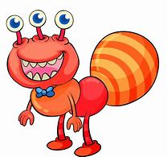
Definition - unusual or surprising; difficult to understand or explain
strange
ADJECTIVE

Slide 176
What a strange sight!
_______

Slide 177

Definition - the period of rule of a monarch
reign
NOUN

Slide 178
Her reign as queen began in 1952.
_____

Slide 179
Let’s investigate.

Slide 180
Can you spot the spelling errors in these sentences?
Write the correct spelling and explain where they went wrong.

Slide 181
He was sertun he had last seen her in febuary.

Slide 182
He was sertun he had last seen her in febuary. certain – ‘cer’ not ‘ser’
‘ai’ not ‘u’

Slide 183
He was sertun he had last seen her in febuary.
February – capital F for proper noun silent ‘r’ after b

Slide 184
He was certain he had last seen her in February.

Slide 185
I couldn’t supress my strang feelings any longer.

Slide 186
I couldn’t supress my strang feelings any longer. suppress – double ‘p’ sup+press sup is a prefix meaning ‘under, below, beneath’

Slide 187
I couldn’t supress my strang feelings any longer. strange – e at the end means the ‘ang’ becomes ‘ange like range’ rather than ‘ang like hang’

Slide 188
I couldn’t suppress my strange feelings any longer.

