Slide 1
Spelling Y4
Mastering spellings: building on the foundations of phonics
Spring 1
Week 1

Slide 2
These slides are slightly different - to reduce the number there are now animations used
Please use these slides in full screen slide show mode to ensure they work how they are designed with chunks of information being shown at a time to prevent overload
Thank you

Slide 3
Year 4 - Spring 1
Week 1 - Monday

Slide 4
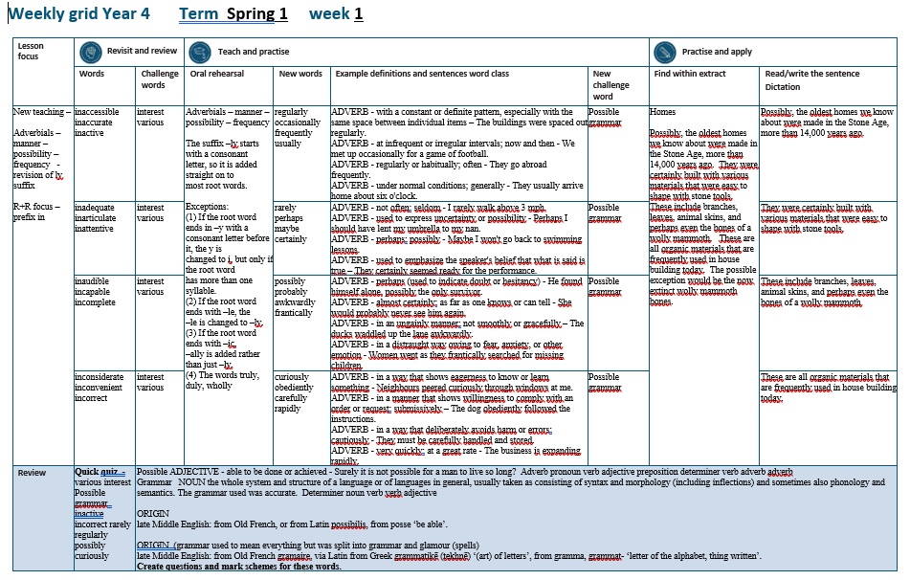

Slide 5
Let’s Revisit and Review…

Slide 6
Do you remember this challenge word?

Slide 7

interest
I thought the book might interest Eliot.
Notes:
View in slide show mode to have each aspect appear separately

Slide 8
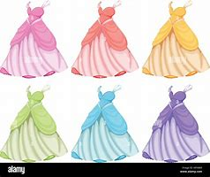
various
The dresses were of various colours.
Notes:
View in slide show mode to have each aspect appear separately

Slide 9
Do you remember the prefix
- in

Slide 10
in-
meaning ‘not’

Slide 11

inaccessible

Slide 12
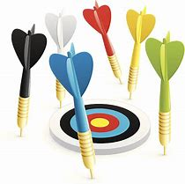
inaccurate

Slide 13
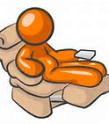
inactive

Slide 14
Let’s Teach and Practise

Slide 15
Adverbials – manner – possibility – frequency
The suffix –ly starts with a consonant letter, so it is added straight on to most root words.

Slide 16
Exceptions:
(1) If the root word ends in –y with a consonant letter before it, the y is changed to i, but only if the root word has more than one syllable.
(2) If the root word ends with –le, the
–le is changed to –ly.

Slide 17
Exceptions:
(3) If the root word ends with –ic,
–ally is added rather than just –ly,
(4) The words truly, duly, wholly

Slide 18
-ly

Slide 19
-ly changing an adjective into an adverb

Slide 20
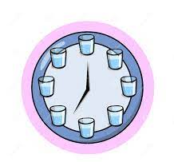
regularly

Slide 21
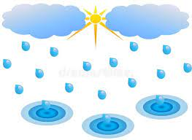
occasionally

Slide 22
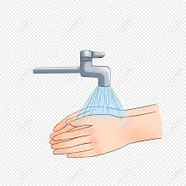
frequently

Slide 23
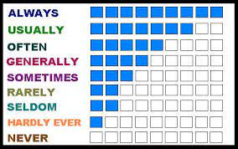
usually

Slide 24
regularly
regular + ly = regularly
ADVERB
Definition - with a constant or definite pattern, especially with the same space between individual items

Slide 25
occasionally
occasional + ly = occasionally
ADVERB
Definition - at infrequent or irregular intervals; now and then

Slide 26
frequently
frequent + ly = frequently
ADVERB
Definition - regularly or habitually; often

Slide 27
usually
usual + ly = usually
ADVERB
Definition - under normal conditions; generally

Slide 28
The buildings were spaced out regularly.
_________.

Slide 29
We met up occasionally for a game of football.
____________

Slide 30
They go abroad frequently.
__________.

Slide 31
They usually arrive home about six o'clock.
_______

Slide 32
New CHALLENGE words.

Slide 33
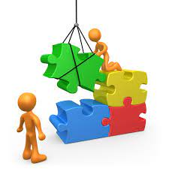
possible
ADJECTIVE
Definition - able to be done or achieved

Slide 34
Surely it is not possible for a man to live so long?
________

Slide 35
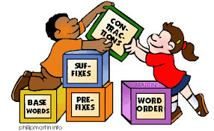
grammar
NOUN
Definition - the whole system and structure of a language or of languages in general, usually taken as consisting of syntax and morphology (including inflections) and sometimes also phonology and semantics.

Slide 36
The grammar used was accurate.
_______

Slide 37
Let’s Practise and Apply.

Slide 38
Can you spot the spelling rule words and the challenge words?

Slide 39
Homes
Possibly, the oldest homes we know about were made in the Stone Age, more than 14,000 years ago. They were certainly built with various materials that were easy to shape with stone tools. These include branches, leaves, animal skins, and perhaps even the bones of a wolly mammoth. These are all organic materials that are frequently used in house building today. The possible exception would be the now extinct wolly mammoth bones.

Slide 40
Homes
Possibly, the oldest homes we know about were made in the Stone Age, more than 14,000 years ago. They were certainly built with various materials that were easy to shape with stone tools. These include branches, leaves, animal skins, and perhaps even the bones of a wolly mammoth. These are all organic materials that are frequently used in house building today. The possible exception would be the now extinct wolly mammoth bones.

Slide 41
Write this sentence as I dictate it to you.
Notes:
Possibly, the oldest homes we know about were made in the Stone Age, more than 14,000 years ago.

Slide 42
Possibly, the oldest homes we know about were made in the Stone Age, more than 14,000 years ago.
Did you write it correctly?
Edit your work and make sure you have it correct.
Can you underline the spelling word that we have covered in this session?

Slide 43
Year 4 - Spring 1
Week 1 - Tuesday
Notes:
Revisit and review the words from previous teaching and challenge words – I say, we say, you say
Ask children to write words only in their spelling book
Introduce the new spelling rule
Children to write the new spelling rule words and challenge words into books when the sentences are shown with the spelling word missing.
Read the extract with the class as choral reading. Practise model of prosody etc.
Ask children to find the spelling words from the session in the text.
Then read allowed the chosen sentence for children to write fully in their books.
Show the extract and ask children to then edit their work to check they were correct in their dictation.

Slide 45
Let’s Revisit and Review…

Slide 46
Do you remember this challenge word?

Slide 47
interest
I thought the book might interest Eliot.

Slide 48
various
The dresses were of various colours.

Slide 49
Do you remember the prefix
- in

Slide 50
in-
meaning ‘not’

Slide 51
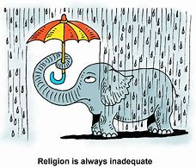
inadequate

Slide 52
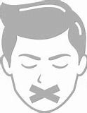
inarticulate

Slide 53
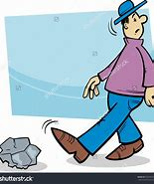
inattentive

Slide 54
Let’s Teach and Practise

Slide 55
Adverbials – manner – possibility – frequency
The suffix –ly starts with a consonant letter, so it is added straight on to most root words.

Slide 56
Exceptions:
(1) If the root word ends in –y with a consonant letter before it, the y is changed to i, but only if the root word has more than one syllable.
(2) If the root word ends with –le, the
–le is changed to –ly.

Slide 57
Exceptions:
(3) If the root word ends with –ic,
–ally is added rather than just –ly,
(4) The words truly, duly, wholly

Slide 58
-ly

Slide 59
-ly changing an adjective into an adverb

Slide 60

rarely

Slide 61

perhaps

Slide 62

maybe

Slide 63
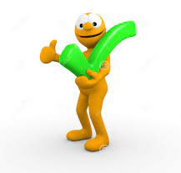
certainly

Slide 64
rarely
rare + ly = rarely
ADVERB
Definition - not often; seldom

Slide 65
perhaps
ADVERB
Definition - used to express uncertainty or possibility

Slide 66
maybe
ADVERB
Definition - perhaps; possibly

Slide 67
certainly
certain + ly = certainly
ADVERB
Definition - used to emphasise the speaker's belief that what is said is true

Slide 68
I rarely walk above 3 mph.
______

Slide 69
Perhaps I should have lent my umbrella to my nan.
_______

Slide 70
Maybe I won't go back to swimming lessons.
_____

Slide 71
They certainly seemed ready for the performance.
_________

Slide 72
New CHALLENGE words.

Slide 73
possible
ADJECTIVE
Definition - able to be done or achieved

Slide 74
Surely it is not possible for a man to live so long?
________

Slide 75
grammar
NOUN
Definition - the whole system and structure of a language or of languages in general, usually taken as consisting of syntax and morphology (including inflections) and sometimes also phonology and semantics.

Slide 76
The grammar used was accurate.
_______

Slide 77
Let’s Practise and Apply.

Slide 78
Can you spot the spelling rule words and the challenge words?

Slide 79
Homes
Possibly, the oldest homes we know about were made in the Stone Age, more than 14,000 years ago. They were certainly built with various materials that were easy to shape with stone tools. These include branches, leaves, animal skins, and perhaps even the bones of a wolly mammoth. These are all organic materials that are frequently used in house building today. The possible exception would be the now extinct wolly mammoth bones.

Slide 80
Homes
Possibly, the oldest homes we know about were made in the Stone Age, more than 14,000 years ago. They were certainly built with various materials that were easy to shape with stone tools. These include branches, leaves, animal skins, and perhaps even the bones of a wolly mammoth. These are all organic materials that are frequently used in house building today. The possible exception would be the now extinct wolly mammoth bones.

Slide 81
Write this sentence as I dictate it to you.
Notes:
They were certainly built with various materials that were easy to shape with stone tools.

Slide 82
They were certainly built with various materials that were easy to shape with stone tools.
Did you write it correctly?
Edit your work and make sure you have it correct.
Can you underline the spelling word that we have covered in this session?

Slide 83
Year 4 - Spring 1
Week 1 - Wednesday
Notes:
Revisit and review the words from previous teaching and challenge words – I say, we say, you say
Ask children to write words only in their spelling book
Introduce the new spelling rule
Children to write the new spelling rule words and challenge words into books when the sentences are shown with the spelling word missing.
Read the extract with the class as choral reading. Practise model of prosody etc.
Ask children to find the spelling words from the session in the text.
Then read allowed the chosen sentence for children to write fully in their books.
Show the extract and ask children to then edit their work to check they were correct in their dictation.

Slide 85
Let’s Revisit and Review…

Slide 86
Do you remember this challenge word?

Slide 87
interest
I thought the book might interest Eliot.

Slide 88
various
The dresses were of various colours.

Slide 89
Do you remember the prefix
- in

Slide 90
in-
meaning ‘not’

Slide 91
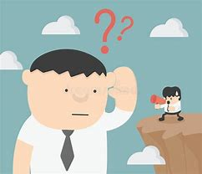
inaudible

Slide 92

incapable

Slide 93
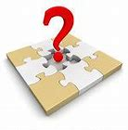
incomplete

Slide 94
Let’s Teach and Practise

Slide 95
Adverbials – manner – possibility – frequency
The suffix –ly starts with a consonant letter, so it is added straight on to most root words.

Slide 96
Exceptions:
(1) If the root word ends in –y with a consonant letter before it, the y is changed to i, but only if the root word has more than one syllable.
(2) If the root word ends with –le, the
–le is changed to –ly.

Slide 97
Exceptions:
(3) If the root word ends with –ic,
–ally is added rather than just –ly,
(4) The words truly, duly, wholly

Slide 98
-ly

Slide 99
-ly changing an adjective into an adverb

Slide 100
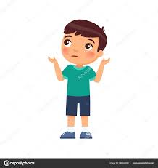
possibly

Slide 101
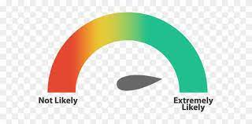
probably

Slide 102
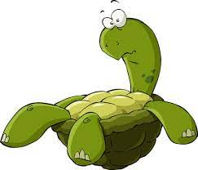
awkwardly

Slide 103
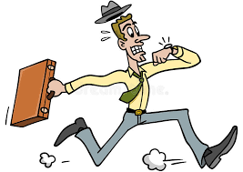
frantically

Slide 104
possibly
possible (-e) + ly = possibly
ADVERB
Definition - perhaps (used to indicate doubt or hesitancy)

Slide 105
probably
probable (-e) + ly = probably
ADVERB
Definition - almost certainly; as far as one knows or can tell

Slide 106
awkwardly
awkward + ly = awkwardly
ADVERB
Definition - in an ungainly manner; not smoothly or gracefully

Slide 107
frantically
frantic (al) + ly = frantically
ADVERB
Definition - in a distraught way owing to fear, anxiety, or other emotion

Slide 108
He found himself alone, possibly the only survivor.
________

Slide 109
She would probably never see him again.
________

Slide 110
The ducks waddled up the lane awkwardly
_________.

Slide 111
Women wept as they frantically searched for missing children.
___________

Slide 112
New CHALLENGE words.

Slide 113
possible
ADJECTIVE
Definition - able to be done or achieved

Slide 114
Surely it is not possible for a man to live so long?
________

Slide 115
grammar
NOUN
Definition - the whole system and structure of a language or of languages in general, usually taken as consisting of syntax and morphology (including inflections) and sometimes also phonology and semantics.

Slide 116
The grammar used was accurate.
_______

Slide 117
Let’s Practise and Apply.

Slide 118
Can you spot the spelling rule words and the challenge words?

Slide 119
Homes
Possibly, the oldest homes we know about were made in the Stone Age, more than 14,000 years ago. They were certainly built with various materials that were easy to shape with stone tools. These include branches, leaves, animal skins, and perhaps even the bones of a wolly mammoth. These are all organic materials that are frequently used in house building today. The possible exception would be the now extinct wolly mammoth bones.

Slide 120
Homes
Possibly, the oldest homes we know about were made in the Stone Age, more than 14,000 years ago. They were certainly built with various materials that were easy to shape with stone tools. These include branches, leaves, animal skins, and perhaps even the bones of a wolly mammoth. These are all organic materials that are frequently used in house building today. The possible exception would be the now extinct wolly mammoth bones.

Slide 121
Write this sentence as I dictate it to you.
Notes:
These include branches, leaves, animal skins, and perhaps even the bones of a wolly mammoth

Slide 122
These include branches, leaves, animal skins, and perhaps even the bones of a wolly mammoth
Did you write it correctly?
Edit your work and make sure you have it correct.
Can you underline the spelling word that we have covered in this session?

Slide 123
Year 4 - Spring 1
Week 1 - Thursday
Notes:
Revisit and review the words from previous teaching and challenge words – I say, we say, you say
Ask children to write words only in their spelling book
Introduce the new spelling rule
Children to write the new spelling rule words and challenge words into books when the sentences are shown with the spelling word missing.
Read the extract with the class as choral reading. Practise model of prosody etc.
Ask children to find the spelling words from the session in the text.
Then read allowed the chosen sentence for children to write fully in their books.
Show the extract and ask children to then edit their work to check they were correct in their dictation.

Slide 125
Let’s Revisit and Review…

Slide 126
Do you remember this challenge word?

Slide 127
interest
I thought the book might interest Eliot.

Slide 128
various
The dresses were of various colours.

Slide 129
Do you remember the prefix
- in

Slide 130
in-
meaning ‘not’

Slide 131
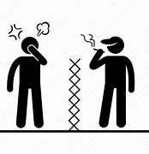
inconsiderate

Slide 132
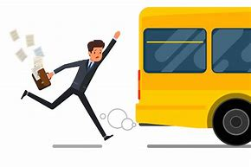
inconvenient

Slide 133

incorrect

Slide 134
Let’s Teach and Practise

Slide 135
Adverbials – manner – possibility – frequency
The suffix –ly starts with a consonant letter, so it is added straight on to most root words.

Slide 136
Exceptions:
(1) If the root word ends in –y with a consonant letter before it, the y is changed to i, but only if the root word has more than one syllable.
(2) If the root word ends with –le, the
–le is changed to –ly.

Slide 137
Exceptions:
(3) If the root word ends with –ic,
–ally is added rather than just –ly,
(4) The words truly, duly, wholly

Slide 138
-ly

Slide 139
-ly changing an adjective into an adverb

Slide 140
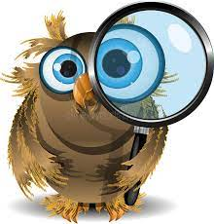
curiously

Slide 141
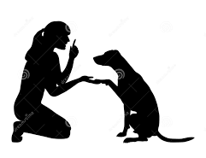
obediently

Slide 142
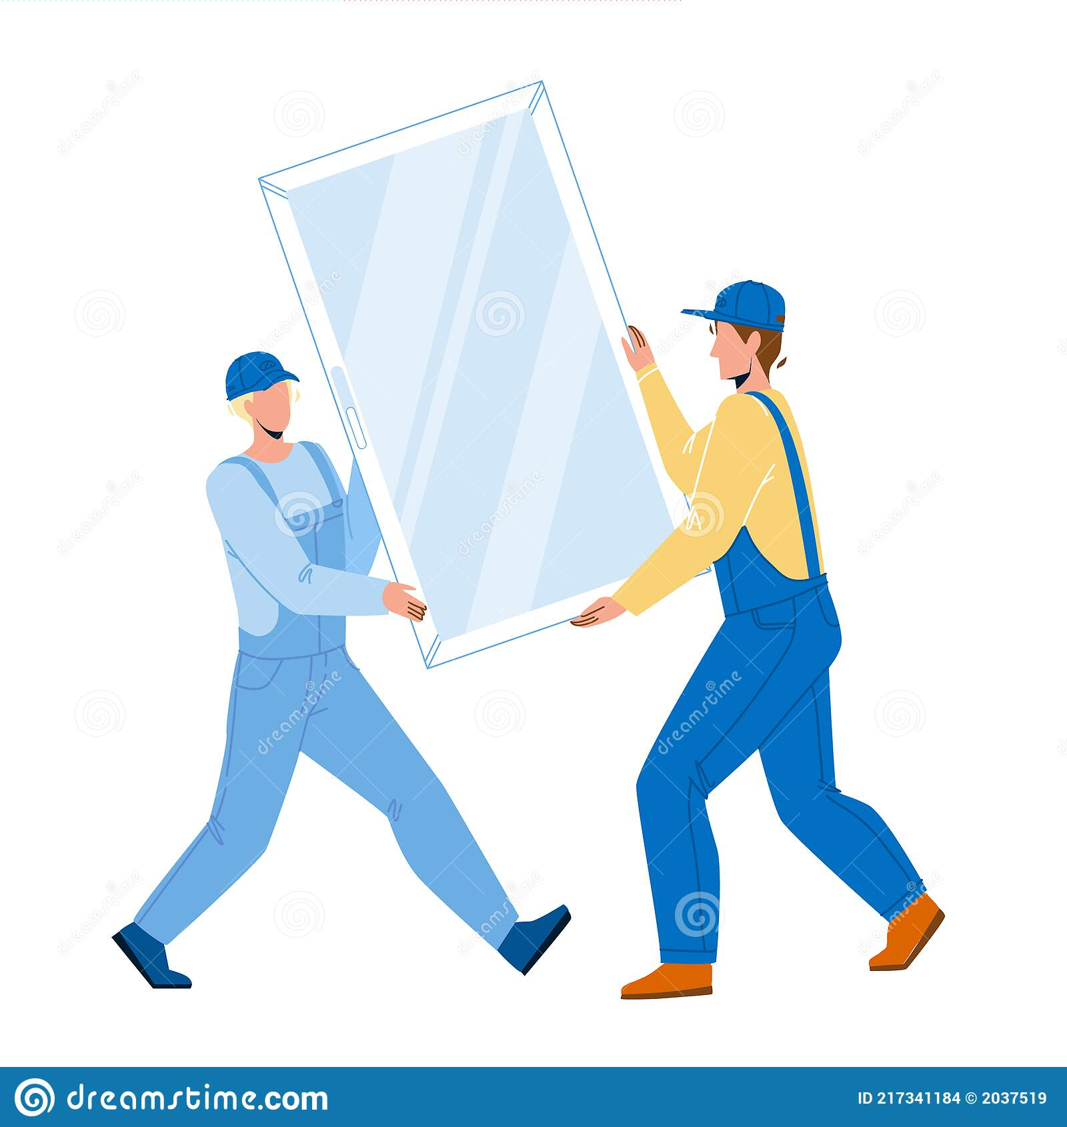
carefully

Slide 143
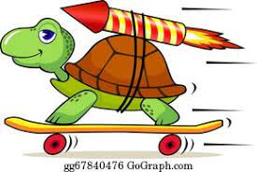
rapidly

Slide 144
curiously
curious + ly = curiously
ADVERB
Definition - in a way that shows eagerness to know or learn something

Slide 145
obediently
obedient + ly = obediently
ADVERB
Definition - in a manner that shows willingness to comply with an order or request; submissively

Slide 146
carefully
careful + ly = carefully
ADVERB
Definition - in a way that deliberately avoids harm or errors

Slide 147
rapidly
rapid + ly = rapidly
ADVERB
Definition - very quickly; at a great rate

Slide 148
Neighbours peered curiously through windows at me.
_________

Slide 149
The dog obediently followed the instructions.
__________

Slide 150
They must be carefully handled and stored.
_________

Slide 151
The business is expanding rapidly.
_______.

Slide 152
New CHALLENGE words.

Slide 153
possible
ADJECTIVE
Definition - able to be done or achieved

Slide 154
Surely it is not possible for a man to live so long?
________

Slide 155
grammar
NOUN
Definition - the whole system and structure of a language or of languages in general, usually taken as consisting of syntax and morphology (including inflections) and sometimes also phonology and semantics.

Slide 156
The grammar used was accurate.
_______

Slide 157
Let’s Practise and Apply.

Slide 158
Can you spot the spelling rule words and the challenge words?

Slide 159
Homes
Possibly, the oldest homes we know about were made in the Stone Age, more than 14,000 years ago. They were certainly built with various materials that were easy to shape with stone tools. These include branches, leaves, animal skins, and perhaps even the bones of a wolly mammoth. These are all organic materials that are frequently used in house building today. The possible exception would be the now extinct wolly mammoth bones.

Slide 160
Homes
Possibly, the oldest homes we know about were made in the Stone Age, more than 14,000 years ago. They were certainly built with various materials that were easy to shape with stone tools. These include branches, leaves, animal skins, and perhaps even the bones of a wolly mammoth. These are all organic materials that are frequently used in house building today. The possible exception would be the now extinct wolly mammoth bones.

Slide 161
Write this sentence as I dictate it to you.
Notes:
These are all organic materials that are frequently used in house building today.

Slide 162
These are all organic materials that are frequently used in house building today.
Did you write it correctly?
Edit your work and make sure you have it correct.
Can you underline the spelling word that we have covered in this session?

Slide 163
Year 4 - Spring 1
Week 1 - Friday
Notes:
Click through the slides for all the R+R words for the week (both the focus and the challenge words)
Click through the slides for all the new learning this week

Slide 165
Old challenge words…

Slide 166
interest

Slide 167
various

Slide 168
Old spelling rule words…

Slide 169
inaccessible

Slide 170
inaccurate

Slide 171
inactive

Slide 172
inadequate

Slide 173
inarticulate

Slide 174
inattentive

Slide 175
inaudible

Slide 176
incapable

Slide 177
incomplete

Slide 178
inconsiderate

Slide 179
inconvenient

Slide 180
incorrect

Slide 181
New spelling rule words…

Slide 182
regularly

Slide 183
occasionally

Slide 184
frequently

Slide 185
usually

Slide 186
rarely

Slide 187
perhaps

Slide 188
maybe

Slide 189
certainly

Slide 190
possibly

Slide 191
probably

Slide 192
awkwardly

Slide 193
frantically

Slide 194
curiously

Slide 195
obediently

Slide 196
carefully

Slide 197
rapidly

Slide 198
New challenge words…

Slide 199
possible

Slide 200
grammar

Slide 201
Quick Quiz time…
Notes:
Say these words for the quiz
various interest Possible grammar inactive incorrect rarely regularly possibly curiously

Slide 202
Did you get them correct?
Edit your work.
various interest possible grammar inactive incorrect rarely regularly possibly curiously

Slide 203
Word class time…

Slide 204
Surely it is not possible for a man to live so long?
Adverb pronoun verb adjective preposition determiner verb adverb adverb
Notes:
Ask for these words to be classed

Slide 205
The grammar used was accurate.
Determiner noun verb verb adjective
Notes:
Ask for these words to be classed

Slide 206
Etymology
The history of a word….

Slide 207
Possible
late Middle English: from Old French, or from Latin possibilis, from posse ‘be able’.
Grammar
(grammar used to mean everything but was split into grammar and glamour – as in spells)
late Middle English: from Old French gramaire, via Latin from Greek grammatikē (tekhnē) ‘(art) of letters’, from gramma, grammat- ‘letter of the alphabet, thing written’.

Slide 208
Let’s investigate….
Create questions and mark schemes for these words.

