Slide 1
Spelling Y4
Mastering spellings: building on the foundations of phonics
Spring 1
Week 2

Slide 2
These slides are slightly different - to reduce the number there are now animations used
Please use these slides in full screen slide show mode to ensure they work how they are designed with chunks of information being shown at a time to prevent overload
Thank you

Slide 3
Year 4 - Spring 1
Week 2 - Monday

Slide 4
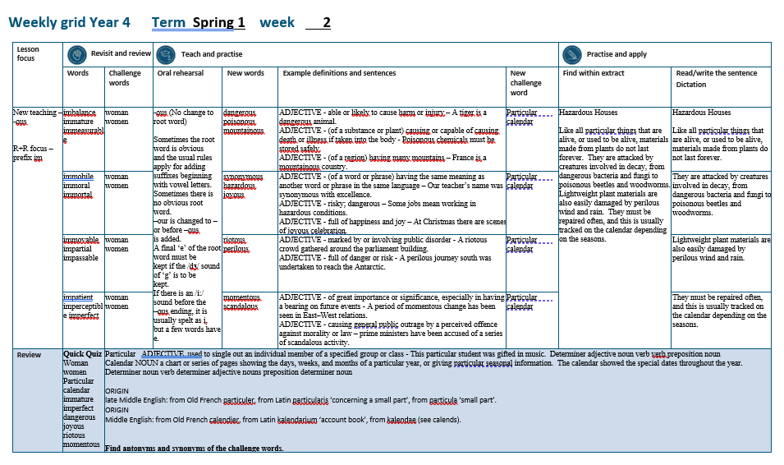

Slide 5
Let’s Revisit and Review…

Slide 6
Do you remember this challenge word?

Slide 7

woman
The drawing of the young woman was beautiful.

Slide 8
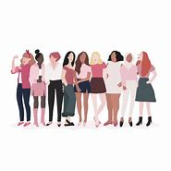
women
The women were very excited to read the next book.

Slide 9
Do you remember the prefix
- im

Slide 10
im-
meaning ‘not’
Before a root word starting with m or p,
in– becomes im–.

Slide 11
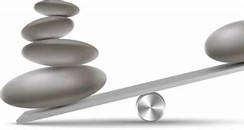
imbalance

Slide 12
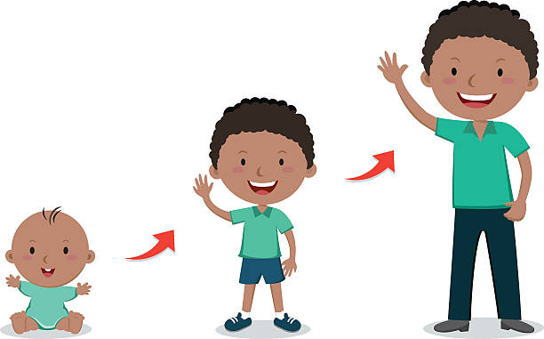
immature

Slide 13

immeasurable

Slide 14
Let’s Teach and Practise

Slide 15
-ous
(no change to root word)
Sometimes the root word is obvious and the usual rules apply for adding suffixes beginning with vowel letters.

Slide 16
Sometimes there is no obvious root word.
–our is changed to –or before –ous is added.
A final ‘e’ of the root word must be kept if the /dʒ/ sound of ‘g’ is to be kept.

Slide 17
If there is an /i:/ sound before the
–ous ending, it is usually spelt as i, but a few words have e.

Slide 18
-ous

Slide 19

dangerous

Slide 20

poisonous

Slide 21

mountainous

Slide 22
dangerous
danger + ous = dangerous
ADJECTIVE
Definition - able or likely to cause harm or injury

Slide 23
poisonous
poison + ous = poisonous
ADJECTIVE
Definition - (of a substance or plant) causing or capable of causing death or illness if taken into the body

Slide 24
mountainous
mountain + ous = mountainous
ADJECTIVE
Definition - (of a region) having many mountains

Slide 25
A tiger is a dangerous animal.
_________

Slide 26
Poisonous chemicals must be stored safely.
_________

Slide 27
France is a mountainous country.
___________

Slide 28
New CHALLENGE words.

Slide 29

particular
ADJECTIVE
Definition - used to single out an individual member of a specified group or class

Slide 30
This particular student was gifted in music
__________

Slide 31
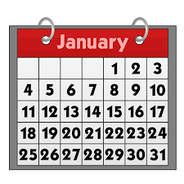
calendar
NOUN
Definition - a chart or series of pages showing the days, weeks, and months of a particular year, or giving particular seasonal information.

Slide 32
The calendar showed the special dates throughout the year.
________

Slide 33
Let’s Practise and Apply.

Slide 34
Can you spot the spelling rule words and the challenge words?

Slide 35
Hazardous Houses
Like all particular things that are alive, or used to be alive, materials made from plants do not last forever. They are attacked by creatures involved in decay, from dangerous bacteria and fungi to poisonous beetles and woodworms. Lightweight plant materials are also easily damaged by perilous wind and rain. They must be repaired often, and this is usually tracked on the calendar depending on the seasons.

Slide 36
Hazardous Houses
Like all particular things that are alive, or used to be alive, materials made from plants do not last forever. They are attacked by creatures involved in decay, from dangerous bacteria and fungi to poisonous beetles and woodworms. Lightweight plant materials are also easily damaged by perilous wind and rain. They must be repaired often, and this is usually tracked on the calendar depending on the seasons.

Slide 37
Write this sentence as I dictate it to you.
Notes:
Like all particular things that are alive, or used to be alive, materials made from plants do not last forever.

Slide 38
Like all particular things that are alive, or used to be alive, materials made from plants do not last forever.
Did you write it correctly?
Edit your work and make sure you have it correct.
Can you underline the spelling word that we have covered in this session?

Slide 39
Year 4 - Spring 1
Week 2 - Tuesday
Notes:
Revisit and review the words from previous teaching and challenge words – I say, we say, you say
Ask children to write words only in their spelling book
Introduce the new spelling rule
Children to write the new spelling rule words and challenge words into books when the sentences are shown with the spelling word missing.
Read the extract with the class as choral reading. Practise model of prosody etc.
Ask children to find the spelling words from the session in the text.
Then read allowed the chosen sentence for children to write fully in their books.
Show the extract and ask children to then edit their work to check they were correct in their dictation.

Slide 41
Let’s Revisit and Review…

Slide 42
Do you remember this challenge word?

Slide 43
woman
The drawing of the young woman was beautiful.

Slide 44
women
The women were very excited to read the next book.

Slide 45
Do you remember the prefix
- im

Slide 46
im-
meaning ‘not’
Before a root word starting with m or p,
in– becomes im–.

Slide 47
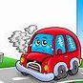
immobile

Slide 48
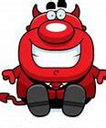
immoral

Slide 49

immortal

Slide 50
Let’s Teach and Practise

Slide 51
-ous
(no change to root word)
Sometimes the root word is obvious and the usual rules apply for adding suffixes beginning with vowel letters.

Slide 52
Sometimes there is no obvious root word.
–our is changed to –or before –ous is added.
A final ‘e’ of the root word must be kept if the /dʒ/ sound of ‘g’ is to be kept.

Slide 53
If there is an /i:/ sound before the
–ous ending, it is usually spelt as i, but a few words have e.

Slide 54
-ous

Slide 55
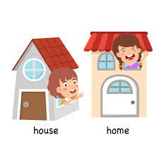
synonymous

Slide 56

hazardous

Slide 57

joyous

Slide 58
synonymous
synonym + ous = synonymous
ADJECTIVE
Definition - (of a word or phrase) having the same meaning as another word or phrase in the same language

Slide 59
hazardous
hazard + ous = hazardous
ADJECTIVE
Definition - risky; dangerous

Slide 60
joyous
joy + ous = joyous
ADJECTIVE
Definition - full of happiness and joy

Slide 61
Our teacher’s name was synonymous with excellence.
__________

Slide 62
Some jobs mean working in hazardous conditions.
_________

Slide 63
At Christmas, there are scenes of joyous celebration.
______

Slide 64
New CHALLENGE words.

Slide 65
particular
ADJECTIVE
Definition - used to single out an individual member of a specified group or class

Slide 66
This particular student was gifted in music
__________

Slide 67
calendar
NOUN
Definition - a chart or series of pages showing the days, weeks, and months of a particular year, or giving particular seasonal information.

Slide 68
The calendar showed the special dates throughout the year.
________

Slide 69
Let’s Practise and Apply.

Slide 70
Can you spot the spelling rule words and the challenge words?

Slide 71
Hazardous Houses
Like all particular things that are alive, or used to be alive, materials made from plants do not last forever. They are attacked by creatures involved in decay, from dangerous bacteria and fungi to poisonous beetles and woodworms. Lightweight plant materials are also easily damaged by perilous wind and rain. They must be repaired often, and this is usually tracked on the calendar depending on the seasons.

Slide 72
Hazardous Houses
Like all particular things that are alive, or used to be alive, materials made from plants do not last forever. They are attacked by creatures involved in decay, from dangerous bacteria and fungi to poisonous beetles and woodworms. Lightweight plant materials are also easily damaged by perilous wind and rain. They must be repaired often, and this is usually tracked on the calendar depending on the seasons.

Slide 73
Write this sentence as I dictate it to you.
Notes:
They are attacked by creatures involved in decay, from dangerous bacteria and fungi to poisonous beetles and woodworms.

Slide 74
They are attacked by creatures involved in decay, from dangerous bacteria and fungi to poisonous beetles and woodworms.
Did you write it correctly?
Edit your work and make sure you have it correct.
Can you underline the spelling word that we have covered in this session?

Slide 75
Year 4 - Spring 1
Week 2 - Wednesday
Notes:
Revisit and review the words from previous teaching and challenge words – I say, we say, you say
Ask children to write words only in their spelling book
Introduce the new spelling rule
Children to write the new spelling rule words and challenge words into books when the sentences are shown with the spelling word missing.
Read the extract with the class as choral reading. Practise model of prosody etc.
Ask children to find the spelling words from the session in the text.
Then read allowed the chosen sentence for children to write fully in their books.
Show the extract and ask children to then edit their work to check they were correct in their dictation.

Slide 77
Let’s Revisit and Review…

Slide 78
Do you remember this challenge word?

Slide 79
woman
The drawing of the young woman was beautiful.

Slide 80
women
The women were very excited to read the next book.

Slide 81
Do you remember the prefix
- im

Slide 82
im-
meaning ‘not’
Before a root word starting with m or p,
in– becomes im–.

Slide 83
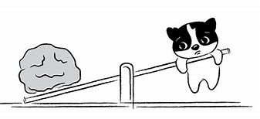
immovable

Slide 84
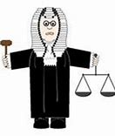
impartial

Slide 85
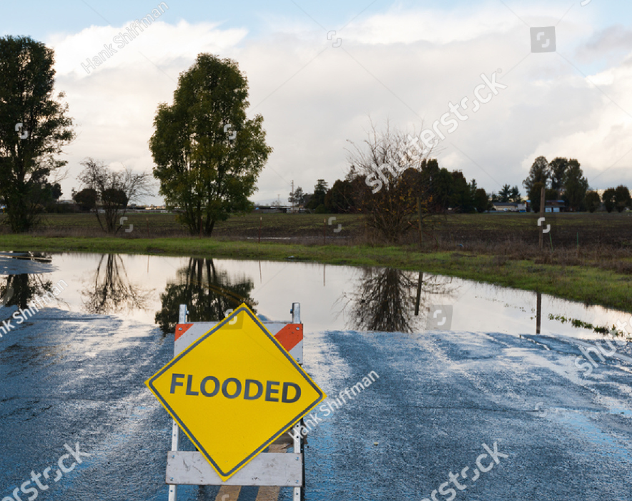
impassable

Slide 86
Let’s Teach and Practise

Slide 87
-ous
(no change to root word)
Sometimes the root word is obvious and the usual rules apply for adding suffixes beginning with vowel letters.

Slide 88
Sometimes there is no obvious root word.
–our is changed to –or before –ous is added.
A final ‘e’ of the root word must be kept if the /dʒ/ sound of ‘g’ is to be kept.

Slide 89
If there is an /i:/ sound before the
–ous ending, it is usually spelt as i, but a few words have e.

Slide 90
-ous

Slide 91
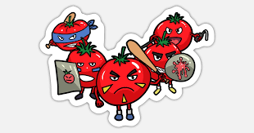
riotous

Slide 92
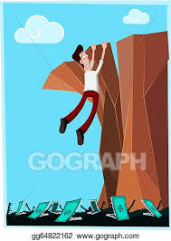
perilous

Slide 93
riotous
riot + ous = riotous
ADJECTIVE
Definition - marked by or involving public disorder

Slide 94
perilous
peril + ous = perilous
ADJECTIVE
Definition - full of danger or risk

Slide 95
A riotous crowd gathered around the parliament building.
_______

Slide 96
A perilous journey south was undertaken to reach the Antarctic.
________

Slide 97
New CHALLENGE words.

Slide 98
particular
ADJECTIVE
Definition - used to single out an individual member of a specified group or class

Slide 99
This particular student was gifted in music
__________

Slide 100
calendar
NOUN
Definition - a chart or series of pages showing the days, weeks, and months of a particular year, or giving particular seasonal information.

Slide 101
The calendar showed the special dates throughout the year.
________

Slide 102
Let’s Practise and Apply.

Slide 103
Can you spot the spelling rule words and the challenge words?

Slide 104
Hazardous Houses
Like all particular things that are alive, or used to be alive, materials made from plants do not last forever. They are attacked by creatures involved in decay, from dangerous bacteria and fungi to poisonous beetles and woodworms. Lightweight plant materials are also easily damaged by perilous wind and rain. They must be repaired often, and this is usually tracked on the calendar depending on the seasons.

Slide 105
Hazardous Houses
Like all particular things that are alive, or used to be alive, materials made from plants do not last forever. They are attacked by creatures involved in decay, from dangerous bacteria and fungi to poisonous beetles and woodworms. Lightweight plant materials are also easily damaged by perilous wind and rain. They must be repaired often, and this is usually tracked on the calendar depending on the seasons.

Slide 106
Write this sentence as I dictate it to you.
Notes:
Lightweight plant materials are also easily damaged by perilous wind and rain.

Slide 107
Lightweight plant materials are also easily damaged by perilous wind and rain.
Did you write it correctly?
Edit your work and make sure you have it correct.
Can you underline the spelling word that we have covered in this session?

Slide 108
Year 4 - Spring 1
Week 2 - Thursday
Notes:
Revisit and review the words from previous teaching and challenge words – I say, we say, you say
Ask children to write words only in their spelling book
Introduce the new spelling rule
Children to write the new spelling rule words and challenge words into books when the sentences are shown with the spelling word missing.
Read the extract with the class as choral reading. Practise model of prosody etc.
Ask children to find the spelling words from the session in the text.
Then read allowed the chosen sentence for children to write fully in their books.
Show the extract and ask children to then edit their work to check they were correct in their dictation.

Slide 110
Let’s Revisit and Review…

Slide 111
Do you remember this challenge word?

Slide 112
woman
The drawing of the young woman was beautiful.

Slide 113
women
The women were very excited to read the next book.

Slide 114
Do you remember the prefix
- im

Slide 115
im-
meaning ‘not’
Before a root word starting with m or p,
in– becomes im–.

Slide 116

impatient

Slide 117

imperceptible

Slide 118
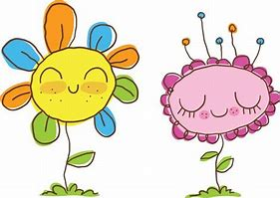
imperfect

Slide 119
Let’s Teach and Practise

Slide 120
-ous
(no change to root word)
Sometimes the root word is obvious and the usual rules apply for adding suffixes beginning with vowel letters.

Slide 121
Sometimes there is no obvious root word.
–our is changed to –or before –ous is added.
A final ‘e’ of the root word must be kept if the /dʒ/ sound of ‘g’ is to be kept.

Slide 122
If there is an /i:/ sound before the
–ous ending, it is usually spelt as i, but a few words have e.

Slide 123
-ous

Slide 124

momentous

Slide 125
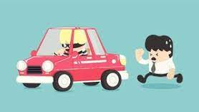
scandalous

Slide 126
momentous
moment + ous = momentous
ADJECTIVE
Definition - of great importance or significance, especially in having a bearing on future events

Slide 127
scandalous
scandal + ous = scandalous
ADJECTIVE
Definition - causing general public outrage by a perceived offence against morality or law

Slide 128
A period of momentous change has been seen in East–West relations.
_________

Slide 129
Prime Ministers have been accused of a series of scandalous activity.
__________

Slide 130
New CHALLENGE words.

Slide 131
particular
ADJECTIVE
Definition - used to single out an individual member of a specified group or class

Slide 132
This particular student was gifted in music
__________

Slide 133
calendar
NOUN
Definition - a chart or series of pages showing the days, weeks, and months of a particular year, or giving particular seasonal information.

Slide 134
The calendar showed the special dates throughout the year.
________

Slide 135
Let’s Practise and Apply.

Slide 136
Can you spot the spelling rule words and the challenge words?

Slide 137
Hazardous Houses
Like all particular things that are alive, or used to be alive, materials made from plants do not last forever. They are attacked by creatures involved in decay, from dangerous bacteria and fungi to poisonous beetles and woodworms. Lightweight plant materials are also easily damaged by perilous wind and rain. They must be repaired often, and this is usually tracked on the calendar depending on the seasons.

Slide 138
Hazardous Houses
Like all particular things that are alive, or used to be alive, materials made from plants do not last forever. They are attacked by creatures involved in decay, from dangerous bacteria and fungi to poisonous beetles and woodworms. Lightweight plant materials are also easily damaged by perilous wind and rain. They must be repaired often, and this is usually tracked on the calendar depending on the seasons.

Slide 139
Write this sentence as I dictate it to you.
Notes:
They must be repaired often, and this is usually tracked on the calendar depending on the seasons.

Slide 140
They must be repaired often, and this is usually tracked on the calendar depending on the seasons.
Did you write it correctly?
Edit your work and make sure you have it correct.
Can you underline the spelling word that we have covered in this session?

Slide 141
Year 4 - Spring 1
Week 2 - Friday
Notes:
Click through the slides for all the R+R words for the week (both the focus and the challenge words)
Click through the slides for all the new learning this week

Slide 143
Old challenge words…

Slide 144
woman

Slide 145
women

Slide 146
Old spelling rule words…

Slide 147
imbalance

Slide 148
immature

Slide 149
immeasurable

Slide 150
immobile

Slide 151
immoral

Slide 152
immortal

Slide 153
immoveable

Slide 154
immpartial

Slide 155
impassable

Slide 156
impatient

Slide 157
imperceptible

Slide 158
imperfect

Slide 159
New spelling rule words…

Slide 160
dangerous

Slide 161
poisonous

Slide 162
mountainous

Slide 163
synonymous

Slide 164
hazardous

Slide 165
joyous

Slide 166
riotous

Slide 167
perilous

Slide 168
momentous

Slide 169
scandalous

Slide 170
New challenge words…

Slide 171
particular

Slide 172
calendar

Slide 173
Quick Quiz time…
Notes:
Say these words for the quiz
Woman women Particular calendar immature imperfect dangerous joyous riotous momentous

Slide 174
Did you get them correct?
Edit your work.
woman women particular calendar immature imperfect dangerous joyous riotous momentous

Slide 175
Word class time…

Slide 176
This particular student was gifted in music.
Determiner adjective noun verb verb preposition noun
Notes:
Ask for these words to be classed

Slide 177
The calendar showed the special dates throughout the year.
Determiner noun verb determiner adjective nouns preposition determiner noun
Notes:
Ask for these words to be classed

Slide 178
Etymology
The history of a word….

Slide 179
Particular
late Middle English: from Old French particuler, from Latin particularis ‘concerning a small part’, from particula ‘small part’.
Calendar
Middle English: from Old French calendier, from Latin kalendarium ‘account book’, from kalendae (see calends).

Slide 180
Let’s investigate….
Find antonyms and synonyms of the challenge words.

