Slide 1
Spelling Y4
Mastering spellings: building on the foundations of phonics
Spring 1
Week 3

Slide 2
These slides are slightly different - to reduce the number there are now animations used
Please use these slides in full screen slide show mode to ensure they work how they are designed with chunks of information being shown at a time to prevent overload
Thank you

Slide 3
Year 4 - Spring 1
Week 3 - Monday

Slide 4
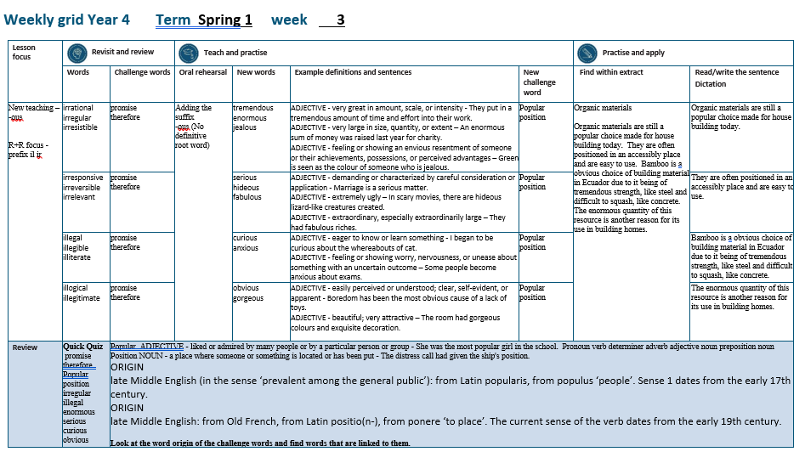

Slide 5
Let’s Revisit and Review…

Slide 6
Do you remember this challenge word?

Slide 7

promise
He promised to forward my mail.

Slide 8

therefore
They were injured and therefore unable to play.

Slide 9
Do you remember the prefix
- ir

Slide 10
ir- meaning ‘not’
Before a root word starting with r, in– becomes ir–.

Slide 11
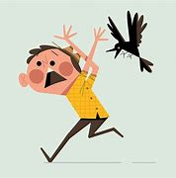
irrational

Slide 12

irregular

Slide 13
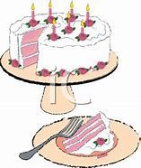
irresistible

Slide 14
Let’s Teach and Practise

Slide 15
Adding the suffix
-ous
Sometimes there is no obvious root word.

Slide 16
-ous

Slide 17

tremendous

Slide 18
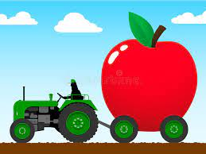
enormous

Slide 19

jealous

Slide 20
tremendous
ADJECTIVE
Definition - very great in amount, scale, or intensity

Slide 21
enormous
ADJECTIVE
Definition - very large in size, quantity, or extent

Slide 22
jealous
ADJECTIVE
Definition - feeling or showing an envious resentment of someone or their achievements, possessions, or perceived advantages

Slide 23
They put in a tremendous amount of time and effort into their work.
__________

Slide 24
An enormous sum of money was raised last year for charity.
________

Slide 25
Green is seen as the colour of someone who is jealous.
_______.

Slide 26
New CHALLENGE words.

Slide 27
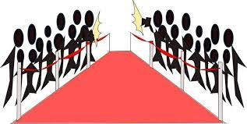
popular
ADJECTIVE
Definition - liked or admired by many people or by a particular person or group

Slide 28
She was the most popular girl in the school.
_______

Slide 29

position
NOUN
Definition - - a place where someone or something is located or has been put

Slide 30
The distress call had given the ship's position.
________.

Slide 31
Let’s Practise and Apply.

Slide 32
Can you spot the spelling rule words and the challenge words?

Slide 33
Organic materials
Organic materials are still a popular choice made for house building today. They are often positioned in an accessible place and are easy to use. Bamboo is a obvious choice of building material in Ecuador due to it being of tremendous strength, like steel and difficult to squash, like concrete. The enormous quantity of this resource is another reason for its use in building homes.

Slide 34
Organic materials
Organic materials are still a popular choice made for house building today. They are often positioned in an accessible place and are easy to use. Bamboo is a obvious choice of building material in Ecuador due to it being of tremendous strength, like steel and difficult to squash, like concrete. The enormous quantity of this resource is another reason for its use in building homes.

Slide 35
Write this sentence as I dictate it to you.
Notes:
Organic materials are still a popular choice made for house building today.

Slide 36
Organic materials are still a popular choice made for house building today.
Did you write it correctly?
Edit your work and make sure you have it correct.
Can you underline the spelling word that we have covered in this session?

Slide 37
Year 4 - Spring 1
Week 3 - Tuesday
Notes:
Revisit and review the words from previous teaching and challenge words – I say, we say, you say
Ask children to write words only in their spelling book
Introduce the new spelling rule
Children to write the new spelling rule words and challenge words into books when the sentences are shown with the spelling word missing.
Read the extract with the class as choral reading. Practise model of prosody etc.
Ask children to find the spelling words from the session in the text.
Then read allowed the chosen sentence for children to write fully in their books.
Show the extract and ask children to then edit their work to check they were correct in their dictation.

Slide 39
Let’s Revisit and Review…

Slide 40
Do you remember this challenge word?

Slide 41
promise
He promised to forward my mail.

Slide 42
therefore
They were injured and therefore unable to play.

Slide 43
Do you remember the prefix
- ir

Slide 44
ir- meaning ‘not’
Before a root word starting with r, in– becomes ir–.

Slide 45
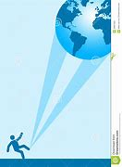
irresponsive

Slide 46
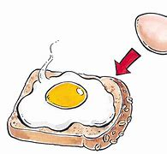
irreversible

Slide 47

irrelevant

Slide 48
Let’s Teach and Practise

Slide 49
Adding the suffix
-ous
Sometimes there is no obvious root word.

Slide 50
-ous

Slide 51

serious

Slide 52
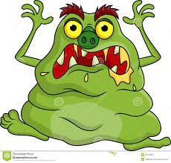
hideous

Slide 53
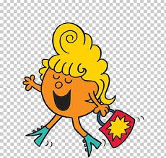
fabulous

Slide 54
serious
ADJECTIVE
Definition - demanding or characterized by careful consideration or application

Slide 55
hideous
ADJECTIVE
Definition - extremely ugly

Slide 56
fabulous
ADJECTIVE
Definition - extraordinary, especially extraordinarily large

Slide 57
Marriage is a serious matter.
_______

Slide 58
In scary movies, there are hideous lizard-like creatures created.
_______

Slide 59
They had fabulous riches.
________

Slide 60
New CHALLENGE words.

Slide 61
popular
ADJECTIVE
Definition - liked or admired by many people or by a particular person or group

Slide 62
She was the most popular girl in the school.
_______

Slide 63
position
NOUN
Definition - - a place where someone or something is located or has been put

Slide 64
The distress call had given the ship's position.
________.

Slide 65
Let’s Practise and Apply.

Slide 66
Can you spot the spelling rule words and the challenge words?

Slide 67
Organic materials
Organic materials are still a popular choice made for house building today. They are often positioned in an accessible place and are easy to use. Bamboo is a obvious choice of building material in Ecuador due to it being of tremendous strength, like steel and difficult to squash, like concrete. The enormous quantity of this resource is another reason for its use in building homes.

Slide 68
Organic materials
Organic materials are still a popular choice made for house building today. They are often positioned in an accessible place and are easy to use. Bamboo is a obvious choice of building material in Ecuador due to it being of tremendous strength, like steel and difficult to squash, like concrete. The enormous quantity of this resource is another reason for its use in building homes.

Slide 69
Write this sentence as I dictate it to you.
Notes:
They are often positioned in an accessibly place and are easy to use.

Slide 70
They are often positioned in an accessibly place and are easy to use.
Did you write it correctly?
Edit your work and make sure you have it correct.
Can you underline the spelling word that we have covered in this session?

Slide 71
Year 4 - Spring 1
Week 3 - Wednesday
Notes:
Revisit and review the words from previous teaching and challenge words – I say, we say, you say
Ask children to write words only in their spelling book
Introduce the new spelling rule
Children to write the new spelling rule words and challenge words into books when the sentences are shown with the spelling word missing.
Read the extract with the class as choral reading. Practise model of prosody etc.
Ask children to find the spelling words from the session in the text.
Then read allowed the chosen sentence for children to write fully in their books.
Show the extract and ask children to then edit their work to check they were correct in their dictation.

Slide 73
Let’s Revisit and Review…

Slide 74
Do you remember this challenge word?

Slide 75
promise
He promised to forward my mail.

Slide 76
therefore
They were injured and therefore unable to play.

Slide 77
The prefix
- il

Slide 78
il-

Slide 79
il- meaning ‘not’

Slide 80

illegal

Slide 81
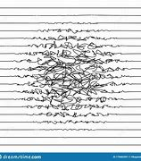
illegible

Slide 82

illiterate

Slide 83
Let’s Teach and Practise

Slide 84
Adding the suffix
-ous
Sometimes there is no obvious root word.

Slide 85
-ous

Slide 86
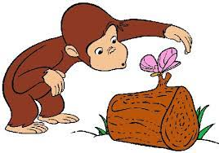
curious

Slide 87

anxious

Slide 88
curious
ADJECTIVE
Definition - eager to know or learn something

Slide 89
anxious
ADJECTIVE
Definition - feeling or showing worry, nervousness, or unease about something with an uncertain outcome

Slide 90
I began to be curious about the whereabouts of cat.
_______

Slide 91
Some people become anxious about exams.
_______

Slide 92
New CHALLENGE words.

Slide 93
popular
ADJECTIVE
Definition - liked or admired by many people or by a particular person or group

Slide 94
She was the most popular girl in the school.
_______

Slide 95
position
NOUN
Definition - - a place where someone or something is located or has been put

Slide 96
The distress call had given the ship's position.
________.

Slide 97
Let’s Practise and Apply.

Slide 98
Can you spot the spelling rule words and the challenge words?

Slide 99
Organic materials
Organic materials are still a popular choice made for house building today. They are often positioned in an accessible place and are easy to use. Bamboo is a obvious choice of building material in Ecuador due to it being of tremendous strength, like steel and difficult to squash, like concrete. The enormous quantity of this resource is another reason for its use in building homes.

Slide 100
Organic materials
Organic materials are still a popular choice made for house building today. They are often positioned in an accessible place and are easy to use. Bamboo is a obvious choice of building material in Ecuador due to it being of tremendous strength, like steel and difficult to squash, like concrete. The enormous quantity of this resource is another reason for its use in building homes.

Slide 101
Write this sentence as I dictate it to you.
Notes:
Bamboo is a obvious choice of building material in Ecuador due to it being of tremendous strength, like steel and difficult to squash, like concrete.

Slide 102
Bamboo is a obvious choice of building material in Ecuador due to it being of tremendous strength, like steel and difficult to squash, like concrete.
Did you write it correctly?
Edit your work and make sure you have it correct.
Can you underline the spelling word that we have covered in this session?

Slide 103
Year 4 - Spring 1
Week 3 - Thursday
Notes:
Revisit and review the words from previous teaching and challenge words – I say, we say, you say
Ask children to write words only in their spelling book
Introduce the new spelling rule
Children to write the new spelling rule words and challenge words into books when the sentences are shown with the spelling word missing.
Read the extract with the class as choral reading. Practise model of prosody etc.
Ask children to find the spelling words from the session in the text.
Then read allowed the chosen sentence for children to write fully in their books.
Show the extract and ask children to then edit their work to check they were correct in their dictation.

Slide 105
Let’s Revisit and Review…

Slide 106
Do you remember this challenge word?

Slide 107
promise
He promised to forward my mail.

Slide 108
therefore
They were injured and therefore unable to play.

Slide 109
The prefix
- il

Slide 110
il-

Slide 111
il- meaning ‘not’

Slide 112
il- meaning ‘not’
Before a root word starting with l, in– becomes il–.

Slide 113
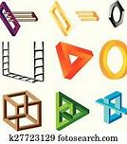
illogical

Slide 114

illegitimate

Slide 115
Let’s Teach and Practise

Slide 116
Adding the suffix
-ous
Sometimes there is no obvious root word.

Slide 117
-ous

Slide 118
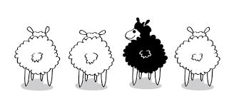
obvious

Slide 119

gorgeous

Slide 120
obvious
ADJECTIVE
Definition - easily perceived or understood

Slide 121
gorgeous
ADJECTIVE
Definition - beautiful; very attractive

Slide 122
Boredom has been the most obvious cause of a lack of toys.
______

Slide 123
The room had gorgeous colours and exquisite decoration.
________

Slide 124
New CHALLENGE words.

Slide 125
popular
ADJECTIVE
Definition - liked or admired by many people or by a particular person or group

Slide 126
She was the most popular girl in the school.
_______

Slide 127
position
NOUN
Definition - - a place where someone or something is located or has been put

Slide 128
The distress call had given the ship's position.
________.

Slide 129
Let’s Practise and Apply.

Slide 130
Can you spot the spelling rule words and the challenge words?

Slide 131
Organic materials
Organic materials are still a popular choice made for house building today. They are often positioned in an accessible place and are easy to use. Bamboo is a obvious choice of building material in Ecuador due to it being of tremendous strength, like steel and difficult to squash, like concrete. The enormous quantity of this resource is another reason for its use in building homes.

Slide 132
Organic materials
Organic materials are still a popular choice made for house building today. They are often positioned in an accessible place and are easy to use. Bamboo is a obvious choice of building material in Ecuador due to it being of tremendous strength, like steel and difficult to squash, like concrete. The enormous quantity of this resource is another reason for its use in building homes.

Slide 133
Write this sentence as I dictate it to you.
Notes:
The enormous quantity of this resource is another reason for its use in building homes.

Slide 134
The enormous quantity of this resource is another reason for its use in building homes.
Did you write it correctly?
Edit your work and make sure you have it correct.
Can you underline the spelling word that we have covered in this session?

Slide 135
Year 4 - Spring 1
Week 3 - Friday
Notes:
Click through the slides for all the R+R words for the week (both the focus and the challenge words)
Click through the slides for all the new learning this week

Slide 137
Old challenge words…

Slide 138
promise

Slide 139
therefore

Slide 140
Old spelling rule words…

Slide 141
irrational

Slide 142
irregular

Slide 143
irresistible

Slide 144
irresponsive

Slide 145
irreversible

Slide 146
irrelevant

Slide 147
illegal

Slide 148
illegible

Slide 149
illiterate

Slide 150
illogical

Slide 151
illegitimate

Slide 152
New spelling rule words…

Slide 153
tremendous

Slide 154
enormous

Slide 155
jealous

Slide 156
serious

Slide 157
hideous

Slide 158
fabulous

Slide 159
curious

Slide 160
anxious

Slide 161
obvious

Slide 162
gorgeous

Slide 163
New challenge words…

Slide 164
popular

Slide 165
position

Slide 166
Quick Quiz time…
Notes:
Say these words for the quiz
Woman women Particular calendar immature imperfect dangerous joyous riotous momentous

Slide 167
Did you get them correct?
Edit your work.
promise therefore popular position irregular illegal enormous serious curious obvious

Slide 168
Word class time…

Slide 169
She was the most popular girl in the school.
Pronoun verb determiner adverb adjective noun preposition noun
Notes:
Ask for these words to be classed

Slide 170
The distress call had given the ship's position.
Determiner adjective noun verb verb determiner adjective noun
Notes:
Ask for these words to be classed

Slide 171
Etymology
The history of a word….

Slide 172
Particular
late Middle English (in the sense ‘prevalent among the general public’): from Latin popularis, from populus ‘people’. Sense 1 dates from the early 17th century.
Calendar
late Middle English: from Old French, from Latin positio(n-), from ponere ‘to place’. The current sense of the verb dates from the early 19th century.

Slide 173
Let’s investigate….
Look at the word origin of the challenge words and find words that are linked to them.

