Slide 1
Spelling Y4
Mastering spellings: building on the foundations of phonics
Spring 1
Week 4

Slide 2
These slides are slightly different - to reduce the number there are now animations used
Please use these slides in full screen slide show mode to ensure they work how they are designed with chunks of information being shown at a time to prevent overload
Thank you

Slide 3
Year 4 - Spring 1
Week 4 - Monday

Slide 4
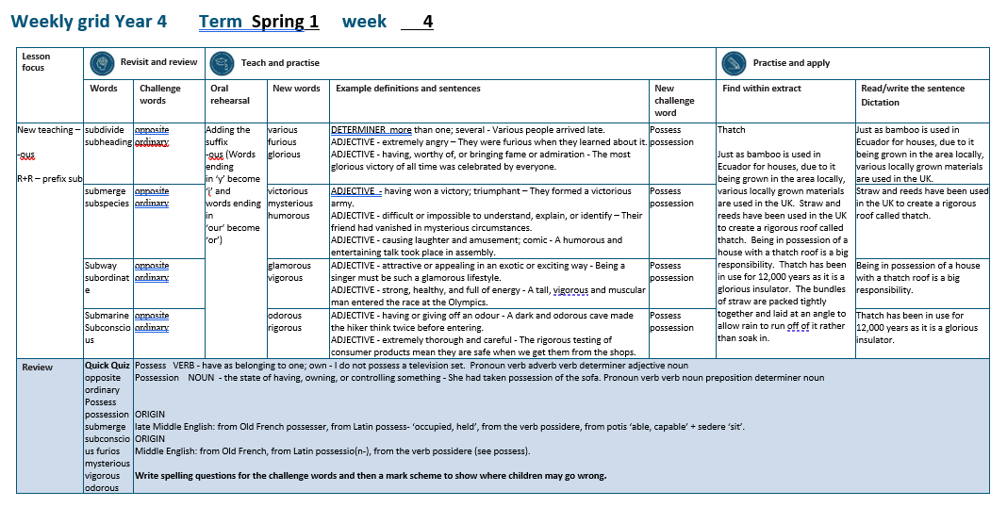

Slide 5
Let’s Revisit and Review…

Slide 6
Do you remember this challenge word?

Slide 7
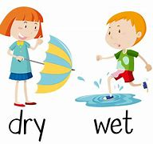
opposite
A crowd gathered on the opposite side of the street.

Slide 8
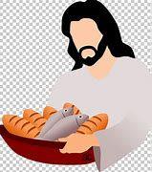
ordinary
The pictures showed ordinary people in extraordinary situations.

Slide 9
The prefix
- sub

Slide 10
sub-
meaning ‘under’
add straight to the root word

Slide 11
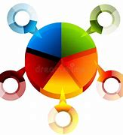
subdivide

Slide 12
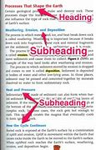
subheading

Slide 13
Let’s Teach and Practise

Slide 14
Adding the suffix
-ous
Adding the suffix -ous
(words ending in ‘y’ become ‘i’)
(words ending in ‘our’ become ‘or’)

Slide 15
-ous

Slide 16
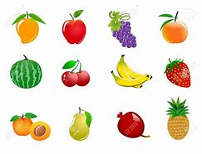
various

Slide 17

furious

Slide 18
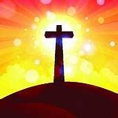
glorious

Slide 19
various
vary (-y +i) + ous = various
DETERMINER
Definition - more than one; several

Slide 20
enormous
fury (-y +i) + ous = furious
ADJECTIVE
Definition - extremely angry

Slide 21
glorious
glory (-y +i) + ous = glorious
ADJECTIVE
Definition - having, worthy of, or bringing fame or admiration

Slide 22
Various people arrived late.
_______

Slide 23
They were furious when they learned about it.
_______

Slide 24
The most glorious victory of all time was celebrated by everyone.
________

Slide 25
New CHALLENGE words.

Slide 26
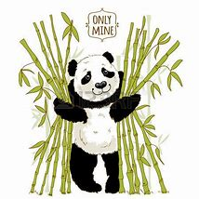
possess
VERB
Definition - have as belonging to one; own

Slide 27
I do not possess a television set.
_______

Slide 28
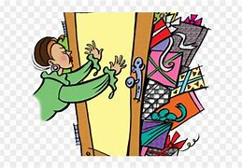
possession
NOUN
Definition - the state of having, owning, or controlling something

Slide 29
She had taken possession of the sofa.
__________

Slide 30
Let’s Practise and Apply.

Slide 31
Can you spot the spelling rule words and the challenge words?

Slide 32
Thatch
Just as bamboo is used in Ecuador for houses, due to it being grown in the area locally, various locally grown materials are used in the UK. Straw and reeds have been used in the UK to create a rigorous roof called thatch. Being in possession of a house with a thatch roof is a big responsibility. Thatch has been in use for 12,000 years as it is a glorious insulator. The bundles of straw are packed tightly together and laid at an angle to allow rain to run off of it rather than soak in.

Slide 33
Thatch
Just as bamboo is used in Ecuador for houses, due to it being grown in the area locally, various locally grown materials are used in the UK. Straw and reeds have been used in the UK to create a rigorous roof called thatch. Being in possession of a house with a thatch roof is a big responsibility. Thatch has been in use for 12,000 years as it is a glorious insulator. The bundles of straw are packed tightly together and laid at an angle to allow rain to run off of it rather than soak in.

Slide 34
Write this sentence as I dictate it to you.
Notes:
…various locally grown materials are used in the UK.

Slide 35
…various locally grown materials are used in the UK.
Did you write it correctly?
Edit your work and make sure you have it correct.
Can you underline the spelling word that we have covered in this session?

Slide 36
Year 4 - Spring 1
Week 4 - Tuesday
Notes:
Revisit and review the words from previous teaching and challenge words – I say, we say, you say
Ask children to write words only in their spelling book
Introduce the new spelling rule
Children to write the new spelling rule words and challenge words into books when the sentences are shown with the spelling word missing.
Read the extract with the class as choral reading. Practise model of prosody etc.
Ask children to find the spelling words from the session in the text.
Then read allowed the chosen sentence for children to write fully in their books.
Show the extract and ask children to then edit their work to check they were correct in their dictation.

Slide 38
Let’s Revisit and Review…

Slide 39
Do you remember this challenge word?

Slide 40
opposite
A crowd gathered on the opposite side of the street.

Slide 41
ordinary
The pictures showed ordinary people in extraordinary situations.

Slide 42
The prefix
- sub

Slide 43
sub-
meaning ‘under’
add straight to the root word

Slide 44
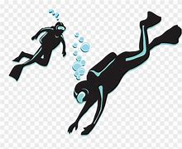
submerge

Slide 45
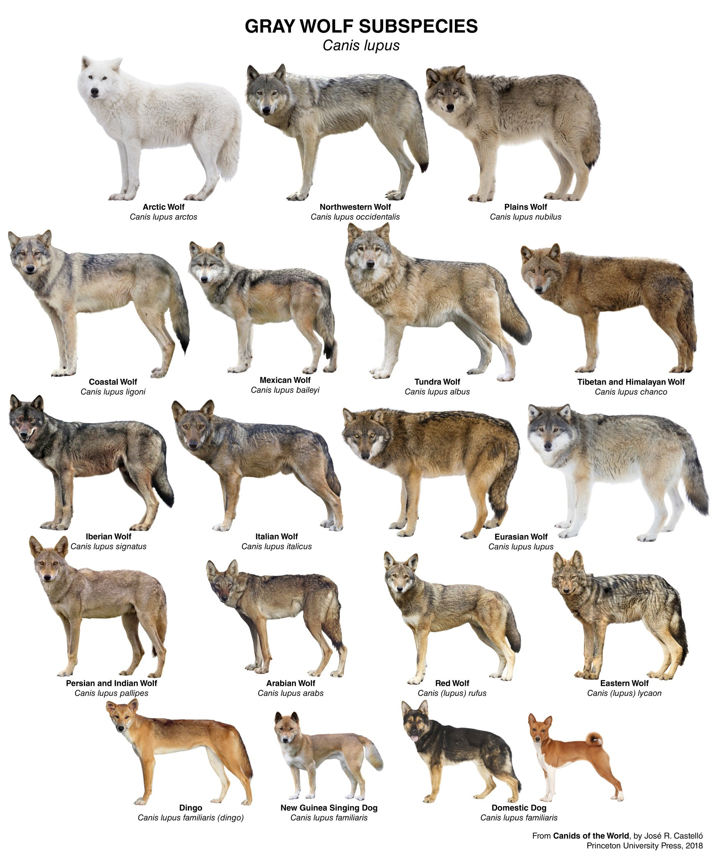
subspecies

Slide 46
Let’s Teach and Practise

Slide 47
Adding the suffix
-ous
Adding the suffix -ous
(words ending in ‘y’ become ‘i’)
(words ending in ‘our’ become ‘or’)

Slide 48
-ous

Slide 49

victorious

Slide 50

mysterious

Slide 51
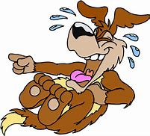
humorous

Slide 52
victorious
victory (-y +i) + ous = victorious
ADJECTIVE
Definition - having won a victory; triumphant

Slide 53
mysterious
mystery (-y +i) + ous = mysterious
ADJECTIVE
Definition - difficult or impossible to understand, explain, or identify

Slide 54
humorous
humour (-u) + ous = humorous
ADJECTIVE
Definition - causing laughter and amusement; comic

Slide 55
They formed a victorious army.
__________

Slide 56
Their friend had vanished in mysterious circumstances.
__________

Slide 57
A humorous and entertaining talk took place in assembly.
________

Slide 58
New CHALLENGE words.

Slide 59
possess
VERB
Definition - have as belonging to one; own

Slide 60
I do not possess a television set.
_______

Slide 61
possession
NOUN
Definition - the state of having, owning, or controlling something

Slide 62
She had taken possession of the sofa.
__________

Slide 63
Let’s Practise and Apply.

Slide 64
Can you spot the spelling rule words and the challenge words?

Slide 65
Thatch
Just as bamboo is used in Ecuador for houses, due to it being grown in the area locally, various locally grown materials are used in the UK. Straw and reeds have been used in the UK to create a rigorous roof called thatch. Being in possession of a house with a thatch roof is a big responsibility. Thatch has been in use for 12,000 years as it is a glorious insulator. The bundles of straw are packed tightly together and laid at an angle to allow rain to run off of it rather than soak in.

Slide 66
Thatch
Just as bamboo is used in Ecuador for houses, due to it being grown in the area locally, various locally grown materials are used in the UK. Straw and reeds have been used in the UK to create a rigorous roof called thatch. Being in possession of a house with a thatch roof is a big responsibility. Thatch has been in use for 12,000 years as it is a glorious insulator. The bundles of straw are packed tightly together and laid at an angle to allow rain to run off of it rather than soak in.

Slide 67
Write this sentence as I dictate it to you.
Notes:
Straw and reeds have been used in the UK to create a rigorous roof called thatch.

Slide 68
Straw and reeds have been used in the UK to create a rigorous roof called thatch.
Did you write it correctly?
Edit your work and make sure you have it correct.
Can you underline the spelling word that we have covered in this session?

Slide 69
Year 4 - Spring 1
Week 4 - Wednesday
Notes:
Revisit and review the words from previous teaching and challenge words – I say, we say, you say
Ask children to write words only in their spelling book
Introduce the new spelling rule
Children to write the new spelling rule words and challenge words into books when the sentences are shown with the spelling word missing.
Read the extract with the class as choral reading. Practise model of prosody etc.
Ask children to find the spelling words from the session in the text.
Then read allowed the chosen sentence for children to write fully in their books.
Show the extract and ask children to then edit their work to check they were correct in their dictation.

Slide 71
Let’s Revisit and Review…

Slide 72
Do you remember this challenge word?

Slide 73
opposite
A crowd gathered on the opposite side of the street.

Slide 74
ordinary
The pictures showed ordinary people in extraordinary situations.

Slide 75
The prefix
- sub

Slide 76
sub-
meaning ‘under’
add straight to the root word

Slide 77
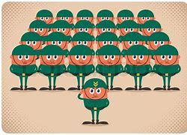
subordinate

Slide 78
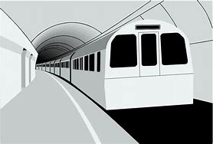
subway

Slide 79
Let’s Teach and Practise

Slide 80
Adding the suffix
-ous
Adding the suffix -ous
(words ending in ‘y’ become ‘i’)
(words ending in ‘our’ become ‘or’)

Slide 81
-ous

Slide 82

glamorous

Slide 83
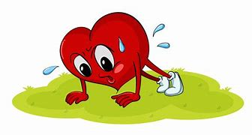
vigorous

Slide 84
glamorous
glamour (-u) + ous = glamorous
ADJECTIVE
Definition - attractive or appealing

Slide 85
vigorous
vigour (-u) + ous = vigorous
ADJECTIVE
Definition - strong, healthy, and full of energy

Slide 86
Being a singer must be such a glamorous lifestyle.
_________

Slide 87
A tall, vigorous and muscular man entered the race at the Olympics.
________

Slide 88
New CHALLENGE words.

Slide 89
possess
VERB
Definition - have as belonging to one; own

Slide 90
I do not possess a television set.
_______

Slide 91
possession
NOUN
Definition - the state of having, owning, or controlling something

Slide 92
She had taken possession of the sofa.
__________

Slide 93
Let’s Practise and Apply.

Slide 94
Can you spot the spelling rule words and the challenge words?

Slide 95
Thatch
Just as bamboo is used in Ecuador for houses, due to it being grown in the area locally, various locally grown materials are used in the UK. Straw and reeds have been used in the UK to create a rigorous roof called thatch. Being in possession of a house with a thatch roof is a big responsibility. Thatch has been in use for 12,000 years as it is a glorious insulator. The bundles of straw are packed tightly together and laid at an angle to allow rain to run off of it rather than soak in.

Slide 96
Thatch
Just as bamboo is used in Ecuador for houses, due to it being grown in the area locally, various locally grown materials are used in the UK. Straw and reeds have been used in the UK to create a rigorous roof called thatch. Being in possession of a house with a thatch roof is a big responsibility. Thatch has been in use for 12,000 years as it is a glorious insulator. The bundles of straw are packed tightly together and laid at an angle to allow rain to run off of it rather than soak in.

Slide 97
Write this sentence as I dictate it to you.
Notes:
Being in possession of a house with a thatch roof is a big responsibility.

Slide 98
Being in possession of a house with a thatch roof is a big responsibility.
Did you write it correctly?
Edit your work and make sure you have it correct.
Can you underline the spelling word that we have covered in this session?

Slide 99
Year 4 - Spring 1
Week 4 - Thursday
Notes:
Revisit and review the words from previous teaching and challenge words – I say, we say, you say
Ask children to write words only in their spelling book
Introduce the new spelling rule
Children to write the new spelling rule words and challenge words into books when the sentences are shown with the spelling word missing.
Read the extract with the class as choral reading. Practise model of prosody etc.
Ask children to find the spelling words from the session in the text.
Then read allowed the chosen sentence for children to write fully in their books.
Show the extract and ask children to then edit their work to check they were correct in their dictation.

Slide 101
Let’s Revisit and Review…

Slide 102
Do you remember this challenge word?

Slide 103
opposite
A crowd gathered on the opposite side of the street.

Slide 104
ordinary
The pictures showed ordinary people in extraordinary situations.

Slide 105
The prefix
- sub

Slide 106
sub-
meaning ‘under’
add straight to the root word

Slide 107
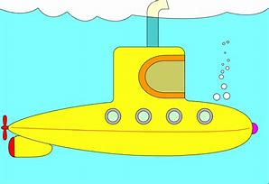
submarine
sub + marine = submarine
NOUN
Definition - a warship that operates completely submerged in the sea.

Slide 108
Let’s Teach and Practise

Slide 109
Adding the suffix
-ous
Adding the suffix -ous
(words ending in ‘y’ become ‘i’)
(words ending in ‘our’ become ‘or’)

Slide 110
-ous

Slide 111

odorous

Slide 112
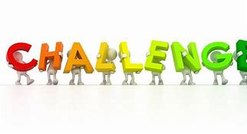
rigorous

Slide 113
odorous
odour (-u) + ous = odorous
ADJECTIVE
Definition - having or giving off an odour / smell

Slide 114
rigorous
rigour (-u) + ous = rigorous
ADJECTIVE
Definition - extremely thorough and careful; a challenge

Slide 115
A dark and odorous cave made the hiker think twice before entering.
_______

Slide 116
The rigorous testing of consumer products mean they are safe when we get them from the shops.
________

Slide 117
New CHALLENGE words.

Slide 118
possess
VERB
Definition - have as belonging to one; own

Slide 119
I do not possess a television set.
_______

Slide 120
possession
NOUN
Definition - the state of having, owning, or controlling something

Slide 121
She had taken possession of the sofa.
__________

Slide 122
Let’s Practise and Apply.

Slide 123
Can you spot the spelling rule words and the challenge words?

Slide 124
Thatch
Just as bamboo is used in Ecuador for houses, due to it being grown in the area locally, various locally grown materials are used in the UK. Straw and reeds have been used in the UK to create a rigorous roof called thatch. Being in possession of a house with a thatch roof is a big responsibility. Thatch has been in use for 12,000 years as it is a glorious insulator. The bundles of straw are packed tightly together and laid at an angle to allow rain to run off of it rather than soak in.

Slide 125
Thatch
Just as bamboo is used in Ecuador for houses, due to it being grown in the area locally, various locally grown materials are used in the UK. Straw and reeds have been used in the UK to create a rigorous roof called thatch. Being in possession of a house with a thatch roof is a big responsibility. Thatch has been in use for 12,000 years as it is a glorious insulator. The bundles of straw are packed tightly together and laid at an angle to allow rain to run off of it rather than soak in.

Slide 126
Write this sentence as I dictate it to you.
Notes:
Thatch has been in use for 12,000 years as it is a glorious insulator.

Slide 127
Thatch has been in use for 12,000 years as it is a glorious insulator.
Did you write it correctly?
Edit your work and make sure you have it correct.
Can you underline the spelling word that we have covered in this session?

Slide 128
Year 4 - Spring 1
Week 4 - Friday
Notes:
Click through the slides for all the R+R words for the week (both the focus and the challenge words)
Click through the slides for all the new learning this week

Slide 130
Old challenge words…

Slide 131
opposite

Slide 132
ordinary

Slide 133
Old spelling rule words…

Slide 134
subdivide

Slide 135
subheading

Slide 136
submerge

Slide 137
subspecies

Slide 138
subordinate

Slide 139
subway

Slide 140
submarine

Slide 141
New spelling rule words…

Slide 142
various

Slide 143
furious

Slide 144
glorious

Slide 145
victorious

Slide 146
mysterious

Slide 147
humorous

Slide 148
glamorous

Slide 149
vigorous

Slide 150
odorous

Slide 151
rigorous

Slide 152
New challenge words…

Slide 153
possess

Slide 154
possession

Slide 155
Quick Quiz time…
Notes:
Say these words for the quiz
opposite ordinary possess possession submerge subconscious furious mysterious vigorous odorous

Slide 156
Did you get them correct?
Edit your work.
opposite ordinary possess possession submerge subconscious furious mysterious vigorous odorous

Slide 157
Word class time…

Slide 158
I do not possess a television set.
Pronoun verb adverb verb determiner adjective noun
Notes:
Ask for these words to be classed

Slide 159
She had taken possession of the sofa.
Pronoun verb verb noun preposition determiner noun
Notes:
Ask for these words to be classed

Slide 160
Etymology
The history of a word….

Slide 161
possess
late Middle English: from Old French possesser, from Latin possess- ‘occupied, held’, from the verb possidere, from potis ‘able, capable’ + sedere ‘sit’.
possession
Middle English: from Old French, from Latin possessio(n-), from the verb possidere (see possess).

Slide 162
Let’s investigate….
Write spelling questions for the challenge words and then a mark scheme to show where children may go wrong.

