Slide 1
Spelling Y4
Mastering spellings: building on the foundations of phonics
Spring 1
Week 5

Slide 2
These slides are slightly different - to reduce the number there are now animations used
Please use these slides in full screen slide show mode to ensure they work how they are designed with chunks of information being shown at a time to prevent overload
Thank you

Slide 3
Year 4 - Spring 1
Week 5 - Monday

Slide 4
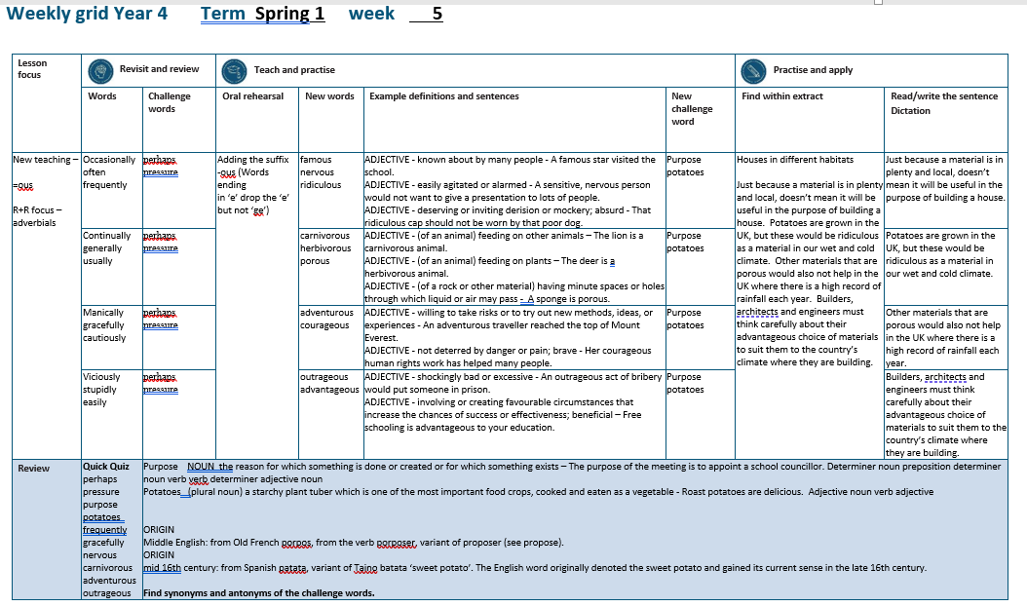

Slide 5
Let’s Revisit and Review…

Slide 6
Do you remember this challenge word?

Slide 7
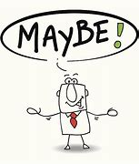
perhaps
Perhaps we should stay in as it is raining.

Slide 8
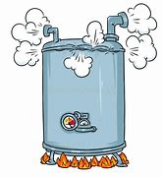
pressure
The gate was buckling under the pressure of the crowd outside.

Slide 9
Adverbials saying the how, where or when of the verb
Adverbials for frequency =
how often

Slide 10
occasionally
ADVERB
Definition - at infrequent or irregular intervals; now and then.

Slide 11
often
ADVERB
Definition - frequently; many times.

Slide 12
frequently
ADVERB
Definition - regularly or habitually; often.

Slide 13
Let’s Teach and Practise

Slide 14
Adding the suffix
-ous
Adding the suffix -ous
(words ending in ‘e’ drop the ‘e’
but not ‘ge’)

Slide 15
-ous

Slide 16

nervous

Slide 17

famous

Slide 18
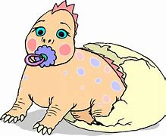
ridiculous

Slide 19
nervous
nerve (-e) + ous = nervous
ADJECTIVE
Definition - easily agitated or alarmed

Slide 20
famous
fame (-e) + ous = famous
ADJECTIVE
Definition - known about by many people

Slide 21
ridiculous
ridicule (-e) + ous = ridiculous
ADJECTIVE
Definition - deserving or inviting derision or mockery; absurd

Slide 22
A sensitive, nervous person would not want to give a presentation to lots of people.
_______

Slide 23
A famous star visited the school.
______

Slide 24
That ridiculous cap should not be worn by that poor dog.
__________

Slide 25
New CHALLENGE words.

Slide 26
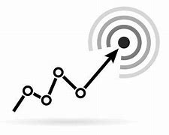
purpose
NOUN
Definition - the reason for which something is done or created or for which something

Slide 27
The purpose of the meeting is to appoint a school councillor.
_______

Slide 28
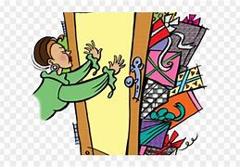
potatoes
PLURAL NOUN
Definition - a starchy plant tuber which is one of the most important food crops, cooked and eaten as a vegetable

Slide 29
Roast potatoes are delicious.
________

Slide 30
Let’s Practise and Apply.

Slide 31
Can you spot the spelling rule words and the challenge words?

Slide 32
Houses in different habitats
Just because a material is in plenty and local, doesn’t mean it will be useful in the purpose of building a house. Potatoes are grown in the UK, but these would be ridiculous as a material in our wet and cold climate. Other materials that are porous would also not help in the UK where there is a high record of rainfall each year. Builders, architects and engineers must think carefully about their advantageous choice of materials to suit them to the country’s climate where they are building.

Slide 33
Houses in different habitats
Just because a material is in plenty and local, doesn’t mean it will be useful in the purpose of building a house. Potatoes are grown in the UK, but these would be ridiculous as a material in our wet and cold climate. Other materials that are porous would also not help in the UK where there is a high record of rainfall each year. Builders, architects and engineers must think carefully about their advantageous choice of materials to suit them to the country’s climate where they are building.

Slide 34
Write this sentence as I dictate it to you.
Notes:
Just because a material is in plenty and local, doesn’t mean it will be useful in the purpose of building a house.

Slide 35
Just because a material is in plenty and local, doesn’t mean it will be useful in the purpose of building a house.
Did you write it correctly?
Edit your work and make sure you have it correct.
Can you underline the spelling word that we have covered in this session?

Slide 36
Year 4 - Spring 1
Week 5 - Tuesday
Notes:
Revisit and review the words from previous teaching and challenge words – I say, we say, you say
Ask children to write words only in their spelling book
Introduce the new spelling rule
Children to write the new spelling rule words and challenge words into books when the sentences are shown with the spelling word missing.
Read the extract with the class as choral reading. Practise model of prosody etc.
Ask children to find the spelling words from the session in the text.
Then read allowed the chosen sentence for children to write fully in their books.
Show the extract and ask children to then edit their work to check they were correct in their dictation.

Slide 38
Let’s Revisit and Review…

Slide 39
Do you remember this challenge word?

Slide 40
perhaps
Perhaps we should stay in as it is raining.

Slide 41
pressure
The gate was buckling under the pressure of the crowd outside.

Slide 42
Adverbials saying the how, where or when of the verb
Adverbials for frequency =
how often

Slide 43
continually
ADVERB
Definition - repeated frequently in the same way; regularly.

Slide 44
generally
ADVERB
Definition - in most cases; usually.

Slide 45
usually
ADVERB
Definition - under normal conditions; generally.

Slide 46
Let’s Teach and Practise

Slide 47
Adding the suffix
-ous
Adding the suffix -ous
(words ending in ‘e’ drop the ‘e’
but not ‘ge’)

Slide 48
-ous

Slide 49
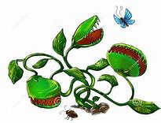
carnivorous

Slide 50
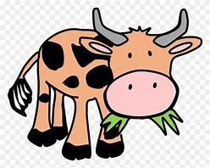
herbivorous

Slide 51
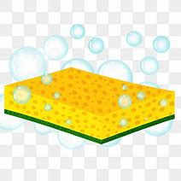
porous

Slide 52
carnivorous
carnivore (-e) + ous = carnivorous
ADJECTIVE
Definition - (of an animal) feeding on other animals

Slide 53
herbivorous
herbivore (-e) + ous = herbivorous
ADJECTIVE
Definition - (of an animal) feeding on plants

Slide 54
porous
ridicule (-e) + ous = ridiculous
ADJECTIVE
Definition - (of a rock or other material) having minute spaces or holes through which liquid or air may pass

Slide 55
The lion is a carnivorous animal.
___________

Slide 56
The deer is a herbivorous animal.
___________

Slide 57
A sponge is porous.
______.

Slide 58
New CHALLENGE words.

Slide 59
purpose
NOUN
Definition - the reason for which something is done or created or for which something

Slide 60
The purpose of the meeting is to appoint a school councillor.
_______

Slide 61
potatoes
PLURAL NOUN
Definition - a starchy plant tuber which is one of the most important food crops, cooked and eaten as a vegetable

Slide 62
Roast potatoes are delicious.
________

Slide 63
Let’s Practise and Apply.

Slide 64
Can you spot the spelling rule words and the challenge words?

Slide 65
Houses in different habitats
Just because a material is in plenty and local, doesn’t mean it will be useful in the purpose of building a house. Potatoes are grown in the UK, but these would be ridiculous as a material in our wet and cold climate. Other materials that are porous would also not help in the UK where there is a high record of rainfall each year. Builders, architects and engineers must think carefully about their advantageous choice of materials to suit them to the country’s climate where they are building.

Slide 66
Houses in different habitats
Just because a material is in plenty and local, doesn’t mean it will be useful in the purpose of building a house. Potatoes are grown in the UK, but these would be ridiculous as a material in our wet and cold climate. Other materials that are porous would also not help in the UK where there is a high record of rainfall each year. Builders, architects and engineers must think carefully about their advantageous choice of materials to suit them to the country’s climate where they are building.

Slide 67
Write this sentence as I dictate it to you.
Notes:
Potatoes are grown in the UK, but these would be ridiculous as a material in our wet and cold climate.

Slide 68
Potatoes are grown in the UK, but these would be ridiculous as a material in our wet and cold climate.
Did you write it correctly?
Edit your work and make sure you have it correct.
Can you underline the spelling word that we have covered in this session?

Slide 69
Year 4 - Spring 1
Week 5 - Wednesday

Slide 71
Let’s Revisit and Review…

Slide 72
Do you remember this challenge word?

Slide 73
perhaps
Perhaps we should stay in as it is raining.

Slide 74
pressure
The gate was buckling under the pressure of the crowd outside.

Slide 75
Adverbials saying the how, where or when of the verb
Adverbials for manner =
saying the how of the verb

Slide 76

manically
ADVERB
Definition - showing wild, apparently deranged, excitement and energy.

Slide 77

gracefully
ADVERB
Definition - in an attractively elegant way.

Slide 78
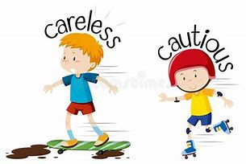
cautiously
ADVERB
Definition - in a way that deliberately avoids potential problems or dangers.

Slide 79
Let’s Teach and Practise

Slide 80
Adding the suffix
-ous
Adding the suffix -ous
(words ending in ‘e’ drop the ‘e’
but not ‘ge’)

Slide 81
-ous

Slide 82
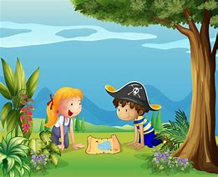
adventurous

Slide 83
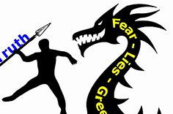
courageous

Slide 84
adventurous
adventure (-e) + ous = adventurous
ADJECTIVE
Definition - willing to take risks or to try out new methods, ideas, or experiences

Slide 85
courageous
courage (keep e) + ous = courageous
ADJECTIVE
Definition - not deterred by danger or pain; brave

Slide 86
An adventurous traveller reached the top of Mount Everest.
___________

Slide 87
Her courageous human rights work has helped many people.
__________

Slide 88
New CHALLENGE words.

Slide 89
purpose
NOUN
Definition - the reason for which something is done or created or for which something

Slide 90
The purpose of the meeting is to appoint a school councillor.
_______

Slide 91
potatoes
PLURAL NOUN
Definition - a starchy plant tuber which is one of the most important food crops, cooked and eaten as a vegetable

Slide 92
Roast potatoes are delicious.
________

Slide 93
Let’s Practise and Apply.

Slide 94
Can you spot the spelling rule words and the challenge words?

Slide 95
Houses in different habitats
Just because a material is in plenty and local, doesn’t mean it will be useful in the purpose of building a house. Potatoes are grown in the UK, but these would be ridiculous as a material in our wet and cold climate. Other materials that are porous would also not help in the UK where there is a high record of rainfall each year. Builders, architects and engineers must think carefully about their advantageous choice of materials to suit them to the country’s climate where they are building.

Slide 96
Houses in different habitats
Just because a material is in plenty and local, doesn’t mean it will be useful in the purpose of building a house. Potatoes are grown in the UK, but these would be ridiculous as a material in our wet and cold climate. Other materials that are porous would also not help in the UK where there is a high record of rainfall each year. Builders, architects and engineers must think carefully about their advantageous choice of materials to suit them to the country’s climate where they are building.

Slide 97
Write this sentence as I dictate it to you.
Notes:
Other materials that are porous would also not help in the UK where there is a high record of rainfall each year.

Slide 98
Other materials that are porous would also not help in the UK where there is a high record of rainfall each year.
Did you write it correctly?
Edit your work and make sure you have it correct.
Can you underline the spelling word that we have covered in this session?

Slide 99
Year 4 - Spring 1
Week 5 - Thursday

Slide 101
Let’s Revisit and Review…

Slide 102
Do you remember this challenge word?

Slide 103
perhaps
Perhaps we should stay in as it is raining.

Slide 104
pressure
The gate was buckling under the pressure of the crowd outside.

Slide 105
Adverbials saying the how, where or when of the verb
Adverbials for frequency =
how often

Slide 106

viciously
ADVERB
Definition - in a cruel or violent manner.

Slide 107

stupidly
ADVERB
Definition - in a way that lacks intelligence or common sense.

Slide 108
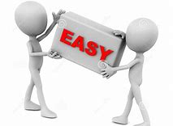
easily
ADVERB
Definition - without difficulty or effort.

Slide 109
Let’s Teach and Practise

Slide 110
Adding the suffix
-ous
Adding the suffix -ous
(words ending in ‘e’ drop the ‘e’
but not ‘ge’)

Slide 111
-ous

Slide 112

outrageous

Slide 113
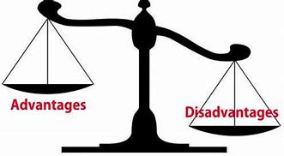
advantageous

Slide 114
outrageous
outrage (keep e) + ous = outrageous
ADJECTIVE
Definition - shockingly bad or excessive

Slide 115
advantageous
advantage (keep e) + ous = advantageous
ADJECTIVE
Definition - involving or creating favourable circumstances that increase the chances of success or effectiveness; beneficial

Slide 116
An outrageous act of bribery would put someone in prison.
__________

Slide 117
Free schooling is advantageous to your education.
___________

Slide 118
New CHALLENGE words.

Slide 119
purpose
NOUN
Definition - the reason for which something is done or created or for which something

Slide 120
The purpose of the meeting is to appoint a school councillor.
_______

Slide 121
potatoes
PLURAL NOUN
Definition - a starchy plant tuber which is one of the most important food crops, cooked and eaten as a vegetable

Slide 122
Roast potatoes are delicious.
________

Slide 123
Let’s Practise and Apply.

Slide 124
Can you spot the spelling rule words and the challenge words?

Slide 125
Houses in different habitats
Just because a material is in plenty and local, doesn’t mean it will be useful in the purpose of building a house. Potatoes are grown in the UK, but these would be ridiculous as a material in our wet and cold climate. Other materials that are porous would also not help in the UK where there is a high record of rainfall each year. Builders, architects and engineers must think carefully about their advantageous choice of materials to suit them to the country’s climate where they are building.

Slide 126
Houses in different habitats
Just because a material is in plenty and local, doesn’t mean it will be useful in the purpose of building a house. Potatoes are grown in the UK, but these would be ridiculous as a material in our wet and cold climate. Other materials that are porous would also not help in the UK where there is a high record of rainfall each year. Builders, architects and engineers must think carefully about their advantageous choice of materials to suit them to the country’s climate where they are building.

Slide 127
Write this sentence as I dictate it to you.
Notes:
Builders, architects and engineers must think carefully about their advantageous choice of materials to suit them to the country’s climate where they are building.

Slide 128
Builders, architects and engineers must think carefully about their advantageous choice of materials to suit them to the country’s climate where they are building.
Did you write it correctly?
Edit your work and make sure you have it correct.
Can you underline the spelling word that we have covered in this session?

Slide 129
Year 4 - Spring 1
Week 5 - Friday
Notes:
Click through the slides for all the R+R words for the week (both the focus and the challenge words)
Click through the slides for all the new learning this week

Slide 131
Old challenge words…

Slide 132
perhaps

Slide 133
pressure

Slide 134
Old spelling rule words…

Slide 135
occasionally

Slide 136
often

Slide 137
frequently

Slide 138
continually

Slide 139
generally

Slide 140
usually

Slide 141
manically

Slide 142
gracefully

Slide 143
cautiously

Slide 144
viciously

Slide 145
stupidly

Slide 146
easily

Slide 147
New spelling rule words…

Slide 148
famous

Slide 149
nervous

Slide 150
ridiculous

Slide 151
carnivorous

Slide 152
herbivorous

Slide 153
porous

Slide 154
adventurous

Slide 155
courageous

Slide 156
advantageous

Slide 157
New challenge words…

Slide 158
purpose

Slide 159
potatoes

Slide 160
Quick Quiz time…
Notes:
Say these words for the quiz
perhaps pressure purpose potatoes frequently gracefully nervous carnivorous adventurous outrageous

Slide 161
Did you get them correct?
Edit your work.
perhaps pressure purpose potatoes frequently gracefully nervous carnivorous adventurous outrageous

Slide 162
Word class time…

Slide 163
The purpose of the meeting is to appoint a school councillor.
Determiner noun preposition determiner noun verb verb determiner adjective noun
Notes:
Ask for these words to be classed

Slide 164
Roast potatoes are delicious.
Adjective noun verb adjective
Notes:
Ask for these words to be classed

Slide 165
Etymology
The history of a word….

Slide 166
purpose
Middle English: from Old French porpos, from the verb porposer, variant of proposer (see propose).
potatoes
mid 16th century: from Spanish patata, variant of Taino batata ‘sweet potato’. The English word originally denoted the sweet potato and gained its current sense in the late 16th century.

Slide 167
Let’s investigate….
Find synonyms and antonyms of the challenge words.

