Slide 1
Spelling Y4
Mastering spellings: building on the foundations of phonics
Spring 1
Week 6

Slide 2
Year 4 - Spring 1
Week 6 - Monday

Slide 3
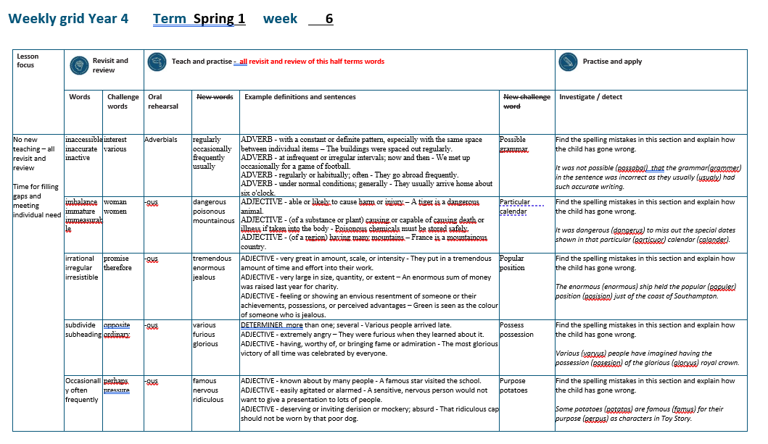

Slide 4
Let’s Revisit and Review…

Slide 5
Do you remember this challenge word?

Slide 6

interest
I thought the book might interest Eliot.
Notes:
View in slide show mode to have each aspect appear separately

Slide 7
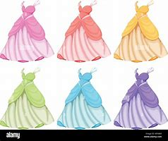
various
The dresses were of various colours.
Notes:
View in slide show mode to have each aspect appear separately

Slide 8
Do you remember the prefix
- in

Slide 9
in-
meaning ‘not’

Slide 10

inaccessible

Slide 11

inaccurate

Slide 12
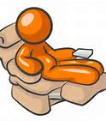
inactive

Slide 13
Let’s Teach and Practise

Slide 14
Adverbials – manner – possibility – frequency
The suffix –ly starts with a consonant letter, so it is added straight on to most root words.

Slide 15
Exceptions:
(1) If the root word ends in –y with a consonant letter before it, the y is changed to i, but only if the root word has more than one syllable.
(2) If the root word ends with –le, the
–le is changed to –ly.

Slide 16
Exceptions:
(3) If the root word ends with –ic,
–ally is added rather than just –ly,
(4) The words truly, duly, wholly

Slide 17
-ly

Slide 18
-ly changing an adjective into an adverb

Slide 19
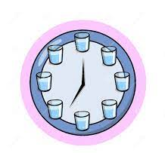
regularly

Slide 20
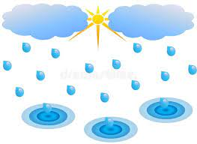
occasionally

Slide 21
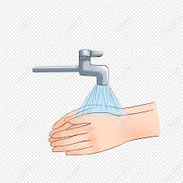
frequently

Slide 22
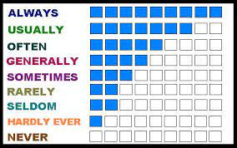
usually

Slide 23
regularly
regular + ly = regularly
ADVERB
Definition - with a constant or definite pattern, especially with the same space between individual items

Slide 24
occasionally
occasional + ly = occasionally
ADVERB
Definition - at infrequent or irregular intervals; now and then

Slide 25
frequently
frequent + ly = frequently
ADVERB
Definition - regularly or habitually; often

Slide 26
usually
usual + ly = usually
ADVERB
Definition - under normal conditions; generally

Slide 27
The buildings were spaced out regularly.
_________.

Slide 28
We met up occasionally for a game of football.
____________

Slide 29
They go abroad frequently.
__________.

Slide 30
They usually arrive home about six o'clock.
_______

Slide 31
New CHALLENGE words.

Slide 32
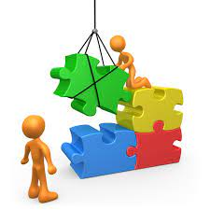
possible
ADJECTIVE
Definition - able to be done or achieved

Slide 33
Surely it is not possible for a man to live so long?
________

Slide 34
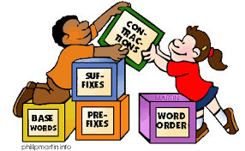
grammar
NOUN
Definition - the whole system and structure of a language or of languages in general, usually taken as consisting of syntax and morphology (including inflections) and sometimes also phonology and semantics.

Slide 35
The grammar used was accurate.
_______

Slide 36
Let’s investigate.

Slide 37
Can you spot the spelling errors in these sentences?
Write the correct spelling and explain where they went wrong.

Slide 38
It was not possabal that the grammer in the sentence was incorrect as they usualy had such accurate writing.

Slide 39
It was not possabal that the grammer in the sentence was incorrect as they usualy had such accurate writing.

Slide 40
It was not possabal that the grammer in the sentence was incorrect as they usualy had such accurate writing. possible – i not a / le not al

Slide 41
It was not possabal that the grammer in the sentence was incorrect as they usualy had such accurate writing. grammar – ar not er

Slide 42
It was not possabal that the grammer in the sentence was incorrect as they usualy had such accurate writing. usually – usual + ly

Slide 43
It was not possible that the grammar in the sentence was incorrect as they usually had such accurate writing.

Slide 44
Year 4 - Spring 1
Week 6 - Tuesday

Slide 46
Let’s Revisit and Review…

Slide 47
Do you remember this challenge word?

Slide 48

woman
The drawing of the young woman was beautiful.

Slide 49

women
The women were very excited to read the next book.

Slide 50
Do you remember the prefix
- im

Slide 51
im-
meaning ‘not’
Before a root word starting with m or p,
in– becomes im–.

Slide 52
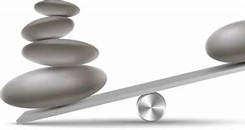
imbalance

Slide 53
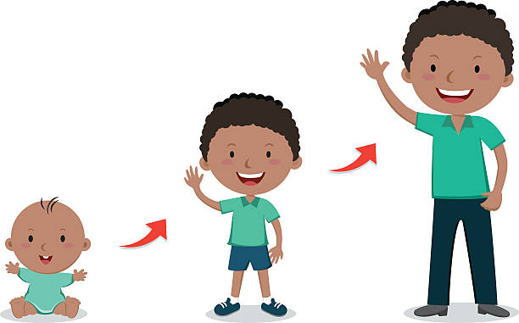
immature

Slide 54

immeasurable

Slide 55
Let’s Teach and Practise

Slide 56
-ous
(no change to root word)
Sometimes the root word is obvious and the usual rules apply for adding suffixes beginning with vowel letters.

Slide 57
Sometimes there is no obvious root word.
–our is changed to –or before –ous is added.
A final ‘e’ of the root word must be kept if the /dʒ/ sound of ‘g’ is to be kept.

Slide 58
If there is an /i:/ sound before the
–ous ending, it is usually spelt as i, but a few words have e.

Slide 59
-ous

Slide 60

dangerous

Slide 61

poisonous

Slide 62

mountainous

Slide 63
dangerous
danger + ous = dangerous
ADJECTIVE
Definition - able or likely to cause harm or injury

Slide 64
poisonous
poison + ous = poisonous
ADJECTIVE
Definition - (of a substance or plant) causing or capable of causing death or illness if taken into the body

Slide 65
mountainous
mountain + ous = mountainous
ADJECTIVE
Definition - (of a region) having many mountains

Slide 66
A tiger is a dangerous animal.
_________

Slide 67
Poisonous chemicals must be stored safely.
_________

Slide 68
France is a mountainous country.
___________

Slide 69
New CHALLENGE words.

Slide 70
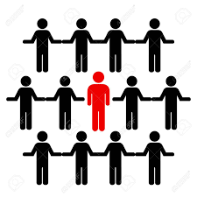
particular
ADJECTIVE
Definition - used to single out an individual member of a specified group or class

Slide 71
This particular student was gifted in music
__________

Slide 72
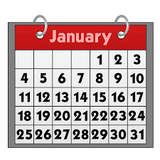
calendar
NOUN
Definition - a chart or series of pages showing the days, weeks, and months of a particular year, or giving particular seasonal information.

Slide 73
The calendar showed the special dates throughout the year.
________

Slide 74
Let’s investigate.

Slide 75
Can you spot the spelling errors in these sentences?
Write the correct spelling and explain where they went wrong.

Slide 76
It was dangerus to miss out the special dates shown in that particulor calander.

Slide 77
It was dangerus to miss out the special dates shown in that particulor calander.

Slide 78
It was dangerus to miss out the special dates shown in that particulor calander. dangerous – danger + ous

Slide 79
It was dangerus to miss out the special dates shown in that particulor calander. particular – ar not or

Slide 80
It was dangerus to miss out the special dates shown in that particulor calander. calendar – ar not er

Slide 81
It was dangerous to miss out the special dates shown in that particular calendar.

Slide 82
Year 4 - Spring 1
Week 6 - Wednesday

Slide 84
Let’s Revisit and Review…

Slide 85
Do you remember this challenge word?

Slide 86

promise
He promised to forward my mail.

Slide 87

therefore
They were injured and therefore unable to play.

Slide 88
Do you remember the prefix
- ir

Slide 89
ir- meaning ‘not’
Before a root word starting with r, in– becomes ir–.

Slide 90
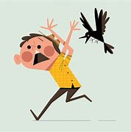
irrational

Slide 91

irregular

Slide 92
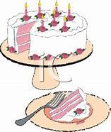
irresistible

Slide 93
Let’s Teach and Practise

Slide 94
Adding the suffix
-ous
Sometimes there is no obvious root word.

Slide 95
-ous

Slide 96

tremendous

Slide 97
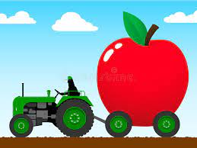
enormous

Slide 98
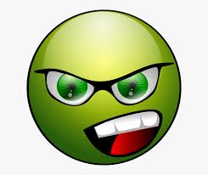
jealous

Slide 99
tremendous
ADJECTIVE
Definition - very great in amount, scale, or intensity

Slide 100
enormous
ADJECTIVE
Definition - very large in size, quantity, or extent

Slide 101
jealous
ADJECTIVE
Definition - feeling or showing an envious resentment of someone or their achievements, possessions, or perceived advantages

Slide 102
They put in a tremendous amount of time and effort into their work.
__________

Slide 103
An enormous sum of money was raised last year for charity.
________

Slide 104
Green is seen as the colour of someone who is jealous.
_______.

Slide 105
New CHALLENGE words.

Slide 106
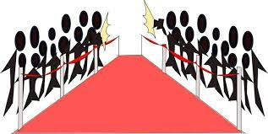
popular
ADJECTIVE
Definition - liked or admired by many people or by a particular person or group

Slide 107
She was the most popular girl in the school.
_______

Slide 108

position
NOUN
Definition - - a place where someone or something is located or has been put

Slide 109
The distress call had given the ship's position.
________.

Slide 110
Let’s investigate.

Slide 111
Can you spot the spelling errors in these sentences?
Write the correct spelling and explain where they went wrong.

Slide 112
The enormus ship held the populer position posision just of the coast of Southampton.

Slide 113
The enormus ship held the populer position posision just of the coast of Southampton.

Slide 114
The enormus ship held the populer position posision just of the coast of Southampton. enormous – ous

Slide 115
The enormus ship held the populer position posision just of the coast of Southampton. popular – ar not er

Slide 116
The enormus ship held the populer position posision just of the coast of Southampton. position – tion not sion

Slide 117
The enormous ship held the popular position just of the coast of Southampton.

Slide 118
Year 4 - Spring 1
Week 6 - Thursday

Slide 120
Let’s Revisit and Review…

Slide 121
Do you remember this challenge word?

Slide 122
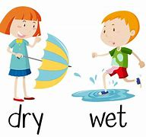
opposite
A crowd gathered on the opposite side of the street.

Slide 123
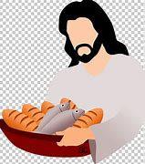
ordinary
The pictures showed ordinary people in extraordinary situations.

Slide 124
The prefix
- sub

Slide 125
sub-
meaning ‘under’
add straight to the root word

Slide 126
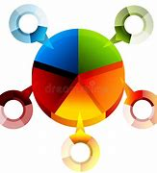
subdivide

Slide 127
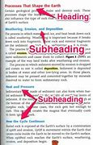
subheading

Slide 128
Let’s Teach and Practise

Slide 129
Adding the suffix
-ous
Adding the suffix -ous
(words ending in ‘y’ become ‘i’)
(words ending in ‘our’ become ‘or’)

Slide 130
-ous

Slide 131
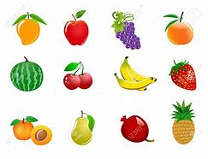
various

Slide 132
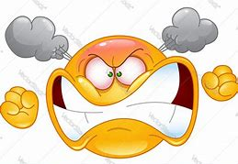
furious

Slide 133
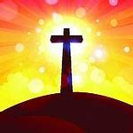
glorious

Slide 134
various
vary (-y +i) + ous = various
DETERMINER
Definition - more than one; several

Slide 135
enormous
fury (-y +i) + ous = furious
ADJECTIVE
Definition - extremely angry

Slide 136
glorious
glory (-y +i) + ous = glorious
ADJECTIVE
Definition - having, worthy of, or bringing fame or admiration

Slide 137
Various people arrived late.
_______

Slide 138
They were furious when they learned about it.
_______

Slide 139
The most glorious victory of all time was celebrated by everyone.
________

Slide 140
New CHALLENGE words.

Slide 141
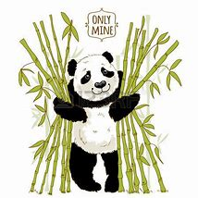
possess
VERB
Definition - have as belonging to one; own

Slide 142
I do not possess a television set.
_______

Slide 143
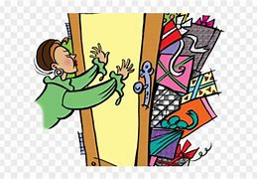
possession
NOUN
Definition - the state of having, owning, or controlling something

Slide 144
She had taken possession of the sofa.
__________

Slide 145
Let’s investigate.

Slide 146
Can you spot the spelling errors in these sentences?
Write the correct spelling and explain where they went wrong.

Slide 147
Varyus people have imagined having the posesion of the gloryus royal crown.

Slide 148
Varyus people have imagined having the posesion of the gloryus royal crown.

Slide 149
Varyus people have imagined having the posesion of the gloryus royal crown. various – vary (-y +i) + ous

Slide 150
Varyus people have imagined having the posesion of the gloryus royal crown. possession – possess + ion

Slide 151
Varyus people have imagined having the posesion of the gloryus royal crown. glorious – glory (-y +i) + ous

Slide 152
Various people have imagined having the possession of the glorious royal crown.

Slide 153
Year 4 - Spring 1
Week 6 - Friday

Slide 155
Let’s Revisit and Review…

Slide 156
Do you remember this challenge word?

Slide 157
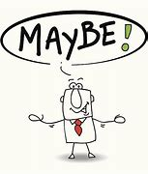
perhaps
Perhaps we should stay in as it is raining.

Slide 158
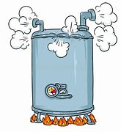
pressure
The gate was buckling under the pressure of the crowd outside.

Slide 159
Adverbials saying the how, where or when of the verb
Adverbials for frequency =
how often

Slide 160
occasionally
ADVERB
Definition - at infrequent or irregular intervals; now and then.

Slide 161
often
ADVERB
Definition - frequently; many times.

Slide 162
frequently
ADVERB
Definition - regularly or habitually; often.

Slide 163
Let’s Teach and Practise

Slide 164
Adding the suffix
-ous
Adding the suffix -ous
(words ending in ‘e’ drop the ‘e’
but not ‘ge’)

Slide 165
-ous

Slide 166

nervous

Slide 167

famous

Slide 168
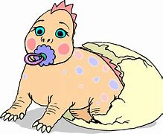
ridiculous

Slide 169
nervous
nerve (-e) + ous = nervous
ADJECTIVE
Definition - easily agitated or alarmed

Slide 170
famous
fame (-e) + ous = famous
ADJECTIVE
Definition - known about by many people

Slide 171
ridiculous
ridicule (-e) + ous = ridiculous
ADJECTIVE
Definition - deserving or inviting derision or mockery; absurd

Slide 172
A sensitive, nervous person would not want to give a presentation to lots of people.
_______

Slide 173
A famous star visited the school.
______

Slide 174
That ridiculous cap should not be worn by that poor dog.
__________

Slide 175
New CHALLENGE words.

Slide 176
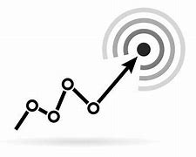
purpose
NOUN
Definition - the reason for which something is done or created or for which something

Slide 177
The purpose of the meeting is to appoint a school councillor.
_______

Slide 178
potatoes
PLURAL NOUN
Definition - a starchy plant tuber which is one of the most important food crops, cooked and eaten as a vegetable

Slide 179
Roast potatoes are delicious.
________

Slide 180
Let’s investigate.

Slide 181
Can you spot the spelling errors in these sentences?
Write the correct spelling and explain where they went wrong.

Slide 182
Some potatos are famus for their perpus as characters in Toy Story.

Slide 183
Some potatos are famus for their perpus as characters in Toy Story.

Slide 184
Some potatos are famus for their perpus as characters in Toy Story. potatoes - missing the e to make plural

Slide 185
Some potatos are famus for their perpus as characters in Toy Story. famous – rule fame – e and add ous

Slide 186
Some potatos are famus for their perpus as characters in Toy Story. purpose – ur sound and split diagraph at end

Slide 187
Some potatoes are famous for their purpose as characters in Toy Story.

