Slide 1
Spelling Y4
Mastering spellings: building on the foundations of phonics
Spring 2
Week 1

Slide 2
Year 4 - Spring 2
Week 1 - Monday

Slide 3
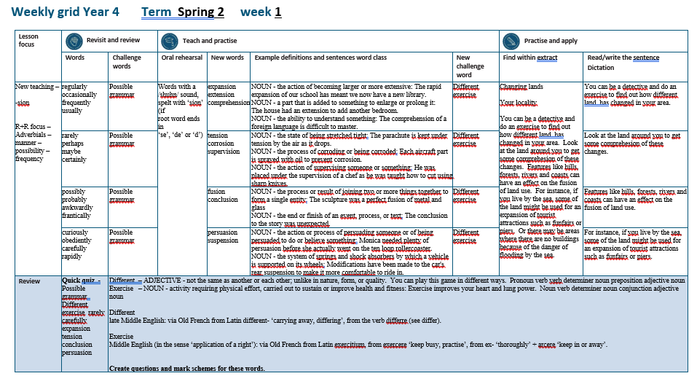

Slide 4
Let’s Revisit and Review…

Slide 5
Do you remember this challenge word?

Slide 6

possible
ADJECTIVE
Definition - able to be done or achieved

Slide 7
Surely it is not possible for a man to live so long?
________

Slide 8
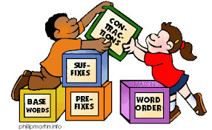
grammar
NOUN
Definition - the whole system and structure of a language or of languages in general, usually taken as consisting of syntax and morphology (including inflections) and sometimes also phonology and semantics.

Slide 9
The grammar used was accurate.
_______

Slide 10
Adverbials – manner – possibility – frequency
The suffix –ly starts with a consonant letter, so it is added straight on to most root words.

Slide 11
Exceptions:
(1) If the root word ends in –y with a consonant letter before it, the y is changed to i, but only if the root word has more than one syllable.
(2) If the root word ends with –le, the
–le is changed to –ly.

Slide 12
Exceptions:
(3) If the root word ends with –ic,
–ally is added rather than just –ly,
(4) The words truly, duly, wholly

Slide 13
-ly

Slide 14
-ly changing an adjective into an adverb

Slide 15
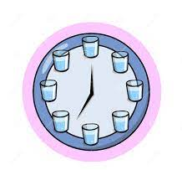
regularly

Slide 16
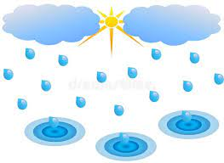
occasionally

Slide 17
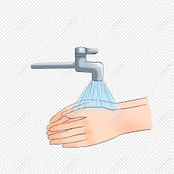
frequently

Slide 18
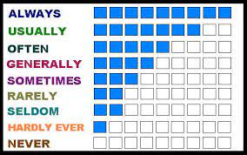
usually

Slide 19
Let’s Teach and Practise

Slide 20
Words with a
/shuhn/ sound, spelt with ‘sion’
(if root word ends in
‘se’, ‘de’ or ‘d’)

Slide 21
-sion

Slide 22

expansion

Slide 23
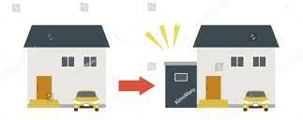
extension

Slide 24
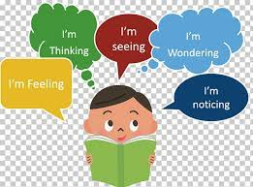
comprehension

Slide 25
expansion
expand (-d) +sion = expansion
NOUN
Definition - the action of becoming larger or more extensive

Slide 26
extension
extend (-d) +sion = extension
NOUN
Definition - a part that is added to something to enlarge or prolong it

Slide 27
comprehension
comprehend (-d) +sion = comprehension
NOUN
Definition - the ability to understand something

Slide 28
The rapid expansion of our school has meant we now have a new library.
_________

Slide 29
The house had an extension to add another bedroom.
__________

Slide 30
The comprehension of a foreign language is difficult to master.
___________

Slide 31
New CHALLENGE words.

Slide 32
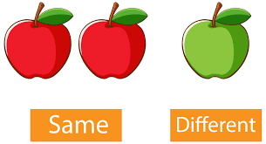
different
ADJECTIVE
Definition - not the same as another or each other; unlike in nature, form, or quality

Slide 33
You can play this game in different ways.
_________

Slide 34

exercise
NOUN
Definition - activity requiring physical effort, carried out to sustain or improve health and fitness

Slide 35
Exercise improves your heart and lung power.
________

Slide 36
Let’s Practise and Apply.

Slide 37
Can you spot the spelling rule words and the challenge words?

Slide 38
Changing lands - Your locality
You can be a detective and do an exercise to find out how different land has changed in your area. Look at the land around you to get some comprehension of these changes. Features like hills, forests, rivers and coasts can have an effect on the fusion of land use. For instance, if you live by the sea, some of the land might be used for an expansion of tourist attractions such as funfairs or piers. Or there may be areas where there are no buildings because of the danger of flooding by the sea.

Slide 39
Changing lands - Your locality
You can be a detective and do an exercise to find out how different land has changed in your area. Look at the land around you to get some comprehension of these changes. Features like hills, forests, rivers and coasts can have an effect on the fusion of land use. For instance, if you live by the sea, some of the land might be used for an expansion of tourist attractions such as funfairs or piers. Or there may be areas where there are no buildings because of the danger of flooding by the sea.

Slide 40
Write this sentence as I dictate it to you.
Notes:
You can be a detective and do an exercise to find out how different land has changed in your area.

Slide 41
You can be a detective and do an exercise to find out how different land has changed in your area.
Did you write it correctly?
Edit your work and make sure you have it correct.
Can you underline the spelling word that we have covered in this session?

Slide 42
Year 4 - Spring 2
Week 1 - Tuesday
Notes:
Revisit and review the words from previous teaching and challenge words – I say, we say, you say
Ask children to write words only in their spelling book
Introduce the new spelling rule
Children to write the new spelling rule words and challenge words into books when the sentences are shown with the spelling word missing.
Read the extract with the class as choral reading. Practise model of prosody etc.
Ask children to find the spelling words from the session in the text.
Then read allowed the chosen sentence for children to write fully in their books.
Show the extract and ask children to then edit their work to check they were correct in their dictation.

Slide 44
Let’s Revisit and Review…

Slide 45
Do you remember this challenge word?

Slide 46
possible
ADJECTIVE
Definition - able to be done or achieved

Slide 47
Surely it is not possible for a man to live so long?
________

Slide 48
grammar
NOUN
Definition - the whole system and structure of a language or of languages in general, usually taken as consisting of syntax and morphology (including inflections) and sometimes also phonology and semantics.

Slide 49
The grammar used was accurate.
_______

Slide 50
Adverbials – manner – possibility – frequency
The suffix –ly starts with a consonant letter, so it is added straight on to most root words.

Slide 51
Exceptions:
(1) If the root word ends in –y with a consonant letter before it, the y is changed to i, but only if the root word has more than one syllable.
(2) If the root word ends with –le, the
–le is changed to –ly.

Slide 52
Exceptions:
(3) If the root word ends with –ic,
–ally is added rather than just –ly,
(4) The words truly, duly, wholly

Slide 53
-ly

Slide 54
-ly changing an adjective into an adverb

Slide 55

rarely

Slide 56

perhaps

Slide 57

maybe

Slide 58
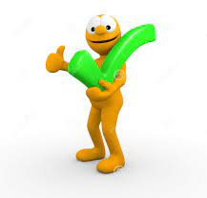
certainly

Slide 59
Let’s Teach and Practise

Slide 60
Words with a
/shuhn/ sound, spelt with ‘sion’
(if root word ends in
‘se’, ‘de’ or ‘d’)

Slide 61
-sion

Slide 62
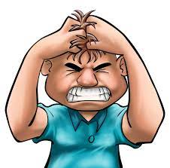
tension

Slide 63

corrosion

Slide 64

supervision

Slide 65
tension
tense (-se) +sion = tension
NOUN
Definition - the state of being stretched tight

Slide 66
corrosion
corrode (-de) +sion = corrosion
NOUN
Definition - the process of corroding or being corroded

Slide 67
supervision
supervise (-se) +sion = supervision
NOUN
Definition - the action of supervising someone or something

Slide 68
The parachute is kept under tension by the air as it drops.
_______

Slide 69
Each aircraft part is sprayed with oil to prevent corrosion.
_________

Slide 70
He was placed under the supervision of a chef as he was taught how to cut using sharp knives.
___________

Slide 71
New CHALLENGE words.

Slide 72
different
ADJECTIVE
Definition - not the same as another or each other; unlike in nature, form, or quality

Slide 73
You can play this game in different ways.
_________

Slide 74
exercise
NOUN
Definition - activity requiring physical effort, carried out to sustain or improve health and fitness

Slide 75
Exercise improves your heart and lung power.
________

Slide 76
Let’s Practise and Apply.

Slide 77
Can you spot the spelling rule words and the challenge words?

Slide 78
Changing lands - Your locality
You can be a detective and do an exercise to find out how different land has changed in your area. Look at the land around you to get some comprehension of these changes. Features like hills, forests, rivers and coasts can have an effect on the fusion of land use. For instance, if you live by the sea, some of the land might be used for an expansion of tourist attractions such as funfairs or piers. Or there may be areas where there are no buildings because of the danger of flooding by the sea.

Slide 79
Changing lands - Your locality
You can be a detective and do an exercise to find out how different land has changed in your area. Look at the land around you to get some comprehension of these changes. Features like hills, forests, rivers and coasts can have an effect on the fusion of land use. For instance, if you live by the sea, some of the land might be used for an expansion of tourist attractions such as funfairs or piers. Or there may be areas where there are no buildings because of the danger of flooding by the sea.

Slide 80
Write this sentence as I dictate it to you.
Notes:
Look at the land around you to get some comprehension of these changes.

Slide 81
Look at the land around you to get some comprehension of these changes.
Did you write it correctly?
Edit your work and make sure you have it correct.
Can you underline the spelling word that we have covered in this session?

Slide 82
Year 4 - Spring 2
Week 1 - Wednesday
Notes:
Revisit and review the words from previous teaching and challenge words – I say, we say, you say
Ask children to write words only in their spelling book
Introduce the new spelling rule
Children to write the new spelling rule words and challenge words into books when the sentences are shown with the spelling word missing.
Read the extract with the class as choral reading. Practise model of prosody etc.
Ask children to find the spelling words from the session in the text.
Then read allowed the chosen sentence for children to write fully in their books.
Show the extract and ask children to then edit their work to check they were correct in their dictation.

Slide 84
Let’s Revisit and Review…

Slide 85
Do you remember this challenge word?

Slide 86
possible
ADJECTIVE
Definition - able to be done or achieved

Slide 87
Surely it is not possible for a man to live so long?
________

Slide 88
grammar
NOUN
Definition - the whole system and structure of a language or of languages in general, usually taken as consisting of syntax and morphology (including inflections) and sometimes also phonology and semantics.

Slide 89
The grammar used was accurate.
_______

Slide 90
Adverbials – manner – possibility – frequency
The suffix –ly starts with a consonant letter, so it is added straight on to most root words.

Slide 91
Exceptions:
(1) If the root word ends in –y with a consonant letter before it, the y is changed to i, but only if the root word has more than one syllable.
(2) If the root word ends with –le, the
–le is changed to –ly.

Slide 92
Exceptions:
(3) If the root word ends with –ic,
–ally is added rather than just –ly,
(4) The words truly, duly, wholly

Slide 93
-ly

Slide 94
-ly changing an adjective into an adverb

Slide 95

possibly

Slide 96

probably

Slide 97
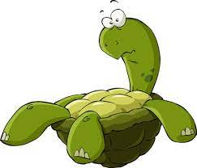
awkwardly

Slide 98

frantically

Slide 99
Let’s Teach and Practise

Slide 100
Words with a
/shuhn/ sound, spelt with ‘sion’
(if root word ends in
‘se’, ‘de’ or ‘d’)

Slide 101
-sion

Slide 102
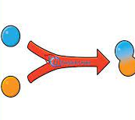
fusion

Slide 103

conclusion

Slide 104
fusion
fuse (-se) +sion = fusion
NOUN
Definition - the process or result of joining two or more things together to form a single entity

Slide 105
conclusion
conclude (-de) +sion = conclusion
NOUN
Definition - the end or finish of an event, process, or text

Slide 106
The sculpture was a perfect fusion of metal and glass
_______

Slide 107
The conclusion to the story was unexpected.
__________

Slide 108
New CHALLENGE words.

Slide 109
different
ADJECTIVE
Definition - not the same as another or each other; unlike in nature, form, or quality

Slide 110
You can play this game in different ways.
_________

Slide 111
exercise
NOUN
Definition - activity requiring physical effort, carried out to sustain or improve health and fitness

Slide 112
Exercise improves your heart and lung power.
________

Slide 113
Let’s Practise and Apply.

Slide 114
Can you spot the spelling rule words and the challenge words?

Slide 115
Changing lands - Your locality
You can be a detective and do an exercise to find out how different land has changed in your area. Look at the land around you to get some comprehension of these changes. Features like hills, forests, rivers and coasts can have an effect on the fusion of land use. For instance, if you live by the sea, some of the land might be used for an expansion of tourist attractions such as funfairs or piers. Or there may be areas where there are no buildings because of the danger of flooding by the sea.

Slide 116
Changing lands - Your locality
You can be a detective and do an exercise to find out how different land has changed in your area. Look at the land around you to get some comprehension of these changes. Features like hills, forests, rivers and coasts can have an effect on the fusion of land use. For instance, if you live by the sea, some of the land might be used for an expansion of tourist attractions such as funfairs or piers. Or there may be areas where there are no buildings because of the danger of flooding by the sea.

Slide 117
Write this sentence as I dictate it to you.
Notes:
Features like hills, forests, rivers and coasts can have an effect on the fusion of land use.

Slide 118
Features like hills, forests, rivers and coasts can have an effect on the fusion of land use.
Did you write it correctly?
Edit your work and make sure you have it correct.
Can you underline the spelling word that we have covered in this session?

Slide 119
Year 4 - Spring 2
Week 1 - Thursday
Notes:
Revisit and review the words from previous teaching and challenge words – I say, we say, you say
Ask children to write words only in their spelling book
Introduce the new spelling rule
Children to write the new spelling rule words and challenge words into books when the sentences are shown with the spelling word missing.
Read the extract with the class as choral reading. Practise model of prosody etc.
Ask children to find the spelling words from the session in the text.
Then read allowed the chosen sentence for children to write fully in their books.
Show the extract and ask children to then edit their work to check they were correct in their dictation.

Slide 121
Let’s Revisit and Review…

Slide 122
Do you remember this challenge word?

Slide 123
possible
ADJECTIVE
Definition - able to be done or achieved

Slide 124
Surely it is not possible for a man to live so long?
________

Slide 125
grammar
NOUN
Definition - the whole system and structure of a language or of languages in general, usually taken as consisting of syntax and morphology (including inflections) and sometimes also phonology and semantics.

Slide 126
The grammar used was accurate.
_______

Slide 127
Adverbials – manner – possibility – frequency
The suffix –ly starts with a consonant letter, so it is added straight on to most root words.

Slide 128
Exceptions:
(1) If the root word ends in –y with a consonant letter before it, the y is changed to i, but only if the root word has more than one syllable.
(2) If the root word ends with –le, the
–le is changed to –ly.

Slide 129
Exceptions:
(3) If the root word ends with –ic,
–ally is added rather than just –ly,
(4) The words truly, duly, wholly

Slide 130
-ly

Slide 131
-ly changing an adjective into an adverb

Slide 132

curiously

Slide 133
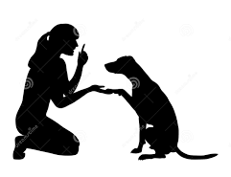
obediently

Slide 134

carefully

Slide 135
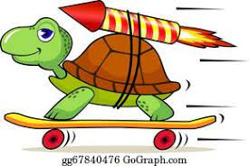
rapidly

Slide 136
Let’s Teach and Practise

Slide 137
Words with a
/shuhn/ sound, spelt with ‘sion’
(if root word ends in
‘se’, ‘de’ or ‘d’)

Slide 138
-sion

Slide 139

persuasion

Slide 140

suspension

Slide 141
persuasion
persuade (-de) +sion = persuasion
NOUN
Definition - the action or process of persuading someone or of being persuaded to do or believe something

Slide 142
suspension
extend (-d) +sion = extension
NOUN
Definition - the system of springs and shock absorbers by which a vehicle is supported on its wheels

Slide 143
Monica needed plenty of persuasion before she actually went on the ten loop rollercoaster.
__________

Slide 144
Modifications have been made to the car's rear suspension to make it more comfortable to ride in.
__________

Slide 145
New CHALLENGE words.

Slide 146
different
ADJECTIVE
Definition - not the same as another or each other; unlike in nature, form, or quality

Slide 147
You can play this game in different ways.
_________

Slide 148
exercise
NOUN
Definition - activity requiring physical effort, carried out to sustain or improve health and fitness

Slide 149
Exercise improves your heart and lung power.
________

Slide 150
Let’s Practise and Apply.

Slide 151
Can you spot the spelling rule words and the challenge words?

Slide 152
Changing lands - Your locality
You can be a detective and do an exercise to find out how different land has changed in your area. Look at the land around you to get some comprehension of these changes. Features like hills, forests, rivers and coasts can have an effect on the fusion of land use. For instance, if you live by the sea, some of the land might be used for an expansion of tourist attractions such as funfairs or piers. Or there may be areas where there are no buildings because of the danger of flooding by the sea.

Slide 153
Changing lands - Your locality
You can be a detective and do an exercise to find out how different land has changed in your area. Look at the land around you to get some comprehension of these changes. Features like hills, forests, rivers and coasts can have an effect on the fusion of land use. For instance, if you live by the sea, some of the land might be used for an expansion of tourist attractions such as funfairs or piers. Or there may be areas where there are no buildings because of the danger of flooding by the sea.

Slide 154
Write this sentence as I dictate it to you.
Notes:
For instance, if you live by the sea, some of the land might be used for an expansion of tourist attractions such as funfairs or piers.

Slide 155
For instance, if you live by the sea, some of the land might be used for an expansion of tourist attractions such as funfairs or piers.
Did you write it correctly?
Edit your work and make sure you have it correct.
Can you underline the spelling word that we have covered in this session?

Slide 156
Year 4 - Spring 2
Week 1 - Friday
Notes:
Click through the slides for all the R+R words for the week (both the focus and the challenge words)
Click through the slides for all the new learning this week

Slide 158
Old challenge words…

Slide 159
possible

Slide 160
grammar

Slide 161
Old spelling rule words…

Slide 162
regularly

Slide 163
occasionally

Slide 164
frequently

Slide 165
usually

Slide 166
rarely

Slide 167
perhaps

Slide 168
maybe

Slide 169
certainly

Slide 170
possibly

Slide 171
probably

Slide 172
awkwardly

Slide 173
frantically

Slide 174
curiously

Slide 175
obediently

Slide 176
carefully

Slide 177
rapidly

Slide 178
New spelling rule words…

Slide 179
expansion

Slide 180
extension

Slide 181
comprehension

Slide 182
tension

Slide 183
corrosion

Slide 184
supervision

Slide 185
fusion

Slide 186
conclusion

Slide 187
persuasion

Slide 188
suspension

Slide 189
New challenge words…

Slide 190
different

Slide 191
exercise

Slide 192
Quick Quiz time…
Notes:
Say these words for the quiz
Possible grammar Different exercise rarely carefully expansion tension conclusion persuasion

Slide 193
Did you get them correct?
Edit your work.
possible grammar different exercise rarely carefully expansion tension conclusion persuasion

Slide 194
Word class time…

Slide 195
You can play this game in different ways.
Pronoun verb verb determiner noun preposition adjective noun
Notes:
Ask for these words to be classed

Slide 196
Exercise improves your heart and lung power.
Noun verb determiner noun conjunction adjective noun
Notes:
Ask for these words to be classed

Slide 197
Etymology
The history of a word….

Slide 198
Different
late Middle English: via Old French from Latin different- ‘carrying away, differing’, from the verb differre (see differ).
Exercise
Middle English (in the sense ‘application of a right’): via Old French from Latin exercitium, from exercere ‘keep busy, practise’, from ex- ‘thoroughly’ + arcere ‘keep in or away’.

Slide 199
Let’s investigate….
Create questions and mark schemes for these words.

