Slide 1
Spelling Y4
Mastering spellings: building on the foundations of phonics
Spring 2
Week 2

Slide 2
Year 4 - Spring 2
Week 2 - Monday

Slide 3
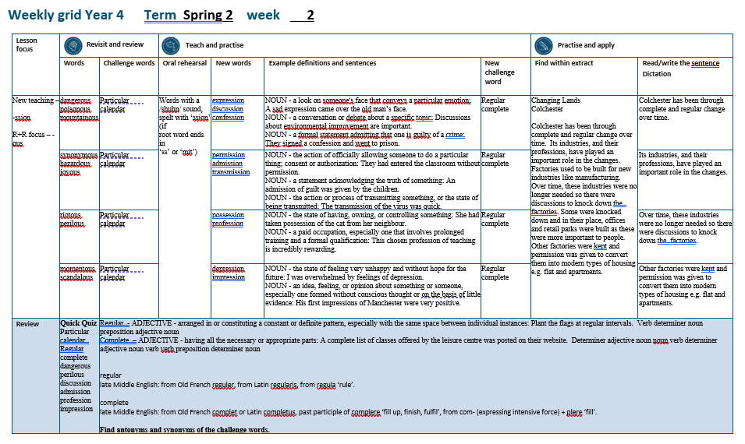

Slide 4
Let’s Revisit and Review…

Slide 5
Do you remember this challenge word?

Slide 6

particular
ADJECTIVE
Definition - used to single out an individual member of a specified group or class

Slide 7
This particular student was gifted in music
__________

Slide 8

calendar
NOUN
Definition - a chart or series of pages showing the days, weeks, and months of a particular year, or giving particular seasonal information.

Slide 9
The calendar showed the special dates throughout the year.
________

Slide 10
-ous
(no change to root word)
Sometimes the root word is obvious and the usual rules apply for adding suffixes beginning with vowel letters.

Slide 11
Sometimes there is no obvious root word.
–our is changed to –or before –ous is added.
A final ‘e’ of the root word must be kept if the /dʒ/ sound of ‘g’ is to be kept.

Slide 12
If there is an /i:/ sound before the
–ous ending, it is usually spelt as i, but a few words have e.

Slide 13
-ous

Slide 14

dangerous

Slide 15

poisonous

Slide 16

mountainous

Slide 17
Let’s Teach and Practise

Slide 18
Words with a
/shuhn/ sound, spelt with ‘ssion’
(if root word ends in
‘ss’ or ‘mit’

Slide 19
-ssion

Slide 20

expression

Slide 21

discussion

Slide 22
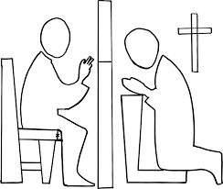
confession

Slide 23
expression
express (-ss) +ssion = expression
NOUN
Definition - a look on someone's face that conveys a particular emotion

Slide 24
discussion
discuss (-ss) +ssion = discussion
NOUN
Definition - a conversation or debate about a specific topic

Slide 25
confession
confess (-ss) +ssion = confession
NOUN
Definition - a formal statement admitting that one is guilty of a crime or sin

Slide 26
A sad expression came over the old man’s face.
__________

Slide 27
Discussions about environmental improvement are important.
____________

Slide 28
They signed a confession and went to prison.
__________

Slide 29
New CHALLENGE words.

Slide 30
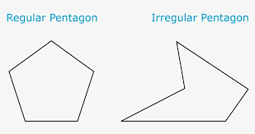
regular
ADJECTIVE
Definition - arranged in or constituting a constant or definite pattern, especially with the same space between individual instances

Slide 31
Plant the flags at regular intervals.
_______

Slide 32

complete
ADJECTIVE
Definition - having all the necessary or appropriate parts

Slide 33
A complete list of classes offered by the leisure centre was posted on their website.
________

Slide 34
Let’s Practise and Apply.

Slide 35
Can you spot the spelling rule words and the challenge words?

Slide 36
Changing Lands - Colchester
Colchester has been through complete and regular change over time. Its industries, and their professions, have played an important role in the changes. Factories used to be built for new industries like manufacturing. Over time, these industries were no longer needed so there were discussions to knock down the factories. Some were knocked down and in their place, offices and retail parks were built as these were more important to people. Other factories were kept and permission was given to convert them into modern types of housing e.g. flat and apartments.

Slide 37
Changing Lands - Colchester
Colchester has been through complete and regular change over time. Its industries, and their professions, have played an important role in the changes. Factories used to be built for new industries like manufacturing. Over time, these industries were no longer needed so there were discussions to knock down the factories. Some were knocked down and in their place, offices and retail parks were built as these were more important to people. Other factories were kept and permission was given to convert them into modern types of housing e.g. flat and apartments.

Slide 38
Write this sentence as I dictate it to you.
Notes:
Colchester has been through complete and regular change over time.

Slide 39
Colchester has been through complete and regular change over time.
Did you write it correctly?
Edit your work and make sure you have it correct.
Can you underline the spelling word that we have covered in this session?

Slide 40
Year 4 - Spring 2
Week 2 - Tuesday
Notes:
Revisit and review the words from previous teaching and challenge words – I say, we say, you say
Ask children to write words only in their spelling book
Introduce the new spelling rule
Children to write the new spelling rule words and challenge words into books when the sentences are shown with the spelling word missing.
Read the extract with the class as choral reading. Practise model of prosody etc.
Ask children to find the spelling words from the session in the text.
Then read allowed the chosen sentence for children to write fully in their books.
Show the extract and ask children to then edit their work to check they were correct in their dictation.

Slide 42
Let’s Revisit and Review…

Slide 43
Do you remember this challenge word?

Slide 44
particular
ADJECTIVE
Definition - used to single out an individual member of a specified group or class

Slide 45
This particular student was gifted in music
__________

Slide 46
calendar
NOUN
Definition - a chart or series of pages showing the days, weeks, and months of a particular year, or giving particular seasonal information.

Slide 47
The calendar showed the special dates throughout the year.
________

Slide 48
-ous
(no change to root word)
Sometimes the root word is obvious and the usual rules apply for adding suffixes beginning with vowel letters.

Slide 49
Sometimes there is no obvious root word.
–our is changed to –or before –ous is added.
A final ‘e’ of the root word must be kept if the /dʒ/ sound of ‘g’ is to be kept.

Slide 50
If there is an /i:/ sound before the
–ous ending, it is usually spelt as i, but a few words have e.

Slide 51
-ous

Slide 52
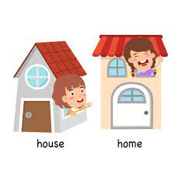
synonymous

Slide 53

hazardous

Slide 54

joyous

Slide 55
Let’s Teach and Practise

Slide 56
Words with a
/shuhn/ sound, spelt with ‘ssion’
(if root word ends in
‘ss’ or ‘mit’

Slide 57
-ssion

Slide 58

permission

Slide 59

admission

Slide 60

transmission

Slide 61
permission
permit (-t) +ssion = permission
NOUN
Definition - the action of officially allowing someone to do a particular thing; consent or authorisation

Slide 62
admission
admit (-t) +ssion = admission
NOUN
Definition - a statement acknowledging the truth of something or access into somewhere

Slide 63
transmission
transmit (-t) +ssion = transmission
NOUN
Definition - the action or process of transmitting something, or the state of being transmitted

Slide 64
They had entered the classroom without permission.
__________

Slide 65
An admission of guilt was given by the children.
_________

Slide 66
The transmission of the virus was quick.
____________

Slide 67
New CHALLENGE words.

Slide 68
regular
ADJECTIVE
Definition - arranged in or constituting a constant or definite pattern, especially with the same space between individual instances

Slide 69
Plant the flags at regular intervals.
_______

Slide 70
complete
ADJECTIVE
Definition - having all the necessary or appropriate parts

Slide 71
A complete list of classes offered by the leisure centre was posted on their website.
________

Slide 72
Let’s Practise and Apply.

Slide 73
Can you spot the spelling rule words and the challenge words?

Slide 74
Changing Lands - Colchester
Colchester has been through complete and regular change over time. Its industries, and their professions, have played an important role in the changes. Factories used to be built for new industries like manufacturing. Over time, these industries were no longer needed so there were discussions to knock down the factories. Some were knocked down and in their place, offices and retail parks were built as these were more important to people. Other factories were kept and permission was given to convert them into modern types of housing e.g. flat and apartments.

Slide 75
Changing Lands - Colchester
Colchester has been through complete and regular change over time. Its industries, and their professions, have played an important role in the changes. Factories used to be built for new industries like manufacturing. Over time, these industries were no longer needed so there were discussions to knock down the factories. Some were knocked down and in their place, offices and retail parks were built as these were more important to people. Other factories were kept and permission was given to convert them into modern types of housing e.g. flat and apartments.

Slide 76
Write this sentence as I dictate it to you.
Notes:
Its industries, and their professions, have played an important role in the changes

Slide 77
Its industries, and their professions, have played an important role in the changes.
Did you write it correctly?
Edit your work and make sure you have it correct.
Can you underline the spelling word that we have covered in this session?

Slide 78
Year 4 - Spring 2
Week 2 - Wednesday
Notes:
Revisit and review the words from previous teaching and challenge words – I say, we say, you say
Ask children to write words only in their spelling book
Introduce the new spelling rule
Children to write the new spelling rule words and challenge words into books when the sentences are shown with the spelling word missing.
Read the extract with the class as choral reading. Practise model of prosody etc.
Ask children to find the spelling words from the session in the text.
Then read allowed the chosen sentence for children to write fully in their books.
Show the extract and ask children to then edit their work to check they were correct in their dictation.

Slide 80
Let’s Revisit and Review…

Slide 81
Do you remember this challenge word?

Slide 82
particular
ADJECTIVE
Definition - used to single out an individual member of a specified group or class

Slide 83
This particular student was gifted in music
__________

Slide 84
calendar
NOUN
Definition - a chart or series of pages showing the days, weeks, and months of a particular year, or giving particular seasonal information.

Slide 85
The calendar showed the special dates throughout the year.
________

Slide 86
-ous
(no change to root word)
Sometimes the root word is obvious and the usual rules apply for adding suffixes beginning with vowel letters.

Slide 87
Sometimes there is no obvious root word.
–our is changed to –or before –ous is added.
A final ‘e’ of the root word must be kept if the /dʒ/ sound of ‘g’ is to be kept.

Slide 88
If there is an /i:/ sound before the
–ous ending, it is usually spelt as i, but a few words have e.

Slide 89
-ous

Slide 90
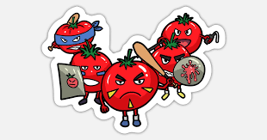
riotous

Slide 91
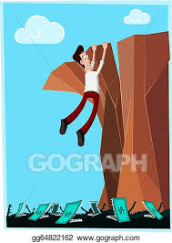
perilous

Slide 92
Let’s Teach and Practise

Slide 93
Words with a
/shuhn/ sound, spelt with ‘ssion’
(if root word ends in
‘ss’ or ‘mit’

Slide 94
-ssion

Slide 95

possession

Slide 96
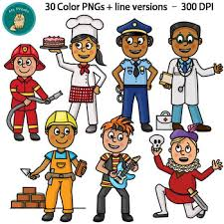
profession

Slide 97
possession
possess (-ss) +ssion = possession
NOUN
Definition - the state of having, owning, or controlling something

Slide 98
profession
profess (-ss) +ssion = profession
NOUN
Definition - a paid occupation, especially one that involves prolonged training and a formal qualification

Slide 99
She had taken possession of the cat from her neighbour.
__________

Slide 100
This chosen profession of teaching is incredibly rewarding.
__________

Slide 101
New CHALLENGE words.

Slide 102
regular
ADJECTIVE
Definition - arranged in or constituting a constant or definite pattern, especially with the same space between individual instances

Slide 103
Plant the flags at regular intervals.
_______

Slide 104
complete
ADJECTIVE
Definition - having all the necessary or appropriate parts

Slide 105
A complete list of classes offered by the leisure centre was posted on their website.
________

Slide 106
Let’s Practise and Apply.

Slide 107
Can you spot the spelling rule words and the challenge words?

Slide 108
Changing Lands - Colchester
Colchester has been through complete and regular change over time. Its industries, and their professions, have played an important role in the changes. Factories used to be built for new industries like manufacturing. Over time, these industries were no longer needed so there were discussions to knock down the factories. Some were knocked down and in their place, offices and retail parks were built as these were more important to people. Other factories were kept and permission was given to convert them into modern types of housing e.g. flat and apartments.

Slide 109
Changing Lands - Colchester
Colchester has been through complete and regular change over time. Its industries, and their professions, have played an important role in the changes. Factories used to be built for new industries like manufacturing. Over time, these industries were no longer needed so there were discussions to knock down the factories. Some were knocked down and in their place, offices and retail parks were built as these were more important to people. Other factories were kept and permission was given to convert them into modern types of housing e.g. flat and apartments.

Slide 110
Write this sentence as I dictate it to you.
Notes:
Over time, these industries were no longer needed so there were discussions to knock down the factories.

Slide 111
Over time, these industries were no longer needed so there were discussions to knock down the factories.
Did you write it correctly?
Edit your work and make sure you have it correct.
Can you underline the spelling word that we have covered in this session?

Slide 112
Year 4 - Spring 2
Week 2 - Thursday
Notes:
Revisit and review the words from previous teaching and challenge words – I say, we say, you say
Ask children to write words only in their spelling book
Introduce the new spelling rule
Children to write the new spelling rule words and challenge words into books when the sentences are shown with the spelling word missing.
Read the extract with the class as choral reading. Practise model of prosody etc.
Ask children to find the spelling words from the session in the text.
Then read allowed the chosen sentence for children to write fully in their books.
Show the extract and ask children to then edit their work to check they were correct in their dictation.

Slide 114
Let’s Revisit and Review…

Slide 115
Do you remember this challenge word?

Slide 116
particular
ADJECTIVE
Definition - used to single out an individual member of a specified group or class

Slide 117
This particular student was gifted in music
__________

Slide 118
calendar
NOUN
Definition - a chart or series of pages showing the days, weeks, and months of a particular year, or giving particular seasonal information.

Slide 119
The calendar showed the special dates throughout the year.
________

Slide 120
-ous
(no change to root word)
Sometimes the root word is obvious and the usual rules apply for adding suffixes beginning with vowel letters.

Slide 121
Sometimes there is no obvious root word.
–our is changed to –or before –ous is added.
A final ‘e’ of the root word must be kept if the /dʒ/ sound of ‘g’ is to be kept.

Slide 122
If there is an /i:/ sound before the
–ous ending, it is usually spelt as i, but a few words have e.

Slide 123
-ous

Slide 124

momentous

Slide 125
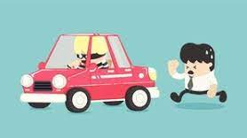
scandalous

Slide 126
Let’s Teach and Practise

Slide 127
Words with a
/shuhn/ sound, spelt with ‘ssion’
(if root word ends in
‘ss’ or ‘mit’

Slide 128
-ssion

Slide 129

depression

Slide 130

impression

Slide 131
depression
depress (-ss) +ssion = depression
NOUN
Definition - the state of feeling very unhappy and without hope for the future

Slide 132
impression
impress (-ss) +ssion = impression
NOUN
Definition - an idea, feeling, or opinion about something or someone, especially one formed without conscious thought or on the basis of little evidence

Slide 133
I was overwhelmed by feelings of depression.
__________

Slide 134
His first impressions of Manchester were very positive.
___________

Slide 135
New CHALLENGE words.

Slide 136
regular
ADJECTIVE
Definition - arranged in or constituting a constant or definite pattern, especially with the same space between individual instances

Slide 137
Plant the flags at regular intervals.
_______

Slide 138
complete
ADJECTIVE
Definition - having all the necessary or appropriate parts

Slide 139
A complete list of classes offered by the leisure centre was posted on their website.
________

Slide 140
Let’s Practise and Apply.

Slide 141
Can you spot the spelling rule words and the challenge words?

Slide 142
Changing Lands - Colchester
Colchester has been through complete and regular change over time. Its industries, and their professions, have played an important role in the changes. Factories used to be built for new industries like manufacturing. Over time, these industries were no longer needed so there were discussions to knock down the factories. Some were knocked down and in their place, offices and retail parks were built as these were more important to people. Other factories were kept and permission was given to convert them into modern types of housing e.g. flat and apartments.

Slide 143
Changing Lands - Colchester
Colchester has been through complete and regular change over time. Its industries, and their professions, have played an important role in the changes. Factories used to be built for new industries like manufacturing. Over time, these industries were no longer needed so there were discussions to knock down the factories. Some were knocked down and in their place, offices and retail parks were built as these were more important to people. Other factories were kept and permission was given to convert them into modern types of housing e.g. flat and apartments.

Slide 144
Write this sentence as I dictate it to you.
Notes:
Other factories were kept and permission was given to convert them into modern types of housing e.g. flat and apartments.

Slide 145
Other factories were kept and permission was given to convert them into modern types of housing e.g. flat and apartments.
Did you write it correctly?
Edit your work and make sure you have it correct.
Can you underline the spelling word that we have covered in this session?

Slide 146
Year 4 - Spring 2
Week 2 - Friday
Notes:
Click through the slides for all the R+R words for the week (both the focus and the challenge words)
Click through the slides for all the new learning this week

Slide 147
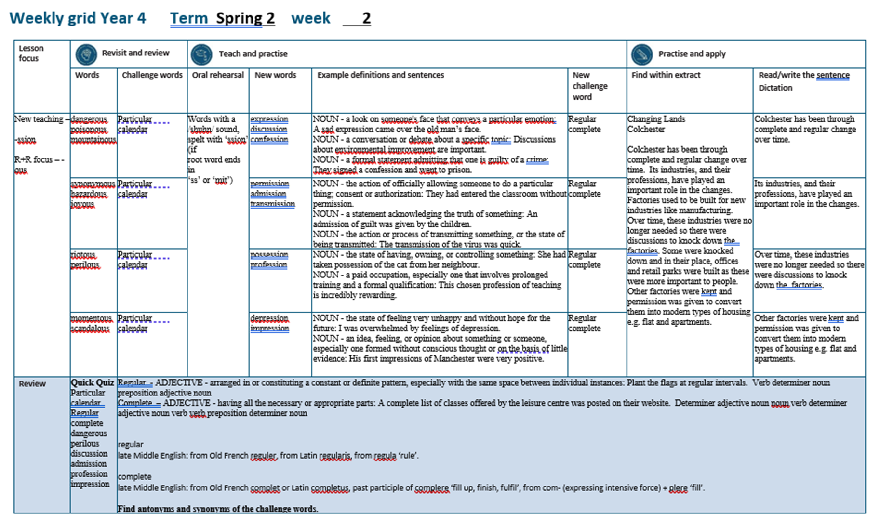

Slide 148
Old challenge words…

Slide 149
particular

Slide 150
calendar

Slide 151
Old spelling rule words…

Slide 152
dangerous

Slide 153
poisonous

Slide 154
mountainous

Slide 155
synonymous

Slide 156
hazardous

Slide 157
joyous

Slide 158
riotous

Slide 159
perilous

Slide 160
momentous

Slide 161
scandalous

Slide 162
New spelling rule words…

Slide 163
expression

Slide 164
discussion

Slide 165
confession

Slide 166
permission

Slide 167
admission

Slide 168
transmission

Slide 169
possession

Slide 170
profession

Slide 171
depression

Slide 172
impression

Slide 173
New challenge words…

Slide 174
regular

Slide 175
complete

Slide 176
Quick Quiz time…
Notes:
Say these words for the quiz
particular calendar Regular complete dangerous perilous discussion admission profession impression

Slide 177
Did you get them correct?
Edit your work.
particular calendar regular complete dangerous perilous discussion admission profession impression

Slide 178
Word class time…

Slide 179
Plant the flags at regular intervals.
Verb determiner noun preposition adjective noun
Notes:
Ask for these words to be classed

Slide 180
A complete list of classes offered by the leisure centre was posted on their website.
Determiner adjective noun noun verb determiner adjective noun verb verb preposition determiner noun
Notes:
Ask for these words to be classed

Slide 181
Etymology
The history of a word….

Slide 182
Regular
Late Middle English: from Old French reguler, from Latin regularis, from regula ‘rule’.
Complete
Late Middle English: from Old French complet or Latin completus, past participle of complere ‘fill up, finish, fulfil’, from com- (expressing intensive force) + plere ‘fill’.

Slide 183
Let’s investigate….
Find antonyms and synonyms of the challenge words.

