Slide 1
Spelling Y4
Mastering spellings: building on the foundations of phonics
Spring 2
Week 3

Slide 2
Year 4 - Spring 2
Week 3 - Monday

Slide 3
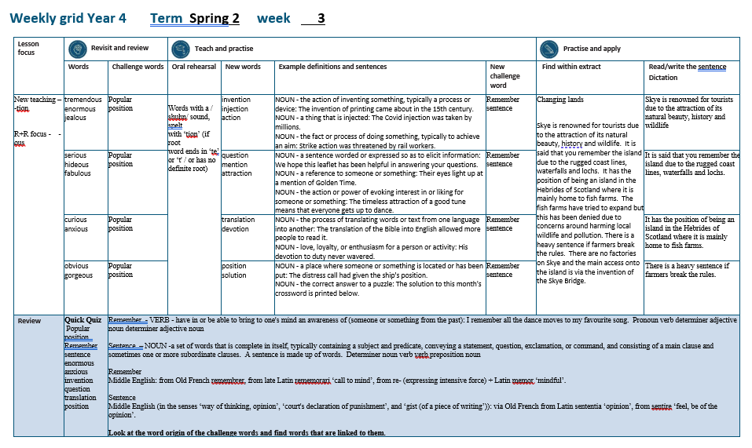

Slide 4
Let’s Revisit and Review…

Slide 5
Do you remember this challenge word?

Slide 6

popular
ADJECTIVE
Definition - liked or admired by many people or by a particular person or group

Slide 7
She was the most popular girl in the school.
_______

Slide 8

position
NOUN
Definition - - a place where someone or something is located or has been put

Slide 9
The distress call had given the ship's position.
________.

Slide 10
Adding the suffix
-ous
Sometimes there is no obvious root word.

Slide 11
-ous

Slide 12

tremendous

Slide 13
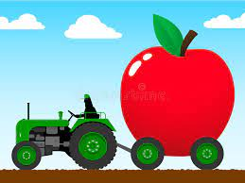
enormous

Slide 14

jealous

Slide 15
Let’s Teach and Practise

Slide 16
Words with a
/shuhn/ sound, spelt with ‘tion’
(if root word ends in
‘te’ or ‘t’ or has no definite root)

Slide 17
-tion

Slide 18

invention

Slide 19

injection

Slide 20

action

Slide 21
invention
invent (-t) +tion = invention
NOUN
Definition - the action of inventing something, typically a process or device

Slide 22
injection
inject (-t) +tion = injection
NOUN
Definition - a thing that is injected

Slide 23
action
act (-t) +tion = action
NOUN
Definition - the fact or process of doing something, typically to achieve an aim

Slide 24
The invention of printing came about in the 15th century.
_________

Slide 25
The Covid injection was taken by millions.
_________

Slide 26
Strike action was threatened by rail workers.
______

Slide 27
New CHALLENGE words.

Slide 28

remember
VERB
Definition - have in or be able to bring to one's mind an awareness of (someone or something from the past)

Slide 29
I remember all the dance moves to my favourite song.
________

Slide 30

sentence
NOUN
Definition - a set of words that is complete in itself, typically containing a subject and predicate, conveying a statement, question, exclamation, or command, and consisting of a main clause and sometimes one or more subordinate clauses.

Slide 31
A sentence is made up of words.
________

Slide 32
Let’s Practise and Apply.

Slide 33
Can you spot the spelling rule words and the challenge words?

Slide 34
Changing lands
Skye is renowned for tourists due to the attraction of its natural beauty, history and wildlife. It is said that you remember the island due to the rugged coast lines, waterfalls and lochs. It has the position of being an island in the Hebrides of Scotland where it is mainly home to fish farms. The fish farms have tried to expand but this has been denied due to concerns around harming local wildlife and pollution. There is a heavy sentence if farmers break the rules. There are no factories on Skye and the main access onto the island is via the invention of the Skye Bridge.

Slide 35
Changing lands
Skye is renowned for tourists due to the attraction of its natural beauty, history and wildlife. It is said that you remember the island due to the rugged coast lines, waterfalls and lochs. It has the position of being an island in the Hebrides of Scotland where it is mainly home to fish farms. The fish farms have tried to expand but this has been denied due to concerns around harming local wildlife and pollution. There is a heavy sentence if farmers break the rules. There are no factories on Skye and the main access onto the island is via the invention of the Skye Bridge.

Slide 36
Write this sentence as I dictate it to you.
Notes:
Skye is renowned for tourists due to the attraction of its natural beauty, history and wildlife

Slide 37
Skye is renowned for tourists due to the attraction of its natural beauty, history and wildlife.
Did you write it correctly?
Edit your work and make sure you have it correct.
Can you underline the spelling word that we have covered in this session?

Slide 38
Year 4 - Spring 2
Week 3 - Tuesday
Notes:
Revisit and review the words from previous teaching and challenge words – I say, we say, you say
Ask children to write words only in their spelling book
Introduce the new spelling rule
Children to write the new spelling rule words and challenge words into books when the sentences are shown with the spelling word missing.
Read the extract with the class as choral reading. Practise model of prosody etc.
Ask children to find the spelling words from the session in the text.
Then read allowed the chosen sentence for children to write fully in their books.
Show the extract and ask children to then edit their work to check they were correct in their dictation.

Slide 40
Let’s Revisit and Review…

Slide 41
Do you remember this challenge word?

Slide 42
popular
ADJECTIVE
Definition - liked or admired by many people or by a particular person or group

Slide 43
She was the most popular girl in the school.
_______

Slide 44
position
NOUN
Definition - - a place where someone or something is located or has been put

Slide 45
The distress call had given the ship's position.
________.

Slide 46
Adding the suffix
-ous
Sometimes there is no obvious root word.

Slide 47
-ous

Slide 48

serious

Slide 49
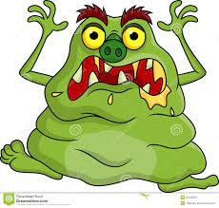
hideous

Slide 50
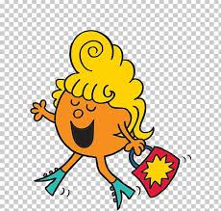
fabulous

Slide 51
Let’s Teach and Practise

Slide 52
Words with a
/shuhn/ sound, spelt with ‘tion’
(if root word ends in
‘te’ or ‘t’ or has no definite root)

Slide 53
-tion

Slide 54

question

Slide 55

mention

Slide 56

attraction

Slide 57
question
quest (-t) +tion = question
NOUN
Definition - a sentence worded or expressed so as to elicit information

Slide 58
mention
NOUN
Definition - a reference to someone or something

Slide 59
attraction
attract (-t) +tion = attraction
NOUN
Definition - the action or power of evoking interest in or liking for someone or something

Slide 60
We hope this leaflet has been helpful in answering your questions.
_________

Slide 61
Their eyes light up at a mention of Golden Time.
_______

Slide 62
The timeless attraction of a good tune means that everyone gets up to dance.
__________

Slide 63
New CHALLENGE words.

Slide 64
remember
VERB
Definition - have in or be able to bring to one's mind an awareness of (someone or something from the past)

Slide 65
I remember all the dance moves to my favourite song.
________

Slide 66
sentence
NOUN
Definition - a set of words that is complete in itself, typically containing a subject and predicate, conveying a statement, question, exclamation, or command, and consisting of a main clause and sometimes one or more subordinate clauses.

Slide 67
A sentence is made up of words.
________

Slide 68
Let’s Practise and Apply.

Slide 69
Can you spot the spelling rule words and the challenge words?

Slide 70
Changing lands
Skye is renowned for tourists due to the attraction of its natural beauty, history and wildlife. It is said that you remember the island due to the rugged coast lines, waterfalls and lochs. It has the position of being an island in the Hebrides of Scotland where it is mainly home to fish farms. The fish farms have tried to expand but this has been denied due to concerns around harming local wildlife and pollution. There is a heavy sentence if farmers break the rules. There are no factories on Skye and the main access onto the island is via the invention of the Skye Bridge.

Slide 71
Changing lands
Skye is renowned for tourists due to the attraction of its natural beauty, history and wildlife. It is said that you remember the island due to the rugged coast lines, waterfalls and lochs. It has the position of being an island in the Hebrides of Scotland where it is mainly home to fish farms. The fish farms have tried to expand but this has been denied due to concerns around harming local wildlife and pollution. There is a heavy sentence if farmers break the rules. There are no factories on Skye and the main access onto the island is via the invention of the Skye Bridge.

Slide 72
Write this sentence as I dictate it to you.
Notes:
It is said that you remember the island due to the rugged coast lines, waterfalls and lochs.

Slide 73
It is said that you remember the island due to the rugged coast lines, waterfalls and lochs.
Did you write it correctly?
Edit your work and make sure you have it correct.
Can you underline the spelling word that we have covered in this session?

Slide 74
Year 4 - Spring 2
Week 3 - Wednesday
Notes:
Revisit and review the words from previous teaching and challenge words – I say, we say, you say
Ask children to write words only in their spelling book
Introduce the new spelling rule
Children to write the new spelling rule words and challenge words into books when the sentences are shown with the spelling word missing.
Read the extract with the class as choral reading. Practise model of prosody etc.
Ask children to find the spelling words from the session in the text.
Then read allowed the chosen sentence for children to write fully in their books.
Show the extract and ask children to then edit their work to check they were correct in their dictation.

Slide 76
Let’s Revisit and Review…

Slide 77
Do you remember this challenge word?

Slide 78
popular
ADJECTIVE
Definition - liked or admired by many people or by a particular person or group

Slide 79
She was the most popular girl in the school.
_______

Slide 80
position
NOUN
Definition - - a place where someone or something is located or has been put

Slide 81
The distress call had given the ship's position.
________.

Slide 82
Adding the suffix
-ous
Sometimes there is no obvious root word.

Slide 83
-ous

Slide 84
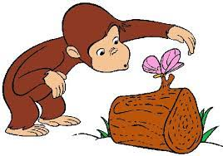
curious

Slide 85

anxious

Slide 86
Let’s Teach and Practise

Slide 87
Words with a
/shuhn/ sound, spelt with ‘tion’
(if root word ends in
‘te’ or ‘t’ or has no definite root)

Slide 88
-tion

Slide 89

translation

Slide 90

devotion

Slide 91
translation
translate (-te) +tion = translation
NOUN
Definition - the process of translating words or text from one language into another

Slide 92
devotion
devote (-te) +tion = devotion
NOUN
Definition - love, loyalty, or enthusiasm for a person or activity

Slide 93
The translation of the Bible into English allowed more people to read it.
___________

Slide 94
His devotion to duty never wavered.
________

Slide 95
New CHALLENGE words.

Slide 96
remember
VERB
Definition - have in or be able to bring to one's mind an awareness of (someone or something from the past)

Slide 97
I remember all the dance moves to my favourite song.
________

Slide 98
sentence
NOUN
Definition - a set of words that is complete in itself, typically containing a subject and predicate, conveying a statement, question, exclamation, or command, and consisting of a main clause and sometimes one or more subordinate clauses.

Slide 99
A sentence is made up of words.
________

Slide 100
Let’s Practise and Apply.

Slide 101
Can you spot the spelling rule words and the challenge words?

Slide 102
Changing lands
Skye is renowned for tourists due to the attraction of its natural beauty, history and wildlife. It is said that you remember the island due to the rugged coast lines, waterfalls and lochs. It has the position of being an island in the Hebrides of Scotland where it is mainly home to fish farms. The fish farms have tried to expand but this has been denied due to concerns around harming local wildlife and pollution. There is a heavy sentence if farmers break the rules. There are no factories on Skye and the main access onto the island is via the invention of the Skye Bridge.

Slide 103
Changing lands
Skye is renowned for tourists due to the attraction of its natural beauty, history and wildlife. It is said that you remember the island due to the rugged coast lines, waterfalls and lochs. It has the position of being an island in the Hebrides of Scotland where it is mainly home to fish farms. The fish farms have tried to expand but this has been denied due to concerns around harming local wildlife and pollution. There is a heavy sentence if farmers break the rules. There are no factories on Skye and the main access onto the island is via the invention of the Skye Bridge.

Slide 104
Write this sentence as I dictate it to you.
Notes:
It has the position of being an island in the Hebrides of Scotland where it is mainly home to fish farms.

Slide 105
It has the position of being an island in the Hebrides of Scotland where it is mainly home to fish farms.
Did you write it correctly?
Edit your work and make sure you have it correct.
Can you underline the spelling word that we have covered in this session?

Slide 106
Year 4 - Spring 2
Week 3 - Thursday
Notes:
Revisit and review the words from previous teaching and challenge words – I say, we say, you say
Ask children to write words only in their spelling book
Introduce the new spelling rule
Children to write the new spelling rule words and challenge words into books when the sentences are shown with the spelling word missing.
Read the extract with the class as choral reading. Practise model of prosody etc.
Ask children to find the spelling words from the session in the text.
Then read allowed the chosen sentence for children to write fully in their books.
Show the extract and ask children to then edit their work to check they were correct in their dictation.

Slide 108
Let’s Revisit and Review…

Slide 109
Do you remember this challenge word?

Slide 110
popular
ADJECTIVE
Definition - liked or admired by many people or by a particular person or group

Slide 111
She was the most popular girl in the school.
_______

Slide 112
position
NOUN
Definition - - a place where someone or something is located or has been put

Slide 113
The distress call had given the ship's position.
________.

Slide 114
Adding the suffix
-ous
Sometimes there is no obvious root word.

Slide 115
-ous

Slide 116
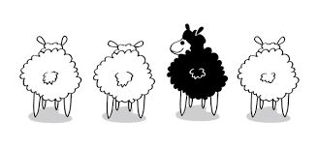
obvious

Slide 117

gorgeous

Slide 118
Let’s Teach and Practise

Slide 119
Words with a
/shuhn/ sound, spelt with ‘tion’
(if root word ends in
‘te’ or ‘t’ or has no definite root)

Slide 120
-tion

Slide 121
position

Slide 122

solution

Slide 123
position
NOUN
Definition - a place where someone or something is located or has been put

Slide 124
solution
NOUN
Definition - the correct answer to a puzzle

Slide 125
The distress call had given the ship's position.
________

Slide 126
The solution to this month's crossword is printed below.
________

Slide 127
New CHALLENGE words.

Slide 128
remember
VERB
Definition - have in or be able to bring to one's mind an awareness of (someone or something from the past)

Slide 129
I remember all the dance moves to my favourite song.
________

Slide 130
sentence
NOUN
Definition - a set of words that is complete in itself, typically containing a subject and predicate, conveying a statement, question, exclamation, or command, and consisting of a main clause and sometimes one or more subordinate clauses.

Slide 131
A sentence is made up of words.
________

Slide 132
Let’s Practise and Apply.

Slide 133
Can you spot the spelling rule words and the challenge words?

Slide 134
Changing lands
Skye is renowned for tourists due to the attraction of its natural beauty, history and wildlife. It is said that you remember the island due to the rugged coast lines, waterfalls and lochs. It has the position of being an island in the Hebrides of Scotland where it is mainly home to fish farms. The fish farms have tried to expand but this has been denied due to concerns around harming local wildlife and pollution. There is a heavy sentence if farmers break the rules. There are no factories on Skye and the main access onto the island is via the invention of the Skye Bridge.

Slide 135
Changing lands
Skye is renowned for tourists due to the attraction of its natural beauty, history and wildlife. It is said that you remember the island due to the rugged coast lines, waterfalls and lochs. It has the position of being an island in the Hebrides of Scotland where it is mainly home to fish farms. The fish farms have tried to expand but this has been denied due to concerns around harming local wildlife and pollution. There is a heavy sentence if farmers break the rules. There are no factories on Skye and the main access onto the island is via the invention of the Skye Bridge.

Slide 136
Write this sentence as I dictate it to you.
Notes:
There is a heavy sentence if farmers break the rules.

Slide 137
There is a heavy sentence if farmers break the rules.
Did you write it correctly?
Edit your work and make sure you have it correct.
Can you underline the spelling word that we have covered in this session?

Slide 138
Year 4 - Spring 2
Week 3 - Friday
Notes:
Click through the slides for all the R+R words for the week (both the focus and the challenge words)
Click through the slides for all the new learning this week

Slide 140
Old challenge words…

Slide 141
popular

Slide 142
position

Slide 143
Old spelling rule words…

Slide 144
tremendous

Slide 145
enormous

Slide 146
jealous

Slide 147
serious

Slide 148
hideous

Slide 149
fabulous

Slide 150
curious

Slide 151
anxious

Slide 152
obvious

Slide 153
gorgeous

Slide 154
New spelling rule words…

Slide 155
invention

Slide 156
injection

Slide 157
action

Slide 158
question

Slide 159
mention

Slide 160
attraction

Slide 161
translation

Slide 162
devotion

Slide 163
position

Slide 164
solution

Slide 165
New challenge words…

Slide 166
remember

Slide 167
sentence

Slide 168
Quick Quiz time…
Notes:
Say these words for the quiz
Popular position Remember sentence enormous anxious invention question translation position

Slide 169
Did you get them correct?
Edit your work.
popular position remember sentence enormous anxious invention question translation position

Slide 170
Word class time…

Slide 171
I remember all the dance moves to my favourite song.
Pronoun verb determiner adjective noun determiner adjective noun
Notes:
Ask for these words to be classed

Slide 172
A sentence is made up of words.
Determiner noun verb verb preposition noun
Notes:
Ask for these words to be classed

Slide 173
Etymology
The history of a word….

Slide 174
Remember
Middle English: from Old French remembrer, from late Latin rememorari ‘call to mind’, from re- (expressing intensive force) + Latin memor ‘mindful’.
Sentence
Middle English (in the senses ‘way of thinking, opinion’, ‘court's declaration of punishment’, and ‘gist (of a piece of writing’)): via Old French from Latin sententia ‘opinion’, from sentire ‘feel, be of the opinion’.

Slide 175
Let’s investigate….
Look at the word origin of the challenge words and find words that are linked to them.

