Slide 1
Spelling Y4
Mastering spellings: building on the foundations of phonics
Spring 2
Week 4

Slide 2
Year 4 - Spring 2
Week 4 - Monday

Slide 3
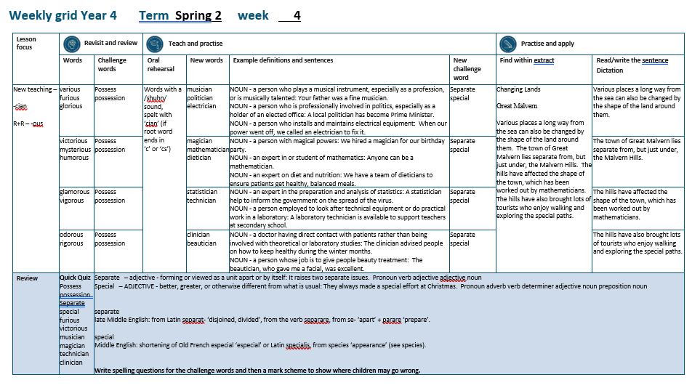

Slide 4
Let’s Revisit and Review…

Slide 5
Do you remember this challenge word?

Slide 6
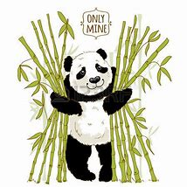
possess
VERB
Definition - have as belonging to one; own

Slide 7
I do not possess a television set.
_______

Slide 8
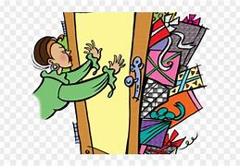
possession
NOUN
Definition - the state of having, owning, or controlling something

Slide 9
She had taken possession of the sofa.
__________

Slide 10
Adding the suffix
-ous
Adding the suffix -ous
(words ending in ‘y’ become ‘i’)
(words ending in ‘our’ become ‘or’)

Slide 11
-ous

Slide 12
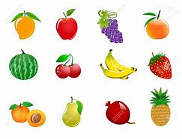
various

Slide 13
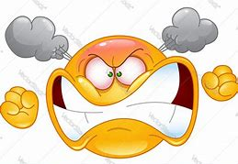
furious

Slide 14
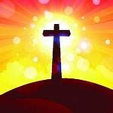
glorious

Slide 15
Let’s Teach and Practise

Slide 16
Words with a
/shuhn/ sound, spelt with ‘cian’
(if root word ends in
‘c’ or ‘cs’)

Slide 17
-cian

Slide 18
-cian usually ‘cian’ ending words are showing someone’s profession or job

Slide 19
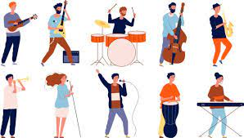
musician

Slide 20

politician

Slide 21
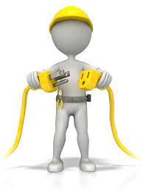
electrician

Slide 22
musician
music (-c) +cian = musician
NOUN
Definition - - a person who plays a musical instrument, especially as a profession, or is musically talented

Slide 23
politician
politic (-c) +cian = politician
NOUN
Definition - a person who is professionally involved in politics, especially as a holder of an elected office

Slide 24
electrician
electric (-c) +cian = electrician
NOUN
Definition - a person who installs and maintains electrical equipment

Slide 25
Your father was a fine musician.
________

Slide 26
A local politician has become Prime Minister.
___________

Slide 27
When our power went off, we called an electrician to fix it.
____________

Slide 28
New CHALLENGE words.

Slide 29
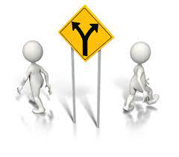
separate
ADJECTIVE
Definition - forming or viewed as a unit apart or by itself

Slide 30
It raises two separate issues.
________

Slide 31

special
ADJECTIVE
Definition - better, greater, or otherwise different from what is usual

Slide 32
They always made a special effort at Christmas.
_______

Slide 33
Let’s Practise and Apply.

Slide 34
Can you spot the spelling rule words and the challenge words?

Slide 35
Changing Lands
Great Malvern
Various places a long way from the sea can also be changed by the shape of the land around them. The town of Great Malvern lies separate from, but just under, the Malvern Hills. The hills have affected the shape of the town, which has been worked out by mathematicians. The hills have also brought lots of tourists who enjoy walking and exploring the special paths.

Slide 36
Changing Lands
Great Malvern
Various places a long way from the sea can also be changed by the shape of the land around them. The town of Great Malvern lies separate from, but just under, the Malvern Hills. The hills have affected the shape of the town, which has been worked out by mathematicians. The hills have also brought lots of tourists who enjoy walking and exploring the special paths.

Slide 37
Write this sentence as I dictate it to you.
Notes:
Various places a long way from the sea can also be changed by the shape of the land around them.

Slide 38
Various places a long way from the sea can also be changed by the shape of the land around them.
Did you write it correctly?
Edit your work and make sure you have it correct.
Can you underline the spelling word that we have covered in this session?

Slide 39
Year 4 - Spring 2
Week 4 - Tuesday
Notes:
Revisit and review the words from previous teaching and challenge words – I say, we say, you say
Ask children to write words only in their spelling book
Introduce the new spelling rule
Children to write the new spelling rule words and challenge words into books when the sentences are shown with the spelling word missing.
Read the extract with the class as choral reading. Practise model of prosody etc.
Ask children to find the spelling words from the session in the text.
Then read allowed the chosen sentence for children to write fully in their books.
Show the extract and ask children to then edit their work to check they were correct in their dictation.

Slide 41
Let’s Revisit and Review…

Slide 42
Do you remember this challenge word?

Slide 43
possess
VERB
Definition - have as belonging to one; own

Slide 44
I do not possess a television set.
_______

Slide 45
possession
NOUN
Definition - the state of having, owning, or controlling something

Slide 46
She had taken possession of the sofa.
__________

Slide 47
Adding the suffix
-ous
Adding the suffix -ous
(words ending in ‘y’ become ‘i’)
(words ending in ‘our’ become ‘or’)

Slide 48
-ous

Slide 49

victorious

Slide 50

mysterious

Slide 51
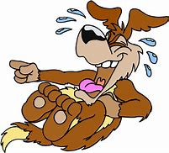
humorous

Slide 52
Let’s Teach and Practise

Slide 53
Words with a
/shuhn/ sound, spelt with ‘cian’
(if root word ends in
‘c’ or ‘cs’)

Slide 54
-cian

Slide 55
-cian usually ‘cian’ ending words are showing someone’s profession or job

Slide 56
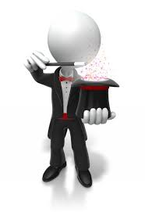
magician

Slide 57

mathematician

Slide 58

dietician

Slide 59
magician
magic (-c) +cian = magician
NOUN
Definition - a person with magical powers

Slide 60
mathematician
mathematic (-c) +cian = mathematician
NOUN
Definition - an expert in or student of mathematics

Slide 61
dietician
diet (+i) +cian = electrician
NOUN
Definition - an expert on diet and nutrition

Slide 62
We hired a magician for our birthday party.
________

Slide 63
Anyone can be a mathematician.
_______________

Slide 64
We have a team of dieticians to ensure patients get healthy, balanced meals.
__________

Slide 65
New CHALLENGE words.

Slide 66
separate
ADJECTIVE
Definition - forming or viewed as a unit apart or by itself

Slide 67
It raises two separate issues.
________

Slide 68
special
ADJECTIVE
Definition - better, greater, or otherwise different from what is usual

Slide 69
They always made a special effort at Christmas.
_______

Slide 70
Let’s Practise and Apply.

Slide 71
Can you spot the spelling rule words and the challenge words?

Slide 72
Changing Lands
Great Malvern
Various places a long way from the sea can also be changed by the shape of the land around them. The town of Great Malvern lies separate from, but just under, the Malvern Hills. The hills have affected the shape of the town, which has been worked out by mathematicians. The hills have also brought lots of tourists who enjoy walking and exploring the special paths.

Slide 73
Changing Lands
Great Malvern
Various places a long way from the sea can also be changed by the shape of the land around them. The town of Great Malvern lies separate from, but just under, the Malvern Hills. The hills have affected the shape of the town, which has been worked out by mathematicians. The hills have also brought lots of tourists who enjoy walking and exploring the special paths.

Slide 74
Write this sentence as I dictate it to you.
Notes:
The town of Great Malvern lies separate from, but just under, the Malvern Hills.

Slide 75
The town of Great Malvern lies separate from, but just under, the Malvern Hills.
Did you write it correctly?
Edit your work and make sure you have it correct.
Can you underline the spelling word that we have covered in this session?

Slide 76
Year 4 - Spring 2
Week 4 - Wednesday
Notes:
Revisit and review the words from previous teaching and challenge words – I say, we say, you say
Ask children to write words only in their spelling book
Introduce the new spelling rule
Children to write the new spelling rule words and challenge words into books when the sentences are shown with the spelling word missing.
Read the extract with the class as choral reading. Practise model of prosody etc.
Ask children to find the spelling words from the session in the text.
Then read allowed the chosen sentence for children to write fully in their books.
Show the extract and ask children to then edit their work to check they were correct in their dictation.

Slide 78
Let’s Revisit and Review…

Slide 79
Do you remember this challenge word?

Slide 80
possess
VERB
Definition - have as belonging to one; own

Slide 81
I do not possess a television set.
_______

Slide 82
possession
NOUN
Definition - the state of having, owning, or controlling something

Slide 83
She had taken possession of the sofa.
__________

Slide 84
Adding the suffix
-ous
Adding the suffix -ous
(words ending in ‘y’ become ‘i’)
(words ending in ‘our’ become ‘or’)

Slide 85
-ous

Slide 86

glamorous

Slide 87
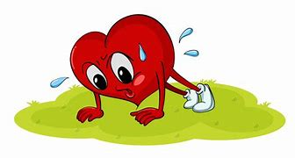
vigorous

Slide 88
Let’s Teach and Practise

Slide 89
Words with a
/shuhn/ sound, spelt with ‘cian’
(if root word ends in
‘c’ or ‘cs’)

Slide 90
-cian

Slide 91
-cian usually ‘cian’ ending words are showing someone’s profession or job

Slide 92
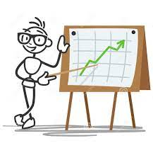
statistician

Slide 93

technician

Slide 94
statistician
statistic (-c) +cian = statistician
NOUN
Definition - an expert in the preparation and analysis of statistics

Slide 95
technician
technic (-c) +cian = technician
NOUN
Definition - a person employed to look after technical equipment or do practical work in a laboratory

Slide 96
A statistician help to inform the government on the spread of the virus.
____________

Slide 97
A laboratory technician is available to support teachers at secondary school.
__________

Slide 98
New CHALLENGE words.

Slide 99
separate
ADJECTIVE
Definition - forming or viewed as a unit apart or by itself

Slide 100
It raises two separate issues.
________

Slide 101
special
ADJECTIVE
Definition - better, greater, or otherwise different from what is usual

Slide 102
They always made a special effort at Christmas.
_______

Slide 103
Let’s Practise and Apply.

Slide 104
Can you spot the spelling rule words and the challenge words?

Slide 105
Changing Lands
Great Malvern
Various places a long way from the sea can also be changed by the shape of the land around them. The town of Great Malvern lies separate from, but just under, the Malvern Hills. The hills have affected the shape of the town, which has been worked out by mathematicians. The hills have also brought lots of tourists who enjoy walking and exploring the special paths.

Slide 106
Changing Lands
Great Malvern
Various places a long way from the sea can also be changed by the shape of the land around them. The town of Great Malvern lies separate from, but just under, the Malvern Hills. The hills have affected the shape of the town, which has been worked out by mathematicians. The hills have also brought lots of tourists who enjoy walking and exploring the special paths.

Slide 107
Write this sentence as I dictate it to you.
Notes:
The hills have affected the shape of the town, which has been worked out by mathematicians.

Slide 108
The hills have affected the shape of the town, which has been worked out by mathematicians.
Did you write it correctly?
Edit your work and make sure you have it correct.
Can you underline the spelling word that we have covered in this session?

Slide 109
Year 4 - Spring 2
Week 4 - Thursday
Notes:
Revisit and review the words from previous teaching and challenge words – I say, we say, you say
Ask children to write words only in their spelling book
Introduce the new spelling rule
Children to write the new spelling rule words and challenge words into books when the sentences are shown with the spelling word missing.
Read the extract with the class as choral reading. Practise model of prosody etc.
Ask children to find the spelling words from the session in the text.
Then read allowed the chosen sentence for children to write fully in their books.
Show the extract and ask children to then edit their work to check they were correct in their dictation.

Slide 111
Let’s Revisit and Review…

Slide 112
Do you remember this challenge word?

Slide 113
possess
VERB
Definition - have as belonging to one; own

Slide 114
I do not possess a television set.
_______

Slide 115
possession
NOUN
Definition - the state of having, owning, or controlling something

Slide 116
She had taken possession of the sofa.
__________

Slide 117
Adding the suffix
-ous
Adding the suffix -ous
(words ending in ‘y’ become ‘i’)
(words ending in ‘our’ become ‘or’)

Slide 118
-ous

Slide 119
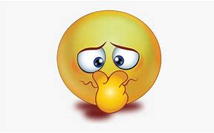
odorous

Slide 120
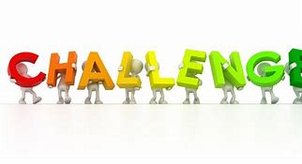
rigorous

Slide 121
Let’s Teach and Practise

Slide 122
Words with a
/shuhn/ sound, spelt with ‘cian’
(if root word ends in
‘c’ or ‘cs’)

Slide 123
-cian

Slide 124
-cian usually ‘cian’ ending words are showing someone’s profession or job

Slide 125

clinician

Slide 126

beautician

Slide 127
clinician
clinic (-c) +cian = clinician
NOUN
Definition - a doctor having direct contact with patients rather than being involved with theoretical or laboratory studies

Slide 128
beautician
beauty (-y +i) +cian = politician
NOUN
Definition - a person whose job is to give people beauty treatment

Slide 129
The clinician advised people on how to keep healthy during the winter months.
________

Slide 130
The beautician, who gave me a facial, was excellent.
__________

Slide 131
New CHALLENGE words.

Slide 132
separate
ADJECTIVE
Definition - forming or viewed as a unit apart or by itself

Slide 133
It raises two separate issues.
________

Slide 134
special
ADJECTIVE
Definition - better, greater, or otherwise different from what is usual

Slide 135
They always made a special effort at Christmas.
_______

Slide 136
Let’s Practise and Apply.

Slide 137
Can you spot the spelling rule words and the challenge words?

Slide 138
Changing Lands
Great Malvern
Various places a long way from the sea can also be changed by the shape of the land around them. The town of Great Malvern lies separate from, but just under, the Malvern Hills. The hills have affected the shape of the town, which has been worked out by mathematicians. The hills have also brought lots of tourists who enjoy walking and exploring the special paths.

Slide 139
Changing Lands
Great Malvern
Various places a long way from the sea can also be changed by the shape of the land around them. The town of Great Malvern lies separate from, but just under, the Malvern Hills. The hills have affected the shape of the town, which has been worked out by mathematicians. The hills have also brought lots of tourists who enjoy walking and exploring the special paths.

Slide 140
Write this sentence as I dictate it to you.
Notes:
The hills have also brought lots of tourists who enjoy walking and exploring the special paths.

Slide 141
The hills have also brought lots of tourists who enjoy walking and exploring the special paths.
Did you write it correctly?
Edit your work and make sure you have it correct.
Can you underline the spelling word that we have covered in this session?

Slide 142
Year 4 - Spring 2
Week 4 - Friday
Notes:
Click through the slides for all the R+R words for the week (both the focus and the challenge words)
Click through the slides for all the new learning this week

Slide 144
Old challenge words…

Slide 145
possess

Slide 146
possession

Slide 147
Old spelling rule words…

Slide 148
various

Slide 149
furious

Slide 150
glorious

Slide 151
victorious

Slide 152
mysterious

Slide 153
humorous

Slide 154
glamorous

Slide 155
vigorous

Slide 156
odorous

Slide 157
rigorous

Slide 158
New spelling rule words…

Slide 159
musician

Slide 160
politician

Slide 161
electrician

Slide 162
magician

Slide 163
mathematician

Slide 164
dietician

Slide 165
statistician

Slide 166
technician

Slide 167
clinician

Slide 168
beautician

Slide 169
New challenge words…

Slide 170
separate

Slide 171
special

Slide 172
Quick Quiz time…
Notes:
Say these words for the quiz
Possess possession Separate special furious victorious musician magician technician clinician

Slide 173
Did you get them correct?
Edit your work.
possess possession separate special furious victorious musician magician technician clinician

Slide 174
Word class time…

Slide 175
It raises two separate issues.
Pronoun verb adjective adjective noun
Notes:
Ask for these words to be classed

Slide 176
They always made a special effort at Christmas.
Pronoun adverb verb determiner adjective noun preposition noun
Notes:
Ask for these words to be classed

Slide 177
Etymology
The history of a word….

Slide 178
Separate
late Middle English: from Latin separat- ‘disjoined, divided’, from the verb separare, from se- ‘apart’ + parare ‘prepare’.
Special
Middle English: shortening of Old French especial ‘especial’ or Latin specialis, from species ‘appearance’ (see species).

Slide 179
Let’s investigate….
Write spelling questions for the challenge words and then a mark scheme to show where children may go wrong.

