Slide 1
Spelling Y4
Mastering spellings: building on the foundations of phonics
Spring 2
Week 5

Slide 2
Year 4 - Spring 2
Week 5 - Monday

Slide 3
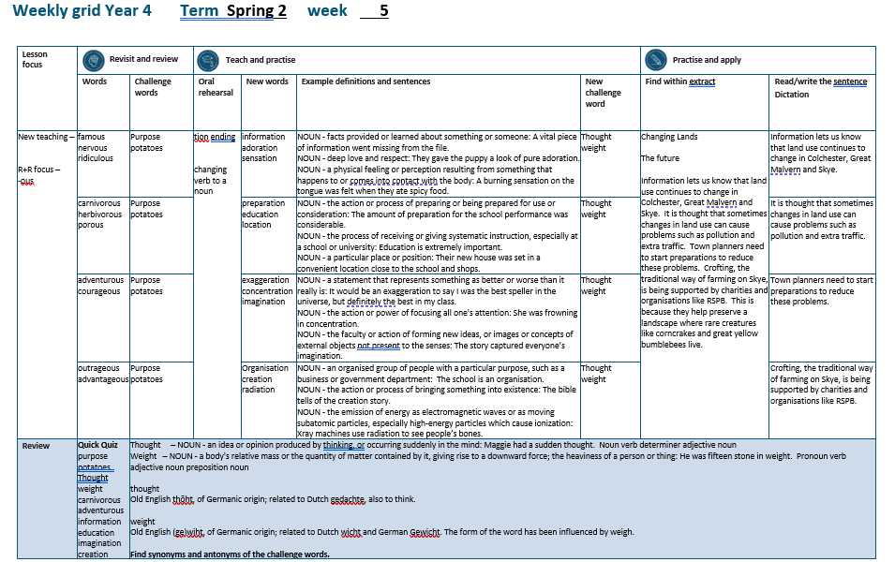

Slide 4
Let’s Revisit and Review…

Slide 5
Do you remember this challenge word?

Slide 6
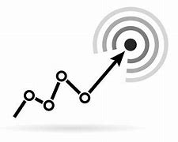
purpose
NOUN
Definition - the reason for which something is done or created or for which something

Slide 7
The purpose of the meeting is to appoint a school councillor.
_______

Slide 8
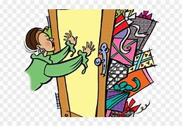
potatoes
PLURAL NOUN
Definition - a starchy plant tuber which is one of the most important food crops, cooked and eaten as a vegetable

Slide 9
Roast potatoes are delicious.
________

Slide 10
Adding the suffix
-ous
Adding the suffix -ous
(words ending in ‘e’ drop the ‘e’
but not ‘ge’)

Slide 11
-ous

Slide 12
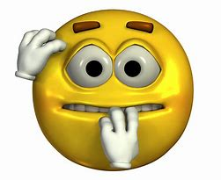
nervous

Slide 13

famous

Slide 14
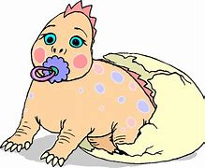
ridiculous

Slide 15
Let’s Teach and Practise

Slide 16
Words with a
/shuhn/ sound, spelt with ‘tion’ changing verbs to a nouns

Slide 17
-tion

Slide 18
-ation verb -> noun

Slide 19

information

Slide 20

adoration

Slide 21
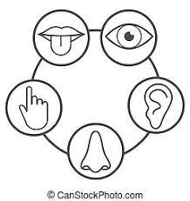
sensation

Slide 22
information
inform +ation = information
VERB -> NOUN
Definition - facts provided or learned about something or someone

Slide 23
adoration
adore (-e)+ation = adoration
VERB -> NOUN
Definition - deep love and respect

Slide 24
sensation
sense (-e) +ation = sensation
VERB -> NOUN
Definition - a physical feeling or perception resulting from something that happens to or comes into contact with the body

Slide 25
A vital piece of information went missing from the file.
___________

Slide 26
They gave the puppy a look of pure adoration.
_________

Slide 27
A burning sensation on the tongue was felt when they ate spicy food.
_________

Slide 28
New CHALLENGE words.

Slide 29

thought
NOUN
Definition - an idea or opinion produced by thinking, or occurring suddenly in the mind

Slide 30
Maggie had a sudden thought.
_______

Slide 31

weight
NOUN
Definition - a body's relative mass or the quantity of matter contained by it, giving rise to a downward force

Slide 32
He was fifteen stone in weight.
______

Slide 33
Let’s Practise and Apply.

Slide 34
Can you spot the spelling rule words and the challenge words?

Slide 35
Changing Lands
The future
Information lets us know that land use continues to change in Colchester, Great Malvern and Skye. It is thought that sometimes changes in land use can cause problems such as pollution and extra traffic. Town planners need to start preparations to reduce these problems. Crofting, the traditional way of farming on Skye, is being supported by charities and organisations like RSPB. This is because they help preserve a landscape where rare creatures like corncrakes and great yellow bumblebees live.

Slide 36
Changing Lands
The future
Information lets us know that land use continues to change in Colchester, Great Malvern and Skye. It is thought that sometimes changes in land use can cause problems such as pollution and extra traffic. Town planners need to start preparations to reduce these problems. Crofting, the traditional way of farming on Skye, is being supported by charities and organisations like RSPB. This is because they help preserve a landscape where rare creatures like corncrakes and great yellow bumblebees live.

Slide 37
Write this sentence as I dictate it to you.
Notes:
Information lets us know that land use continues to change in Colchester, Great Malvern and Skye.

Slide 38
Information lets us know that land use continues to change in Colchester, Great Malvern and Skye.
Did you write it correctly?
Edit your work and make sure you have it correct.
Can you underline the spelling word that we have covered in this session?

Slide 39
Year 4 - Spring 2
Week 5 - Tuesday
Notes:
Revisit and review the words from previous teaching and challenge words – I say, we say, you say
Ask children to write words only in their spelling book
Introduce the new spelling rule
Children to write the new spelling rule words and challenge words into books when the sentences are shown with the spelling word missing.
Read the extract with the class as choral reading. Practise model of prosody etc.
Ask children to find the spelling words from the session in the text.
Then read allowed the chosen sentence for children to write fully in their books.
Show the extract and ask children to then edit their work to check they were correct in their dictation.

Slide 41
Let’s Revisit and Review…

Slide 42
Do you remember this challenge word?

Slide 43
purpose
NOUN
Definition - the reason for which something is done or created or for which something

Slide 44
The purpose of the meeting is to appoint a school councillor.
_______

Slide 45
potatoes
PLURAL NOUN
Definition - a starchy plant tuber which is one of the most important food crops, cooked and eaten as a vegetable

Slide 46
Roast potatoes are delicious.
________

Slide 47
Adding the suffix
-ous
Adding the suffix -ous
(words ending in ‘e’ drop the ‘e’
but not ‘ge’)

Slide 48
-ous

Slide 49
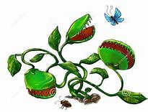
carnivorous

Slide 50
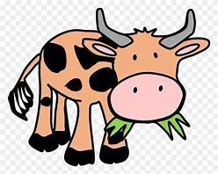
herbivorous

Slide 51
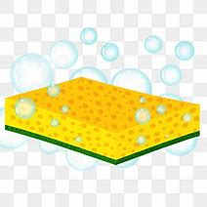
porous

Slide 52
Let’s Teach and Practise

Slide 53
Words with a
/shuhn/ sound, spelt with ‘tion’ changing verbs to a nouns

Slide 54
-tion

Slide 55
-ation verb -> noun

Slide 56

preparation

Slide 57

education

Slide 58
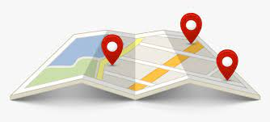
location

Slide 59
preparation
prepare (-e) +ation = preparation
VERB -> NOUN
Definition - the action or process of preparing or being prepared for use or consideration

Slide 60
education
educate (-ate)+ation = education
VERB -> NOUN
Definition - the process of receiving or giving systematic instruction, especially at a school or university

Slide 61
location
locate (-ate) +ation = location
VERB -> NOUN
Definition - a particular place or position

Slide 62
The amount of preparation for the school performance was considerable.
___________

Slide 63
Education is extremely important.
________

Slide 64
Their new house was set in a convenient location close to the school and shops.
________

Slide 65
New CHALLENGE words.

Slide 66
thought
NOUN
Definition - an idea or opinion produced by thinking, or occurring suddenly in the mind

Slide 67
Maggie had a sudden thought.
_______

Slide 68
weight
NOUN
Definition - a body's relative mass or the quantity of matter contained by it, giving rise to a downward force

Slide 69
He was fifteen stone in weight.
______

Slide 70
Let’s Practise and Apply.

Slide 71
Can you spot the spelling rule words and the challenge words?

Slide 72
Changing Lands
The future
Information lets us know that land use continues to change in Colchester, Great Malvern and Skye. It is thought that sometimes changes in land use can cause problems such as pollution and extra traffic. Town planners need to start preparations to reduce these problems. Crofting, the traditional way of farming on Skye, is being supported by charities and organisations like RSPB. This is because they help preserve a landscape where rare creatures like corncrakes and great yellow bumblebees live.

Slide 73
Changing Lands
The future
Information lets us know that land use continues to change in Colchester, Great Malvern and Skye. It is thought that sometimes changes in land use can cause problems such as pollution and extra traffic. Town planners need to start preparations to reduce these problems. Crofting, the traditional way of farming on Skye, is being supported by charities and organisations like RSPB. This is because they help preserve a landscape where rare creatures like corncrakes and great yellow bumblebees live.

Slide 74
Write this sentence as I dictate it to you.
Notes:
It is thought that sometimes changes in land use can cause problems such as pollution and extra traffic.

Slide 75
It is thought that sometimes changes in land use can cause problems such as pollution and extra traffic.
Did you write it correctly?
Edit your work and make sure you have it correct.
Can you underline the spelling word that we have covered in this session?

Slide 76
Year 4 - Spring 2
Week 5 - Wednesday
Notes:
Revisit and review the words from previous teaching and challenge words – I say, we say, you say
Ask children to write words only in their spelling book
Introduce the new spelling rule
Children to write the new spelling rule words and challenge words into books when the sentences are shown with the spelling word missing.
Read the extract with the class as choral reading. Practise model of prosody etc.
Ask children to find the spelling words from the session in the text.
Then read allowed the chosen sentence for children to write fully in their books.
Show the extract and ask children to then edit their work to check they were correct in their dictation.

Slide 78
Let’s Revisit and Review…

Slide 79
Do you remember this challenge word?

Slide 80
purpose
NOUN
Definition - the reason for which something is done or created or for which something

Slide 81
The purpose of the meeting is to appoint a school councillor.
_______

Slide 82
potatoes
PLURAL NOUN
Definition - a starchy plant tuber which is one of the most important food crops, cooked and eaten as a vegetable

Slide 83
Roast potatoes are delicious.
________

Slide 84
Adding the suffix
-ous
Adding the suffix -ous
(words ending in ‘e’ drop the ‘e’
but not ‘ge’)

Slide 85
-ous

Slide 86
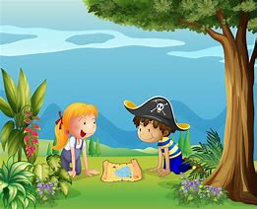
adventurous

Slide 87
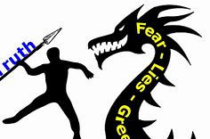
courageous

Slide 88
Let’s Teach and Practise

Slide 89
Words with a
/shuhn/ sound, spelt with ‘tion’ changing verbs to a nouns

Slide 90
-tion

Slide 91
-ation verb -> noun

Slide 92
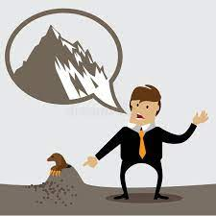
exaggeration

Slide 93
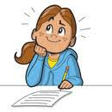
concentration

Slide 94
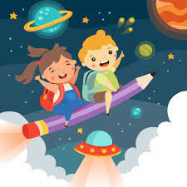
imagination

Slide 95
exaggeration
exaggerate (-ate)+ation = exaggeration
VERB -> NOUN
Definition - a statement that represents something as better or worse than it really is

Slide 96
concentration
concentrate (-ate)+ation = concentration
VERB -> NOUN
Definition - the action or power of focusing all one's attention

Slide 97
imagination
imagine (-e) +ation = imagination
VERB -> NOUN
Definition - the faculty or action of forming new ideas, or images or concepts of external objects not present to the senses

Slide 98
It would be an exaggeration to say I was the best speller in the universe, but definitely the best in my class.
____________

Slide 99
She was frowning in concentration.
_____________

Slide 100
The story captured everyone’s imagination.
____________

Slide 101
New CHALLENGE words.

Slide 102
thought
NOUN
Definition - an idea or opinion produced by thinking, or occurring suddenly in the mind

Slide 103
Maggie had a sudden thought.
_______

Slide 104
weight
NOUN
Definition - a body's relative mass or the quantity of matter contained by it, giving rise to a downward force

Slide 105
He was fifteen stone in weight.
______

Slide 106
Let’s Practise and Apply.

Slide 107
Can you spot the spelling rule words and the challenge words?

Slide 108
Changing Lands
The future
Information lets us know that land use continues to change in Colchester, Great Malvern and Skye. It is thought that sometimes changes in land use can cause problems such as pollution and extra traffic. Town planners need to start preparations to reduce these problems. Crofting, the traditional way of farming on Skye, is being supported by charities and organisations like RSPB. This is because they help preserve a landscape where rare creatures like corncrakes and great yellow bumblebees live.

Slide 109
Changing Lands
The future
Information lets us know that land use continues to change in Colchester, Great Malvern and Skye. It is thought that sometimes changes in land use can cause problems such as pollution and extra traffic. Town planners need to start preparations to reduce these problems. Crofting, the traditional way of farming on Skye, is being supported by charities and organisations like RSPB. This is because they help preserve a landscape where rare creatures like corncrakes and great yellow bumblebees live.

Slide 110
Write this sentence as I dictate it to you.
Notes:
Town planners need to start preparations to reduce these problems.

Slide 111
Town planners need to start preparations to reduce these problems.
Did you write it correctly?
Edit your work and make sure you have it correct.
Can you underline the spelling word that we have covered in this session?

Slide 112
Year 4 - Spring 2
Week 5 - Thursday
Notes:
Revisit and review the words from previous teaching and challenge words – I say, we say, you say
Ask children to write words only in their spelling book
Introduce the new spelling rule
Children to write the new spelling rule words and challenge words into books when the sentences are shown with the spelling word missing.
Read the extract with the class as choral reading. Practise model of prosody etc.
Ask children to find the spelling words from the session in the text.
Then read allowed the chosen sentence for children to write fully in their books.
Show the extract and ask children to then edit their work to check they were correct in their dictation.

Slide 114
Let’s Revisit and Review…

Slide 115
Do you remember this challenge word?

Slide 116
purpose
NOUN
Definition - the reason for which something is done or created or for which something

Slide 117
The purpose of the meeting is to appoint a school councillor.
_______

Slide 118
potatoes
PLURAL NOUN
Definition - a starchy plant tuber which is one of the most important food crops, cooked and eaten as a vegetable

Slide 119
Roast potatoes are delicious.
________

Slide 120
Adding the suffix
-ous
Adding the suffix -ous
(words ending in ‘e’ drop the ‘e’
but not ‘ge’)

Slide 121
-ous

Slide 122

outrageous

Slide 123
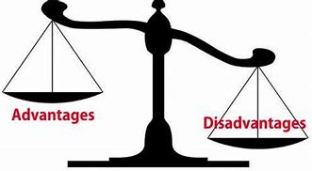
advantageous

Slide 124
Let’s Teach and Practise

Slide 125
Words with a
/shuhn/ sound, spelt with ‘tion’ changing verbs to a nouns

Slide 126
-tion

Slide 127
-ation verb -> noun

Slide 128
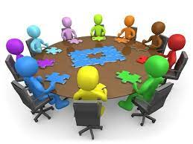
organisation

Slide 129
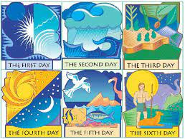
creation

Slide 130

radiation

Slide 131
organisation
organise (-e) +ation = organisation
VERB -> NOUN
Definition - an organised group of people with a particular purpose, such as a business or government department

Slide 132
creation
create (-ate)+ation = creation
VERB -> NOUN
Definition - the action or process of bringing something into existence

Slide 133
radiation
radiate (-ate) +ation = radiation
VERB -> NOUN
Definition - the emission of energy as electromagnetic waves or as moving subatomic particles, especially high-energy particles which cause ionization

Slide 134
The school is an organisation.
____________

Slide 135
The bible tells of the creation story.
________

Slide 136
Xray machines use radiation to see people’s bones.
_________

Slide 137
New CHALLENGE words.

Slide 138
thought
NOUN
Definition - an idea or opinion produced by thinking, or occurring suddenly in the mind

Slide 139
Maggie had a sudden thought.
_______

Slide 140
weight
NOUN
Definition - a body's relative mass or the quantity of matter contained by it, giving rise to a downward force

Slide 141
He was fifteen stone in weight.
______

Slide 142
Let’s Practise and Apply.

Slide 143
Can you spot the spelling rule words and the challenge words?

Slide 144
Changing Lands
The future
Information lets us know that land use continues to change in Colchester, Great Malvern and Skye. It is thought that sometimes changes in land use can cause problems such as pollution and extra traffic. Town planners need to start preparations to reduce these problems. Crofting, the traditional way of farming on Skye, is being supported by charities and organisations like RSPB. This is because they help preserve a landscape where rare creatures like corncrakes and great yellow bumblebees live.

Slide 145
Changing Lands
The future
Information lets us know that land use continues to change in Colchester, Great Malvern and Skye. It is thought that sometimes changes in land use can cause problems such as pollution and extra traffic. Town planners need to start preparations to reduce these problems. Crofting, the traditional way of farming on Skye, is being supported by charities and organisations like RSPB. This is because they help preserve a landscape where rare creatures like corncrakes and great yellow bumblebees live.

Slide 146
Write this sentence as I dictate it to you.
Notes:
Crofting, the traditional way of farming on Skye, is being supported by charities and organisations like RSPB.

Slide 147
Crofting, the traditional way of farming on Skye, is being supported by charities and organisations like RSPB.
Did you write it correctly?
Edit your work and make sure you have it correct.
Can you underline the spelling word that we have covered in this session?

Slide 148
Year 4 - Spring 2
Week 5 - Friday
Notes:
Click through the slides for all the R+R words for the week (both the focus and the challenge words)
Click through the slides for all the new learning this week

Slide 150
Old challenge words…

Slide 151
purpose

Slide 152
potatoes

Slide 153
Old spelling rule words…

Slide 154
famous

Slide 155
nervous

Slide 156
ridiculous

Slide 157
carnivorous

Slide 158
herbivorous

Slide 159
porous

Slide 160
adventurous

Slide 161
courageous

Slide 162
advantageous

Slide 163
New spelling rule words…

Slide 164
information

Slide 165
adoration

Slide 166
sensation

Slide 167
preparation

Slide 168
education

Slide 169
location

Slide 170
exaggeration

Slide 171
concentration

Slide 172
imagination

Slide 173
organisation

Slide 174
creation

Slide 175
radiation

Slide 176
New challenge words…

Slide 177
weight

Slide 178
thought

Slide 179
Quick Quiz time…
Notes:
Say these words for the quiz
purpose potatoes Thought weight carnivorous adventurous information education imagination creation

Slide 180
Did you get them correct?
Edit your work.
purpose potatoes thought weight carnivorous adventurous information education imagination creation

Slide 181
Word class time…

Slide 182
Maggie had a sudden thought.
Noun verb determiner adjective noun
Notes:
Ask for these words to be classed

Slide 183
He was fifteen stone in weight.
Pronoun verb adjective noun preposition noun
Notes:
Ask for these words to be classed

Slide 184
Etymology
The history of a word….

Slide 185
Thought
Old English thōht, of Germanic origin; related to Dutch gedachte, also to think.
Weight
Old English (ge)wiht, of Germanic origin; related to Dutch wicht and German Gewicht. The form of the word has been influenced by weigh.

Slide 186
Let’s investigate….
Find synonyms and antonyms of the challenge words.

