Slide 1
Spelling Y4
Mastering spellings: building on the foundations of phonics
Spring 2
Week 6

Slide 2
Year 4 - Spring 2
Week 6 - Monday

Slide 3
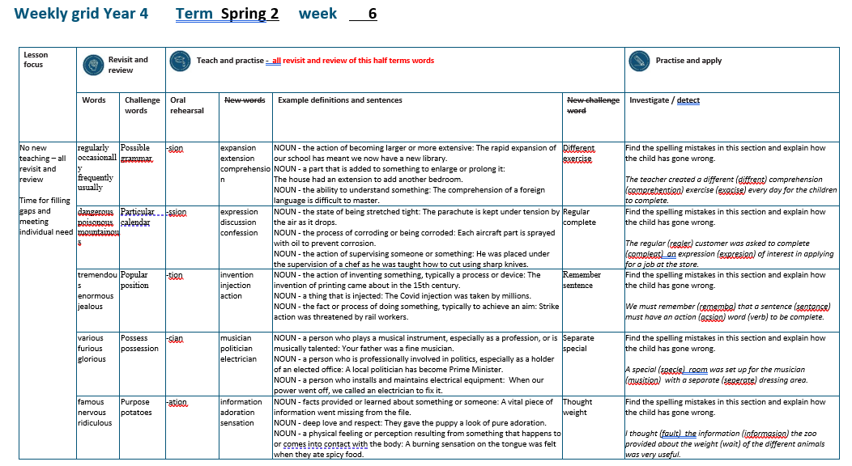

Slide 4
Let’s Revisit and Review…

Slide 5
Do you remember this challenge word?

Slide 6

possible
ADJECTIVE
Definition - able to be done or achieved

Slide 7
Surely it is not possible for a man to live so long?
________

Slide 8
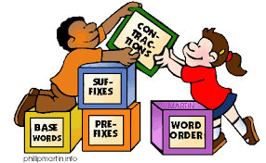
grammar
NOUN
Definition - the whole system and structure of a language or of languages in general, usually taken as consisting of syntax and morphology (including inflections) and sometimes also phonology and semantics.

Slide 9
The grammar used was accurate.
_______

Slide 10
Adverbials – manner – possibility – frequency
The suffix –ly starts with a consonant letter, so it is added straight on to most root words.

Slide 11
Exceptions:
(1) If the root word ends in –y with a consonant letter before it, the y is changed to i, but only if the root word has more than one syllable.
(2) If the root word ends with –le, the
–le is changed to –ly.

Slide 12
Exceptions:
(3) If the root word ends with –ic,
–ally is added rather than just –ly,
(4) The words truly, duly, wholly

Slide 13
-ly

Slide 14
-ly changing an adjective into an adverb

Slide 15
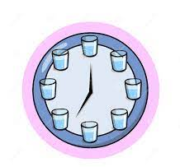
regularly

Slide 16
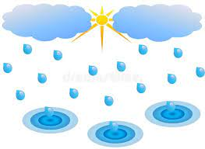
occasionally

Slide 17
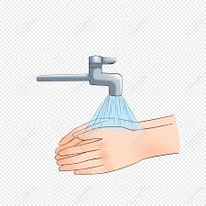
frequently

Slide 18
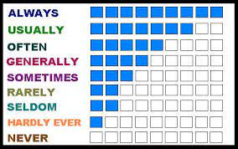
usually

Slide 19
Let’s Teach and Practise

Slide 20
Words with a
/shuhn/ sound, spelt with ‘sion’
(if root word ends in
‘se’, ‘de’ or ‘d’)

Slide 21
-sion

Slide 22

expansion

Slide 23
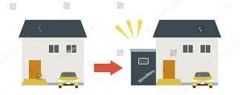
extension

Slide 24

comprehension

Slide 25
expansion
expand (-d) +sion = expansion
NOUN
Definition - the action of becoming larger or more extensive

Slide 26
extension
extend (-d) +sion = extension
NOUN
Definition - a part that is added to something to enlarge or prolong it

Slide 27
comprehension
comprehend (-d) +sion = comprehension
NOUN
Definition - the ability to understand something

Slide 28
The rapid expansion of our school has meant we now have a new library.
_________

Slide 29
The house had an extension to add another bedroom.
__________

Slide 30
The comprehension of a foreign language is difficult to master.
___________

Slide 31
New CHALLENGE words.

Slide 32
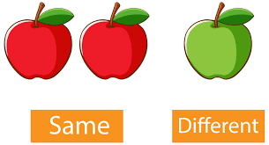
different
ADJECTIVE
Definition - not the same as another or each other; unlike in nature, form, or quality

Slide 33
You can play this game in different ways.
_________

Slide 34

exercise
NOUN
Definition - activity requiring physical effort, carried out to sustain or improve health and fitness

Slide 35
Exercise improves your heart and lung power.
________

Slide 36
Let’s investigate.

Slide 37
Can you spot the spelling errors in these sentences?
Write the correct spelling and explain where they went wrong.

Slide 38
The teacher created a diffrent comprehention exacise every day for the children to complete.

Slide 39
The teacher created a diffrent comprehention exacise every day for the children to complete.

Slide 40
The teacher created a diffrent comprehention exacise every day for the children to complete. different - ‘e’ unstressed vowel

Slide 41
The teacher created a diffrent comprehention exacise every day for the children to complete. comprehension – ‘sion’ as root ends ‘d’

Slide 42
The teacher created a diffrent comprehention exacise every day for the children to complete. exercise – ‘e’ not ‘a’ unstressed vowel

Slide 43
The teacher created a different comprehension exercise every day for the children to complete.

Slide 44
Year 4 - Spring 2
Week 6 - Tuesday

Slide 45
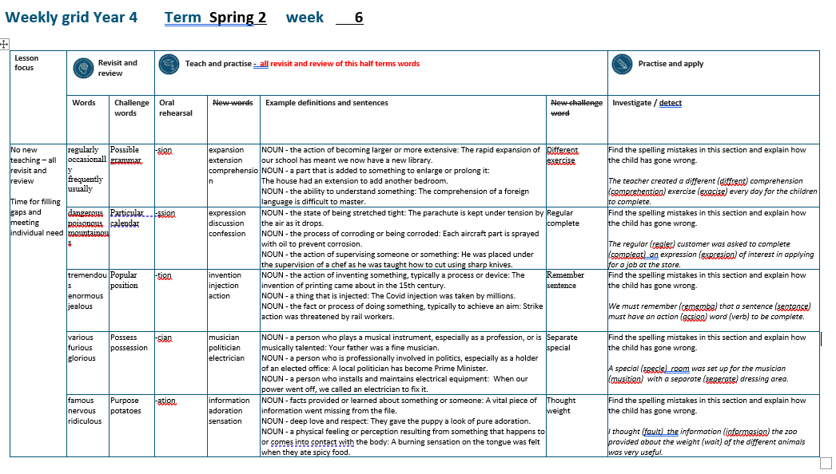

Slide 46
Let’s Revisit and Review…

Slide 47
Do you remember this challenge word?

Slide 48

particular
ADJECTIVE
Definition - used to single out an individual member of a specified group or class

Slide 49
This particular student was gifted in music
__________

Slide 50
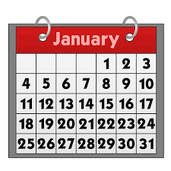
calendar
NOUN
Definition - a chart or series of pages showing the days, weeks, and months of a particular year, or giving particular seasonal information.

Slide 51
The calendar showed the special dates throughout the year.
________

Slide 52
-ous
(no change to root word)
Sometimes the root word is obvious and the usual rules apply for adding suffixes beginning with vowel letters.

Slide 53
Sometimes there is no obvious root word.
–our is changed to –or before –ous is added.
A final ‘e’ of the root word must be kept if the /dʒ/ sound of ‘g’ is to be kept.

Slide 54
If there is an /i:/ sound before the
–ous ending, it is usually spelt as i, but a few words have e.

Slide 55
-ous

Slide 56

dangerous

Slide 57

poisonous

Slide 58

mountainous

Slide 59
Let’s Teach and Practise

Slide 60
Words with a
/shuhn/ sound, spelt with ‘ssion’
(if root word ends in
‘ss’ or ‘mit’

Slide 61
-ssion

Slide 62
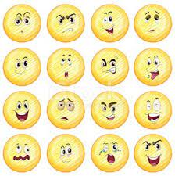
expression

Slide 63

discussion

Slide 64
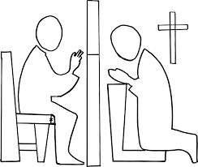
confession

Slide 65
expression
express (-ss) +ssion = expression
NOUN
Definition - a look on someone's face that conveys a particular emotion

Slide 66
discussion
discuss (-ss) +ssion = discussion
NOUN
Definition - a conversation or debate about a specific topic

Slide 67
confession
confess (-ss) +ssion = confession
NOUN
Definition - a formal statement admitting that one is guilty of a crime or sin

Slide 68
A sad expression came over the old man’s face.
__________

Slide 69
Discussions about environmental improvement are important.
____________

Slide 70
They signed a confession and went to prison.
__________

Slide 71
New CHALLENGE words.

Slide 72
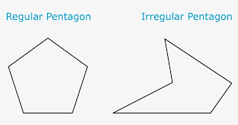
regular
ADJECTIVE
Definition - arranged in or constituting a constant or definite pattern, especially with the same space between individual instances

Slide 73
Plant the flags at regular intervals.
_______

Slide 74

complete
ADJECTIVE
Definition - having all the necessary or appropriate parts

Slide 75
A complete list of classes offered by the leisure centre was posted on their website.
________

Slide 76
Let’s investigate.

Slide 77
Can you spot the spelling errors in these sentences?
Write the correct spelling and explain where they went wrong.

Slide 78
The regler customer was asked to compleat an expresion of interest in applying for a job at the store.

Slide 79
The regler customer was asked to compleat an expresion of interest in applying for a job at the store.

Slide 80
The regler customer was asked to compleat an expresion of interest in applying for a job at the store. regular – ‘ular’ not ‘gler’

Slide 81
The regler customer was asked to compleat an expresion of interest in applying for a job at the store. complete – ‘ete’ not ‘ate’

Slide 82
The regler customer was asked to compleat an expresion of interest in applying for a job at the store. express -> expression – double ss from root

Slide 83
The regular customer was asked to complete an expression of interest in applying for a job at the store.

Slide 84
Year 4 - Spring 2
Week 6 - Wednesday

Slide 85


Slide 86
Let’s Revisit and Review…

Slide 87
Do you remember this challenge word?

Slide 88
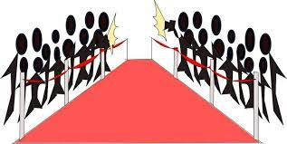
popular
ADJECTIVE
Definition - liked or admired by many people or by a particular person or group

Slide 89
She was the most popular girl in the school.
_______

Slide 90

position
NOUN
Definition - - a place where someone or something is located or has been put

Slide 91
The distress call had given the ship's position.
________.

Slide 92
Adding the suffix
-ous
Sometimes there is no obvious root word.

Slide 93
-ous

Slide 94

tremendous

Slide 95
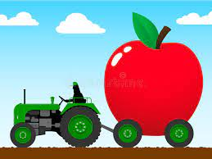
enormous

Slide 96

jealous

Slide 97
Let’s Teach and Practise

Slide 98
Words with a
/shuhn/ sound, spelt with ‘tion’
(if root word ends in
‘te’ or ‘t’ or has no definite root)

Slide 99
-tion

Slide 100

invention

Slide 101

injection

Slide 102

action

Slide 103
invention
invent (-t) +tion = invention
NOUN
Definition - the action of inventing something, typically a process or device

Slide 104
injection
inject (-t) +tion = injection
NOUN
Definition - a thing that is injected

Slide 105
action
act (-t) +tion = action
NOUN
Definition - the fact or process of doing something, typically to achieve an aim

Slide 106
The invention of printing came about in the 15th century.
_________

Slide 107
The Covid injection was taken by millions.
_________

Slide 108
Strike action was threatened by rail workers.
______

Slide 109
New CHALLENGE words.

Slide 110

remember
VERB
Definition - have in or be able to bring to one's mind an awareness of (someone or something from the past)

Slide 111
I remember all the dance moves to my favourite song.
________

Slide 112
sentence
NOUN
Definition - a set of words that is complete in itself, typically containing a subject and predicate, conveying a statement, question, exclamation, or command, and consisting of a main clause and sometimes one or more subordinate clauses.

Slide 113
A sentence is made up of words.
________

Slide 114
Let’s investigate.

Slide 115
Can you spot the spelling errors in these sentences?
Write the correct spelling and explain where they went wrong.

Slide 116
We must rememba that a sentance must have an acsion word (verb) to be complete.

Slide 117
We must rememba that a sentance must have an acsion word (verb) to be complete.

Slide 118
We must rememba that a sentance must have an acsion word (verb) to be complete. remember – ‘er’ not ‘a’

Slide 119
We must rememba that a sentance must have an acsion word (verb) to be complete. sentence – ‘e’ not ‘a’ unstressed vowel

Slide 120
We must rememba that a sentance must have an acsion word (verb) to be complete. action – ‘tion’ not ‘sion’ as root ends in t

Slide 121
We must remember that a sentence must have an action word (verb) to be complete.

Slide 122
Year 4 - Spring 2
Week 6 - Thursday

Slide 123


Slide 124
Let’s Revisit and Review…

Slide 125
Do you remember this challenge word?

Slide 126

possess
VERB
Definition - have as belonging to one; own

Slide 127
I do not possess a television set.
_______

Slide 128
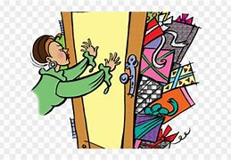
possession
NOUN
Definition - the state of having, owning, or controlling something

Slide 129
She had taken possession of the sofa.
__________

Slide 130
Adding the suffix
-ous
Adding the suffix -ous
(words ending in ‘y’ become ‘i’)
(words ending in ‘our’ become ‘or’)

Slide 131
-ous

Slide 132
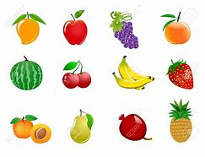
various

Slide 133
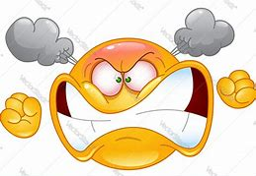
furious

Slide 134

glorious

Slide 135
Let’s Teach and Practise

Slide 136
Words with a
/shuhn/ sound, spelt with ‘cian’
(if root word ends in
‘c’ or ‘cs’)

Slide 137
-cian

Slide 138
-cian usually ‘cian’ ending words are showing someone’s profession or job

Slide 139
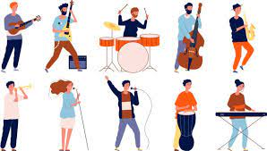
musician

Slide 140

politician

Slide 141

electrician

Slide 142
musician
music (-c) +cian = musician
NOUN
Definition - - a person who plays a musical instrument, especially as a profession, or is musically talented

Slide 143
politician
politic (-c) +cian = politician
NOUN
Definition - a person who is professionally involved in politics, especially as a holder of an elected office

Slide 144
electrician
electric (-c) +cian = electrician
NOUN
Definition - a person who installs and maintains electrical equipment

Slide 145
Your father was a fine musician.
________

Slide 146
A local politician has become Prime Minister.
___________

Slide 147
When our power went off, we called an electrician to fix it.
____________

Slide 148
New CHALLENGE words.

Slide 149

separate
ADJECTIVE
Definition - forming or viewed as a unit apart or by itself

Slide 150
It raises two separate issues.
________

Slide 151

special
ADJECTIVE
Definition - better, greater, or otherwise different from what is usual

Slide 152
They always made a special effort at Christmas.
_______

Slide 153
Let’s investigate.

Slide 154
Can you spot the spelling errors in these sentences?
Write the correct spelling and explain where they went wrong.

Slide 155
A specle room was set up for the musition with a seperate dressing area.

Slide 156
A specle room was set up for the musition with a seperate dressing area.

Slide 157
A specle room was set up for the musition with a seperate dressing area. special – ‘ial’ not ‘le’

Slide 158
A specle room was set up for the musition with a seperate dressing area. musician – cian for jobs

Slide 159
A specle room was set up for the musition with a seperate dressing area. separate – ‘a’ not ‘e’ unstressed vowel

Slide 160
A special room was set up for the musician with a separate dressing area.

Slide 161
Year 4 - Spring 2
Week 6 - Friday

Slide 162


Slide 163
Let’s Revisit and Review…

Slide 164
Do you remember this challenge word?

Slide 165

purpose
NOUN
Definition - the reason for which something is done or created or for which something

Slide 166
The purpose of the meeting is to appoint a school councillor.
_______

Slide 167
potatoes
PLURAL NOUN
Definition - a starchy plant tuber which is one of the most important food crops, cooked and eaten as a vegetable

Slide 168
Roast potatoes are delicious.
________

Slide 169
Adding the suffix
-ous
Adding the suffix -ous
(words ending in ‘e’ drop the ‘e’
but not ‘ge’)

Slide 170
-ous

Slide 171

nervous

Slide 172

famous

Slide 173
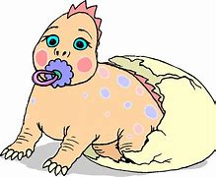
ridiculous

Slide 174
Let’s Teach and Practise

Slide 175
Words with a
/shuhn/ sound, spelt with ‘tion’ changing verbs to a nouns

Slide 176
-tion

Slide 177
-ation verb -> noun

Slide 178

information

Slide 179

adoration

Slide 180
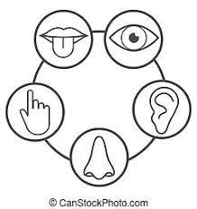
sensation

Slide 181
information
inform +ation = information
VERB -> NOUN
Definition - facts provided or learned about something or someone

Slide 182
adoration
adore (-e)+ation = adoration
VERB -> NOUN
Definition - deep love and respect

Slide 183
sensation
sense (-e) +ation = sensation
VERB -> NOUN
Definition - a physical feeling or perception resulting from something that happens to or comes into contact with the body

Slide 184
A vital piece of information went missing from the file.
___________

Slide 185
They gave the puppy a look of pure adoration.
_________

Slide 186
A burning sensation on the tongue was felt when they ate spicy food.
_________

Slide 187
New CHALLENGE words.

Slide 188

thought
NOUN
Definition - an idea or opinion produced by thinking, or occurring suddenly in the mind

Slide 189
Maggie had a sudden thought.
_______

Slide 190

weight
NOUN
Definition - a body's relative mass or the quantity of matter contained by it, giving rise to a downward force

Slide 191
He was fifteen stone in weight.
______

Slide 192
Let’s investigate.

Slide 193
Can you spot the spelling errors in these sentences?
Write the correct spelling and explain where they went wrong.

Slide 194
I fault the informasion the zoo provided about the wait of the different animals was very useful.

Slide 195
I fault the informasion the zoo provided about the wait of the different animals was very useful.

Slide 196
I fault the informasion the zoo provided about the wait of the different animals was very useful. thought – incorrect near homophone used

Slide 197
I fault the informasion the zoo provided about the wait of the different animals was very useful. information – verb inform + ation

Slide 198
I fault the informasion the zoo provided about the wait of the different animals was very useful. weight – incorrect homophone

Slide 199
I thought the information the zoo provided about the weight of the different animals was very useful.

