Slide 1
Spelling Y4
Mastering spellings: building on the foundations of phonics
Summer 1
Week 1

Slide 2
Year 4 - Summer 1
Week 1 - Monday

Slide 3
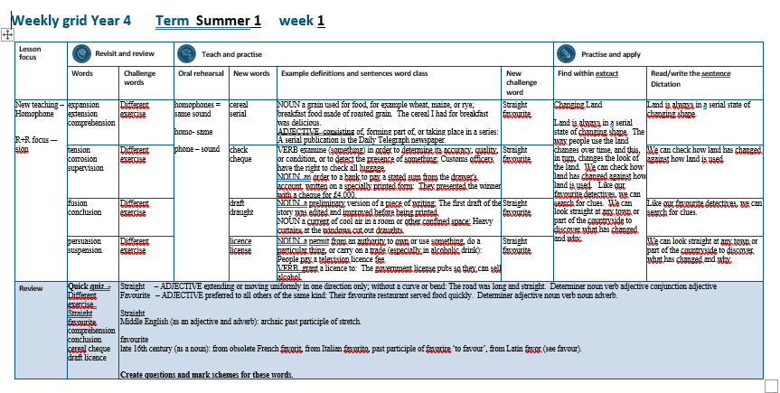

Slide 4
Let’s Revisit and Review…

Slide 5
Do you remember this challenge word?

Slide 6
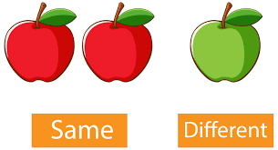
different
ADJECTIVE
Definition - not the same as another or each other; unlike in nature, form, or quality

Slide 7
You can play this game in different ways.
_________

Slide 8

exercise
NOUN
Definition - activity requiring physical effort, carried out to sustain or improve health and fitness

Slide 9
Exercise improves your heart and lung power.
________

Slide 10
Words with a
/shuhn/ sound, spelt with ‘sion’
(if root word ends in
‘se’, ‘de’ or ‘d’)

Slide 11
-sion

Slide 12

expansion

Slide 13
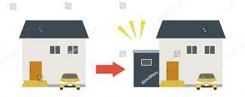
extension

Slide 14
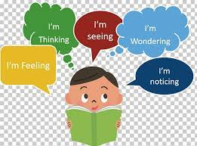
comprehension

Slide 15
Let’s Teach and Practise

Slide 16
homophones = same sound homo- same phone – sound

Slide 17
homophones

Slide 18
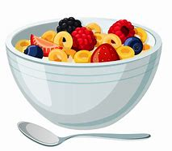
cereal

Slide 19

serial

Slide 20
cereal
NOUN
Definition - a grain used for food, for example wheat, maize, or rye; breakfast food made of roasted grain

Slide 21
serial
ADJECTIVE
Definition - consisting of, forming part of, or taking place in a series

Slide 22
The cereal I had for breakfast was delicious.
______

Slide 23
A serial publication is the Daily Telegraph newspaper.
______

Slide 24
New CHALLENGE words.

Slide 25
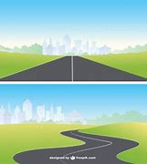
straight
ADJECTIVE
Definition - extending or moving uniformly in one direction only; without a curve or bend

Slide 26
The road was long and straight.
________

Slide 27

favourite
ADJECTIVE
Definition - preferred to all others of the same kind

Slide 28
Their favourite restaurant served food quickly.
_________

Slide 29
Let’s Practise and Apply.

Slide 30
Can you spot the spelling rule words and the challenge words?

Slide 31
Changing Land
Land is always in a serial state of changing shape. The way people use the land changes over time, and this, in turn, changes the look of the land. We can check how land has changed against how land is used. Like our favourite detectives, we can search for clues. We can look straight at any town or part of the countryside to discover what has changed and why.

Slide 32
Changing Land
Land is always in a serial state of changing shape. The way people use the land changes over time, and this, in turn, changes the look of the land. We can check how land has changed against how land is used. Like our favourite detectives, we can search for clues. We can look straight at any town or part of the countryside to discover what has changed and why.

Slide 33
Write this sentence as I dictate it to you.
Notes:
Land is always in a serial state of changing shape.

Slide 34
Land is always in a serial state of changing shape.
Did you write it correctly?
Edit your work and make sure you have it correct.
Can you underline the spelling word that we have covered in this session?

Slide 35
Year 4 - Summer 1
Week 1 - Tuesday
Notes:
Revisit and review the words from previous teaching and challenge words – I say, we say, you say
Ask children to write words only in their spelling book
Introduce the new spelling rule
Children to write the new spelling rule words and challenge words into books when the sentences are shown with the spelling word missing.
Read the extract with the class as choral reading. Practise model of prosody etc.
Ask children to find the spelling words from the session in the text.
Then read allowed the chosen sentence for children to write fully in their books.
Show the extract and ask children to then edit their work to check they were correct in their dictation.

Slide 37
Let’s Revisit and Review…

Slide 38
Do you remember this challenge word?

Slide 39
different
ADJECTIVE
Definition - not the same as another or each other; unlike in nature, form, or quality

Slide 40
You can play this game in different ways.
_________

Slide 41
exercise
NOUN
Definition - activity requiring physical effort, carried out to sustain or improve health and fitness

Slide 42
Exercise improves your heart and lung power.
________

Slide 43
Words with a
/shuhn/ sound, spelt with ‘sion’
(if root word ends in
‘se’, ‘de’ or ‘d’)

Slide 44
-sion

Slide 45
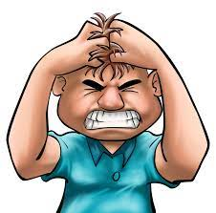
tension

Slide 46

corrosion

Slide 47

supervision

Slide 48
Let’s Teach and Practise

Slide 49
homophones = same sound homo- same phone – sound

Slide 50
homophones

Slide 51

cheque

Slide 52

check

Slide 53
cheque
NOUN
Definition - an order to a bank to pay a stated sum from the drawer's account, written on a specially printed form

Slide 54
check
VERB
Definition - examine (something) in order to determine its accuracy, quality, or condition, or to detect the presence of something

Slide 55
They presented the winner with a cheque for £4,000.
______

Slide 56
Customs officers have the right to check all luggage.
_____

Slide 57
New CHALLENGE words.

Slide 58
straight
ADJECTIVE
Definition - extending or moving uniformly in one direction only; without a curve or bend

Slide 59
The road was long and straight.
________

Slide 60
favourite
ADJECTIVE
Definition - preferred to all others of the same kind

Slide 61
Their favourite restaurant served food quickly.
_________

Slide 62
Let’s Practise and Apply.

Slide 63
Can you spot the spelling rule words and the challenge words?

Slide 64
Changing Land
Land is always in a serial state of changing shape. The way people use the land changes over time, and this, in turn, changes the look of the land. We can check how land has changed against how land is used. Like our favourite detectives, we can search for clues. We can look straight at any town or part of the countryside to discover what has changed and why.

Slide 65
Changing Land
Land is always in a serial state of changing shape. The way people use the land changes over time, and this, in turn, changes the look of the land. We can check how land has changed against how land is used. Like our favourite detectives, we can search for clues. We can look straight at any town or part of the countryside to discover what has changed and why.

Slide 66
Write this sentence as I dictate it to you.
Notes:
We can check how land has changed against how land is used.

Slide 67
We can check how land has changed against how land is used.
Did you write it correctly?
Edit your work and make sure you have it correct.
Can you underline the spelling word that we have covered in this session?

Slide 68
Year 4 - Summer 1
Week 1 - Wednesday
Notes:
Revisit and review the words from previous teaching and challenge words – I say, we say, you say
Ask children to write words only in their spelling book
Introduce the new spelling rule
Children to write the new spelling rule words and challenge words into books when the sentences are shown with the spelling word missing.
Read the extract with the class as choral reading. Practise model of prosody etc.
Ask children to find the spelling words from the session in the text.
Then read allowed the chosen sentence for children to write fully in their books.
Show the extract and ask children to then edit their work to check they were correct in their dictation.

Slide 70
Let’s Revisit and Review…

Slide 71
Do you remember this challenge word?

Slide 72
different
ADJECTIVE
Definition - not the same as another or each other; unlike in nature, form, or quality

Slide 73
You can play this game in different ways.
_________

Slide 74
exercise
NOUN
Definition - activity requiring physical effort, carried out to sustain or improve health and fitness

Slide 75
Exercise improves your heart and lung power.
________

Slide 76
Words with a
/shuhn/ sound, spelt with ‘sion’
(if root word ends in
‘se’, ‘de’ or ‘d’)

Slide 77
-sion

Slide 78
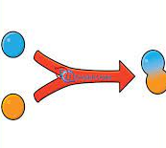
fusion

Slide 79

conclusion

Slide 80
Let’s Teach and Practise

Slide 81
homophones = same sound homo- same phone – sound

Slide 82
homophones

Slide 83

draft

Slide 84
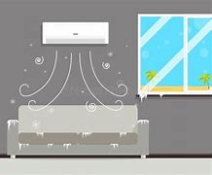
draught

Slide 85
draft
NOUN
Definition - a preliminary version of a piece of writing

Slide 86
draught
NOUN
Definition - a current of cool air in a room or other confined space

Slide 87
The first draft of the story was edited and improved before being printed.
_____

Slide 88
Heavy curtains at the windows cut out draughts.
________

Slide 89
New CHALLENGE words.

Slide 90
straight
ADJECTIVE
Definition - extending or moving uniformly in one direction only; without a curve or bend

Slide 91
The road was long and straight.
________

Slide 92
favourite
ADJECTIVE
Definition - preferred to all others of the same kind

Slide 93
Their favourite restaurant served food quickly.
_________

Slide 94
Let’s Practise and Apply.

Slide 95
Can you spot the spelling rule words and the challenge words?

Slide 96
Changing Land
Land is always in a serial state of changing shape. The way people use the land changes over time, and this, in turn, changes the look of the land. We can check how land has changed against how land is used. Like our favourite detectives, we can search for clues. We can look straight at any town or part of the countryside to discover what has changed and why.

Slide 97
Changing Land
Land is always in a serial state of changing shape. The way people use the land changes over time, and this, in turn, changes the look of the land. We can check how land has changed against how land is used. Like our favourite detectives, we can search for clues. We can look straight at any town or part of the countryside to discover what has changed and why.

Slide 98
Write this sentence as I dictate it to you.
Notes:
Like our favourite detectives, we can search for clues.

Slide 99
Like our favourite detectives, we can search for clues.
Did you write it correctly?
Edit your work and make sure you have it correct.
Can you underline the spelling word that we have covered in this session?

Slide 100
Year 4 - Summer 1
Week 1 - Thursday
Notes:
Revisit and review the words from previous teaching and challenge words – I say, we say, you say
Ask children to write words only in their spelling book
Introduce the new spelling rule
Children to write the new spelling rule words and challenge words into books when the sentences are shown with the spelling word missing.
Read the extract with the class as choral reading. Practise model of prosody etc.
Ask children to find the spelling words from the session in the text.
Then read allowed the chosen sentence for children to write fully in their books.
Show the extract and ask children to then edit their work to check they were correct in their dictation.

Slide 102
Let’s Revisit and Review…

Slide 103
Do you remember this challenge word?

Slide 104
different
ADJECTIVE
Definition - not the same as another or each other; unlike in nature, form, or quality

Slide 105
You can play this game in different ways.
_________

Slide 106
exercise
NOUN
Definition - activity requiring physical effort, carried out to sustain or improve health and fitness

Slide 107
Exercise improves your heart and lung power.
________

Slide 108
Words with a
/shuhn/ sound, spelt with ‘sion’
(if root word ends in
‘se’, ‘de’ or ‘d’)

Slide 109
-sion

Slide 110

persuasion

Slide 111

suspension

Slide 112
Let’s Teach and Practise

Slide 113
homophones = same sound homo- same phone – sound

Slide 114
homophones

Slide 115

licence

Slide 116

license

Slide 117
licence
NOUN
Definition - a permit from an authority to own or use something, do a particular thing, or carry on a trade (especially in alcoholic drink)

Slide 118
license
VERB
Definition - grant a licence to

Slide 119
People pay a television licence fee.
_______

Slide 120
The government license pubs so they can sell alcohol.
_______

Slide 121
New CHALLENGE words.

Slide 122
straight
ADJECTIVE
Definition - extending or moving uniformly in one direction only; without a curve or bend

Slide 123
The road was long and straight.
________

Slide 124
favourite
ADJECTIVE
Definition - preferred to all others of the same kind

Slide 125
Their favourite restaurant served food quickly.
_________

Slide 126
Let’s Practise and Apply.

Slide 127
Can you spot the spelling rule words and the challenge words?

Slide 128
Changing Land
Land is always in a serial state of changing shape. The way people use the land changes over time, and this, in turn, changes the look of the land. We can check how land has changed against how land is used. Like our favourite detectives, we can search for clues. We can look straight at any town or part of the countryside to discover what has changed and why.

Slide 129
Changing Land
Land is always in a serial state of changing shape. The way people use the land changes over time, and this, in turn, changes the look of the land. We can check how land has changed against how land is used. Like our favourite detectives, we can search for clues. We can look straight at any town or part of the countryside to discover what has changed and why.

Slide 130
Write this sentence as I dictate it to you.
Notes:
We can look straight at any town or part of the countryside to discover what has changed and why.

Slide 131
We can look straight at any town or part of the countryside to discover what has changed and why.
Did you write it correctly?
Edit your work and make sure you have it correct.
Can you underline the spelling word that we have covered in this session?

Slide 132
Year 4 - Summer 1
Week 1 - Friday
Notes:
Click through the slides for all the R+R words for the week (both the focus and the challenge words)
Click through the slides for all the new learning this week

Slide 134
Old challenge words…

Slide 135
different

Slide 136
exercise

Slide 137
Old spelling rule words…

Slide 138
expansion

Slide 139
extension

Slide 140
comprehension

Slide 141
tension

Slide 142
corrosion

Slide 143
supervision

Slide 144
fusion

Slide 145
conclusion

Slide 146
persuasion

Slide 147
suspension

Slide 148
New spelling rule words…

Slide 149
cheque

Slide 150
draft

Slide 151
draught

Slide 152
license

Slide 153
licence

Slide 154
New challenge words…

Slide 155
straight

Slide 156
favourite

Slide 157
Quick Quiz time…
Notes:
Say these words for the quiz
Different exercise Straight favourite compréhension conclusion cereal cheque draft licence

Slide 158
Did you get them correct?
Edit your work.
different exercise straight favourite compréhension conclusion cereal cheque draft licence

Slide 159
Word class time…

Slide 160
The road was long and straight.
Determiner noun verb adjective conjunction adjective
Notes:
Ask for these words to be classed

Slide 161
Their favourite restaurant served food quickly.
Determiner adjective noun verb noun adverb
Notes:
Ask for these words to be classed

Slide 162
Etymology
The history of a word….

Slide 163
Straight
Middle English (as an adjective and adverb): archaic past participle of stretch.
Favourite
Late 16th century (as a noun): from obsolete French favorit, from Italian favorito, past participle of favorire ‘to favour’, from Latin favor (see favour).

Slide 164
Let’s investigate….
Create questions and mark schemes for these words.

