Slide 1
Spelling Y4
Mastering spellings: building on the foundations of phonics
Summer 1
Week 2

Slide 2
Year 4 - Summer 1
Week 2 - Monday

Slide 3
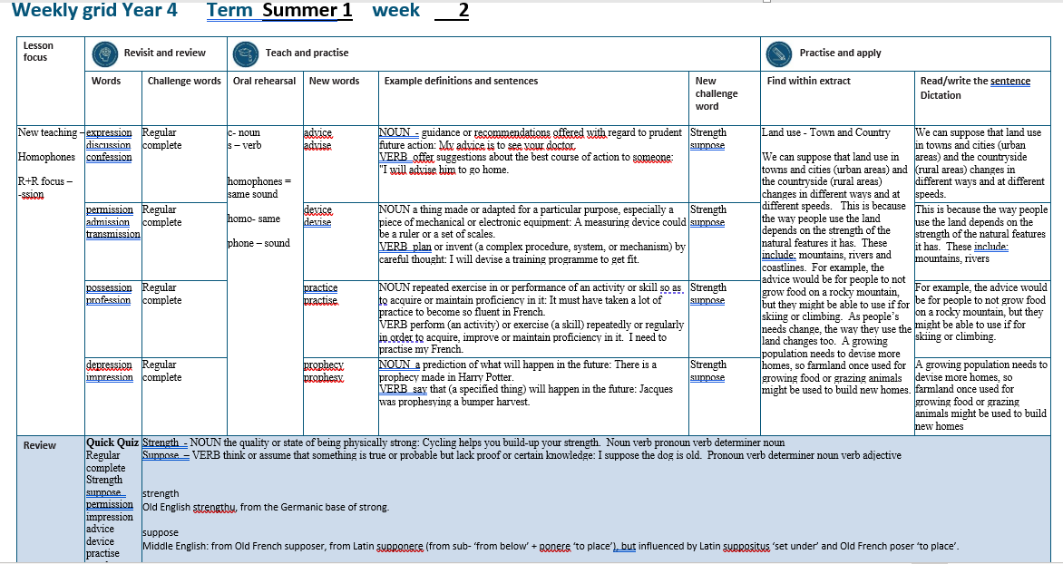

Slide 4
Let’s Revisit and Review…

Slide 5
Do you remember this challenge word?

Slide 6
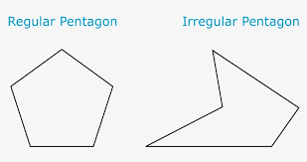
regular
ADJECTIVE
Definition - arranged in or constituting a constant or definite pattern, especially with the same space between individual instances

Slide 7
Plant the flags at regular intervals.
_______

Slide 8

complete
ADJECTIVE
Definition - having all the necessary or appropriate parts

Slide 9
A complete list of classes offered by the leisure centre was posted on their website.
________

Slide 10
Words with a
/shuhn/ sound, spelt with ‘ssion’
(if root word ends in
‘ss’ or ‘mit’

Slide 11
-ssion

Slide 12

expression

Slide 13

discussion

Slide 14
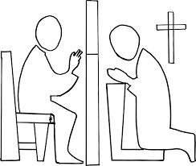
confession

Slide 15
Let’s Teach and Practise

Slide 16
homophones = same sound homo- same phone – sound

Slide 17
c - noun s – verb homophones = same sound homo- same phone – sound

Slide 18
Homophones c - noun s – verb

Slide 19

advice

Slide 20
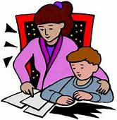
advise

Slide 21
advice
THE advice
NOUN
Definition - guidance or recommendations offered with regard to prudent future action

Slide 22
advise
TO advise
VERB
Definition - offer suggestions about the best course of action to someone

Slide 23
My advice is to see your doctor.
______

Slide 24
I will advise him to go home.
______

Slide 25
New CHALLENGE words.

Slide 26
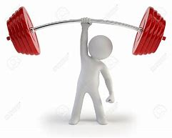
strength
NOUN
Definition - the quality or state of being physically strong

Slide 27
Cycling helps you build-up your strength.
________

Slide 28

suppose
VERB
Definition - think or assume that something is true or probable but lack proof or certain knowledge

Slide 29
I suppose the dog is old.
_______

Slide 30
Let’s Practise and Apply.

Slide 31
Can you spot the spelling rule words and the challenge words?

Slide 32
Land use - Town and Country
We can suppose that land use in towns and cities (urban areas) and the countryside (rural areas) changes in different ways and at different speeds. This is because the way people use the land depends on the strength of the natural features it has. These include: mountains, rivers and coastlines. For example, the advice would be for people to not grow food on a rocky mountain, but they might be able to use if for skiing or climbing. As people’s needs change, the way they use the land changes too. A growing population needs to devise more homes, so farmland once used for growing food or grazing animals might be used to build new homes.

Slide 33
Land use - Town and Country
We can suppose that land use in towns and cities (urban areas) and the countryside (rural areas) changes in different ways and at different speeds. This is because the way people use the land depends on the strength of the natural features it has. These include: mountains, rivers and coastlines. For example, the advice would be for people to not grow food on a rocky mountain, but they might be able to use if for skiing or climbing. As people’s needs change, the way they use the land changes too. A growing population needs to devise more homes, so farmland once used for growing food or grazing animals might be used to build new homes.

Slide 34
Write this sentence as I dictate it to you.
Notes:
We can suppose that land use in towns and cities (urban areas) and the countryside (rural areas) changes in different ways and at different speeds.

Slide 35
We can suppose that land use in towns and cities (urban areas) and the countryside (rural areas) changes in different ways and at different speeds.
Did you write it correctly?
Edit your work and make sure you have it correct.
Can you underline the spelling word that we have covered in this session?

Slide 36
Year 4 - Summer 1
Week 2 - Tuesday
Notes:
Revisit and review the words from previous teaching and challenge words – I say, we say, you say
Ask children to write words only in their spelling book
Introduce the new spelling rule
Children to write the new spelling rule words and challenge words into books when the sentences are shown with the spelling word missing.
Read the extract with the class as choral reading. Practise model of prosody etc.
Ask children to find the spelling words from the session in the text.
Then read allowed the chosen sentence for children to write fully in their books.
Show the extract and ask children to then edit their work to check they were correct in their dictation.

Slide 38
Let’s Revisit and Review…

Slide 39
Do you remember this challenge word?

Slide 40
regular
ADJECTIVE
Definition - arranged in or constituting a constant or definite pattern, especially with the same space between individual instances

Slide 41
Plant the flags at regular intervals.
_______

Slide 42
complete
ADJECTIVE
Definition - having all the necessary or appropriate parts

Slide 43
A complete list of classes offered by the leisure centre was posted on their website.
________

Slide 44
Words with a
/shuhn/ sound, spelt with ‘ssion’
(if root word ends in
‘ss’ or ‘mit’

Slide 45
-ssion

Slide 46

permission

Slide 47

admission

Slide 48

transmission

Slide 49
Let’s Teach and Practise

Slide 50
homophones = same sound homo- same phone – sound

Slide 51
c - noun s – verb homophones = same sound homo- same phone – sound

Slide 52
Homophones c - noun s – verb

Slide 53

device

Slide 54

devise

Slide 55
device
THE device
NOUN
Definition - a thing made or adapted for a particular purpose, especially a piece of mechanical or electronic equipment

Slide 56
devise
TO devise
VERB
Definition - plan or invent (a complex procedure, system, or mechanism) by careful thought

Slide 57
A measuring device could be a ruler or a set of scales.
______

Slide 58
I will devise a training programme to get fit.
______

Slide 59
New CHALLENGE words.

Slide 60
strength
NOUN
Definition - the quality or state of being physically strong

Slide 61
Cycling helps you build-up your strength.
________

Slide 62
suppose
VERB
Definition - think or assume that something is true or probable but lack proof or certain knowledge

Slide 63
I suppose the dog is old.
_______

Slide 64
Let’s Practise and Apply.

Slide 65
Can you spot the spelling rule words and the challenge words?

Slide 66
Land use - Town and Country
We can suppose that land use in towns and cities (urban areas) and the countryside (rural areas) changes in different ways and at different speeds. This is because the way people use the land depends on the strength of the natural features it has. These include: mountains, rivers and coastlines. For example, the advice would be for people to not grow food on a rocky mountain, but they might be able to use if for skiing or climbing. As people’s needs change, the way they use the land changes too. A growing population needs to devise more homes, so farmland once used for growing food or grazing animals might be used to build new homes.

Slide 67
Land use - Town and Country
We can suppose that land use in towns and cities (urban areas) and the countryside (rural areas) changes in different ways and at different speeds. This is because the way people use the land depends on the strength of the natural features it has. These include: mountains, rivers and coastlines. For example, the advice would be for people to not grow food on a rocky mountain, but they might be able to use if for skiing or climbing. As people’s needs change, the way they use the land changes too. A growing population needs to devise more homes, so farmland once used for growing food or grazing animals might be used to build new homes.

Slide 68
Write this sentence as I dictate it to you.
Notes:
This is because the way people use the land depends on the strength of the natural features it has. These include: mountains, rivers and coastlines.

Slide 69
This is because the way people use the land depends on the strength of the natural features it has. These include: mountains, rivers and coastlines.
Did you write it correctly?
Edit your work and make sure you have it correct.
Can you underline the spelling word that we have covered in this session?

Slide 70
Year 4 - Summer 1
Week 2 - Wednesday
Notes:
Revisit and review the words from previous teaching and challenge words – I say, we say, you say
Ask children to write words only in their spelling book
Introduce the new spelling rule
Children to write the new spelling rule words and challenge words into books when the sentences are shown with the spelling word missing.
Read the extract with the class as choral reading. Practise model of prosody etc.
Ask children to find the spelling words from the session in the text.
Then read allowed the chosen sentence for children to write fully in their books.
Show the extract and ask children to then edit their work to check they were correct in their dictation.

Slide 72
Let’s Revisit and Review…

Slide 73
Do you remember this challenge word?

Slide 74
regular
ADJECTIVE
Definition - arranged in or constituting a constant or definite pattern, especially with the same space between individual instances

Slide 75
Plant the flags at regular intervals.
_______

Slide 76
complete
ADJECTIVE
Definition - having all the necessary or appropriate parts

Slide 77
A complete list of classes offered by the leisure centre was posted on their website.
________

Slide 78
Words with a
/shuhn/ sound, spelt with ‘ssion’
(if root word ends in
‘ss’ or ‘mit’

Slide 79
-ssion

Slide 80

possession

Slide 81
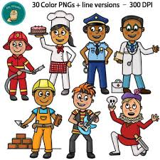
profession

Slide 82
Let’s Teach and Practise

Slide 83
homophones = same sound homo- same phone – sound

Slide 84
c - noun s – verb homophones = same sound homo- same phone – sound

Slide 85
Homophones c - noun s – verb

Slide 86

practice

Slide 87
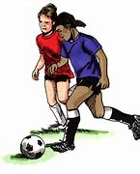
practise

Slide 88
practice
THE practice
NOUN
Definition – a place or repeated exercise in or performance of an activity or skill so as to acquire or maintain proficiency in it

Slide 89
practise
TO practise
VERB
Definition - perform (an activity) or exercise (a skill) repeatedly or regularly in order to acquire, improve or maintain proficiency in it

Slide 90
My mother took me to the dental practice to check on my teeth.
________

Slide 91
I need to practise my French.
________

Slide 92
New CHALLENGE words.

Slide 93
strength
NOUN
Definition - the quality or state of being physically strong

Slide 94
Cycling helps you build-up your strength.
________

Slide 95
suppose
VERB
Definition - think or assume that something is true or probable but lack proof or certain knowledge

Slide 96
I suppose the dog is old.
_______

Slide 97
Let’s Practise and Apply.

Slide 98
Can you spot the spelling rule words and the challenge words?

Slide 99
Land use - Town and Country
We can suppose that land use in towns and cities (urban areas) and the countryside (rural areas) changes in different ways and at different speeds. This is because the way people use the land depends on the strength of the natural features it has. These include: mountains, rivers and coastlines. For example, the advice would be for people to not grow food on a rocky mountain, but they might be able to use if for skiing or climbing. As people’s needs change, the way they use the land changes too. A growing population needs to devise more homes, so farmland once used for growing food or grazing animals might be used to build new homes.

Slide 100
Land use - Town and Country
We can suppose that land use in towns and cities (urban areas) and the countryside (rural areas) changes in different ways and at different speeds. This is because the way people use the land depends on the strength of the natural features it has. These include: mountains, rivers and coastlines. For example, the advice would be for people to not grow food on a rocky mountain, but they might be able to use if for skiing or climbing. As people’s needs change, the way they use the land changes too. A growing population needs to devise more homes, so farmland once used for growing food or grazing animals might be used to build new homes.

Slide 101
Write this sentence as I dictate it to you.
Notes:
For example, the advice would be for people to not grow food on a rocky mountain, but they might be able to use if for skiing or climbing.

Slide 102
For example, the advice would be for people to not grow food on a rocky mountain, but they might be able to use if for skiing or climbing.
Did you write it correctly?
Edit your work and make sure you have it correct.
Can you underline the spelling word that we have covered in this session?

Slide 103
Year 4 - Summer 1
Week 2 - Thursday
Notes:
Revisit and review the words from previous teaching and challenge words – I say, we say, you say
Ask children to write words only in their spelling book
Introduce the new spelling rule
Children to write the new spelling rule words and challenge words into books when the sentences are shown with the spelling word missing.
Read the extract with the class as choral reading. Practise model of prosody etc.
Ask children to find the spelling words from the session in the text.
Then read allowed the chosen sentence for children to write fully in their books.
Show the extract and ask children to then edit their work to check they were correct in their dictation.

Slide 105
Let’s Revisit and Review…

Slide 106
Do you remember this challenge word?

Slide 107
regular
ADJECTIVE
Definition - arranged in or constituting a constant or definite pattern, especially with the same space between individual instances

Slide 108
Plant the flags at regular intervals.
_______

Slide 109
complete
ADJECTIVE
Definition - having all the necessary or appropriate parts

Slide 110
A complete list of classes offered by the leisure centre was posted on their website.
________

Slide 111
Words with a
/shuhn/ sound, spelt with ‘ssion’
(if root word ends in
‘ss’ or ‘mit’

Slide 112
-ssion

Slide 113
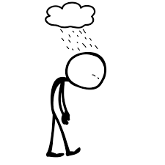
depression

Slide 114

impression

Slide 115
Let’s Teach and Practise

Slide 116
homophones = same sound homo- same phone – sound

Slide 117
c - noun s – verb homophones = same sound homo- same phone – sound

Slide 118
Homophones c - noun s – verb

Slide 119
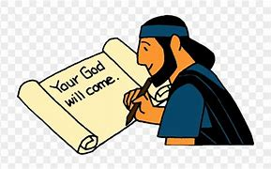
prophecy

Slide 120
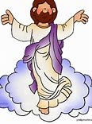
prophesy

Slide 121
prophecy
THE prophecy
NOUN
Definition - a prediction of what will happen in the future

Slide 122
prophesy
TO prophesy
VERB
Definition - saying that (a specified thing) will happen in the future

Slide 123
There is a prophecy made in Harry Potter.
________

Slide 124
Jacques was prophesying a bumper harvest.
___________

Slide 125
New CHALLENGE words.

Slide 126
strength
NOUN
Definition - the quality or state of being physically strong

Slide 127
Cycling helps you build-up your strength.
________

Slide 128
suppose
VERB
Definition - think or assume that something is true or probable but lack proof or certain knowledge

Slide 129
I suppose the dog is old.
_______

Slide 130
Let’s Practise and Apply.

Slide 131
Can you spot the spelling rule words and the challenge words?

Slide 132
Land use - Town and Country
We can suppose that land use in towns and cities (urban areas) and the countryside (rural areas) changes in different ways and at different speeds. This is because the way people use the land depends on the strength of the natural features it has. These include: mountains, rivers and coastlines. For example, the advice would be for people to not grow food on a rocky mountain, but they might be able to use if for skiing or climbing. As people’s needs change, the way they use the land changes too. A growing population needs to devise more homes, so farmland once used for growing food or grazing animals might be used to build new homes.

Slide 133
Land use - Town and Country
We can suppose that land use in towns and cities (urban areas) and the countryside (rural areas) changes in different ways and at different speeds. This is because the way people use the land depends on the strength of the natural features it has. These include: mountains, rivers and coastlines. For example, the advice would be for people to not grow food on a rocky mountain, but they might be able to use if for skiing or climbing. As people’s needs change, the way they use the land changes too. A growing population needs to devise more homes, so farmland once used for growing food or grazing animals might be used to build new homes.

Slide 134
Write this sentence as I dictate it to you.
Notes:
A growing population needs to devise more homes, so farmland once used for growing food or grazing animals might be used to build new homes

Slide 135
A growing population needs to devise more homes, so farmland once used for growing food or grazing animals might be used to build new homes
Did you write it correctly?
Edit your work and make sure you have it correct.
Can you underline the spelling word that we have covered in this session?

Slide 136
Year 4 - Summer 1
Week 2 - Friday
Notes:
Click through the slides for all the R+R words for the week (both the focus and the challenge words)
Click through the slides for all the new learning this week

Slide 138
Old challenge words…

Slide 139
regular

Slide 140
complete

Slide 141
Old spelling rule words…

Slide 142
expression

Slide 143
discussion

Slide 144
confession

Slide 145
permission

Slide 146
admission

Slide 147
transmission

Slide 148
possession

Slide 149
profession

Slide 150
depression

Slide 151
impression

Slide 152
New challenge words…

Slide 153
strength

Slide 154
suppose

Slide 155
New spelling rule words…

Slide 156
advice

Slide 157
advise

Slide 158
device

Slide 159
devise

Slide 160
practice

Slide 161
practise

Slide 162
prophecy

Slide 163
prophesy

Slide 164
Quick Quiz time…
Notes:
Say these words for the quiz
Regular complete Strength suppose permission impression advice device practise prophecy

Slide 165
Did you get them correct?
Edit your work.
regular complete strength suppose permission impression advice device practise prophecy

Slide 166
Word class time…

Slide 167
Cycling helps you build-up your strength.
Noun verb pronoun verb determiner noun
Notes:
Ask for these words to be classed

Slide 168
I suppose the dog is old.
Pronoun verb determiner noun verb adjective
Notes:
Ask for these words to be classed

Slide 169
Etymology
The history of a word….

Slide 170
Strength
Old English strengthu, from the Germanic base of strong.
Suppose
Middle English: from Old French supposer, from Latin supponere (from sub- ‘from below’ + ponere ‘to place’), but influenced by Latin suppositus ‘set under’ and Old French poser ‘to place’.

Slide 171
Let’s investigate….
Find antonyms and synonyms of the challenge words.

