Slide 1
Spelling Y4
Mastering spellings: building on the foundations of phonics
Summer 1
Week 3

Slide 2
Year 4 - Summer 1
Week 3 - Monday

Slide 3
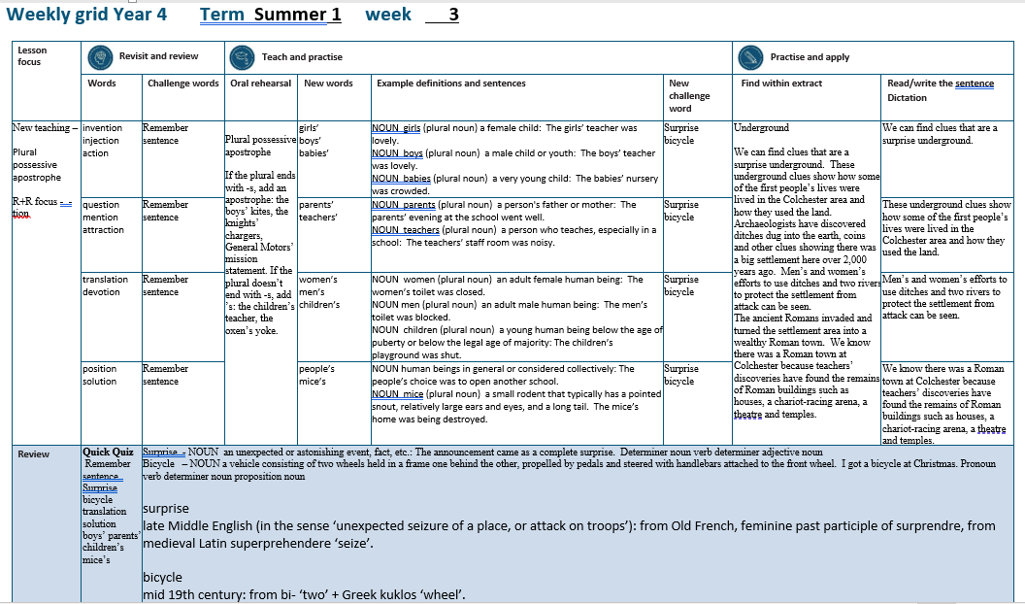

Slide 4
Let’s Revisit and Review…

Slide 5
Do you remember this challenge word?

Slide 6

remember
VERB
Definition - have in or be able to bring to one's mind an awareness of (someone or something from the past)

Slide 7
I remember all the dance moves to my favourite song.
________

Slide 8

sentence
NOUN
Definition - a set of words that is complete in itself, typically containing a subject and predicate, conveying a statement, question, exclamation, or command, and consisting of a main clause and sometimes one or more subordinate clauses.

Slide 9
A sentence is made up of words.
________

Slide 10
Words with a
/shuhn/ sound, spelt with ‘tion’
(if root word ends in
‘te’ or ‘t’ or has no definite root)

Slide 11
-tion

Slide 12

invention

Slide 13

injection

Slide 14

action

Slide 15
Let’s Teach and Practise

Slide 16
Plural possessive apostrophe

Slide 17
Plural possessive apostrophe plural = more than 1 possessive = owned by apostrophe = _’

Slide 18
Plural possessive apostrophe
If the plural ends with -s, add an apostrophe: the boys’ kites, the knights’ chargers, General Motors’ mission statement.

Slide 19
Plural possessive apostrophe
If the plural doesn’t end with -s, add ’s: the children’s teacher, the oxen’s yoke.

Slide 20
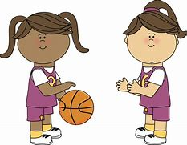
girls’

Slide 21
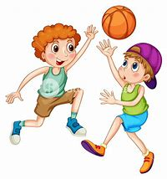
boys’

Slide 22
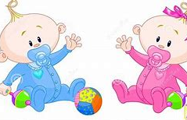
babies’

Slide 23
girls’
1 girl → 2 girls
More than 1 girl owns the ball
PLURAL NOUN

Slide 24
boys’
1 boy → 2 boys
More than 1 boy owns the ball
PLURAL NOUN

Slide 25
babies’
1 baby → 2 babies
More than 1 baby owns the ball
PLURAL NOUN

Slide 26
The girls’ teacher was lovely.
______

Slide 27
The boys’ teacher was lovely.
_____

Slide 28
The babies’ nursery was crowded.
_______

Slide 29
New CHALLENGE words.

Slide 30

surprise
NOUN
Definition - an unexpected or astonishing event, fact, etc.

Slide 31
The announcement came as a complete surprise.
________

Slide 32
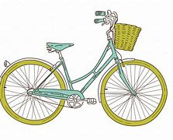
bicycle
NOUN
Definition - a vehicle consisting of two wheels held in a frame one behind the other, propelled by pedals and steered with handlebars attached to the front wheel

Slide 33
I got a bicycle at Christmas.
_______

Slide 34
Let’s Practise and Apply.

Slide 35
Can you spot the spelling rule words and the challenge words?

Slide 36
Underground
We can find clues that are a surprise underground. These underground clues show how some of the first people’s lives were lived in the Colchester area and how they used the land. Archaeologists have discovered ditches dug into the earth, coins and other clues showing there was a big settlement here over 2,000 years ago. Men’s and women’s efforts to use ditches and two rivers to protect the settlement from attack can be seen. The ancient Romans invaded and turned the settlement area into a wealthy Roman town. We know there was a Roman town at Colchester because teachers’ discoveries have found the remains of Roman buildings such as houses, a chariot-racing arena, a theatre and temples.

Slide 37
Underground
We can find clues that are a surprise underground. These underground clues show how some of the first people’s lives were lived in the Colchester area and how they used the land. Archaeologists have discovered ditches dug into the earth, coins and other clues showing there was a big settlement here over 2,000 years ago. Men’s and women’s efforts to use ditches and two rivers to protect the settlement from attack can be seen. The ancient Romans invaded and turned the settlement area into a wealthy Roman town. We know there was a Roman town at Colchester because teachers’ discoveries have found the remains of Roman buildings such as houses, a chariot-racing arena, a theatre and temples.

Slide 38
Write this sentence as I dictate it to you.
Notes:
We can find clues that are a surprise underground.

Slide 39
We can find clues that are a surprise underground.
Did you write it correctly?
Edit your work and make sure you have it correct.
Can you underline the spelling word that we have covered in this session?

Slide 40
Year 4 - Summer 1
Week 3 - Tuesday
Notes:
Revisit and review the words from previous teaching and challenge words – I say, we say, you say
Ask children to write words only in their spelling book
Introduce the new spelling rule
Children to write the new spelling rule words and challenge words into books when the sentences are shown with the spelling word missing.
Read the extract with the class as choral reading. Practise model of prosody etc.
Ask children to find the spelling words from the session in the text.
Then read allowed the chosen sentence for children to write fully in their books.
Show the extract and ask children to then edit their work to check they were correct in their dictation.

Slide 42
Let’s Revisit and Review…

Slide 43
Do you remember this challenge word?

Slide 44
remember
VERB
Definition - have in or be able to bring to one's mind an awareness of (someone or something from the past)

Slide 45
I remember all the dance moves to my favourite song.
________

Slide 46
sentence
NOUN
Definition - a set of words that is complete in itself, typically containing a subject and predicate, conveying a statement, question, exclamation, or command, and consisting of a main clause and sometimes one or more subordinate clauses.

Slide 47
A sentence is made up of words.
________

Slide 48
Words with a
/shuhn/ sound, spelt with ‘tion’
(if root word ends in
‘te’ or ‘t’ or has no definite root)

Slide 49
-tion

Slide 50

question

Slide 51

mention

Slide 52

attraction

Slide 53
Let’s Teach and Practise

Slide 54
Plural possessive apostrophe

Slide 55
Plural possessive apostrophe plural = more than 1 possessive = owned by apostrophe = _’

Slide 56
Plural possessive apostrophe
If the plural ends with -s, add an apostrophe: the boys’ kites, the knights’ chargers, General Motors’ mission statement.

Slide 57
Plural possessive apostrophe
If the plural doesn’t end with -s, add ’s: the children’s teacher, the oxen’s yoke.

Slide 58
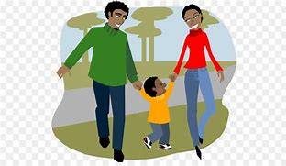
parents’

Slide 59
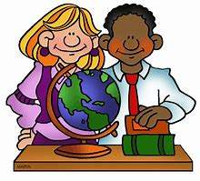
teachers’

Slide 60
parents’
1 parent → 2 parents
More than 1 parent owns the house
PLURAL NOUN

Slide 61
teachers’
1 teacher → 2 teachers
More than 1 teacher owns the textbooks
PLURAL NOUN

Slide 62
The parents’ evening at the school went well.
________

Slide 63
The teachers’ staff room was noisy.
_________

Slide 64
New CHALLENGE words.

Slide 65
surprise
NOUN
Definition - an unexpected or astonishing event, fact, etc.

Slide 66
The announcement came as a complete surprise.
________

Slide 67
bicycle
NOUN
Definition - a vehicle consisting of two wheels held in a frame one behind the other, propelled by pedals and steered with handlebars attached to the front wheel

Slide 68
I got a bicycle at Christmas.
_______

Slide 69
Let’s Practise and Apply.

Slide 70
Can you spot the spelling rule words and the challenge words?

Slide 71
Underground
We can find clues that are a surprise underground. These underground clues show how some of the first people’s lives were lived in the Colchester area and how they used the land. Archaeologists have discovered ditches dug into the earth, coins and other clues showing there was a big settlement here over 2,000 years ago. Men’s and women’s efforts to use ditches and two rivers to protect the settlement from attack can be seen. The ancient Romans invaded and turned the settlement area into a wealthy Roman town. We know there was a Roman town at Colchester because teachers’ discoveries have found the remains of Roman buildings such as houses, a chariot-racing arena, a theatre and temples.

Slide 72
Underground
We can find clues that are a surprise underground. These underground clues show how some of the first people’s lives were lived in the Colchester area and how they used the land. Archaeologists have discovered ditches dug into the earth, coins and other clues showing there was a big settlement here over 2,000 years ago. Men’s and women’s efforts to use ditches and two rivers to protect the settlement from attack can be seen. The ancient Romans invaded and turned the settlement area into a wealthy Roman town. We know there was a Roman town at Colchester because teachers’ discoveries have found the remains of Roman buildings such as houses, a chariot-racing arena, a theatre and temples.

Slide 73
Write this sentence as I dictate it to you.
Notes:
These underground clues show how some of the first people’s lives were lived in the Colchester area and how they used the land.

Slide 74
These underground clues show how some of the first people’s lives were lived in the Colchester area and how they used the land.
Did you write it correctly?
Edit your work and make sure you have it correct.
Can you underline the spelling word that we have covered in this session?

Slide 75
Year 4 - Summer 1
Week 3 - Wednesday
Notes:
Revisit and review the words from previous teaching and challenge words – I say, we say, you say
Ask children to write words only in their spelling book
Introduce the new spelling rule
Children to write the new spelling rule words and challenge words into books when the sentences are shown with the spelling word missing.
Read the extract with the class as choral reading. Practise model of prosody etc.
Ask children to find the spelling words from the session in the text.
Then read allowed the chosen sentence for children to write fully in their books.
Show the extract and ask children to then edit their work to check they were correct in their dictation.

Slide 77
Let’s Revisit and Review…

Slide 78
Do you remember this challenge word?

Slide 79
remember
VERB
Definition - have in or be able to bring to one's mind an awareness of (someone or something from the past)

Slide 80
I remember all the dance moves to my favourite song.
________

Slide 81
sentence
NOUN
Definition - a set of words that is complete in itself, typically containing a subject and predicate, conveying a statement, question, exclamation, or command, and consisting of a main clause and sometimes one or more subordinate clauses.

Slide 82
A sentence is made up of words.
________

Slide 83
Words with a
/shuhn/ sound, spelt with ‘tion’
(if root word ends in
‘te’ or ‘t’ or has no definite root)

Slide 84
-tion

Slide 85

translation

Slide 86

devotion

Slide 87
Let’s Teach and Practise

Slide 88
Plural possessive apostrophe

Slide 89
Plural possessive apostrophe plural = more than 1 possessive = owned by apostrophe = _’

Slide 90
Plural possessive apostrophe
If the plural ends with -s, add an apostrophe: the boys’ kites, the knights’ chargers, General Motors’ mission statement.

Slide 91
Plural possessive apostrophe
If the plural doesn’t end with -s, add ’s: the children’s teacher, the oxen’s yoke.

Slide 92
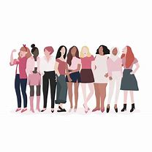
women’s

Slide 93
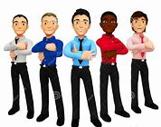
men’s

Slide 94

children’s

Slide 95
women’s
1 woman → 2 women
More than 1 woman owns the club
PLURAL NOUN

Slide 96
men’s
1 man → 2 men
More than 1 man owns the club
PLURAL NOUN

Slide 97
children’s
1 child → 2 children
More than 1 child owns the classroom
PLURAL NOUN

Slide 98
The women’s toilet was closed.
_______

Slide 99
The men’s toilet was blocked.
_____

Slide 100
The children’s playground was shut.
__________

Slide 101
New CHALLENGE words.

Slide 102
surprise
NOUN
Definition - an unexpected or astonishing event, fact, etc.

Slide 103
The announcement came as a complete surprise.
________

Slide 104
bicycle
NOUN
Definition - a vehicle consisting of two wheels held in a frame one behind the other, propelled by pedals and steered with handlebars attached to the front wheel

Slide 105
I got a bicycle at Christmas.
_______

Slide 106
Let’s Practise and Apply.

Slide 107
Can you spot the spelling rule words and the challenge words?

Slide 108
Underground
We can find clues that are a surprise underground. These underground clues show how some of the first people’s lives were lived in the Colchester area and how they used the land. Archaeologists have discovered ditches dug into the earth, coins and other clues showing there was a big settlement here over 2,000 years ago. Men’s and women’s efforts to use ditches and two rivers to protect the settlement from attack can be seen. The ancient Romans invaded and turned the settlement area into a wealthy Roman town. We know there was a Roman town at Colchester because teachers’ discoveries have found the remains of Roman buildings such as houses, a chariot-racing arena, a theatre and temples.

Slide 109
Underground
We can find clues that are a surprise underground. These underground clues show how some of the first people’s lives were lived in the Colchester area and how they used the land. Archaeologists have discovered ditches dug into the earth, coins and other clues showing there was a big settlement here over 2,000 years ago. Men’s and women’s efforts to use ditches and two rivers to protect the settlement from attack can be seen. The ancient Romans invaded and turned the settlement area into a wealthy Roman town. We know there was a Roman town at Colchester because teachers’ discoveries have found the remains of Roman buildings such as houses, a chariot-racing arena, a theatre and temples.

Slide 110
Write this sentence as I dictate it to you.
Notes:
Men’s and women’s efforts to use ditches and two rivers to protect the settlement from attack can be seen.

Slide 111
Men’s and women’s efforts to use ditches and two rivers to protect the settlement from attack can be seen.
Did you write it correctly?
Edit your work and make sure you have it correct.
Can you underline the spelling word that we have covered in this session?

Slide 112
Year 4 - Summer 1
Week 3 - Thursday
Notes:
Revisit and review the words from previous teaching and challenge words – I say, we say, you say
Ask children to write words only in their spelling book
Introduce the new spelling rule
Children to write the new spelling rule words and challenge words into books when the sentences are shown with the spelling word missing.
Read the extract with the class as choral reading. Practise model of prosody etc.
Ask children to find the spelling words from the session in the text.
Then read allowed the chosen sentence for children to write fully in their books.
Show the extract and ask children to then edit their work to check they were correct in their dictation.

Slide 114
Let’s Revisit and Review…

Slide 115
Do you remember this challenge word?

Slide 116
remember
VERB
Definition - have in or be able to bring to one's mind an awareness of (someone or something from the past)

Slide 117
I remember all the dance moves to my favourite song.
________

Slide 118
sentence
NOUN
Definition - a set of words that is complete in itself, typically containing a subject and predicate, conveying a statement, question, exclamation, or command, and consisting of a main clause and sometimes one or more subordinate clauses.

Slide 119
A sentence is made up of words.
________

Slide 120
Words with a
/shuhn/ sound, spelt with ‘tion’
(if root word ends in
‘te’ or ‘t’ or has no definite root)

Slide 121
-tion

Slide 122

position

Slide 123

solution

Slide 124
Let’s Teach and Practise

Slide 125
Plural possessive apostrophe

Slide 126
Plural possessive apostrophe plural = more than 1 possessive = owned by apostrophe = _’

Slide 127
Plural possessive apostrophe
If the plural ends with -s, add an apostrophe: the boys’ kites, the knights’ chargers, General Motors’ mission statement.

Slide 128
Plural possessive apostrophe
If the plural doesn’t end with -s, add ’s: the children’s teacher, the oxen’s yoke.

Slide 129

people’s

Slide 130
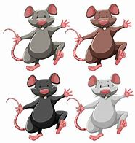
mice’s

Slide 131
people’s
1 person → 2 people
More than 1 person owns the newspaper
PLURAL NOUN

Slide 132
mice’s
1 mouse → 2 mice
More than 1 mouse owns the cheese
PLURAL NOUN

Slide 133
The people’s choice was to open another school.
________

Slide 134
The mice’s home was being destroyed.
______

Slide 135
New CHALLENGE words.

Slide 136
surprise
NOUN
Definition - an unexpected or astonishing event, fact, etc.

Slide 137
The announcement came as a complete surprise.
________

Slide 138
bicycle
NOUN
Definition - a vehicle consisting of two wheels held in a frame one behind the other, propelled by pedals and steered with handlebars attached to the front wheel

Slide 139
I got a bicycle at Christmas.
_______

Slide 140
Let’s Practise and Apply.

Slide 141
Can you spot the spelling rule words and the challenge words?

Slide 142
Underground
We can find clues that are a surprise underground. These underground clues show how some of the first people’s lives were lived in the Colchester area and how they used the land. Archaeologists have discovered ditches dug into the earth, coins and other clues showing there was a big settlement here over 2,000 years ago. Men’s and women’s efforts to use ditches and two rivers to protect the settlement from attack can be seen. The ancient Romans invaded and turned the settlement area into a wealthy Roman town. We know there was a Roman town at Colchester because teachers’ discoveries have found the remains of Roman buildings such as houses, a chariot-racing arena, a theatre and temples.

Slide 143
Underground
We can find clues that are a surprise underground. These underground clues show how some of the first people’s lives were lived in the Colchester area and how they used the land. Archaeologists have discovered ditches dug into the earth, coins and other clues showing there was a big settlement here over 2,000 years ago. Men’s and women’s efforts to use ditches and two rivers to protect the settlement from attack can be seen. The ancient Romans invaded and turned the settlement area into a wealthy Roman town. We know there was a Roman town at Colchester because teachers’ discoveries have found the remains of Roman buildings such as houses, a chariot-racing arena, a theatre and temples.

Slide 144
Write this sentence as I dictate it to you.
Notes:
We know there was a Roman town at Colchester because teachers’ discoveries have found the remains of Roman buildings such as houses, a chariot-racing arena, a theatre and temples.

Slide 145
We know there was a Roman town at Colchester because teachers’ discoveries have found the remains of Roman buildings such as houses, a chariot-racing arena, a theatre and temples.
Did you write it correctly?
Edit your work and make sure you have it correct.
Can you underline the spelling word that we have covered in this session?

Slide 146
Year 4 - Summer 1
Week 3 - Friday
Notes:
Click through the slides for all the R+R words for the week (both the focus and the challenge words)
Click through the slides for all the new learning this week

Slide 148
Old challenge words…

Slide 149
remember

Slide 150
sentence

Slide 151
Old spelling rule words…

Slide 152
invention

Slide 153
injection

Slide 154
action

Slide 155
question

Slide 156
mention

Slide 157
attraction

Slide 158
translation

Slide 159
devotion

Slide 160
position

Slide 161
solution

Slide 162
New challenge words…

Slide 163
surprise

Slide 164
bicycle

Slide 165
New spelling rule words…

Slide 166
girls’

Slide 167
boys’

Slide 168
babies’

Slide 169
parents’

Slide 170
teachers’

Slide 171
women’s

Slide 172
men’s

Slide 173
children’s

Slide 174
people’s

Slide 175
mice’s

Slide 176
Quick Quiz time…
Notes:
Say these words for the quiz
Remember sentence Surprise bicycle translation solution boys’ parents’ children’s mice’s

Slide 177
Did you get them correct?
Edit your work.
remember sentence surprise bicycle translation solution boys’ parents’ children’s mice’s

Slide 178
Word class time…

Slide 179
The announcement came as a complete surprise.
Determiner noun verb determiner adjective noun
Notes:
Ask for these words to be classed

Slide 180
I got a bicycle at Christmas.
Pronoun verb determiner noun proposition noun
Notes:
Ask for these words to be classed

Slide 181
Etymology
The history of a word….

Slide 182
Surprise
Late Middle English (in the sense ‘unexpected seizure of a place, or attack on troops’): from Old French, feminine past participle of surprendre, from medieval Latin superprehendere ‘seize’.
Bicycle
Mid 19th century: from bi- ‘two’ + Greek kuklos ‘wheel’.

Slide 183
Let’s investigate….
Look at the word origin of the challenge words and find words that are linked to them.

