Slide 1
Spelling Y4
Mastering spellings: building on the foundations of phonics
Summer 1
Week 4

Slide 2
Year 4 - Summer 1
Week 4 - Monday

Slide 3
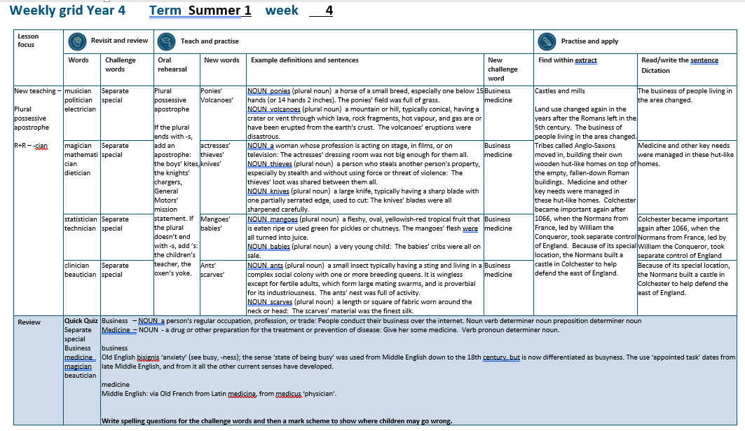

Slide 4
Let’s Revisit and Review…

Slide 5
Do you remember this challenge word?

Slide 6
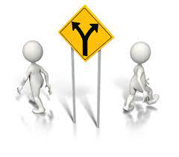
separate
ADJECTIVE
Definition - forming or viewed as a unit apart or by itself

Slide 7
It raises two separate issues.
________

Slide 8

special
ADJECTIVE
Definition - better, greater, or otherwise different from what is usual

Slide 9
They always made a special effort at Christmas.
_______

Slide 10
Words with a
/shuhn/ sound, spelt with ‘cian’
(if root word ends in
‘c’ or ‘cs’)

Slide 11
-cian

Slide 12
-cian usually ‘cian’ ending words are showing someone’s profession or job

Slide 13
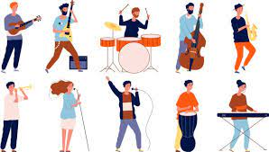
musician

Slide 14

politician

Slide 15

electrician

Slide 16
Let’s Teach and Practise

Slide 17
Plural possessive apostrophe

Slide 18
Plural possessive apostrophe plural = more than 1 possessive = owned by apostrophe = _’

Slide 19
Plural possessive apostrophe
If the plural ends with -s, add an apostrophe: the boys’ kites, the knights’ chargers, General Motors’ mission statement.

Slide 20
Plural possessive apostrophe
If the plural doesn’t end with -s, add ’s: the children’s teacher, the oxen’s yoke.

Slide 21
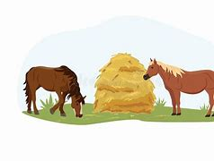
ponies’

Slide 22
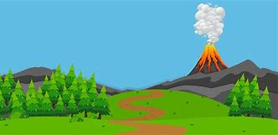
volcanoes’

Slide 23

girls’
1 horse → 2 horses
More than 1 horse owns the hay
PLURAL NOUN

Slide 24
volcanoes’
1 volcano → 2 volcanoes
More than 1 volcano owns the ash in the air
PLURAL NOUN

Slide 25
The ponies’ field was full of grass.
_______

Slide 26
The volcanoes’ eruptions were disastrous.
__________

Slide 27
New CHALLENGE words.

Slide 28

business
NOUN
Definition - a person's regular occupation, profession, or trade

Slide 29
People conduct their business over the internet.
________

Slide 30
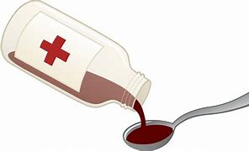
medicine
NOUN
Definition - a drug or other preparation for the treatment or prevention of disease

Slide 31
Give her some medicine.
________

Slide 32
Let’s Practise and Apply.

Slide 33
Can you spot the spelling rule words and the challenge words?

Slide 34
Castles and mills
Land use changed again in the years after the Romans left in the 5th century. The business of people living in the area changed. Tribes called Anglo-Saxons moved in, building their own wooden hut-like homes on top of the empty, fallen-down Roman buildings. Medicine and other key needs were managed in these hut-like homes. Colchester became important again after 1066, when the Normans from France, led by William the Conqueror, took separate control of England. Because of its special location, the Normans built a castle in Colchester to help defend the east of England.

Slide 35
Castles and mills
Land use changed again in the years after the Romans left in the 5th century. The business of people living in the area changed. Tribes called Anglo-Saxons moved in, building their own wooden hut-like homes on top of the empty, fallen-down Roman buildings. Medicine and other key needs were managed in these hut-like homes. Colchester became important again after 1066, when the Normans from France, led by William the Conqueror, took separate control of England. Because of its special location, the Normans built a castle in Colchester to help defend the east of England.

Slide 36
Write this sentence as I dictate it to you.
Notes:
The business of people living in the area changed.

Slide 37
The business of people living in the area changed.
Did you write it correctly?
Edit your work and make sure you have it correct.
Can you underline the spelling word that we have covered in this session?

Slide 38
Year 4 - Summer 1
Week 4 - Tuesday
Notes:
Revisit and review the words from previous teaching and challenge words – I say, we say, you say
Ask children to write words only in their spelling book
Introduce the new spelling rule
Children to write the new spelling rule words and challenge words into books when the sentences are shown with the spelling word missing.
Read the extract with the class as choral reading. Practise model of prosody etc.
Ask children to find the spelling words from the session in the text.
Then read allowed the chosen sentence for children to write fully in their books.
Show the extract and ask children to then edit their work to check they were correct in their dictation.

Slide 40
Let’s Revisit and Review…

Slide 41
Do you remember this challenge word?

Slide 42
separate
ADJECTIVE
Definition - forming or viewed as a unit apart or by itself

Slide 43
It raises two separate issues.
________

Slide 44
special
ADJECTIVE
Definition - better, greater, or otherwise different from what is usual

Slide 45
They always made a special effort at Christmas.
_______

Slide 46
Words with a
/shuhn/ sound, spelt with ‘cian’
(if root word ends in
‘c’ or ‘cs’)

Slide 47
-cian

Slide 48
-cian usually ‘cian’ ending words are showing someone’s profession or job

Slide 49
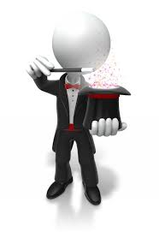
magician

Slide 50

mathematician

Slide 51
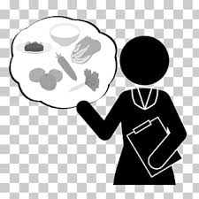
dietician

Slide 52
Let’s Teach and Practise

Slide 53
Plural possessive apostrophe

Slide 54
Plural possessive apostrophe plural = more than 1 possessive = owned by apostrophe = _’

Slide 55
Plural possessive apostrophe
If the plural ends with -s, add an apostrophe: the boys’ kites, the knights’ chargers, General Motors’ mission statement.

Slide 56
Plural possessive apostrophe
If the plural doesn’t end with -s, add ’s: the children’s teacher, the oxen’s yoke.

Slide 57

actresses’

Slide 58

thieves’

Slide 59

knives’

Slide 60
actresses’
1 actress → 2 actresses
More than 1 actress owns the award
PLURAL NOUN

Slide 61
thieves’
1 thief → 2 thieves
More than 1 thief owns the loot
PLURAL NOUN

Slide 62
knives’
1 knife → 2 knives
More than 1 knife owns the blades
PLURAL NOUN

Slide 63
The actresses’ dressing room was not big enough for them all.
__________

Slide 64
The thieves’ loot was shared between them all.
________

Slide 65
The knives’ blades were all sharpened carefully.
_______

Slide 66
New CHALLENGE words.

Slide 67
business
NOUN
Definition - a person's regular occupation, profession, or trade

Slide 68
People conduct their business over the internet.
________

Slide 69
medicine
NOUN
Definition - a drug or other preparation for the treatment or prevention of disease

Slide 70
Give her some medicine.
________

Slide 71
Let’s Practise and Apply.

Slide 72
Can you spot the spelling rule words and the challenge words?

Slide 73
Castles and mills
Land use changed again in the years after the Romans left in the 5th century. The business of people living in the area changed. Tribes called Anglo-Saxons moved in, building their own wooden hut-like homes on top of the empty, fallen-down Roman buildings. Medicine and other key needs were managed in these hut-like homes. Colchester became important again after 1066, when the Normans from France, led by William the Conqueror, took separate control of England. Because of its special location, the Normans built a castle in Colchester to help defend the east of England.

Slide 74
Castles and mills
Land use changed again in the years after the Romans left in the 5th century. The business of people living in the area changed. Tribes called Anglo-Saxons moved in, building their own wooden hut-like homes on top of the empty, fallen-down Roman buildings. Medicine and other key needs were managed in these hut-like homes. Colchester became important again after 1066, when the Normans from France, led by William the Conqueror, took separate control of England. Because of its special location, the Normans built a castle in Colchester to help defend the east of England.

Slide 75
Write this sentence as I dictate it to you.
Notes:
Medicine and other key needs were managed in these hut-like homes.

Slide 76
Medicine and other key needs were managed in these hut-like homes.
Did you write it correctly?
Edit your work and make sure you have it correct.
Can you underline the spelling word that we have covered in this session?

Slide 77
Year 4 - Summer 1
Week 4 - Wednesday
Notes:
Revisit and review the words from previous teaching and challenge words – I say, we say, you say
Ask children to write words only in their spelling book
Introduce the new spelling rule
Children to write the new spelling rule words and challenge words into books when the sentences are shown with the spelling word missing.
Read the extract with the class as choral reading. Practise model of prosody etc.
Ask children to find the spelling words from the session in the text.
Then read allowed the chosen sentence for children to write fully in their books.
Show the extract and ask children to then edit their work to check they were correct in their dictation.

Slide 79
Let’s Revisit and Review…

Slide 80
Do you remember this challenge word?

Slide 81
separate
ADJECTIVE
Definition - forming or viewed as a unit apart or by itself

Slide 82
It raises two separate issues.
________

Slide 83
special
ADJECTIVE
Definition - better, greater, or otherwise different from what is usual

Slide 84
They always made a special effort at Christmas.
_______

Slide 85
Words with a
/shuhn/ sound, spelt with ‘cian’
(if root word ends in
‘c’ or ‘cs’)

Slide 86
-cian

Slide 87
-cian usually ‘cian’ ending words are showing someone’s profession or job

Slide 88

statistician

Slide 89

technician

Slide 90
Let’s Teach and Practise

Slide 91
Plural possessive apostrophe

Slide 92
Plural possessive apostrophe plural = more than 1 possessive = owned by apostrophe = _’

Slide 93
Plural possessive apostrophe
If the plural ends with -s, add an apostrophe: the boys’ kites, the knights’ chargers, General Motors’ mission statement.

Slide 94
Plural possessive apostrophe
If the plural doesn’t end with -s, add ’s: the children’s teacher, the oxen’s yoke.

Slide 95
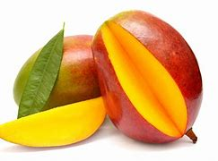
mangoes’

Slide 96
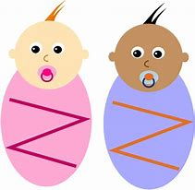
babies’

Slide 97
mangoes’
1 mango → 2 mangoes
More than 1 mango owns the skin
PLURAL NOUN

Slide 98
babies’
1 baby → 2 babies
More than 1 baby owns the swaddling cloths
PLURAL NOUN

Slide 99
The mangoes’ flesh were all turned into juice.
________

Slide 100
The babies’ cribs were all on sale.
_______

Slide 101
New CHALLENGE words.

Slide 102
business
NOUN
Definition - a person's regular occupation, profession, or trade

Slide 103
People conduct their business over the internet.
________

Slide 104
medicine
NOUN
Definition - a drug or other preparation for the treatment or prevention of disease

Slide 105
Give her some medicine.
________

Slide 106
Let’s Practise and Apply.

Slide 107
Can you spot the spelling rule words and the challenge words?

Slide 108
Castles and mills
Land use changed again in the years after the Romans left in the 5th century. The business of people living in the area changed. Tribes called Anglo-Saxons moved in, building their own wooden hut-like homes on top of the empty, fallen-down Roman buildings. Medicine and other key needs were managed in these hut-like homes. Colchester became important again after 1066, when the Normans from France, led by William the Conqueror, took separate control of England. Because of its special location, the Normans built a castle in Colchester to help defend the east of England.

Slide 109
Castles and mills
Land use changed again in the years after the Romans left in the 5th century. The business of people living in the area changed. Tribes called Anglo-Saxons moved in, building their own wooden hut-like homes on top of the empty, fallen-down Roman buildings. Medicine and other key needs were managed in these hut-like homes. Colchester became important again after 1066, when the Normans from France, led by William the Conqueror, took separate control of England. Because of its special location, the Normans built a castle in Colchester to help defend the east of England.

Slide 110
Write this sentence as I dictate it to you.
Notes:
Colchester became important again after 1066, when the Normans from France, led by William the Conqueror, took separate control of England.

Slide 111
Colchester became important again after 1066, when the Normans from France, led by William the Conqueror, took separate control of England.
Did you write it correctly?
Edit your work and make sure you have it correct.
Can you underline the spelling word that we have covered in this session?

Slide 112
Year 4 - Summer 1
Week 4 - Thursday
Notes:
Revisit and review the words from previous teaching and challenge words – I say, we say, you say
Ask children to write words only in their spelling book
Introduce the new spelling rule
Children to write the new spelling rule words and challenge words into books when the sentences are shown with the spelling word missing.
Read the extract with the class as choral reading. Practise model of prosody etc.
Ask children to find the spelling words from the session in the text.
Then read allowed the chosen sentence for children to write fully in their books.
Show the extract and ask children to then edit their work to check they were correct in their dictation.

Slide 114
Let’s Revisit and Review…

Slide 115
Do you remember this challenge word?

Slide 116
separate
ADJECTIVE
Definition - forming or viewed as a unit apart or by itself

Slide 117
It raises two separate issues.
________

Slide 118
special
ADJECTIVE
Definition - better, greater, or otherwise different from what is usual

Slide 119
They always made a special effort at Christmas.
_______

Slide 120
Words with a
/shuhn/ sound, spelt with ‘cian’
(if root word ends in
‘c’ or ‘cs’)

Slide 121
-cian

Slide 122
-cian usually ‘cian’ ending words are showing someone’s profession or job

Slide 123

clinician

Slide 124
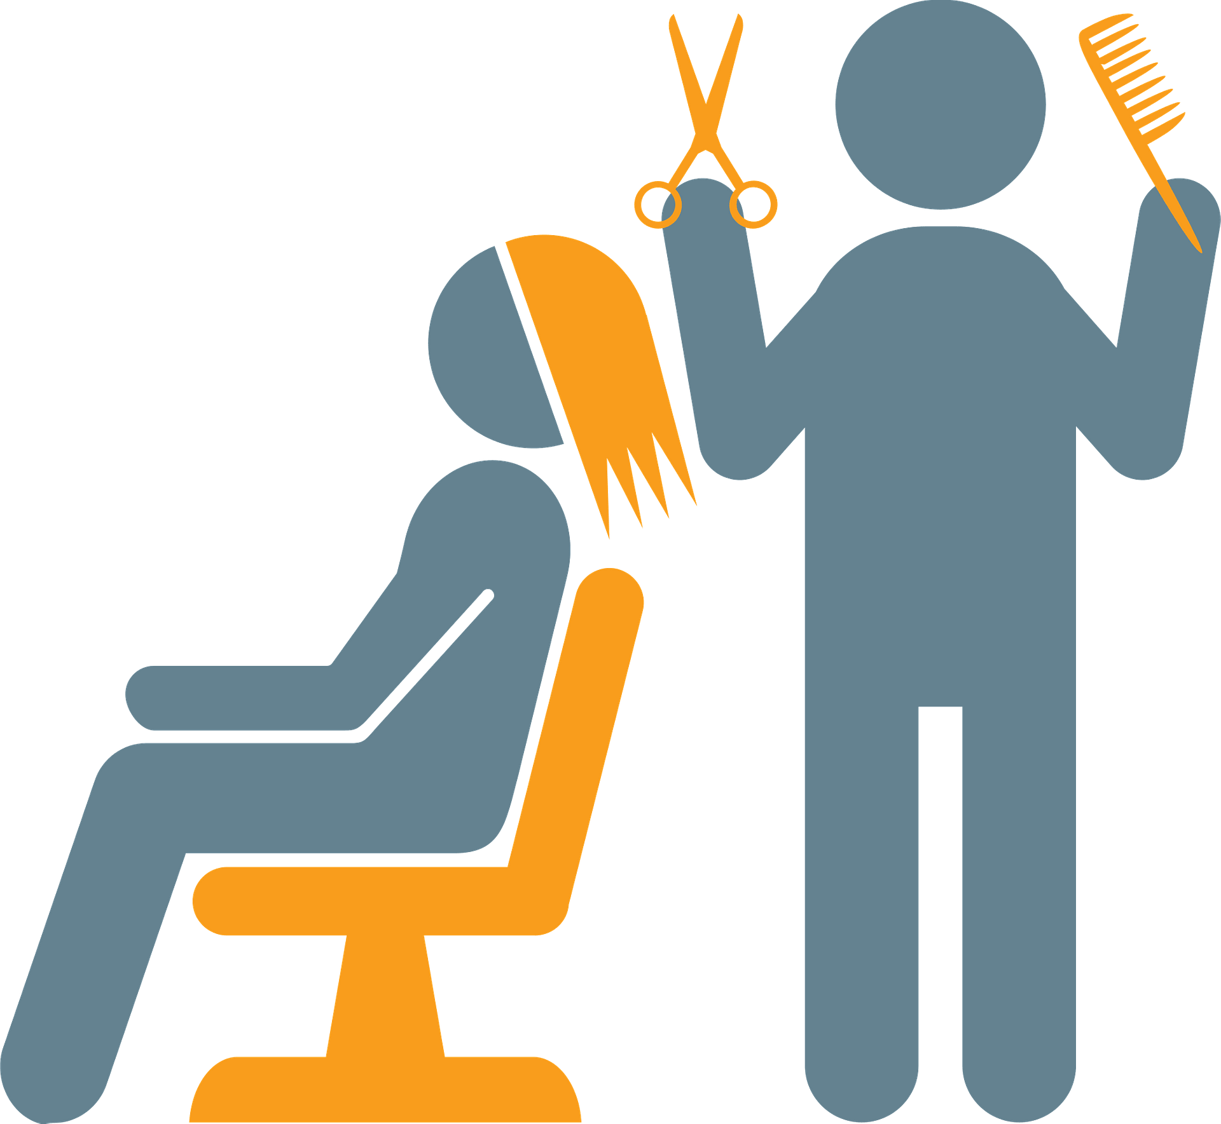
beautician

Slide 125
Let’s Teach and Practise

Slide 126
Plural possessive apostrophe

Slide 127
Plural possessive apostrophe plural = more than 1 possessive = owned by apostrophe = _’

Slide 128
Plural possessive apostrophe
If the plural ends with -s, add an apostrophe: the boys’ kites, the knights’ chargers, General Motors’ mission statement.

Slide 129
Plural possessive apostrophe
If the plural doesn’t end with -s, add ’s: the children’s teacher, the oxen’s yoke.

Slide 130
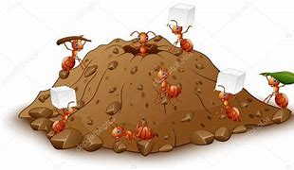
ants’

Slide 131
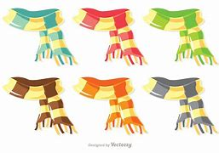
scarves’

Slide 132
ants’
1 ant → 2 ants
More than 1 ant owns the hill
PLURAL NOUN

Slide 133
scarves’
1 scarf → 2 scarves
More than 1 scarf owns the woollen material
PLURAL NOUN

Slide 134
The ants’ nest was full of activity.
_____

Slide 135
The scarves’ material was the finest silk.
________

Slide 136
New CHALLENGE words.

Slide 137
business
NOUN
Definition - a person's regular occupation, profession, or trade

Slide 138
People conduct their business over the internet.
________

Slide 139
medicine
NOUN
Definition - a drug or other preparation for the treatment or prevention of disease

Slide 140
Give her some medicine.
________

Slide 141
Let’s Practise and Apply.

Slide 142
Can you spot the spelling rule words and the challenge words?

Slide 143
Castles and mills
Land use changed again in the years after the Romans left in the 5th century. The business of people living in the area changed. Tribes called Anglo-Saxons moved in, building their own wooden hut-like homes on top of the empty, fallen-down Roman buildings. Medicine and other key needs were managed in these hut-like homes. Colchester became important again after 1066, when the Normans from France, led by William the Conqueror, took separate control of England. Because of its special location, the Normans built a castle in Colchester to help defend the east of England.

Slide 144
Castles and mills
Land use changed again in the years after the Romans left in the 5th century. The business of people living in the area changed. Tribes called Anglo-Saxons moved in, building their own wooden hut-like homes on top of the empty, fallen-down Roman buildings. Medicine and other key needs were managed in these hut-like homes. Colchester became important again after 1066, when the Normans from France, led by William the Conqueror, took separate control of England. Because of its special location, the Normans built a castle in Colchester to help defend the east of England.

Slide 145
Write this sentence as I dictate it to you.
Notes:
Because of its special location, the Normans built a castle in Colchester to help defend the east of England.

Slide 146
Because of its special location, the Normans built a castle in Colchester to help defend the east of England.
Did you write it correctly?
Edit your work and make sure you have it correct.
Can you underline the spelling word that we have covered in this session?

Slide 147
Year 4 - Summer 1
Week 4 - Friday
Notes:
Click through the slides for all the R+R words for the week (both the focus and the challenge words)
Click through the slides for all the new learning this week

Slide 149
Old challenge words…

Slide 150
separate

Slide 151
special

Slide 152
Old spelling rule words…

Slide 153
musician

Slide 154
politician

Slide 155
electrician

Slide 156
magician

Slide 157
mathematician

Slide 158
dietician

Slide 159
statistician

Slide 160
technician

Slide 161
clinician

Slide 162
beautician

Slide 163
New challenge words…

Slide 164
business

Slide 165
medicine

Slide 166
New spelling rule words…

Slide 167
ponies’

Slide 168
volcanoes’

Slide 169
actresses’

Slide 170
thieves’

Slide 171
knives’

Slide 172
mangoes’

Slide 173
babies’

Slide 174
ants’

Slide 175
scarves’

Slide 176
Quick Quiz time…
Notes:
Say these words for the quiz
Separate special Business medicine magician beautician

Slide 177
Did you get them correct?
Edit your work.
separate special business medicine magician beautician

Slide 178
Word class time…

Slide 179
People conduct their business over the internet.
noun verb determiner noun preposition determiner noun
Notes:
Ask for these words to be classed

Slide 180
Give her some medicine.
Verb pronoun determiner noun.
Notes:
Ask for these words to be classed

Slide 181
Etymology
The history of a word….

Slide 182
Business
Old English bisignis ‘anxiety’ (see busy, -ness); the sense ‘state of being busy’ was used from Middle English down to the 18th century, but is now differentiated as busyness. The use ‘appointed task’ dates from late Middle English, and from it all the other current senses have developed.
Medicine
Middle English: via Old French from Latin medicina, from medicus ‘physician’.

Slide 183
Let’s investigate….
Write spelling questions for the challenge words and then a mark scheme to show where children may go wrong.

