Slide 1
Spelling Y4
Mastering spellings: building on the foundations of phonics
Summer 1
Week 5

Slide 2
Year 4 - Summer 1
Week 5 - Monday

Slide 3
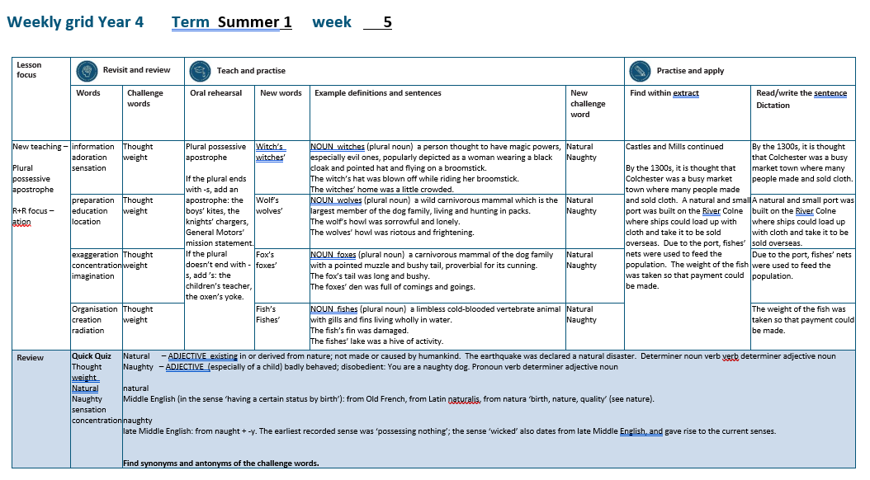

Slide 4
Let’s Revisit and Review…

Slide 5
Do you remember this challenge word?

Slide 6

thought
NOUN
Definition - an idea or opinion produced by thinking, or occurring suddenly in the mind

Slide 7
Maggie had a sudden thought.
_______

Slide 8

weight
NOUN
Definition - a body's relative mass or the quantity of matter contained by it, giving rise to a downward force

Slide 9
He was fifteen stone in weight.
______

Slide 10
Words with a
/shuhn/ sound, spelt with ‘tion’ changing verbs to a nouns

Slide 11
-tion

Slide 12
-ation verb -> noun

Slide 13

information

Slide 14

adoration

Slide 15
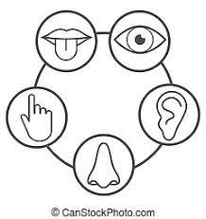
sensation

Slide 16
Let’s Teach and Practise

Slide 17
Plural possessive apostrophe

Slide 18
Plural possessive apostrophe plural = more than 1 possessive = owned by apostrophe = _’

Slide 19
Plural possessive apostrophe
If the plural ends with -s, add an apostrophe: the boys’ kites, the knights’ chargers, General Motors’ mission statement.

Slide 20
Plural possessive apostrophe
If the plural doesn’t end with -s, add ’s: the children’s teacher, the oxen’s yoke.

Slide 21
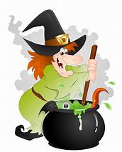
witch’s

Slide 22
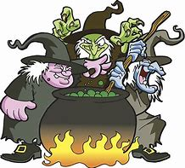
witches’

Slide 23
witch’s
1 witch owns the cauldron
SINGULAR NOUN

Slide 24
witches’
1 witch → 2 witches
More than 1 witch owns the cauldron
PLURAL NOUN

Slide 25
The witch’s hat was blown off while riding her broomstick.
_______

Slide 26
The witches’ home was a little crowded.
________

Slide 27
New CHALLENGE words.

Slide 28

natural
ADJECTIVE
Definition - existing in or derived from nature; not made or caused by humankind

Slide 29
The earthquake was declared a natural disaster.
_______

Slide 30
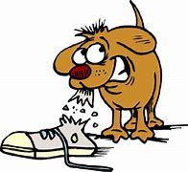
naughty
ADJECTIVE
Definition - (especially of a child) badly behaved; disobedient

Slide 31
You are a naughty dog.
_______

Slide 32
Let’s Practise and Apply.

Slide 33
Can you spot the spelling rule words and the challenge words?

Slide 34
Castles and mills (continued)
By the 1300s, it is thought that Colchester was a busy market town where many people made and sold cloth. A natural and small port was built on the River Colne where ships could load up with cloth and take it to be sold overseas. Due to the port, fishes’ nets were used to feed the population. The weight of the fish was taken so that payment could be made.

Slide 35
Castles and mills (continued)
By the 1300s, it is thought that Colchester was a busy market town where many people made and sold cloth. A natural and small port was built on the River Colne where ships could load up with cloth and take it to be sold overseas. Due to the port, fishes’ nets were used to feed the population. The weight of the fish was taken so that payment could be made.

Slide 36
Write this sentence as I dictate it to you.
Notes:
By the 1300s, it is thought that Colchester was a busy market town where many people made and sold cloth.

Slide 37
By the 1300s, it is thought that Colchester was a busy market town where many people made and sold cloth.
Did you write it correctly?
Edit your work and make sure you have it correct.
Can you underline the spelling word that we have covered in this session?

Slide 38
Year 4 - Summer 1
Week 5 - Tuesday
Notes:
Revisit and review the words from previous teaching and challenge words – I say, we say, you say
Ask children to write words only in their spelling book
Introduce the new spelling rule
Children to write the new spelling rule words and challenge words into books when the sentences are shown with the spelling word missing.
Read the extract with the class as choral reading. Practise model of prosody etc.
Ask children to find the spelling words from the session in the text.
Then read allowed the chosen sentence for children to write fully in their books.
Show the extract and ask children to then edit their work to check they were correct in their dictation.

Slide 40
Let’s Revisit and Review…

Slide 41
Do you remember this challenge word?

Slide 42
thought
NOUN
Definition - an idea or opinion produced by thinking, or occurring suddenly in the mind

Slide 43
Maggie had a sudden thought.
_______

Slide 44
weight
NOUN
Definition - a body's relative mass or the quantity of matter contained by it, giving rise to a downward force

Slide 45
He was fifteen stone in weight.
______

Slide 46
Words with a
/shuhn/ sound, spelt with ‘tion’ changing verbs to a nouns

Slide 47
-tion

Slide 48
-ation verb -> noun

Slide 49

preparation

Slide 50

education

Slide 51

location

Slide 52
Let’s Teach and Practise

Slide 53
Plural possessive apostrophe

Slide 54
Plural possessive apostrophe plural = more than 1 possessive = owned by apostrophe = _’

Slide 55
Plural possessive apostrophe
If the plural ends with -s, add an apostrophe: the boys’ kites, the knights’ chargers, General Motors’ mission statement.

Slide 56
Plural possessive apostrophe
If the plural doesn’t end with -s, add ’s: the children’s teacher, the oxen’s yoke.

Slide 57
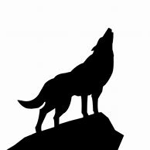
wolf’s

Slide 58
wolves’

Slide 59
wolf’s
1 wolf owns their howl
SINGULAR NOUN

Slide 60
wolves’
1 wolf → 2 wolves
More than 1 wolf owns the howl
PLURAL NOUN

Slide 61
The wolf’s howl was sorrowful and lonely.
______

Slide 62
The wolves’ howl was riotous and frightening.
_______

Slide 63
New CHALLENGE words.

Slide 64
natural
ADJECTIVE
Definition - existing in or derived from nature; not made or caused by humankind

Slide 65
The earthquake was declared a natural disaster.
_______

Slide 66
naughty
ADJECTIVE
Definition - (especially of a child) badly behaved; disobedient

Slide 67
You are a naughty dog.
_______

Slide 68
Let’s Practise and Apply.

Slide 69
Can you spot the spelling rule words and the challenge words?

Slide 70
Castles and mills (continued)
By the 1300s, it is thought that Colchester was a busy market town where many people made and sold cloth. A natural and small port was built on the River Colne where ships could load up with cloth and take it to be sold overseas. Due to the port, fishes’ nets were used to feed the population. The weight of the fish was taken so that payment could be made.

Slide 71
Castles and mills (continued)
By the 1300s, it is thought that Colchester was a busy market town where many people made and sold cloth. A natural and small port was built on the River Colne where ships could load up with cloth and take it to be sold overseas. Due to the port, fishes’ nets were used to feed the population. The weight of the fish was taken so that payment could be made.

Slide 72
Write this sentence as I dictate it to you.
Notes:
A natural and small port was built on the River Colne where ships could load up with cloth and take it to be sold overseas.

Slide 73
A natural and small port was built on the River Colne where ships could load up with cloth and take it to be sold overseas.
Did you write it correctly?
Edit your work and make sure you have it correct.
Can you underline the spelling word that we have covered in this session?

Slide 74
Year 4 - Summer 1
Week 5 - Wednesday
Notes:
Revisit and review the words from previous teaching and challenge words – I say, we say, you say
Ask children to write words only in their spelling book
Introduce the new spelling rule
Children to write the new spelling rule words and challenge words into books when the sentences are shown with the spelling word missing.
Read the extract with the class as choral reading. Practise model of prosody etc.
Ask children to find the spelling words from the session in the text.
Then read allowed the chosen sentence for children to write fully in their books.
Show the extract and ask children to then edit their work to check they were correct in their dictation.

Slide 76
Let’s Revisit and Review…

Slide 77
Do you remember this challenge word?

Slide 78
thought
NOUN
Definition - an idea or opinion produced by thinking, or occurring suddenly in the mind

Slide 79
Maggie had a sudden thought.
_______

Slide 80
weight
NOUN
Definition - a body's relative mass or the quantity of matter contained by it, giving rise to a downward force

Slide 81
He was fifteen stone in weight.
______

Slide 82
Words with a
/shuhn/ sound, spelt with ‘tion’ changing verbs to a nouns

Slide 83
-tion

Slide 84
-ation verb -> noun

Slide 85
preparation

Slide 86
education

Slide 87
location

Slide 88
Let’s Teach and Practise

Slide 89
Plural possessive apostrophe

Slide 90
Plural possessive apostrophe plural = more than 1 possessive = owned by apostrophe = _’

Slide 91
Plural possessive apostrophe
If the plural ends with -s, add an apostrophe: the boys’ kites, the knights’ chargers, General Motors’ mission statement.

Slide 92
Plural possessive apostrophe
If the plural doesn’t end with -s, add ’s: the children’s teacher, the oxen’s yoke.

Slide 93
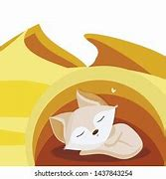
fox’s

Slide 94
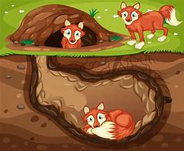
foxes’

Slide 95
fox’s
1 fox owns the den
SINGULAR NOUN

Slide 96
foxes’
1 fox → 2 foxes
More than 1 fox owns the den
PLURAL NOUN

Slide 97
The fox’s tail was long and bushy.
_____

Slide 98
The foxes’ den was full of comings and goings.
______

Slide 99
New CHALLENGE words.

Slide 100
natural
ADJECTIVE
Definition - existing in or derived from nature; not made or caused by humankind

Slide 101
The earthquake was declared a natural disaster.
_______

Slide 102
naughty
ADJECTIVE
Definition - (especially of a child) badly behaved; disobedient

Slide 103
You are a naughty dog.
_______

Slide 104
Let’s Practise and Apply.

Slide 105
Can you spot the spelling rule words and the challenge words?

Slide 106
Castles and mills (continued)
By the 1300s, it is thought that Colchester was a busy market town where many people made and sold cloth. A natural and small port was built on the River Colne where ships could load up with cloth and take it to be sold overseas. Due to the port, fishes’ nets were used to feed the population. The weight of the fish was taken so that payment could be made.

Slide 107
Castles and mills (continued)
By the 1300s, it is thought that Colchester was a busy market town where many people made and sold cloth. A natural and small port was built on the River Colne where ships could load up with cloth and take it to be sold overseas. Due to the port, fishes’ nets were used to feed the population. The weight of the fish was taken so that payment could be made.

Slide 108
Write this sentence as I dictate it to you.
Notes:
Due to the port, fishes’ nets were used to feed the population.

Slide 109
Due to the port, fishes’ nets were used to feed the population.
Did you write it correctly?
Edit your work and make sure you have it correct.
Can you underline the spelling word that we have covered in this session?

Slide 110
Year 4 - Summer 1
Week 5 - Thursday
Notes:
Revisit and review the words from previous teaching and challenge words – I say, we say, you say
Ask children to write words only in their spelling book
Introduce the new spelling rule
Children to write the new spelling rule words and challenge words into books when the sentences are shown with the spelling word missing.
Read the extract with the class as choral reading. Practise model of prosody etc.
Ask children to find the spelling words from the session in the text.
Then read allowed the chosen sentence for children to write fully in their books.
Show the extract and ask children to then edit their work to check they were correct in their dictation.

Slide 112
Let’s Revisit and Review…

Slide 113
Do you remember this challenge word?

Slide 114
thought
NOUN
Definition - an idea or opinion produced by thinking, or occurring suddenly in the mind

Slide 115
Maggie had a sudden thought.
_______

Slide 116
weight
NOUN
Definition - a body's relative mass or the quantity of matter contained by it, giving rise to a downward force

Slide 117
He was fifteen stone in weight.
______

Slide 118
Words with a
/shuhn/ sound, spelt with ‘tion’ changing verbs to a nouns

Slide 119
-tion

Slide 120
-ation verb -> noun

Slide 121
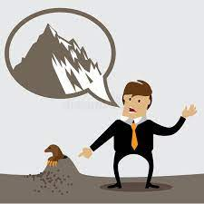
exaggeration

Slide 122

concentration

Slide 123
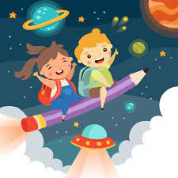
imagination

Slide 124
Let’s Teach and Practise

Slide 125
Plural possessive apostrophe

Slide 126
Plural possessive apostrophe plural = more than 1 possessive = owned by apostrophe = _’

Slide 127
Plural possessive apostrophe
If the plural ends with -s, add an apostrophe: the boys’ kites, the knights’ chargers, General Motors’ mission statement.

Slide 128
Plural possessive apostrophe
If the plural doesn’t end with -s, add ’s: the children’s teacher, the oxen’s yoke.

Slide 129
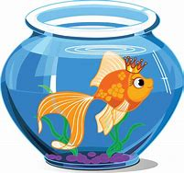
fish’s

Slide 130

fishes’

Slide 131
fish’s
1 fish owns the bowl
SINGULAR NOUN

Slide 132
fishes’
1 fish → 2 fishes
More than 1 fish owns the bowl
PLURAL NOUN

Slide 133
The fish’s fin was damaged.
______

Slide 134
The fishes’ lake was a hive of activity.
_______

Slide 135
New CHALLENGE words.

Slide 136
natural
ADJECTIVE
Definition - existing in or derived from nature; not made or caused by humankind

Slide 137
The earthquake was declared a natural disaster.
_______

Slide 138
naughty
ADJECTIVE
Definition - (especially of a child) badly behaved; disobedient

Slide 139
You are a naughty dog.
_______

Slide 140
Let’s Practise and Apply.

Slide 141
Can you spot the spelling rule words and the challenge words?

Slide 142
Castles and mills (continued)
By the 1300s, it is thought that Colchester was a busy market town where many people made and sold cloth. A natural and small port was built on the River Colne where ships could load up with cloth and take it to be sold overseas. Due to the port, fishes’ nets were used to feed the population. The weight of the fish was taken so that payment could be made.

Slide 143
Castles and mills (continued)
By the 1300s, it is thought that Colchester was a busy market town where many people made and sold cloth. A natural and small port was built on the River Colne where ships could load up with cloth and take it to be sold overseas. Due to the port, fishes’ nets were used to feed the population. The weight of the fish was taken so that payment could be made.

Slide 144
Write this sentence as I dictate it to you.
Notes:
The weight of the fish was taken so that payment could be made.

Slide 145
The weight of the fish was taken so that payment could be made.
Did you write it correctly?
Edit your work and make sure you have it correct.
Can you underline the spelling word that we have covered in this session?

Slide 146
Year 4 - Summer 1
Week 5 - Friday
Notes:
Click through the slides for all the R+R words for the week (both the focus and the challenge words)
Click through the slides for all the new learning this week

Slide 148
Old challenge words…

Slide 149
weight

Slide 150
thought

Slide 151
Old spelling rule words…

Slide 152
information

Slide 153
adoration

Slide 154
sensation

Slide 155
preparation

Slide 156
education

Slide 157
location

Slide 158
exaggeration

Slide 159
concentration

Slide 160
imagination

Slide 161
organisation

Slide 162
creation

Slide 163
radiation

Slide 164
New challenge words…

Slide 165
natural

Slide 166
naughty

Slide 167
New spelling rule words…

Slide 168
witch’s

Slide 169
witches’

Slide 170
wolf’s

Slide 171
wolves’

Slide 172
fox’s

Slide 173
foxes’

Slide 174
fish’s

Slide 175
fishes’

Slide 176
Quick Quiz time…
Notes:
Say these words for the quiz
Thought weight Natural Naughty sensation concentration

Slide 177
Did you get them correct?
Edit your work.
thought weight natural naughty sensation concentration

Slide 178
Word class time…

Slide 179
The earthquake was declared a natural disaster.
Determiner noun verb verb determiner adjective noun
Notes:
Ask for these words to be classed

Slide 180
You are a naughty dog.
Pronoun verb determiner adjective noun.
Notes:
Ask for these words to be classed

Slide 181
Etymology
The history of a word….

Slide 182
Natural
Middle English (in the sense ‘having a certain status by birth’): from Old French, from Latin naturalis, from natura ‘birth, nature, quality’ (see nature).
Naughty
Late Middle English: from naught + -y. The earliest recorded sense was ‘possessing nothing’; the sense ‘wicked’ also dates from late Middle English, and gave rise to the current senses.

Slide 183
Let’s investigate….
Find synonyms and antonyms of the challenge words.

