Slide 1
Spelling Y4
Mastering spellings: building on the foundations of phonics
Summer 1
Week 6

Slide 2
Year 4 - Summer 1
Week 6 - Monday

Slide 3
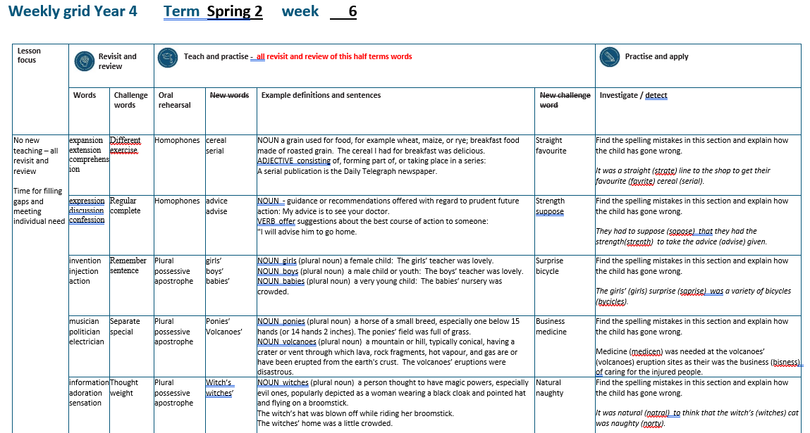

Slide 4
Let’s Revisit and Review…

Slide 5
Do you remember this challenge word?

Slide 6
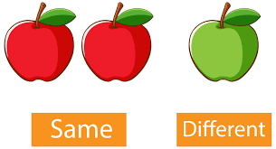
different
ADJECTIVE
Definition - not the same as another or each other; unlike in nature, form, or quality

Slide 7
You can play this game in different ways.
_________

Slide 8

exercise
NOUN
Definition - activity requiring physical effort, carried out to sustain or improve health and fitness

Slide 9
Exercise improves your heart and lung power.
________

Slide 10
Words with a
/shuhn/ sound, spelt with ‘sion’
(if root word ends in
‘se’, ‘de’ or ‘d’)

Slide 11
-sion

Slide 12

expansion

Slide 13
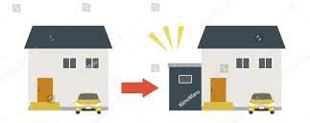
extension

Slide 14

comprehension

Slide 15
Let’s Teach and Practise

Slide 16
homophones = same sound homo- same phone – sound

Slide 17
homophones

Slide 18
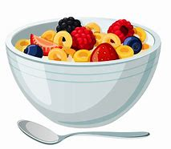
cereal

Slide 19
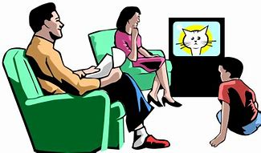
serial

Slide 20
cereal
NOUN
Definition - a grain used for food, for example wheat, maize, or rye; breakfast food made of roasted grain

Slide 21
serial
ADJECTIVE
Definition - consisting of, forming part of, or taking place in a series

Slide 22
The cereal I had for breakfast was delicious.
______

Slide 23
A serial publication is the Daily Telegraph newspaper.
______

Slide 24
New CHALLENGE words.

Slide 25

straight
ADJECTIVE
Definition - extending or moving uniformly in one direction only; without a curve or bend

Slide 26
The road was long and straight.
________

Slide 27

favourite
ADJECTIVE
Definition - preferred to all others of the same kind

Slide 28
Their favourite restaurant served food quickly.
_________

Slide 29
Let’s investigate.

Slide 30
Can you spot the spelling errors in these sentences?
Write the correct spelling and explain where they went wrong.

Slide 31
It was a strate line to the shop to get their favrite serial.

Slide 32
It was a strate line to the shop to get their favrite serial.

Slide 33
It was a strate line to the shop to get their favrite serial. straight – ‘aigh’ not ‘a_e’

Slide 34
It was a strate line to the shop to get their favrite serial. favourite – ‘ou’ missing

Slide 35
It was a strate line to the shop to get their favrite serial. cereal – incorrect homophone used

Slide 36
It was a straight line to the shop to get their favourite cereal.

Slide 37
Year 4 - Summer 1
Week 6 - Tuesday

Slide 39
Let’s Revisit and Review…

Slide 40
Do you remember this challenge word?

Slide 41
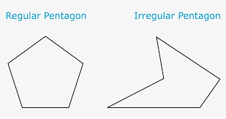
regular
ADJECTIVE
Definition - arranged in or constituting a constant or definite pattern, especially with the same space between individual instances

Slide 42
Plant the flags at regular intervals.
_______

Slide 43

complete
ADJECTIVE
Definition - having all the necessary or appropriate parts

Slide 44
A complete list of classes offered by the leisure centre was posted on their website.
________

Slide 45
Words with a
/shuhn/ sound, spelt with ‘ssion’
(if root word ends in
‘ss’ or ‘mit’

Slide 46
-ssion

Slide 47

expression

Slide 48

discussion

Slide 49
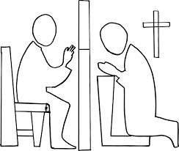
confession

Slide 50
Let’s Teach and Practise

Slide 51
homophones = same sound homo- same phone – sound

Slide 52
c - noun s – verb homophones = same sound homo- same phone – sound

Slide 53
Homophones c - noun s – verb

Slide 54

advice

Slide 55
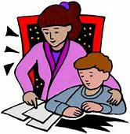
advise

Slide 56
advice
THE advice
NOUN
Definition - guidance or recommendations offered with regard to prudent future action

Slide 57
advise
TO advise
VERB
Definition - offer suggestions about the best course of action to someone

Slide 58
My advice is to see your doctor.
______

Slide 59
I will advise him to go home.
______

Slide 60
New CHALLENGE words.

Slide 61
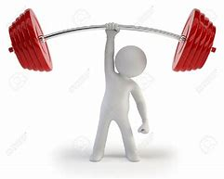
strength
NOUN
Definition - the quality or state of being physically strong

Slide 62
Cycling helps you build-up your strength.
________

Slide 63

suppose
VERB
Definition - think or assume that something is true or probable but lack proof or certain knowledge

Slide 64
I suppose the dog is old.
_______

Slide 65
Let’s investigate.

Slide 66
Can you spot the spelling errors in these sentences?
Write the correct spelling and explain where they went wrong.

Slide 67
They had to soppose that they had the strenth to take the advise given.

Slide 68
They had to soppose that they had the strenth to take the advise given.

Slide 69
They had to soppose that they had the strenth to take the advise given.
Suppose – ‘u’ not ‘s’

Slide 70
They had to soppose that they had the strenth to take the advise given. strength – ‘g’ missing

Slide 71
They had to soppose that they had the strenth to take the advise given. advice – noun (‘the’ clue) ‘c’ not ‘s’

Slide 72
They had to suppose that they had the strength to take the advice given.

Slide 73
Year 4 - Summer 1
Week 6 - Wednesday

Slide 75
Let’s Revisit and Review…

Slide 76
Do you remember this challenge word?

Slide 77

remember
VERB
Definition - have in or be able to bring to one's mind an awareness of (someone or something from the past)

Slide 78
I remember all the dance moves to my favourite song.
________

Slide 79
sentence
NOUN
Definition - a set of words that is complete in itself, typically containing a subject and predicate, conveying a statement, question, exclamation, or command, and consisting of a main clause and sometimes one or more subordinate clauses.

Slide 80
A sentence is made up of words.
________

Slide 81
Words with a
/shuhn/ sound, spelt with ‘tion’
(if root word ends in
‘te’ or ‘t’ or has no definite root)

Slide 82
-tion

Slide 83
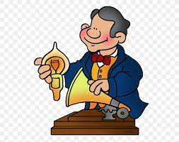
invention

Slide 84

injection

Slide 85

action

Slide 86
Let’s Teach and Practise

Slide 87
Plural possessive apostrophe

Slide 88
Plural possessive apostrophe plural = more than 1 possessive = owned by apostrophe = _’

Slide 89
Plural possessive apostrophe
If the plural ends with -s, add an apostrophe: the boys’ kites, the knights’ chargers, General Motors’ mission statement.

Slide 90
Plural possessive apostrophe
If the plural doesn’t end with -s, add ’s: the children’s teacher, the oxen’s yoke.

Slide 91
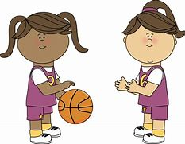
girls’

Slide 92
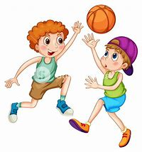
boys’

Slide 93
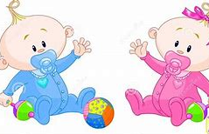
babies’

Slide 94
girls’
1 girl → 2 girls
More than 1 girl owns the ball
PLURAL NOUN

Slide 95
boys’
1 boy → 2 boys
More than 1 boy owns the ball
PLURAL NOUN

Slide 96
babies’
1 baby → 2 babies
More than 1 baby owns the ball
PLURAL NOUN

Slide 97
The girls’ teacher was lovely.
______

Slide 98
The boys’ teacher was lovely.
_____

Slide 99
The babies’ nursery was crowded.
_______

Slide 100
New CHALLENGE words.

Slide 101
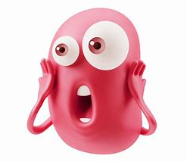
surprise
NOUN
Definition - an unexpected or astonishing event, fact, etc.

Slide 102
The announcement came as a complete surprise.
________

Slide 103
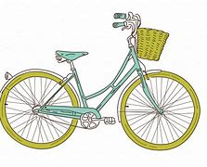
bicycle
NOUN
Definition - a vehicle consisting of two wheels held in a frame one behind the other, propelled by pedals and steered with handlebars attached to the front wheel

Slide 104
I got a bicycle at Christmas.
_______

Slide 105
Let’s investigate.

Slide 106
Can you spot the spelling errors in these sentences?
Write the correct spelling and explain where they went wrong.

Slide 107
The girls saprise was a variety of bycicles.

Slide 108
The girls saprise was a variety of bycicles.

Slide 109
The girls saprise was a variety of bycicles. girls’ - more than 1 girl owned the surprise

Slide 110
The girls saprise was a variety of bycicles. surprise – ‘ur’ not ‘a’

Slide 111
The girls saprise was a variety of bycicles. bicycle – ‘bi’ = two / ‘cycle’

Slide 112
The girls’ surprise was a variety of bicycles.

Slide 113
Year 4 - Summer 1
Week 6 - Thursday

Slide 115
Let’s Revisit and Review…

Slide 116
Do you remember this challenge word?

Slide 117
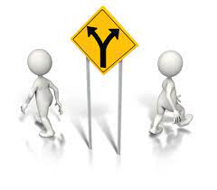
separate
ADJECTIVE
Definition - forming or viewed as a unit apart or by itself

Slide 118
It raises two separate issues.
________

Slide 119

special
ADJECTIVE
Definition - better, greater, or otherwise different from what is usual

Slide 120
They always made a special effort at Christmas.
_______

Slide 121
Words with a
/shuhn/ sound, spelt with ‘cian’
(if root word ends in
‘c’ or ‘cs’)

Slide 122
-cian

Slide 123
-cian usually ‘cian’ ending words are showing someone’s profession or job

Slide 124
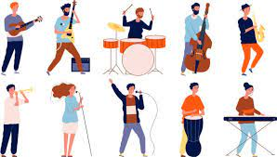
musician

Slide 125

politician

Slide 126
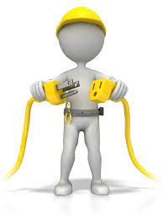
electrician

Slide 127
Let’s Teach and Practise

Slide 128
Plural possessive apostrophe

Slide 129
Plural possessive apostrophe plural = more than 1 possessive = owned by apostrophe = _’

Slide 130
Plural possessive apostrophe
If the plural ends with -s, add an apostrophe: the boys’ kites, the knights’ chargers, General Motors’ mission statement.

Slide 131
Plural possessive apostrophe
If the plural doesn’t end with -s, add ’s: the children’s teacher, the oxen’s yoke.

Slide 132
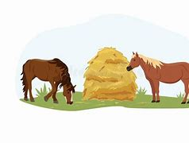
ponies’

Slide 133
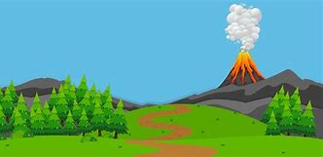
volcanoes’

Slide 134

girls’
1 horse → 2 horses
More than 1 horse owns the hay
PLURAL NOUN

Slide 135
volcanoes’
1 volcano → 2 volcanoes
More than 1 volcano owns the ash in the air
PLURAL NOUN

Slide 136
The ponies’ field was full of grass.
_______

Slide 137
The volcanoes’ eruptions were disastrous.
__________

Slide 138
New CHALLENGE words.

Slide 139

business
NOUN
Definition - a person's regular occupation, profession, or trade

Slide 140
People conduct their business over the internet.
________

Slide 141
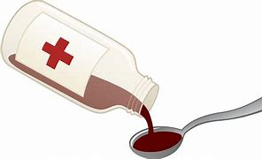
medicine
NOUN
Definition - a drug or other preparation for the treatment or prevention of disease

Slide 142
Give her some medicine.
________

Slide 143
Let’s investigate.

Slide 144
Can you spot the spelling errors in these sentences?
Write the correct spelling and explain where they went wrong.

Slide 145
medicen was needed at the volcanoes eruption sites as their was the bisness of caring for the injured people.

Slide 146
medicen was needed at the volcanoes eruption sites as their was the bisness of caring for the injured people.

Slide 147
medicen was needed at the volcanoes eruption sites as their was the bisness of caring for the injured people. medicine – ‘i_e’ not ‘e’

Slide 148
medicen was needed at the volcanoes eruption sites as their was the bisness of caring for the injured people. volcanoes’ – eruption sites owned by more than 1 volcano

Slide 149
medicen was needed at the volcanoes eruption sites as their was the bisness of caring for the injured people. business – ‘i’ in wrong place and missing ‘u’

Slide 150
Medicine was needed at the volcanoes’ eruption sites as their was the business of caring for the injured people.

Slide 151
Year 4 - Summer 1
Week 6 - Friday

Slide 153
Let’s Revisit and Review…

Slide 154
Do you remember these challenge words?

Slide 155

thought
NOUN
Definition - an idea or opinion produced by thinking, or occurring suddenly in the mind

Slide 156
Maggie had a sudden thought.
_______

Slide 157

weight
NOUN
Definition - a body's relative mass or the quantity of matter contained by it, giving rise to a downward force

Slide 158
He was fifteen stone in weight.
______

Slide 159
Words with a
/shuhn/ sound, spelt with ‘tion’ changing verbs to a nouns

Slide 160
-tion

Slide 161
-ation verb -> noun

Slide 162

information

Slide 163

adoration

Slide 164
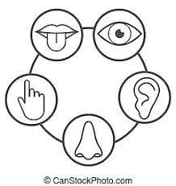
sensation

Slide 165
Let’s Teach and Practise

Slide 166
Plural possessive apostrophe

Slide 167
Plural possessive apostrophe plural = more than 1 possessive = owned by apostrophe = _’

Slide 168
Plural possessive apostrophe
If the plural ends with -s, add an apostrophe: the boys’ kites, the knights’ chargers, General Motors’ mission statement.

Slide 169
Plural possessive apostrophe
If the plural doesn’t end with -s, add ’s: the children’s teacher, the oxen’s yoke.

Slide 170
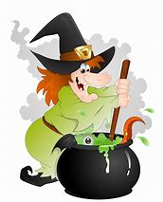
witch’s

Slide 171
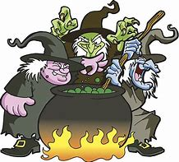
witches’

Slide 172
witch’s
1 witch owns the cauldron
SINGULAR NOUN

Slide 173
witches’
1 witch → 2 witches
More than 1 witch owns the cauldron
PLURAL NOUN

Slide 174
The witch’s hat was blown off while riding her broomstick.
_______

Slide 175
The witches’ home was a little crowded.
________

Slide 176
New CHALLENGE words.

Slide 177

natural
ADJECTIVE
Definition - existing in or derived from nature; not made or caused by humankind

Slide 178
The earthquake was declared a natural disaster.
_______

Slide 179
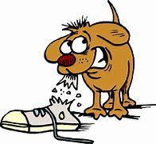
naughty
ADJECTIVE
Definition - (especially of a child) badly behaved; disobedient

Slide 180
You are a naughty dog.
_______

Slide 181
Let’s investigate.

Slide 182
Can you spot the spelling errors in these sentences?
Write the correct spelling and explain where they went wrong.

Slide 183
It was natral to think that the witches cat was norty.

Slide 184
It was natral to think that the witches cat was norty.

Slide 185
It was natral to think that the witches cat was norty. natural – ‘u’ missing

Slide 186
It was natral to think that the witches cat was norty. witch’s – 1 witch owns a cat

Slide 187
It was natral to think that the witches cat was norty. naughty – ‘augh’ not ‘or’

Slide 188
It was natural to think that the witch’s cat was naughty.

