Slide 1
Spelling Y5
Mastering spellings: building on the foundations of phonics
Spring 1
Week 1

Slide 2
These slides are slightly different - to reduce the number there are now animations used
Please use these slides in full screen slide show mode to ensure they work how they are designed with chunks of information being shown at a time to prevent overload
Thank you

Slide 3
Year 5 - Spring 1
Week 1 - Monday

Slide 4
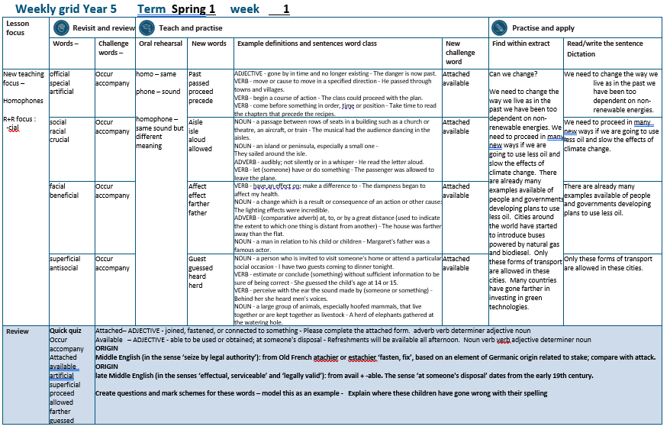

Slide 5
Let’s Revisit and Review…

Slide 6
Do you remember this challenge word?

Slide 7

occur
For the event to occur, the rain had to stop.

Slide 8
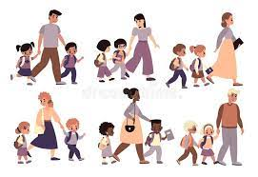
accompany
Ishmael had to accompany his dad to work.

Slide 9
Words with ending sound /shuhl/ after a vowel letter
-cial

Slide 10
-cial

Slide 11
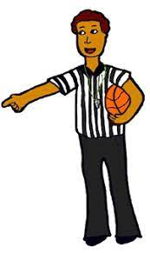
official

Slide 12

special

Slide 13
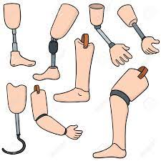
artificial

Slide 14
Let’s Teach and Practise

Slide 15
homo – same phone – sound
homophone –
same sound but different meaning

Slide 16
homophones

Slide 17
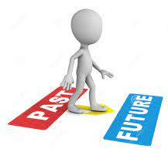
past

Slide 18
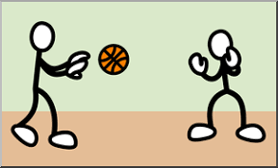
passed

Slide 19

proceed

Slide 20
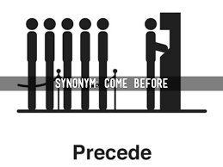
precede

Slide 21
past
ADJECTIVE
Definition - gone by in time and no longer existing

Slide 22
passed
VERB
Definition - move or cause to move in a specified direction

Slide 23
proceed
VERB
Definition - begin a course of action

Slide 24
precede
VERB
Definition - come before something in order, time or position

Slide 25
The danger is now past.
____

Slide 26
He passed through towns and villages.
______

Slide 27
The class could proceed with the plan.
_______

Slide 28
Take time to read the chapters that precede the recipes.
_______

Slide 29
New CHALLENGE words.

Slide 30

attached
ADJECTIVE
Definition - joined, fastened, or connected to something

Slide 31
Please complete the attached form.
________

Slide 32

available
ADJECTIVE
Definition - able to be used or obtained; at someone's disposal

Slide 33
Refreshments will be available all afternoon.
_________

Slide 34
Let’s Practise and Apply.

Slide 35
Can you spot the spelling rule words and the challenge words?

Slide 36
Can we change?
We need to change the way we live as in the past we have been too dependent on non-renewable energies. We need to proceed in many new ways if we are going to use less oil and slow the effects of climate change. There are already many examples available of people and governments developing plans to use less oil. Cities around the world have started to introduce buses powered by natural gas and biodiesel. Only these forms of transport are allowed in these cities. Many countries have gone farther in investing in green technologies.

Slide 37
Can we change?
We need to change the way we live as in the past we have been too dependent on non-renewable energies. We need to proceed in many new ways if we are going to use less oil and slow the effects of climate change. There are already many examples available of people and governments developing plans to use less oil. Cities around the world have started to introduce buses powered by natural gas and biodiesel. Only these forms of transport are allowed in these cities. Many countries have gone farther in investing in green technologies.

Slide 38
Write this sentence as I dictate it to you.
Notes:
We need to change the way we live as in the past we have been too dependent on non-renewable energies.

Slide 39
We need to change the way we live as in the past we have been too dependent on non-renewable energies.
Did you write it correctly?
Edit your work and make sure you have it correct.
Can you underline the spelling word that we have covered in this session?

Slide 40
Year 5 - Spring 1
Week 1 - Tuesday
Notes:
Revisit and review the words from previous teaching and challenge words – I say, we say, you say
Ask children to write words only in their spelling book
Introduce the new spelling rule
Children to write the new spelling rule words and challenge words into books when the sentences are shown with the spelling word missing.
Read the extract with the class as choral reading. Practise model of prosody etc.
Ask children to find the spelling words from the session in the text.
Then read allowed the chosen sentence for children to write fully in their books.
Show the extract and ask children to then edit their work to check they were correct in their dictation.

Slide 42
Let’s Revisit and Review…

Slide 43
Do you remember this challenge word?

Slide 44
occur
For the event to occur, the rain had to stop.

Slide 45
accompany
Ishmael had to accompany his dad to work.

Slide 46
Words with ending sound /shuhl/ after a vowel letter
-cial

Slide 47
-cial

Slide 48
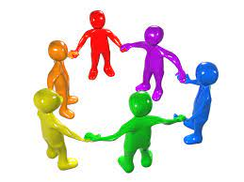
social

Slide 49
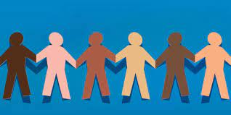
racial

Slide 50

crucial

Slide 51
Let’s Teach and Practise

Slide 52
homo – same phone – sound
homophone –
same sound but different meaning

Slide 53
homophones

Slide 54
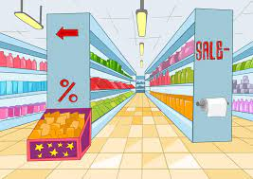
aisle

Slide 55

isle

Slide 56

aloud

Slide 57

allowed

Slide 58
aisle
NOUN
Definition - a passage between rows of seats in a building such as a church or theatre, an aircraft, or train

Slide 59
isle
NOUN
Definition - an island or peninsula, especially a small one

Slide 60
aloud
ADVERB
Definition - audibly; not silently or in a whisper

Slide 61
allowed
VERB
Definition - let (someone) have or do something

Slide 62
The musical had the audience dancing in the aisles.
_____.

Slide 63
They sailed around the isle.
____.

Slide 64
He read the letter aloud.
_____.

Slide 65
The passenger was allowed to leave the plane.
_______

Slide 66
New CHALLENGE words.

Slide 67
attached
ADJECTIVE
Definition - joined, fastened, or connected to something

Slide 68
Please complete the attached form.
________

Slide 69
available
ADJECTIVE
Definition - able to be used or obtained; at someone's disposal

Slide 70
Refreshments will be available all afternoon.
_________

Slide 71
Let’s Practise and Apply.

Slide 72
Can you spot the spelling rule words and the challenge words?

Slide 73
Can we change?
We need to change the way we live as in the past we have been too dependent on non-renewable energies. We need to proceed in many new ways if we are going to use less oil and slow the effects of climate change. There are already many examples available of people and governments developing plans to use less oil. Cities around the world have started to introduce buses powered by natural gas and biodiesel. Only these forms of transport are allowed in these cities. Many countries have gone farther in investing in green technologies.

Slide 74
Can we change?
We need to change the way we live as in the past we have been too dependent on non-renewable energies. We need to proceed in many new ways if we are going to use less oil and slow the effects of climate change. There are already many examples available of people and governments developing plans to use less oil. Cities around the world have started to introduce buses powered by natural gas and biodiesel. Only these forms of transport are allowed in these cities. Many countries have gone farther in investing in green technologies.

Slide 75
Write this sentence as I dictate it to you.
Notes:
We need to proceed in many new ways if we are going to use less oil and slow the effects of climate change.

Slide 76
We need to proceed in many new ways if we are going to use less oil and slow the effects of climate change.
Did you write it correctly?
Edit your work and make sure you have it correct.
Can you underline the spelling word that we have covered in this session?

Slide 77
Year 5 - Spring 1
Week 1 - Wednesday
Notes:
Revisit and review the words from previous teaching and challenge words – I say, we say, you say
Ask children to write words only in their spelling book
Introduce the new spelling rule
Children to write the new spelling rule words and challenge words into books when the sentences are shown with the spelling word missing.
Read the extract with the class as choral reading. Practise model of prosody etc.
Ask children to find the spelling words from the session in the text.
Then read allowed the chosen sentence for children to write fully in their books.
Show the extract and ask children to then edit their work to check they were correct in their dictation.

Slide 79
Let’s Revisit and Review…

Slide 80
Do you remember this challenge word?

Slide 81
occur
For the event to occur, the rain had to stop.

Slide 82
accompany
Ishmael had to accompany his dad to work.

Slide 83
Words with ending sound /shuhl/ after a vowel letter
-cial

Slide 84
-cial

Slide 85
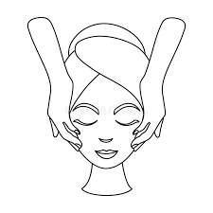
facial

Slide 86

beneficial

Slide 87
Let’s Teach and Practise

Slide 88
homo – same phone – sound
homophone –
same sound but different meaning

Slide 89
homophones

Slide 90
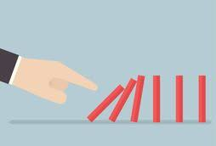
affect

Slide 91
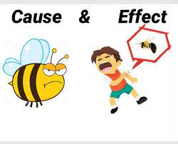
effect

Slide 92
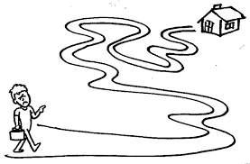
farther

Slide 93
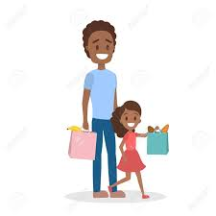
father

Slide 94
affect
VERB
Definition - have an effect on; make a difference to

Slide 95
effect
NOUN
Definition - a change which is a result or consequence of an action or other cause:

Slide 96
farther
COMPARATIVE ADVERB
Definition - at, to, or by a great distance (used to indicate the extent to which one thing is distant from another)

Slide 97
father
NOUN
Definition - a man in relation to his child or children

Slide 98
The dampness began to affect my health.
______

Slide 99
The lighting effects were incredible.
_______

Slide 100
The house was farther away than the flat.
_______

Slide 101
Margaret's father was a famous actor.
______

Slide 102
New CHALLENGE words.

Slide 103
attached
ADJECTIVE
Definition - joined, fastened, or connected to something

Slide 104
Please complete the attached form.
________

Slide 105
available
ADJECTIVE
Definition - able to be used or obtained; at someone's disposal

Slide 106
Refreshments will be available all afternoon.
_________

Slide 107
Let’s Practise and Apply.

Slide 108
Can you spot the spelling rule words and the challenge words?

Slide 109
Can we change?
We need to change the way we live as in the past we have been too dependent on non-renewable energies. We need to proceed in many new ways if we are going to use less oil and slow the effects of climate change. There are already many examples available of people and governments developing plans to use less oil. Cities around the world have started to introduce buses powered by natural gas and biodiesel. Only these forms of transport are allowed in these cities. Many countries have gone farther in investing in green technologies.

Slide 110
Can we change?
We need to change the way we live as in the past we have been too dependent on non-renewable energies. We need to proceed in many new ways if we are going to use less oil and slow the effects of climate change. There are already many examples available of people and governments developing plans to use less oil. Cities around the world have started to introduce buses powered by natural gas and biodiesel. Only these forms of transport are allowed in these cities. Many countries have gone farther in investing in green technologies.

Slide 111
Write this sentence as I dictate it to you.
Notes:
There are already many examples available of people and governments developing plans to use less oil.

Slide 112
There are already many examples available of people and governments developing plans to use less oil.
Did you write it correctly?
Edit your work and make sure you have it correct.
Can you underline the spelling word that we have covered in this session?

Slide 113
Year 5 - Spring 1
Week 1 - Thursday
Notes:
Revisit and review the words from previous teaching and challenge words – I say, we say, you say
Ask children to write words only in their spelling book
Introduce the new spelling rule
Children to write the new spelling rule words and challenge words into books when the sentences are shown with the spelling word missing.
Read the extract with the class as choral reading. Practise model of prosody etc.
Ask children to find the spelling words from the session in the text.
Then read allowed the chosen sentence for children to write fully in their books.
Show the extract and ask children to then edit their work to check they were correct in their dictation.

Slide 115
Let’s Revisit and Review…

Slide 116
Do you remember this challenge word?

Slide 117
occur
For the event to occur, the rain had to stop.

Slide 118
accompany
Ishmael had to accompany his dad to work.

Slide 119
Words with ending sound /shuhl/ after a vowel letter
-cial

Slide 120
-cial

Slide 121
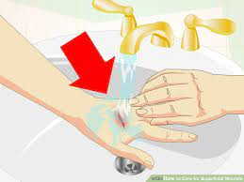
superficial

Slide 122
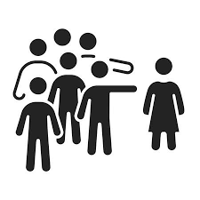
antisocial

Slide 123
Let’s Teach and Practise

Slide 124
homo – same phone – sound
homophone –
same sound but different meaning

Slide 125
homophones

Slide 126
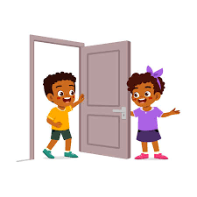
guest

Slide 127

guessed

Slide 128

heard

Slide 129
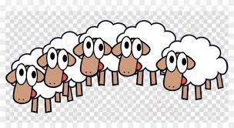
herd

Slide 130
guest
NOUN
Definition - a person who is invited to visit someone's home or attend a particular social occasion

Slide 131
guessed
VERB
Definition - estimate or conclude (something) without sufficient information to be sure of being correct

Slide 132
heard
VERB
Definition - perceive with the ear the sound made by (someone or something)

Slide 133
herd
NOUN
Definition - a large group of animals, especially hoofed mammals, that live together or are kept together as livestock

Slide 134
I have two guests coming to dinner tonight.
______

Slide 135
She guessed the child's age at 14 or 15.
_______

Slide 136
Behind her she heard men's voices.
_____

Slide 137
A herd of elephants gathered at the watering hole.
____

Slide 138
New CHALLENGE words.

Slide 139
attached
ADJECTIVE
Definition - joined, fastened, or connected to something

Slide 140
Please complete the attached form.
________

Slide 141
available
ADJECTIVE
Definition - able to be used or obtained; at someone's disposal

Slide 142
Refreshments will be available all afternoon.
_________

Slide 143
Let’s Practise and Apply.

Slide 144
Can you spot the spelling rule words and the challenge words?

Slide 145
Can we change?
We need to change the way we live as in the past we have been too dependent on non-renewable energies. We need to proceed in many new ways if we are going to use less oil and slow the effects of climate change. There are already many examples available of people and governments developing plans to use less oil. Cities around the world have started to introduce buses powered by natural gas and biodiesel. Only these forms of transport are allowed in these cities. Many countries have gone farther in investing in green technologies.

Slide 146
Can we change?
We need to change the way we live as in the past we have been too dependent on non-renewable energies. We need to proceed in many new ways if we are going to use less oil and slow the effects of climate change. There are already many examples available of people and governments developing plans to use less oil. Cities around the world have started to introduce buses powered by natural gas and biodiesel. Only these forms of transport are allowed in these cities. Many countries have gone farther in investing in green technologies.

Slide 147
Write this sentence as I dictate it to you.
Notes:
Only these forms of transport are allowed in these cities.

Slide 148
Only these forms of transport are allowed in these cities.
Did you write it correctly?
Edit your work and make sure you have it correct.
Can you underline the spelling word that we have covered in this session?

Slide 149
Year 5 - Spring 1
Week 1 - Friday
Notes:
Click through the slides for all the R+R words for the week (both the focus and the challenge words)
Click through the slides for all the new learning this week

Slide 151
Old challenge words…

Slide 152
occur

Slide 153
accompany

Slide 154
Old spelling rule words…

Slide 155
official

Slide 156
special

Slide 157
artificial

Slide 158
social

Slide 159
racial

Slide 160
crucial

Slide 161
facial

Slide 162
beneficial

Slide 163
superficial

Slide 164
antisocial

Slide 165
New spelling rule words…

Slide 166
past

Slide 167
passed

Slide 168
proceed

Slide 169
precede

Slide 170
aisle

Slide 171
isle

Slide 172
aloud

Slide 173
allowed

Slide 174
affect

Slide 175
effect

Slide 176
farther

Slide 177
father

Slide 178
guest

Slide 179
guessed

Slide 180
heard

Slide 181
herd

Slide 182
New challenge words…

Slide 183
attached

Slide 184
available

Slide 185
Quick Quiz time…
Notes:
Say these words for the quiz
Occur accompany Attached available artificial superficial proceed allowed farther guessed

Slide 186
Did you get them correct?
Edit your work.
occur accompany attached available artificial superficial proceed allowed farther guessed

Slide 187
Word class time…

Slide 188
Please complete the attached form.
adverb verb determiner adjective noun
Notes:
Ask for these words to be classed

Slide 189
Refreshments will be available all afternoon.
Noun verb verb adjective determiner noun
Notes:
Ask for these words to be classed

Slide 190
Etymology
The history of a word….

Slide 191
Attached
Middle English (in the sense ‘seize by legal authority’): from Old French atachier or estachier ‘fasten, fix’, based on an element of Germanic origin related to stake; compare with attack.
Available
Late Middle English (in the senses ‘effectual, serviceable’ and ‘legally valid’): from avail + -able. The sense ‘at someone's disposal’ dates from the early 19th century.

Slide 192
Let’s investigate….
Create questions and mark schemes for these words.

