Slide 1
Spelling Y5
Mastering spellings: building on the foundations of phonics
Spring 1
Week 2

Slide 2
These slides are slightly different - to reduce the number there are now animations used
Please use these slides in full screen slide show mode to ensure they work how they are designed with chunks of information being shown at a time to prevent overload
Thank you

Slide 3
Year 5 - Spring 1
Week 2 - Monday

Slide 4
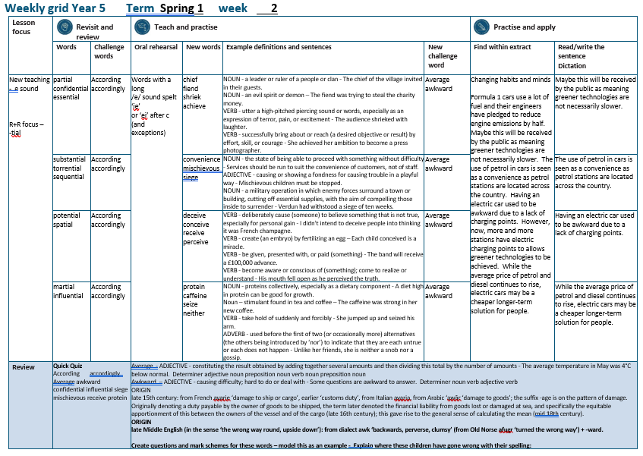

Slide 5
Let’s Revisit and Review…

Slide 6
Do you remember this challenge word?

Slide 7

According to the weather report, there will be sunshine today.
according

Slide 8
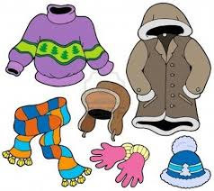
If there is rain, then I dress accordingly.
accordingly

Slide 9
Words with ending sound /shuhl/ after a consonant letter
-tial

Slide 10
-tial

Slide 11

partial

Slide 12

confidential

Slide 13
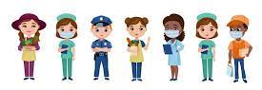
essential

Slide 14
Let’s Teach and Practise

Slide 15
(and exceptions)
Words with a long
/e/ sound spelt ‘ie’
or ‘ei’ after c

Slide 16
ie or ei

Slide 17

chief

Slide 18

fiend

Slide 19
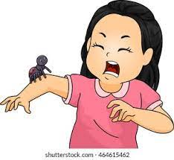
shriek

Slide 20

achieve

Slide 21
chief
NOUN
Definition - a leader or ruler of a people or clan

Slide 22
fiend
NOUN
Definition - an evil spirit or demon

Slide 23
shriek
VERB
Definition - utter a high-pitched piercing sound or words, especially as an expression of terror, pain, or excitement

Slide 24
achieve
VERB
Definition - successfully bring about or reach (a desired objective or result) by effort, skill, or courage

Slide 25
The chief of the village invited in their guests.
_____

Slide 26
The fiend was trying to steal the charity money.
_____

Slide 27
The audience shrieked with laughter.
_______

Slide 28
She achieved her ambition to become a press photographer.
________

Slide 29
New CHALLENGE words.

Slide 30

average
ADJECTIVE
Definition -constituting the result obtained by adding together several amounts and then dividing this total by the number of amounts

Slide 31
The average temperature in May was 4°C below normal.
_______

Slide 32
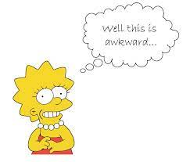
awkward
ADJECTIVE
Definition - causing difficulty; hard to do or deal with

Slide 33
Some questions are awkward to answer.
_______

Slide 34
Let’s Practise and Apply.

Slide 35
Can you spot the spelling rule words and the challenge words?

Slide 36
Changing habits and minds
Formula 1 cars use a lot of fuel and their engineers have pledged to reduce engine emissions by half. Maybe this will be received by the public as meaning greener technologies are not necessarily slower. The use of petrol in cars is seen as a convenience as petrol stations are located across the country. Having an electric car used to be awkward due to a lack of charging points. However, now, more and more stations have electric charging points to allows greener technologies to be achieved. While the average price of petrol and diesel continues to rise, electric cars may be a cheaper longer-term solution for people.

Slide 37
Changing habits and minds
Formula 1 cars use a lot of fuel and their engineers have pledged to reduce engine emissions by half. Maybe this will be received by the public as meaning greener technologies are not necessarily slower. The use of petrol in cars is seen as a convenience as petrol stations are located across the country. Having an electric car used to be awkward due to a lack of charging points. However, now, more and more stations have electric charging points to allows greener technologies to be achieved. While the average price of petrol and diesel continues to rise, electric cars may be a cheaper longer-term solution for people.

Slide 38
Write this sentence as I dictate it to you.
Notes:
Maybe this will be received by the public as meaning greener technologies are not necessarily slower.

Slide 39
Maybe this will be received by the public as meaning greener technologies are not necessarily slower.
Did you write it correctly?
Edit your work and make sure you have it correct.
Can you underline the spelling word that we have covered in this session?

Slide 40
Year 5 - Spring 1
Week 2 - Tuesday
Notes:
Revisit and review the words from previous teaching and challenge words – I say, we say, you say
Ask children to write words only in their spelling book
Introduce the new spelling rule
Children to write the new spelling rule words and challenge words into books when the sentences are shown with the spelling word missing.
Read the extract with the class as choral reading. Practise model of prosody etc.
Ask children to find the spelling words from the session in the text.
Then read allowed the chosen sentence for children to write fully in their books.
Show the extract and ask children to then edit their work to check they were correct in their dictation.

Slide 42
Let’s Revisit and Review…

Slide 43
Do you remember this challenge word?

Slide 44
According to the weather report, there will be sunshine today.
according

Slide 45
If there is rain, then I dress accordingly.
accordingly

Slide 46
Words with ending sound /shuhl/ after a consonant letter
-tial

Slide 47
-tial

Slide 48
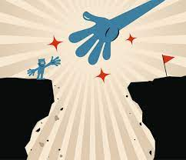
substantial

Slide 49
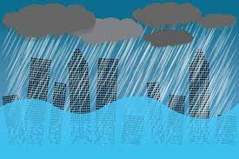
torrential

Slide 50
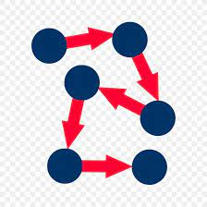
sequential

Slide 51
Let’s Teach and Practise

Slide 52
(and exceptions)
Words with a long
/e/ sound spelt ‘ie’
or ‘ei’ after c

Slide 53
ie or ei

Slide 54
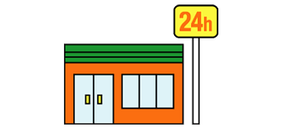
convenience

Slide 55
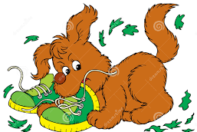
mischievous

Slide 56
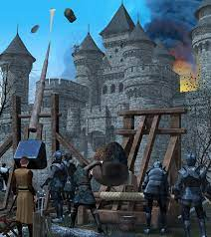
siege

Slide 57
convenience
NOUN
Definition - the state of being able to proceed with something without difficulty

Slide 58
mischievous
ADJECTIVE
Definition - causing or showing a fondness for causing trouble in a playful way

Slide 59
siege
NOUN
Definition - a military operation in which enemy forces surround a town or building, cutting off essential supplies, with the aim of compelling those inside to surrender

Slide 60
Services should be run to suit the convenience of customers, not of staff.
___________

Slide 61
Mischievous children must be stopped.
____________

Slide 62
Verdun had withstood a siege of ten weeks.
_____

Slide 63
New CHALLENGE words.

Slide 64
average
ADJECTIVE
Definition -constituting the result obtained by adding together several amounts and then dividing this total by the number of amounts

Slide 65
The average temperature in May was 4°C below normal.
_______

Slide 66
awkward
ADJECTIVE
Definition - causing difficulty; hard to do or deal with

Slide 67
Some questions are awkward to answer.
_______

Slide 68
Let’s Practise and Apply.

Slide 69
Can you spot the spelling rule words and the challenge words?

Slide 70
Changing habits and minds
Formula 1 cars use a lot of fuel and their engineers have pledged to reduce engine emissions by half. Maybe this will be received by the public as meaning greener technologies are not necessarily slower. The use of petrol in cars is seen as a convenience as petrol stations are located across the country. Having an electric car used to be awkward due to a lack of charging points. However, now, more and more stations have electric charging points to allows greener technologies to be achieved. While the average price of petrol and diesel continues to rise, electric cars may be a cheaper longer-term solution for people.

Slide 71
Changing habits and minds
Formula 1 cars use a lot of fuel and their engineers have pledged to reduce engine emissions by half. Maybe this will be received by the public as meaning greener technologies are not necessarily slower. The use of petrol in cars is seen as a convenience as petrol stations are located across the country. Having an electric car used to be awkward due to a lack of charging points. However, now, more and more stations have electric charging points to allows greener technologies to be achieved. While the average price of petrol and diesel continues to rise, electric cars may be a cheaper longer-term solution for people.

Slide 72
Write this sentence as I dictate it to you.
Notes:
The use of petrol in cars is seen as a convenience as petrol stations are located across the country.

Slide 73
The use of petrol in cars is seen as a convenience as petrol stations are located across the country.
Did you write it correctly?
Edit your work and make sure you have it correct.
Can you underline the spelling word that we have covered in this session?

Slide 74
Year 5 - Spring 1
Week 2 - Wednesday
Notes:
Revisit and review the words from previous teaching and challenge words – I say, we say, you say
Ask children to write words only in their spelling book
Introduce the new spelling rule
Children to write the new spelling rule words and challenge words into books when the sentences are shown with the spelling word missing.
Read the extract with the class as choral reading. Practise model of prosody etc.
Ask children to find the spelling words from the session in the text.
Then read allowed the chosen sentence for children to write fully in their books.
Show the extract and ask children to then edit their work to check they were correct in their dictation.

Slide 76
Let’s Revisit and Review…

Slide 77
Do you remember this challenge word?

Slide 78
According to the weather report, there will be sunshine today.
according

Slide 79
If there is rain, then I dress accordingly.
accordingly

Slide 80
Words with ending sound /shuhl/ after a consonant letter
-tial

Slide 81
-tial

Slide 82

potential

Slide 83
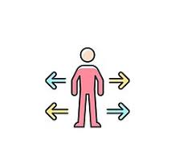
spatial

Slide 84
Let’s Teach and Practise

Slide 85
(and exceptions)
Words with a long
/e/ sound spelt ‘ie’
or ‘ei’ after c

Slide 86
ie or ei

Slide 87
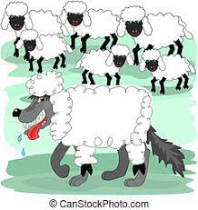
deceive

Slide 88

conceive

Slide 89
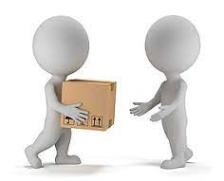
receive

Slide 90

perceive

Slide 91
deceive
VERB
Definition - deliberately cause (someone) to believe something that is not true, especially for personal gain

Slide 92
conceive
VERB
Definition - create (an embryo) by fertilizing an egg

Slide 93
receive
VERB
Definition - be given, presented with, or paid (something)

Slide 94
perceive
VERB
Definition - become aware or conscious of (something); come to realise or understand

Slide 95
I didn't intend to deceive people into thinking it was French champagne.
_______

Slide 96
Each child conceived is a miracle.
_________

Slide 97
The band will receive a £100,000 advance.
_______

Slide 98
His mouth fell open as he perceived the truth.
_________

Slide 99
New CHALLENGE words.

Slide 100
average
ADJECTIVE
Definition -constituting the result obtained by adding together several amounts and then dividing this total by the number of amounts

Slide 101
The average temperature in May was 4°C below normal.
_______

Slide 102
awkward
ADJECTIVE
Definition - causing difficulty; hard to do or deal with

Slide 103
Some questions are awkward to answer.
_______

Slide 104
Let’s Practise and Apply.

Slide 105
Can you spot the spelling rule words and the challenge words?

Slide 106
Changing habits and minds
Formula 1 cars use a lot of fuel and their engineers have pledged to reduce engine emissions by half. Maybe this will be received by the public as meaning greener technologies are not necessarily slower. The use of petrol in cars is seen as a convenience as petrol stations are located across the country. Having an electric car used to be awkward due to a lack of charging points. However, now, more and more stations have electric charging points to allows greener technologies to be achieved. While the average price of petrol and diesel continues to rise, electric cars may be a cheaper longer-term solution for people.

Slide 107
Changing habits and minds
Formula 1 cars use a lot of fuel and their engineers have pledged to reduce engine emissions by half. Maybe this will be received by the public as meaning greener technologies are not necessarily slower. The use of petrol in cars is seen as a convenience as petrol stations are located across the country. Having an electric car used to be awkward due to a lack of charging points. However, now, more and more stations have electric charging points to allows greener technologies to be achieved. While the average price of petrol and diesel continues to rise, electric cars may be a cheaper longer-term solution for people.

Slide 108
Write this sentence as I dictate it to you.
Notes:
Having an electric car used to be awkward due to a lack of charging points.

Slide 109
Having an electric car used to be awkward due to a lack of charging points.
Did you write it correctly?
Edit your work and make sure you have it correct.
Can you underline the spelling word that we have covered in this session?

Slide 110
Year 5 - Spring 1
Week 2 - Thursday
Notes:
Revisit and review the words from previous teaching and challenge words – I say, we say, you say
Ask children to write words only in their spelling book
Introduce the new spelling rule
Children to write the new spelling rule words and challenge words into books when the sentences are shown with the spelling word missing.
Read the extract with the class as choral reading. Practise model of prosody etc.
Ask children to find the spelling words from the session in the text.
Then read allowed the chosen sentence for children to write fully in their books.
Show the extract and ask children to then edit their work to check they were correct in their dictation.

Slide 112
Let’s Revisit and Review…

Slide 113
Do you remember this challenge word?

Slide 114
According to the weather report, there will be sunshine today.
according

Slide 115
If there is rain, then I dress accordingly.
accordingly

Slide 116
Words with ending sound /shuhl/ after a consonant letter
-tial

Slide 117
-tial

Slide 118

martial

Slide 119
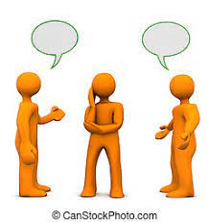
influential

Slide 120
Let’s Teach and Practise

Slide 121
(and exceptions)
Words with a long
/e/ sound spelt ‘ie’
or ‘ei’ after c

Slide 122
ie or ei

Slide 123
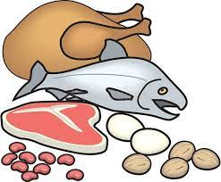
protein

Slide 124

caffeine

Slide 125
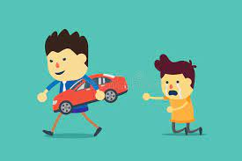
seize

Slide 126

neither

Slide 127
protein
NOUN
Definition - proteins collectively, especially as a dietary component

Slide 128
caffeine
NOUN
Definition - stimulant found in tea and coffee

Slide 129
seize
VERB
Definition - take hold of suddenly and forcibly

Slide 130
neither
ADVERB
Definition - used before the first of two (or occasionally more) alternatives (the others being introduced by ‘nor’) to indicate that they are each untrue or each does not happen

Slide 131
A diet high in protein can be good for growth.
_______

Slide 132
The caffeine was strong in her new coffee.
________

Slide 133
She jumped up and seized his arm.
______

Slide 134
Unlike her friends, she is neither a snob nor a gossip.
_______

Slide 135
New CHALLENGE words.

Slide 136
average
ADJECTIVE
Definition -constituting the result obtained by adding together several amounts and then dividing this total by the number of amounts

Slide 137
The average temperature in May was 4°C below normal.
_______

Slide 138
awkward
ADJECTIVE
Definition - causing difficulty; hard to do or deal with

Slide 139
Some questions are awkward to answer.
_______

Slide 140
Let’s Practise and Apply.

Slide 141
Can you spot the spelling rule words and the challenge words?

Slide 142
Changing habits and minds
Formula 1 cars use a lot of fuel and their engineers have pledged to reduce engine emissions by half. Maybe this will be received by the public as meaning greener technologies are not necessarily slower. The use of petrol in cars is seen as a convenience as petrol stations are located across the country. Having an electric car used to be awkward due to a lack of charging points. However, now, more and more stations have electric charging points to allows greener technologies to be achieved. While the average price of petrol and diesel continues to rise, electric cars may be a cheaper longer-term solution for people.

Slide 143
Changing habits and minds
Formula 1 cars use a lot of fuel and their engineers have pledged to reduce engine emissions by half. Maybe this will be received by the public as meaning greener technologies are not necessarily slower. The use of petrol in cars is seen as a convenience as petrol stations are located across the country. Having an electric car used to be awkward due to a lack of charging points. However, now, more and more stations have electric charging points to allows greener technologies to be achieved. While the average price of petrol and diesel continues to rise, electric cars may be a cheaper longer-term solution for people.

Slide 144
Write this sentence as I dictate it to you.
Notes:
While the average price of petrol and diesel continues to rise, electric cars may be a cheaper longer-term solution for people.

Slide 145
While the average price of petrol and diesel continues to rise, electric cars may be a cheaper longer-term solution for people.
Did you write it correctly?
Edit your work and make sure you have it correct.
Can you underline the spelling word that we have covered in this session?

Slide 146
Year 5 - Spring 1
Week 2 - Friday
Notes:
Click through the slides for all the R+R words for the week (both the focus and the challenge words)
Click through the slides for all the new learning this week

Slide 148
Old challenge words…

Slide 149
according

Slide 150
accordingly

Slide 151
Old spelling rule words…

Slide 152
partial

Slide 153
confidential

Slide 154
essential

Slide 155
substantial

Slide 156
torrential

Slide 157
sequential

Slide 158
potential

Slide 159
spatial

Slide 160
martial

Slide 161
influential

Slide 162
New spelling rule words…

Slide 163
chief

Slide 164
fiend

Slide 165
shriek

Slide 166
achieve

Slide 167
convenience

Slide 168
mischievous

Slide 169
siege

Slide 170
deceive

Slide 171
conceive

Slide 172
receive

Slide 173
protein

Slide 174
caffeine

Slide 175
seize

Slide 176
neither

Slide 177
New challenge words…

Slide 178
average

Slide 179
awkward

Slide 180
Quick Quiz time…
Notes:
Say these words for the quiz
According accordingly Average awkward confidential influential siege mischievous receive protein

Slide 181
Did you get them correct?
Edit your work.
according accordingly average awkward confidential influential siege mischievous receive protein

Slide 182
Word class time…

Slide 183
The average temperature in May was 4°C below normal.
Determiner adjective noun preposition noun verb noun preposition noun
Notes:
Ask for these words to be classed

Slide 184
Some questions are awkward to answer.
Determiner noun verb adjective verb
Notes:
Ask for these words to be classed

Slide 185
Etymology
The history of a word….

Slide 186
Average
late 15th century: from French avarie ‘damage to ship or cargo’, earlier ‘customs duty’, from Italian avaria, from Arabic ‘awār ‘damage to goods’; the suffix -age is on the pattern of damage. Originally denoting a duty payable by the owner of goods to be shipped, the term later denoted the financial liability from goods lost or damaged at sea, and specifically the equitable apportionment of this between the owners of the vessel and of the cargo (late 16th century); this gave rise to the general sense of calculating the mean (mid 18th century).
Awkward
late Middle English (in the sense ‘the wrong way round, upside down’): from dialect awk ‘backwards, perverse, clumsy’ (from Old Norse afugr ‘turned the wrong way’) + -ward.

Slide 187
Let’s investigate….
Find antonyms and synonyms of the challenge words.

