Slide 1
Spelling Y5
Mastering spellings: building on the foundations of phonics
Spring 1
Week 3

Slide 2
These slides are slightly different - to reduce the number there are now animations used
Please use these slides in full screen slide show mode to ensure they work how they are designed with chunks of information being shown at a time to prevent overload
Thank you

Slide 3
Year 5 - Spring 1
Week 3 - Monday

Slide 4
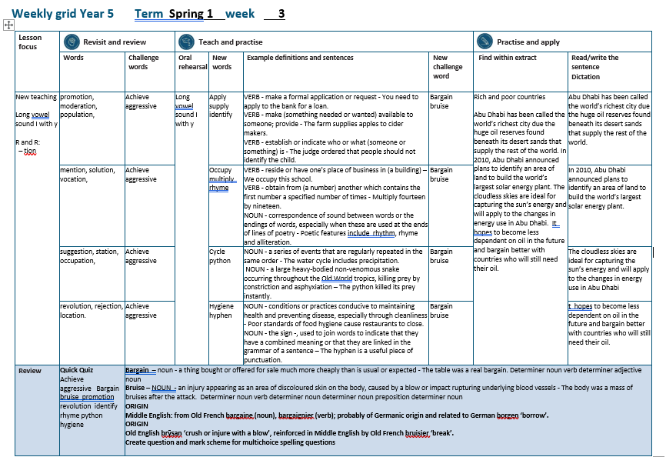

Slide 5
Let’s Revisit and Review…

Slide 6
Do you remember this challenge word?

Slide 7

If you believe in yourself, you can achieve anything.
achieve

Slide 8

Some animals, when provoked, can become aggressive.
aggressive

Slide 9
It is used if the root word ends in t or te.
Words with ending sound /ʃən/ –tion is the most common spelling.

Slide 10
-tion

Slide 11
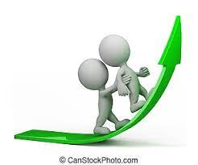
promotion

Slide 12
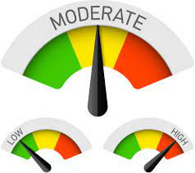
moderation

Slide 13

population

Slide 14
Let’s Teach and Practise

Slide 15
y
Long vowel sound i with y

Slide 16

apply

Slide 17
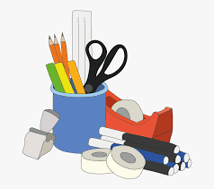
supply

Slide 18

identify

Slide 19
apply
VERB
Definition - make a formal application or request

Slide 20
supply
VERB
Definition - make (something needed or wanted) available to someone; provide

Slide 21
identify
VERB
Definition - establish or indicate who or what (someone or something) is

Slide 22
You need to apply to the bank for a loan.
_____

Slide 23
The farm can supply apples to make cider.
______

Slide 24
The judge ordered that people should not identify the child.
________

Slide 25
New CHALLENGE words.

Slide 26

bargain
NOUN
Definition -a thing bought or offered for sale much more cheaply than is usual or expected

Slide 27
The table was a real bargain.
_______

Slide 28
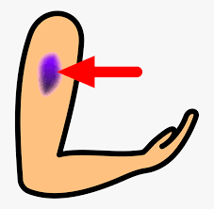
bruise
NOUN
Definition - an injury appearing as an area of discoloured skin on the body, caused by a blow or impact rupturing underlying blood vessels

Slide 29
The body was a mass of bruises after the attack.
_______

Slide 30
Let’s Practise and Apply.

Slide 31
Can you spot the spelling rule words and the challenge words?

Slide 32
Rich and poor countries
Abu Dhabi has been called the world’s richest city due the huge oil reserves found beneath its desert sands that supply the rest of the world. In 2010, Abu Dhabi announced plans to identify an area of land to build the world’s largest solar energy plant. The cloudless skies are ideal for capturing the sun’s energy and will apply to the changes in energy use in Abu Dhabi. It hopes to become less dependent on oil in the future and bargain better with countries who will still need their oil.

Slide 33
Rich and poor countries
Abu Dhabi has been called the world’s richest city due the huge oil reserves found beneath its desert sands that supply the rest of the world. In 2010, Abu Dhabi announced plans to identify an area of land to build the world’s largest solar energy plant. The cloudless skies are ideal for capturing the sun’s energy and will apply to the changes in energy use in Abu Dhabi. It hopes to become less dependent on oil in the future and bargain better with countries who will still need their oil.

Slide 34
Write this sentence as I dictate it to you.
Notes:
Abu Dhabi has been called the world’s richest city due the huge oil reserves found beneath its desert sands that supply the rest of the world.

Slide 35
Abu Dhabi has been called the world’s richest city due the huge oil reserves found beneath its desert sands that supply the rest of the world.
Did you write it correctly?
Edit your work and make sure you have it correct.
Can you underline the spelling word that we have covered in this session?

Slide 36
Year 5 - Spring 1
Week 3 - Tuesday
Notes:
Revisit and review the words from previous teaching and challenge words – I say, we say, you say
Ask children to write words only in their spelling book
Introduce the new spelling rule
Children to write the new spelling rule words and challenge words into books when the sentences are shown with the spelling word missing.
Read the extract with the class as choral reading. Practise model of prosody etc.
Ask children to find the spelling words from the session in the text.
Then read allowed the chosen sentence for children to write fully in their books.
Show the extract and ask children to then edit their work to check they were correct in their dictation.

Slide 38
Let’s Revisit and Review…

Slide 39
Do you remember this challenge word?

Slide 40
If you believe in yourself, you can achieve anything.
achieve

Slide 41
Some animals, when provoked, can become aggressive.
aggressive

Slide 42
It is used if the root word ends in t or te.
Words with ending sound /ʃən/ –tion is the most common spelling.

Slide 43
-tion

Slide 44

mention

Slide 45

solution

Slide 46

vocation

Slide 47
Let’s Teach and Practise

Slide 48
y
Long vowel sound i with y

Slide 49
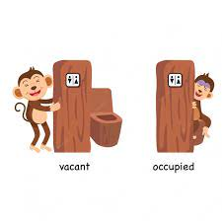
occupy

Slide 50

multiply

Slide 51

rhyme

Slide 52
occupy
VERB
Definition - reside or have one's place of business in (a building)

Slide 53
multiply
VERB
Definition - obtain from (a number) another which contains the first number a specified number of times

Slide 54
rhyme
NOUN
Definition - correspondence of sound between words or the endings of words, especially when these are used at the ends of lines of poetry

Slide 55
We occupy this school.
______

Slide 56
Multiply fourteen by nineteen.
________

Slide 57
Poetic features include rhythm, rhyme and alliteration.
_____

Slide 58
New CHALLENGE words.

Slide 59
bargain
NOUN
Definition -a thing bought or offered for sale much more cheaply than is usual or expected

Slide 60
The table was a real bargain.
_______

Slide 61
bruise
NOUN
Definition - an injury appearing as an area of discoloured skin on the body, caused by a blow or impact rupturing underlying blood vessels

Slide 62
The body was a mass of bruises after the attack.
_______

Slide 63
Let’s Practise and Apply.

Slide 64
Can you spot the spelling rule words and the challenge words?

Slide 65
Rich and poor countries
Abu Dhabi has been called the world’s richest city due the huge oil reserves found beneath its desert sands that supply the rest of the world. In 2010, Abu Dhabi announced plans to identify an area of land to build the world’s largest solar energy plant. The cloudless skies are ideal for capturing the sun’s energy and will apply to the changes in energy use in Abu Dhabi. It hopes to become less dependent on oil in the future and bargain better with countries who will still need their oil.

Slide 66
Rich and poor countries
Abu Dhabi has been called the world’s richest city due the huge oil reserves found beneath its desert sands that supply the rest of the world. In 2010, Abu Dhabi announced plans to identify an area of land to build the world’s largest solar energy plant. The cloudless skies are ideal for capturing the sun’s energy and will apply to the changes in energy use in Abu Dhabi. It hopes to become less dependent on oil in the future and bargain better with countries who will still need their oil.

Slide 67
Write this sentence as I dictate it to you.
Notes:
In 2010, Abu Dhabi announced plans to identify an area of land to build the world’s largest solar energy plant.

Slide 68
In 2010, Abu Dhabi announced plans to identify an area of land to build the world’s largest solar energy plant.
Did you write it correctly?
Edit your work and make sure you have it correct.
Can you underline the spelling word that we have covered in this session?

Slide 69
Year 5 - Spring 1
Week 3 - Wednesday
Notes:
Revisit and review the words from previous teaching and challenge words – I say, we say, you say
Ask children to write words only in their spelling book
Introduce the new spelling rule
Children to write the new spelling rule words and challenge words into books when the sentences are shown with the spelling word missing.
Read the extract with the class as choral reading. Practise model of prosody etc.
Ask children to find the spelling words from the session in the text.
Then read allowed the chosen sentence for children to write fully in their books.
Show the extract and ask children to then edit their work to check they were correct in their dictation.

Slide 71
Let’s Revisit and Review…

Slide 72
Do you remember this challenge word?

Slide 73
If you believe in yourself, you can achieve anything.
achieve

Slide 74
Some animals, when provoked, can become aggressive.
aggressive

Slide 75
It is used if the root word ends in t or te.
Words with ending sound /ʃən/ –tion is the most common spelling.

Slide 76
-tion

Slide 77

suggestion

Slide 78
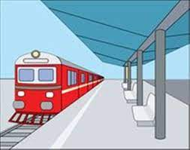
station

Slide 79
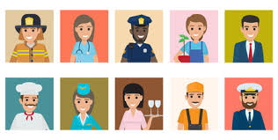
occupation

Slide 80
Let’s Teach and Practise

Slide 81
y
Long vowel sound i with y

Slide 82
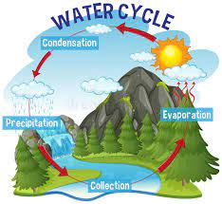
cycle

Slide 83
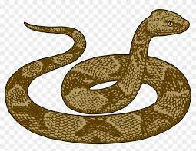
python

Slide 84
cycle
noun
Definition - a series of events that are regularly repeated in the same order

Slide 85
python
NOUN
Definition - a large heavy-bodied non-venomous snake occurring throughout the Old World tropics, killing prey by constriction and asphyxiation

Slide 86
The water cycle includes precipitation.
_____

Slide 87
The python killed its prey instantly.
______

Slide 88
New CHALLENGE words.

Slide 89
bargain
NOUN
Definition -a thing bought or offered for sale much more cheaply than is usual or expected

Slide 90
The table was a real bargain.
_______

Slide 91
bruise
NOUN
Definition - an injury appearing as an area of discoloured skin on the body, caused by a blow or impact rupturing underlying blood vessels

Slide 92
The body was a mass of bruises after the attack.
_______

Slide 93
Let’s Practise and Apply.

Slide 94
Can you spot the spelling rule words and the challenge words?

Slide 95
Rich and poor countries
Abu Dhabi has been called the world’s richest city due the huge oil reserves found beneath its desert sands that supply the rest of the world. In 2010, Abu Dhabi announced plans to identify an area of land to build the world’s largest solar energy plant. The cloudless skies are ideal for capturing the sun’s energy and will apply to the changes in energy use in Abu Dhabi. It hopes to become less dependent on oil in the future and bargain better with countries who will still need their oil.

Slide 96
Rich and poor countries
Abu Dhabi has been called the world’s richest city due the huge oil reserves found beneath its desert sands that supply the rest of the world. In 2010, Abu Dhabi announced plans to identify an area of land to build the world’s largest solar energy plant. The cloudless skies are ideal for capturing the sun’s energy and will apply to the changes in energy use in Abu Dhabi. It hopes to become less dependent on oil in the future and bargain better with countries who will still need their oil.

Slide 97
Write this sentence as I dictate it to you.
Notes:
The cloudless skies are ideal for capturing the sun’s energy and will apply to the changes in energy use in Abu Dhabi.

Slide 98
The cloudless skies are ideal for capturing the sun’s energy and will apply to the changes in energy use in Abu Dhabi.
Did you write it correctly?
Edit your work and make sure you have it correct.
Can you underline the spelling word that we have covered in this session?

Slide 99
Year 5 - Spring 1
Week 3 - Thursday
Notes:
Revisit and review the words from previous teaching and challenge words – I say, we say, you say
Ask children to write words only in their spelling book
Introduce the new spelling rule
Children to write the new spelling rule words and challenge words into books when the sentences are shown with the spelling word missing.
Read the extract with the class as choral reading. Practise model of prosody etc.
Ask children to find the spelling words from the session in the text.
Then read allowed the chosen sentence for children to write fully in their books.
Show the extract and ask children to then edit their work to check they were correct in their dictation.

Slide 101
Let’s Revisit and Review…

Slide 102
Do you remember this challenge word?

Slide 103
If you believe in yourself, you can achieve anything.
achieve

Slide 104
Some animals, when provoked, can become aggressive.
aggressive

Slide 105
It is used if the root word ends in t or te.
Words with ending sound /ʃən/ –tion is the most common spelling.

Slide 106
-tion

Slide 107
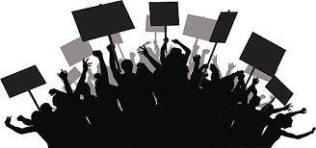
revolution

Slide 108

rejection

Slide 109
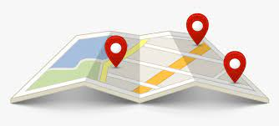
location

Slide 110
Let’s Teach and Practise

Slide 111
y
Long vowel sound i with y

Slide 112
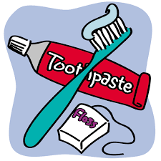
hygiene

Slide 113

hyphen

Slide 114
hygiene
NOUN
Definition - conditions or practices conducive to maintaining health and preventing disease, especially through cleanliness

Slide 115
hyphen
NOUN
Definition - the sign -, used to join words to indicate that they have a combined meaning or that they are linked in the grammar of a sentence

Slide 116
Poor standards of food hygiene cause restaurants to close.
_______

Slide 117
The hyphen is a useful piece of punctuation.
______

Slide 118
New CHALLENGE words.

Slide 119
bargain
NOUN
Definition -a thing bought or offered for sale much more cheaply than is usual or expected

Slide 120
The table was a real bargain.
_______

Slide 121
bruise
NOUN
Definition - an injury appearing as an area of discoloured skin on the body, caused by a blow or impact rupturing underlying blood vessels

Slide 122
The body was a mass of bruises after the attack.
_______

Slide 123
Let’s Practise and Apply.

Slide 124
Can you spot the spelling rule words and the challenge words?

Slide 125
Rich and poor countries
Abu Dhabi has been called the world’s richest city due the huge oil reserves found beneath its desert sands that supply the rest of the world. In 2010, Abu Dhabi announced plans to identify an area of land to build the world’s largest solar energy plant. The cloudless skies are ideal for capturing the sun’s energy and will apply to the changes in energy use in Abu Dhabi. It hopes to become less dependent on oil in the future and bargain better with countries who will still need their oil.

Slide 126
Rich and poor countries
Abu Dhabi has been called the world’s richest city due the huge oil reserves found beneath its desert sands that supply the rest of the world. In 2010, Abu Dhabi announced plans to identify an area of land to build the world’s largest solar energy plant. The cloudless skies are ideal for capturing the sun’s energy and will apply to the changes in energy use in Abu Dhabi. It hopes to become less dependent on oil in the future and bargain better with countries who will still need their oil.

Slide 127
Write this sentence as I dictate it to you.
Notes:
It hopes to become less dependent on oil in the future and bargain better with countries who will still need their oil.

Slide 128
It hopes to become less dependent on oil in the future and bargain better with countries who will still need their oil.
Did you write it correctly?
Edit your work and make sure you have it correct.
Can you underline the spelling word that we have covered in this session?

Slide 129
Year 5 - Spring 1
Week 3 - Friday
Notes:
Click through the slides for all the R+R words for the week (both the focus and the challenge words)
Click through the slides for all the new learning this week

Slide 131
Old challenge words…

Slide 132
achieve

Slide 133
aggressive

Slide 134
Old spelling rule words…

Slide 135
promotion

Slide 136
moderation

Slide 137
population

Slide 138
mention

Slide 139
solution

Slide 140
vocation

Slide 141
suggestion

Slide 142
station

Slide 143
occupation

Slide 144
revolution

Slide 145
rejection

Slide 146
location

Slide 147
New spelling rule words…

Slide 148
apply

Slide 149
supply

Slide 150
identify

Slide 151
occupy

Slide 152
mulitply

Slide 153
rhyme

Slide 154
cycle

Slide 155
python

Slide 156
hygiene

Slide 157
hyphen

Slide 158
New challenge words…

Slide 159
bargain

Slide 160
bruise

Slide 161
Quick Quiz time…
Notes:
Say these words for the quiz
Achieve aggressive Bargain bruise promotion revolution identify rhyme python hygiene

Slide 162
Did you get them correct?
Edit your work.
achieve aggressive bargain bruise promotion revolution identify rhyme python hygiene

Slide 163
Word class time…

Slide 164
The table was a real bargain.
Determiner noun verb determiner adjective noun
Notes:
Ask for these words to be classed

Slide 165
- The body was a mass of bruises after the attack.
Determiner noun verb determiner noun determiner noun preposition determiner noun
Notes:
Ask for these words to be classed

Slide 166
Etymology
The history of a word….

Slide 167
Bargain
Middle English: from Old French bargaine (noun), bargaignier (verb); probably of Germanic origin and related to German borgen ‘borrow’.
Bruise
Old English brȳsan ‘crush or injure with a blow’, reinforced in Middle English by Old French bruisier ‘break’.

Slide 168
Let’s investigate….
Look at the word origin of the challenge words and find words that are linked to them.

